Slide 1
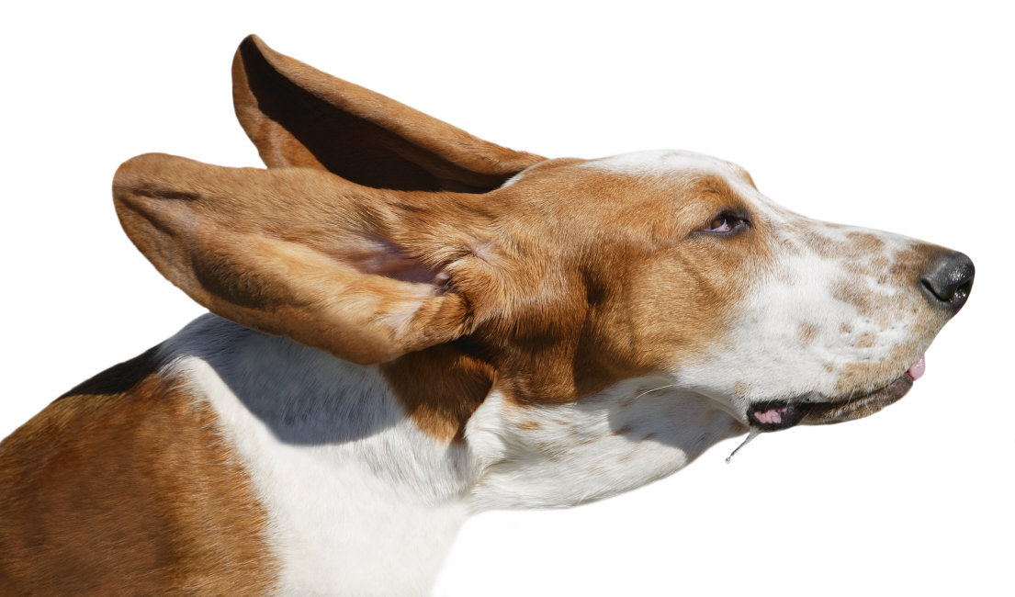

OOP – The last 10 Years
Java
Smalltalk

Slide 2
OOP – The last 3 Years
Java
Dynamic
Languages

Slide 3
Are the types to blame?
Conventional wisdom: dynamic languages are great because they do not have static types.
I believe this is wrong.
It’s lightweight syntax + several other tricks which dynamic languages adopted from functional programming. (e.g. closures, list comprehensions, high-level types).

Slide 4
The new challenge
Multicore computing is changing our assumptions everywhere.
Mutation is becoming expensive.
  Cache coherence is hard.
  Card marking for GC is slow.
  Transaction aborts due to memory conflicts.
Pure functions are becoming cheap.
  Because they parallelize nicely.
Need to start thinking functionally to make best use of parallelism in hardware.
Distributed web software pushes in the same direction (shared state is problematic!)

Slide 5
But don’t forget your objects!
Objects are inevitable – at the end of the day, you have to put your data and operations somewhere.
Once you do that, you might as well make object construction fully general.
OOP is about scalability – start small, grow large.
But why are so few people doing this?

Slide 6

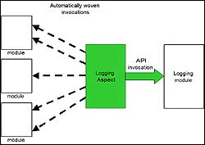
Crutches that detract from objects
What
happens
if we try
without?
super package
static
Enum
Dependency injection frameworks
Aspects
Reflection

Slide 7
How to advance?
Hypothesis 1: A general-purpose language needs to be scalable; the same concepts should describe small as well as large parts.
Hypothesis 2: Scalability can be achieved by unifying and generalizing functional and object-oriented programming concepts.

Slide 8

Prediction
In the near future, the distinction between FP and OOP will become irrelevant.
Functions are objects, after all, and so are modules.
The distinction between scripting and general purpose with also become irrelevant.
Static typing will lose some baggage and then
stage a comeback.
  (after all, it’s our best means to talk precisely
  about program components.)
To get a glimpse of what the future will hold, try Scala today!

