Slide 1
Native DRAM Cache Re-architecting DRAM as a Large-Scale Cache for Data Centers
Yesin Ryu†§, Yoojin Kim†, Giyong Jung†, Jung Ho Ahn‡, Jungrae Kim†
†Sungkyunkwan University, §Samsung Electronics, ‡Seoul National University
Notes:
Hello everyone,
My name is Yesin.
During my DRAM development career, I noticed ongoing efforts in the industry to use DRAM as a cache, which prompted me to explore what a cache-optimized DRAM would look like and how its control could be designed.
This led to the creation of the paper Native DRAM cache.

Slide 2
Outline
Introduction
Overview
Native DRAM Cache
In-Subarray Processing
Cache Operation
Address Mapping
Evaluation
Conclusion
Notes:
So, I hope this presentation will spark meaningful discussions.

Slide 3
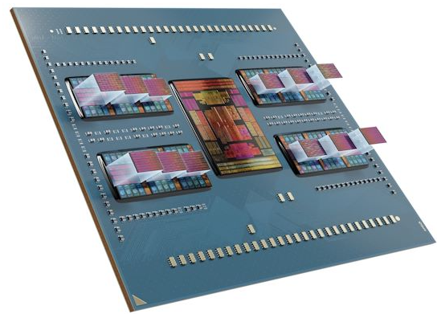
Demands for Large-Capacity LLCs
Ⅰ
Introduction
Data center CPUs require large-capacity LLCs
To support the increasing number of cores (384 cores by 2030)
The IEEE roadmap (IRDS) projects 4GB LLCs by 2030
4GB LLC
AMD’s
Genoa-X
384 cores
Number of Cores / Chiplet
LLC size (MB)
96 cores / 1.1GB LLC
[SRC : IRDS roadmap ’23]
Notes:
As the demand for data processing continues to rise, the number of CPU cores in data centers is growing rapidly.
Looking to the future, the International Roadmap for Devices and Systems predicts that by 2034, CPUs could have up to 640 cores.
However, as shown by the red line in the graph, the increase in core count must be matched by an expansion in Last-Level Cache (LLC) size.
Without this, both performance and energy efficiency could suffer.
Typically, each socket requires 1 to 4GB of LLC.

Slide 4
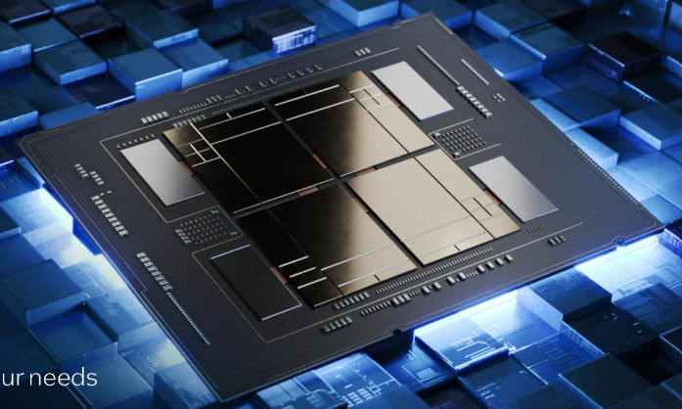
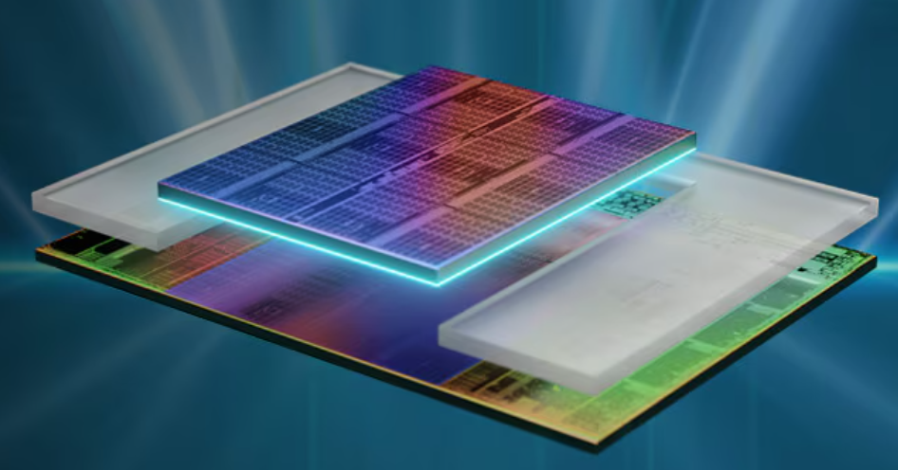
DRAM vs. SRAM LLC
Ⅰ
Introduction
DRAM provides superior density and scalability
Intel Xeon Max (DRAM LLC)
AMD 3D V-Cache (SRAM LLC)
16GB
HBM2E
64MB
SRAM
16GB
HBM2E
16GB
HBM2E
16GB
HBM2E
[SRC : Intel]
[SRC : AMD]
64GB LLC/socket based on
256MB LLC/socket based on
1T-1C DRAM
6T SRAM
Notes:
To efficiently integrate large caches, CPU manufacturers have adopted a new approach called heterogeneous integration.
Examples of this include AMD's V-Cache and Intel's Sapphire Rapids with HBM2E stacks.
The main difference between these two approaches lies in the structure of SRAM and DRAM.
As shown, SRAM consists of six transistors to store one bit, whereas DRAM has a simpler structure with one transistor and one capacitor.
Considering the increasing number of cores, this makes DRAM more advantageous[ˌædvənˈteɪdʒəs] in terms of density and scalability.

Slide 5
Challenges of DRAM Cache
Ⅰ
Introduction
Circuit-level challenge
Slower charge-sensing operation
Architecture-level challenge
Extra operations due to commodity DRAMs
Serialized tag and data accesses
Poor row-buffer reuse
Architectural overheads often outweigh circuit-level overheads
<Read operation in the LH cache>
<Write operation in the Alloy cache>
Notes:
However, there are challenges to overcome when using DRAM as a cache at both the circuit and architecture levels.
In a set-associative cache setup, serialized accesses are needed before a data request to read tag, leading to significant latency increase and reduced cache throughput.
Although it is possible to fetch tags and data simultaneously, this capability is limited to direct-mapped caches only.
Moreover, because tags must be read[e] before a write operation, the sequential accesses cannot be entirely[in] avoided.
Additionally, DRAM introdu’ces inherent[ɪn│herənt] delays as it needs to activate a specific row before issuing read or write commands.
Sometimes these architectural[│ɑːrkɪ│tektʃərəl] overheads outweigh circuit-level overheads. 3

Slide 6
Outline
Introduction
Overview
Native DRAM Cache
In-Subarray Processing
Cache Operation
Address Mapping
Evaluation
Conclusion
Notes:
So, I would like to introduce native DRAM cache, a new type of DRAM cache designed for processing-in-memory.
This is the NDC overview.

Slide 7
Caching-In-Memory (CIM)
Ⅱ
Overview
Cache operations inside a DRAM
To eliminate architectural overheads of DRAM caches
Caching-In-Memory
Tags
Data
Cmd
ACT
RD
PRE
Addr
Idx
Tag
Tag matching, way selection, cache replacement
Hit
Rsp
Hit
Data
Cmd/ Addr
Data
Rsp
(hit/miss)
Miss
Rsp
Miss
Data
Processor
Notes:
We propose Caching-in-Memory, allowing cache operations to be processed within DRAM itself.
By autonomously[ɔː│tɑːnəməs] performing functions such as tag matching, way selection, and cache replacement within DRAM, it can eliminate the architectural overheads.
Thus, a memory controller can manage these operations with a simple command sequence, as shown in the timing diagram.

Slide 8
Native DRAM Cache (NDC)
Ⅱ
Overview
A highly-efficient CIM μ-architecture
Can speed up SPEC/NPB/GAP by 2.8%/52.5%/44.2% (up to 8.4%/140.6%/85.5%)
0.6% area overhead
Native DRAM Cache
Subarray
Tags
Data
Tag matching
Way-selection
Replacement
Based on
in-subarray processing
Subarray
Tags
Data
Tag matching
Way-selection
Replacement
…
Notes:
An important aspect is that this Caching-in-Memory scheme operates within a subarray of DRAM, which is a group of rows that share a row buffer..
Typically, adding circuits within subarrays imposes significant area overhead on DRAM.
However, NDC limits this overhead to just 0.6% through microarchitectural changes in the subarray area.
As a result, NDC demonstrates significant performance improvements in SPEC/NPB/GAP benchmarks: 2.8, 52.5, and 44.2%, respectively.

Slide 9
Outline
Introduction
Overview
Native DRAM Cache
In-Subarray Processing
Cache Operation
Address Mapping
Evaluation
Conclusion
Notes:
The next slides will delve deeper into Native DRAM Cache and its three features.
The first feature is In-subarray processing.
5

Slide 10
NDC Organization: Subarray
Ⅲ
Native DRAM Cache
A cache set = a DRAM row
Tags in special mats (metadata-MATs)
Data in normal mats (data-MATs)
Native DRAM Cache
MD-MAT
D-MAT
D-MAT
D-MAT
Tags
Data
Data
Data
W0 | … | W15
W0 | … | W15
W0 | … | W15
W0 | … | W15
…
Subarray
Row
Row
Buffer
BLSA
BLSA
BLSA
BLSA
…
Notes:
Allow me to briefly explain the structure of DRAM.
Each subarray is composed of multiple MATs, and the BLSA performs the function of sensing BL and BLB in a MAT, also serving as a device to store data from an activated row; hence, it is also called a row buffer.
In DRAM cache, the activated row corresponds to a set selected by an index.
On the other hand, DRAM caches typically store metadata such as tags, valid status, dirty status, etc., along with data by adding dedicated MATs.
In NDC, we redesigned the microarchitecture of the metadata MATs to implement cache operations.

Slide 11
NDC Organization: Metadata MAT
Ⅲ
Native DRAM Cache
Data MAT + per-column matching circuitry
Motivated by CAM with 3-transitor matching
But amortize the overhead across all rows (0.6% area overhead)
High set-associativity cache
Simultaneously matching all ways in a set → 16 ways (or more)
Tags
W0 | … | W15
BLSA
Match
D-MAT
MD-MAT
Cell array
Cell array
BL
BLB
BL
BLB
WL0
WL0
WL1
…
WL1
…
…
…
Peripherals
Peripherals
BLSA
…
BLSA
2 or 3 transistors
…
BL
BLB
Match
Match
Line (ML)
ML
TLB
TL
Tag Line Bar
Tag Line
Notes:
Now let's take a look at the tag matching circuit in NDC.
The circuit on the left represents the traditional MAT used in DRAM.
The tag matching circuit, motivated by CAM with 3-transistor matching, is configured as shown on the right, to compare the data stored in BLSA with the tag line and output this to the match line (ML).
This circuit allows simultaneous matching of all data sensed by BLSA, making it straightforward to manage a large number of ways.

Slide 12
In-Subarray Processing
Ⅲ
Native DRAM Cache
In-Subarray Way Selection
2-way NDC example
Hit? Miss?
BL
BLB
Miss
Hit
…
BLSA
Match
Data
Way
Selection
Metadata
Notes:
For example, in a 2-way set-associative cache configuration, if a hit occurs in way1, the match line of way1 stays at 1, enabling read or write operations to the corresponding data area.
6

Slide 13
Outline
Introduction
Overview
Native DRAM Cache
In-Subarray Processing
Cache Operation
Address Mapping
Evaluation
Conclusion
Notes:
This in-subarray processing enables single access cache control.
The following slides will demonstrate how each cache operation is facilitated[fə] using NDC. 7

Slide 14
Read Operation
Ⅲ
Native DRAM Cache
Row Activation
Cmd
ACT
Addr
Idx
MD-MAT
D-MAT
D-MAT
D-MAT
Tags
Data
Data
Data
Subarray
…
BLSA
BLSA
BLSA
BLSA
Row
Buffer
Match
Way Selection
Index
Notes:
During activation, data from the row selected by an index is stored in a row buffer.

Slide 15
Read Operation
Ⅲ
Native DRAM Cache
Tag Matching
Cmd
ACT
RD
Addr
Idx
Tag
MD-MAT
D-MAT
D-MAT
D-MAT
Tags
Data
Data
Data
Subarray
…
Hit? Miss?
BLSA
BLSA
BLSA
BLSA
Match
Way Selection
Tag
Notes:
Then tag is inputted with a read command, and the MAT for metadata determines the hit status.

Slide 16
Read Operation
Ⅲ
Native DRAM Cache
Way selection
Column selection within a subarray
Without resorting to bank peripherals
Compared to commodity DRAMs,
+1.1ns latency / same throughput
Cmd
ACT
RD
Addr
Idx
Tag
Rsp
Hit
Data
MD-MAT
D-MAT
D-MAT
D-MAT
Tags
Data
Data
Data
Subarray
…
Way
Selection
BLSA
BLSA
BLSA
BLSA
Match
Data
Hit
Notes:
‘Subsequently, if there is a way where a hit occurred, data from that way is read.
Additionally, the hit is reported to the controller through a dedicated pin.
This reporting is crucial for a controller to ascertain[æ] whether it is a hit or a miss and to schedule subsequent operations accordingly.
On the contrary, when examining a miss, since there is no hit in any way, the data does not need to be read[red] out.
This is more efficient and leads to better throughput and energy savings than traditional DRAM caches, which often transfer unnecessary miss data.

Slide 17
Write Operation
Ⅲ
Native DRAM Cache
Write (except for dirty miss)
Cmd
ACT
WR
Addr
Idx
Tag
Rsp
Hit/
Clean
Data
MD-MAT
D-MAT
D-MAT
D-MAT
Tags
Data
Data
Data
Subarray
…
Way
Selection
BLSA
BLSA
BLSA
BLSA
Match
Data
Hit
Notes:
Here, it is clear that the write hit case is similar to the read hit case.
Now, suppose there is a write miss, then NDC must arbitrarily[│ɑ:rbə│trerəli] determine the victim way to write the new data.
If a clean way is present[ˈpreznt], NDC can easily determine the victim way and write the new data on that way.

Slide 18
Write Operation
Ⅲ
Native DRAM Cache
Write (for dirty miss)
Cmd
ACT
WR
Addr
Idx
Tag
Rsp
Dirty
Data
MD-MAT
D-MAT
D-MAT
Tags
Data
Data
Data
Subarray
…
BLSA
BLSA
BLSA
BLSA
Match
Victim Way
Old Data
Dirty Miss
New Data
Victim Buffer
Notes:
In the case of a dirty miss, a slightly more involved operation is required.
The data from the randomly selected victim way is moved to the victim buffer, and then the new data can be written on the victim way.
This process is similar to the traditional DRAM read-modify-write operation and can be described as a read-store-write operation.

Slide 19
Outline
Introduction
Overview
Native DRAM Cache
In-Subarray Processing
Cache Operation
Address Mapping
Evaluation
Conclusion
Notes:
Now, I will explain the final feature of NDC, which is the address mapping strategy. 9

Slide 20

Dilemma in DRAM Caches
Ⅲ
Native DRAM Cache
Cache hit vs. Row buffer hit
(Option 1) Distribute consecutive lines to different rows/sets
(Option 2) Gather consecutive lines in the same row/set
Row x
Line 1
Row y
Line 2
Row x
Row z
Line 3
Line 1
Line 2
Line 3
Line 4
Row w
Line 4
More cache hits
with less conflicts
Option1
Option2
Less cache hits due to conflict misses
Less buffer hits
with poor locality
More buffer hits
with better locality
Hameed, F., Bauer, L., & Henkel, J. (2015). Architecting on-chip DRAM cache for simultaneous miss rate and latency reduction. IEEE Transactions on Computer-Aided Design of Integrated Circuits and Systems
Notes:
Generally, when there is a high likelihood of accessing consecutive addresses in address space sequentially, placing them in different sets, as shown in the left option 1, can improve the cache hit ratio.
However, each set corresponds to a different row in a DRAM cache, thereby potentially reducing the row buffer hit ratio.
On the other hand, placing them in the same set, as depicted[di] in the right option 2, can enhance the row buffer hit ratio.
However, that being the case, the cache hit ratio can be degraded[diɡréidid] due to cache conflicts.
This ‘illustrates the address mapping dilemma[[dɪ│lemə] in DRAM caches highlighted in the prior work.

Slide 21
Address Mapping in NDC
Ⅲ
Native DRAM Cache
Achieves both high cache-hit and row-buffer-hit ratios
Can serve 4KB pages with cache & row-buffer hits
After channel and bank-group interleaving
NDC
Notes:
By contrast, leveraging NDC's capability to easily increase the number of ways allows placing the consecutive addresses into different ways within the same set to avoid the conflicts.
This improves the row buffer hit ratio without degrading the cache hit ratio.

Slide 22
NDC Benefits
Ⅲ
Native DRAM Cache
Can serve 4KB pages with cache & row-buffer hits
Could provide comparable latency to SRAM-based caches
 | LH Cache (16-way) | Alloy Cache (Direct mapped) | NDC
Associativity | 16 | 1 | 16+
Latency | +15ns | +0ns | +1.1ns
Throughput | Low | High | High
Row buffer hit | High | Low | High
DRAM area | 0 | 0 | 0.6%
History based predictor | O | O | X
Notes:
As a result of these three features, NDC can achieve a high cache hit ratio by providing a high level of associativity similar to set-associative cache models like LH cache.
Plus, its single access control, much like direct-mapped cache models such as Alloy cache, enables achieving high throughput.

Slide 23
Outline
Introduction
Overview
Native DRAM Cache
In-Subarray Processing
Cache Operation
Address Mapping
Evaluation
Conclusion
Notes:
Now, I will break down the experimental[ɪkˌsperɪˈmentl] results. 11

Slide 24
Latency
Ⅳ
Evaluation
SPICE Simulation
NDC 16-way
20nm-class DRAM (SS), 100’C
VWL=2.8V, VDD=1.0V, VREF=0.55V, VSS=0V, VEQL=VLL=VTL(VTLB)=VCSL=1.5V
tPCD (Pre-compare Duration) | 0.23n
tCOMP (Compare latency) | 0.86n
△ CL (Read Latenty) | 1.09n
Notes:
We used HSPICE to measure the delay caused by tag matching and way-selection in NDC.
Under these conditions, a 16-way NDC incurs an additional 1.09 nanoseconds of latency compared to conventional DRAM.

Slide 25
Performance
Ⅳ
Evaluation
DRAM Cache Configuration
BEAR [17] : Direct-mapped, No writeback probe, MAP-I predictor
LH16 [35] : 16-way, 256KB MissMap
Accord [47] : 4-way, 256KB MissMap, Way predictor
DEC [24] : 16-way, 256KB MissMap, Concurrent access to metadata and data
NDC8 : 8-way, without predictor (MAP-I, MissMap, Way predictor)
NDC16 : 16-way, without predictor (MAP-I, MissMap, Way predictor)
Notes:
Taking into account this latency increase, we compared the performance of a system with NDC to that of other DRAM cache models.

Slide 26
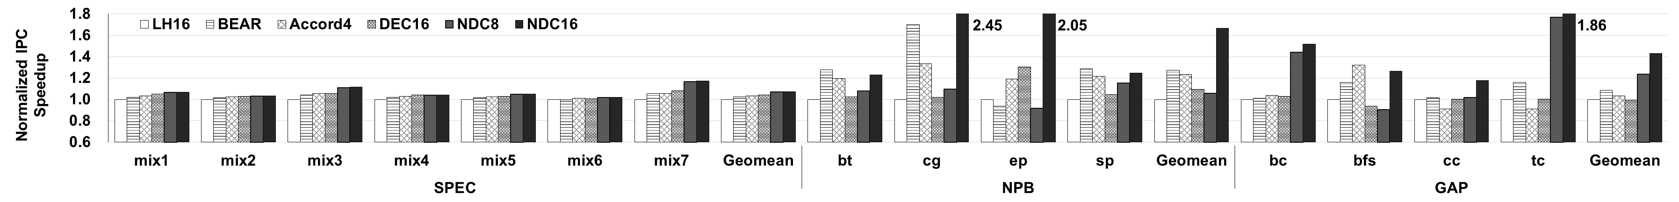
Performance
Ⅳ
Evaluation
IPC speed-ups
Can speed up SPEC/NPB/GAP benchmarks by 2.8%/52.5%/44.2%
Can reduce energy SPEC/NPB/GAP benchmarks by 17.7%/25.8%/34.6%
SPEC
IPC
NPB
IPC
GAP
IPC
Notes:
Owing to its high cache hit ratio, and row buffer hit ratio, NDC's performance improvement compared to the state-of-the-art in SPEC/NPB/GAP benchmarks is 2.8, 52.5, and 44.2%, respectively.
Furthermore, reducing unnecessary data transfers and simplifying the interface results in energy savings of 17.7, 25.8, and 34.6%.

Slide 27
Conclusion
Ⅴ
Conclusion
Cache-in-memory (CIM)
Native DRAM Cache
A novel CIM μ-architecture with in-subarray processing
Benefits
2.8%/52.5%/44.2% speeds-ups for SPEC/NPB/GAP
17.7%/25.8%/34.6% energy reduction for SPEC/NPB/GAP
Costs
0.6% DRAM area
NDC is a promising solution for data centers with a rapidly increasing number of cores.
Notes:
In conclusion, NDC leverages an ‘innovative DRAM microarchitecture to provide caching-in-memory.
We have demonstrated the performance improvements and energy savings of NDC, positioning it as a highly promising[|prɑːmɪsɪŋ] solution for data centers facing increasing core counts.

Slide 28
Notes:
Prefech 등 cache configuration에 대한 설명
This paper focuses on the operation and control of DRAM cache. Therefore, when evaluating performance, we used the basic settings of gem5 except for this aspect.
Hit rate가 다 같은 상황에서도 여전히 NDC가 우수하냐?
Even if the hit ratio does not impact, NDC remains superior. This is because, as I explained, it performs cache operations with a single command and completely eliminates unnecessary data transfers.
이것이 진짜 상용화 될 것 같냐?
Actually, calculating the overhead on DRAM was one of my jobs. So, I have examined this aspect very carefully. However, bringing it into practical use poses other issues. While there are no specific product plans yet, I believe it will happen soon.
History based predictor 등 다른 cache에서 쓴 기술들을 적용할 수 있냐?
Certainly, it can be used. However, since NDC performs well even without additional devices, we did not include them in our experiments. In contrast, other prior work for comparison included all the elements they proposed.
어떤 응용에서 사용 가능하냐?
I believe caching-in-memory strategies can be used anywhere, especially in memory-intensive tasks that require high capacity and bandwidth. While system configurations may vary depending on the application, this approach can be used in many scenarios.
Victim buffer의 overhead
The victim buffer needs to exist for each bank group, and there are about 32 bank groups per die in HBM3. Depending on the implementation method, creating a 16-entry buffer in a simple flip-flop format results in about a 0.03% area overhead.
Additionally, to maintain memory coherence, data in the victim buffer must undergo tag matching for each read or write operation. This matching occurs concurrently with the tag matching in the subarray, causing no additional delay. While transferring the contents of the victim buffer to main memory requires some time, the resulting performance degradation is negligible. For more details, please refer to the paper.
실험
We evaluated the performance using gem5. Our system includes private L1 and L2 caches, and a shared L3 cache. For detailed configuration, please refer to the paper. The L3 cache is implemented as a DRAM cache, and we have also implemented a new controller to manage it.
기타
I didn't include this content in the presentation due to time limits, but it is explained in detail in the paper. Please refer to the paper for more information.

