Slide 1
CacheCraft Enhancing GPU Performance under Memory Protection through Reconstructed Caching
Soyoung Park†, Hojung Namkoong†, Boyeol Choi†, Michael Sullivan‡, Jungrae Kim†
†Sungkyunkwan University (SKKU), ‡NVIDIA
Notes:
Hello everyone. My name is Soyoung Park from Sungkyunkwan University.
I’ll be presenting the final talk in this session, and I hope this presentation will spark meaningful discussions.
In our research, we explore a memory protection technique, examine its associated costs, and introduce our solution to enhance GPU performance under such constraints. I’m excited to present our work, CacheCraft.

Slide 2
Outline
Introduction
Background
Prior Work
CacheCraft
Evaluation
Conclusion

Slide 3
Demands for GPU Reliability
Ⅰ
Introduction
GPU reliability challenge
A large-scale field study ^{[1]} indicates
NVIDIA A100 GPUs show 14,000-hour MTBF (Mean Time Between Failures)
A large-scale cluster (992 A100s) shows 14-hour MTBF
Major source of GPU failures: memory errors
Another large-scale field study ^{[2]} indicates
HBM2 caused ~260,000,000 error events in 19 data centers over 2 years.
[1] Zhang, S., et al (2022). OPT: Open Pre-trained Transformer Language Models. in arXiv.
[2] Wu, R., et al (2024). "Removing Obstacles before Breaking Through the Memory Wall: A Close Look at HBM Errors in the Field." in ATC. USENIX Association.
Notes:
I wanna first begin with GPU reliability. I’ve brought up some interesting field measurements to emphasize GPU reliability challenges.
A single NVIDIA A100 GPU shows around 14,000 hours of Mean Time Between Failures.
So, if we linearly scale this to a large-scale cluster with about a thousand GPUs, it roughly translates to a system failure every 14 hours — quite a frequent risk.
Now, one of the major sources contributing to these failures is memory errors. Our main memory, especially DRAM, is vulnerable to such errors.

Slide 4
Error Correcting Codes (ECC)
Ⅰ
Introduction
Modern GPUs utilize ECC to safeguard data
ECC can detect and correct erroneous bits using redundancy.
ECC
Encoding
Original Data
Data
Redundancy
A bit flip
ECC
Decoding
Corrected Data
Data
Redundancy
Notes:
To address this, modern GPUs utilize Error Correcting Codes (ECC) to safeguard data and computational accuracy.
With original data, we encode some redundant information-so called redundancy.
And then ECC can detect and correct some erroneous bits by decoding the data with its redundancy.

Slide 5
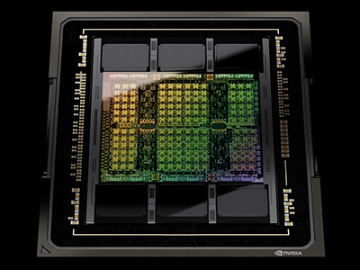
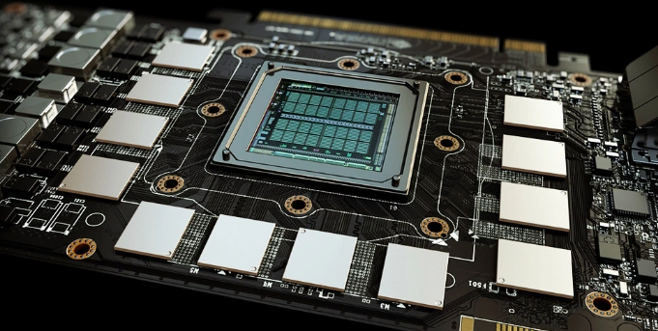
GPU Memories
Ⅰ
Introduction
HBM and GDDR with different trade-offs
HBM
GDDR
GDDR6
64MB
SRAM
HBM3
[SRC : NVIDIA]
[SRC : NVIDIA]
Target GPU | Flagship data center GPUs | Other data center GPUs Consumer GPUs
Target application | HPC and large-scale AI models | Medium- and small-scale AI models
Bandwidth | Provide state-of-the-art bandwidth (E.g. NVIDIA H100 with 3.3 TB/s) | Suitable for most mainstream apps (E.g. NVIDIA L40 with 0.86 TB/s)
Accessibility & costs | Limited supply due to high cost and packaging complexity | More accessible and cost-effective
Notes:
Let’s move to the next topic. There are two prominent types of memory for GPUs. One is HBM, and the other one is GDDR. They have respective target markets considering their different trade-offs.
For HBM, HBM offers state-of-the-art bandwidth. So it’s specialized for Flagship data center GPUs. However, HBM cannot dominate the entire GPU market, only limited supply is available due to its high cost and packaging complexity.
On the other hand, GDDR is widely used in consumer GPUs and also for other data center GPUs.
I mean the lower power and cost-effective datacenter GPUs, such as NVIDIA L40/L20. It still delivers sufficient bandwidth for most applications, along with its superior performance per watt and performance per dollar. So, GDDR could be a more accessible and cost-effective option.

Slide 6
GPU ECC
Ⅰ
Introduction
Two types: Side-band ECC and in-band ECC
Side-band ECC (for HBMs)
In-band ECC (for GDDRs)
Channel (a HBM die)
Channel (½ GDDR chip)
...
...
Data
Data
Redun.
Redun.
Data
Data
Data
Redun.
Redun.
Redun.
Data pins
Redun. pins
Data pins
(Channel Sharing)
With built-in ECC support
Without built-in ECC support
time
time
Delay
CMD
RD
CMD
RD
RD
Data
Data
Redun.
Data
Redun.
Data
ECC
Decode
ECC
Decode
Parallel transfer
Serial transfer
Notes:
Now, let’s see how GPUs with HBM and GDDR apply ECC in their systems. The two exhibit quite different implementations for managing redundancy.
The ECC scheme for HBM is commonly referred to as side-band ECC.
HBM memory is equipped with additional cells for redundancy and separate pins for its transfer. This enables parallel transmission of data and redundancy without additional latency overheads. However, HBM is currently the only DRAM type with built-in support for side-band implementation.
GDDR does not offer a built-in ECC support. Instead, it stores redundancy using the same cell space as data and transfers the redundancy using the same pins.
As a result, data and redundancy transfer becomes serialized.
Oh..by the way, some sources refer to this scheme as in-line ECC, but we used the term in-band for clear comparison with the side-band one.

Slide 7
Costs of In-band ECC
Ⅰ
Introduction
The serial transfer of data and redundancy
Consumes data throughput
Approximately 20% bandwidth reduction (NVIDIA Documentation^{[1]})
Up to 59.5% bandwidth reduction (our field measurement)
Degrades system performance
Up to 54.5% slowdown on NVIDIA Tesla K40C^{[2]}
We need a more efficient in-band ECC implementation
[1] NVIDIA Corp, “Tuning CUDA Applications for Pascal," [Online]. Available: https://docs.nvidia.com/cuda/pascal-tuning-guide/index.html.
[2] G. Juckeland et al., "Spec accel: A standard application suite for measuring hardware accelerator performance," in HPCA.
Notes:
So far, we’ve discussed that in-band ECC incurs serialized transfer of data and redundancy
In-band ECC poses a serious challenge—it consumes data throughput and degrades system performance.
NVIDIA documentation states that when you enable ECC on your system, there would be an approximately 20% bandwidth reduction, which varies from applications, of course.
However, in our evaluation, actually we did it on NVIDIA T4, there could be a 59.5% bandwidth reduction in a certain application, which was much more serious than the previously reported.
And, the delay between those two transfers, and also the increased bandwidth consumption could affect system performance.
We’re clearly bearing a substantial cost for in-band ECC. So, we need a more efficient solution for in-band ECC implementation.
In the following slides, I’ll delve deeper into these issues and introduce our solution, CacheCraft.

Slide 8
Outline
Introduction
Background
Prior Work
CacheCraft
Evaluation
Conclusion
Notes:
Before that, I’d like to briefly cover two key concepts in the background section.

Slide 9
GPU Sector Cache
Ⅱ
Background
GPUs utilize
128B cache lines
Can serve a 128B coalesced request from 32 threads within a warp
Sometimes lead to memory over-fetching and bandwidth wastage
Sector cache
Divides a cache line into smaller segments (sectors)
Reduces over-fetching while maintaining low tag overhead
A 128B cache line
Tag | Sector0 | Sector1 | Sector2 | Sector3
A | 32B | 32B | 32B | 32B
Notes:
First, GPU Sector Cache.
GPUs use a 128B cache line to serve a coalesced request from a warp instruction in a single cycle.
However, such a wide cache line can lead to memory over-fetching issues.
So, modern GPUs employ a sector cache.
A sector cache divides each cache line into smaller segments, called sectors.
Typically, a 128B cache line consists of four 32B sectors to align with the 32B memory access granularity.

Slide 10
GPU Memory Interleaving
Ⅱ
Background
GPUs employ fine-grained memory interleaving
256B channel interleaving
128B BankGroup interleaving
Interleaving enhances load balancing but degrades row buffer locality
Each bank houses only a single cache line (128B) from a 4KB page (in GPUs with 8 GDDRs)
CH B
GDDR 7
256B channel
interleaving
128B BankGroup
interleaving
CH A
CH 15
Line30
Line31
Bank0 (BG0)
Bank4 (BG1)
…
Line 30
CH B
Line 31
Bank0 (BG0)
Bank4 (BG1)
CH 14
Line28
Line29
GDDR 0
…
Page
(4KB)
Line 28
CH A
Line 29
︙
︙
︙
CH 1
Line2
Line3
Bank0 (BG0)
Bank4 (BG1)
…
Line 2
Line 3
CH 0
Line0
Line1
Bank0 (BG0)
Bank4 (BG1)
…
Line 0
Line 1
Notes:
Next, GPU Memory Interleaving. GPUs employ fine-grained memory interleaving to maximize parallelism..
With 256B channel interleaving, a 4KB page is evenly distributed across the channels.
Then, within each channel, 128B bank group interleaving takes place.
As a result, each bank holds only a single cache line from a page.
So, this interleaving scheme enhances load balancing but it degrades row buffer locality.

Slide 11
Outline
Introduction
Background
Prior Work
CacheCraft
Evaluation
Conclusion
Notes:
Now that we’ve gone through the background section, let’s take a closer look at how GPUs implement in-band ECC.

Slide 12
GPU Error Correcting Codes
Ⅲ
Prior Work
SEC-DED on a 32B block (sector)
Single Error Correction – Double Error Detection
6.25% redundancy (2B redundancy for every 32B data)
32B
2B
ECC
Encoding
Original Data
Data
Redundancy
Notes:
GPUs implement ECC on a 32B sector basis, using single error correction and double error detection.
GDDR-based GPUs provide 2 bytes redundancy for every 32 bytes of data to align with sector addresses.
This setup gives us exactly 6 and a quarter percent redundancy per data.

Slide 13
Single Sector Access with In-band ECC
Ⅲ
Prior Work
Data and redundancy in the same row
2KiB DRAM row
32B Sector
2B redun.
…
<A timing diagram of a sector access>
100% bandwidth overhead
Time
tCCDL
CMD
RD
RD
Data
R.
Sector
32B
32B
Decode
ECC
S
+
Notes:
Then first, let’s begin by understanding a single sector access with in-band ECC.
Here, data and redundancy are located in the same DRAM row for a single row activation, and the bank-level parallelism.
Now, let’s look at the timing diagram below.
To retrieve redundancy along with data, we need an additional memory access.
So, the first read command fetches 2 bytes of redundancy.
Here, we still have to fetch the entire 32-byte block because of the minimum access granularity
Then, the second RD command finally retrieves the original 32-byte sector data.
As a result, the bandwidth consumption doubles, leading to a 100% bandwidth overhead for a single sector access.
And also, the process adds a delay between the two memory accesses.

Slide 14
Single Line Access with In-band ECC
Ⅲ
Prior Work
Rcaches (Redundancy Caches) can alleviate BW penalty
Reduces # of memory accesses of full cache line requests (8 to 5)
Four for data sectors, and the other for the shared redundancy blocks
2KiB DRAM row
128 line
…
 | 32B |  |  |  | 32B |  |  |  | 32B |  |  |  | 32B
Sector 0 | Sector 1 | Sector 2 | Sector 3
②
③
④
⑤
Rcache
(32B)
①
Caching Redundancy
Notes:
Next, let’s think about a single cache line access scenario.
When we have a contiguous memory access, it could be coalesced into a single line access.
In this case, we sequentially access each of the four sectors within a line.
Simply, we could fetch the corresponding redundancy for each 32B sector data, which results in a total 8 memory accesses.
But actually, these redundancies belong to the same memory block.
Here, we can use redundancy caches to reduce the high bandwidth penalty.
Each Rcache temporarily stores the fetched redundancy block, so once we cache the redundancy block, we don’t need to fetch it again for neighboring sectors.
This can reduce the number of memory accesses from 8 to 5.

Slide 15
Single Line Access with In-band ECC
Ⅲ
Prior Work
Rcaches (Redundancy Caches) can alleviate BW penalty
Reduces # of memory accesses of full cache line requests (8 to 5)
Four for data sectors, and the other for the shared redundancy blocks
2KiB DRAM row
128 line
…
<A timing diagram of a line access>
25% bandwidth overhead
Time
tCCDL
tCCDL
tCCDL
tCCDL
tCCDL
CMD
RD
RD
RD
RD
RD
Data
R.
S0
S1
S2
S0
ECC
Decode
Decode
Decode
Decode
S0
+
S1
+
S
+
S
+
Notes:
So, let’s see the timing diagram again.
To read the 4 sector data, we just need one additional read for redundancy this time.
With line access, especially in programs with high locality, the Rcache can reduce the original 100% bandwidth penalty down to just 25%.

Slide 16
Multiple Line Access with In-band ECC
Ⅲ
Prior Work
Poor row buffer locality limits the efficacy of RCache
Only 8 bytes in the redundancy block are adjacent to each other
Other 24 bytes belong to other pages or are distant by at least 4KiB
 | 2KiB DRAM row
 | 1920B (=128B x 15) data |  |  |  |  |  |  |  |  |  |  |  |  |  |  |  |  |  |  |  |  |  |  |  |  |  |  |  |  |  |  |  | 120B
 | 128B line |  |  |  |  |  |  |  |  |  |  |  |  |  |  |  |  |  |  |  |  |  |  |  |  |  |  |  |  |  |  |  | (=8Bx15)
…
Page A | Page B | Page C | Page D | ... | Page M | Page N | Page O | Redun.
 | 32B |  |  |  | 32B |  |  |  | 32B |  |  |  | 32B
8 | 8 | 8 | 8 | 32B |  |  |  | 32B |  |  |  | 24B
Sector 0 | Sector 1 | Sector 2 | Sector 3
Notes:
However, the fine-grained memory interleaving limits the efficacy of RCache.
Here’s the data layout. Each bank contains only a single cache line from a page.
And this 128B block is divided into four 32B sector chunks, requiring 8 bytes of redundancy per block.
To place data and redundancy in the same row, fifteen blocks will be used for data storage, and the last block will be used for redundancy.
Under this layout, when considering the 32B redundancy block, only 8 bytes within the redundancy block are adjacent to each other;
the remaining 24 bytes belong to other pages or are separated by at least 4KiB.
This poor row buffer locality restricts the efficacy of caching the 32B redundancy block with RCaches.

Slide 17

Evaluation of In-band ECC Costs
Ⅲ
Prior Work
Empirical evaluation on NVIDIA T4 GPU with ECC enabled/disabled
Out of 32 benchmarks, 27 exceed 25% memory traffic amplification with 14 over 50%
Impact of excessive transfers vary across applications
* R/W cmd amp. $= \frac{total \# of R+W cmd (ECC enabled)}{total \# of R+W cmd (ECC disabled) }−1$
Notes:
Based on our previous discussion, let’s explore how the cost of in-band ECC appears in real GPUs.
Our evaluation shows that the cost of in-band ECC can be even worse than previously reported.
Using an NVIDIA T4 with ECC enabled and disabled, we measured IPC and Read/Write memory traffic.
Among 32 benchmarks, 27 showed more than a quarter increase in memory traffic, and 14 exceeded even half.
The impact of excessive transfers on system performance varies across applications, largely depending on whether they are memory-bound or compute-bound.
For example, ostencil exhibits a 39% increase in memory traffic, leading to nearly a 40% slowdown in performance.
In contrast, compute-bound applications tend to experience less degradation.

Slide 18
Evaluation of In-band ECC Costs
Ⅲ
Prior Work
Empirical evaluation on NVIDIA T4 GPU with ECC enabled/disabled
Out of 32 benchmarks, 27 exceed 25% memory traffic amplification with 14 over 50%
Impact of excessive transfers vary across applications
Existing in-band ECC necessitates additional memory access for redundancy
⇒ Bandwidth consumption , Performance
* R/W cmd amp. $= \frac{total \# of R+W cmd (ECC enabled)}{total \# of R+W cmd (ECC disabled) }−1$
Notes:
To conclude here, existing in-band ECC necessitates additional memory access for redundancy.
And the cost is the increased bandwidth consumption and degraded performance.

Slide 19
Outline
Introduction
Background
Prior work
CacheCraft
Evaluation
Conclusion
Notes:
Next, I will introduce our solution, CachCraft

Slide 20


CacheCraft - Overview
Ⅳ
CacheCraft
Let’s think outside the box
Cache-centric Strategy
Memory-oriented Strategy
“Preserve cache,
adjust memory to cache ”
“Preserve memory,
adjust cache to memory”
Cache
32B
32B
32B
32B
Cache
30B
30B
30B
…
32B
32B
32B
32B
2B
30B
2B Redun.
GDDR
GDDR
2B
① Data
② Redun.
① Data + Redun.
Notes:
Let’s define the problem again.
So, why do we need additional memory access for redundancy? It’s because we force the memory to conform to the cache layout.
In previous cache-centric strategy, we preserve cache and adjust memory to cache.
A sector access requires 32B of data, and the maximum access granularity of DRAM is also 32B. So, we need at least two memory accesses to fetch data and redundancy.
Instead, we take a memory-oriented strategy. Preserve memory and adjust cache to memory.
If we adjust the cache configuration to better align with memory, additional memory accesses won’t be necessary
We can fetch 32B in a single access, and that should include 2B redundancy. So, 30B is left for the sector data.
Based on this, we reconfigure GPU sector cache by reducing the sector size to 30B

Slide 21
CacheCraft - Overview
Ⅳ
CacheCraft
Let’s think outside the box
We can fetch both data (30B) and redun. (2B)
in a single 32B memory access !
Cache-centric Strategy
Memory-oriented Strategy
“Preserve cache,
adjust memory to cache ”
“Preserve memory,
adjust cache to memory”
Cache
32B
32B
32B
32B
Cache
30B
30B
30B
…
32B
32B
32B
32B
2B
30B
2B Redun.
GDDR
GDDR
2B
① Data
② Redun.
① Data + Redun.
Notes:
Very simple idea but now we could fetch both data and redundancy in a single 32B memory access.

Slide 22
CacheCraft - Overview
Ⅳ
CacheCraft
Reconfigures 128B cache lines to “30-30-30-30-8”
30B sectors: A 32B memory chunk contains 30B data and the corresponding 2B redun
8B sectors: Complements 30B sectors within the 128B line
GPU
L1 Cache
30B
30B
30B
30B
8B
128B line
30B or 8B transfer
L2 Cache
30B
30B
30B
30B
8B
128B line
30B or 8B transfer
DRAM Controller
ECC
32B transfer
GDDR
Notes:
We apply this idea into GPU Micro-architecture.
We maintain the conventional 128B cache line size and reconfigures this cache line into four 30B sectors and one 8B sector. So that leads us to 30-30-30-30-8 cofigs.
So when we retrieve sector data from main memory, a 32B memory chunk will contain 30B sector data and the corresponding 2B redundancy in a single access.
Here, 8B sector is to complement 30B sectors with the 128B line.

Slide 23
CacheCraft – Single 30B Sector Access
Ⅳ
CacheCraft
For requests colaesced into a 30B sector
GPU
Caches
30B
30B
30B
30B
8B
128B line
30B transfer
DRAM Controller
ECC
32B transfer
GDDR
Bank
2KiB row
…
Reduce bandwidth consumption by 50%
Time
CMD
RD
Data
D+R
ECC
30B
Notes:
Let’s see what happens for the single 30B sector access.
If a request is coalesced into a 30B sector, each 30B sector is tailored to correspond with a 32B memory chunk.
Thus, Cachecraft require only one memory access, comparing to the baseline which required two memory accesses.
So, we can reduce bandwidth consumption by 50%.

Slide 24
CacheCraft – Single Line Access
Ⅳ
CacheCraft
For a full line access
GPU
Caches
30B
30B
30B
30B
8B
128B line
DRAM Controller
ECC
GDDR
Bank
2KiB row
…
The same bandwidth overhead as baseline
Time
CMD
RD
RD
RD
RD
RD
Data
D+R
D+R
D+R
D+R
D+R
ECC
30B
30B
30B
30B
8
B
Notes:
And for a cache line access, the number of memory accesses remain the same
We don’t need additional read for redundancy but because we increased from 4 sectors to 5 sectors.
Thus, the bandwidth overhead remains the same as baseline.
Anyway, CacheCraft would benefit a lot for those programs with irregular memory patterns. It reduces 50% of bandwidth consumption.

Slide 25
CacheCraft – Modifications
Ⅳ
CacheCraft
Software
No change (the cache line size remains the same)
Hardware
Memory Coalescer
To match with “30-30-30-30-8” sectoring scheme
Caches
Sector matching logic
Adjusts SRAM banking
128B line
30B
30B
30B
30B
8B
SRAM
Bank
Bank
Bank
Bank
Bk
30B
30B
30B
30B
8B
128B
Notes:
Also, we have some modifications to make this cache configuration feasible.
There’s no change in software since the cache line size remains the same.
However, there should be plenty modifications in hardware.
First, memory coalescer to match with new sector scheme.
And then, we need to adjust sector matching logic and SRAM banking.

Slide 26
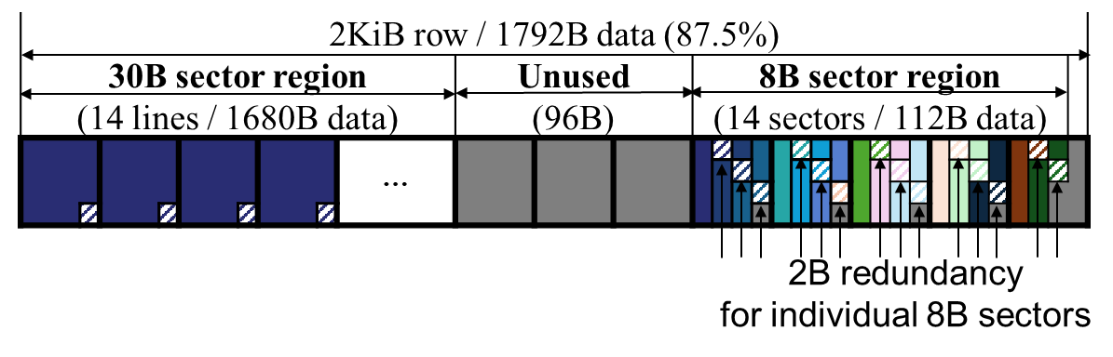
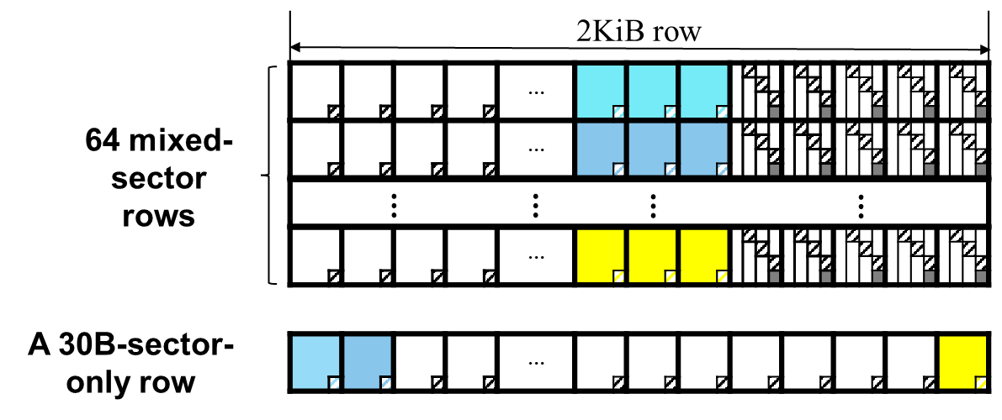
CacheCraft – Modifications
Ⅳ
CacheCraft
Memory layouts
Simple: unused capacity to meet 30-30-30-30-8
Balanced between capacity and bandwidth
Notes:
And finally, we also have to consider memory layouts.
We devised various memory layouts, each with own trade-offs.
Considering all the factors, we proposed the balanced layout which has reasonable capacity overhead with optimized bandwidth.

Slide 27
CacheCraft – Modifications
Ⅳ
CacheCraft
Memory layouts
Simple: unused capacity to meet 30-30-30-30-8
Balanced between capacity and bandwidth
Further details are presented in the paper !
Notes:
For the more details, you can refer to our paper. It is explained in details.

Slide 28
Outline
Introduction
Background
Prior Work
CacheCraft
Evaluation
Conclusion
Notes:
Finally, I’d like to close my presentation with some experimental results.

Slide 29
Evaluation Environment
Ⅴ
Evaluation
Accel-Sim with NVIDIA RTX 3070 config
Benchmarks: Rodinia (RO), Parboil (PA), Polybench (PO), GraphBig (GB)
We analyze 3 schemes
Non-ECC | - No ECC performance overheads - Caches have 32-32-32-32 sectors
Baseline | - Current in-band ECC implementations in NVIDIA - Caches have 32-32-32-32 sectors - Includes one 32B RCache per GDDR bank
CacheCraft | - Caches have 30-30-30-30-8 sectoring schemes - Memory-layout: Balanced layout
Notes:
We used Accel-sim with NVIDIA RTX 3070 config, which is a GDDR based one.
And we compared three schemes.
First non-ECC with no ECC performance overheads.
And then baseline, baseline use conventional cache with four 32B sectors and implement in-band ECC.
And Baseline includes one 32B Rcache per bank.
Finally, our CacheCraft with 30-30-30-30-8 sectoring scheme with balanced layout.

Slide 30
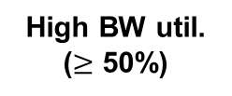

Memory Access
Ⅴ
Evaluation
Access amplification factor (compared to Non-ECC)
Baseline: overall 41.9%, ranges from 15.2% (RO-PTF) to 96.9%(GB-SSSP)
CacheCraft: overall 21.9%, ranges form 10.2%(GB-SSSP) to 28.2% (RO-KM)
Low BW util.
($<$ 25%)
Mid BW util.
(25 - 50%)
High BW util.
($≥$ 50%)
GMEAN
⇒ CacheCraft can reduce memory access overhead by up to 89.4% (GB-SSSP)
Notes:
When we enable in-band ECC, both Baseline and Cachecraft make excessive memory access.
The amplification factor was average 41.9% in baseline, however CacheCraft reduced to 21.9%.
One interesting observations is that, SSSP from Graphbig had the highest overhead in the baseline, but has the lowest overhead in CacheCraft.
Cachecraft reduced this memory access overhead dramatically by 89.4%.

Slide 31


Performance
Ⅴ
Evaluation
IPC slowdowns (normalized to Non-ECC)
Baseline: 33.2% (average), 52.6% (worst: PA-SPMV)
CacheCraft: 18.1% (average), 16.6% (worst: PA-SPMV)
Low BW util.
($<$ 25%)
Mid BW util.
(25 - 50%)
High BW util.
($≥$ 50%)
GMEAN
⇒ CacheCraft can enhance the performance
of memory-intensive applications by up to 23.5% (PA-SPMV)
Notes:
And for IPC slowdown:
We already found on real-GPU simulation that the impact of excessive transfers on performance varies across applications. So, we classified benchmarks into three groups : Low, Mid, High bandwidth utilization
And as we expected, the advantage of CacheCraft became evident in high bandwidth utilization scenarios.
In SPMV from parboil, baseline had 52.6% slow-down on Non-ECC. And CacheCraft could enhance the performance by 23.5%.

Slide 32
Conclusion
Ⅵ
Conclusion
GPU in-band ECC
Diminishes data throughput
Degrades system performance
CacheCraft
A novel GPU μ-architecture with new sectoring of “30-30-30-30-8”
Benefits
Reduce memory access overhead by up to 89.4% (GB-SSSP)
Improve performance of applications by up to 23.5% (PA-SPMV)
CacheCraft is a promising solution for GDDR-based GPUs, enhancing performance under memory protection
Notes:
To sum up, applying in-band ECC has costs of data throughput and system performance.
Our CacheCraft proposes a novel GPU microarchitecture with new sectoring scheme.
We’ve demonstrated that CacheCraft reduces memory access overhead and possibly improve performance of memoy-intensive applications.
I expect CacheCraft could be a promising solution for GDDR-based GPUs, enhancing performance under memory protection.

Slide 33
Notes:
Thank you.
Software Compatibility
We maintain the cache line size at 128B, and this is because we wanted CacheCraft to operate in a software-agnostic manner.
Cache control operations, such as invalidate, flush, and coherency control, operate at the line granularity and are not affected by the new sectoring scheme.
2. CPU + LPDDR
Thank you for raising that point. I believe there are a few aspects to consider here. LPDDR also implements in-band ECC due to the lack of side-band implementation and its wide interface. CPU+LPDDR system typically has a 64 cache line size, right? Unlike the sector cache in GPUs, we have to reduce the cache line size for a single access retrieval data and redundancy. It could be an interesting topic, but there would more challenges like address translation and software compatibility, and so on.
3. Align
If an unaligned request doesn’t coalesce into a single 30B access, CacheCraft will handle it by splitting the request into two sector accesses. This means we’d end up with two memory accesses, same to the baseline. However we can deliver more data during the two accesses. CacheCraft delievers 60B data while the baseline in-band ECC has 32B only.
4. Memory Controller
5. Complexity
*답변 못해
- That’s an interesting perspective. Unfortunately, I don’t have a definitive answer at this moment. I’ll need to look into that further, but thank you for bringing it up.
- For more details, I’d be happy to discuss this further after the session.
- We didn’t cover this in our study, but it could be an interesting direction for further work.
- Feel free to ask if you’d like further clarification on any part of my answer.

Slide 34

Graphics DDR DRAM (GDDR)
Ⅱ
Background
A GDDR6 chip is divided into two pseudo-channels
Each channel can handle a 32B request (using 16 data pins and 16 burst length)
GDDR leverages bank-level parallelism
Following GDDR5, multiple banks are organized into BankGroup
CAS-to-CAS delay (tCCD) was differentiated into tCCDS and tCCDL
tCCD Short (tCCDS) in different BankGroup
tCCD Long (tCCDL) within same BankGroup
time
time
tCCD = 4
tCCDL = 6
CMD
RD
RD
CMD
RD
RD
Data
Redun.
Data
Data
Redun.
Data
ECC
Decode
ECC
Decode
The delay between Data-Redun. transfer has increased (tCCD → tCCDL)

Slide 35
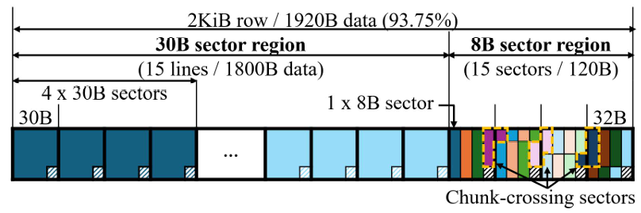
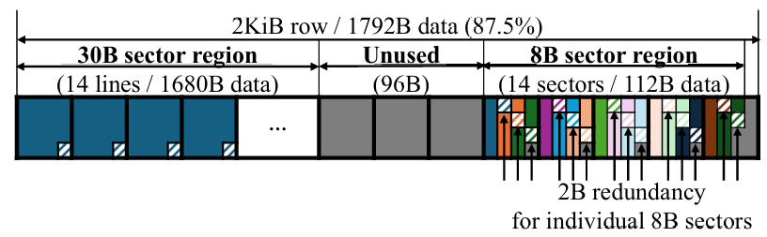
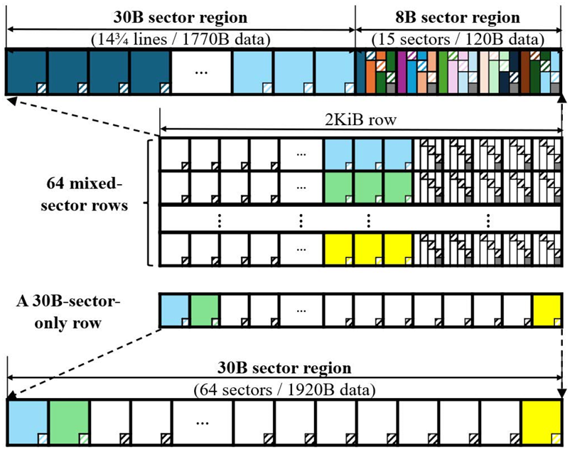
CacheCraft – Memory Layouts
Ⅳ
CacheCraft
Various memory layouts are available, each with own trade-offs
<Capacity-Oriented Layout>
<A Comparison of memory layouts>
 |  | Baseline | CacheCraft
 |  |  | Capacity-Oriented | BW- Oriented | Balanced
Capacity | Data | 93.75% | 93.75% | 87.50% | 92.31%
 | Redun. | 5.86% | 6.25% | 6.84% | 7.21%
 | Unused. | 0.39% | 0.00% | 5.66% | 0.48%
# of accesses (sector) | Read | 2 RDs | 1RD (96%) 2RDs (4%) | 1 RD | 1 RD
 | Write | 2 WRs | 1WR (80%) 1RMW (16%) 2RMWs (4%) | 1 WR | 1 WR
# of accesses (cache-line) | Read | 5 RDs | 5RDs (80%) 6RDs (20%) | 5 RDs | 5 RDs
 | Write | 5 WRs | 4WR + 1RMW (80%) 4WRs + 2RMWs (20%) | 5 WRs | 5 WRs
<Bandwidth-Oriented Layout>
<Balanced Layout>
Notes:
With Cachecraft, we also have to consider memory layouts.
We devised various memory layouts, each with own trade-offs. Capacity-Oriented layout has the same capacity with baseline. But it sacrifices some BW in some cases.
BW-Oriented layout maximizes BW, but it has pretty much storage overheads.
Considering all the factors, we propose the balanced layout which has reasonable capacity overhead with optimized bandwidth.
Details are well-described in the paper.

Slide 36
Demands for GPU Reliability
Ⅰ
Introduction
GPU reliability challenge
A large-scale field study ^{[1]} indicates
NVIDIA A100 GPUs show 14,000-hour MTBF (Mean Time Between Failures)
A large-scale cluster (992 A100s) shows 14-hour MTBF
The downtime cost per data center reaches 740,000 USD
Major source of GPU failure: memory errors
A large-scale field study indicates
HBM2 caused 260 million error events from 19 data centers over 2 years.
HBM2E has 100,000-hours MTBF after on-die ECC
single DRAM device shows ~40 FIT (Failure In Time, # of failures per billion hours)
A data center suffers from up to 300,000 DRAM errors per month
Notes:
First, I’d like to begin with GPU reliability. Ensuring GPU reliability is important these days.
There’s a remarkable field measurement that the A100 GPU card has a Mean Time Between Failures (MTBF) of approximately 14,000 hours.
From that, a large-scale cluster might have 14 hours MTBF — which is a significant risk.
One of the major source of these GPU failure is memory errors.
Our main memory, especially DRAM is vulnerable to such errors, which could be led to hardware failures in data centers.
In order to safeguard data and computational accuracy, modern GPUs integrate Error Correcting Codes (ECC).
With original data we encode some redundant information, so called redundancy. Then by decoding the data with redundancy, ECC can detect and correct some erroneous bits.

Slide 37
GPU Memories
Ⅰ
Introduction
HBM and GDDR are customized for respective target markets.
HBM
GDDR
GDDR6
64MB
SRAM
HBM3
[SRC : NVIDIA]
[SRC : NVIDIA]
Target GPU | Flagship data center GPUs | Other data center GPUs Consumer GPUs
Target application | HPC and large-scale AI models | Small and Medium-scale AI models
Bandwidth | Provide state-of-the-art bandwidth (Ex. NVIDIA H100 achieves 3.3 TB/s) | Lower but sufficient BW for most apps (Ex. NVIDIA L4 achieves 0.86 TB/s)
Accessibility & costs | Limited supply due to high cost and packaging complexity | More accessible and cost-effective
Notes:
And then, there are two prominent types of memory for GPUs. GDDR and HBM
Both HBM and GDDR have their advantages, and disadvantages, and they have respective target markets.
First, HBM offers state-of-the-art bandwidth. So it’s specialized for Flagship data center GPUs. However, HBM cannot dominate the entire GPU market, only limited supply is available due to its high cost and packaging complexity.
On the other hand, GDDR is widely used in consumer GPUs. Even though it has lower bandwidth, it still delivers sufficient BW for most applications.
Thus, GDDR could be more accessible and cost-effective option.

Slide 38
GPU Memory Layout (w/o In-band ECC)
Ⅲ
Prior Work
An example with 2KiB DRAM rows
Each row house sixteen 128B blocks
Each block houses four sectors
Poor row buffer locality due to memory interleaving
 | 128B line
2KiB DRAM row
…
Page A | Page B | Page C | Page D | ... | Page M | Page N | Page O | Page P
 | 32B |  |  |  | 32B |  |  |  | 32B |  |  |  | 32B
Sector 0 | Sector 1 | Sector 2 | Sector 3
Notes:
Here’s a data layout example. As mentioned earlier, each bank holds only a single cache line after channel and BG interleaving.
So, a 2KiB DRAM row can accommodate a total of sixteen blocks from Page A to Page P.

Slide 39
GPU Memory Layout (with In-band ECC)
Ⅲ
Prior Work
An example with 2KiB DRAM rows
2B redundancy for 32B data protection
Co-locate data and redundancy within a single row
 | 2KiB DRAM row
 | 1920B (=128B x 15) data
 | 128B line
…
Page A | Page B | Page C | Page D | ... | Page M | Page N | Page O
Redun.
 | 32B |  |  |  | 32B |  |  |  | 32B |  |  |  | 32B
Sector 0 | Sector 1 | Sector 2 | Sector 3
ECC Decoding
Data 32B
Redun.
2B
Notes:
Since we need 2B redundancy for every 32B data, each block requires 8B of redundancy.

Slide 40
RCaches (Redundancy Caches)
Ⅲ
Prior Work
Alleviate BW penalty for programs with high-locality
Reduces # of memory accesses of full cache line requests (8 to 5)
Four for data sectors, and the other for the shared redundancy blocks
…
Page A | Page B | Page C | Page D | ... | Page M | Page N | Page O | Redun.
 | 32B |  |  |  | 32B |  |  |  | 32B |  |  |  | 32B
8 | 8 | 8 | 8 | 32B |  |  |  | 32B |  |  |  | 24B
Sector 0 | Sector 1 | Sector 2 | Sector 3
①
Rcache
(32B)
Notes:
We can add redundancy cache to alleviate BW penalty for programs with high-locality.
By temporarily caching redundancy block, rcache reduces the number of memory accesses of full cache line requests.
For a cache line access, we fetch four contiguous data sectors along with redun, which may require 8 memory accesses.
But the sectors share the same redundancy block.
For example, to access from sector0 to sector3 sequentially, we first fetch and caching redundancy block .

Slide 41
RCaches (Redundancy Caches)
Ⅲ
Prior Work
Alleviate BW penalty for programs with high-locality
Reduces # of memory accesses of full cache line requests (8 to 5)
Four for data sectors, and the other for the shared redundancy blocks
…
Page A | Page B | Page C | Page D | ... | Page M | Page N | Page O | Redun.
 | 32B |  |  |  | 32B |  |  |  | 32B |  |  |  | 32B
8 | 8 | 8 | 8 | 32B |  |  |  | 32B |  |  |  | 24B
Sector 0 | Sector 1 | Sector 2 | Sector 3
②
①
Rcache
(32B)
Notes:
Then, Rcache will serve every required redundancy from sector0 to sector3.

Slide 42
Rcaches (Redundancy Caches)
Ⅲ
Prior Work
Alleviate BW penalty for programs with high-locality
Reduces # of memory accesses of full cache line requests (8 to 5)
Four for data sectors, and the other for the shared redundancy blocks
…
Page A | Page B | Page C | Page D | ... | Page M | Page N | Page O | Redun.
 | 32B |  |  |  | 32B |  |  |  | 32B |  |  |  | 32B
8 | 8 | 8 | 8 | 32B |  |  |  | 32B |  |  |  | 24B
Sector 0 | Sector 1 | Sector 2 | Sector 3
②
③
①
Rcache
(32B)

Slide 43
RCaches (Redundancy Caches)
Ⅲ
Prior Work
Alleviate BW penalty for programs with high-locality
Reduces # of memory accesses of full cache line requests (8 to 5)
Four for data sectors, and the other for the shared redundancy blocks
…
Page A | Page B | Page C | Page D | ... | Page M | Page N | Page O | Redun.
 | 32B |  |  |  | 32B |  |  |  | 32B |  |  |  | 32B
8 | 8 | 8 | 8 | 32B |  |  |  | 32B |  |  |  | 24B
Sector 0 | Sector 1 | Sector 2 | Sector 3
②
③
④
①
Rcache
(32B)
Notes:
We can add redundancy cache to alleviate BW penalty for programs with high-locality.
By temporarily caching redundancy block, rcache reduces number of memory accesses of full cache line requests.
For a cache line access, we fetch four contiguous 32B data sectors and their corresponding 2B redun, which may require 8 memory accesses.
But the redundancies belong to the same block, here.

Slide 44
RCaches (Redundancy Caches)
Ⅲ
Prior Work
Alleviate BW penalty for programs with high-locality
Reduces # of memory accesses of full cache line requests (8 to 5)
Four for data sectors, and the other for the shared redundancy blocks
…
Page A | Page B | Page C | Page D | ... | Page M | Page N | Page O | Redun.
 | 32B |  |  |  | 32B |  |  |  | 32B |  |  |  | 32B
8 | 8 | 8 | 8 | 32B |  |  |  | 32B |  |  |  | 24B
Sector 0 | Sector 1 | Sector 2 | Sector 3
②
③
④
⑤
①
Rcache
(32B)
Notes:
Thus, we can reduce memory accesses and possibly alleviate the BW penalty of full cache line requests.

Slide 45
Overhead of In-band ECC
Ⅲ
Prior Work
A sector access
Two sequential 32B memory accesses for data and redundancy
A cache line access
Redundancy Caches (Rcaches) can alleviate bandwidth penalty
100% bandwidth overhead
Time
tCCDL
CMD
RD
RD
Redun.
Sector
Data
.
32B
32B
Decode
ECC
S
+
Time
25% bandwidth overhead
tCCDL
tCCDL
tCCDL
tCCDL
CMD
RD
RD
RD
RD
RD
.
S0
S1
S2
S3
Data
Redun.
Caching
Decode
Decode
Decode
Decode
ECC
S0
+
S1
+
S2
+
S3
+
Notes:
To review the in-band ECC overhead based on the layout:
First, memory is accessed on a sector basis. In-band ECC generates two sequential 32B memory accesses—one for data and one for redundancy.
This dual-access approach doubles the bandwidth requirement and adds a latency panality of tCCDL
Next, we can mitigate the bandwidth penalty for cache line accesses by using Rcaches.
The bandwidth overhead is reduced to one-fourth, and regular memory access patterns would benefit from this.

Slide 46
CacheCraft - Overview
Ⅳ
CacheCraft
Reconfigures 128B cache lines to “30-30-30-30-8”
30B sectors: A 32B memory chunk contains 30B data and the corresponding 2B redun
8B sectors: Complements 30B sectors within the 128B line
GPU
L1 Cache
128B line
L2 Cache
128B line
DRAM Controller
ECC
32B transfer
GDDR
Notes:
Based on this idea, we reconfigure our cache line.

Slide 47
CacheCraft - Overview
Ⅳ
CacheCraft
Reconfigures 128B cache lines to “30-30-30-30-8”
30B sectors: A 32B memory chunk contains 30B data and the corresponding 2B redun.
8B sectors: packed within a 32B memory chunk alongside other pairs
GPU
L1 Cache
30B
30B
30B
30B
8B
128B line
30B transfer
L2 Cache
30B
30B
30B
30B
8B
128B line
30B transfer
DRAM Controller
ECC
32B transfer
GDDR
Bank
2KiB row
…
Notes:
And the other ones to the next.

Slide 48
CacheCraft - Overview
Ⅳ
CacheCraft
Reconfigures 128B cache lines to “30-30-30-30-8”
30B sectors: A 32B memory chunk contains 30B data and the corresponding 2B redun.
8B sectors: packed within a 32B memory chunk alongside other pairs
GPU
L1 Cache
30B
30B
30B
30B
8B
128B line
30B transfer
L2 Cache
30B
30B
30B
30B
8B
128B line
30B transfer
DRAM Controller
ECC
32B transfer
GDDR
Bank
2KiB row
…
Notes:
Then, what happens in the DRAM Controller is quite simple.

Slide 49
CacheCraft - Overview
Ⅳ
CacheCraft
Reconfigures 128B cache lines to “30-30-30-30-8”
30B sectors: A 32B memory chunk contains 30B data and the corresponding 2B redun.
8B sectors: packed within a 32B memory chunk alongside other pairs
GPU
L1 Cache
30B
30B
30B
30B
8B
128B line
Write
30B transfer
30B
30B
30B
30B
8B
128B line
30B
data
2B
redun.
32B
block
L2 Cache
+
⇒
30B transfer
=
Read
DRAM Controller
ECC
30B
data
2B
redun.
32B
block
32B transfer
+
⇒
GDDR
Bank
2KiB row
…
Notes:
So, when we write sector data to DRAM, the memory controller generates a 32B memory chunk by encoding 2B of redundancy with 30B of data.
This chunk will be stored in the red-highlighted part.
When we want to read this data, the memory controller fetches the 32B memory chunk, which includes the 30B sector data and its 2B redundancy.
If ECC decoding completes without any error, the redundancy is discarded, and only the 30B of data is sent to the cache.

Slide 50
CacheCraft - Overview
Ⅳ
CacheCraft
Reconfigures 128B cache lines to “30-30-30-30-8”
30B sectors: A 32B memory chunk contains 30B data and the corresponding 2B redun.
8B sectors: packed within a 32B memory chunk alongside other pairs
GPU
L1 Cache
30B
30B
30B
30B
8B
128B line
8B transfer
L2 Cache
30B
30B
30B
30B
8B
128B line
8B transfer
DRAM Controller
ECC
32B transfer
8B
2B
redun.
=
+
x 3
GDDR
32B
Bank
2KiB row
…
Notes:
Then, for 8B sectors:
A pair of 8B sectors are packed within a 32B memory chunk. Of course it’s for storage efficiency.
We can pack at most three pairs of 8B sectors with its redundancy in a 32B memory chunk.

Slide 51
CacheCraft - Overview
Ⅳ
CacheCraft
Reconfigures 128B cache lines to “30-30-30-30-8”
30B sectors: A 32B memory chunk contains 30B data and the corresponding 2B redun.
8B sectors: packed within a 32B memory chunk alongside other pairs
GPU
L1 Cache
30B
30B
30B
30B
8B
128B line
Write
Mask bit
(10-19)
8B transfer
L2 Cache
30B
30B
30B
30B
8B
128B line
8
B
2B
redun.
+
⇒
8B transfer
=
Read
DRAM Controller
ECC
2B
redun.
8
B
32B transfer
+
⇒
GDDR
Bank
2KiB row
…
Notes:
Then, read and write process is quite similar with 30B sectors.
For WRITE, memory controller generates redundancy with ECC encoding. But this time, we just wanna partially write these 10 bytes. So we can use masked write here.
And for READ, the memory controller fetches entire 32B memory chunk as same as before.
After ECC decoding, we discard the redundancy, and only the 8B sector data is sent to the cache.

Slide 52
CacheCraft - Timing Diagram
Ⅳ
CacheCraft
A request is coalesced into a 30B sector
A request is coalesced into two 30B sectors
A cache line access
Reduce bandwidth consumption by 50%
Time
CMD
RD
Data
D+R
ECC
30B
CacheCraft can fetch more data (60B)
Time
CMD
RD
RD
Data
D+R
D+R
ECC
30B
30B
The same bandwidth overhead as baseline
Time
CMD
RD
RD
RD
RD
RD
Data
D+R
D+R
D+R
D+R
D+R
ECC
30B
30B
30B
30B
8
B
Notes:
Now, let’s see how much CacheCraft can improve in-band ECC overheads.
If a request is coalesced into a 30B sector, Cachecraft require only one memory access, comparing to the baseline which required two memory accesses.
So we can reduce bandwidth consumption by 50%.
But unfortunately since we reduced the sector size, a request might be splitted into two sector accesses. Even in this case, Cache can fetch more data of 60B, comparing with baseline of 32B.
And for a cache line access, the number of memory accesses remain the same, since we increased from 4 sectors to 5 sectors.
The bandwidth overhead remains the same as baseline.
Anyway, CacheCraft would benefit a lot for those programs with irregular memory patterns. It reduces 50% of bandwidth consumption.

