Slide 1
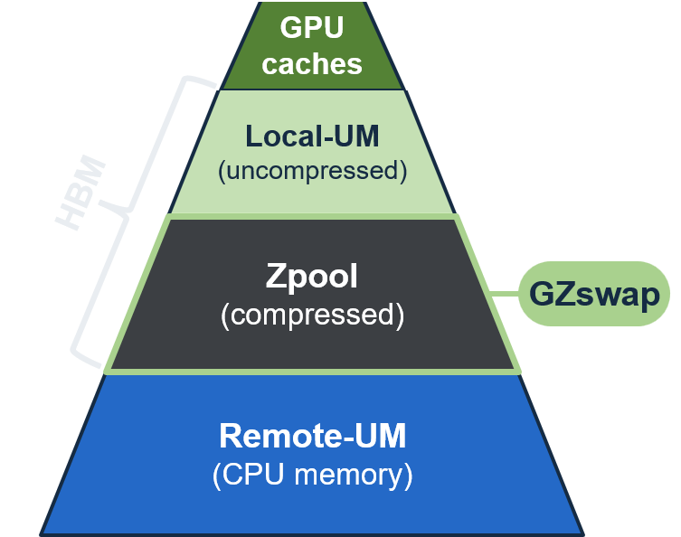
GZswap
Hardware-Managed Compressed Swap
for GPU Memory Oversubscription
Boyeol Choi¹ Sanghyun Park² Sanghyun Hong³
Seokin Hong¹ Jungrae Kim¹
¹Sungkyunkwan University ²FuriosaAI ³MangoBoost
PACT 2026 · Chicago, Illinois, USA
Notes:
Hello everyone. I’m Boyeol Choi from Sungkyunkwan University, and today I’ll present GZswap, hardware-managed compressed swap for GPU memory oversubscription.
The pyramid on the right shows the main idea. GZswap uses part of GPU memory as a compressed pool, the Zpool.
Evicted pages stay there in compressed form. When they are needed, hardware brings them back, without the CPU driver handling or PCIe traffic.

Slide 2
GPU Memory Capacity Wall
INTRODUCTION
GPU workloads already exceed the memory of a single GPU
DeepSeek-V3 · 1.3 TB
PaLM · 1.1 TB
Graph analytics
WDC web graph · ≈0.5 TB
1.3–3.5×
SQL analytics
TPC-H SF1000 · 1 TB
B300 · 288 GB
datasets vs largest GPU (288 GB)
Vector search
Deep-1B · 384 GB
GPT-3 · 350 GB
B200 · 192 GB
A100 · 80 GB
H200 · 141 GB
~2×
H100 · 80 GB
V100 · 32 GB
GPU memory growth
every 2 years
P100 · 16 GB
How can a GPU run a workload larger than its memory?
Notes:
GPUs are now used for much more broadly than AI. SQL / graph analytics and vector search all run on GPUs.
GPU memory grows only about 2x every two years, still these datasets are already larger than the GPU memory.
And of course, large language models are also huge. So how can a GPU run a workload larger than its memory?

Slide 3
Overcoming the GPU Memory Capacity Wall
INTRODUCTION
Splitting the data needs a clean partition; Unified Memory works for broad workloads
MULTI-GPU
SINGLE GPU
SINGLE GPU
Data partitioning
Sequential execution
Unified Memory
A
B
C
A
B
C
A
B
C
A
B
C
GPU 0
GPU 1
GPU 2
GPU
time
GPU
CPU
✗ More GPUs
✗ Manual chunking
✓ Transparent
Unified Memory enables transparent oversubscription, but migration limits performance
Notes:
There are three options.
First, data partitioning splits the data across multiple GPUs. But then you buy more GPUs, even when you only need more memory.
Second, sequential execution processes the data chunk by chunk on one GPU.
But the programmer must split and copy every chunk by hand. And some workloads, like graph analytics, do not split cleanly.
Third, Unified Memory combines GPU and the larger CPU memory as one space.
It is transparent and works for many workloads. But its performance is limited by page migration.

Slide 4
Unified Memory: Concept & Details
BACKGROUND · UNIFIED MEMORY
CPU memory backs the whole dataset; GPU memory holds only the pages in use
One virtual address space
Handling one GPU page fault
VA0
VA1
VA2
VA3
VA4
VA5
VA6
VA7
TLB miss
Page table walk
fault!
CPU memory
GPU memory
VA0
VA1
UVM driver on CPU
1
SW handling
VA1
swap-in
CPU driver handling
VA2
VA3
VA4
Swap-out: GPU→CPU
2
Serialized
VA4
VA5
swap-out → swap-in
VA6
swap-out
Off-package
VA6
VA7
Swap-in: CPU→GPU
3
both cross PCIe
Demand paging
Backing storage of GPU
Replay
Notes:
Let’s look at Unified Memory more closely. UM gives the CPU and GPU one virtual address space.
CPU memory holds the whole dataset, and GPU memory holds only the pages in use.
Now, let’s see how a page fault is handled.
When the GPU accesses a page that is only in CPU memory, the TLB misses and the page walk raises a fault.
The UVM driver on the CPU handles this fault. If GPU memory is full, the driver first swaps out a victim to CPU.
Then it swaps in the faulting page to GPU and replays the access.
This is slow for three reasons. [click] First, the fault is handled in software on the CPU. Second, swap-out and swap-in are serialized. Third, both transfers cross the slow PCIe link.

Slide 5
Prior Work: Data Placement & Prefetching
MOTIVATION & PRIOR WORK
hot (in WSS)
cold
Placement and prefetching decide which pages stay on the GPU, e.g., TBNE [ISCA ’19]
Prefetching & eviction
Thrashing
GPU memory < WSS
CPU memory
GPU memory
GPU memory
Prefetch / Evict
CPU memory (backing store)
TBNE prefetches neighboring pages by subtree,and evicts cold subtrees back to CPU memory
✗ Hot pages evict each other
✗ Evicted pages must come back over PCIe
Once the working set exceeds GPU memory, capacity is the bottleneck, not placement
Notes:
Most prior work decides which pages stay on the GPU.
Data placement mainly focus on keeping hot pages in GPU memory and cold pages in CPU memory.
But when the working set is larger than GPU memory, there are no cold pages left for eviction.
Hot pages evict each other, and evicted pages come back through PCIe.
This is called thrashing. In this case, placement alone is not enough. Capacity becomes the main bottleneck.

Slide 6
Prior Work: Compression in GPU Memory
MOTIVATION & PRIOR WORK
Compress each cacheline between L2 and HBM, e.g., Buddy Compression [ISCA ’20]
Cacheline compression
Small windows & exceptions
128 B windows, fixed slots
4 KB page
Comp. /
Decomp.
HBM
each line compressed alone
L2
cache
48 B
✓ fits
80 B
!
exception
expanded capacity
64 B slot
128 B line
Overflow is fetched remotely on every access
Buddy compresses each 128 B line on its way to HBM, and stores it in a fixed slot, (e.g., 64 B for 2×)
✗ Small 32–128 B windows, simple encoders
✗ Exception handling on a tight memory path
What if we compress whole pages instead of cachelines?
Notes:
Another way to get more GPU memory is compression. Prior GPU compression schemes with cacheline compression, it compresses each 128-byte line between L2 and HBM, and stores it in a fixed slot. But this has two limits. First, a 128-byte window is too small to compress well. Second, every line must fit its slot, or it becomes an exception. Because compression sits on the memory access path, exceptions directly slow down memory accesses. Both limits come from compressing small cachelines. So why not compress whole pages instead?

Slide 7








Linux zswap: Compressed Swap on CPUs
MOTIVATION & PRIOR WORK
Compressed swap in memory already works for CPUs, but not as-is for GPUs
Why zswap can’t simply move to GPUs
CPU
caches
Concurrent faults
DRAM
CPU
GPU
Resident pages
(uncompressed)
Thousands of GPU threads can fault at once
zswap pool
(compressed)
No OS on the device side
Swap device
(SSD / disk)
CPU
GPU
zswap pool management
needs the OS kernel
In production at Google [ASPLOS’19] and Meta [ASPLOS’22]
CPU zswap can’t simply move to GPUs: thousands of concurrent faults, no OS to manage it
Notes:
Compressed swap already exists on CPUs.
Linux zswap adds a compressed pool in DRAM, between resident pages and the swap device.
An evicted page is compressed into this pool. On a later fault, the page comes back from this pool, not from the disk.
Google and Meta already use it in production for reducing memory cost.
But zswap cannot simply move to GPUs. First, thousands of GPU threads can fault at once, and a software fault path cannot keep up.
Second, there is no OS on the GPU side, but zswap needs the kernel to manage its pool.
So its not simple just move zswap to gpu side.

Slide 8

GZswap: Compressed Swap Inside GPU Memory
GZSWAP · OVERVIEW
Evicted pages stay on the GPU, compressed, instead of crossing PCIe
GPU
caches
HBM
1. Zswap-out
compress evicted pages
Local-UM
(uncompressed)
2. Zswap-in
decompress on a fault
Zpool
(compressed)
3. Management
pool mangement (Local-UM / Zpool)
Remote-UM
(CPU memory)
GZswap: zswap on the GPU side, implemented in hardware (no CPU driver, no OS)
Notes:
GZswap brings zswap to the GPU. Like CPU zswap, it reserves part of HBM as the Zpool.
Evicted pages stay there in compressed form, instead of going to CPU memory.
Zswap-out compresses a victim into the Zpool and Zswap-in decompresses it back to Local-UM on a fault.
Hardware hanldes page movement between Local-UM and the Zpool, and manages the free space in both.
So GZswap is work about building zswap on the GPU side, in hardware, with no CPU driver intervention.
It this presentation, I'll explain design point and overview of hardware offloading.

Slide 9
Move 64 KB, Restore 4 KB, Pack Tight
GZSWAP · PAGE COMPRESSION
Inside zswap-out and zswap-in: three design choices
1
Keep UM’s 64 KB unit
P0
P1
P2
P3
…
P14
P15
Transparent
same 64 KB unit as UM
UM migrates in 64 KB chunks for efficient DMA and PCIe
64 KB page-group = 16 × 4 KB pages
2
Compress each 4 KB page
64 KB stream
replay ≈ 4400 ns
Fast Replay
faulting page first
One 64 KB stream must be fully restored before replay
4 KB pages
others: background
replay ≈ 277 ns
3
Pack into 4 KB zpages
ZP0
ZP1
ZP2
ZP3
16 pages → 4 zpages
No Exception
no fixed target to miss
Compressed sizes vary; fixed slots would fragment or overflow
P0
P1
P2
P3
P4
P6
P7
P8
P9
zpage 0
zpage 1
zpage 2
zpage 3
64 KB movement, 4 KB Compression with Packing = Transparent, Fast Replay, No Exception
Notes:
Let’s start with the three design choices behind page compression.
First, Unified Memory moves data in 64 KB groups for PCIe and DMA utilization.
GZswap keeps the same 64 KB unit for Remote-UM, Local-UM and the Zpool. So it stays transparent to Unified Memory.
Second, compression works on each 4 KB pages. If whole 64 KB group is compressed at once, the access must wait for decompressing all 16 pages. With each 4 KB page compression, GZswap decompresses the faulting page first, and the rest of the pages are decompressed in the background. This gives fast replay.
Third, the compressed pages are packed into 4 KB zpages. So each page simply takes the space it needs and there is no exception, with low fragmented space.
In short: move 64 KB, compress 4 KB, and pack. GZswap is transparent, replays fast, and has no exception path.

Slide 10
Compress Big, Restore Small
GZSWAP · PAGE COMPRESSION VS. CACHELINE
Page-level compression ratio, yet only the faulting page is restored before replay
Cacheline compression (prior)
GZswap: page compression
32–128 B lines, on every memory access
4 KB pages, once at eviction, packed
Compression ratio
Compression ratio
Low 1.2–2.4×
High 6.45× on average
Restore before replay
Restore before replay
other evicted pages: restored in background
Short one line, but paid on every access
Short faulting page first, ≈ 277 ns
Exception path
Exception path
Need misses its target → overflow to host
None no fixed target to miss
No fixed target: no exception and also alleviating internal fragmentation
Notes:
Compare this with cacheline compression, cacheline compression restoring a line fastly, but the compression ratio is only 1.2 to 2.4x.
And a line that misses its target becomes an exception.
GZswap compresses each 4 KB page only once, at eviction.
The larger window gives 6.45x on average.
On a fault, only the faulting page is restored before replay.
There is no exception path because page that compresses poorly just takes more space.

Slide 11
GZswap Takes Over the Fault Inside the GPU
GZSWAP · DECOMPRESSION · HARDWARE OFFLOAD
Faults on compressed pages are handled in the GPU MMU, before they reach the CPU driver
Baseline UM fault path
GPU MMU (GMMU)
TLB miss
C = 1
(compressed)
Candidate queue
Page table walk
Fault Management Unit
pop
refill
Available Region
Manager
fault!
64KB
free frames
UVM driver on CPU
ZDE + free frame
Critical page first
Swap-out: GPU→CPU
skipped
Decompressor
Zpool → Local-UM
ZDE lengths: 10+6+4+6 = P4’s offset
P0
P1
P2
P3
P4
…
Swap-in: CPU→GPU
10
6
4
6
6
2
3
3
replay
Replay
P4
rest of the group: background
Handled in GPU hardware: a ready free frame, and the faulting page decompressed first
Notes:
Now, we'll show how hardware offloading works through the decompression path. On the left is the baseline fault path from before. GZswap adds a one-bit flag, C, to the page-table entry. It marks a compressed page in the Zpool. If the page walk finds C is set, the Fault Management Unit in the GPU MMU handles the fault, and these steps are skipped. First, the FMU pops a free 64 KB frame from the candidate queue. Then it sends this frame and the group’s metadata to the Decompressor. The Decompressor restores the faulting page, P4, first. The metadata stores each page’s compressed length, so adding the lengths before P4 gives its location. Once P4 is restored, the access is replayed, and the rest of pages are decompressed in the background. So the fault is handled right away in GPU hardware, not by the CPU driver.

Slide 12
How the Candidate Queues Stay Filled
GZSWAP · RESOURCE MANAGEMENT · HARDWARE OFFLOAD
The ARM refills the queues from the inverted page tables, skipping full regions
Candidate queue
Available Region
Manager (ARM)
Inverted page table
Availability Bitmap
ready to pop
in GPU memory
1 bit per 2 MB region
0x000
0xA0000
0
Local-UM (64 KB)
for page fault handling & decompression
push
Availability Bitmap
read
⋮
⋮
⋮
64KB
0
0
1
0
0
1
0x043
—
1
0
0
1
0
0
1
0
0
head
tail
skip
skip
read
skip
skip
read
⋮
⋮
⋮
0x3FF
0xC2000
0
No full-table scans
regions marked 0 are skipped
0x000
0x3F2
0
Zpool (4 KB)
for compression
push
Availability Bitmap
read
⋮
⋮
⋮
4
KB
0
1
0
0
0
1
0x0B5
—
1
1 bit summarizes 32 entries
(2 MB of 64 KB frames)
head
tail
skip
read
skip
skip
skip
read
⋮
⋮
⋮
0x7FF
0x1A7
0
Free frames for faults, free zpages for compression: kept ready (details in the paper!)
Notes:
Next, let me briefly explain how GZswap manages memory space inside the GPU.
There are two regions to manage: uncompressed Local-UM, kept as free 64 KB frames for page-fault handling, and the compressed Zpool, kept as free 4 KB zpages for packing compressed pages.
To manage these with hardware, GZswap tracks free space with inverted page tables, one entry per frame or zpage.
The Available Region Manager, the ARM, reads these tables and pushes free entries into the queues.
To avoid full-table scans, the ARM keeps a small SRAM bitmap that records whether each large region has any free entry.
By doing so, free frames and free zpages are always ready.
For more details, please see the paper.

Slide 13
Evaluation Setup
EVALUATION · ENVIRONMENT
1
System
2
Workloads
3
Compared
Simulator
Accel-Sim + UVMSmart + Ramulator
15 workloads, 4 suites
2MBE
PolyBench
GraphBIG
NVIDIA UM (SW faults)
Parboil
Rodinia
TBNE
A100-class GPU
1/5 scale for cycle-level simulation
Baseline (Placement Policy)
Compression ratio 1.1× – 11.2×
UVMMU
Memory pressure
(R = GPU memory / footprint)
HW fault handling
Zpool Ratio
(20% of GPU memory)
GZswap
R90
R75
HW fault handling + Zpool
Baseline · 10 GB
R50
Buddy
GZswap · 8 + 2 GB
R35
Cacheline compression
UVMMU vs. GZswap: same HW fault path, so the gap is the value of the Zpool
Notes:
Now, the evaluation. The simulator combines Accel-Sim, UVMSmart and Ramulator. It is cycle-accurate, and models an A100-class GPU at one-fifth scale.
All schemes get the same memory, and GZswap uses 20% of it as the Zpool like figure shows.
There are 15 workloads from four suites, with compression ratios from 1.1 to 11.2x.
For observing memory capacity limitation, we shrink available gpu memory size, relative to gpu workload footprint.
For example, at R50, GPU memory is half of workload footprint.
GZswap is compared with 2MBE which shows NVIDIA UM, TBNE shows data placmenet, UVMMU hardare fault handling and Buddy Compression which shows cacheline compression.

Slide 14
Performance
EVALUATION · PERFORMANCE
Geomean IPC normalized to TBNE at the same R · higher is better
+59%
vs. TBNE at R35
+69%
vs. UVMMU at R35
UVMMU = same HW fault path, but no Zpool
~10× compression → big gain
1.1× compression → little gain
PO-MVT, PO-ATAX, RO-RA keep ≥ 92% of no oversubscription IPC at R35 (RO-RA baselines: < 12%)
PB-SGEM fills the Zpool quickly, so GZswap does no better than UVMMU
GZswap’s gain grows with memory pressure and compressibility
Notes:
This graph shows geomean IPC, normalized to TBNE at the same memory pressure.
At R35, GZswap improves IPC by 59% over TBNE.
Compared with UVMMU, the gain is 69%. UVMMU has the same hardware fault path, but no Zpool. So this gap comes from keeping evicted pages compressed on the GPU.
Per workload, the gain follows the compression ratio.
Some workloads compress about 10x, like PO-MVT, PO-ATAX and RO-RA. They keep at least 92% of their no oversubscription IPC, even at R35,
[click] PB-SGEM compresses only 1.13x. Its pages fill the Zpool quickly, so GZswap does no better than UVMMU.
[click] So the gain grows with memory pressure and with the compression ratio.

Slide 15
I/O Traffic & Energy Consumption (at R35)
EVALUATION · I/O TRAFFIC & ENERGY
Energy: AccelWattch extended with Comp/Decomp Engine, CPU DRAM, PCIe · lower is better
Relocation I/O traffic
Total system energy
−55%
−24%
vs. TBNE at R35
vs. TBNE at R35
Evicted pages come back from the Zpool, not over PCIe
Shorter runtime and less PCIe traffic outweigh compression energy
Notes:
Next, I/O traffic and energy at R35, the highest memory pressure. GZswap reduces I/O traffic by 55%. It keeps recently evicted pages in the Zpool, so reused pages come back locally, not over PCIe. For energy, AccelWattch is extended with the compression engine, PCIe and CPU DRAM. Total energy drops by 24%. The shorter runtime saves static energy, and there is less PCIe traffic. Together, these save more energy than compression uses.

Slide 16
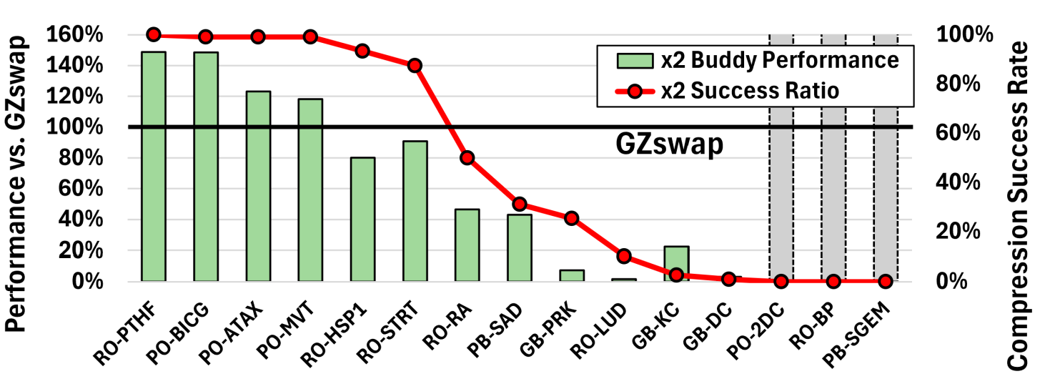
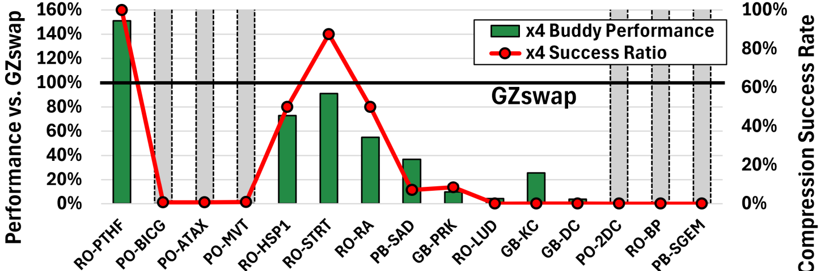
Comparing with Buddy Compression (Cacheline Comp.)
EVALUATION · VS. BUDDY COMPRESSION
Bars: Buddy IPC vs. GZswap (100%) · line: target success ratio · gray bars: timed out
Buddy 2× at R50
Buddy 4× at R25
2× target: lines fit → Buddy ≥ GZswap
4× target: lines miss → Buddy collapses
Target success ratio (share of lines that fit the 2× slot): 99–100% for BICG · ATAX · MVT
4× (128 B line → 32 B) is too high for cacheline compression: target success ratio < 1%
Buddy works only when its fixed target fits; GZswap has no target to miss
Notes:
We also compare with Buddy Compression under the same memory budget.
The bars show Buddy’s IPC relative to GZswap. The red line is the buddy's compression success ratio which means compressed result fit fixed slot.
With a 2x target, almost all lines in BICG, ATAX and MVT fit in, so Buddy matches or beats GZswap.
With a 4x target at R25, each 128-byte line must fit in 32 bytes, cacheline compression rarely does that.
For the same three workloads, the success ratio drops below 1%. Almost every line overflows to host memory.
So Buddy work well when its fixed target fits. GZswap has no target to miss and work well.

Slide 17
Zpool Size: No Single Size Fits All
EVALUATION · SENSITIVITY
IPC at R50, normalized to the default 20% Zpool · same GPU memory, split differently
Zpool share:
Local-UM
Zpool
20%
40%
60%
80%
RO-LUD
PO-BICG
GB-PRK
More Zpool keeps helping (80%)
Default (20%) is best
Best in the middle (60%)
Best size depends on compressibility and working-set size → runtime sizing is future work
Notes:
The GZswap carves portion of GPU memory as Zpool. So a bigger Zpool gives more compressed space, but less memory for direct use. Here, we also did zpool size sensitivity study from 20% to 80%. The result in this slide shows IPC at R50, normalized to the default 20% Zpool.
RO-LUD keeps improving, up to 3.1x with an 80% Zpool.
PO-BICG is best at the default 20%.
GB-PRK is best in the middle, at 60%.
So the best size of zpool depends on both the compression ratio and the working-set size. Sizing the Zpool at runtime left as future work.

Slide 18
Hardware and Metadata Overhead
EVALUATION · COST
Full A100 (80 GB HBM, 826 mm² die); metadata sized for a Zpool spanning all of HBM
1.81%
0.26%
of HBM capacity for metadata
of GPU die area
HBM · 80 GB
GPU die · 826 mm²
descriptor table 1.60% · inverted tables 0.21%
compression engine 0.255% · bitmaps 0.0035%
Metadata scales with physical frames · metadata accesses < 0.5% even at R35
Notes:
Finally we shows overhead of GZswap based with full A100 with 80 GB of HBM.
Even if we provision metadata as if the Zpool covered all of HBM, it takes only 1.81% of HBM, mostly the descriptor table.
The overall die area overhead with compression engine and the bitmaps take 0.26% of the A100 die.
Metadata accesses stay under 0.5% of device-memory accesses even at R35, and all of them are charged in our simulation.

Slide 19
GZswap: Compressed Swap Space Inside the GPU
Evicted pages stay on the GPU, compressed, and come back without crossing PCIe
1
Page compression
2
Hardware offload
move 64 KB · compress 4 KB · pack into zpages
→ transparent, fast replay, no exception path
faults, free space, (de)compression in hardware
→ no CPU driver, no OS, no PCIe for Zpool hits
32–59%
36–55%
up to 29%
1.81% · 0.26%
IPC gain
I/O traffic reduction
total energy reduction
capacity / area overhead
vs. baseline across memory pressure (R90–R35)
Thank you! Questions?
Boyeol Choi (gju06051@gmail.com)
Notes:
To conclude, GZswap is a compressed swap space inside the GPU, built on two ideas. page compression / hardware offload
The result is 32 to 59% higher IPC, 36 to 55% less I/O traffic, and up to 29% less energy. with negligible area and capacity overhead.
Thank you for listening. I’m happy to take questions.

Slide 20
Backup Slides
BACKUP
In paper order: motivation, design details, evaluation
Motivation
Design details
Evaluation
Oversubscription on a real GPU
Overall architecture
Evaluation setup (details)
21
23
29
GPU memory compressibility
Zswap-out: compress & pack
IPC per workload
22
24
30
Packing vs. fixed slots
I/O & energy per workload
25
31
Chunk size for lengths
Zpool size heat map
26
32
Zswap-in: fault on the GPU
27
Zswap-in: restore with the ZDE
28
Click a row to open that slide · click the green label at the top of a backup slide to come back here
Notes:
Backup index, for Q&A. Click a row, or type its slide number and press Enter, to jump there. On every backup slide, clicking the green label at the top left (for example BACKUP · DESIGN DETAILS) comes back to this index; typing 20 and Enter does the same.

Slide 21
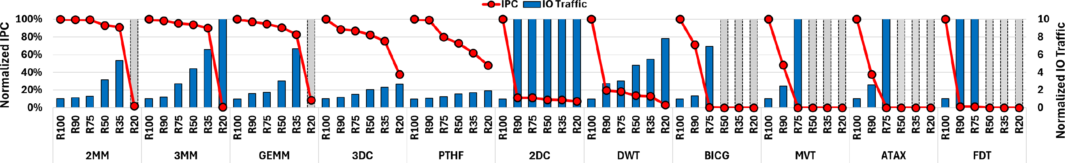
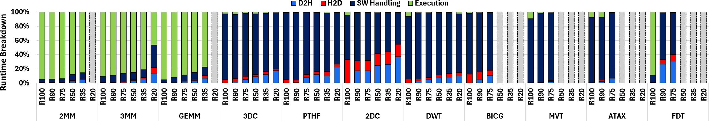
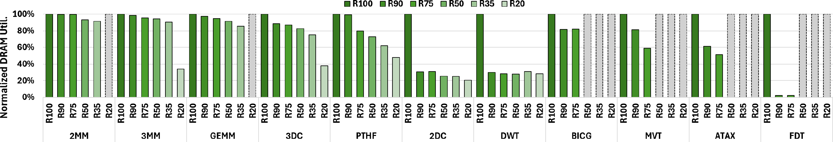
Where oversubscription time goes (real GPU)
BACKUP · MOTIVATION
RTX 3090 + EPYC 7313 over PCIe 4.0 ×16, UVMBench · R = GPU memory / footprint
1
IPC collapses
I/O traffic surges past a workload-specific R
2
Fault handling + I/O
dominate time as pressure grows
3
DRAM bandwidth idles
GPU waits on the link
Notes:
Backup, motivation: measured on a real system, an RTX 3090 with an EPYC 7313 over PCIe 4.0 x16, running UVMBench. One: once R drops below a workload-specific point, IPC collapses while I/O traffic surges. Two: fault handling and I/O dominate the runtime as memory pressure grows. Three: DRAM bandwidth sits idle, because the GPU waits on the link. This is why GZswap removes both the software fault path and the PCIe transfers for evicted pages.

Slide 22
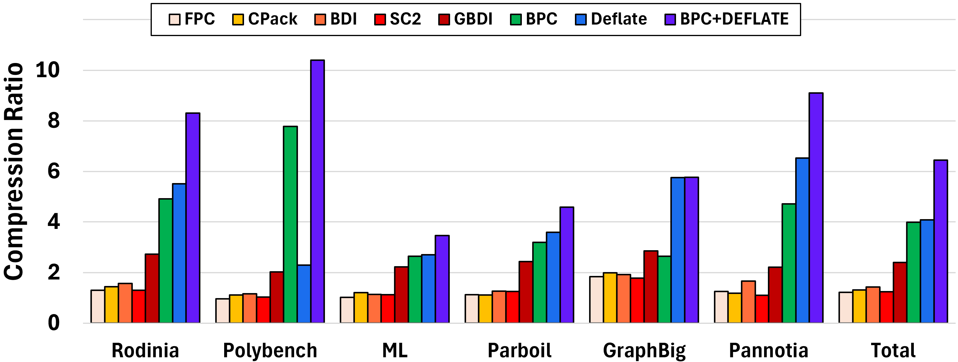
GPU memory compressibility by suite
BACKUP · MOTIVATION
57 workloads × 10 snapshots via NVBit memory dumps · all-zero pages excluded
Cacheline schemes
FPC, CPack, BDI, SC2, GBDI: 1–2.5×
BPC
3.98×: bit-planes fit GPU structure-of-arrays data
Deflate (page)
4.07×: larger window
BPC + Deflate
6.45×: pick the smaller per page
Notes:
Backup, motivation: how compressible GPU memory is. We took 10 memory snapshots of each of 57 workloads with NVBit, excluding all-zero pages. Cacheline schemes, FPC, CPack, BDI, SC2 and GBDI, reach about 1 to 2.5x. BPC reaches 3.98x, because its bit-planes fit GPU structure-of-arrays data, and Deflate on whole pages reaches 4.07x thanks to the larger window. Taking the smaller of the two for each page gives 6.45x, which is what the GZswap compression engine does. BPC does well on PolyBench because its inputs are generated by simple formulas with small deltas between neighbors.

Slide 23
GZswap Overall Architecture
BACKUP · DESIGN DETAILS
① Zswap-out: compress ② Zswap-in: decompress ③ Preparation: free space
added by GZswap
GPU
PCIe
Host memory
SMs
GMMU
GZMU
CDE
comp. /
decomp.
PME
page
migration
Remote-UM
Page-table
walker
FMU
ARM
TLBs
PgCQ
ZCQ
3
GPU memory (HBM)
Page table
V
A
C
ZDT
IPgT
IZT
Local-UM
1
Zpool
2
packed 4 KB zpages
Notes:
Here is the whole architecture; the dark blocks are what GZswap adds. In GPU memory, part of HBM becomes the Zpool, which stores evicted pages compressed and packed into 4 KB zpages; the rest, Local-UM, holds ordinary pages. The page table gets one more flag, C, next to the aperture flag A: C=1 means the page is in the Zpool. Three metadata tables live in HBM: the ZDT describes each compressed group, and two inverted tables track who owns each frame. Inside the GMMU, next to the page-table walker, sits the GZswap Management Unit. Its Fault Management Unit serves faults, its Available Region Manager prepares free space, and two queues hold ready-to-use free space: PgCQ for free 64 KB Local-UM frames and ZCQ for free zpages. The compression engine, CDE, compresses and decompresses pages. Three operations: zswap-out compresses a victim into the Zpool instead of sending it over PCIe, zswap-in decompresses it on a fault, and preparation keeps free frames and zpages ready; when the Zpool is full, a group is reclaimed to host memory.

Slide 24
1. Zswap-out (Compression): compress and pack the pages
BACKUP · DESIGN DETAILS
Pages move as 64 KB page-groups; each 4 KB page is compressed on its own
Victim page-group
P0
P1
P2
P3
P4
P5
P6
P7
P8
P9
P10
P11
P12
P13
P14
P15
64 KB = 16 × 4 KB
Compress
each 4 KB page
compression
10
6
4
6
6
2
3
3
4
4
2
2
2
3
3
3
Pack
P0
P1
P2
P3
P4
P6
P7
P8
P9
P13
P14
P15
packing into
4 KB zpages
zpage 0
zpage 1
zpage 2
zpage 3
Why pack pages back to back instead of giving each a fixed slot?
Notes:
Operation one, zswap-out. When Local-UM needs space, the ARM picks a victim 64 KB page-group. The compression engine compresses each of its sixteen 4 KB pages independently, running BPC and Deflate in parallel and keeping the smaller result. The numbers are each page's compressed size in 256-byte chunks; sixteen chunks would be an uncompressed page. The compressed pages are then packed back to back into 4 KB zpages taken from the ZCQ, and a page may cross a zpage boundary. In this example sixteen pages fit into four zpages, a 4x saving. Why pack instead of giving each page a fixed slot? That is the next slide.

Slide 25
1. Zswap-out (Packing): no exceptions, little fragmentation
BACKUP · DESIGN DETAILS
The same 16 compressed pages stored two ways, drawn to the same scale (sizes in 256 B chunks)
P0
P1
P2
P3
P4
P5
P6
P7
P8
P9
P10
P11
P12
P13
P14
P15
Fixed slots
P0
2 KB per page
(2× target)
!
exception P0: 10 chunks > 8-chunk slot
32 KB for 16 pages · unused (gray): 67 of 128 chunks
1 spare chunk
GZswap packing
P0
P1
P2
P3
P4
P6
P7
P8
P9
16 KB for 16 pages · unused: 1 of 64 chunks
back to back,
in 256 B chunks
zpage 0
zpage 1
zpage 2
zpage 3
✓ No exception
✓ Little internal fragmentation
A compressed page is at most 16 chunks (4 KB):
it always fits, at worst across two zpages
Pages of any size share zpages: only the tail of
each page’s last chunk and of the last zpage is unused
earlier pages
incompressible page
← 16 chunks = 4 KB
Chunk-size study: 256 B chunks keep 80.1% compressed capacity (64 B chunks: 82.7%) → next slide
zpage k
zpage k+1
No fixed target → no exception · packed back to back → little internal fragmentation
Notes:
Why do we pack compressed pages back to back instead of giving each page a fixed slot? This is the page-group from the previous slide, stored two ways and drawn to the same scale. On top, fixed slots, like a cacheline scheme's target: every page gets 2 KB, a 2x target. P0 compresses only to 10 chunks, 2.5 KB, so it misses its slot and becomes an exception, while every smaller page leaves the rest of its slot unused: 67 of the 128 chunks are wasted, and the group still takes 32 KB. At the bottom, GZswap packs the same sixteen pages back to back in 256-byte chunks: they fit in four zpages, 16 KB, with one chunk to spare. Two properties follow. First, no exceptions: a compressed page is never larger than 4 KB, because a page that does not compress is stored as is, sixteen chunks, and zpages are 4 KB, so every page fits, at worst across two zpages. Second, little internal fragmentation: pages of any size share zpages, so only the tail of each page's last chunk and of the group's last zpage stay unused. The next slide shows that 256-byte chunks keep 80.1% compressed capacity, close to the 82.7% of 64-byte chunks.

Slide 26
Chunk size for encoding compressed lengths
BACKUP · DESIGN DETAILS
Smaller chunks waste less space but need more length bits in each ZDE
256 B
keeps most of the capacity benefit (80.1%) with modest metadata
Length field = number of chunks a compressed page occupies
Notes:
Backup, design: the ZDE stores each page's length in chunks. Smaller chunks waste less space at the end of each page but need more length bits in every ZDE. Compressed capacity is 82.7% with 64-byte chunks, 82.1% with 128, 80.1% with 256 and 72.7% with 512. We use 256-byte chunks: they keep most of the benefit with modest metadata, so the space lost by rounding each page up to whole chunks stays small.

Slide 27
2. Zswap-in (Decompression): fault is handled on the GPU
BACKUP · DESIGN DETAILS
One fault on a compressed page, from TLB miss to replay
GPU
6
1
TLB miss → page walk
SMs
GMMU
fault
GZMU
CDE
comp. /
decomp.
PME
page
migration
Page-table
walker
4
2
PTE has C = 1
→ fault goes to the FMU
FMU
ARM
1
TLBs
PgCQ
ZCQ
3
FMU reads the ZDE from the ZDT
2
3
4
FMU pops a free frame from PgCQ, calls the CDE
GPU memory (HBM)
5
Page table
V
A
C
ZDT
IPgT
IZT
5
CDE restores the faulting page
Local-UM
Zpool
6
FMU updates the PTE → replay
packed 4 KB zpages
No driver · no PCIe
Notes:
This is the same architecture as the overview; the orange path is one fault on a compressed page. One: a GPU access misses in the TLB and the page-table walker reads the PTE. Two: the PTE has C=1, so the fault is forwarded to the Fault Management Unit inside the GMMU, not to the driver on the CPU. Three: the FMU uses the ZDE index in the PTE's PFN field to read the page-group's descriptor, the ZDE, from the ZDT. Four: it pops a free 64 KB frame from the PgCQ, which the ARM keeps filled, and sends a decompression request to the CDE. Five: the CDE reads the compressed bytes from the Zpool and restores the faulting 4 KB page into Local-UM. Six: the FMU updates the PTE and replays the access. There is no driver and no PCIe transfer on this path.

Slide 28
2. Zswap-in (Decompression): restoring a page with its ZDE
BACKUP · DESIGN DETAILS
The PTE leads to the group’s ZDE; its lengths and ZPFNs locate the faulting page’s bytes
Page table entry
P0
P1
P2
P3
P4
P5
ZPFN0
ZPFN1
ZPFN2
ZPFN3
V
A
C
ZDE index
ZDE
10
6
4
6
6
2
…
0x2D
0x94
0x31
0xA7
C = 1 → PFN field points
to the ZDE in the ZDT (HBM)
64 B
Length of each page (× 256 B)
ZPFN: where each zpage is in Zpool
Fault on P4: 10 + 6 + 4 + 6 = 26 chunks = 6.5 KB → zpage 1 (0x94), +2.5 KB, 1.5 KB long
In general: start = Σ lengths before the page; zpage = ZPFN[start div 16]; offset = (start mod 16) × 256 B; a page may continue in the next zpage
+2.5 KB
1.5 KB
Zpool
P0
P1
P2
P3
P4
P6
P7
P8
P9
P13
P14
P15
zpage 0 · 0x2D
zpage 1 · 0x94
zpage 2 · 0x31
zpage 3 · 0xA7
Whole group first
replay ≈ 4.4 µs
Critical page first
other 15 pages: background
replay ≈ 277 ns
Notes:
How does the FMU find and restore only the faulting page? It starts from the PTE. When C is 1, the PFN field points to the group's ZDE in the ZDT, a table in HBM with one 64-byte ZDE per compressed page-group. The ZDE has two parts: the compressed length of each of the sixteen pages, in 256-byte chunks, and the ZPFNs, the zpages that hold the group in the Zpool, in packing order. Say the fault is on P4. The FMU adds the lengths of P0 to P3: 26 chunks, 6.5 KB. A zpage holds sixteen chunks, so P4 is in zpage 1, which the ZPFN list places at frame 0x94; it starts 10 chunks, 2.5 KB, into that zpage and is 6 chunks, 1.5 KB, long. A page that runs past the end of a zpage simply continues in the next ZPFN. The CDE decompresses only those bytes into a free frame from the PgCQ, the PTE is updated, and the access replays after one page, about 277 ns of decompression, instead of 4.4 microseconds for the whole group. The other fifteen pages are restored in the background.

Slide 29
Evaluation setup
BACKUP · EVALUATION
Cycle-accurate simulation: Accel-Sim + UVMSmart + Ramulator
1
System configuration
2
Benchmarks
3
Targets
GPU
15 workloads, 4 suites
2MBE (NVIDIA UM)
A100-class, 1/5 scale
21 SMs · 8 MiB L2
HBM 256 GB/s
PCIe 12.8 GB/s
PolyBench
GraphBIG
UM: SW faults, 2 MB eviction
Parboil
Rodinia
TBNE (Baseline)
SW faults, tree-based eviction
Memory pressure
UVMMU (HW-based)
Fault handling
R = GPU memory / footprint
SW 26.23 µs
HW 20 cycles + 8.23 µs
HW faults
R90
GZswap (Our work)
R75
Comp/decomp engine
R50
HW faults with zpool residency
1/4 of HBM bandwidth
662 / 277 ns per page latency
R35
Buddy (Cache Compression)
fixed 2× / 4× target
Same memory budget
Zpool
Baseline · 10 GB
20% of GPU memory
UVMMU vs. GZswap: the gap is compressed residency
GZswap · 8 + 2 GB
Notes:
Setup in three parts. System: a cycle-accurate simulator built from Accel-Sim, UVMSmart and Ramulator, modelling an A100-class GPU at one-fifth scale. Fault latencies come from profiling real hardware: 26 microseconds for software handling, versus a 20-cycle hardware handler plus the same 8.23 microsecond unmapping. The compression engine is provisioned at a quarter of HBM bandwidth, and the Zpool is 20% of GPU memory. Benchmarks: 15 workloads from PolyBench, GraphBIG, Parboil and Rodinia, at memory-pressure levels from R90 down to R35, where R is GPU memory over the footprint. Every mechanism gets the same memory budget: where a baseline has 10 GB, GZswap has 8 GB of Local-UM plus a 2 GB Zpool. Targets: 2MBE models NVIDIA UM, TBNE is our software baseline, and UVMMU has hardware fault handling with the same 64 KB granularity and victim policy as GZswap but evicts to the host, so UVMMU versus GZswap isolates compressed residency. We also compare with Buddy Compression.

Slide 30
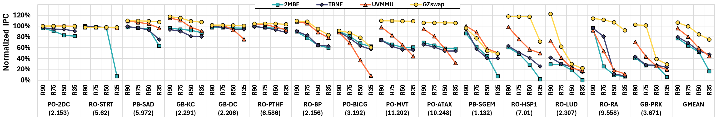
IPC per workload and memory pressure
BACKUP · EVALUATION
IPC normalized to TBNE at R100 · numbers under names: effective Zpool compression ratio
RO-RA (9.56×)
PB-SGEM (1.13×)
Takeaway
keeps 92.3% IPC at R35; all baselines fall below 12%
compresses poorly: Zpool fills fast, small benefit
gain depends on compressibility, reuse, and page turnover
Notes:
Backup, evaluation: per-workload IPC from R90 to R35, normalized to TBNE at R100; the numbers under the names are each workload's effective Zpool compression ratio. Highly compressible workloads gain the most: RO-RA, at 9.56x, keeps 92.3% of its IPC at R35, while all baselines fall below 12%. PB-SGEM compresses only 1.13x, so the Zpool fills quickly and the benefit is small. Overall, the gain depends on compressibility, reuse and page turnover.

Slide 31
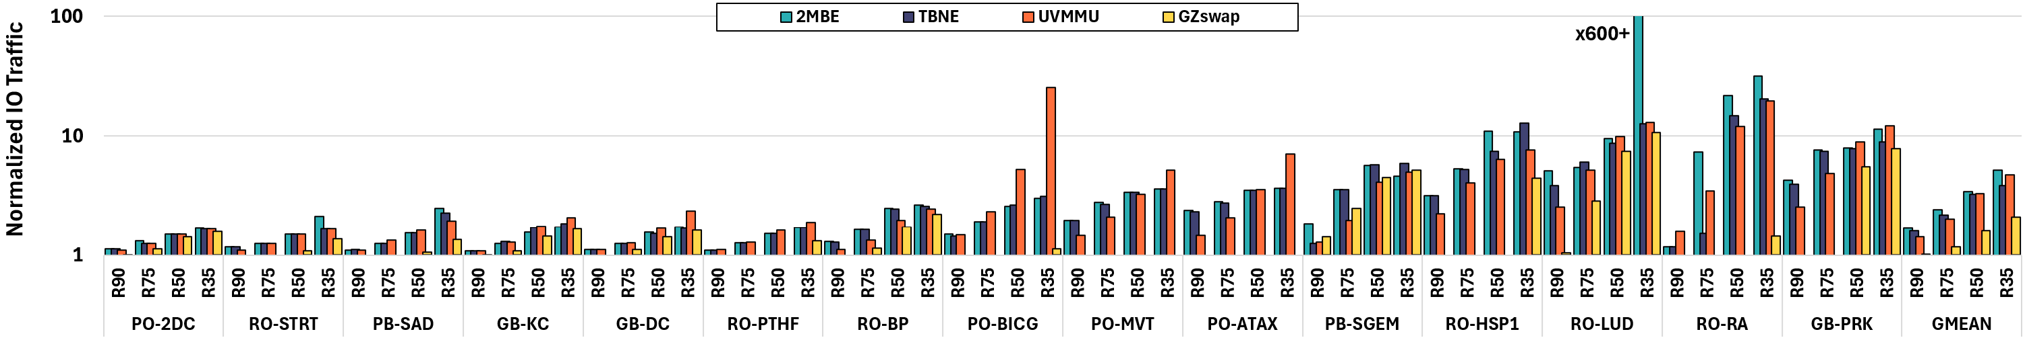
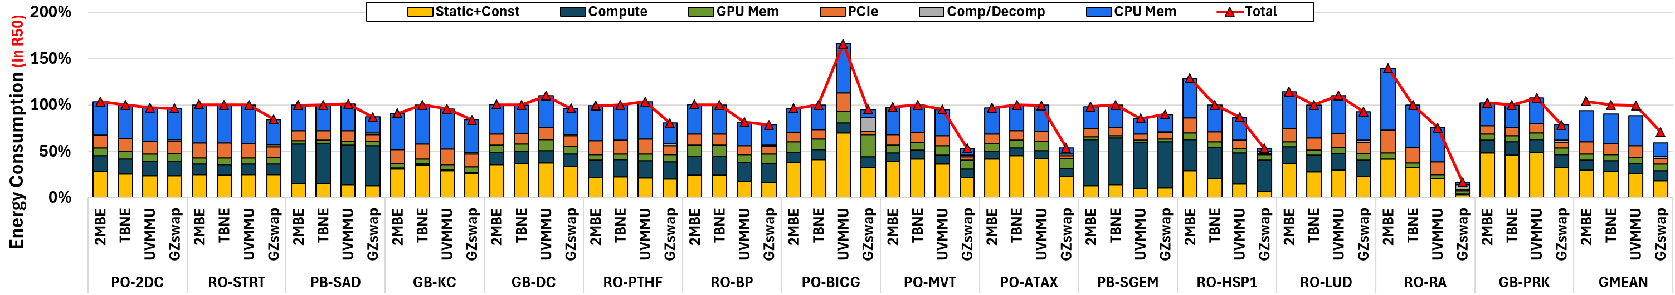
I/O traffic and energy per workload
BACKUP · EVALUATION
I/O: normalized to TBNE at R100 (log scale) · energy: normalized to TBNE at R50
Relocation I/O traffic (R90/R75/R50/R35)
Energy breakdown at R50
Notes:
Backup, evaluation: per-workload versions of the I/O and energy results. Top: relocation I/O traffic from R90 to R35, normalized to TBNE at R100, on a log scale. Bottom: the energy breakdown at R50, normalized to TBNE, split into static and constant, compute, GPU memory, PCIe, compression and decompression, and CPU memory. Higher IPC shortens runtime and cuts static energy, and local HBM accesses replace PCIe and host-memory traffic; together they outweigh the energy of compression.

Slide 32
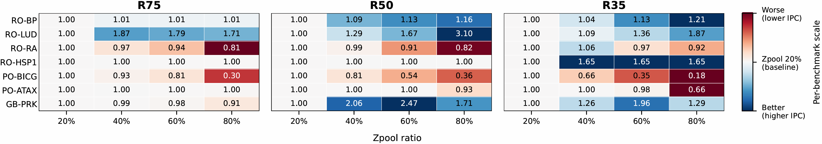
Zpool size: compressed vs. directly usable capacity
BACKUP · EVALUATION
IPC normalized to the default 20% Zpool at the same R · blue = better, red = worse
Same HBM budget
20% Zpool
40% Zpool
60% Zpool
80% Zpool
Local-UM
Zpool
RO-LUD
PO-BICG
GB-PRK
Best size grows with pressure: 40% at R75, 80% at R50
Default 20% stays best: direct capacity matters more
Not monotonic: 60% is best at R50 and R35
No single Zpool size fits all → compressibility × working-set size × workload behavior
Notes:
Because the Zpool is carved out of the same budget, a bigger Zpool means more compressed capacity but less directly accessible Local-UM. Each cell is IPC relative to the default 20% Zpool. RO-LUD wants more Zpool as pressure grows: 40% is best at R75, and 80% gives 3.1x at R50. PO-BICG is best at the default 20%, because losing direct capacity hurts more. GB-PRK is not monotonic: 60% is best at R50 and R35. So there is no single right size; sizing the Zpool at runtime is future work.

