Slide 1
Spring Basics, RESTFUL webservices

Slide 2
Collection of utility, convention, methodology which helps us to ease repeated and duplicate work, hence improving productivity and efficiency in development, testing and deployment: FRAMEWORK

Slide 3

Birth of Spring framework
Rod Johnson publishes J2EE Development without EJB
2004 - Spring Framework 1.0 released
Champions dependency injection
Encourages POJOs
Uses XML files to describe application configuration
Becomes popular quickly as an EJB alternative

Slide 4
Spring and Pivotal – The partnership
- SpringSource, the company behind Spring
- acquired by VMware in 2009
- transferred to Pivotal joint venture 2013
- Spring projects key to Pivotal's big-data and cloud strategies
- Cloud Foundry PaaS
- Deploy to private, public, hybrid clouds
- Microservices, Spring Cloud
- Real-time analytics, IoT
- Spot trends as they happen
- Spring Data, Spring Hadoop, Spring Cloud Data Flow

Slide 5
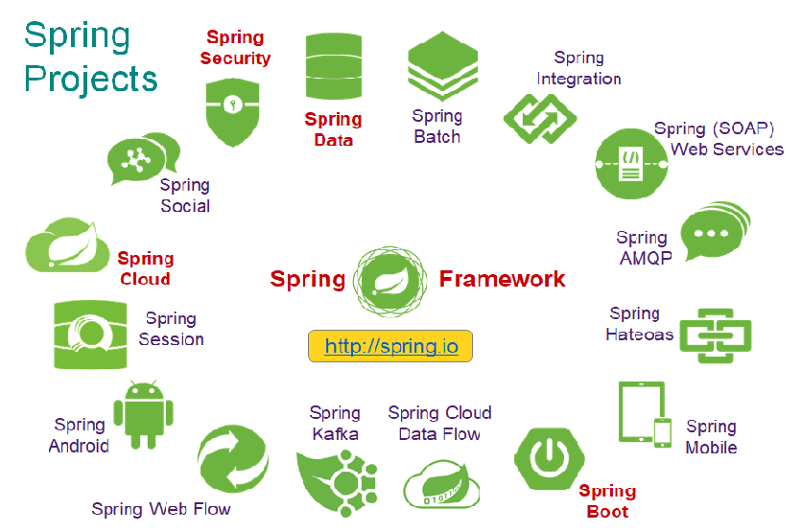
Spring Project Ecosystem

Slide 6
Spring is an open source, lightweight, container and framework for building Java Enterprise class applications: SPRING

Slide 7
Spring Framework – key elements
Open Source
Light weight
Container
Framework

Slide 8
Spring – A lightweight framework
Spring applications do not require a Java EE application server
But they can be deployed on one
Spring is not invasive
Does not require you to extend framework classes or implement framework interfaces for most usage
We write our code as POJOs
Low overhead
Spring jars are relatively small
JARs used in this course are < 8 MB

Slide 9
Spring – A container
Spring serves as a container for your application objects
Our objects do not have to worry about finding / connecting to each other.
Spring instantiates and dependency injects your objects
Serves as a lifecycle manager

Slide 10
Java configuration

Slide 11
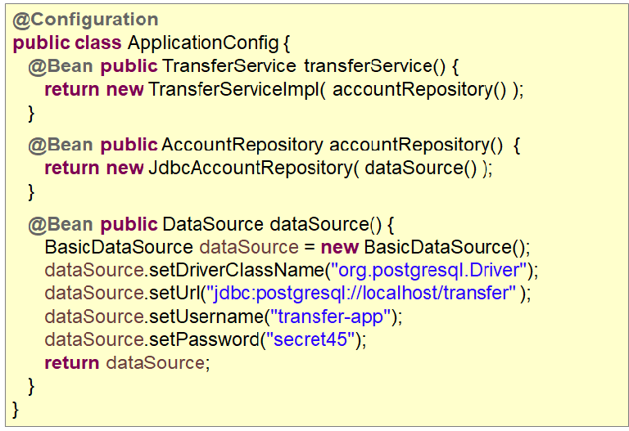
Configuration Class

Slide 12
Accessing a Bean
ApplicationContext context = //acquire application context
// we need to cast to the interface type
TransferService ts1 = (TransferService) context.getBean(“transferService”);
// Using the type parameter
TransferService ts2 = context.getBean(“transferService”, TransferService.class);
// Assuming that service interface is cast by type
TransferService ts3 = context.getBean(TransferService.class );

Slide 13
Multiple configuration classes
@Configuration
@Import({InfrastructureConfig.class, DBConfig.class })
public class PrimaryApplicationConfig {
...
}
@Configuration
public class InfrastructureConfig {
...
}
@Configuration
public class DBConfig {
...
}

Slide 14
Annotation based configuration

Slide 15
Stereotype annotations
Component
Configuration
Service
Repository
Controller

Slide 16
After annotation configuration
@Configuration
@ComponentScan(“com.spring”)
public class AnnotationBasedConfig {
}
Component scan to scan through the package and sub packages
@Component
public class TransferServiceImpl implement ITransferService {
@Autowire
public TransferServiceImpl(AccountRepository repository) {
this.repository = repository;
}
}

Slide 17
After annotation configuration
Constructor auto wiring
@Autowired
public TransferServiceImpl(AccountRepository repository) {
}
Setter auto wiring
@Autowired
public void setAccountRepository(AccountRepository repository) {
}
Property auto wiring
@Autowired
private AccountRepository repository;

Slide 18
Bean life cycle

Slide 19
After annotation configuration
for-each bean ...
Bean Definitions Loaded
Post Process
Bean Definitions
Instantiate Beans
Load Bean Definitions
Setters
Called
Dependency
Injection
Bean
Ready
For Use
Initializer
BPP
BPP
BPP
BPP
Bean Post Processors
Create and Initialize Beans

Slide 20
Spring REST

Slide 21
Spring REST – key points
Built on Spring MVC.
Spring REST is not aligned with other frameworks which are based on JAX-RS.
Spring REST has all utilities needed to build web service endpoint and client.
Easily integrates with an application that is build on Spring.
Has wide support for unit testing.

Slide 22
Using @RequestMapping
@RequestMapping(path="/orders", method=RequestMethod.DELETE)
public void updateOrders( ... ) {
// delete all Orders
}
@RequestMapping(path="/orders/{id}", method=RequestMethod.PUT)
public void updateOrder( ... ) {
// update order using data from the request
}
Can map HTTP requests based on method
- Allows same URL to be mapped to multiple Java methods
RequestMethod enumerators are
- GET, POST, PUT, PATCH, DELETE, HEAD, OPTIONS, TRACE

Slide 23
Produces and consumes attribute
@RequestMapping(path="/orders", method=RequestMethod.DELETE, produces={“application/xml”}, consumes={“application/json”})
public Order updateOrder( String orderId ) {
// update order and returned updated order
}

Slide 24
Simpler annotations
Alternative handler mapping shortcuts
@RequestMapping(path="/accounts”, method=RequestMethod.GET)
Or @GetMapping("/accounts");
Exist for these HTTP methods
@GetMapping
@PostMapping
@PutMapping
@DeleteMapping
@PatchMapping

