Slide 1
Spring data access

Slide 2
Spring – data access options
Spring JDBC
Spring JPA (ORM)
Spring Data

Slide 3
SPRING JDBC

Slide 4
Spring JDBC – The basic advantage
Steps Required
-Access a data source and establish a connection
-Begin a transaction
-Do the work – execute business logic
-Commit or rollback the transaction
-Close the connection
Spring Advantages
-No code to implement (classic cross-cutting concern)
-No connection or session leakage
-Throws own exceptions, independent of underlying API

Slide 5
Templates – A very powerful way to integrate
Widely used and useful pattern
http://en.wikipedia.org/wiki/Template_method_pattern
Define the outline or skeleton of an algorithm
-Leave the details to specific implementations later
-Hides away large amounts of boilerplate code
Spring provides many template classes
-JdbcTemplate
-JmsTemplate, RestTemplate, WebServiceTemplate …
-Most hide low-level resource management

Slide 6
JDBC – Traditional code
public List findByLastName(String lastName) {
List personList = new ArrayList();
Connection conn = null;
String sql = "select first_name, age from PERSON where last_name=?";
try {
DataSource dataSource = DataSourceUtils.getDataSource();
conn = dataSource.getConnection();
PreparedStatement ps = conn.prepareStatement(sql);
ps.setString(1, lastName);
ResultSet rs = ps.executeQuery();
while (rs.next()) {
personList.add(new Person(rs.getString("first_name"), ...));
}
} catch (SQLException e) { /* ??? */ }
finally {
try {
conn.close();
} catch (SQLException e) { /* ??? */ }
}
return personList;
}

Slide 7
JDBC – Boiler plate code
public List findByLastName(String lastName) {
List personList = new ArrayList();
Connection conn = null;
String sql = "select first_name, age from PERSON where last_name=?";
try {
DataSource dataSource = DataSourceUtils.getDataSource();
conn = dataSource.getConnection();
PreparedStatement ps = conn.prepareStatement(sql);
ps.setString(1, lastName);
ResultSet rs = ps.executeQuery();
while (rs.next()) {
personList.add(new Person(rs.getString(“first_name”), ...));
}
} catch (SQLException e) { /* ??? */ }
finally {
try {
conn.close();
} catch (SQLException e) { /* ??? */ }
}
return personList;
}

Slide 8
Spring’s JDBC
Greatly simplifies use of the JDBC API
-Eliminates repetitive boilerplate code
-Alleviates common causes of bugs
-Handles SQLExceptions properly
Without sacrificing power
-Provides full access to the standard JDBC constructs

Slide 9
Spring’s JDBC
Acquisition of the connection
Participation in the transaction
Execution of the statement
Processing of the result set
Handling any exceptions
Release of the connection
int count = jdbcTemplate.queryForObject(
"SELECT COUNT(*) FROM CUSTOMER", Integer.class);
All handled by Spring

Slide 10
Error classes for various error codes
Select iddd from T_ACCOUNT
Plain JDBC
Spring
java.sql.SQLException
Message: Column not found:
IDDD in statement
errorCode: -28
java.sql.SQLException
Message: Column not found:
IDDD in statement
errorCode: -28
Error code mapping
BadSqlGrammarException
Message: PreparedStatementCallback;
bad SQL grammar … Column not found:
IDDD in statement

Slide 11
Query for simple object
public Date getOldest() {
String sql = "select min(dob) from PERSON";
return jdbcTemplate.queryForObject(sql, Date.class);
}
public long getPersonCount() {
String sql = "select count(*) from PERSON";
return jdbcTemplate.queryForObject(sql, Long.class);
}

Slide 12
SPRING JPA

Slide 13
Spring JPA – An intro
The Java Persistence API is designed for operating on domain objects
Defined as POJO entities
No special interface required
Replaces previous persistence mechanisms
EJB Entity Beans
Java Data Objects (JDO)
A common API for object-relational mapping
Derived from experience with existing products such as JBoss Hibernate and Oracle TopLink (now EclipseLink)

Slide 14
Persistent unit
Describes a group of persistent classes (entities)
Defines provider(s)
Defines transactional types (local vs JTA)
Multiple Units per application are allowed
Defined by the file: persistence.xml

Slide 15
JPA Providers
Several major implementations of JPA spec
Hibernate EntityManager
Used inside JBoss
EclipseLink (RI)
Used inside Glassfish
Apache OpenJPA
Used by Oracle WebLogic and IBM Websphere
Data Nucleus
Used by Google App Engine
Can all be used without application server as well
Independent part of EJB 3 spec

Slide 16
Entity manager and factory
EntityManager
Manages a unit of work and persistent objects therein: the PersistenceContext
Lifecycle often bound to a Transaction (usually container-managed)
EntityManagerFactory
thread-safe, shareable object that represents a single data source / persistence unit
Provides access to new application-managed EntityManagers

Slide 17
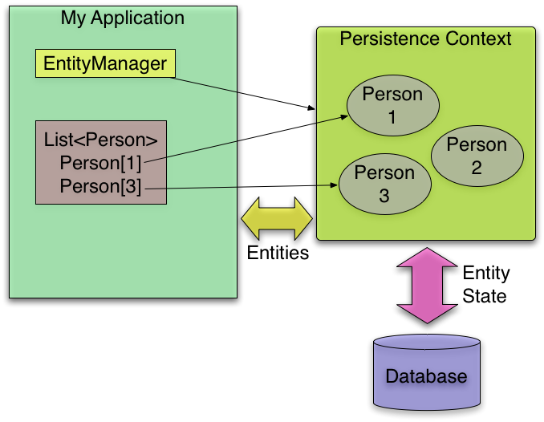
Entity manager and factory integration
Entity
Manager
Factory
creates

Slide 18
Entity
@Entity
@Table(name= “T_CUSTOMER”)
public class Customer {
@Id
@Column(name=“cust_id”)
private Long id;
@Column(name=“first_name”)
private String firstName;
@Transient
private User currentUser;
...

Slide 19
JPA Querying using JPQL
Long customerId = 123L;
Customer customer = entityManager.find(Customer.class, customerId);
// Query with named parameters
TypedQuery<Customer> query = entityManager.createQuery(
“select c from Customer c where c.address.city = :city”, Customer.class);
query.setParameter(“city”, “Chicago”);
List<Customer> customers = query.getResultList();
// … or using a single statement
List<Customer> customers2 = entityManager.
createQuery(“select c from Customer c ...”, Customer.class).
setParameter(“city”, “Chicago”).getResultList();

Slide 20
SPRING DATA

Slide 21
Spring Data
Spring Data
Core project
JPA
Pivotal
Gemfire
MongoDB
Apache
Hadoop
JDBC
extensions
Sub-projects
Solr
Neo4j
Redis
And more ...

Slide 22
CRUD repository
public interface CrudRepository<T, ID
extends Serializable> extends Repository<T, ID> {
public <S extends T> save(S entity);
public <S extends T> Iterable<S> save(Iterable<S> entities);
public T findOne(ID id);
public Iterable<T> findAll();
public void delete(ID id);
public void delete(T entity);
public void deleteAll();
}

