Slide 1
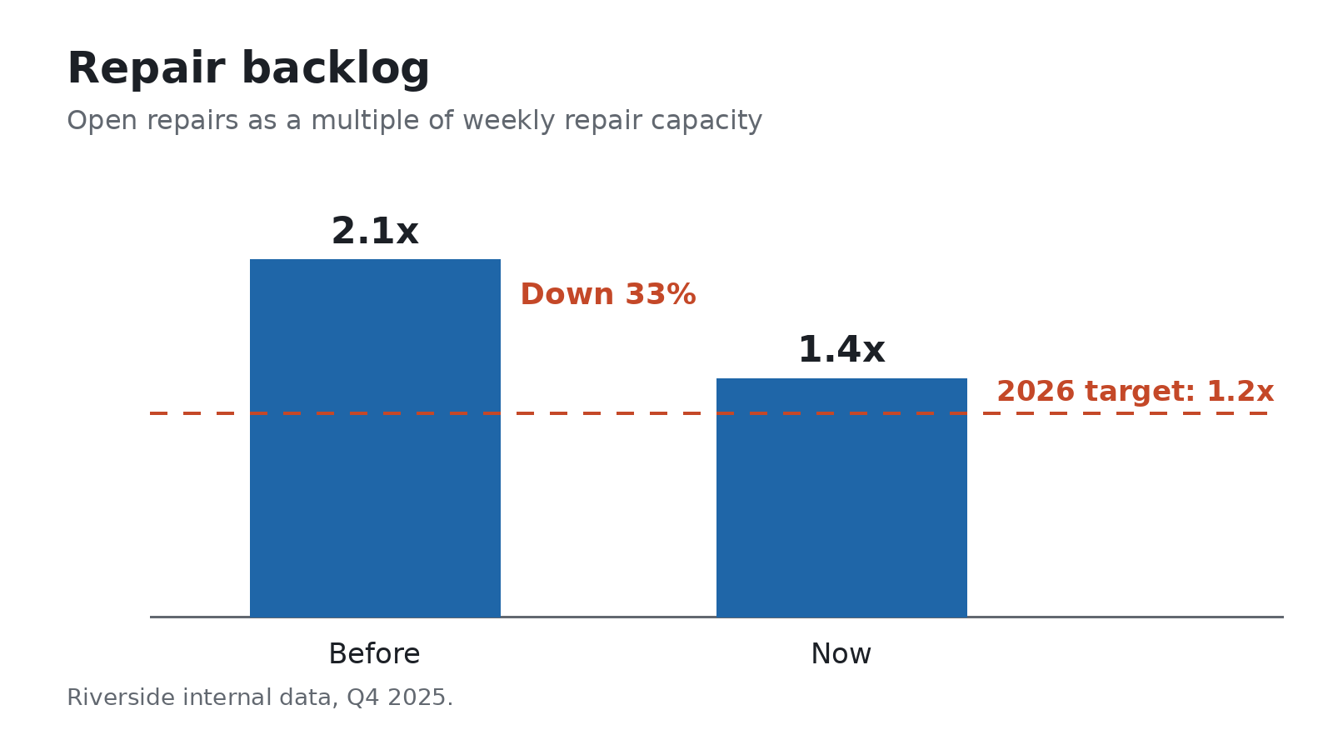

Network results

Slide 2
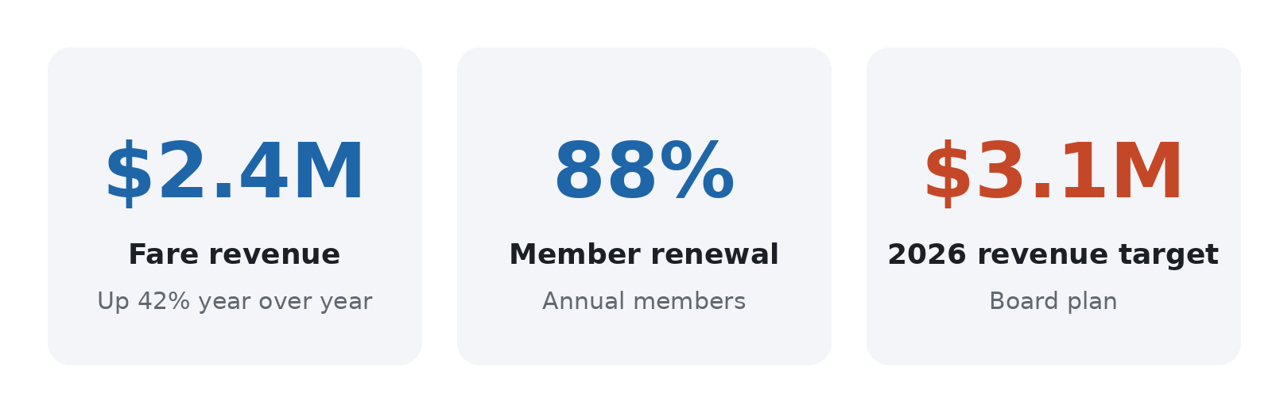
Fleet and docks
Two thirds of new docks are going to the east bank.

