Slide 1
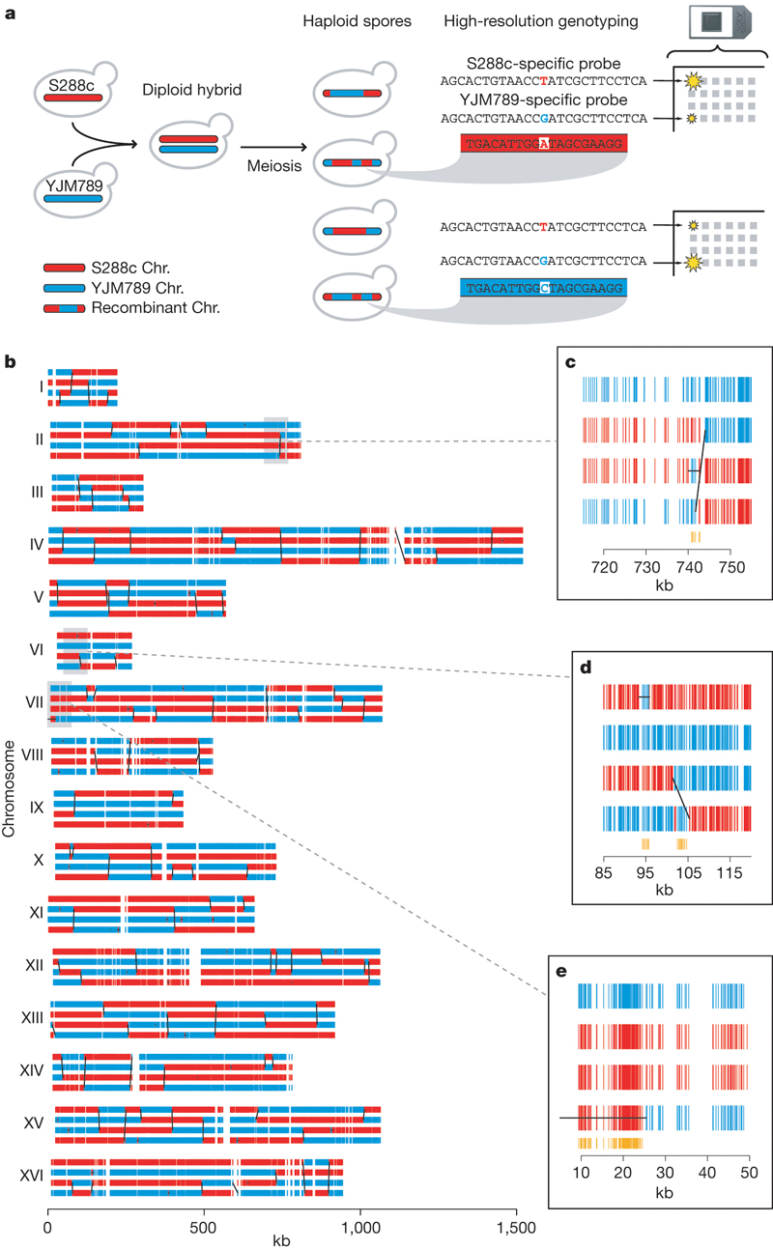

High-resolution mapping of meiotic recombination
along the yeast genome.
E Mancera et al. Nature 000, 1-7 (2008) doi:10.1038/nature07135

