Slide 1
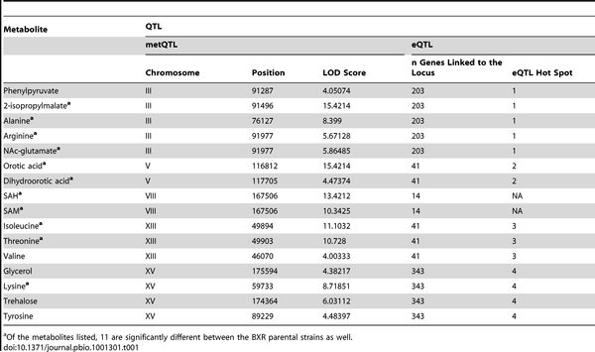

Table 1. Metabolite concentrations that are under significant genetic control in the BXR cross (LOD score&gt;3.9 corresponds to FDR 0.05), where the metabolite QTL are coincident with eQTL hot spots.
Zhu J, Sova P, Xu Q, Dombek KM, Xu EY, et al. (2012) Stitching together Multiple Data Dimensions Reveals Interacting Metabolomic and Transcriptomic Networks That Modulate Cell Regulation. PLoS Biol 10(4): e1001301. doi:10.1371/journal.pbio.1001301
http://journals.plos.org/plosbiology/article?id=info:doi/10.1371/journal.pbio.1001301

