Slide 1


Slide 2
What is Phaser
free HTML5 game framework
http://http://phaser.io/

Slide 3

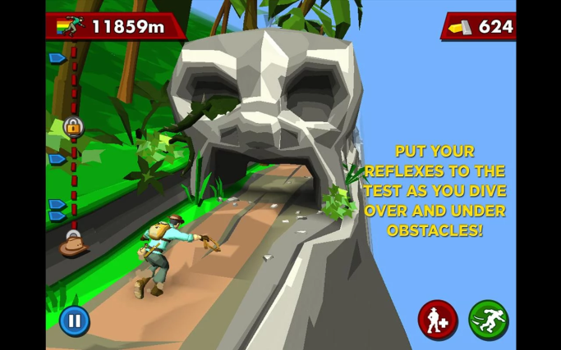
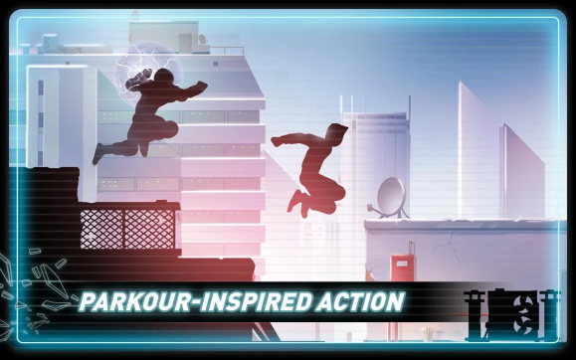
Endless runner game
"Endless runner" or "infinite runner" game
In these kind of games the player character is continuously moving forward through a randomly generated endless game world.

Slide 4
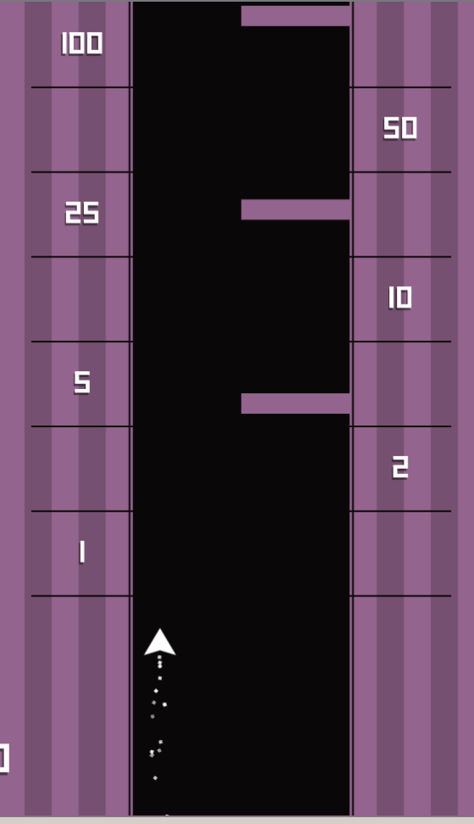
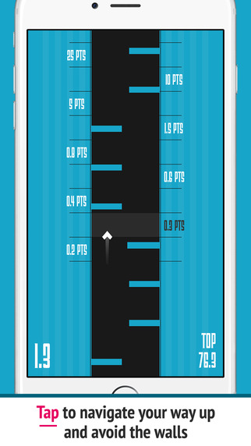
Rising Ships
http://avaya/~pietschj/phaserRisingShips/
A rise above clone

Slide 5

Tool-chain
Text editor: Brackets, Textpad, notepad
Webserver: Mamp, Wamp, Avaya or XDK
Why a webserver?
Loading a page locally is fine if it is just a static HTML webpage.
More complex scripts load and handle resources from
images, audio files other kind of data
browser implements series of security measures which stop file access

Slide 6
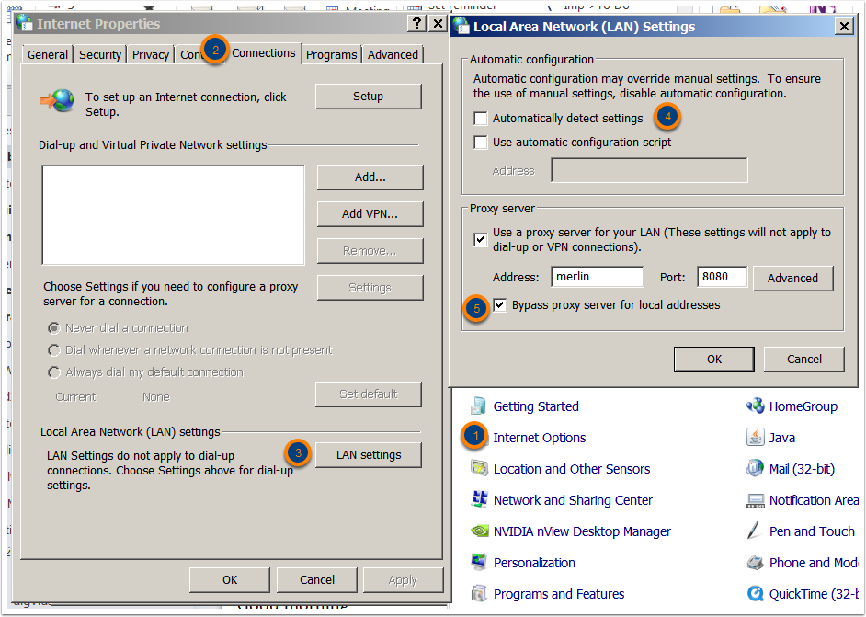
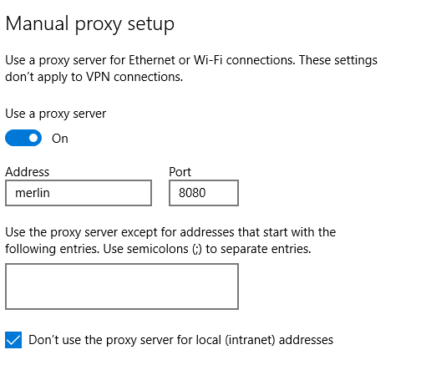
configuring XDK
Windows 7:
Open Control Panel > Internet Option
Select Connections Tab
Click “LAN settings”
uncheck “automatically detect settings
check “Bypass proxy server for local addresses.
Note: some students needed to uninstall and then reinstall to a know location such as D:\

Slide 7
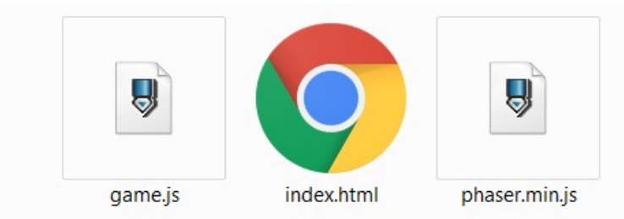
Setting up the project
include the minified phaser version:
phaser.min.js
game.js will contain the script for our game
index.html is the splash page.

Slide 8
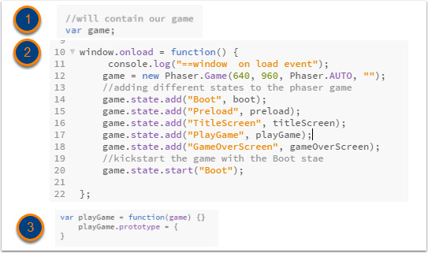
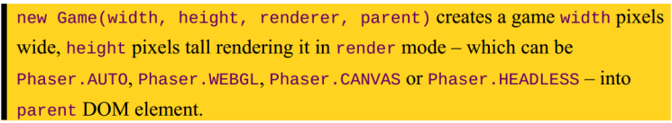
Setting up the Project
var game : stores the game
window.onload initiates the game
The game gets initialised (line 12);
5 different states get added to the game
The states are objects with various prototype methods. The states require the game object as an argument

Slide 9

Run your game
Point your browser to your game, i.e:
http://localhost/yourgamefolder/
You should get a console output like this:
(ignore preload error)

Slide 10
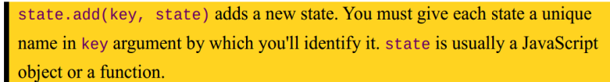
Game states
The states of the game. Some of them correspond to Screens:
Boot state:
adjustment to the game to be resized
Preload state:
preload all assets we will use in the game.
classic “loading” screen
Title Screen state:
showing your game name and a play button.
Game state:
game itself.
Game over state:
the most hated screen, the one you won't want to see
contains a “play again” button

Slide 11
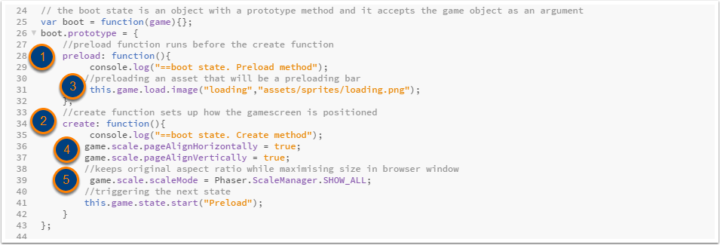
Creation of the Boot state
preload method is triggered before
create method
preloading of an asset
aligning the game horizontally and verticallyinside the browser
keeps original aspect ratio while maximising size in browser window

Slide 12
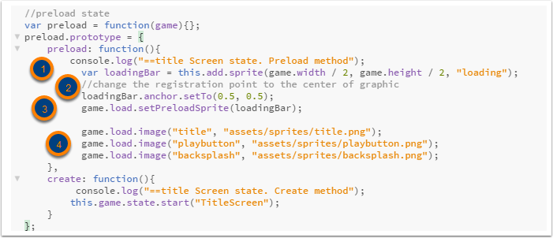
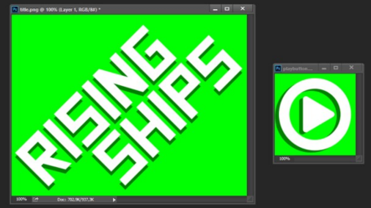
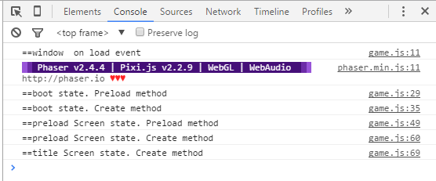
Creation of the Preload state
Console output now:
creates a image sprite from the “loading” asset in the centre of the screen
Changes pivot point to center
setPreloadSprite() creates a preloader out of a graphic that will be rescaled according to the load progress.
load various assets for the game.

Slide 13
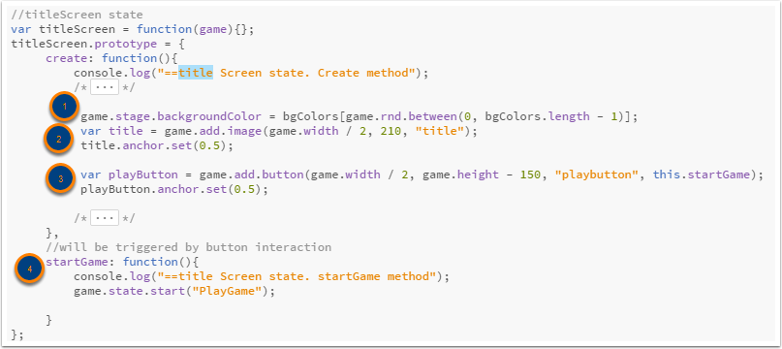
Creation of title screen
create an array of Colors
select a random color from the array, using phaser’s game.rnd() method create a title from the “title” asset.
create a playButton form the “playbutton” asset
define a startGame() method that is triggered by the button and that launches the Game start

Slide 14
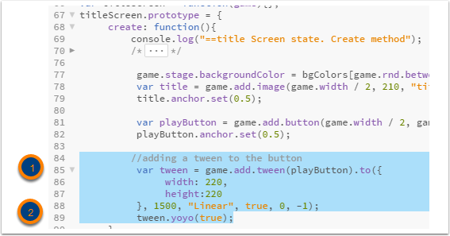
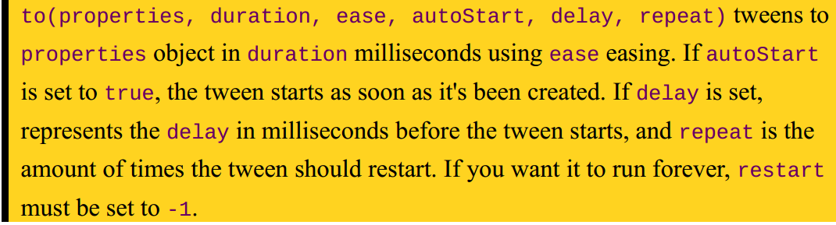
Add an animation to the button
adding a tween to the playButton
tween.yoyo creates an infinite loop

Slide 15
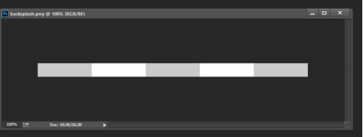

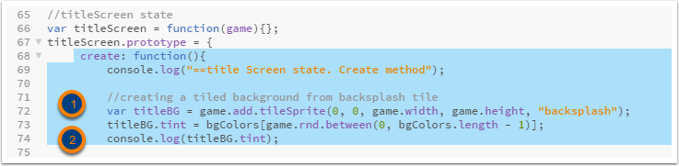
title Screen refined
repeat grayscale tile: “backsplash” in the Y direction
Apply a random tint to the grayscale image

Slide 16
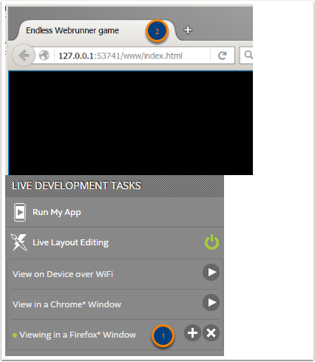



Previewing with XDK in Browser
In XDK in Live development Tasks: Select a Browser
This will open up the page from an internal webserver.
Changes get refreshed without reloading

Slide 17

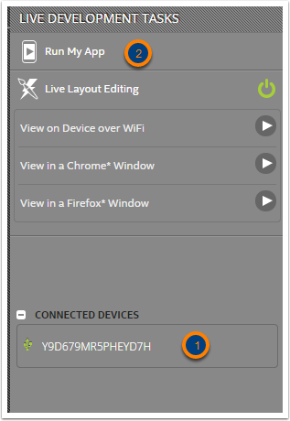
Previewing with XDK on Device
Ensure that you have USB drivers installed for your device.
Connect your device via USB or Wifi (see documentation)
Install “Intel XDK Preview” on Device from Playstore or Apple Appstore.
Changes get refreshed without reloading

Slide 18

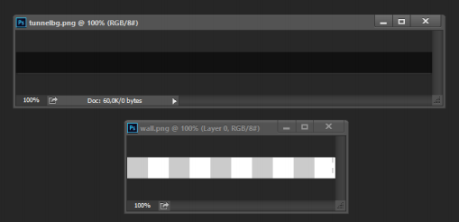
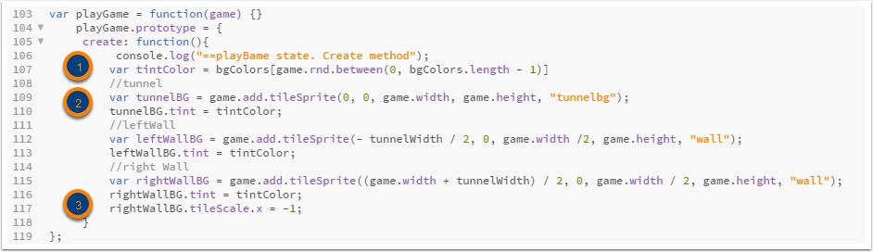
Creation of game background
initialise a tunnelWidth variable
Tunnel background is a 640x32 pixels dark gray image Tunnel wall is a 320x32 image with white and light gray stripes.
load these assets in the preload state in the preload method.
In the playGame State in the create method:
create random Tint colour
load tunnel Background and left and right Wall texture
flip right wall tile by setting tileScale to -1

Slide 19
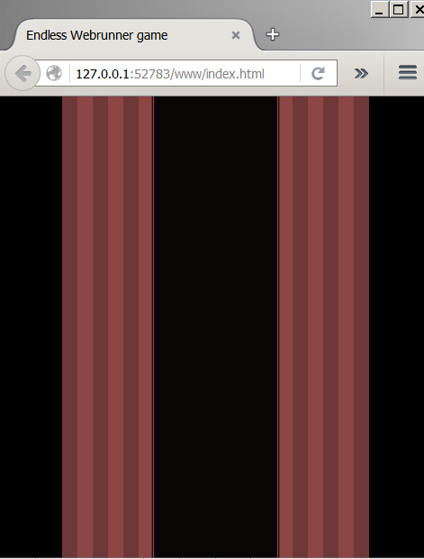

Slide 20
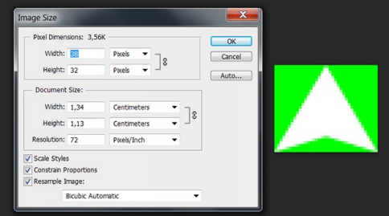
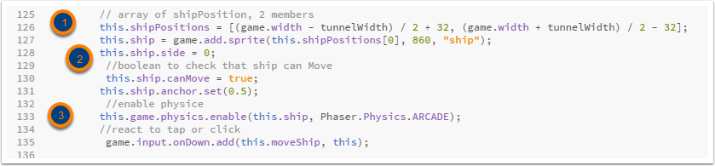
Creating the Player/Spaceship
1. add image to preload method of preload state
2. add sprite in create method of playGame state
shipPositions is an array of 2 X positions
this.ship.side can either be 1 or 0 for left & right
we enable a physics engine & make ship part of this.

Slide 21

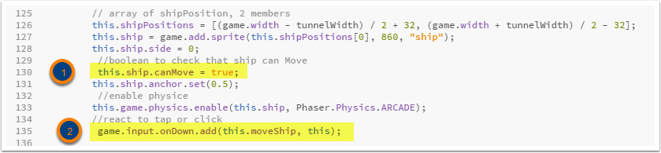
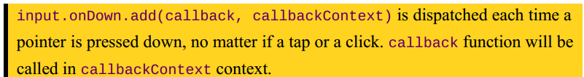
Moving the spaceship horizontally
1. create 2 variables to control horizontal movement
2. make the following amendments
a flag that states if ship can move or not: set to true
we detect the player’s tap or click and trigger a callback

Slide 22
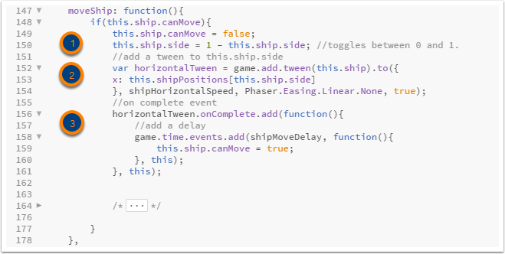
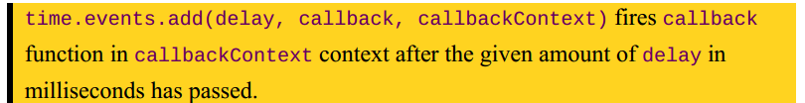
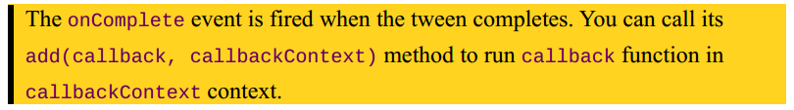
moving the Ship: moveShip
only move if ship.canMove = true; toggle ship.side between 1 and 0
move the ship using the add.tween method the new X position is retrieved from the this.shipPositions array
When the tween is completed add a timeDelay using time.events.add() After the delay set the ship.canMove back to true.

Slide 23
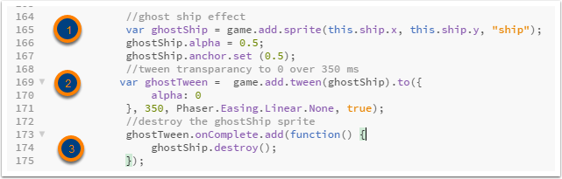
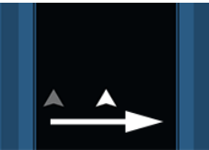
Adding a Ghost effect
Creates the effect of the ship gradually fading out from its previous position
Add this to the moveShip function
Create a new Sprite “ghostship” from the same “ship” image asset
Create a tween that changes the alpha from 50 – 0% over 350 ms.
when the tween is complete destroy the sprite “ghostship”

Slide 24
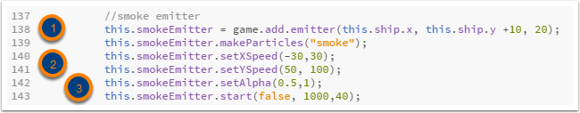
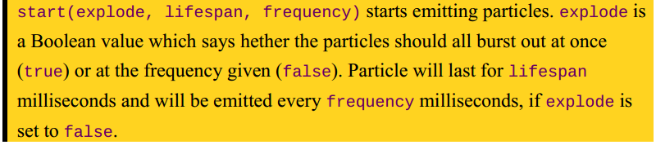
Adding smoke with a particle system
1. add image to preload method of preload state
2. add an emitter, a lighweight particle emitter that uses ARCADE Physics
This gets added to the create method of the playGame state
create an emitter with 20 particles and position it
set properties for the individual particles
start the particle system: The duration is 1000 ms, each 40 ms a new particle will be generated

Slide 25


Adding smoke with a particle system
1. add an update method for the playGame state
this updates the Emitter every single frame

Slide 26

Make the spaceship rise
slowly add spaceship to the top of the screen
add a variable for duration of tween
in create method of playGame state create a tween.

Slide 27
Using Swipe to move the ship back
A swipe will move the ship back down
Phaser has no native swipe detection. We will code our own in the update method of playGame state
set a variable for distance between onUp and onDown
add a Boolean variable canSwipe to the shipObject: this.ship.canSwipe = false;

Slide 28
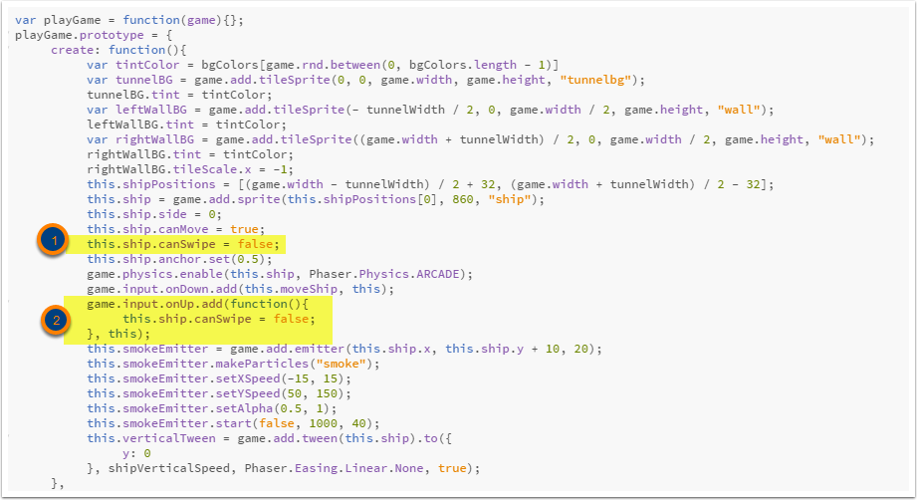
add the canSwipe boolean to ship object
onUp event also sets this flag to false

Slide 29
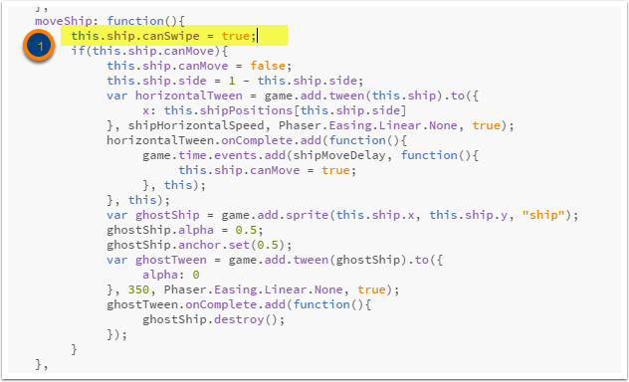
onDown triggers moveShip. Here we set the canSwipe flag to true

Slide 30
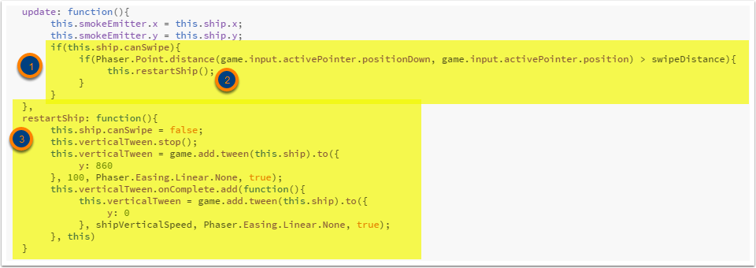
In the update we calculate the distance between positionDown and current position and see if its greater than swipeDistance
If so we call the restartShip method,
restartShip 1st cancels the current verticalTween, and then creates a new tween which resets the ship’s position back to the bottom

Slide 31
Adding Barriers
are added to a group
a container for display objects including Sprites and Images
Barriers will travel down the screen
Create a variable for barrierSpeed
Load the asset for the barrier in the preload method of the preload state

Slide 32


Add a group to the game
Create a new barrier using a Barrier class
Add this barrier to the new barrierGroup

Slide 33
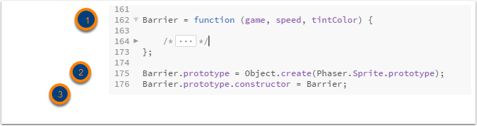
the Barrier class
blueprint of the Barrier class
The protoype is a Phaser Sprite
The Constructor is pointed explicitly at Barrier

Slide 34
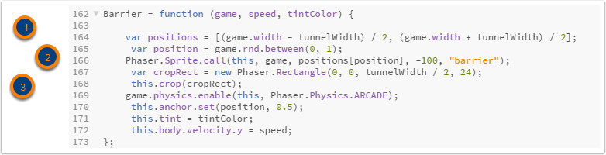

inside the Barrier class
set a random X position for Barrier
Invoke Sprite creation with the Barrier instance itself (1st arg. -> this)
Create a rectangle and crop the graphic to size
Set properties, like Physics, anchor, tint,velocity

Slide 35
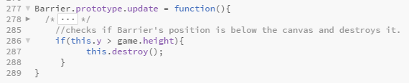
Removing Barriers
the update method of each Barrier object removes itself when it reaches the bottom of the screen

Slide 36

Continuously adding Barriers
a new Barrier will be created when the last barrier has reached a gap from the top

Slide 37
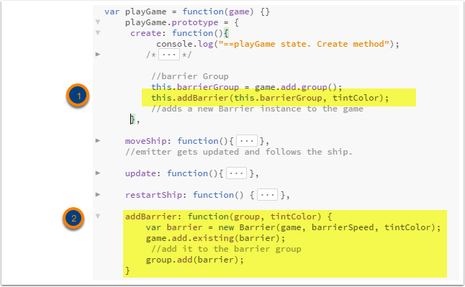
the Barrier generation code gets wrapped into a function (because it gets called repeatedly)
addBarrier The code itself does not change

Slide 38
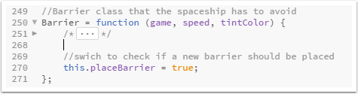
Each barrier will set a placeBarrier Boolean variable to true -> meaning a new Barrier can be placed.

Slide 39
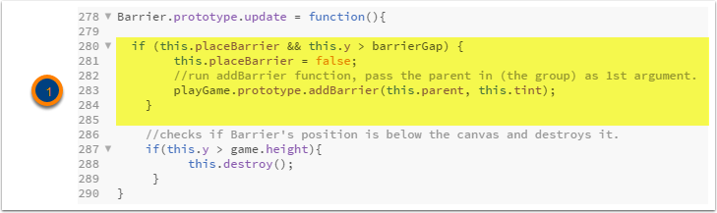
In the update method of the Barrier class
add a test that checks if Barrier has reached barrierGap. Set placeBarrier to false
call the addBarrier function of the parent.

Slide 40
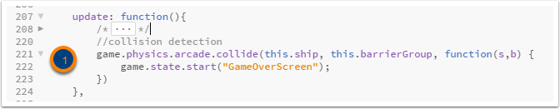
Detecting Collisions
1 the collide method of the Arcade physics is a AABB collision detection method
Callback has 2 arguments: s, b -> they represent the objects that have collided (s = spaceship, b=barrier)
Here, we only call the GameOverScreen state

Slide 41

game Over Screen State

Slide 42
Building your App
Please read:
https://software.intel.com/en-us/xdk/docs/build-cordova-apps-intel-xdk

