Slide 1

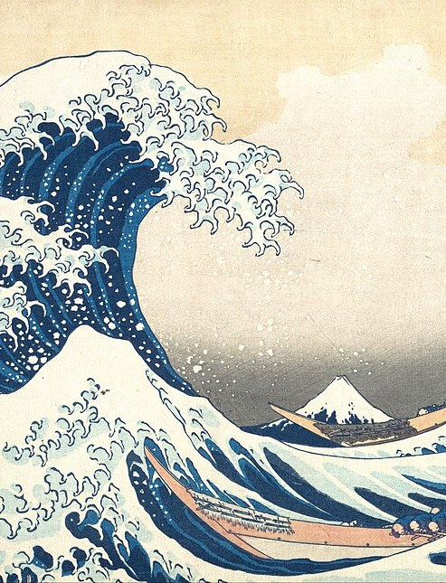

Họa. ▪ TERM ESSAY
01 / 38
Họa.
From requirements to running code.
Analysis and design of a painting shop with multimodal search, Gemma 4 and Whisper
INFORMATION SYSTEM ANALYSIS AND DESIGN ▪ CLASS 04
VŨ HÙNG ANH — B23DCDT022
THE GREAT WAVE OFF KANAGAWA (1831) — KATSUSHIKA HOKUSAI ▪ PUBLIC DOMAIN
Notes:
Good morning. I present my term essay for Information System Analysis and Design, titled "From requirements to running code". Throughout the talk I use one concrete product, Họa., an online painting shop with multimodal search: customers find a painting by typing, by speaking or by uploading a photo. It has a shopping assistant powered by Gemma 4 and speech recognition by Whisper running on the laptop itself. The talk follows the content of the course, and every concept is illustrated with an example taken from Họa.

Slide 2
Họa. ▪ CONTENTS
02 / 38
One system, five perspectives
01
02
03
04
05
Requirement Determination
Analysis
AI in e-commerce
Design
Code
What is the business, and where is the system boundary?
What must it do, how does it behave, what does it store?
How does AI help a customer find the right painting?
How does the software realise the model?
From model to running code, name for name
LECTURE 01
LECTURES 02–04
A06 ▪ GEMMA 4
LECTURE 05
LIVE DEMO
THE THREAD OF THE COURSE (LECTURE 01, SLIDE 32)
PROBLEM → NEED → REQUIREMENT → USE CASE → BEHAVIOUR → DOMAIN MODEL → DESIGN → CODE
Notes:
The talk has five parts, matching the five chapters of the essay: requirement determination from Lecture 01, analysis from Lectures 02 to 04, AI in e-commerce from Assignment 06, design from Lecture 05, and finally the code with a live demo. The line at the bottom is the thread the lecturer draws in Lecture 01: from a business problem to a stakeholder need, a requirement, a use case, behaviour, a domain model, a design and finally code. Each part of the talk is one link of that chain.

Slide 3
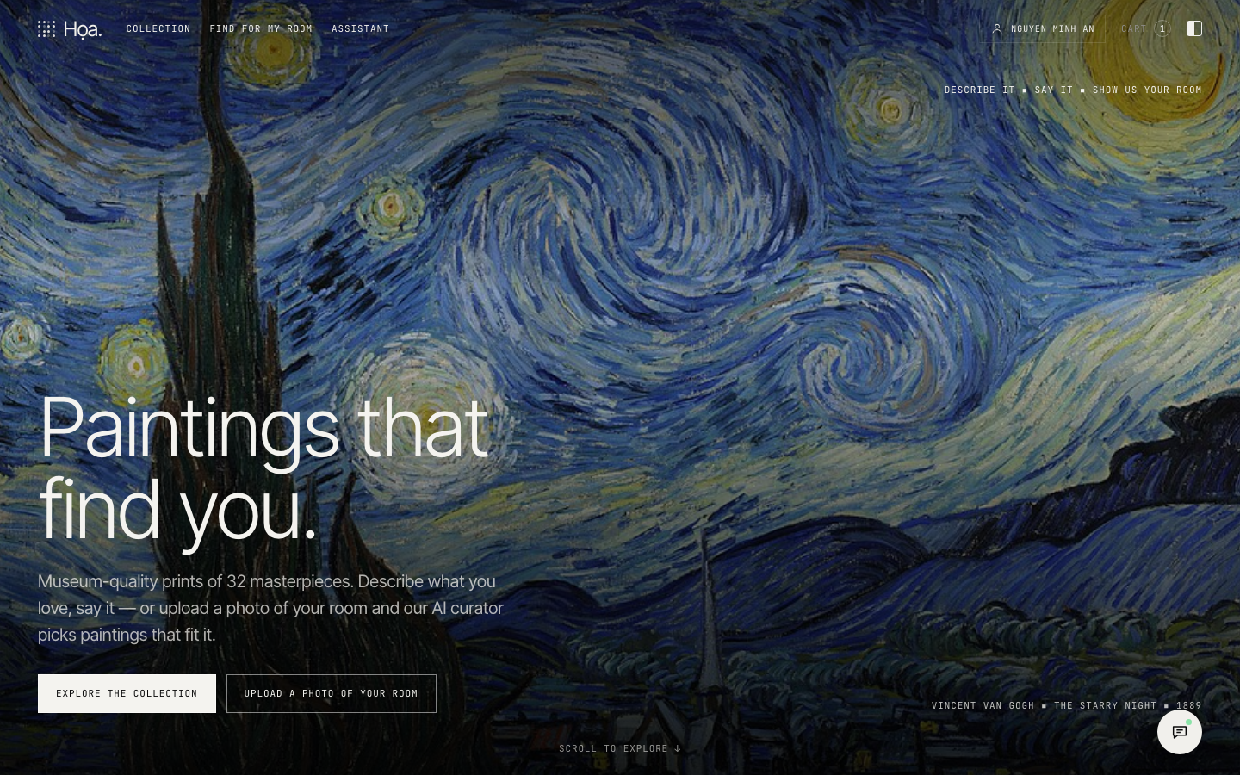
Họa. ▪ PRODUCT
03 / 38
Họa. — a painting shop that listens and sees
Sells prints of 32 public-domain masterpieces and matching frames, priced in USD.
Search by text, voice or photo
Try a painting on a photo of your own room
Curator assistant: ask about paintings and orders
Cart → checkout → track or cancel orders
Administration: paintings, prices, stock, order status
JAVA ▪ SQLITE ▪ HTML/CSS/JS ▪ GEMMA 4 ▪ WHISPER
22 REQUIREMENTS ▪ 14 USE CASES
58 JAVA CLASSES ▪ 17 TABLES
DEMO SCREENSHOT ▪ HOME PAGE
Notes:
Họa. sells prints of public-domain masterpieces, with images from Wikimedia Commons, together with frames, priced in US dollars. Besides the usual e-commerce functions — cart, checkout, order tracking and cancellation — the shop has five AI features that I present in Chapter 3. The numbers at the bottom, requirements, use cases, Java classes and tables, are read directly from the shared specification file of the project, so they always match the report and the code.

Slide 4
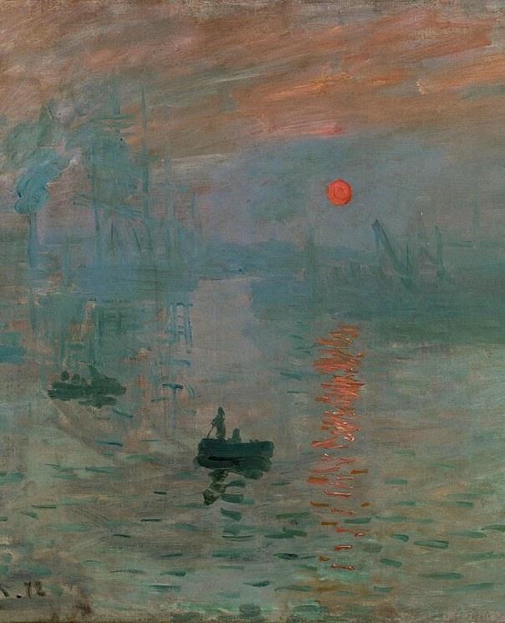
Họa. ▪ CHAPTER 01
04 / 38
CHAPTER 01
01
Requirement
Determination
Understand the business, its problems and the system boundary
LECTURE 01 ▪ BUSINESS INVESTIGATION AND SYSTEM CONTEXT
IMPRESSION, SUNRISE (1872) — CLAUDE MONET ▪ PUBLIC DOMAIN
Notes:
Chapter 1 follows Lecture 01: understand the business first — its people, processes, information and problems — trace each problem to its root cause, and fix the boundary of the system in a context diagram. The requirements themselves are written in Chapter 2.

Slide 5
Họa. ▪ 01 REQUIREMENT DETERMINATION
05 / 38
Understand the business before drawing diagrams
INFORMATION SYSTEM = PEOPLE + PROCESSES + DATA + TECHNOLOGY
PEOPLE
PROCESSES
DATA
TECHNOLOGY
Customers, administrator, warehouse and delivery
Search → cart → checkout → delivery, cancellation
Paintings, artists, carts, orders, payments
Java, SQLite, Gemma 4, Whisper
STAKEHOLDER | GOAL | INFORMATION NEED
Customer | Find and buy paintings they like | Paintings, prices, stock, order status
Administrator | Manage paintings and orders | Prices, stock, pending orders
Warehouse, delivery | Ship the right painting to the right place | Order details, addresses
Support staff | Answer customers quickly | Customer order history
WHO IS INSIDE THE SYSTEM AND WHO IS OUTSIDE → CONTEXT DIAGRAM (END OF CHAPTER 1)
Notes:
Lecture 01 stresses that an information system is not just software: it is people, processes, data and technology. For Họa., the people are customers, the administrator, the warehouse and support staff; the main process is search, cart, checkout, delivery and cancellation. The table is the stakeholder analysis in the lecture's format: the goal of each stakeholder and the information they need. Who is inside the system and who is outside is drawn in the context diagram at the start of Chapter 2.

Slide 6
Họa. ▪ 01 REQUIREMENT DETERMINATION
06 / 38
From business problem to system requirement
01 ▪ PROBLEM
02 ▪ ROOT CAUSE
03 ▪ NEED
04 ▪ REQUIREMENT
05 ▪ USE CASE
Business problem
Root cause
Stakeholder need
FR03 ▪ Should
UC04 Search by Image
Customers like a painting but do not know its title or artist.
Search matches exact keywords only; images are hard to put into words.
Find a painting from a natural sentence, the voice or a photo.
The system shall return the paintings most similar to a photo uploaded by the customer, ranked by similarity.
Primary actor Customer; supporting actor Gemma 4 Service.
NEED ≠ SOLUTION — “USE GEMMA” IS A SOLUTION, NOT A REQUIREMENT
PATTERN (LECTURE 02): THE SYSTEM SHALL + ACTION + OBJECT + CONDITION
Notes:
This is the central chain of Lectures 01 and 02. The business problem: customers like a painting but do not know its title or artist. The root cause: the old search only matches exact keywords. The stakeholder need: find a painting from a natural sentence, the voice or a photo. Only then do I write the system requirement FR03, in the pattern "the system shall plus action plus object plus condition", and the use case UC04 Search by Image. Note that "use Gemma" is a solution, not a requirement: a need is not an implementation.

Slide 7
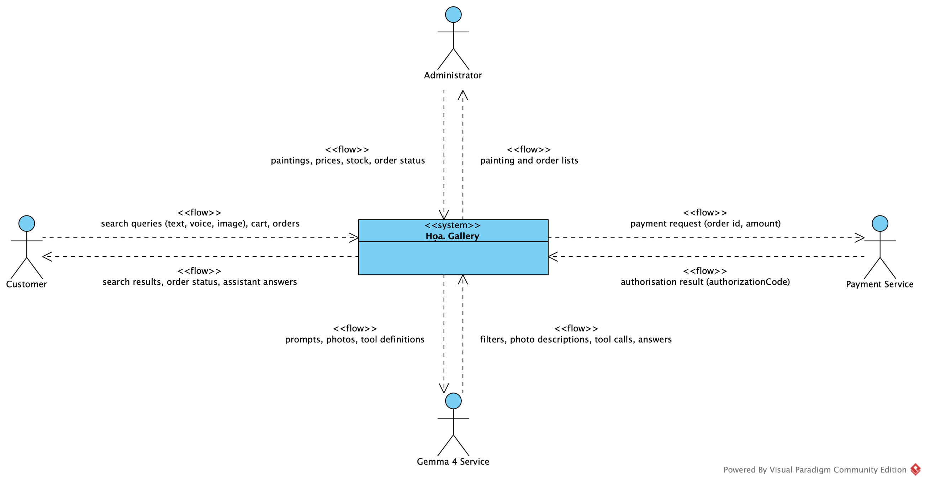
Họa. ▪ 01 REQUIREMENT DETERMINATION
07 / 38
Context diagram: what enters and leaves the system
READ EVERY FLOW TWICE
In: a use case receives it, a concept keeps it.
Out: a use case produces it.
ENTITY | USE CASES
Customer | UC01–UC11, UC14
Administrator | UC12–UC13
Payment Service | UC07
Gemma 4 Service | UC02–UC04, UC10, UC14
THE BOUNDARY DECIDES
Whisper is inside: the voice never leaves
Gemma is outside: the shop's rules check its answers
Payment is outside: it can say no
Notes:
Analysis starts from the boundary. The context diagram shows Họa. Gallery as one box and the four external entities that exchange information with it: the customer, the administrator, the payment service and the Gemma 4 service. Each arrow is a flow labelled with what it carries; Visual Paradigm Community Edition has no data-flow diagram, so the flows are «flow» dependencies. I read every flow twice: what comes in must be received by a use case and kept by a concept of the domain model; what goes out must be produced by a use case. The table on the right gives the use cases of each entity. The boundary also decides three things: Whisper runs on the shop's own machine, so the customer's voice never leaves the system; Gemma is outside, so prices, stock and access rights are always decided by the shop's own rules, with a keyword fallback; and the payment service is outside, so it can refuse a card, which is the alternative flow "card refused" of checkout.

Slide 8
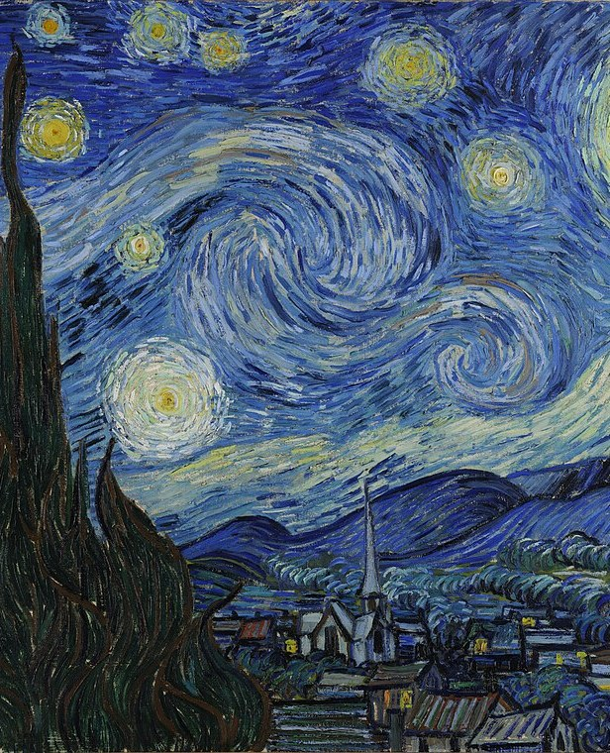
Họa. ▪ CHAPTER 02
08 / 38
CHAPTER 02
02
Analysis
Requirements, use cases, behaviour, concepts and data
LECTURE 02 ▪ REQUIREMENTS — LECTURE 03 ▪ BEHAVIOUR — LECTURE 04 ▪ DOMAIN AND DATA
THE STARRY NIGHT (1889) — VINCENT VAN GOGH ▪ PUBLIC DOMAIN
Notes:
Chapter 2 starts from the needs of Chapter 1. Lecture 02 turns them into functional and non-functional requirements, actors and use cases. Then Lecture 03 asks how the system behaves when an actor performs a use case: scenarios, alternative flows and activity diagrams. Lecture 04, which is Assignment 03, asks which concepts the system must manage: the domain model; and the data model, at its conceptual and logical levels, says which of them must be stored.

Slide 9
Họa. ▪ 02 ANALYSIS
09 / 38
14 functional requirements, prioritised with MoSCoW
ID | REQUIREMENT | MOSCOW | USE CASE
FR01 | Search paintings by keyword or natural sentence | Must | UC02
FR02 | Search by voice | Should | UC03
FR03 | Search by image | Should | UC04
FR04 | Multimodal search combining text and image with weighted scores | Could | UC01
FR05 | View painting details | Must | UC05
FR06 | Manage the cart | Must | UC06
FR07 | Checkout | Must | UC07
ID | REQUIREMENT | MOSCOW | USE CASE
FR08 | View my orders and my latest order | Must | UC08
FR09 | Look up an order by id | Must | UC09
FR10 | AI shopping assistant | Should | UC10
FR11 | Cancel my order while it is not shipped yet | Should | UC11
FR12 | The administrator adds paintings and changes price and stock | Must | UC12
FR13 | The administrator moves an order PLACED → PROCESSING → SHIPPED → DELIVERED | Must | UC13
FR14 | Find a painting for my room | Could | UC14
FR: MUST 8 ▪ SHOULD 4 ▪ COULD 2 ▪ WON'T (THIS RELEASE): REAL PAYMENTS — THE PAYMENT SERVICE IS SIMULATED
Notes:
Here is the table of functional requirements in the format of Lecture 02: an identifier, a short description, a MoSCoW priority and the related use case. The Must requirements are the core of the shop: searching, viewing details, the cart, checkout, viewing and looking up orders, and administration. The advanced AI features, such as voice and image search or the assistant, are Should; trying a painting in your room and multimodal search are Could. Real payments are Won't for this release: the payment service is only simulated.

Slide 10
Họa. ▪ 02 ANALYSIS
10 / 38
Non-functional requirements must be measurable
NFR01 ▪ MUST
NFR02 ▪ MUST
NFR03 ▪ MUST
NFR04 ▪ MUST
Security
Fallback
Uploaded images
Layered architecture
The system shall take the identity from the signed-in session and check order ownership on the server.
The system shall still find paintings with keyword rules when the Gemma service fails or times out.
The system shall reject uploaded images that are not JPEG, PNG or WebP or are larger than 5 MB.
The system shall separate presentation, application, domain and infrastructure; the user interface shall not access the database directly.
NFR05 ▪ MUST
NFR06 ▪ SHOULD
NFR07 ▪ SHOULD
NFR08 ▪ MUST
Payment data
Runs offline on one machine
Performance
Voice privacy
The system shall not store full card numbers; only the last four digits and the authorisation code are kept.
The system shall run on one machine with a SQLite database and need the network only to call Gemma.
The system shall return text search results within 2 seconds on the demo data.
The system shall process audio on the local machine with self-hosted Whisper, never send audio outside, and transcribe a 5-second sentence within 3 seconds.
“THE SYSTEM SHALL BE FAST” → “The system shall return text search results within 2 seconds on the demo data” (NFR07)
Notes:
Lecture 02 warns about requirements like "the system shall be fast": they cannot be verified. Every non-functional requirement of Họa. has a measurable condition: text search within two seconds on the demo data, images of at most five megabytes in three formats, audio processed only on the laptop, order ownership checked on the server. Each of these requirements can therefore become a test case.

Slide 11
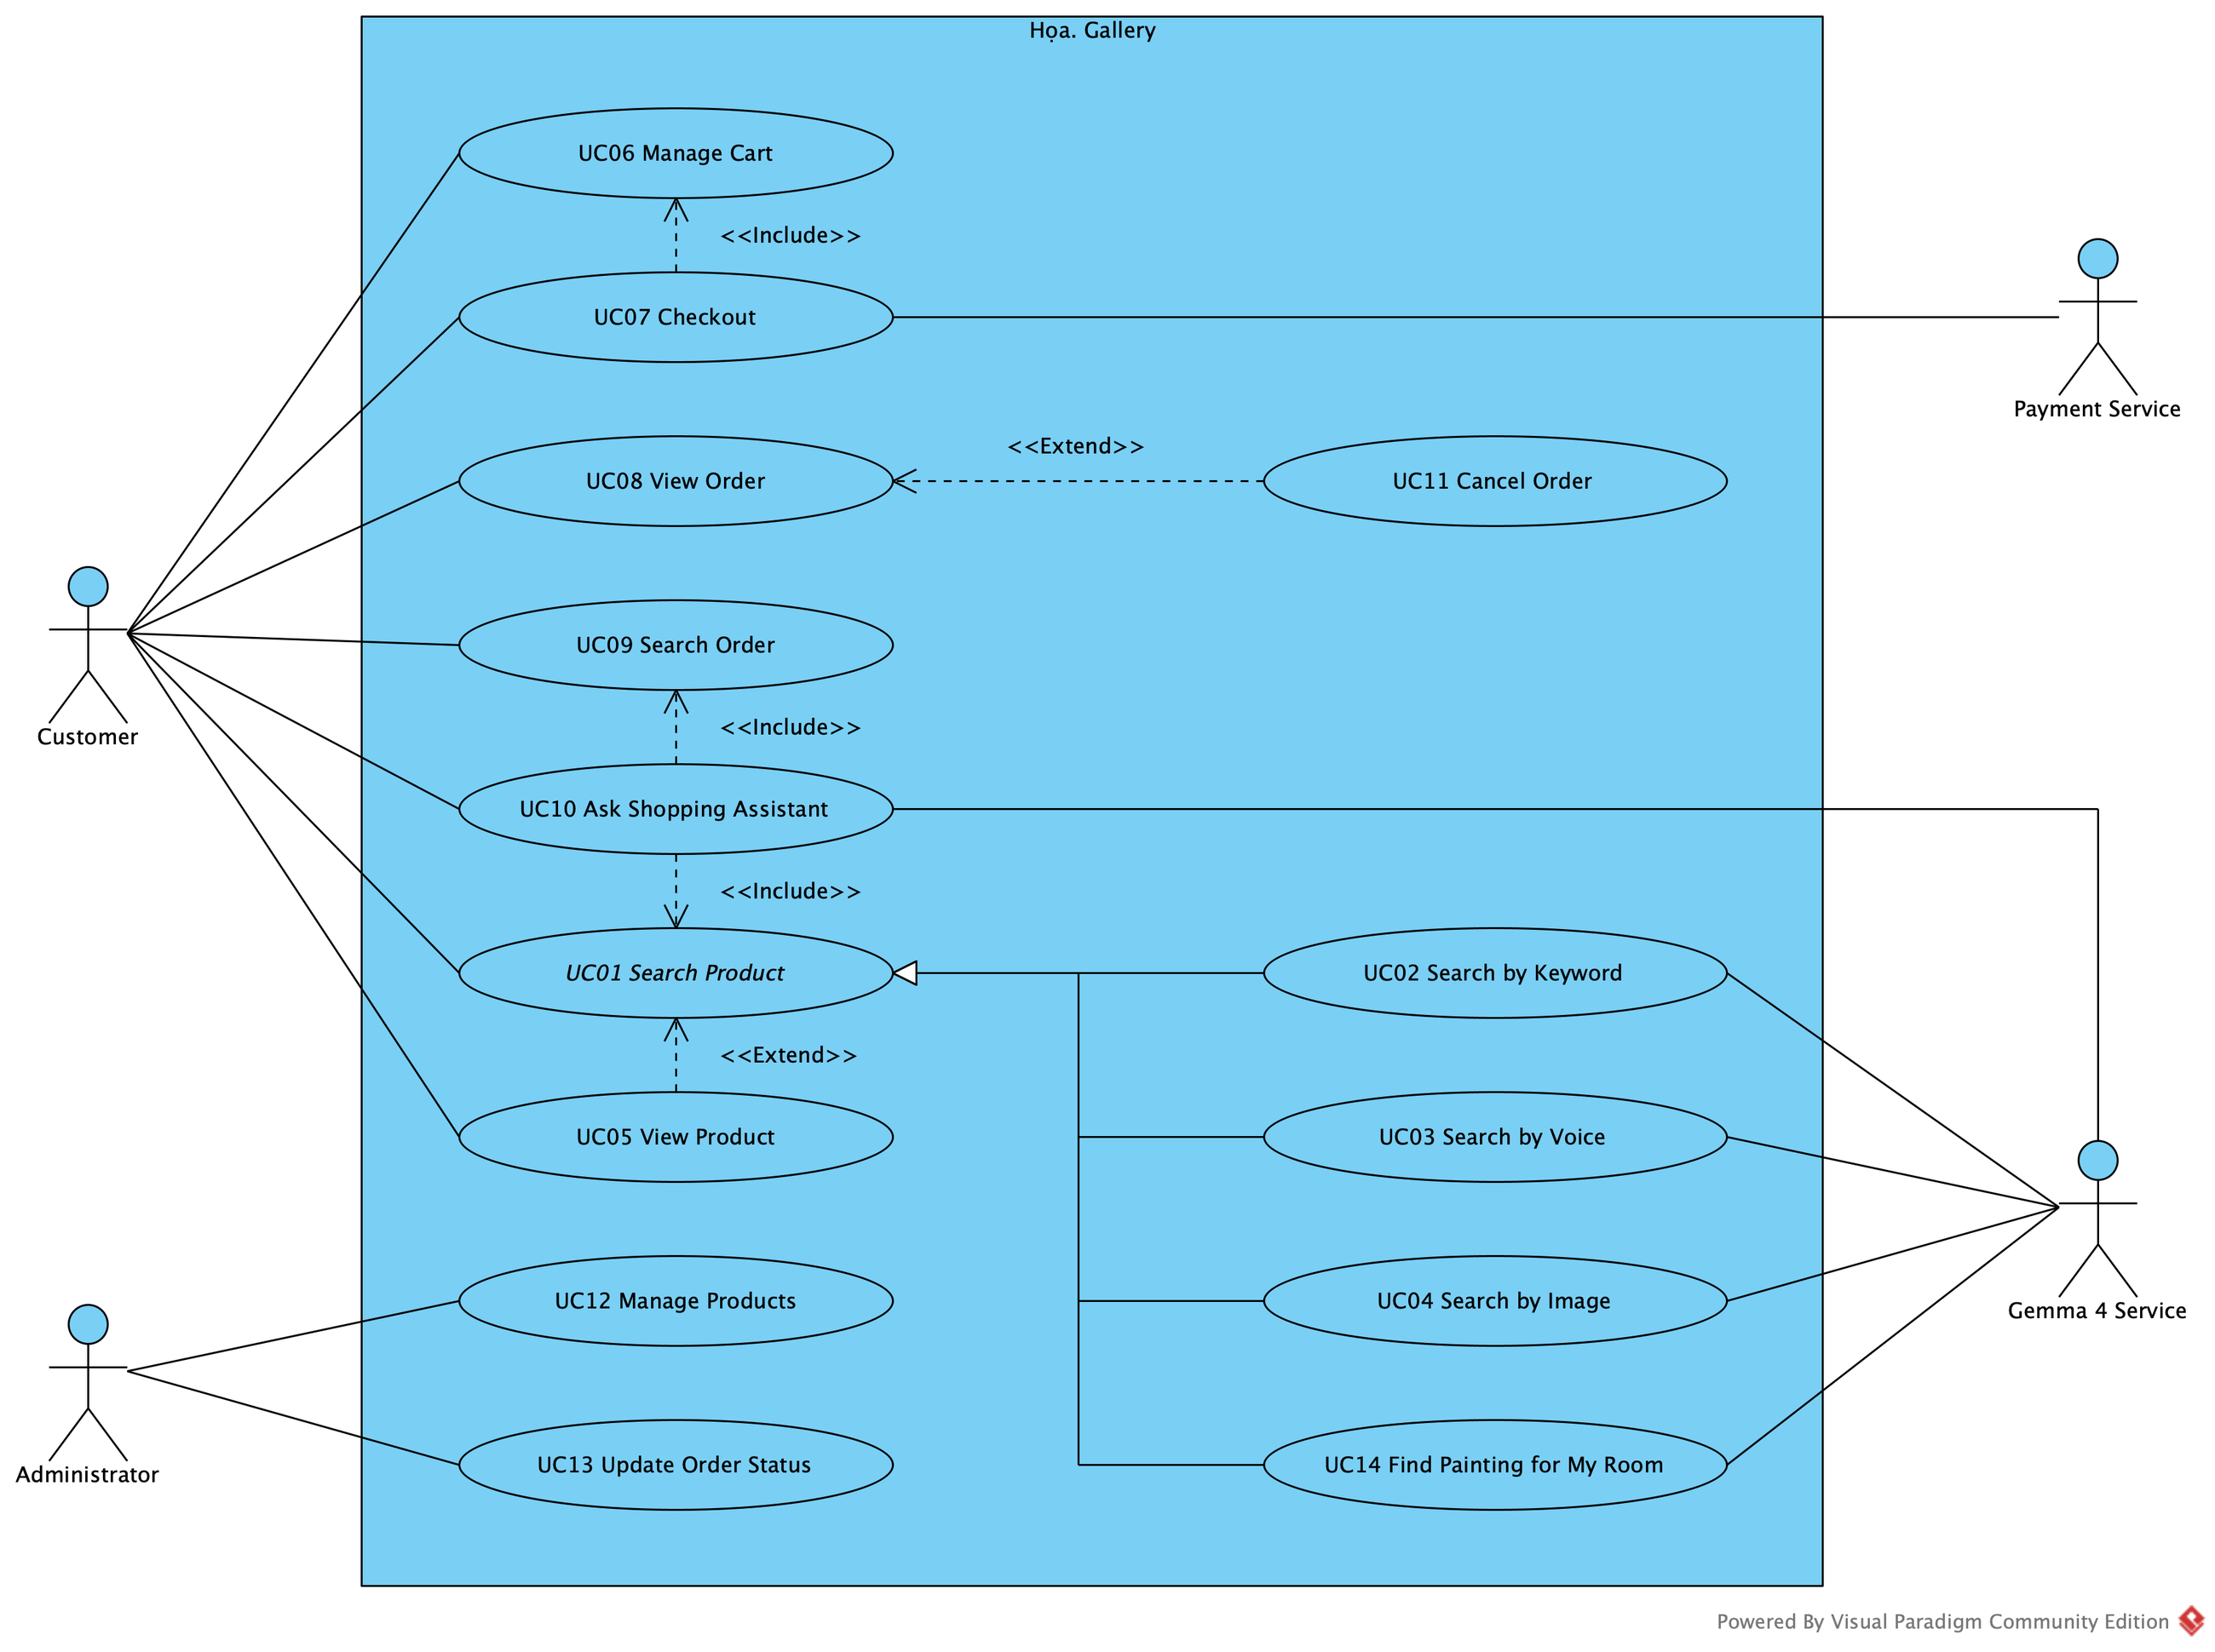
Họa. ▪ 02 ANALYSIS
11 / 38
A use case is a goal, not a button
4 ACTORS
Customer primary
Administrator primary
Gemma 4 Service supporting
Payment Service supporting
STAKEHOLDER ≠ ACTOR
Warehouse and support staff have a stake but do not use the system directly.
USE CASE = GOAL
“Click Search” ✗ Search Product ✓
FR03 → UC04 → SearchService.searchImage(image) → TEST
Notes:
The use case diagram shows all use cases and four actors. Customer and Administrator are primary actors; the Gemma 4 Service and the Payment Service are supporting actors that the system calls. Two points from Lecture 02: a stakeholder is not an actor — the warehouse or support staff have a stake but do not interact directly; and a use case is a goal, not a button — "Search Product", not "click search". The three search modes specialise Search Product, exactly as in the structure of Assignment 06. The last line is a trace from a requirement to a method and its test.

Slide 12
Họa. ▪ 02 ANALYSIS
12 / 38
Use case specification: Checkout (UC07)
ELEMENT | DESCRIPTION
Requirement | FR07 — Checkout: create an order from the cart, freeze prices, decrease stock, empty the cart
Primary actor | Customer
Supporting actor | Payment Service
Goal | Create a valid order from the cart
Trigger | The customer clicks “Place order” in the cart
Precondition | The customer is signed in; the cart has at least one line
Postcondition | A PLACED order is saved, stock is reduced, the cart is empty
MAIN FLOW
01 The system shows the cart lines and the total
02 The customer picks an address and a payment method
03 The system re-reads prices and checks stock
04 It creates the Order and OrderItems at frozen prices
05 It records the payment, reduces stock, empties the cart
ALTERNATIVE FLOWS
Painting out of stock → name it, create no order
Address not owned by the customer → choose again
Payment rejected → choose another method
Notes:
This is the Checkout use case specified with the template of Lecture 03: primary and supporting actors, goal, trigger, pre- and postconditions. The main flow has five steps. The lecturer insists that the normal flow is not enough, so I also list alternative flows: a painting out of stock, an address that does not belong to the customer, a rejected payment. Each alternative flow later becomes a decision in the activity diagram and a check in the code.

Slide 13
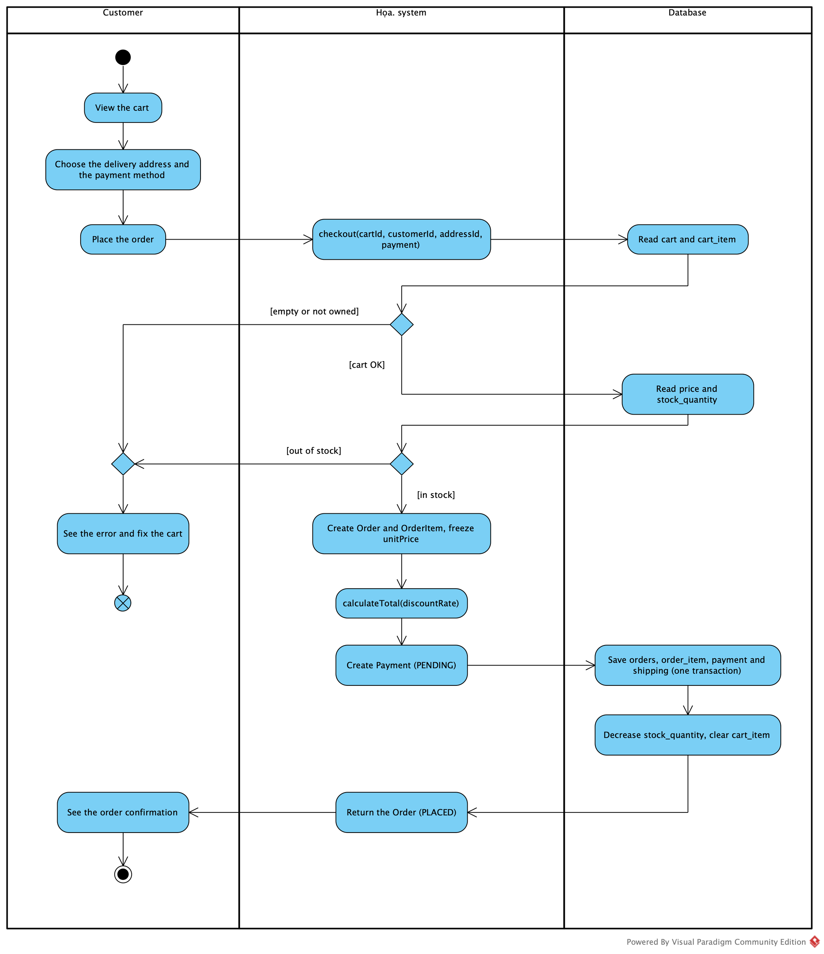
Họa. ▪ 02 ANALYSIS
13 / 38
From scenario to activity: decisions follow rules
FOUR QUESTIONS (LECTURE 03)
01 What is the actor's goal?
02 What is the normal flow?
03 What can go wrong?
04 How does the system respond?
BUSINESS RULE → DECISION
No stock, no order
The address must belong to the customer
Cancel only before shipment
FR07 → UC07 → SCENARIO → ACTIVITY
Notes:
From the scenario I draw an activity diagram with swimlanes: the customer, the Họa. system and the database. Every decision node comes from a business rule: no stock means no order, the address must belong to the customer, and an order can only be cancelled before shipment. On the right are the four questions of functional analysis from Lecture 03. The trace FR07, UC07, scenario, activity answers the question "where is this requirement represented in the model?"

Slide 14
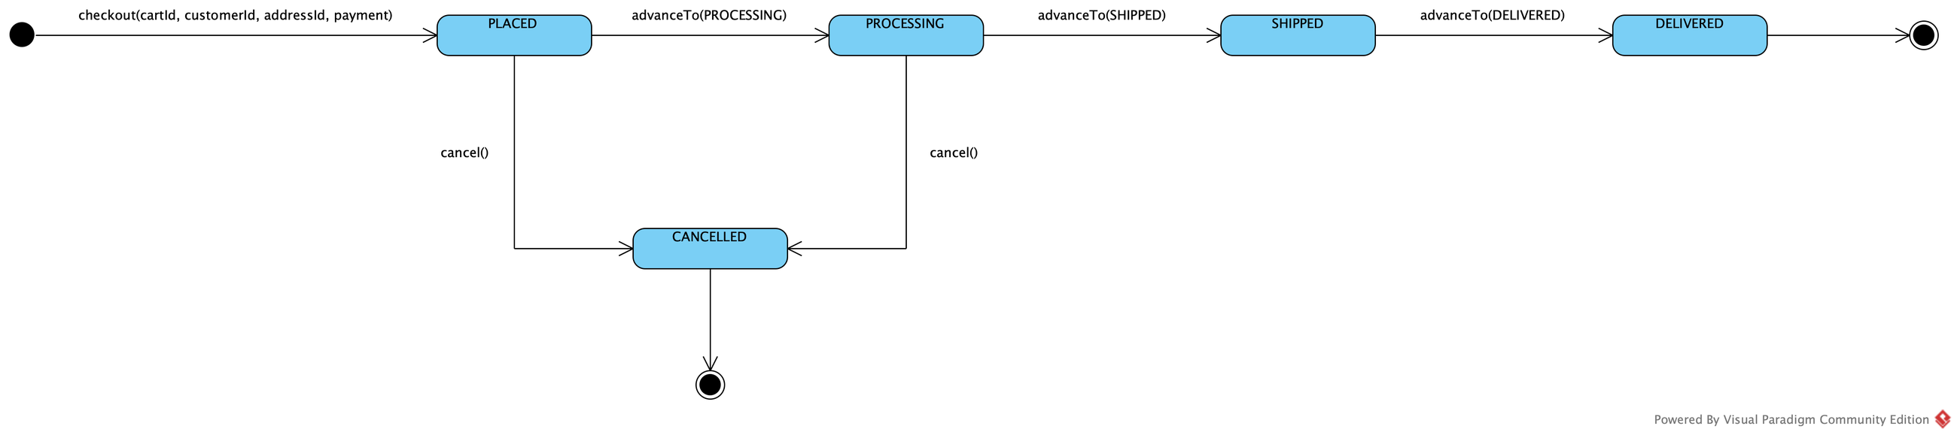
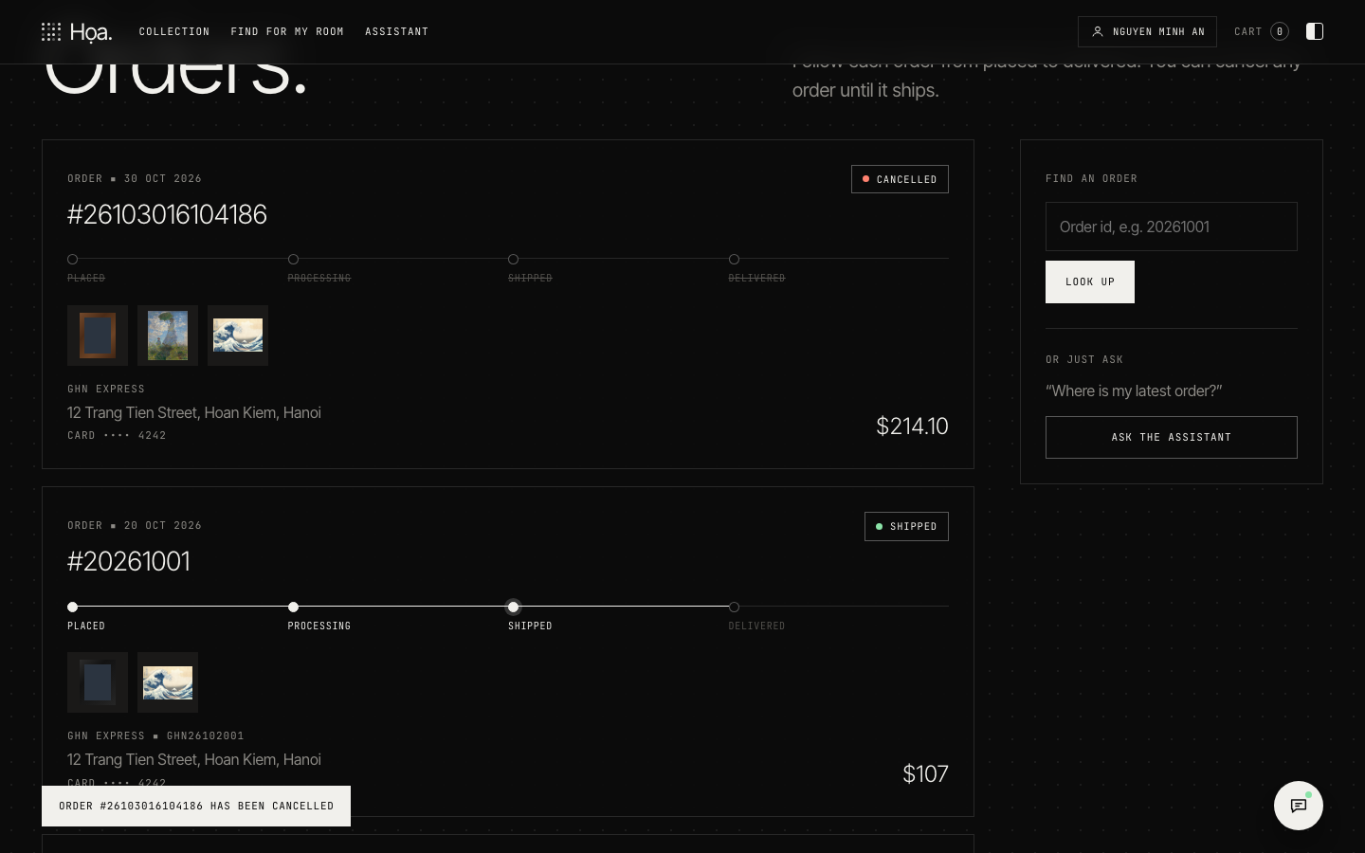
Họa. ▪ 02 ANALYSIS
14 / 38
Consistency check: cancel before shipment
ARTEFACT | WHAT MUST AGREE
Requirement | FR11 — Cancel my order while it is not shipped yet (PLACED or PROCESSING)
Use case | UC11 Cancel Order «extend» UC08 View Order
Decision | Has the order been shipped yet?
State machine | Cancel only from PLACED or PROCESSING
Design | OrderService.cancelOrder(customerId, orderId) → Order.cancel()
Operations | AdminController.updateOrderStatus(orderId, status) moves the order to SHIPPED
Notes:
Lecture 03 has an example of a consistency check for the requirement "a customer may cancel an order before shipment". I did exactly that exercise for Họa.: requirement FR11, the Cancel Order use case extending View Order, the decision "has the order been shipped", a state machine that allows cancellation only from PLACED or PROCESSING, and a design where cancelOrder calls Order.cancel. On the operations side, the administrator moves the order to SHIPPED, and from then on the customer can no longer cancel. The screenshot shows the cancellation in the demo.

Slide 15
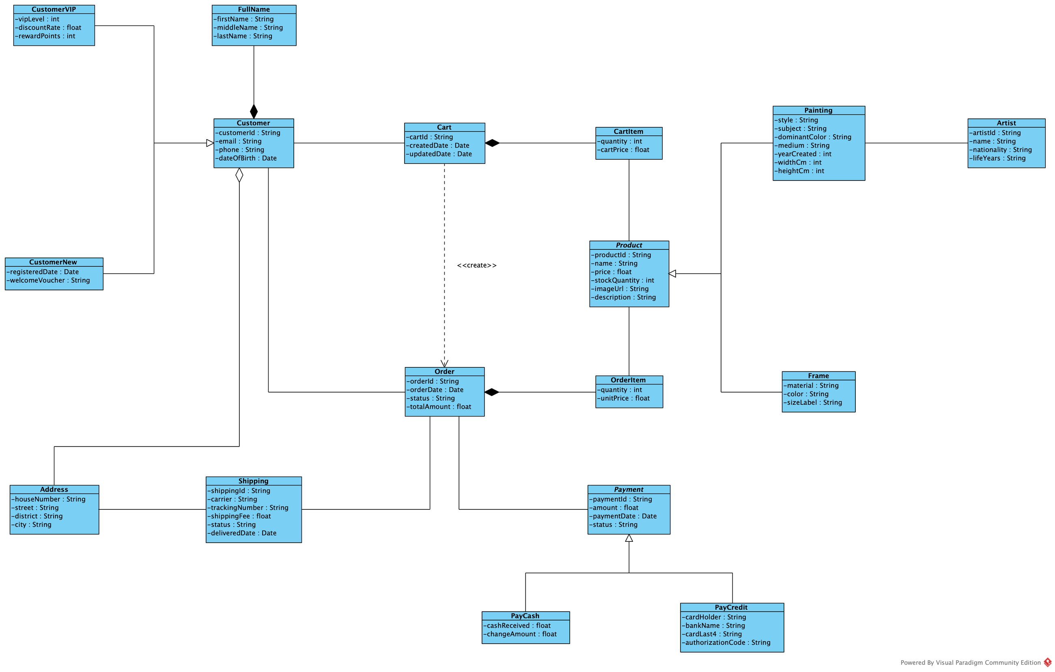
Họa. ▪ 02 ANALYSIS
15 / 38
Domain model: CartItem ≠ OrderItem
 | CARTITEM | ORDERITEM
Purpose | Shopping | Transaction
Lifetime | Temporary | Persistent
Owned by | Cart | Order
Price | cartPrice: when added | unitPrice: frozen at checkout
After checkout | Cart is emptied | Stays in the order
CHECKOUT IS A TRANSFORMATION (A03)
Cart —checkout «create»→ Order
ANALYSIS: ATTRIBUTES + KIND OF RELATIONSHIP
Association, composition ◆, aggregation ◇, generalization △, «create». Names and 1 – n come in the data model.
Notes:
This is the core of Lecture 04. On the left is the domain model drawn as the analysis class diagram: the classes of Họa. — customers, paintings, artists, carts, orders, shipping and payments — each with its attributes. Each line shows only the kind of relationship: a plain association, a composition with a filled diamond, an aggregation with a hollow diamond, a generalization with a hollow triangle, and the «create» dependency of checkout. Names and multiplicities are added one step later, in the data model. The lecture stresses that CartItem is not OrderItem: one holds temporary shopping information with the price when the item was added; the other holds persistent transaction information with the price frozen at checkout. Checkout transforms a Cart into an Order, which is why it is a «create» dependency rather than a permanent association.

Slide 16
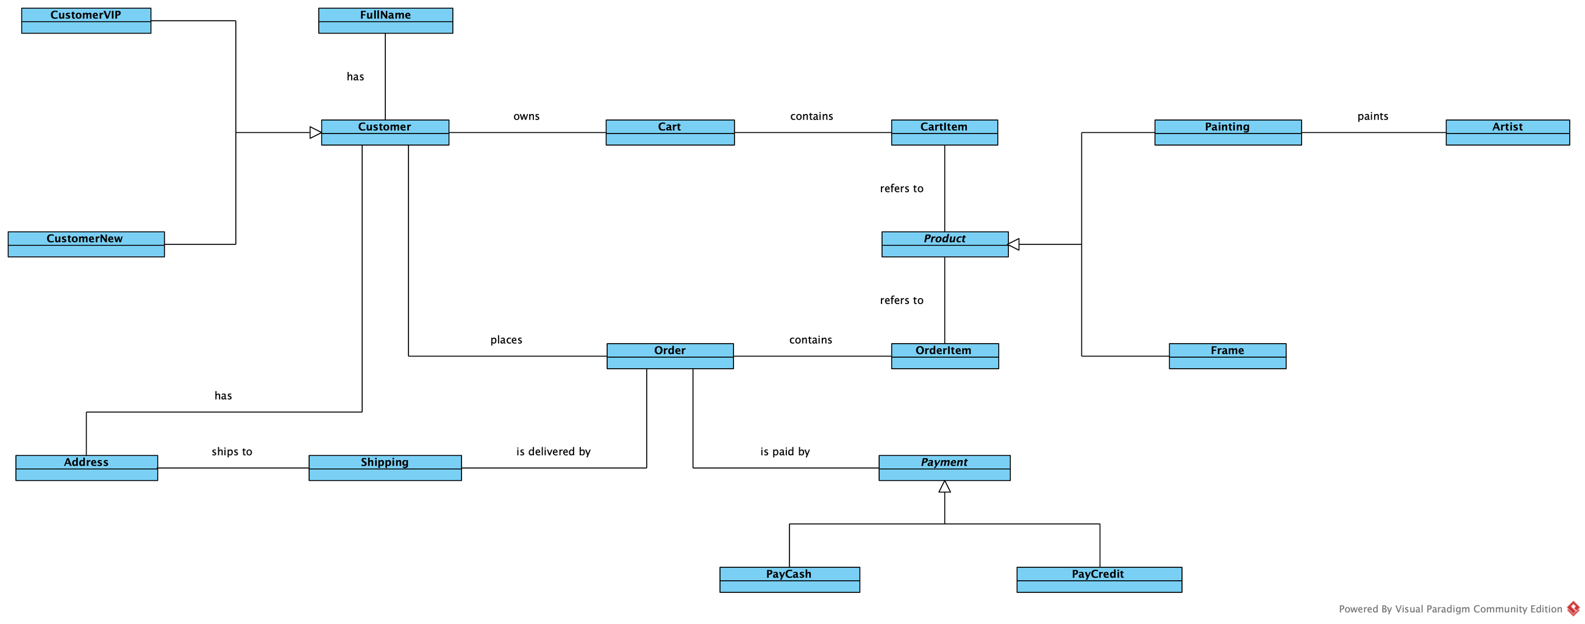
Họa. ▪ 02 ANALYSIS
16 / 38
Conceptual data model: names and links only
DATA MODEL ▪ LEVEL 1 OF 3
CONCEPTUAL → LOGICAL → PHYSICAL
SHOWS
17 entities by name; links named like a sentence: places, contains, refers to, is delivered by …
LEAVES OUT
Attributes, multiplicities, keys, data types, and «create»: an operation, not data
NEXT: + ATTRIBUTES, ORM, LABELS, 1 – N
Notes:
The data model is drawn at three levels; the first two belong to the analysis, and this is the first one, the conceptual data model. It is deliberately rough: the seventeen things the shop must keep, by name only, and the links between them, each with a name that reads as a sentence — a customer owns a cart, places orders, an order contains order items. There are no attributes, no multiplicities, no keys and no data types yet, and the «create» dependency of checkout is gone, because it is an operation, not something to store. The logical level adds the detail on the next slide; the physical level, with tables, keys and data types, is a design decision and comes in Chapter 4.

Slide 17
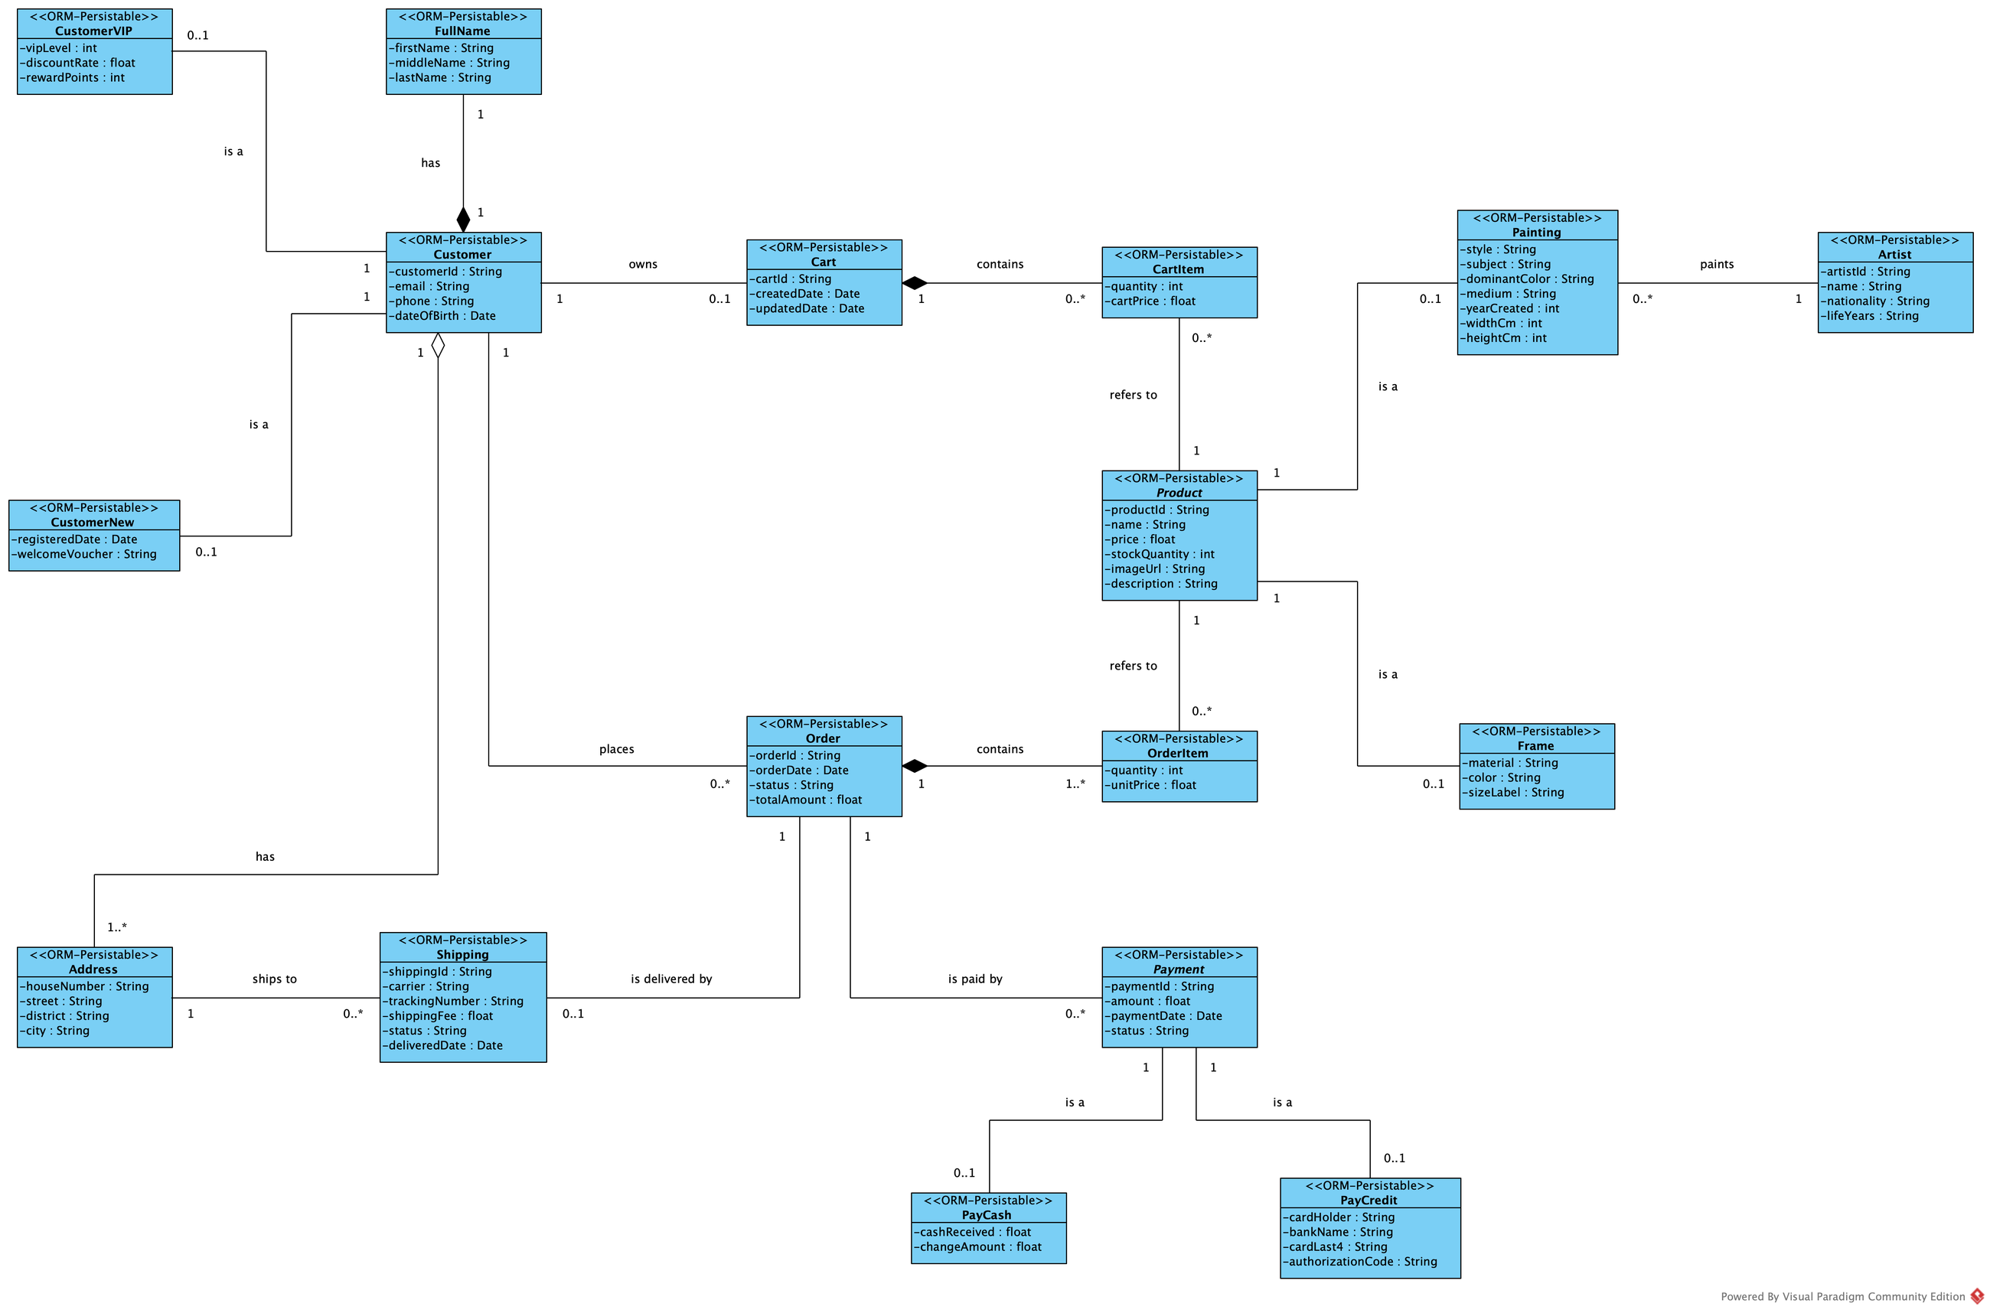
Họa. ▪ 02 ANALYSIS
17 / 38
Logical data model: persistable classes, named links
DATA MODEL ▪ LEVEL 2 OF 3
CONCEPTUAL → LOGICAL → PHYSICAL
+ ATTRIBUTES ▪ «ORM-PERSISTABLE»
Every class is stored as records
LABEL
Every association has a name: has, owns, places, contains, refers to …
1 – N
Multiplicity at both ends: 1, 0..1, 0..*, 1..*
IS A ▪ 1 – 0..1
Each generalization becomes an “is a” link: tables have no inheritance
LEVEL 3 (TABLES, KEYS, TYPES): CHAPTER 4
Notes:
The second level is the logical data model, drawn as a class diagram with the things the lecturer asks for. It adds the attributes. First, every class is marked «ORM-Persistable»: its objects are stored as records. Second, every association has a label, its name: a customer owns a cart and places orders, an order is paid by payments, an artist paints paintings. Third, every association has its multiplicities at both ends — one, zero or one, zero or many, one or many — which later decide where the foreign keys go. Because tables have no inheritance, each generalization becomes an "is a" association with multiplicity one to zero-or-one; and the «create» dependency of checkout is dropped, because it is an operation, not data. The next slide turns these classes into tables.

Slide 18
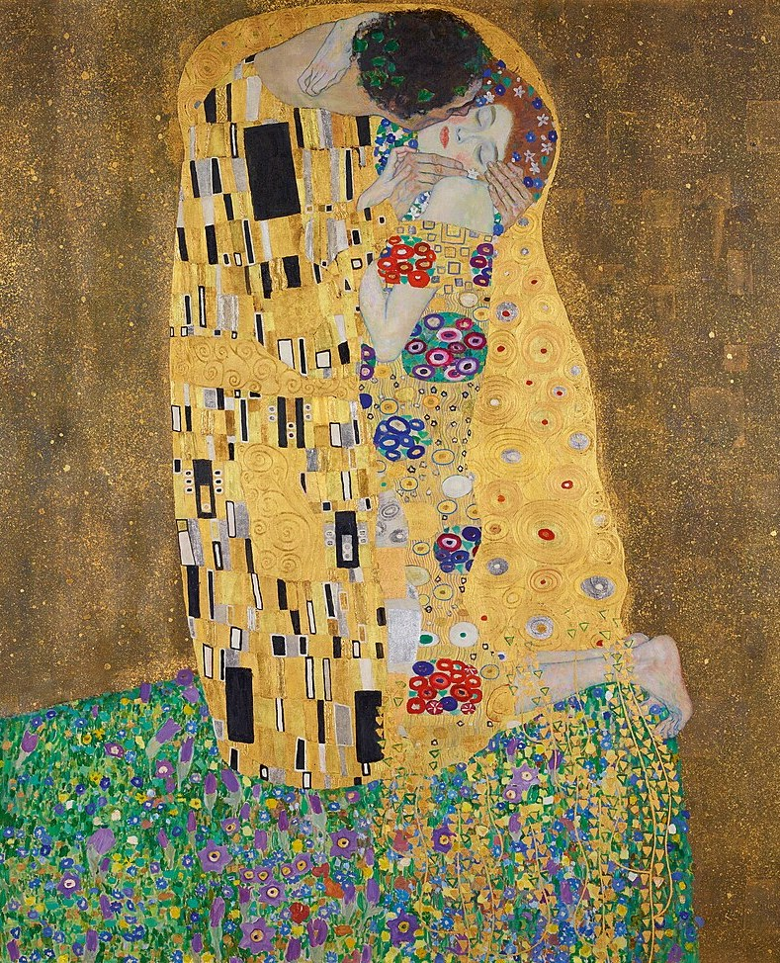
Họa. ▪ CHAPTER 03
18 / 38
CHAPTER 03
03
AI in
e-commerce
Five ways AI helps a customer find the right painting
01 TEXT
02 VOICE
03 IMAGE
04 ROOM
05 ASSISTANT
ASSIGNMENT A06 ▪ MULTIMODAL SEARCH — GEMMA 4 (L40S SERVER) ▪ WHISPER (ON THE LAPTOP)
THE KISS (1908) — GUSTAV KLIMT ▪ PUBLIC DOMAIN
Notes:
Chapter 3 covers AI in e-commerce. Họa. has five AI features: understanding natural text, voice search with Whisper running on the laptop, image search, trying a painting in your own room, and a curator assistant. The common principle: AI helps customers express what they want, while prices, stock and access rights stay under the control of business rules in the code.

Slide 19
Họa. ▪ 03 AI IN E-COMMERCE
19 / 38
Different inputs, one common query
TEXT
SearchUI.submitText
QueryService.textQuery
COMMON QUERY
RETRIEVAL
RANKING
RESULTS
VOICE
CommonQuery
SearchService
RankingService
SearchResultView
VoiceInput.upload
SpeechService.transcribe
QueryService.voiceQuery
type, query, embedding, style, subject, color, artist, maxPrice, aiUsed
.retrieve(query)
ProductRepository
.allProducts()
VectorIndex
.nearest(queryEmbedding, k)
.rank(query, candidates, limit)
S = α·Stext + β·Simage + γ·Sbusiness
.render(results)
PAINTING PHOTO
ImageUpload.choose
ImageService.embed
QueryService.imageQuery
ROOM PHOTO
RoomPreview.chooseRoom
ImageService.describe
SearchService.searchRoom
DIFFERENT INPUTS → ONE COMMON REPRESENTATION
RETRIEVAL ≠ RANKING
THE UI NEVER TOUCHES THE DATABASE
START SIMPLE
Notes:
The central principle of Assignment 06: different inputs are turned into one common representation, then candidates are retrieved, then ranked. Họa. has four inputs — text, voice, a photo of a painting and a photo of a room — and each one goes through exactly the classes and methods written in its box. They all meet in CommonQuery. SearchService retrieves candidates from ProductRepository and VectorIndex, and RankingService ranks them with the formula of the assignment. The four principles at the bottom also come from A06: one common representation, retrieval separate from ranking, the UI never touching the database, and starting simple.

Slide 20
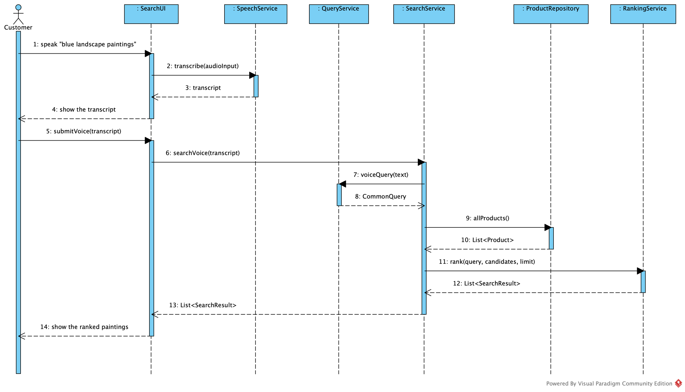
Họa. ▪ 03 AI IN E-COMMERCE
20 / 38
Voice search: the audio never leaves the laptop
01 VoiceInput.upload(audio) sends the recording
02 SpeechService.transcribe(audioInput) calls WhisperClient on the laptop
03 The customer reviews and edits the transcript
04 SearchService.searchVoice(transcript) follows the text path
05 Whisper down → null; the customer is asked to type
MEASURED ON THE LAPTOP ▪ WHISPER SMALL
0.70 s
2.0 %
18/20
MEAN TIME
WORD ERROR
EXACT
THE 7 PARTICIPANTS OF A06: CUSTOMER ▪ SEARCHUI ▪ SPEECHSERVICE ▪ QUERYSERVICE ▪ SEARCHSERVICE ▪ PRODUCTREPOSITORY ▪ RANKINGSERVICE
MAX 1.43 S ▪ NFR08 LIMIT 3 S ▪ 20 EN SENTENCES
Notes:
Voice search. The sequence diagram on the left has exactly the seven participants required by Assignment 06. In Họa., the recording is sent to a self-hosted Whisper model running on the laptop, so the audio never leaves the machine — that is a privacy requirement. The transcript is shown so the customer can correct it, and then it follows the same path as a typed query. If the Whisper server is not running, the system asks the customer to type instead. I deliberately do not implement text-to-speech. I measured it on 20 English test sentences: Whisper small on the laptop's processor needs 0.70 seconds on average and at most 1.43 seconds, well within the 3 seconds of NFR08, with a word error rate of 2.0 percent.

Slide 21
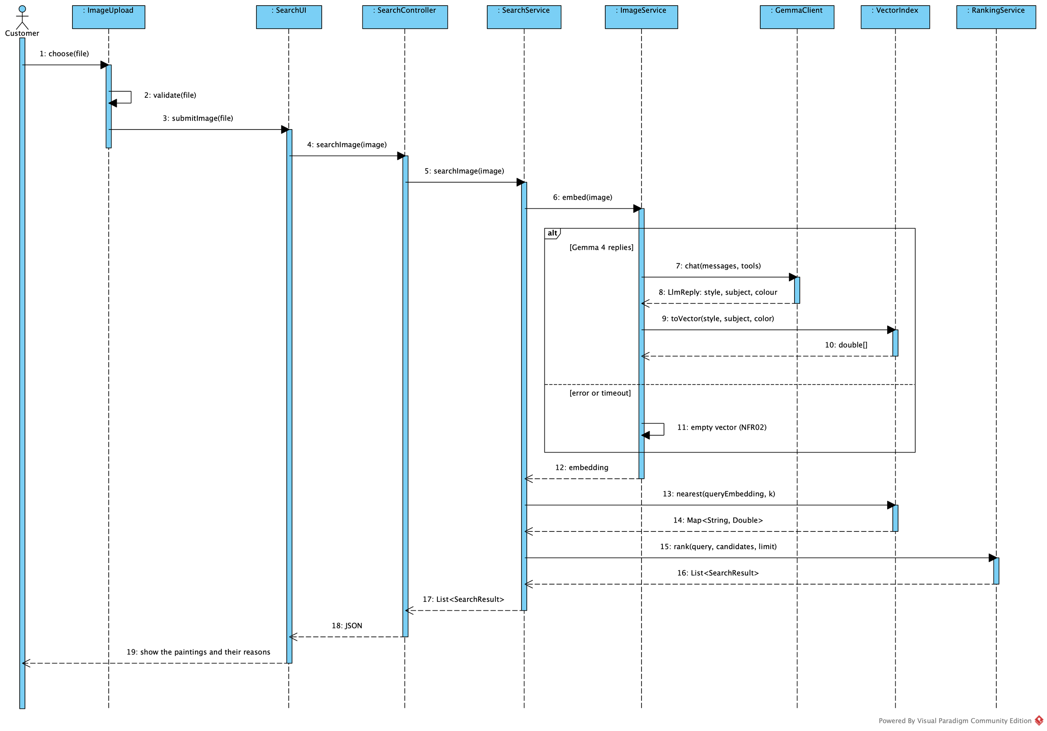
Họa. ▪ 03 AI IN E-COMMERCE
21 / 38
Search by image: describe it, then match it
01 ▪ DESCRIBE
Gemma 4 looks at the photo and describes it with three tags: style, subject and main colour.
VectorIndex.toVector(style, subject, color)
02 ▪ MATCH
Every painting in the shop carries the same three tags. The more tags it shares with the photo, the more alike they are.
VectorIndex.cosineSimilarity(a, b)
03 ▪ RANK
Text match counts 45 %, photo match 45 %, and being in stock 10 %. The best total comes first.
RankingService.rank(query, candidates, limit)
EXAMPLE ▪ THE GREAT WAVE → UKIYO-E ▪ SEASCAPE ▪ BLUE → SAME THREE TAGS = BEST MATCH
NO GEMMA ▪ THE PHOTO'S AVERAGE COLOUR IS USED INSTEAD
Notes:
Image search in three plain steps. One, describe: Gemma 4 looks at the photo and describes it with three tags, the style, the subject and the main colour. Two, match: every painting in the shop carries the same three tags, so the system counts how many tags a painting shares with the photo; the more they share, the more alike they are. In the code this comparison is the cosine similarity of Assignment 06, but you can think of it as counting shared tags. Three, rank: RankingService puts the candidates in order. Text match counts 45 percent, photo match 45 percent and being in stock 10 percent, as set in the configuration file, and the best total comes first. For example, a photo of The Great Wave is described as ukiyo-e, seascape, blue, and the painting with exactly those three tags comes first. If Gemma is not available, the photo's average colour is used instead, and the result is much weaker. The sequence diagram on the right shows the order of calls from ImageUpload to RankingService.

Slide 22
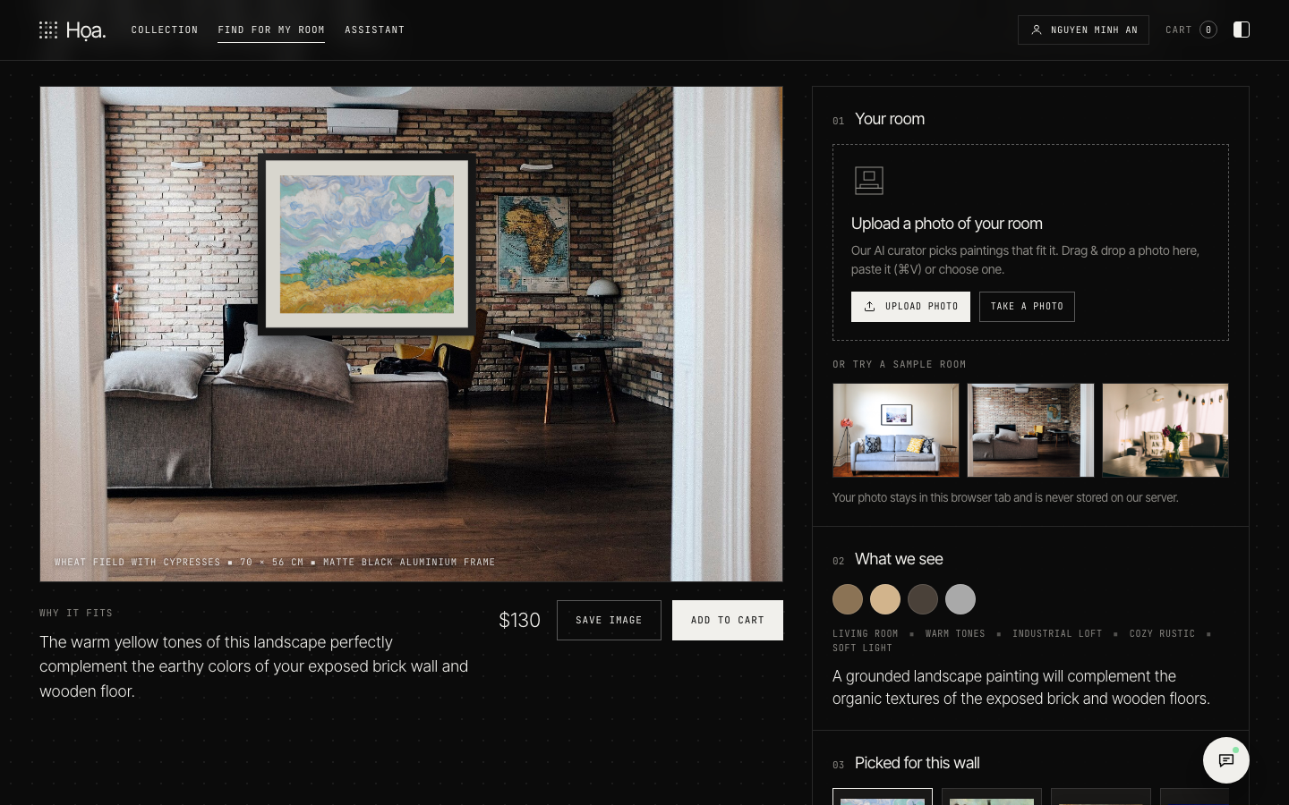
Họa. ▪ 03 AI IN E-COMMERCE
22 / 38
Try it in your room (UC14 Find Painting for My Room)
01 The customer uploads a photo of the room: RoomPreview.chooseRoom(file)
02 Gemma 4 reads its palette, style and mood: SearchService.describeRoom(image)
03 SearchService.searchRoom(image) shortlists the 12 closest paintings by cosine
04 Gemma 4 picks 3–5 and writes one “why it fits” sentence each (SearchResult.reason)
05 RoomPreview.placePainting(product) hangs the chosen painting on the wall
FR14 ▪ COULD ▪ THE SYSTEM SHALL SUGGEST PAINTINGS THAT SUIT A ROOM FROM A PHOTO OF THE ROOM AND LET THE CUSTOMER PREVIEW A PAINTING ON THE WALL.
DEMO SCREENSHOT ▪ TRY IT IN YOUR ROOM
Notes:
"Try it in your room" is use case UC14. The customer uploads a photo of their room, and Gemma 4 first reads it: the colours, the interior style, the mood and the light. SearchService.searchRoom then follows the two steps of Assignment 06. Retrieval: VectorIndex shortlists the twelve paintings closest to the suggested style, subject and colour by cosine similarity. Ranking: Gemma 4 sees the photo again with the shortlist, picks the three to five paintings that fit best and writes one sentence for each explaining why it fits, for example that its warm browns echo the wooden floor and the brick wall. If Gemma is unavailable, the vector ranking stays and the sentence is built from the painting's attributes. RoomPreview then hangs the chosen painting on the wall in the photo, so the customer can see how it would look. This requirement is a Could: it adds value to the experience but is not part of the core buying process.

Slide 23
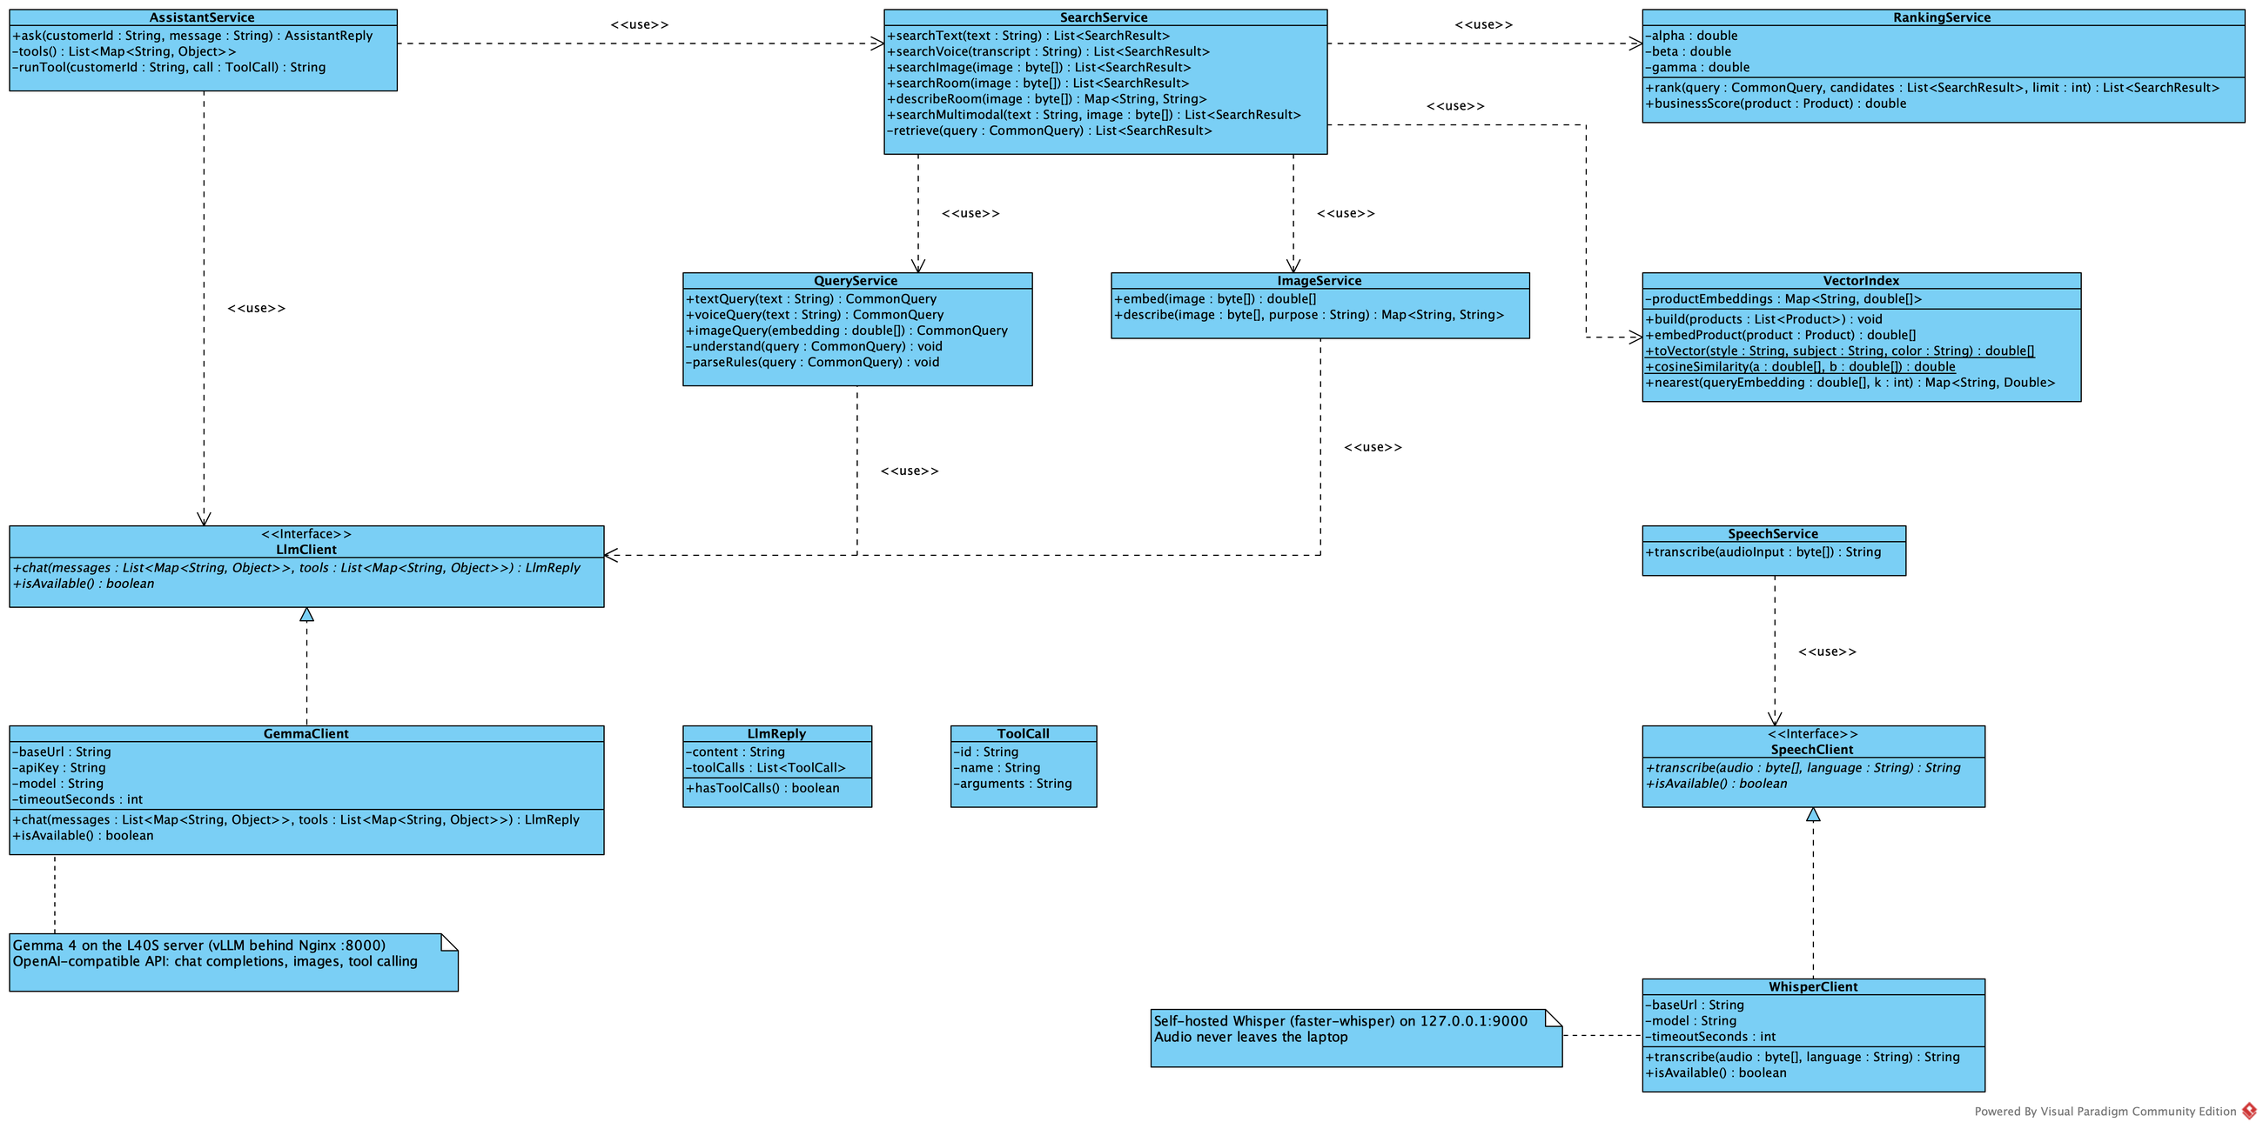
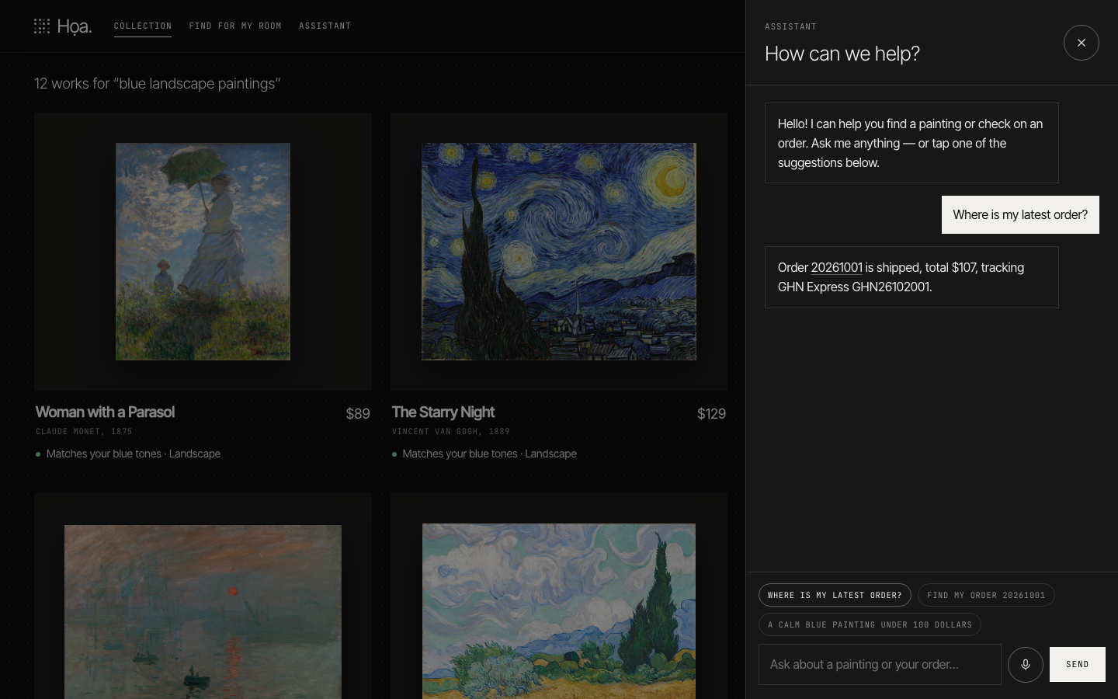
Họa. ▪ 03 AI IN E-COMMERCE
23 / 38
AI behind interfaces, always with a fallback
LlmClient ◁ GemmaClient ▪ SpeechClient ◁ WhisperClient
WHEN | WHAT Họa. DOES
Gemma fails or takes > 15 s | QueryService.parseRules: keyword rules
Whisper is not running | transcribe returns null; the customer types
Image not JPEG/PNG/WebP or > 5 MB | Rejected before Gemma is called
Gemma misreads the request | AI only builds filters; paintings, prices, stock come from the database
Someone asks for another's order | OrderService checks ownership against the session
SCREENSHOT: SEARCH STILL WORKS WITH GEMMA OFF
Notes:
Architecturally, every use of AI goes through an interface: LlmClient for Gemma and SpeechClient for Whisper. This makes it possible to swap the model, or use a fake one in tests. The table on the right lists how Họa. reacts when AI fails: if Gemma fails or takes more than 15 seconds, search falls back to keyword rules; if Whisper is down, the customer types; images of the wrong type or size are rejected before Gemma is called; AI only builds filters and never decides prices or stock; order access is always checked on the server.

Slide 24
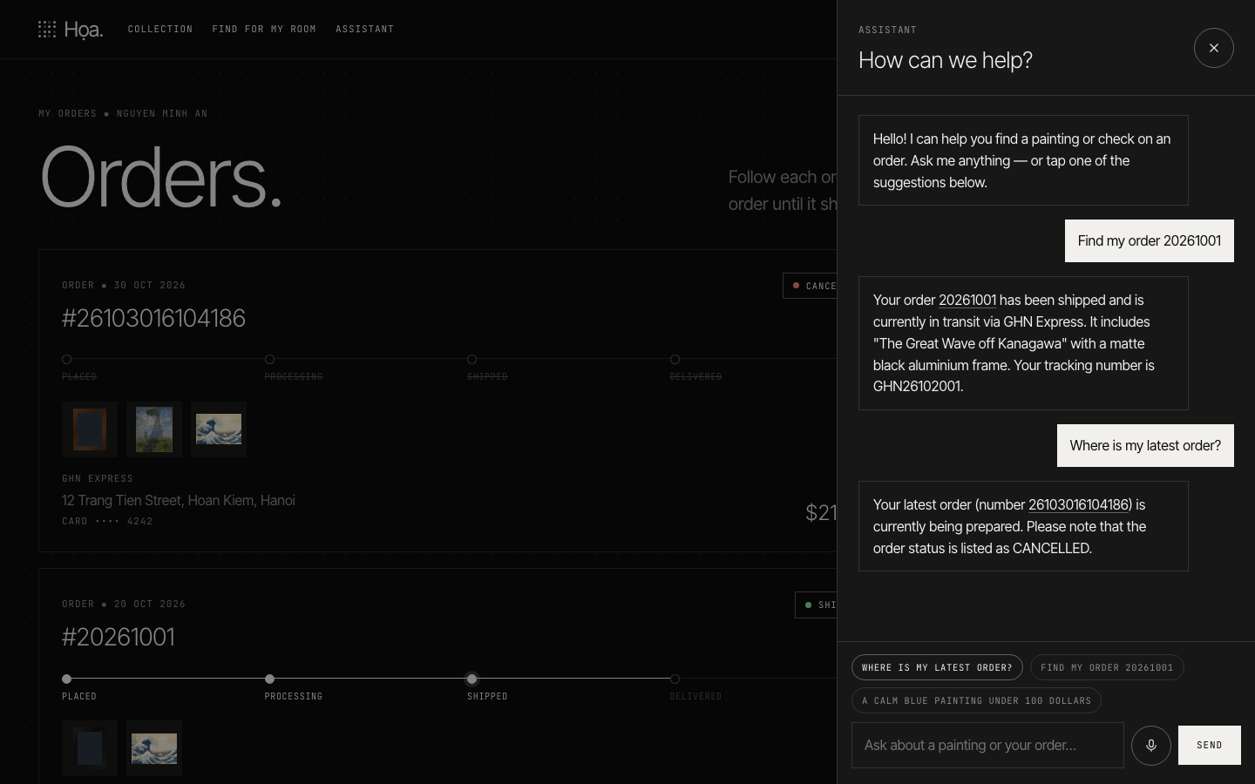
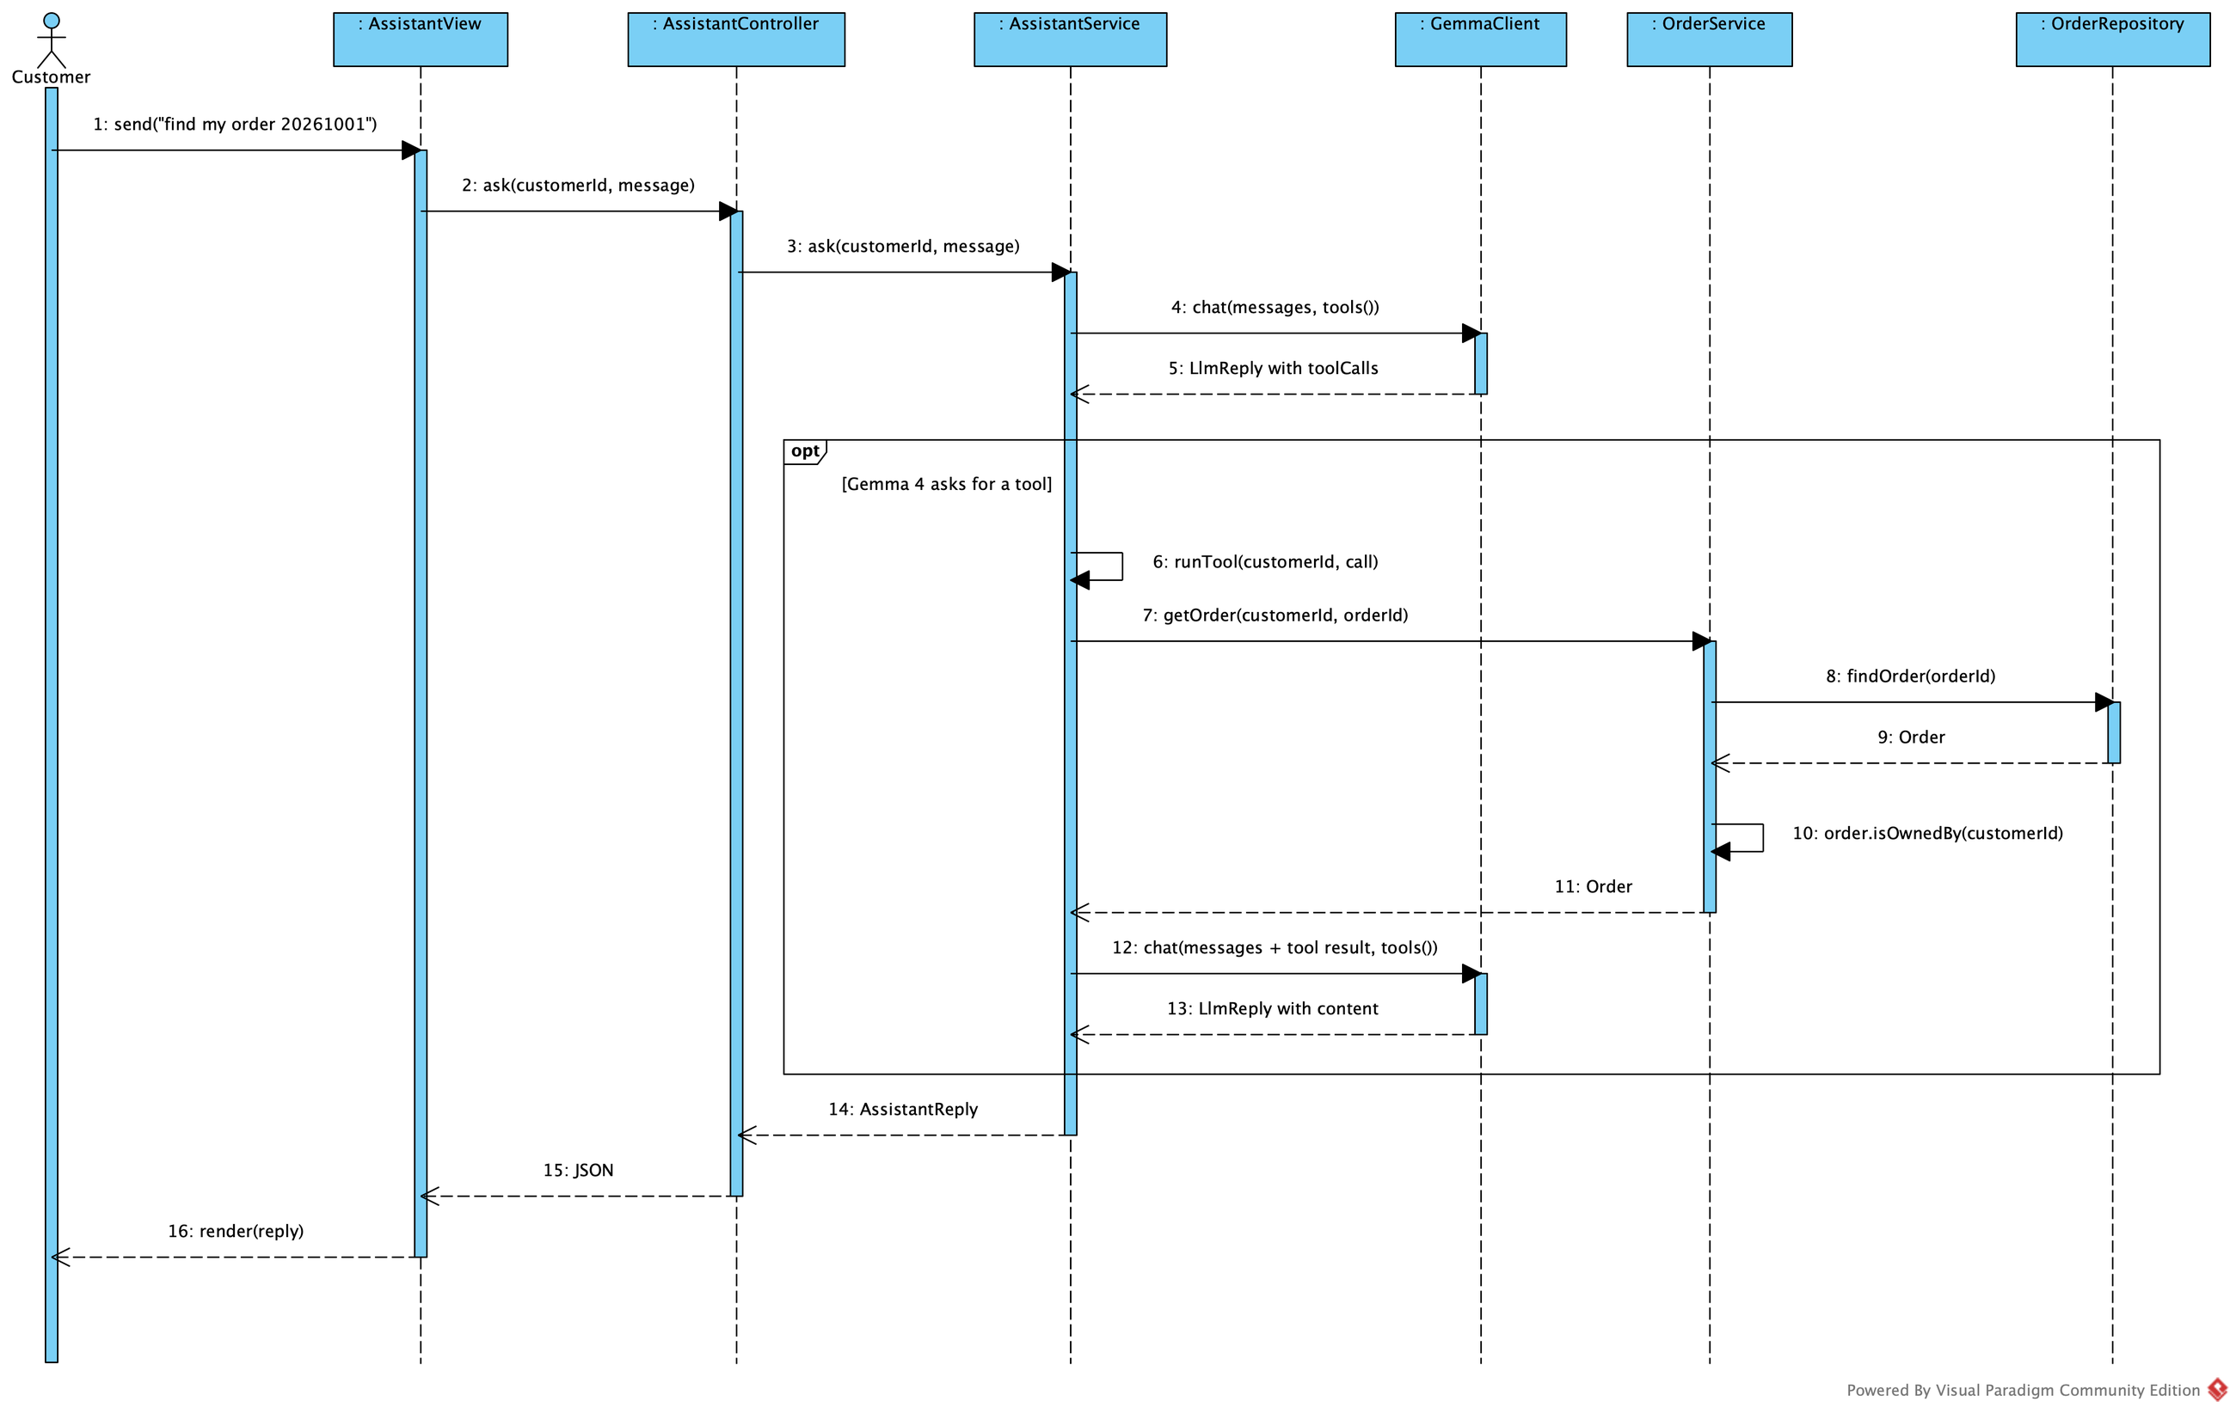
Họa. ▪ 03 AI IN E-COMMERCE
24 / 38
Curator assistant: Gemma picks the tool
AssistantService.ask(customerId, message) sends the question with tools()
Gemma 4 picks a tool; AssistantService.runTool(customerId, call) runs it for the session's customer
Ask by text or by voice (Whisper); answers are text only
Notes:
The curator assistant uses Gemma 4 tool calling. AssistantService sends the question together with the list of tools — search paintings and look up orders. Gemma chooses a tool and its arguments; runTool executes it with the customer id taken from the session, not from the question, so a customer can never retrieve someone else's order. The result goes back to Gemma, which writes the answer. Customers can ask by text or by voice through Whisper; the assistant answers in text.

Slide 25
Họa. ▪ 03 AI IN E-COMMERCE
25 / 38
Evaluation as required by A06
WITH GEMMA 4
WITHOUT GEMMA (OFFLINE RULES)
DEMO QUERIES (MATCHING A06)
100%
100%
Họa. | ASSIGNMENT A06
blue landscape paintings | black running shoes
Monet paintings under 100 dollars | find Nike shoes under 100 dollars
show me paintings similar to this image | show me products similar to this image
find my order 20261001 | find my order 20261001
where is my latest order? | where is my latest order?
100%
93%
93%
83%
75%
67%
67%
50%
12%
0%
TEXT, DIRECT
N = 14
TEXT, PARAPHRASED
N = 6
VOICE (WHISPER)
N = 12
IMAGE
N = 8
ASSISTANT
N = 7
REPORTED: QUERIES, SUCCESSES, RATE, FAILURE EXAMPLES (build/eval/)
HIT@1 = TOP RESULT IS RELEVANT ▪ ASSISTANT = ANSWER CORRECT ▪ VOICE: NO OFFLINE RUN ▪ ONE RUN, SMALL SETS, GEMMA VARIES BETWEEN RUNS
Notes:
Assignment 06 asks for an evaluation on a small set of queries: the number of queries, the number of successes, the rate and examples of failures. I ran the demo twice on the same sets: once with Gemma 4 online and once with Gemma switched off, so the offline keyword rules answer alone. The chart shows the result honestly. On text queries Gemma and the rules tie: 93 percent on direct requests and 67 percent on paraphrased ones, so on this small catalogue Gemma does not beat the rules. The clear gain is image search: 75 percent with Gemma against 12 percent with the local colour reader. The voice pipeline reaches 83 percent with a word error rate of about 4 percent, and the assistant answers all seven questions correctly without leaking any other customer's data. These are one run on small sets, and Gemma's results vary a little between runs, so I read them as indications, not proof. The table on the right lists the demo queries of Họa. next to the example queries of the assignment.

Slide 26
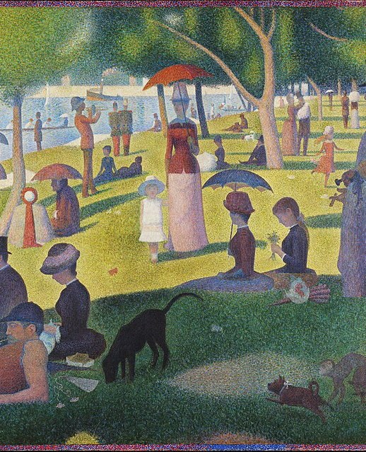
Họa. ▪ CHAPTER 04
26 / 38
CHAPTER 04
04
Design
Analysis says WHAT, design says HOW
LECTURE 05 ▪ FROM ANALYSIS TO DESIGN — OUTLINE 4.1–4.6
A SUNDAY ON LA GRANDE JATTE (1884) — GEORGES SEURAT ▪ PUBLIC DOMAIN
Notes:
Chapter 4 is the design, following Lecture 05 and the outline 4.1 to 4.6 given by the lecturer. Analysis says what the system needs; design says how the software realises it: design classes, the database, layers and packages, and finally the code.

Slide 27
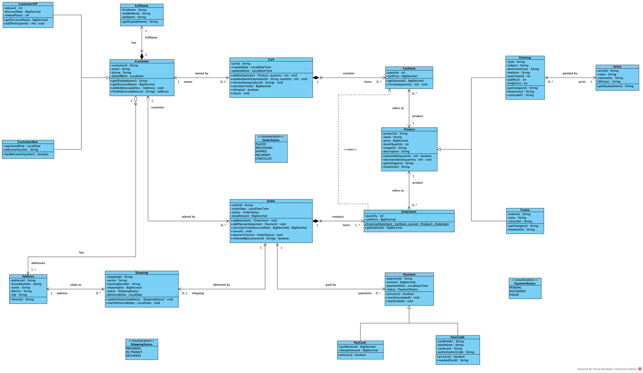
Họa. ▪ 04 DESIGN
27 / 38
From analysis classes (A04) to design classes (A05)
ANALYSIS | DESIGN (LECTURE) | Họa.
Cart, CartItem | Domain class | Cart.addItem, Cart.calculateTotal
CartItem → OrderItem | Domain class | OrderItem.fromCartItem(item, current)
checkout(Cart) | CheckoutService.checkout(cartID) | CheckoutService.checkout(cartId, customerId, addressId, payment)
Business interaction | Controller + Service | CheckoutController → CheckoutService
Persistence need | Repository | CartRepository, OrderRepository
Analysis model | Design class model | 17 analysis → 58 Java classes
Domain structure | Layered architecture | 3 layers, 14 packages
PACKAGE | DOMAIN CLASSES
customer | FullName, Address, Customer, CustomerVIP, CustomerNew
product | Product, Artist, Painting, Frame
cart | Cart, CartItem
order | OrderStatus, Order, OrderItem, ShippingStatus, Shipping
payment | PaymentStatus, Payment, PayCash, PayCredit
Notes:
This transformation table follows slide 22 of Lecture 05. The analysis classes Cart, CartItem, Order and OrderItem become domain classes with behaviour; checkout of a Cart at analysis level becomes CheckoutService.checkout at design level; the business interaction becomes a controller plus a service; the need to persist data becomes repositories. Besides the cartId of the lecture, my method also receives the customer id from the session to check ownership, the address and the payment method. On the right is the design class diagram with types, methods and navigability.

Slide 28
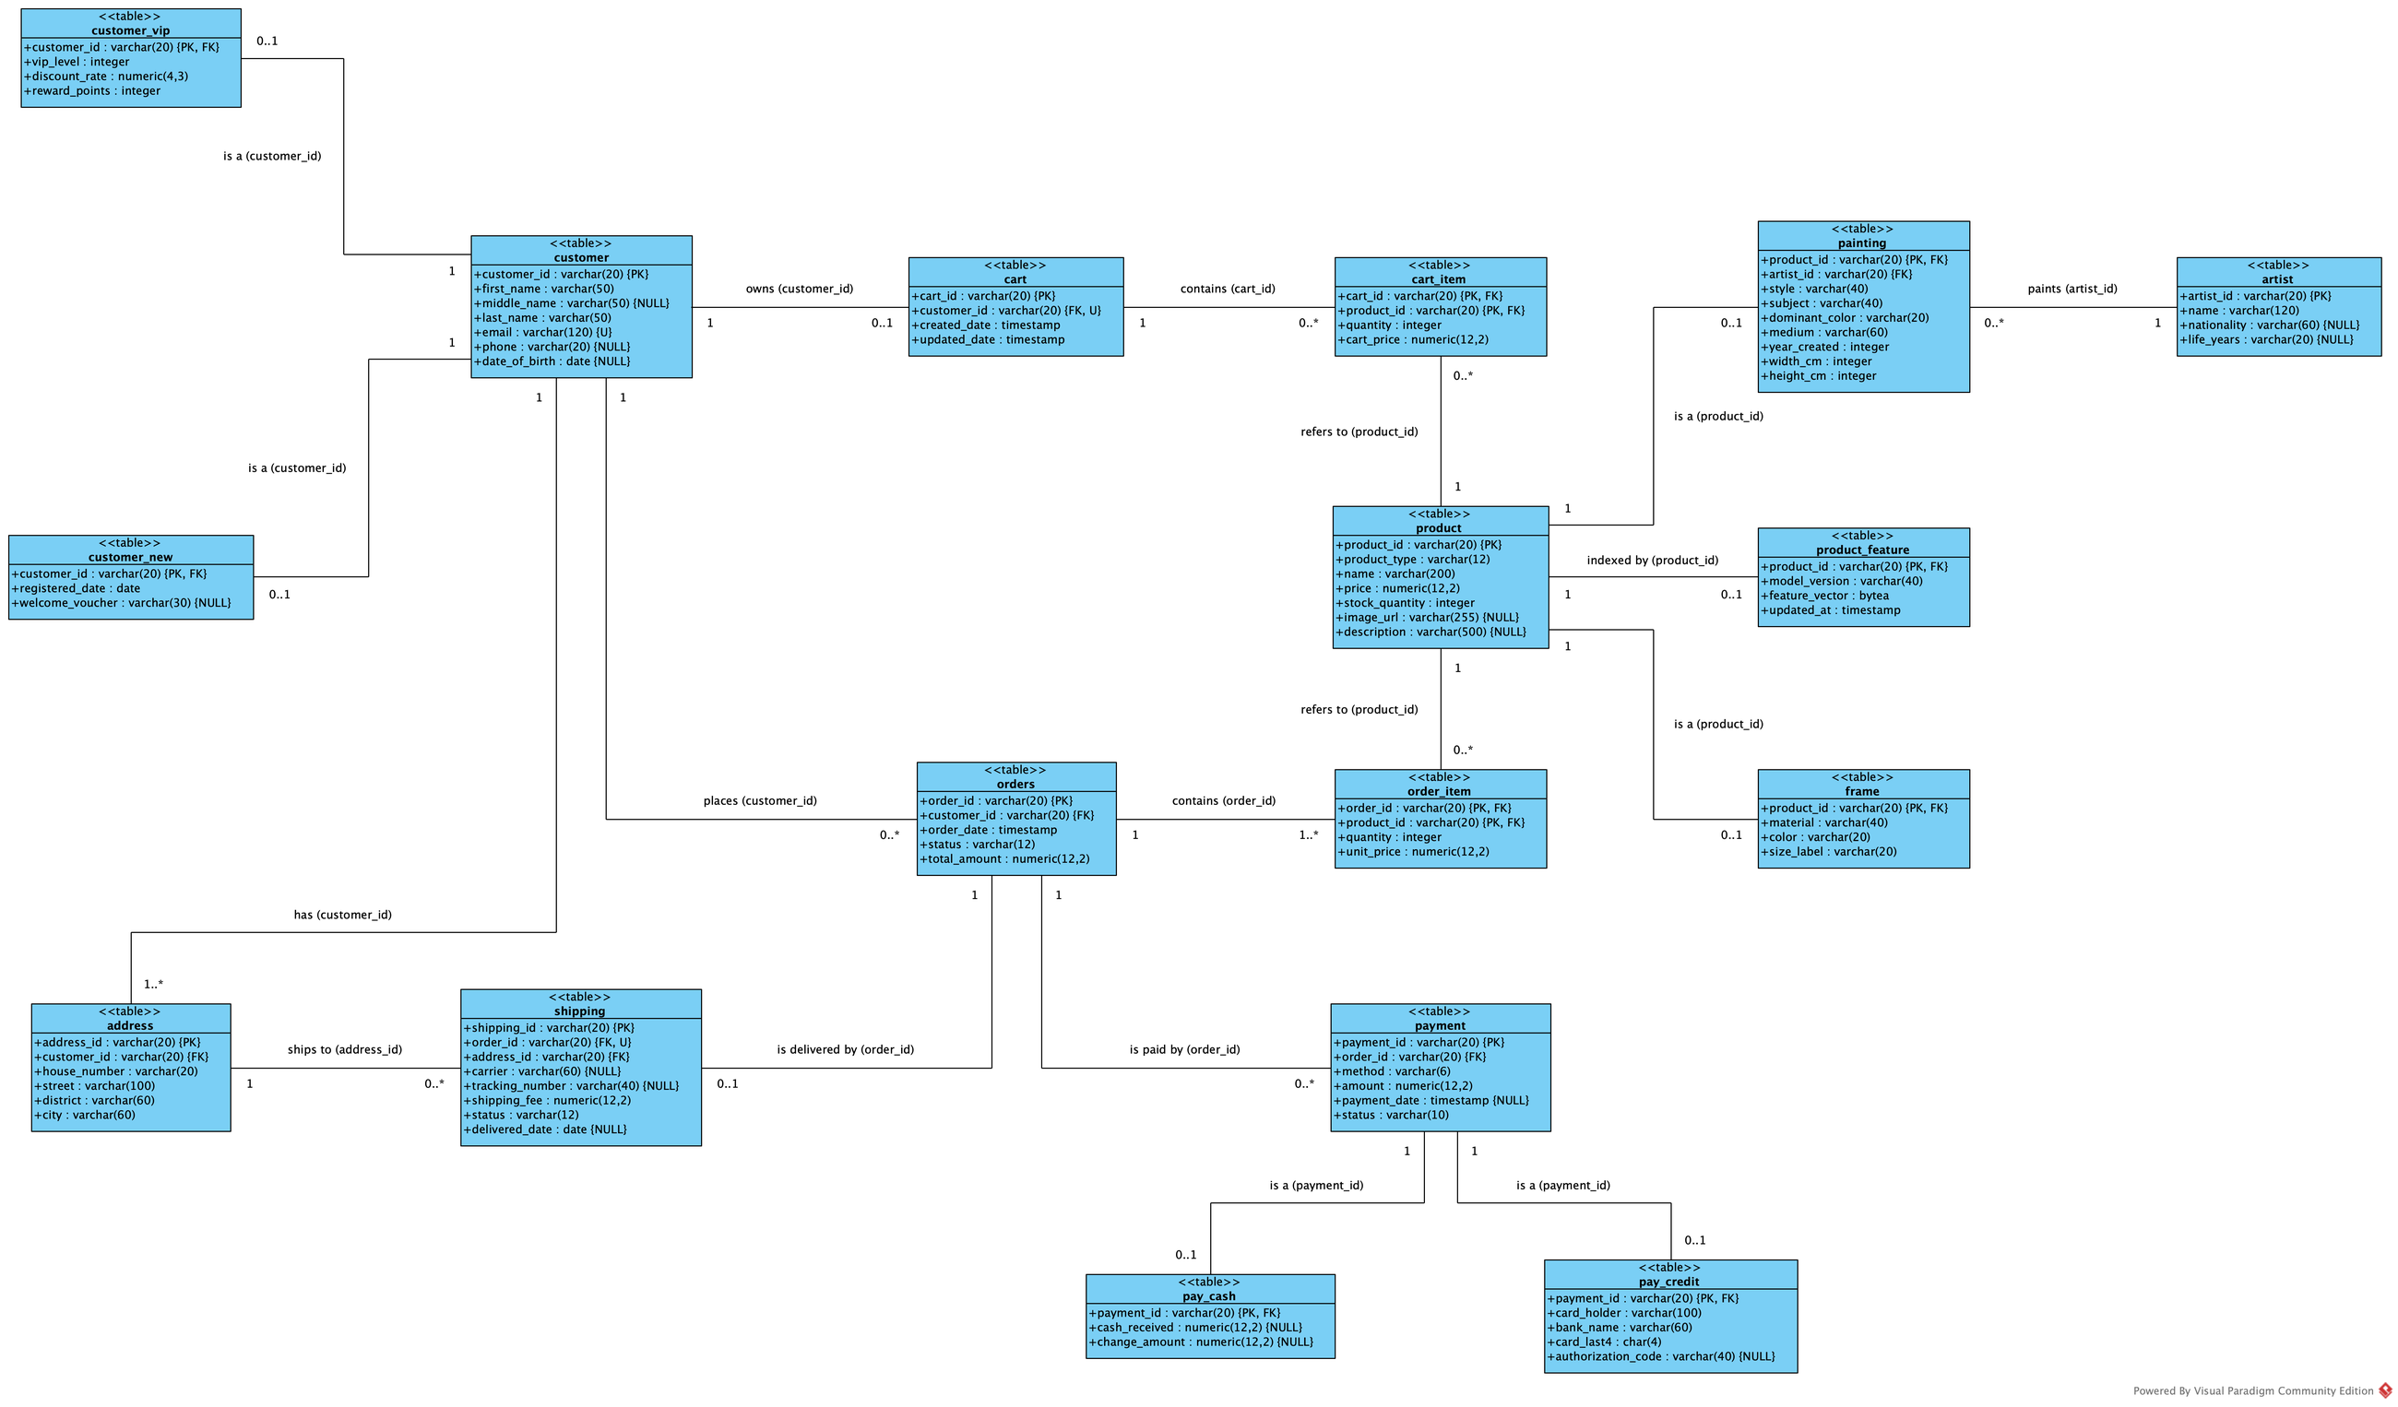
Họa. ▪ 04 DESIGN
28 / 38
Physical data model: tables, keys and types
DATA MODEL ▪ LEVEL 3 OF 3
CONCEPTUAL → LOGICAL → PHYSICAL
+ TABLES, COLUMNS, SQL TYPES, KEYS
Inheritance → the subclass table's PK is also its FK
1 – * → FK on the many side
1 – 0..1 → FK with UNIQUE
Composition → composite key, ON DELETE CASCADE
Money numeric(12,2), states CHECK … IN
NEXT: THE DATABASE (ERD)
Notes:
Section 4.2: the third level of the data model, the physical data model, is a design decision. The diagram on the left shows the tables with their columns, SQL data types, primary keys, foreign keys and unique constraints. The main mapping rules: inheritance becomes a subclass table whose primary key is also a foreign key; a one-to-many association puts the foreign key on the many side; a one-to-zero-or-one association adds a unique constraint; composition, such as cart lines and order lines, uses a composite primary key and cascading deletes; money is numeric with two decimals and states are checked against their allowed values. The next slide draws the database itself.

Slide 29
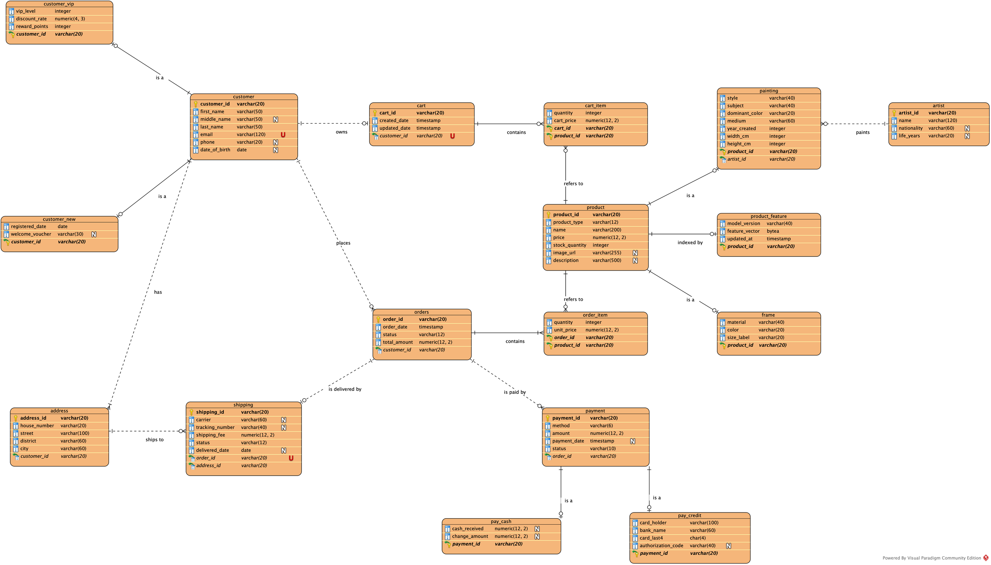
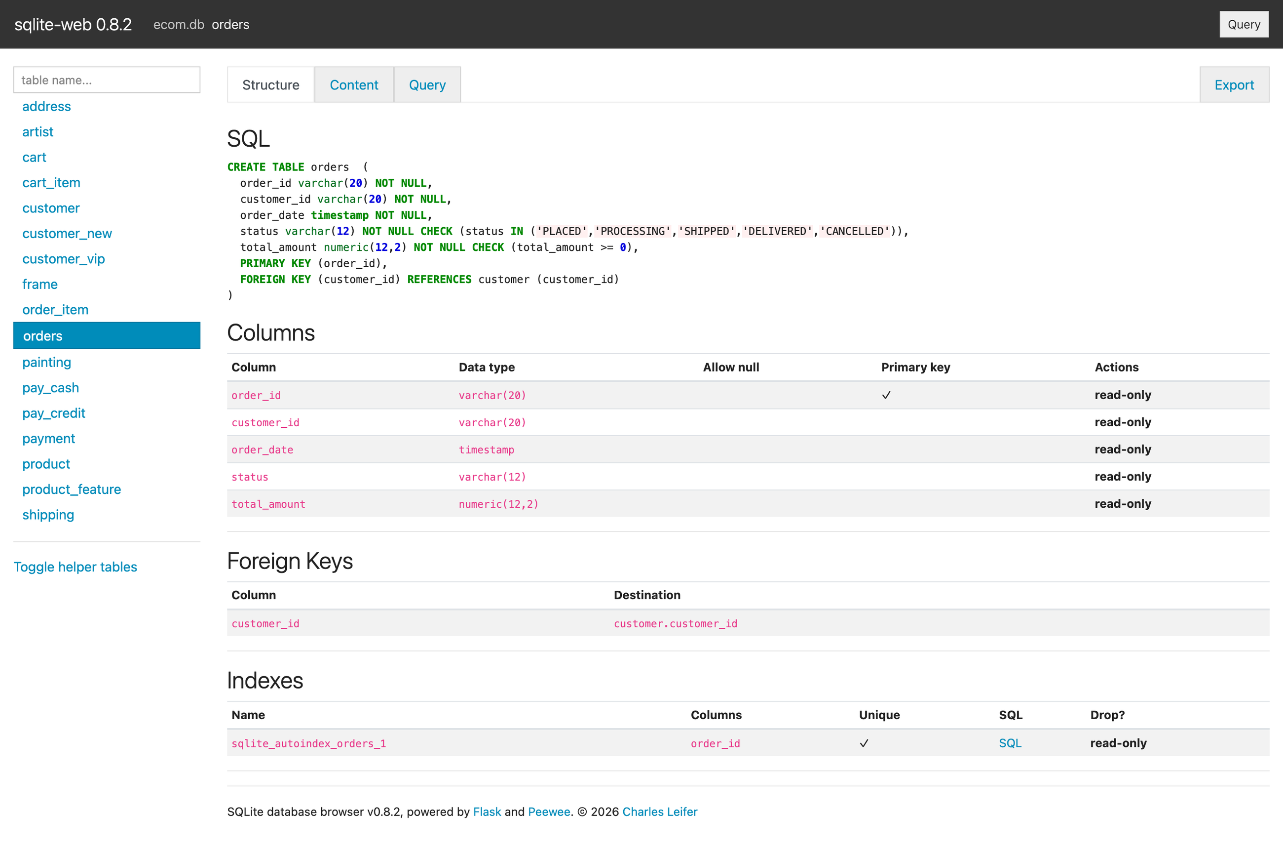
Họa. ▪ 04 DESIGN
29 / 38
Database: the ERD of the physical data model
VISUAL PARADIGM ERD
Same tables and places as the physical model
Key icon: primary key; key with link: foreign key
N: may be empty ▪ U: unique
Crow's foot: 1, 0..1, 0..*, 1..*
COPY SCREEN OF DB ▪ ecom.db
Notes:
Still in Section 4.2: from the physical data model I draw the database as an entity relationship diagram in Visual Paradigm — the orange tables. It follows the physical model table by table, on the same grid. Every table lists all its columns with their types; the key icon marks the primary key, a key with a link marks a foreign key, N marks a column that may be empty and U a unique column. Each foreign key is a relationship with its name and crow's-foot ends: one, zero or one, zero or many, one or many. The screenshot on the right is the real SQLite database of the demo, generated from the same model — the "copy screen of DB" the lecturer asked for.

Slide 30
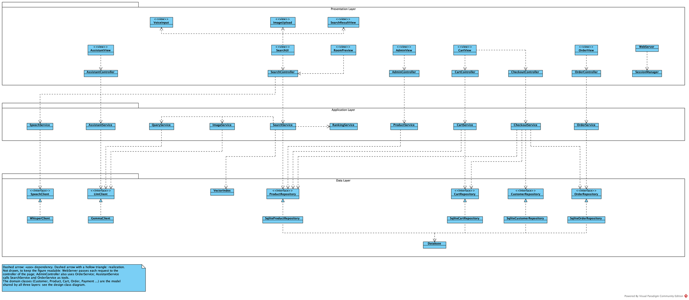
Họa. ▪ 04 DESIGN
30 / 38
Three layers, and the classes inside are linked
PRESENTATION
APPLICATION
DATA
DOMAIN MODEL
Views, controllers, web server
Shop services, search and AI services
Repositories, SQLite, vector index, AI clients
Shared by all three layers
Notes:
Section 4.4: Họa. uses the three-layer architecture of Assignment 06 — presentation, application and data — and each layer is drawn with its classes inside. Inside the presentation layer a view calls the controller of its feature and the web server asks the session who the customer is; inside the application layer the search service coordinates the query, image and ranking services; inside the data layer each SQLite repository implements its interface and uses the database, and the Gemma and Whisper clients implement the AI interfaces. Between layers the arrows only go down: controllers call services, services call repositories and AI interfaces. The domain classes are not a layer: they are the model shared by all three layers. The UI never touches the database, and services depend only on interfaces, so the database or the AI can be replaced.

Slide 31
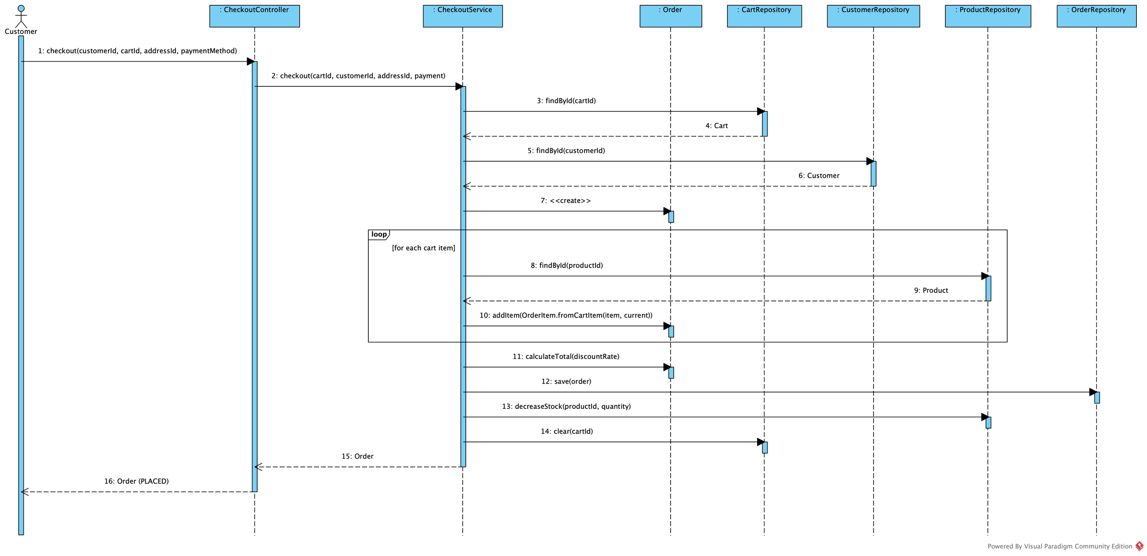
Họa. ▪ 04 DESIGN
31 / 38
Checkout across the layers (Lecture 05)
CheckoutController → CheckoutService.checkout(cartId, customerId, addressId, payment) → Cart, Order (domain)
→ CartRepository, OrderRepository, ProductRepository
THE SERVICE COORDINATES; CART.ADDITEM AND ORDER.CALCULATETOTAL LIVE IN THE DOMAIN — NO “GOD CLASS”
Notes:
This is the checkout sequence across the layers — the central example of Lecture 05. The controller receives the request and CheckoutService coordinates: it reads the cart, checks stock, creates the Order and its OrderItems, saves the order, reduces stock and empties the cart. Business rules such as adding a cart line or computing the total live in the domain classes Cart and Order rather than in the service, which avoids the "God class" the lecture warns about.

Slide 32
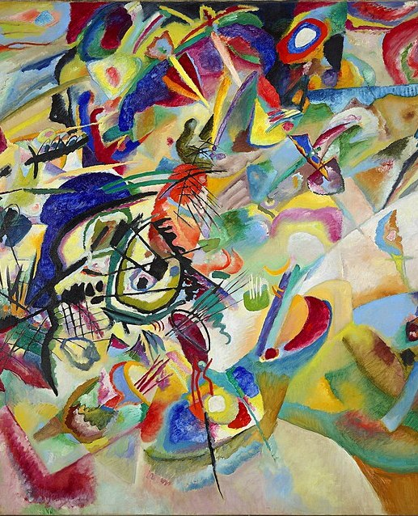
Họa. ▪ CHAPTER 05
32 / 38
CHAPTER 05
05
Code
From model to running code, name for name
JAVA ▪ SQLITE ▪ HTML/CSS/JS ▪ PYTHON (WHISPER SERVER)
COMPOSITION VII (1913) — WASSILY KANDINSKY ▪ PUBLIC DOMAIN
Notes:
Chapter 5 is the code. The goal is not only that it runs, but that it matches the model name for name: classes, methods, parameters, tables and columns in the code are identical to the specification.

Slide 33
Họa. ▪ 05 CODE
33 / 38
Course code ↔ Họa. code
LECTURE CODE (A05, A06) | Họa. (JAVA) | PACKAGE
product_repository.py: all_products() | ProductRepository.allProducts() | infrastructure.repository
query_service.py: text_query, voice_query | QueryService.textQuery(text) | application.search
speech_service.py: transcribe(audio_input) | SpeechService.transcribe(audioInput) | application.search
search_service.py: search_text(query) | SearchService.searchText(text) | application.search
cosine_similarity(a, b) | VectorIndex.cosineSimilarity(a, b) | infrastructure.search
S = αStext + βSimage + γSbusiness | RankingService.rank(query, candidates, limit) | application.search
order_repository.py: find_order(order_id) | OrderRepository.findOrder(orderId) | infrastructure.repository
CheckoutService.checkout(cartID) : Order | CheckoutService.checkout(cartId, customerId, addressId, payment) | application.service
main.py | EcomApplication.main(args) | presentation.web
58 JAVA CLASSES ▪ 9 JS VIEWS ▪ 14 PACKAGES (FROM model.py)
TECHNOLOGY MAPPING (LECTURE 05): CONTROLLER → JAVA HTTP HANDLER ▪ REPOSITORY → JDBC ON SQLITE ▪ DATABASE → ecom.db
Notes:
This table maps the sample code of the course slides to the code of Họa. The Python code of Assignment 06 — all_products, text_query, transcribe, search_text, cosine_similarity, find_order — keeps its names following Java conventions, and so does CheckoutService.checkout from Lecture 05. The package column shows the layer of each class. The last line is the technology mapping of Lecture 05: a controller is a Java HTTP handler, a repository is JDBC on SQLite.

Slide 34
Họa. ▪ 05 CODE
34 / 38
Representative code and how it is verified
build/excerpts5/VectorIndex.java
01 ▪ MODEL ↔ CODE
public class VectorIndex {
// ...
/** One-hot vector: [10 styles | 8 subjects | 10 colours]; an unknown value l…
public static double[] toVector(String style, String subject, String color) {
double[] vector = new double[STYLES.length + SUBJECTS.length + COLORS.len…
mark(vector, 0, STYLES, style);
mark(vector, STYLES.length, SUBJECTS, subject);
mark(vector, STYLES.length + SUBJECTS.length, COLORS, color);
return vector;
}
// ...
/** cosine_similarity(a, b) of slide A06. */
public static double cosineSimilarity(double[] a, double[] b) {
double numerator = 0, normA = 0, normB = 0;
for (int i = 0; i < a.length; i++) {
numerator += a[i] * b[i];
normA += a[i] * a[i];
normB += b[i] * b[i];
}
double denominator = Math.sqrt(normA) * Math.sqrt(normB);
return denominator == 0 ? 0.0 : numerator / denominator;
}
// ...
tools/check_code_model.py: 58 Java classes, 162 fields, 184 operations, 26 view functions, 17 tables, 87 columns, 60 SQL statements -> all match the model
02 ▪ TESTS
61 automated tests pass, 0 fail (build/test_results.txt)
03 ▪ A06 EVALUATION
Image search Hit@1 75% with Gemma vs 12% offline; text 93%; assistant 100%
04 ▪ DATABASE
SQLite schema generated from the same specification: 17 tables
Notes:
On the left is a representative excerpt of the real code. On the right are the four ways I verify consistency: the check_code_model tool compares class, method, parameter, table and column names between the code and the specification, and reports that everything matches; sixty-one automated tests pass; the evaluation required by Assignment 06 gives the success rates you saw; and the SQLite schema is generated from the same specification. This is how the report, the diagrams and the code stay aligned.

Slide 35
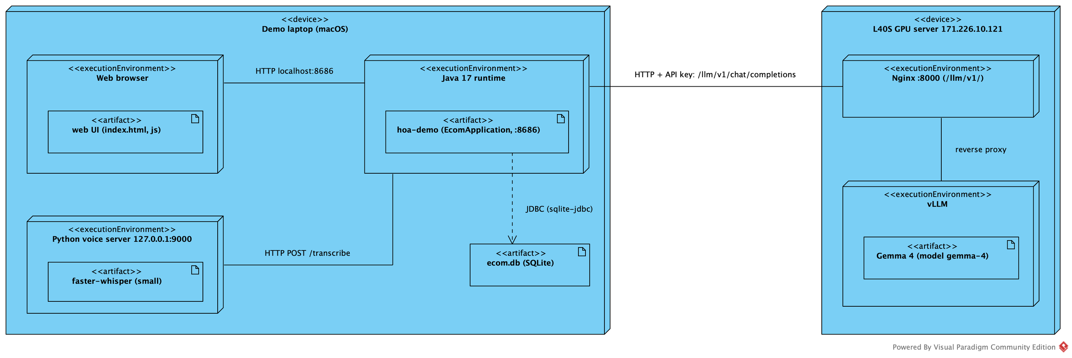
Họa. ▪ 05 CODE
35 / 38
Live demo script
01 Run demo/run.sh (it also starts Whisper); open http://localhost:8686 as C001
02 Type “blue landscape paintings”
03 Click the microphone, say “Monet paintings under 100 dollars”, fix the transcript if needed
04 Upload a photo: “show me paintings similar to this image”; then try a painting in a room
05 Add a painting and a frame to the cart → checkout → order PLACED
06 Ask the assistant: “find my order 20261001”, “where is my latest order?”
07 Cancel the new PLACED order; switch to C002, ask for order 20261001 → refused
08 Switch to ADMIN: change price and stock; move an order to SHIPPED
09 Set a wrong gemma.baseUrl and restart → search still works with keyword rules
DEPLOYMENT
LAPTOP: BROWSER ▪ JAVA :8686 ▪ ecom.db ▪ WHISPER :9000
L40S: NGINX :8000 ▪ vLLM GEMMA 4
ACCOUNTS: C001 (VIP) ▪ C002 ▪ ADMIN
Notes:
This is the script of the live demo. I search by text, by voice, by image and try a painting in a room; add a painting and a frame to the cart and check out; ask the assistant about orders; cancel an order; sign in as another customer to show that their order is refused; open the administration page to change price, stock and order status; and finally switch Gemma off to show that search still works. The diagram on the right is the deployment: everything runs on the laptop except Gemma 4, which runs on the L40S server.

Slide 36
Họa. ▪ CONCLUSION
36 / 38
Traceable from requirement to code
FR03
UC04
ACTIVITY
SEQUENCE
ImageService
.embed
VectorIndex
.cosineSimilarity
product_feature
TESTS
EVALUATION
LESSONS
LIMITATIONS AND NEXT STEPS
Understand the problem and the stakeholders before choosing technology
Analysis says what; design says how (A03 → A05)
AI is a component behind an interface, with a fallback
One shared specification keeps diagrams, database, code and report in sync
Payments are simulated; no real gateway yet
Small evaluation set; needs more real queries and customer photos
Personalised recommendations need interaction data and consent
Several machines would need a server database instead of SQLite
Notes:
To conclude, I kept one continuous trace: from requirement FR03 and use case UC04, through the activity and sequence diagrams, to the methods in the code, the database table and the test and evaluation results. The main lessons: understand the problem before choosing technology; analysis says what and design says how; AI is a component behind an interface with a fallback; and one shared specification keeps every artefact consistent. Limitations: payments are simulated and the evaluation set is still small.

Slide 37
Họa. ▪ Q&A
37 / 38
Questions & answers
THANK YOU FOR LISTENING
Họa.
Notes:
Thank you for listening. I am happy to answer your questions.

Slide 38
Họa. ▪ APPENDIX ▪ BACKUP
38 / 38
Folder map of tieuluan/
PATH | CONTENTS | USED IN | EXISTS
README.md | Folder map: where each chapter's files are | All | ✓
tools/model.py | Single specification: requirements, use cases, classes, tables | Ch. 1–5 | ✓
vp/ | Visual Paradigm project and the diagram builder plugin | Ch. 1–4 | ✓
figures/vp/ | Figures exported from VP (c1_… to c5_…) | Report, slides | ✓
demo/ | Họa. Java application: src, web, config, data | Ch. 5, demo | ✓
demo/voice-server/ | Self-hosted Whisper server (voice search) | Ch. 3 | ✓
demo/db/ | SQLite schema and sample data | Ch. 4.2 | ✓
figures/demo/ | Screenshots of the UI and the database | Report, slides | ✓
build/eval/ | A06 and voice evaluation results | Ch. 3 | ✓
build/excerpts5/ | Code excerpts for Chapter 5 | Ch. 5 | ✓
report/ | LaTeX essay, five chapters | Submission | ✓
slides/ | Script that builds this deck | Presentation | ✓
Notes:
Backup slide, for questions about where an artefact lives: each row is a folder of tieuluan, what it contains and the chapter that uses it. The last column shows whether the folder existed when the deck was built.

