Slide 1

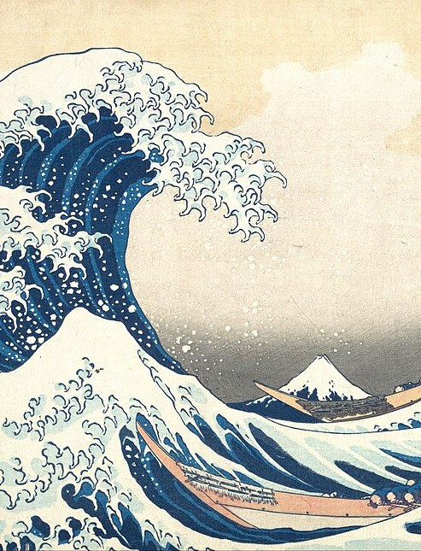

Họa. ▪ TERM ESSAY
01 / 34
Họa.
From requirements to running code.
Analysis and design of a painting shop with multimodal search, Gemma 4 and Whisper
INFORMATION SYSTEM ANALYSIS AND DESIGN ▪ CLASS 04
VŨ HÙNG ANH — B23DCDT022
THE GREAT WAVE OFF KANAGAWA (1831) — KATSUSHIKA HOKUSAI ▪ PUBLIC DOMAIN
Notes:
Good morning. Our group presents the term essay for Information System Analysis and Design, titled "From requirements to running code". Throughout the talk we use one concrete product, Họa., an online painting shop with multimodal search: customers find a painting by typing, by speaking or by uploading a photo. It has a shopping assistant powered by Gemma 4 and speech recognition by Whisper running on the laptop itself. The talk follows the content of the course, and every concept is illustrated with an example taken from Họa.

Slide 2
Họa. ▪ CONTENTS
02 / 34
One system, five perspectives
01
02
03
04
05
Requirement Determination
Analysis
AI in e-commerce
Design
Code
What must the system do, and for whom?
How does it behave, which concepts does it manage?
How does AI help a customer find the right painting?
How does the software realise the model?
From model to running code, name for name
LECTURES 01–02
LECTURES 03–04
A06 ▪ GEMMA 4
LECTURE 05
LIVE DEMO
THE THREAD OF THE COURSE (LECTURE 01, SLIDE 32)
PROBLEM → NEED → REQUIREMENT → USE CASE → BEHAVIOUR → DOMAIN MODEL → DESIGN → CODE
Notes:
The talk has five parts, matching the five chapters of the essay: requirement determination from Lectures 01 and 02, analysis from Lectures 03 and 04, AI in e-commerce from Assignment 06, design from Lecture 05, and finally the code with a live demo. The line at the bottom is the thread our lecturer draws in Lecture 01: from a business problem to a stakeholder need, a requirement, a use case, behaviour, a domain model, a design and finally code. Each part of the talk is one link of that chain.

Slide 3
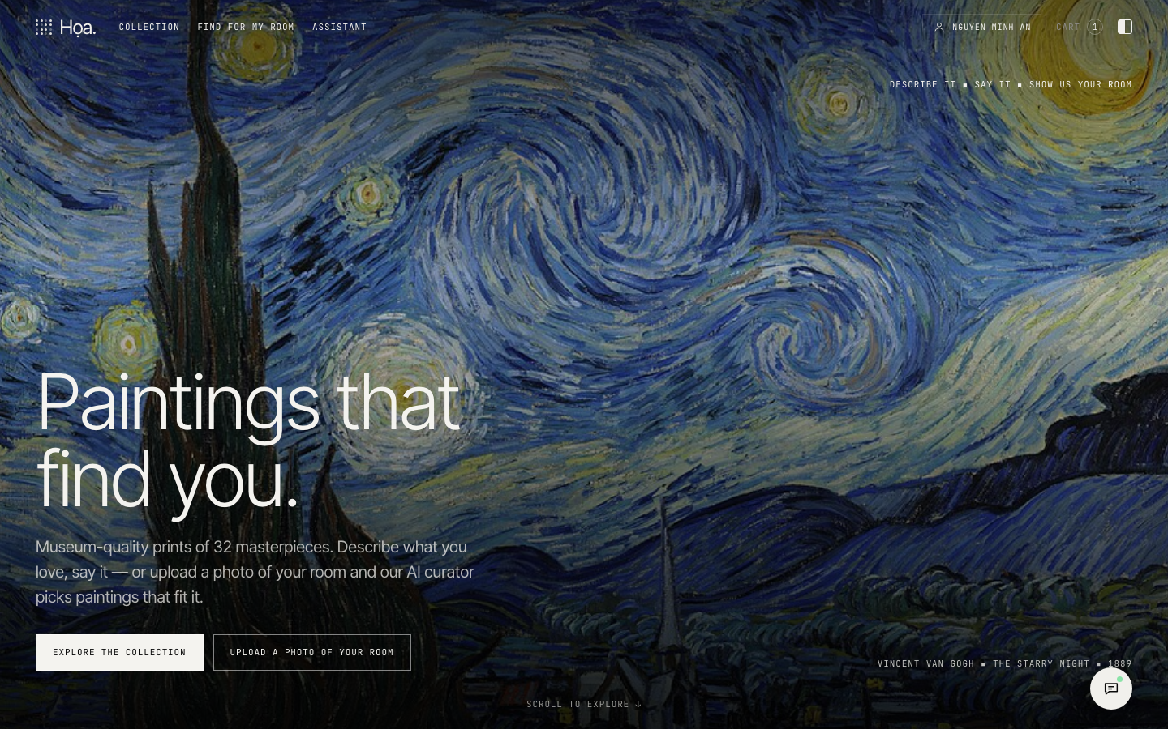
Họa. ▪ PRODUCT
03 / 34
Họa. — a painting shop that listens and sees
Sells prints of 32 public-domain masterpieces and matching frames, priced in USD.
Search by text, voice or photo
Try a painting on a photo of your own room
Curator assistant: ask about paintings and orders
Cart → checkout → track or cancel orders
Administration: paintings, prices, stock, order status
JAVA ▪ SQLITE ▪ HTML/CSS/JS ▪ GEMMA 4 ▪ WHISPER
22 REQUIREMENTS ▪ 14 USE CASES
58 JAVA CLASSES ▪ 17 TABLES
DEMO SCREENSHOT ▪ HOME PAGE
Notes:
Họa. sells prints of public-domain masterpieces, with images from Wikimedia Commons, together with frames, priced in US dollars. Besides the usual e-commerce functions — cart, checkout, order tracking and cancellation — the shop has five AI features that we present in Chapter 3. The numbers at the bottom, requirements, use cases, Java classes and tables, are read directly from the shared specification file of the project, so they always match the report and the code.

Slide 4
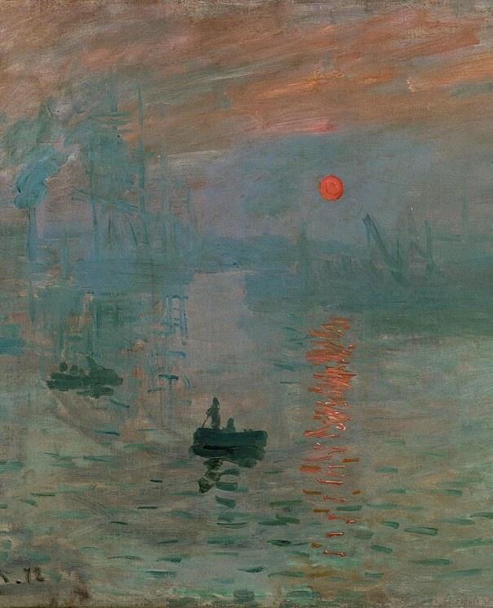
Họa. ▪ CHAPTER 01
04 / 34
CHAPTER 01
01
Requirement
Determination
Understand the business first, then write the requirements
LECTURE 01 ▪ BUSINESS INVESTIGATION — LECTURE 02 ▪ REQUIREMENTS ENGINEERING
IMPRESSION, SUNRISE (1872) — CLAUDE MONET ▪ PUBLIC DOMAIN
Notes:
Chapter 1 answers the question: what must the system do, and for whom? Lecture 01 says we must understand the business first: its people, processes, information and problems. Lecture 02 turns that understanding into functional and non-functional requirements, actors and use cases.

Slide 5
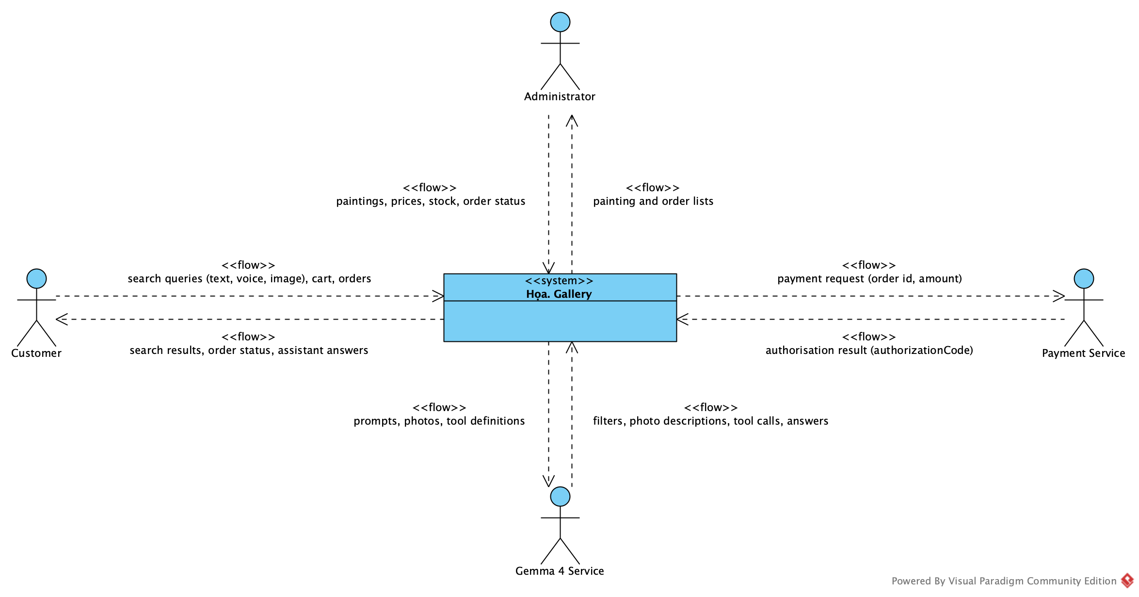
Họa. ▪ 01 REQUIREMENT DETERMINATION
05 / 34
Understand the business before drawing diagrams
INFORMATION SYSTEM = PEOPLE + PROCESSES + DATA + TECHNOLOGY
PEOPLE
PROCESSES
Customers, administrator, warehouse and delivery
Search → cart → checkout → delivery, cancellation
DATA
TECHNOLOGY
Paintings, artists, carts, orders, payments
Java, SQLite, Gemma 4, Whisper
STAKEHOLDER | GOAL | INFORMATION NEED
Customer | Find and buy paintings they like | Paintings, prices, stock, order status
Administrator | Manage paintings and orders | Prices, stock, pending orders
Warehouse, delivery | Ship the right painting to the right place | Order details, addresses
Support staff | Answer customers quickly | Customer order history
Notes:
Lecture 01 stresses that an information system is not just software: it is people, processes, data and technology. For Họa., the people are customers, the administrator, the warehouse and support staff; the main process is search, cart, checkout, delivery and cancellation. The table on the left is the stakeholder analysis in the lecture's format: the goal of each stakeholder and the information they need. The diagram on the right is the context view: it fixes the boundary of the Họa. Gallery system and its external entities — customer, administrator, payment service and the Gemma 4 service.

Slide 6
Họa. ▪ 01 REQUIREMENT DETERMINATION
06 / 34
From business problem to system requirement
01 ▪ PROBLEM
02 ▪ ROOT CAUSE
03 ▪ NEED
04 ▪ REQUIREMENT
05 ▪ USE CASE
Business problem
Root cause
Stakeholder need
FR03 ▪ Should
UC04 Search by Image
Customers like a painting but do not know its title or artist.
Search matches exact keywords only; images are hard to put into words.
Find a painting from a natural sentence, the voice or a photo.
The system shall return the paintings most similar to a photo uploaded by the customer, ranked by similarity.
Primary actor Customer; supporting actor Gemma 4 Service.
NEED ≠ SOLUTION — “USE GEMMA” IS A SOLUTION, NOT A REQUIREMENT
PATTERN (LECTURE 02): THE SYSTEM SHALL + ACTION + OBJECT + CONDITION
Notes:
This is the central chain of Lectures 01 and 02. The business problem: customers like a painting but do not know its title or artist. The root cause: the old search only matches exact keywords. The stakeholder need: find a painting from a natural sentence, the voice or a photo. Only then do we write the system requirement FR03, in the pattern "the system shall plus action plus object plus condition", and the use case UC04 Search by Image. Note that "use Gemma" is a solution, not a requirement: a need is not an implementation.

Slide 7
Họa. ▪ 01 REQUIREMENT DETERMINATION
07 / 34
14 functional requirements, prioritised with MoSCoW
ID | REQUIREMENT | MOSCOW | USE CASE
FR01 | Search paintings by keyword or natural sentence | Must | UC02
FR02 | Search by voice | Should | UC03
FR03 | Search by image | Should | UC04
FR04 | Multimodal search combining text and image with weighted scores | Could | UC01
FR05 | View painting details | Must | UC05
FR06 | Manage the cart | Must | UC06
FR07 | Checkout | Must | UC07
ID | REQUIREMENT | MOSCOW | USE CASE
FR08 | View my orders and my latest order | Must | UC08
FR09 | Look up an order by id | Must | UC09
FR10 | AI shopping assistant | Should | UC10
FR11 | Cancel my order while it is not shipped yet | Should | UC11
FR12 | The administrator adds paintings and changes price and stock | Must | UC12
FR13 | The administrator moves an order PLACED → PROCESSING → SHIPPED → DELIVERED | Must | UC13
FR14 | Find a painting for my room | Could | UC14
FR: MUST 8 ▪ SHOULD 4 ▪ COULD 2 ▪ WON'T (THIS RELEASE): REAL PAYMENTS — THE PAYMENT SERVICE IS SIMULATED
Notes:
Here is the table of functional requirements in the format of Lecture 02: an identifier, a short description, a MoSCoW priority and the related use case. The Must requirements are the core of the shop: searching, viewing details, the cart, checkout, viewing and looking up orders, and administration. The advanced AI features, such as voice and image search or the assistant, are Should; trying a painting in your room and multimodal search are Could. Real payments are Won't for this release: the payment service is only simulated.

Slide 8
Họa. ▪ 01 REQUIREMENT DETERMINATION
08 / 34
Non-functional requirements must be measurable
NFR01 ▪ MUST
NFR02 ▪ MUST
NFR03 ▪ MUST
NFR04 ▪ MUST
Security
Fallback
Uploaded images
Layered architecture
The system shall take the identity from the signed-in session and check order ownership on the server.
The system shall still find paintings with keyword rules when the Gemma service fails or times out.
The system shall reject uploaded images that are not JPEG, PNG or WebP or are larger than 5 MB.
The system shall separate presentation, application, domain and infrastructure; the user interface shall not access the database directly.
NFR05 ▪ MUST
NFR06 ▪ SHOULD
NFR07 ▪ SHOULD
NFR08 ▪ MUST
Payment data
Runs offline on one machine
Performance
Voice privacy
The system shall not store full card numbers; only the last four digits and the authorisation code are kept.
The system shall run on one machine with a SQLite database and need the network only to call Gemma.
The system shall return text search results within 2 seconds on the demo data.
The system shall process audio on the local machine with self-hosted Whisper, never send audio outside, and transcribe a 5-second sentence within 3 seconds.
“THE SYSTEM SHALL BE FAST” → “The system shall return text search results within 2 seconds on the demo data” (NFR07)
Notes:
Lecture 02 warns about requirements like "the system shall be fast": they cannot be verified. Every non-functional requirement of Họa. has a measurable condition: text search within two seconds on the demo data, images of at most five megabytes in three formats, audio processed only on the laptop, order ownership checked on the server. Each of these requirements can therefore become a test case.

Slide 9
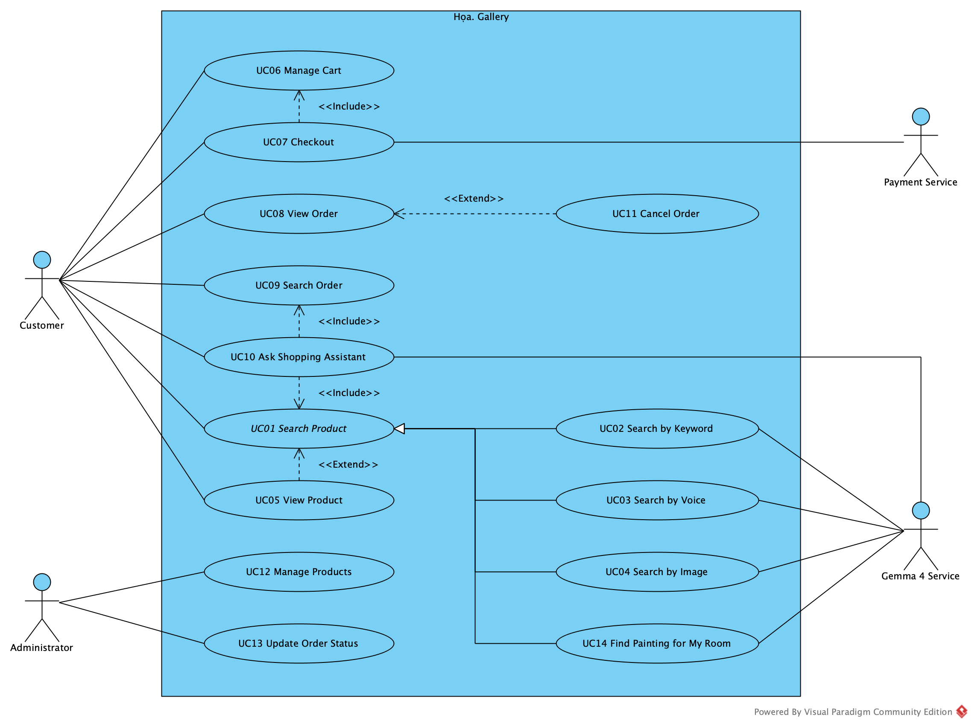
Họa. ▪ 01 REQUIREMENT DETERMINATION
09 / 34
A use case is a goal, not a button
4 ACTORS
Customer primary
Administrator primary
Gemma 4 Service supporting
Payment Service supporting
STAKEHOLDER ≠ ACTOR
Warehouse and support staff have a stake but do not use the system directly.
USE CASE = GOAL
“Click Search” ✗ Search Product ✓
FR03 → UC04 → SearchService.searchImage(image) → TEST
Notes:
The use case diagram shows all use cases and four actors. Customer and Administrator are primary actors; the Gemma 4 Service and the Payment Service are supporting actors that the system calls. Two points from Lecture 02: a stakeholder is not an actor — the warehouse or support staff have a stake but do not interact directly; and a use case is a goal, not a button — "Search Product", not "click search". The three search modes specialise Search Product, exactly as in the structure of Assignment 06. The last line is a trace from a requirement to a method and its test.

Slide 10
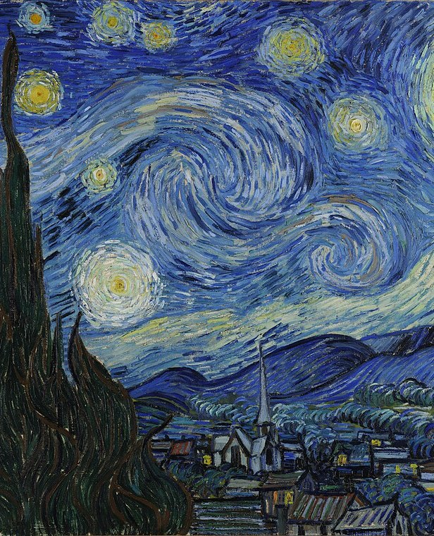
Họa. ▪ CHAPTER 02
10 / 34
CHAPTER 02
02
Analysis
How the system behaves, and which concepts it manages
LECTURE 03 ▪ FUNCTIONAL ANALYSIS — LECTURE 04 ▪ DOMAIN MODEL (A03)
THE STARRY NIGHT (1889) — VINCENT VAN GOGH ▪ PUBLIC DOMAIN
Notes:
Chapter 2 turns requirements into models. Lecture 03 asks how the system behaves when an actor performs a use case: scenarios, alternative flows and activity diagrams. Lecture 04, which is Assignment 03, asks which concepts the system must manage: the domain model and the analysis class diagram.

Slide 11
Họa. ▪ 02 ANALYSIS
11 / 34
Use case specification: Checkout (UC07)
ELEMENT | DESCRIPTION
Requirement | FR07 — Checkout: create an order from the cart, freeze prices, decrease stock, empty the cart
Primary actor | Customer
Supporting actor | Payment Service
Goal | Create a valid order from the cart
Trigger | The customer clicks “Place order” in the cart
Precondition | The customer is signed in; the cart has at least one line
Postcondition | A PLACED order is saved, stock is reduced, the cart is empty
MAIN FLOW
01 The system shows the cart lines and the total
02 The customer picks an address and a payment method
03 The system re-reads prices and checks stock
04 It creates the Order and OrderItems at frozen prices
05 It records the payment, reduces stock, empties the cart
ALTERNATIVE FLOWS
Painting out of stock → name it, create no order
Address not owned by the customer → choose again
Payment rejected → choose another method
Notes:
This is the Checkout use case specified with the template of Lecture 03: primary and supporting actors, goal, trigger, pre- and postconditions. The main flow has five steps. Our lecturer insists that the normal flow is not enough, so we also list alternative flows: a painting out of stock, an address that does not belong to the customer, a rejected payment. Each alternative flow later becomes a decision in the activity diagram and a check in the code.

Slide 12
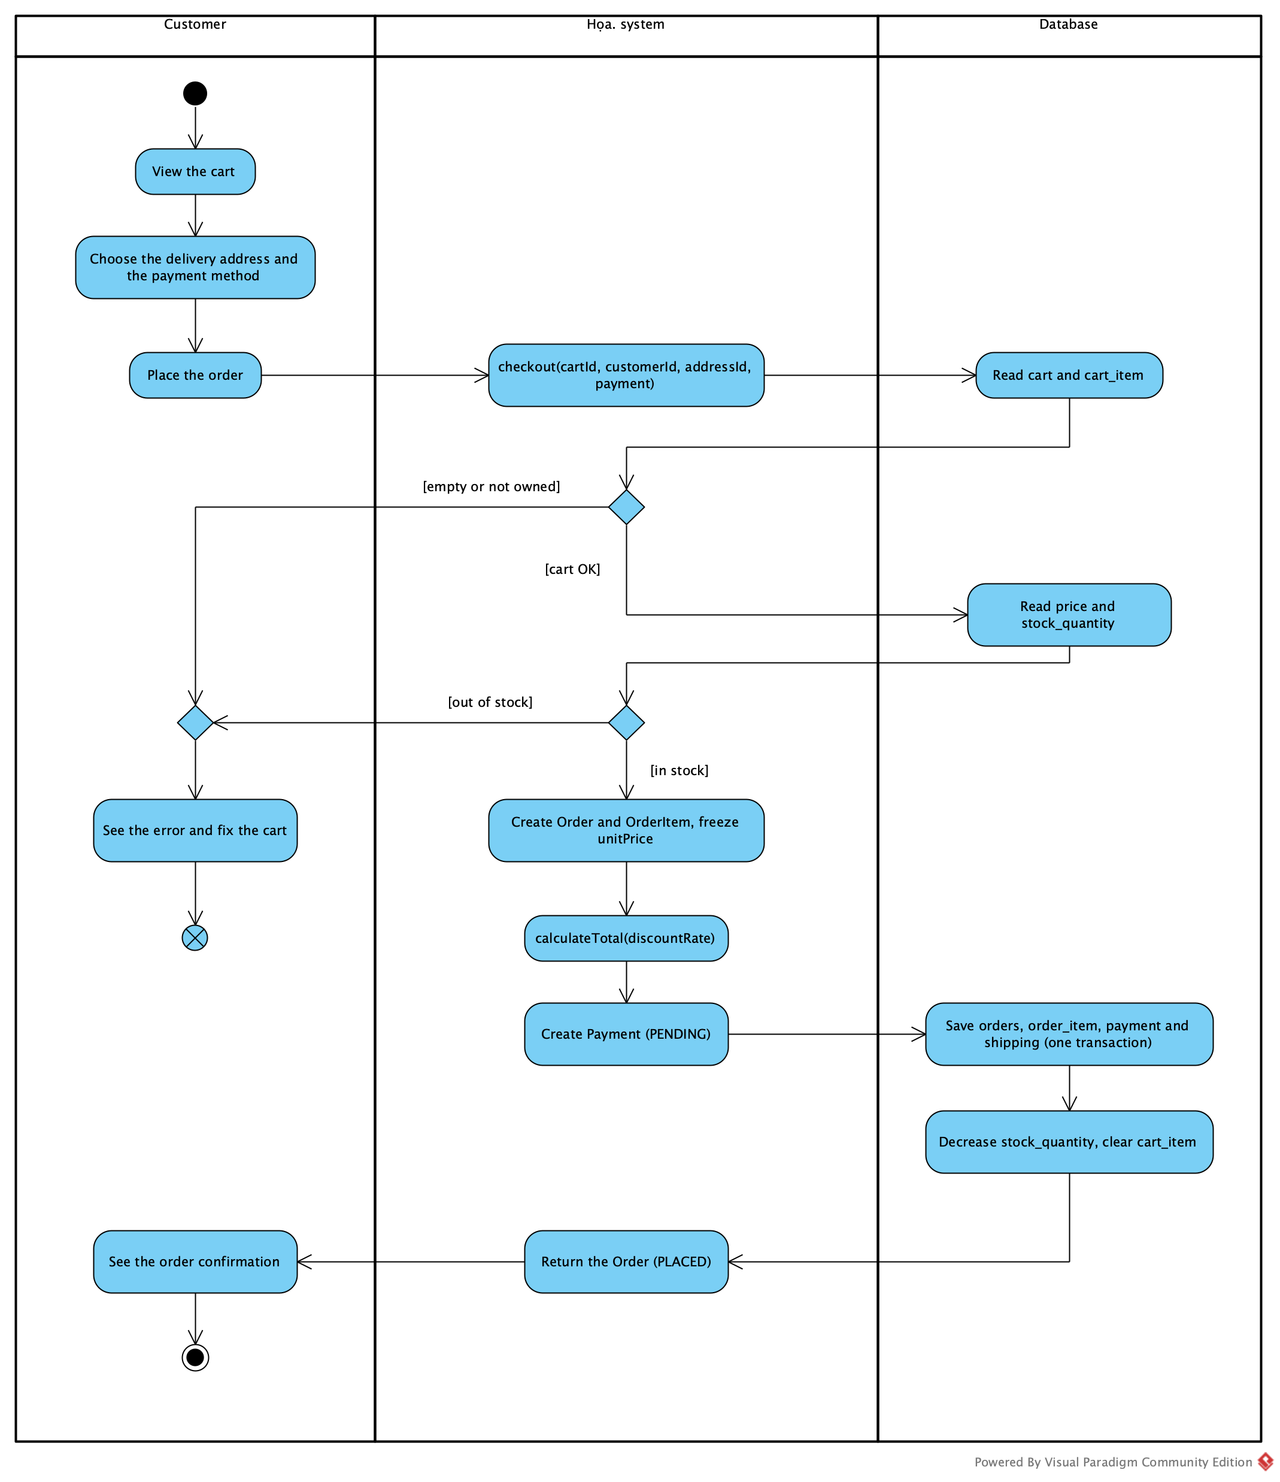
Họa. ▪ 02 ANALYSIS
12 / 34
From scenario to activity: decisions follow rules
FOUR QUESTIONS (LECTURE 03)
01 What is the actor's goal?
02 What is the normal flow?
03 What can go wrong?
04 How does the system respond?
BUSINESS RULE → DECISION
No stock, no order
The address must belong to the customer
Cancel only before shipment
FR07 → UC07 → SCENARIO → ACTIVITY
Notes:
From the scenario we draw an activity diagram with swimlanes: the customer, the Họa. system and the database. Every decision node comes from a business rule: no stock means no order, the address must belong to the customer, and an order can only be cancelled before shipment. On the right are the four questions of functional analysis from Lecture 03. The trace FR07, UC07, scenario, activity answers the question "where is this requirement represented in our model?"

Slide 13
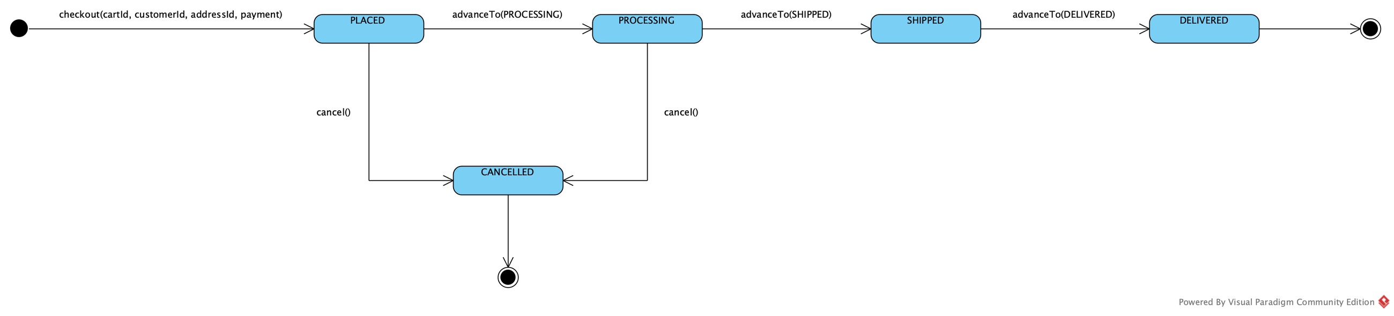
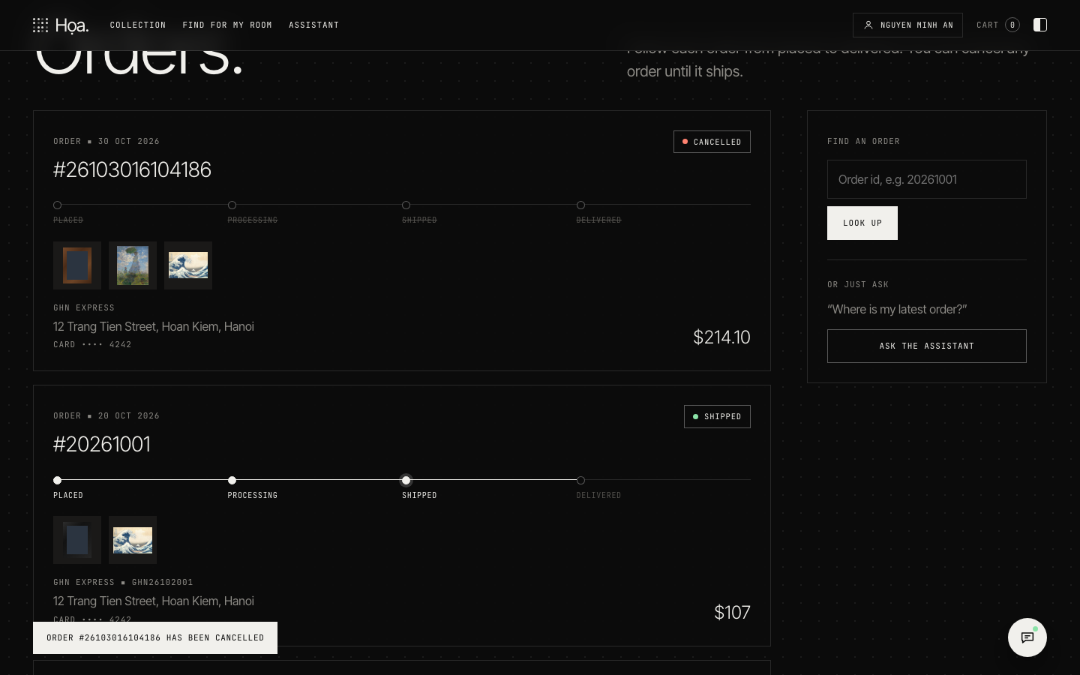
Họa. ▪ 02 ANALYSIS
13 / 34
Consistency check: cancel before shipment
ARTEFACT | WHAT MUST AGREE
Requirement | FR11 — Cancel my order while it is not shipped yet (PLACED or PROCESSING)
Use case | UC11 Cancel Order «extend» UC08 View Order
Decision | Has the order been shipped yet?
State machine | Cancel only from PLACED or PROCESSING
Design | OrderService.cancelOrder(customerId, orderId) → Order.cancel()
Operations | AdminController.updateOrderStatus(orderId, status) moves the order to SHIPPED
Notes:
Lecture 03 has an example of a consistency check for the requirement "a customer may cancel an order before shipment". We did exactly that exercise for Họa.: requirement FR11, the Cancel Order use case extending View Order, the decision "has the order been shipped", a state machine that allows cancellation only from PLACED or PROCESSING, and a design where cancelOrder calls Order.cancel. On the operations side, the administrator moves the order to SHIPPED, and from then on the customer can no longer cancel. The screenshot shows the cancellation in the demo.

Slide 14
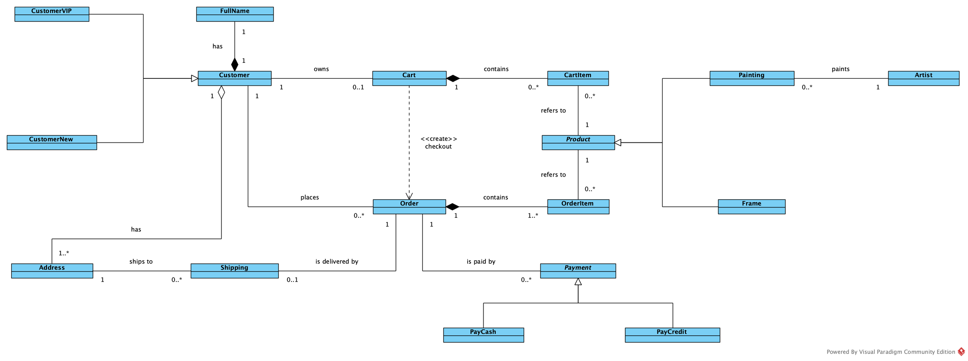
Họa. ▪ 02 ANALYSIS
14 / 34
Domain concepts: CartItem ≠ OrderItem
 | CARTITEM | ORDERITEM
Purpose | Shopping | Transaction
Lifetime | Temporary | Persistent
Owned by | Cart | Order
Price | cartPrice: when added | unitPrice: frozen at checkout
After checkout | Cart is emptied | Stays in the order
CHECKOUT IS A TRANSFORMATION (A03)
Cart —checkout «create»→ Order
Customer 1 — 0..1 Cart
Cart 1 — 0..* CartItem
Order 1 — 1..* OrderItem
CartItem 0..* — 1 Product
Notes:
This is the core of Lecture 04. On the left is the domain model with the concepts of Họa.: customers, paintings, artists, carts, orders, shipping and payments. The lecture stresses that CartItem is not OrderItem: one holds temporary shopping information with the price when the item was added; the other holds persistent transaction information with the price frozen at checkout. Checkout transforms a Cart into an Order, which is why it is drawn as a «create» dependency rather than a permanent association. The multiplicities below are read directly from the model.

Slide 15
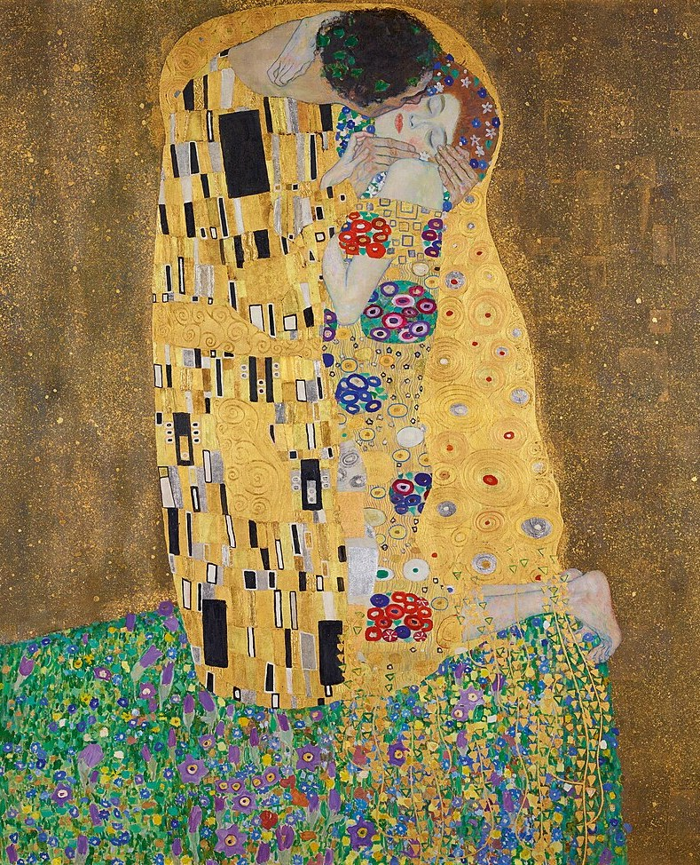
Họa. ▪ CHAPTER 03
15 / 34
CHAPTER 03
03
AI in
e-commerce
Five ways AI helps a customer find the right painting
01 TEXT
02 VOICE
03 IMAGE
04 ROOM
05 ASSISTANT
ASSIGNMENT A06 ▪ MULTIMODAL SEARCH — GEMMA 4 (L40S SERVER) ▪ WHISPER (ON THE LAPTOP)
THE KISS (1908) — GUSTAV KLIMT ▪ PUBLIC DOMAIN
Notes:
Chapter 3 covers AI in e-commerce. Họa. has five AI features: understanding natural text, voice search with Whisper running on the laptop, image search, trying a painting in your own room, and a curator assistant. The common principle: AI helps customers express what they want, while prices, stock and access rights stay under the control of business rules in the code.

Slide 16
Họa. ▪ 03 AI IN E-COMMERCE
16 / 34
Different inputs, one common query
TEXT
SearchUI.submitText
QueryService.textQuery
COMMON QUERY
RETRIEVAL
RANKING
RESULTS
VOICE
CommonQuery
SearchService
RankingService
SearchResultView
VoiceInput.upload
SpeechService.transcribe
QueryService.voiceQuery
type, query, embedding, style, subject, color, artist, maxPrice, aiUsed
.retrieve(query)
ProductRepository
.allProducts()
VectorIndex
.nearest(queryEmbedding, k)
.rank(query, candidates, limit)
S = α·Stext + β·Simage + γ·Sbusiness
.render(results)
PAINTING PHOTO
ImageUpload.choose
ImageService.embed
QueryService.imageQuery
ROOM PHOTO
RoomPreview.chooseRoom
ImageService.describe
SearchService.searchRoom
DIFFERENT INPUTS → ONE COMMON REPRESENTATION
RETRIEVAL ≠ RANKING
THE UI NEVER TOUCHES THE DATABASE
START SIMPLE
Notes:
The central principle of Assignment 06: different inputs are turned into one common representation, then candidates are retrieved, then ranked. Họa. has four inputs — text, voice, a photo of a painting and a photo of a room — and each one goes through exactly the classes and methods written in its box. They all meet in CommonQuery. SearchService retrieves candidates from ProductRepository and VectorIndex, and RankingService ranks them with the formula of the assignment. The four principles at the bottom also come from A06: one common representation, retrieval separate from ranking, the UI never touching the database, and starting simple.

Slide 17
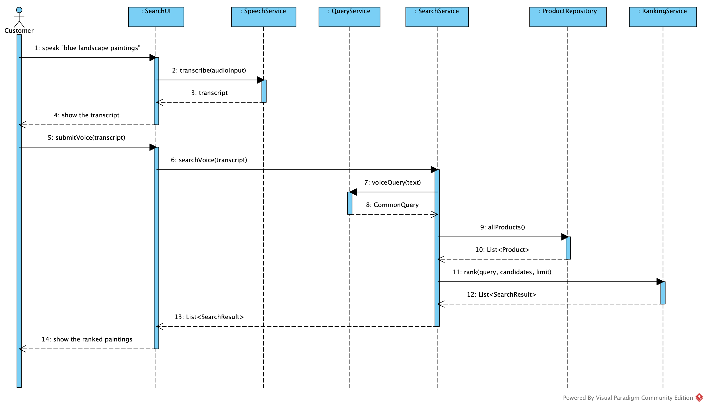
Họa. ▪ 03 AI IN E-COMMERCE
17 / 34
Voice search: the audio never leaves the laptop
01 VoiceInput.upload(audio) sends the recording
02 SpeechService.transcribe(audioInput) calls WhisperClient on the laptop
03 The customer reviews and edits the transcript
04 SearchService.searchVoice(transcript) follows the text path
05 Whisper down → null; the customer is asked to type
MEASURED ON THE LAPTOP ▪ WHISPER SMALL
0.70 s
2.0 %
18/20
MEAN TIME
WORD ERROR
EXACT
THE 7 PARTICIPANTS OF A06: CUSTOMER ▪ SEARCHUI ▪ SPEECHSERVICE ▪ QUERYSERVICE ▪ SEARCHSERVICE ▪ PRODUCTREPOSITORY ▪ RANKINGSERVICE
MAX 1.43 S ▪ NFR08 LIMIT 3 S ▪ 20 EN SENTENCES
Notes:
Voice search. The sequence diagram on the left has exactly the seven participants required by Assignment 06. In Họa., the recording is sent to a self-hosted Whisper model running on the laptop, so the audio never leaves the machine — that is a privacy requirement. The transcript is shown so the customer can correct it, and then it follows the same path as a typed query. If the Whisper server is not running, the system asks the customer to type instead. We deliberately do not implement text-to-speech. We measured it on 20 English test sentences: Whisper small on the laptop's processor needs 0.70 seconds on average and at most 1.43 seconds, well within the 3 seconds of NFR08, with a word error rate of 2.0 percent.

Slide 18
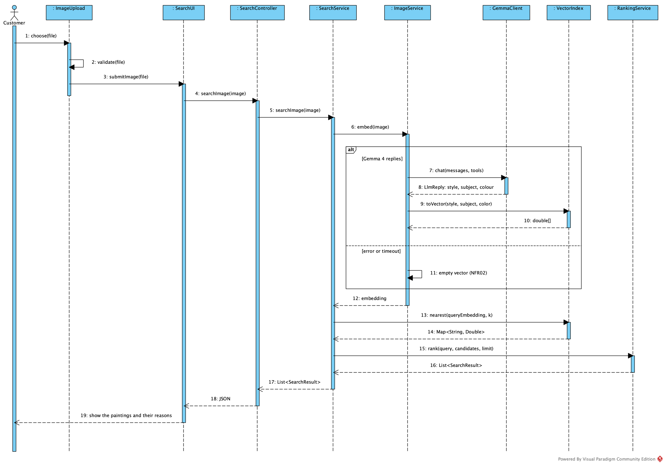
Họa. ▪ 03 AI IN E-COMMERCE
18 / 34
Search by image: vectors and cosine similarity
IMAGE ENCODER (fθ)
z_{q} = f_{θ}(I_{q})
Gemma 4 describes the photo → style, subject, colour → VectorIndex.toVector(style, subject, color)
COSINE SIMILARITY
s(q, p) = z_{q} · z_{p} / (‖z_{q}‖ ‖z_{p}‖)
VectorIndex.cosineSimilarity(a, b)
RANKING (ASSIGNMENT A06)
S(x|q) = α·S_{text} + β·S_{image} + γ·S_{business}
RankingService(alpha, beta, gamma).rank(...)
Họa. (app.properties): α = 0.45 ▪ β = 0.45 ▪ γ = 0.10
MULTIMODAL: λt + λi = 1 (A06: λt = λi = 0.5)
Notes:
Image search uses the formulas of Assignment 06. Here the encoder f-theta is Gemma 4 vision: the model describes the photo as a style, a subject and a colour, and VectorIndex.toVector turns that description into a vector. Similarity is the cosine between the query vector and the vector of each painting. The final score combines the text, image and business scores with the alpha, beta and gamma weights of RankingService. The sequence diagram on the right shows the order of calls from ImageUpload to RankingService.

Slide 19
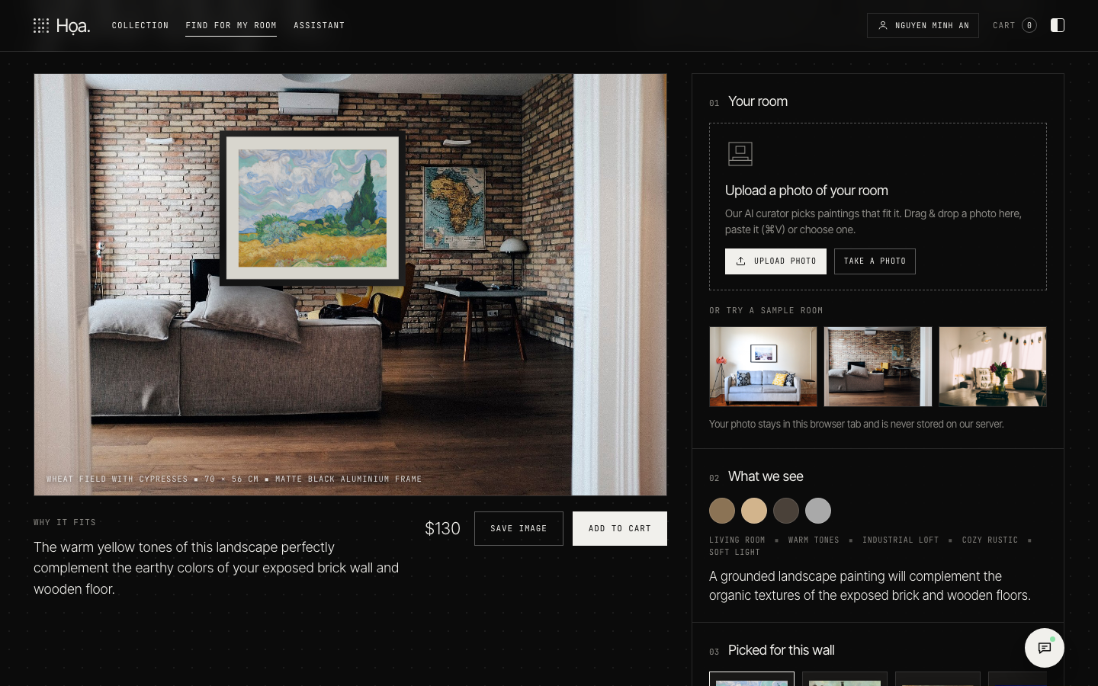
Họa. ▪ 03 AI IN E-COMMERCE
19 / 34
Try it in your room (UC14 Find Painting for My Room)
01 The customer uploads a photo of the room: RoomPreview.chooseRoom(file)
02 Gemma 4 reads its palette, style and mood: SearchService.describeRoom(image)
03 SearchService.searchRoom(image) shortlists the 12 closest paintings by cosine
04 Gemma 4 picks 3–5 and writes one “why it fits” sentence each (SearchResult.reason)
05 RoomPreview.placePainting(product) hangs the chosen painting on the wall
FR14 ▪ COULD ▪ THE SYSTEM SHALL SUGGEST PAINTINGS THAT SUIT A ROOM FROM A PHOTO OF THE ROOM AND LET THE CUSTOMER PREVIEW A PAINTING ON THE WALL.
DEMO SCREENSHOT ▪ TRY IT IN YOUR ROOM
Notes:
"Try it in your room" is use case UC14. The customer uploads a photo of their room, and Gemma 4 first reads it: the colours, the interior style, the mood and the light. SearchService.searchRoom then follows the two steps of Assignment 06. Retrieval: VectorIndex shortlists the twelve paintings closest to the suggested style, subject and colour by cosine similarity. Ranking: Gemma 4 sees the photo again with the shortlist, picks the three to five paintings that fit best and writes one sentence for each explaining why it fits, for example that its warm browns echo the wooden floor and the brick wall. If Gemma is unavailable, the vector ranking stays and the sentence is built from the painting's attributes. RoomPreview then hangs the chosen painting on the wall in the photo, so the customer can see how it would look. This requirement is a Could: it adds value to the experience but is not part of the core buying process.

Slide 20
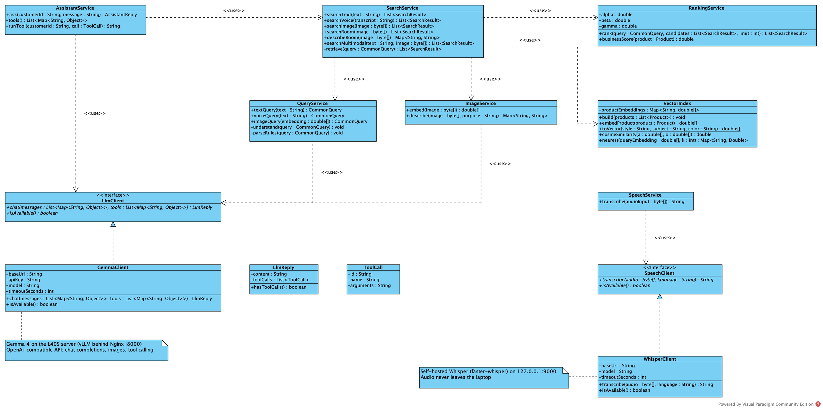
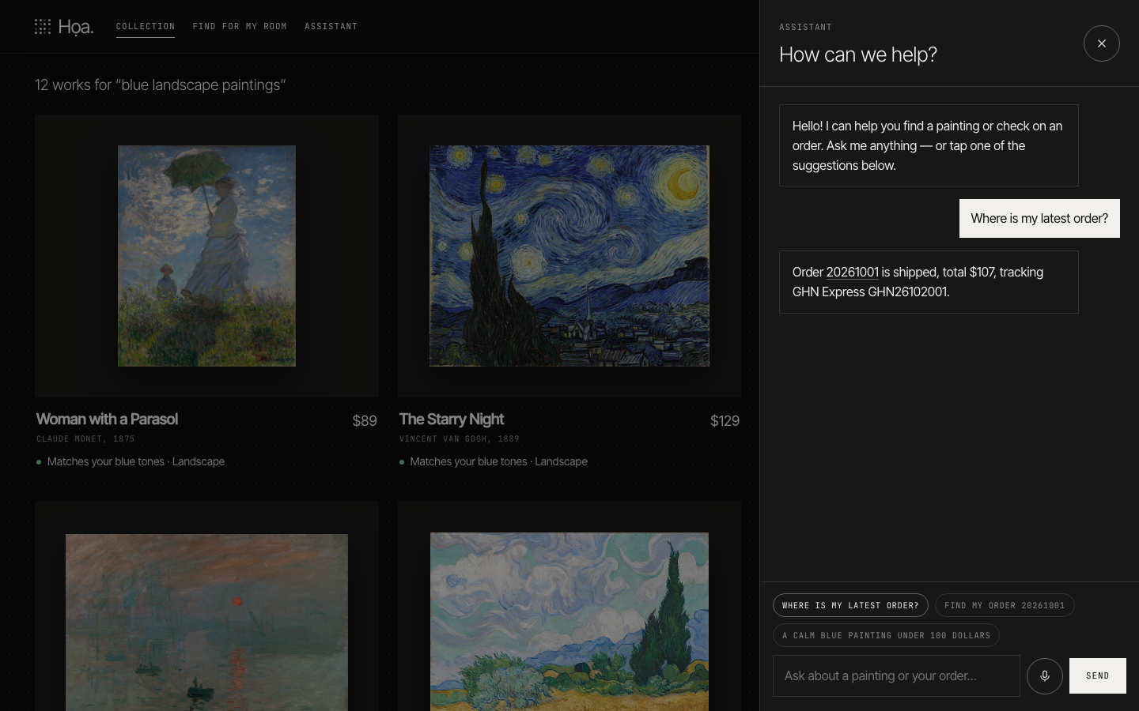
Họa. ▪ 03 AI IN E-COMMERCE
20 / 34
AI behind interfaces, always with a fallback
LlmClient ◁ GemmaClient ▪ SpeechClient ◁ WhisperClient
WHEN | WHAT Họa. DOES
Gemma fails or takes > 15 s | QueryService.parseRules: keyword rules
Whisper is not running | transcribe returns null; the customer types
Image not JPEG/PNG/WebP or > 5 MB | Rejected before Gemma is called
Gemma misreads the request | AI only builds filters; paintings, prices, stock come from the database
Someone asks for another's order | OrderService checks ownership against the session
SCREENSHOT: SEARCH STILL WORKS WITH GEMMA OFF
Notes:
Architecturally, every use of AI goes through an interface: LlmClient for Gemma and SpeechClient for Whisper. This lets us swap the model, or use a fake one in tests. The table on the right lists how Họa. reacts when AI fails: if Gemma fails or takes more than 15 seconds, search falls back to keyword rules; if Whisper is down, the customer types; images of the wrong type or size are rejected before Gemma is called; AI only builds filters and never decides prices or stock; order access is always checked on the server.

Slide 21
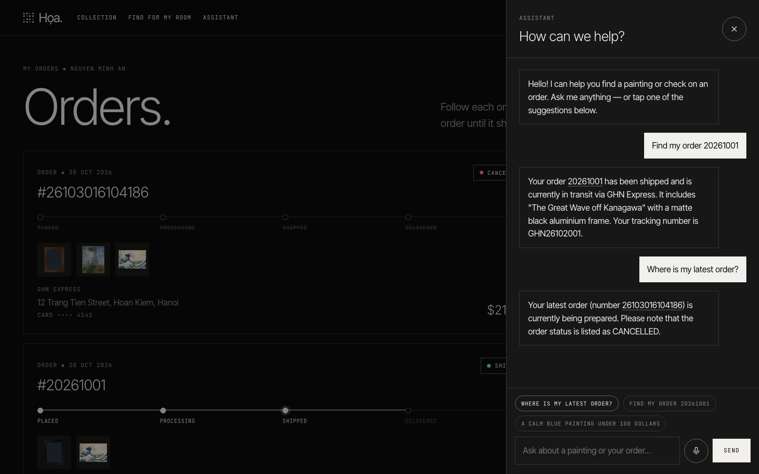
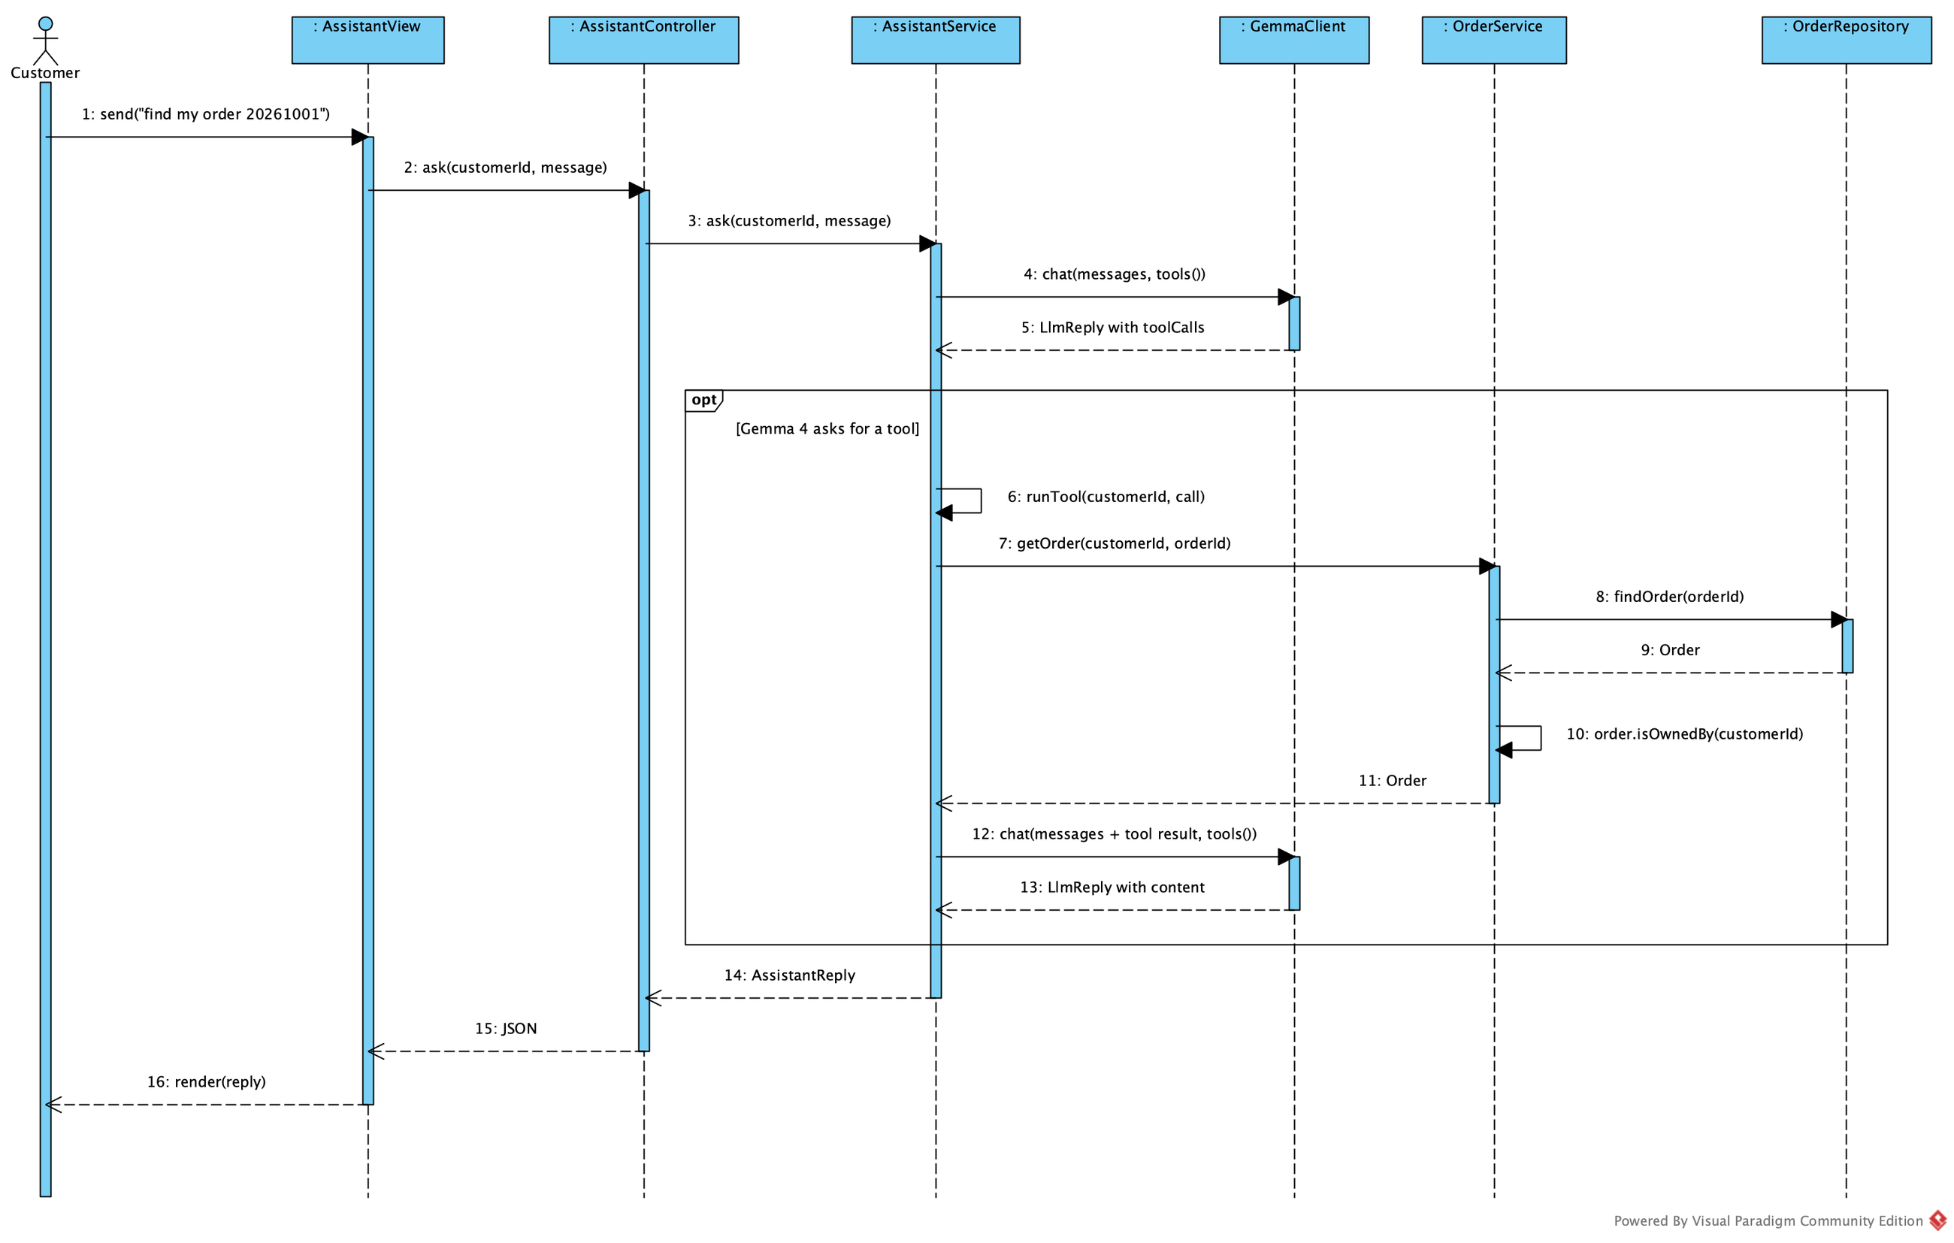
Họa. ▪ 03 AI IN E-COMMERCE
21 / 34
Curator assistant: Gemma picks the tool
AssistantService.ask(customerId, message) sends the question with tools()
Gemma 4 picks a tool; AssistantService.runTool(customerId, call) runs it for the session's customer
Ask by text or by voice (Whisper); answers are text only
Notes:
The curator assistant uses Gemma 4 tool calling. AssistantService sends the question together with the list of tools — search paintings and look up orders. Gemma chooses a tool and its arguments; runTool executes it with the customer id taken from the session, not from the question, so a customer can never retrieve someone else's order. The result goes back to Gemma, which writes the answer. Customers can ask by text or by voice through Whisper; the assistant answers in text.

Slide 22
Họa. ▪ 03 AI IN E-COMMERCE
22 / 34
Evaluation as required by A06
Họa. demo — experimental evaluation (2026-10-30 16:09)
Two copies of the shop on fresh databases: Gemma 4 online, and Gemma …
Relevance of a search result is judged from the catalogue attributes …
Hit@1 = top result relevant; P@5 = relevant results in the top 5 / mi…
1. Search
Input n Hit@1 P@5 MRR s/query
Text, Gemma 4 14 0.93 0.93 0.94 0.44
Text, keyword rules (offline) 14 0.93 0.93 0.94 0.01
Paraphrased text, Gemma 4 6 0.67 0.67 0.69 0.41
Paraphrased text, keyword rules 6 0.67 0.67 0.67 0.00
Voice, Whisper small + Gemma 4 12 0.83 0.83 0.85 1.19
Whisper: 16 recordings, mean WER 0.041, 0.78 s per recording, orde…
DEMO QUERIES (MATCHING A06)
Họa. | ASSIGNMENT A06
blue landscape paintings | black running shoes
Monet paintings under 100 dollars | find Nike shoes under 100 dollars
show me paintings similar to this image | show me products similar to this image
find my order 20261001 | find my order 20261001
where is my latest order? | where is my latest order?
REPORTED: QUERIES, SUCCESSES, RATE, FAILURE EXAMPLES (build/eval/)
SUCCESS RATE = SUCCESSFUL QUERIES / ALL QUERIES
Notes:
Assignment 06 asks for an evaluation on a small set of queries: the number of queries, the number of successes, the success rate and examples of failures. The chart on the left shows the success rate per mode on our test set. The table on the right lists the demo queries of Họa. next to the example queries of the assignment: "black running shoes" becomes "blue landscape paintings", "Nike shoes under 100 dollars" becomes "Monet paintings under 100 dollars", and the order queries are kept unchanged.

Slide 23
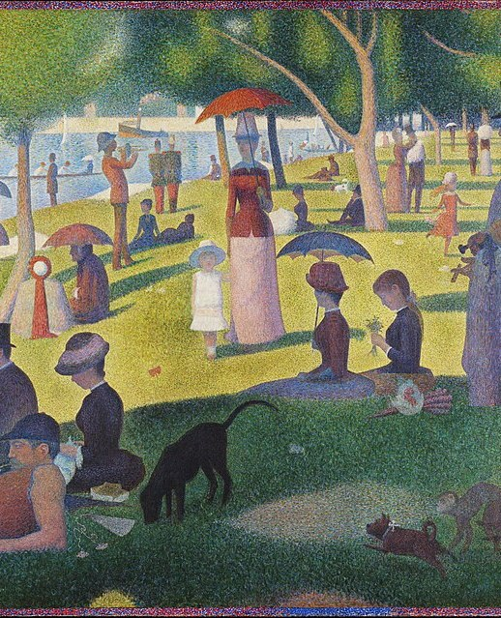
Họa. ▪ CHAPTER 04
23 / 34
CHAPTER 04
04
Design
Analysis says WHAT, design says HOW
LECTURE 05 ▪ FROM ANALYSIS TO DESIGN — OUTLINE 4.1–4.6
A SUNDAY ON LA GRANDE JATTE (1884) — GEORGES SEURAT ▪ PUBLIC DOMAIN
Notes:
Chapter 4 is the design, following Lecture 05 and the outline 4.1 to 4.6 given by our lecturer. Analysis says what the system needs; design says how the software realises it: design classes, the database, layers and packages, and finally the code.

Slide 24
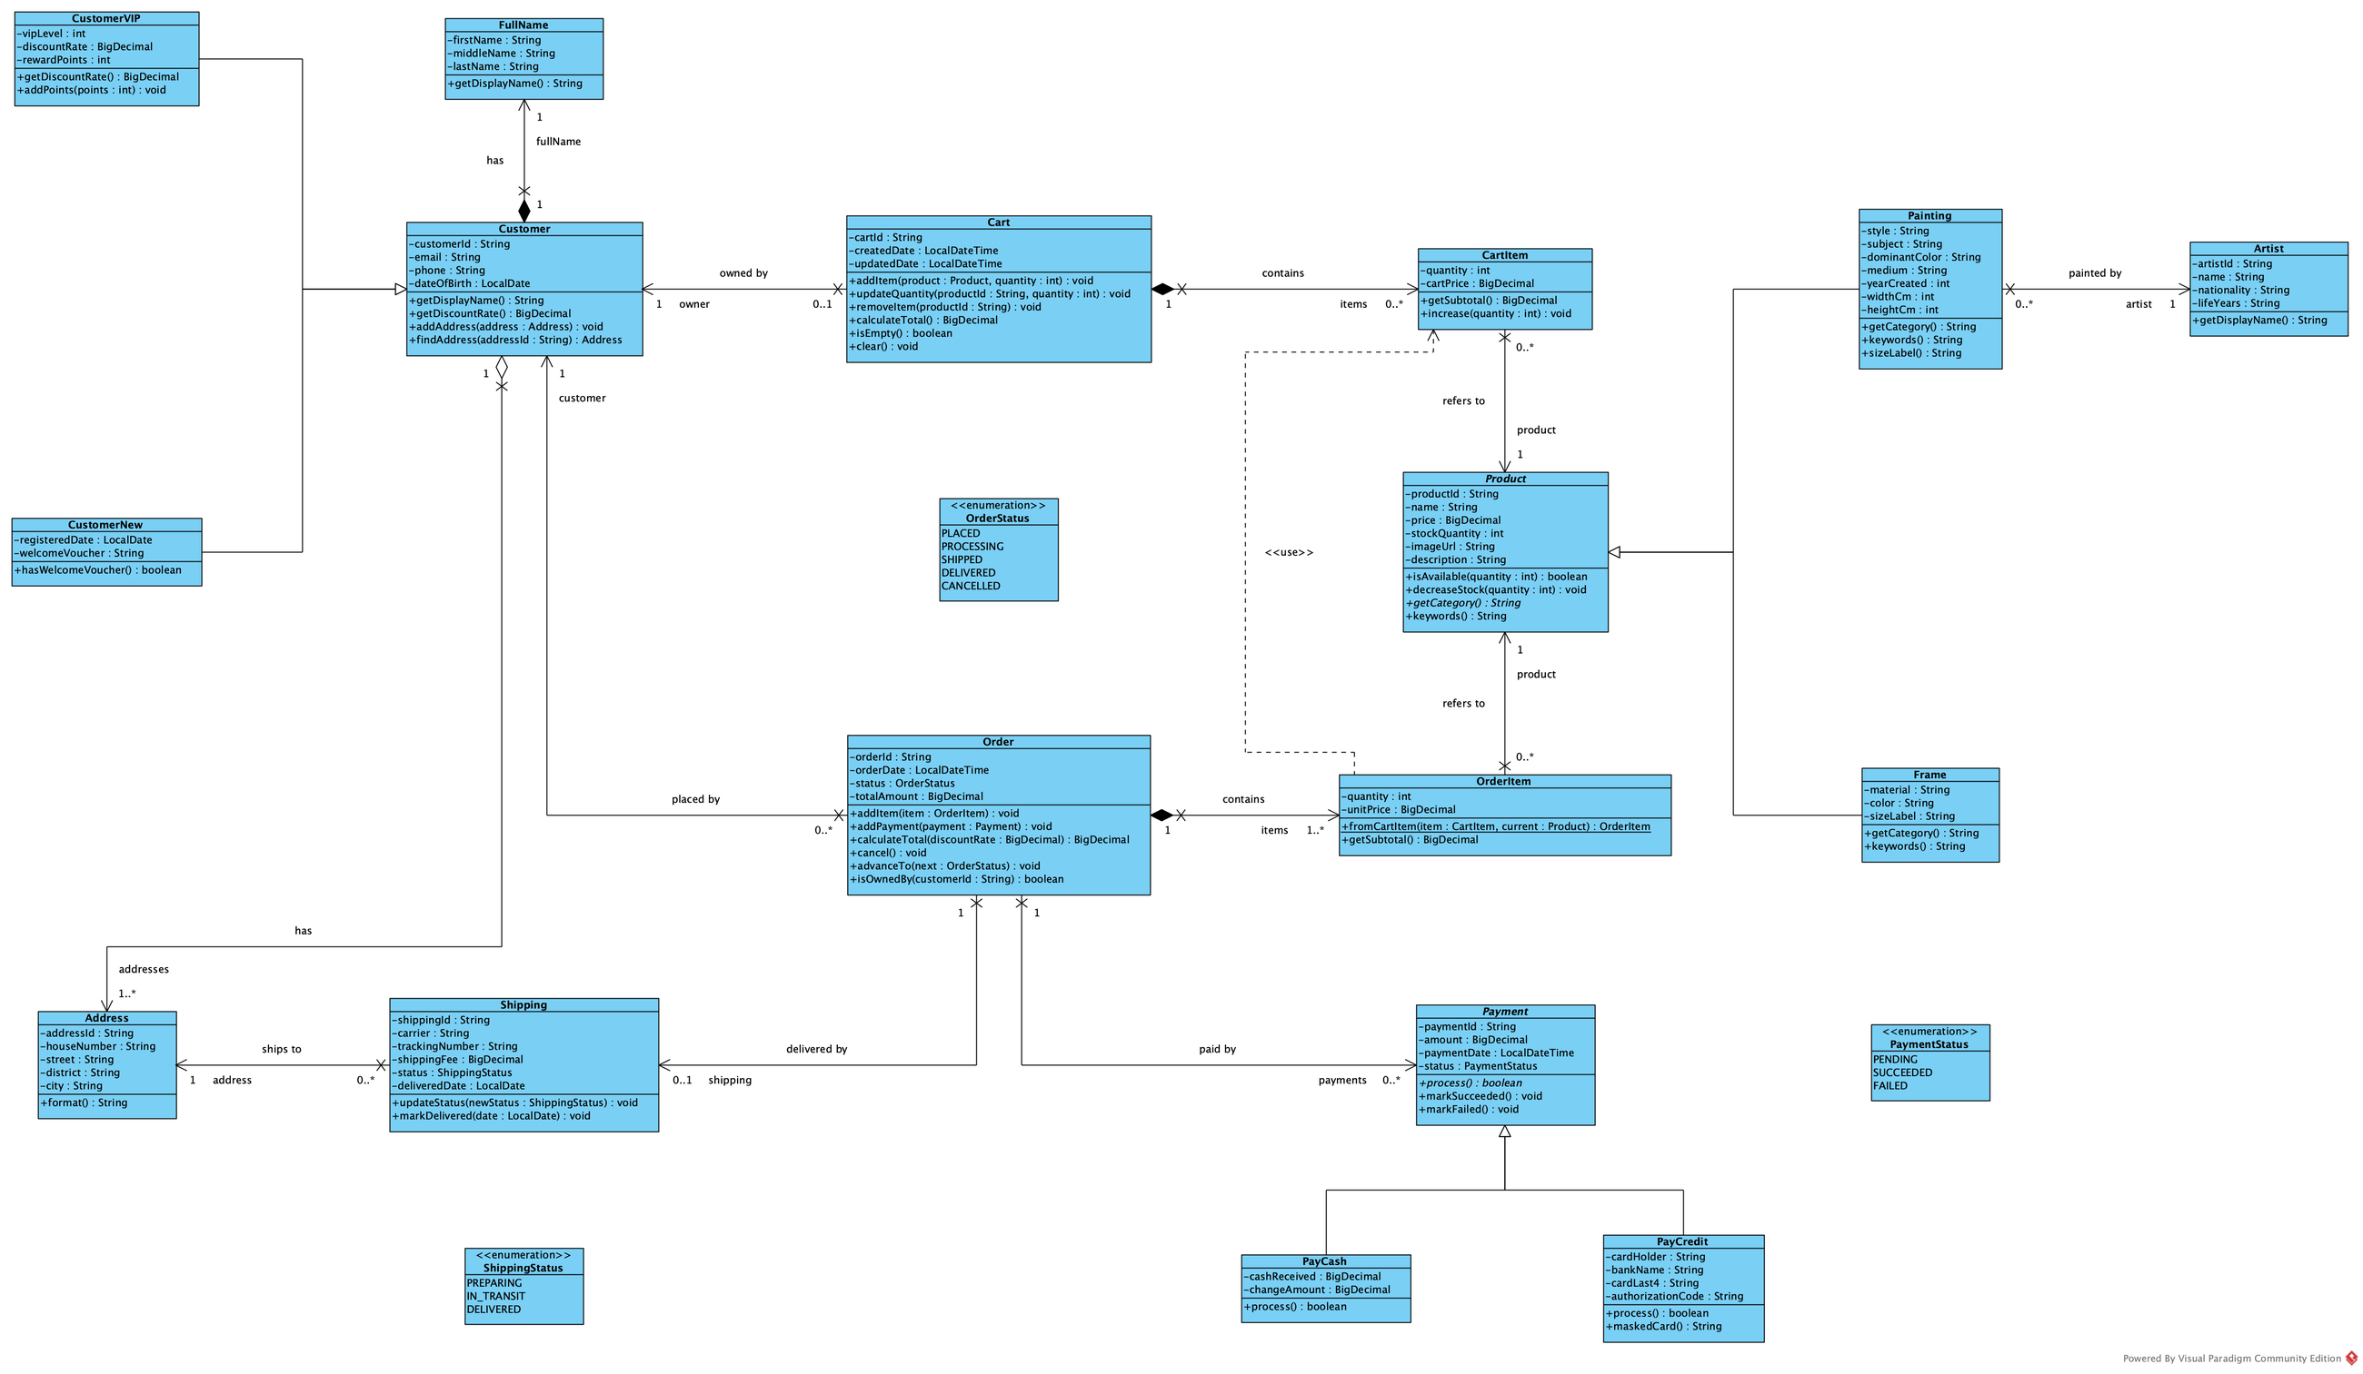
Họa. ▪ 04 DESIGN
24 / 34
From analysis classes (A04) to design classes (A05)
ANALYSIS | DESIGN (LECTURE) | Họa.
Cart, CartItem | Domain class | Cart.addItem, Cart.calculateTotal
CartItem → OrderItem | Domain class | OrderItem.fromCartItem(item, current)
checkout(Cart) | CheckoutService.checkout(cartID) | CheckoutService.checkout(cartId, customerId, addressId, payment)
Business interaction | Controller + Service | CheckoutController → CheckoutService
Persistence need | Repository | CartRepository, OrderRepository
Analysis model | Design class model | 17 analysis → 58 Java classes
Domain structure | Layered architecture | 4 layers, 14 packages
PACKAGE | DOMAIN CLASSES
customer | FullName, Address, Customer, CustomerVIP, CustomerNew
product | Product, Artist, Painting, Frame
cart | Cart, CartItem
order | OrderStatus, Order, OrderItem, ShippingStatus, Shipping
payment | PaymentStatus, Payment, PayCash, PayCredit
Notes:
This transformation table follows slide 22 of Lecture 05. The analysis classes Cart, CartItem, Order and OrderItem become domain classes with behaviour; checkout of a Cart at analysis level becomes CheckoutService.checkout at design level; the business interaction becomes a controller plus a service; the need to persist data becomes repositories. Besides the cartId of the lecture, our method also receives the customer id from the session to check ownership, the address and the payment method. On the right is the design class diagram with types, methods and navigability.

Slide 25
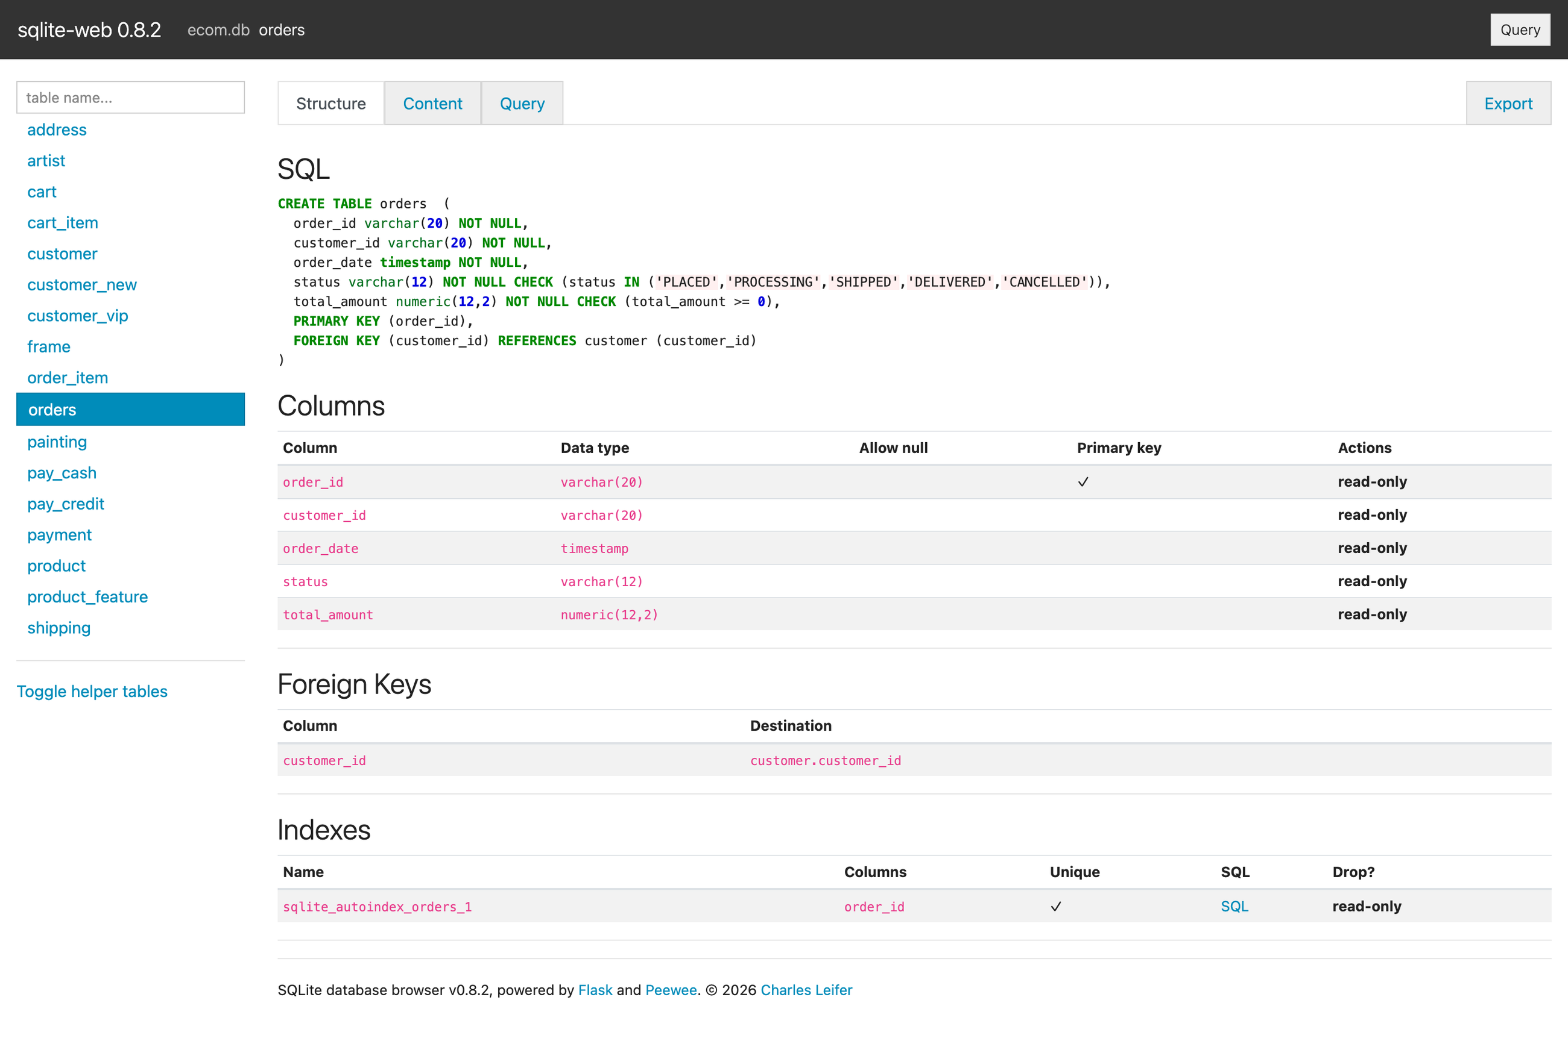
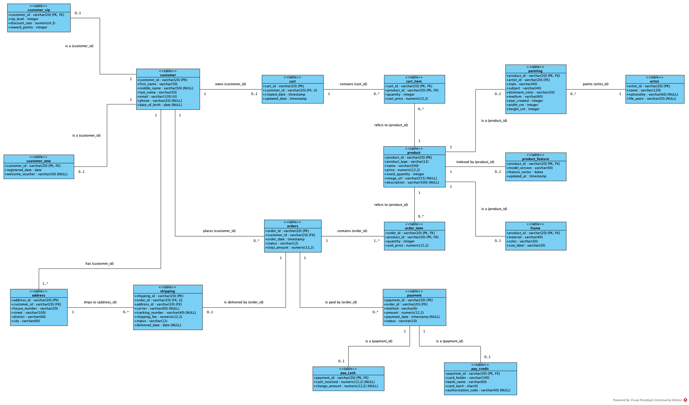
Họa. ▪ 04 DESIGN
25 / 34
From data model to an SQLite database
COPY SCREEN OF DB ▪ ecom.db
Inheritance → the subclass table's PK is also its FK
1 – * → FK on the many side; 1 – 0..1 → add UNIQUE
Composition → composite key, ON DELETE CASCADE
Notes:
Section 4.2: from the data model we generate the database. The diagram on the left shows the tables with their primary keys, foreign keys and unique constraints. Three main mapping rules: inheritance becomes a subclass table whose primary key is also a foreign key; a one-to-many association puts the foreign key on the many side; composition, such as cart lines and order lines, uses a composite primary key. The screenshot on the right is the real SQLite database of the demo — the "copy screen of DB" our lecturer asked for.

Slide 26
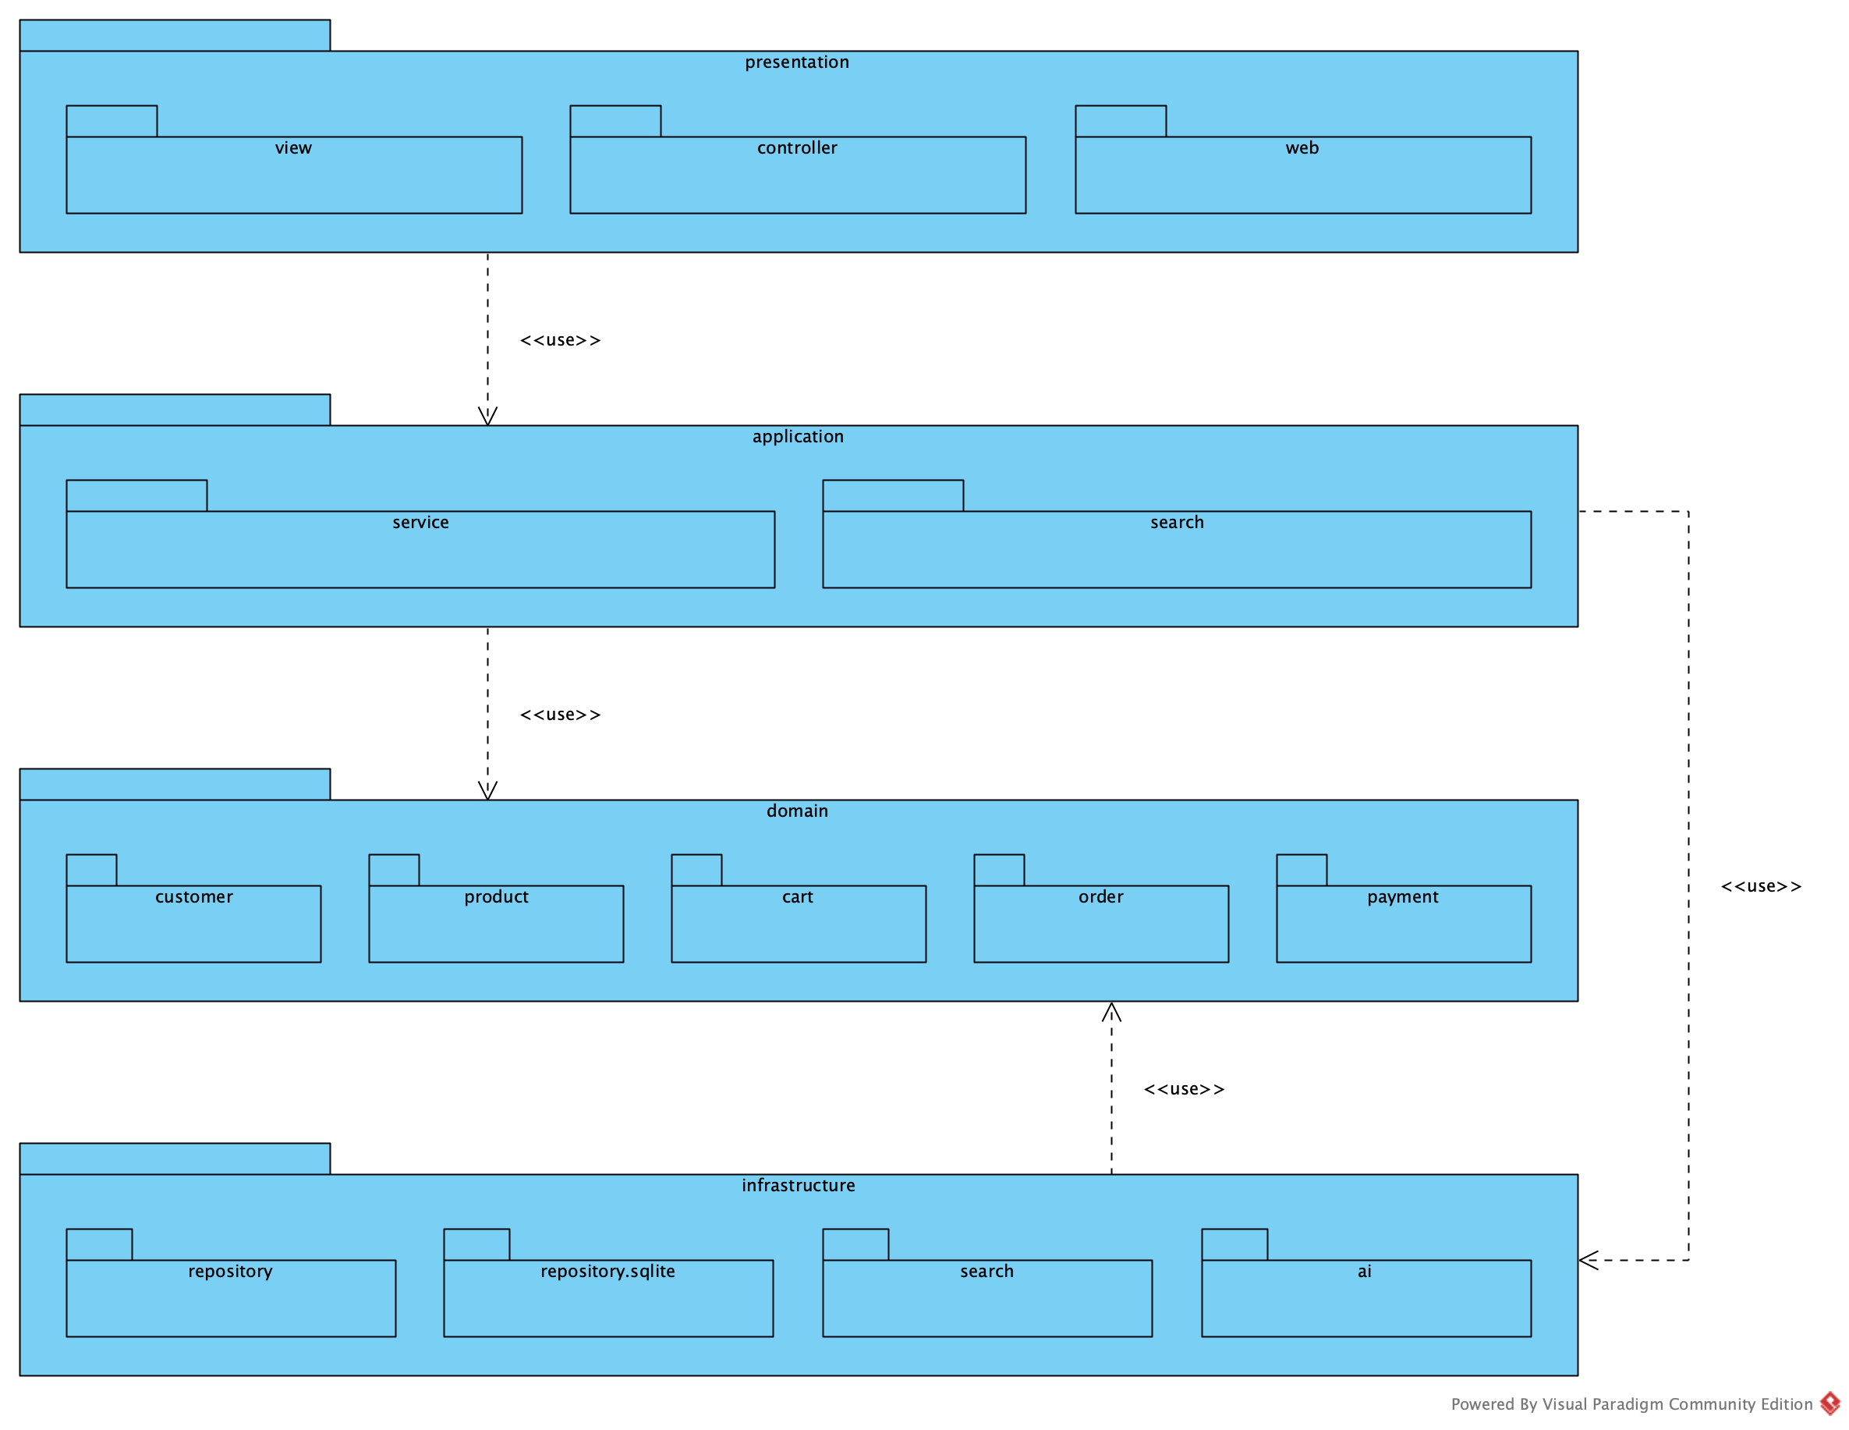
Họa. ▪ 04 DESIGN
26 / 34
Four layers — a layer is not a package
PRESENTATION
Receive requests, present results
presentation.view ▪ presentation.controller ▪ presentation.web
APPLICATION
Coordinate use cases and workflows
application.service ▪ application.search
DOMAIN
Business concepts and rules
domain.customer ▪ domain.product ▪ domain.cart ▪ domain.order ▪ domain.payment
INFRASTRUCTURE
SQLite, vector index, Gemma, Whisper
infrastructure.repository ▪ infrastructure.repository.sqlite ▪ infrastructure.search ▪ infrastructure.ai
THE UI NEVER TOUCHES THE DATABASE
SERVICES DEPEND ON INTERFACES
Notes:
Section 4.4: the four-layer architecture of Lecture 05 — presentation, application, domain and infrastructure. Each layer has its own responsibility, listed on the right together with the Java packages that implement it. The lecture points out that a layer is not a package: a layer is an architectural responsibility, a package is a way to organise code, so each layer is split into several packages. Two dependency rules: the UI never touches the database, and services depend only on the interfaces of the repositories and of the AI clients.

Slide 27
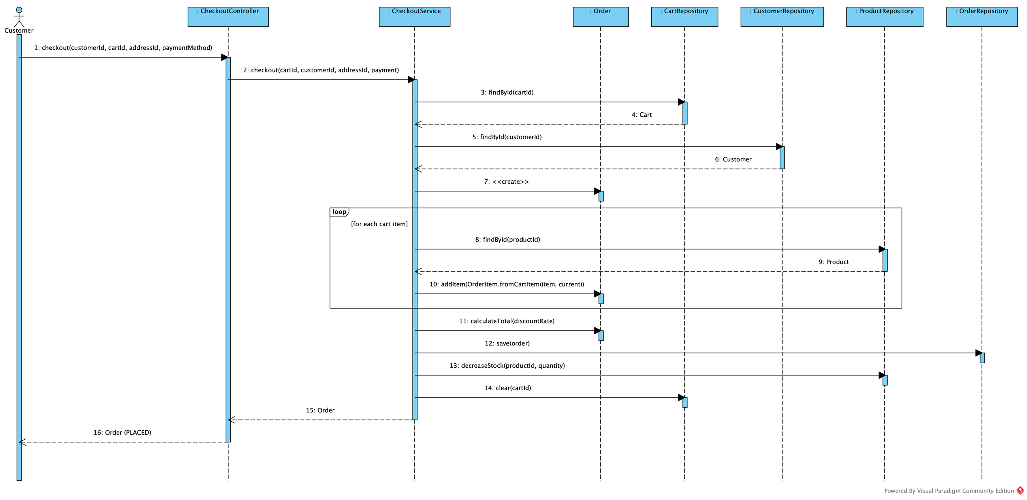
Họa. ▪ 04 DESIGN
27 / 34
Checkout across the layers (Lecture 05)
CheckoutController → CheckoutService.checkout(cartId, customerId, addressId, payment) → Cart, Order (domain)
→ CartRepository, OrderRepository, ProductRepository
THE SERVICE COORDINATES; CART.ADDITEM AND ORDER.CALCULATETOTAL LIVE IN THE DOMAIN — NO “GOD CLASS”
Notes:
This is the checkout sequence across the layers — the central example of Lecture 05. The controller receives the request and CheckoutService coordinates: it reads the cart, checks stock, creates the Order and its OrderItems, saves the order, reduces stock and empties the cart. Business rules such as adding a cart line or computing the total live in the domain classes Cart and Order rather than in the service, which avoids the "God class" the lecture warns about.

Slide 28
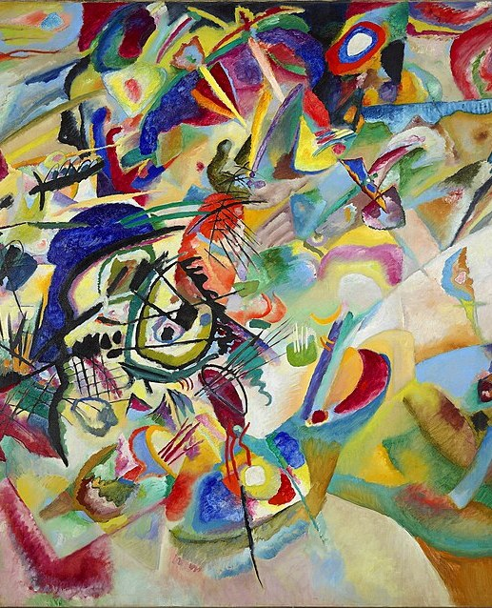
Họa. ▪ CHAPTER 05
28 / 34
CHAPTER 05
05
Code
From model to running code, name for name
JAVA ▪ SQLITE ▪ HTML/CSS/JS ▪ PYTHON (WHISPER SERVER)
COMPOSITION VII (1913) — WASSILY KANDINSKY ▪ PUBLIC DOMAIN
Notes:
Chapter 5 is the code. The goal is not only that it runs, but that it matches the model name for name: classes, methods, parameters, tables and columns in the code are identical to the specification.

Slide 29
Họa. ▪ 05 CODE
29 / 34
Course code ↔ Họa. code
LECTURE CODE (A05, A06) | Họa. (JAVA) | PACKAGE
product_repository.py: all_products() | ProductRepository.allProducts() | infrastructure.repository
query_service.py: text_query, voice_query | QueryService.textQuery(text) | application.search
speech_service.py: transcribe(audio_input) | SpeechService.transcribe(audioInput) | application.search
search_service.py: search_text(query) | SearchService.searchText(text) | application.search
cosine_similarity(a, b) | VectorIndex.cosineSimilarity(a, b) | infrastructure.search
S = αStext + βSimage + γSbusiness | RankingService.rank(query, candidates, limit) | application.search
order_repository.py: find_order(order_id) | OrderRepository.findOrder(orderId) | infrastructure.repository
CheckoutService.checkout(cartID) : Order | CheckoutService.checkout(cartId, customerId, addressId, payment) | application.service
main.py | EcomApplication.main(args) | presentation.web
58 JAVA CLASSES ▪ 9 JS VIEWS ▪ 14 PACKAGES (FROM model.py)
TECHNOLOGY MAPPING (LECTURE 05): CONTROLLER → JAVA HTTP HANDLER ▪ REPOSITORY → JDBC ON SQLITE ▪ DATABASE → ecom.db
Notes:
This table maps the sample code of the course slides to the code of Họa. The Python code of Assignment 06 — all_products, text_query, transcribe, search_text, cosine_similarity, find_order — keeps its names following Java conventions, and so does CheckoutService.checkout from Lecture 05. The package column shows the layer of each class. The last line is the technology mapping of Lecture 05: a controller is a Java HTTP handler, a repository is JDBC on SQLite.

Slide 30
Họa. ▪ 05 CODE
30 / 34
Representative code and how it is verified
build/excerpts5/VectorIndex.java
01 ▪ MODEL ↔ CODE
public class VectorIndex {
// ...
/** One-hot vector: [10 styles | 8 subjects | 10 colours]; an unknown value l…
public static double[] toVector(String style, String subject, String color) {
double[] vector = new double[STYLES.length + SUBJECTS.length + COLORS.len…
mark(vector, 0, STYLES, style);
mark(vector, STYLES.length, SUBJECTS, subject);
mark(vector, STYLES.length + SUBJECTS.length, COLORS, color);
return vector;
}
// ...
/** cosine_similarity(a, b) of slide A06. */
public static double cosineSimilarity(double[] a, double[] b) {
double numerator = 0, normA = 0, normB = 0;
for (int i = 0; i < a.length; i++) {
numerator += a[i] * b[i];
normA += a[i] * a[i];
normB += b[i] * b[i];
}
double denominator = Math.sqrt(normA) * Math.sqrt(normB);
return denominator == 0 ? 0.0 : numerator / denominator;
}
// ...
tools/check_code_model.py compares classes, methods, parameters, tables and columns with model.py
02 ▪ TESTS
PASS Gemma's JSON becomes a CommonQuery (style, artist, ma…
03 ▪ A06 EVALUATION
build/eval/: success rate per search mode
04 ▪ DATABASE
SQLite schema generated from the same specification: 17 tables
Notes:
On the left is a representative excerpt of the real code. On the right are the four ways we verify consistency: the check_code_model tool compares class, method, parameter, table and column names between the code and the specification; the test suite; the evaluation required by Assignment 06; and the SQLite schema generated from the same specification. This is how the report, the diagrams and the code stay aligned.

Slide 31
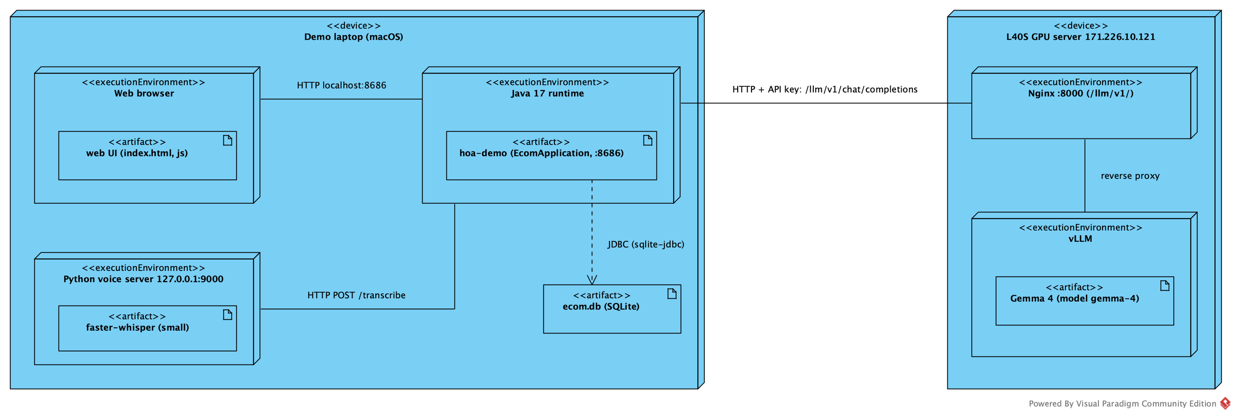
Họa. ▪ 05 CODE
31 / 34
Live demo script
01 Run demo/run.sh (it also starts Whisper); open http://localhost:8686 as C001
02 Type “blue landscape paintings”
03 Click the microphone, say “Monet paintings under 100 dollars”, fix the transcript if needed
04 Upload a photo: “show me paintings similar to this image”; then try a painting in a room
05 Add a painting and a frame to the cart → checkout → order PLACED
06 Ask the assistant: “find my order 20261001”, “where is my latest order?”
07 Cancel the new PLACED order; switch to C002, ask for order 20261001 → refused
08 Switch to ADMIN: change price and stock; move an order to SHIPPED
09 Set a wrong gemma.baseUrl and restart → search still works with keyword rules
DEPLOYMENT
LAPTOP: BROWSER ▪ JAVA :8686 ▪ ecom.db ▪ WHISPER :9000
L40S: NGINX :8000 ▪ vLLM GEMMA 4
ACCOUNTS: C001 (VIP) ▪ C002 ▪ ADMIN
Notes:
This is the script of the live demo. We search by text, by voice, by image and try a painting in a room; add a painting and a frame to the cart and check out; ask the assistant about orders; cancel an order; sign in as another customer to show that their order is refused; open the administration page to change price, stock and order status; and finally switch Gemma off to show that search still works. The diagram on the right is the deployment: everything runs on the laptop except Gemma 4, which runs on the L40S server.

Slide 32
Họa. ▪ CONCLUSION
32 / 34
Traceable from requirement to code
FR03
UC04
ACTIVITY
SEQUENCE
ImageService
.embed
VectorIndex
.cosineSimilarity
product_feature
TESTS
EVALUATION
LESSONS
LIMITATIONS AND NEXT STEPS
Understand the problem and the stakeholders before choosing technology
Analysis says what; design says how (A03 → A05)
AI is a component behind an interface, with a fallback
One shared specification keeps diagrams, database, code and report in sync
Payments are simulated; no real gateway yet
Small evaluation set; needs more real queries and customer photos
Personalised recommendations need interaction data and consent
Several machines would need a server database instead of SQLite
Notes:
To conclude, we kept one continuous trace: from requirement FR03 and use case UC04, through the activity and sequence diagrams, to the methods in the code, the database table and the test and evaluation results. The main lessons: understand the problem before choosing technology; analysis says what and design says how; AI is a component behind an interface with a fallback; and one shared specification keeps every artefact consistent. Limitations: payments are simulated and the evaluation set is still small.

Slide 33
Họa. ▪ Q&A
33 / 34
Questions & answers
THANK YOU FOR LISTENING
Họa.
Notes:
Thank you for listening. We are happy to answer your questions.

Slide 34
Họa. ▪ APPENDIX ▪ BACKUP
34 / 34
Folder map of tieuluan/
PATH | CONTENTS | USED IN | EXISTS
README.md | Folder map: where each chapter's files are | All | ✓
tools/model.py | Single specification: requirements, use cases, classes, tables | Ch. 1–5 | ✓
vp/ | Visual Paradigm project and the diagram builder plugin | Ch. 1–4 | ✓
figures/vp/ | Figures exported from VP (c1_… to c5_…) | Report, slides | ✓
demo/ | Họa. Java application: src, web, config, data | Ch. 5, demo | ✓
demo/voice-server/ | Self-hosted Whisper server (voice search) | Ch. 3 | ✓
demo/db/ | SQLite schema and sample data | Ch. 4.2 | ✓
figures/demo/ | Screenshots of the UI and the database | Report, slides | ✓
build/eval/ | A06 and voice evaluation results | Ch. 3 | ✓
build/excerpts5/ | Code excerpts for Chapter 5 | Ch. 5 | ✓
report/ | LaTeX essay, five chapters | Submission | ✓
slides/ | Script that builds this deck | Presentation | ✓
Notes:
Backup slide, for questions about where an artefact lives: each row is a folder of tieuluan, what it contains and the chapter that uses it. The last column shows whether the folder existed when the deck was built.

