Slide 1

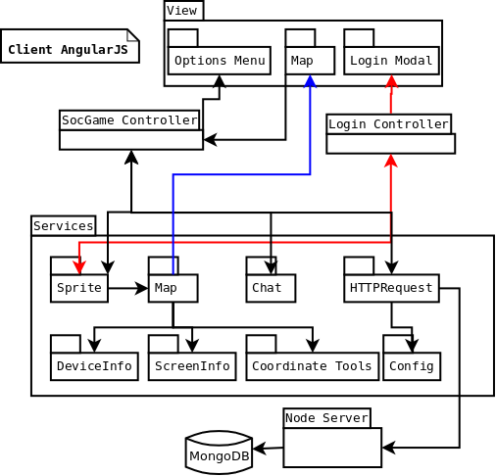
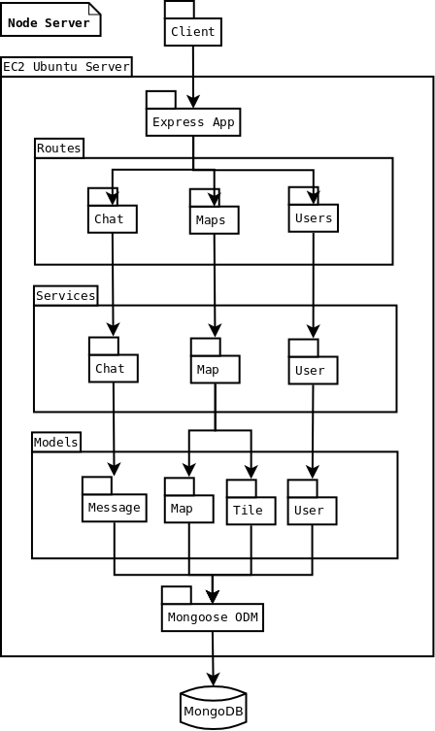


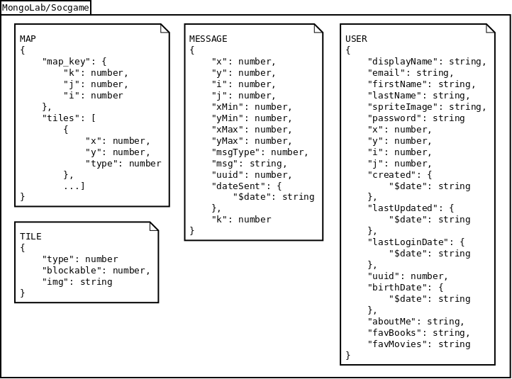
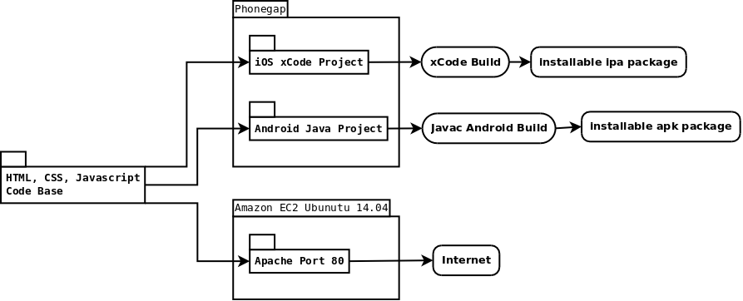
Cross Platform Mobile Application
MEAN Stack and Phonegap
Student Project Symposium
June 2016
CSET
Chris Meyer
Introduction
Architecture
Architecture
Conclusions
Implement a cross platform mobile application entirely in web languages, and try to solve problems related to mobile development with these technologies.
  Client side framework and build system is valid for thin clients
  CSS Animations increased frame rate 10-15 fps
  Image loading time did not improve with server side rendering. Image caching scheme needed.
Comments:
Using Phonegap as a build framework is valid for thin clients that need to access to device resources (camera, file system, etc.). To secure business logic one would have to either use security by obscurity (may not be desirable), or implement native code and access through a wrapper that can interface with JavaScript.
The CSS animation engine was somewhat successful, but needs optimization before it can become a valid production solution.
Fig. 1. Client – Implemented with the AngularJS 1 framework. Manages views, animations, messaging, and profiles.
Additional Information/ Next steps
Fig. 2. Server – Uses RESTful architecture. Manages user logins, real time messaging, map definitions, user map locations, and image rendering for maps.
This project is intended to be a proof of concept to determine the validity of the build framework and to determine if a CSS animation framework is a valid work around for the poor performance of HTML5 canvas in Android 4.4.2 webView.
Next steps are to take the lessons learned from this project and apply them to new ones.
Objectives
Chris Meyer
Christopher.meyer@oit.edu
Problems to Solve:
  Determine validity of a web based mobile app.
  Canvas in Android 4.4.2 webView is 5-8 fps.
  Reduce image rendering time on the client.
Solutions:
  Leverage MEAN stack and Phonegap.
  Implement a small CSS animation framework.
  Render images server side dynamically
Technology Resources:
MongoDB - https://www.mongodb.com/
Express - http://expressjs.com/
AngularJS - https://angularjs.org
NodeJS - https://nodejs.org/en/
Phonegap - http://phonegap.com/
Fig. 3. Database – Persistent storage for user information, message logs, and map definitions.
Fig. 4. Phonegap Build – Takes common web code and creates a project folder for each platform targeted. Each project folder is then built into an installable package for the specified platform.

