Slide 1
Combinatorial Games on Graphs
Shanley Camara

Slide 2
Introduction to Combinatorial Games
Terminology, The Game of Nim, and the Sprague-Grundy Theorem

Slide 3
Combinatorial game terminology
Combinatorial game: A game in which there is no randomization (like dice or flipping a coin) and in which there is perfect information, meaning that both players know everything about the state of the game
This includes tic-tac-toe, checkers, chess, go, etc.
Impartial: An impartial game is one in which there is no difference between the two players except who goes first.
Normal play convention: The first player unable to make a move loses.
misère play convention: The first player unable to make a move wins.

Slide 4
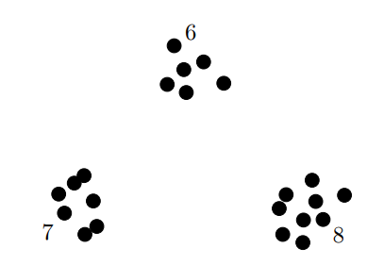
Nim
A classic and ancient impartial combinatorial game played with two players and normal play convention
How to play:
There are three heaps of objects
Players take turns removing any number of objects from a single heap
By normal play convention, the player unable to move loses

Slide 5
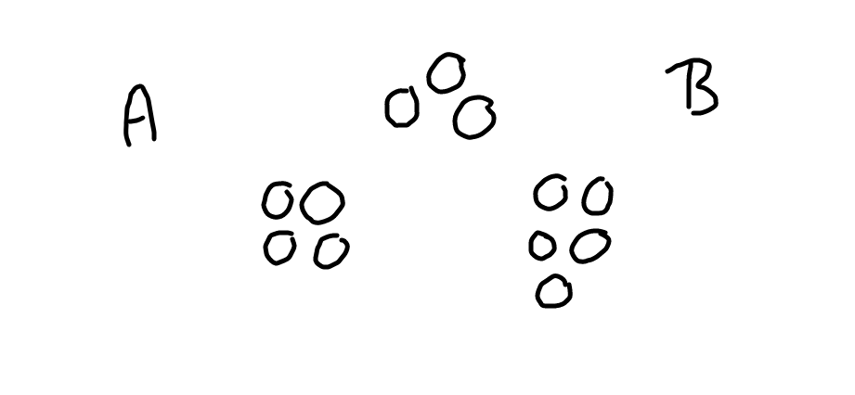

Slide 6
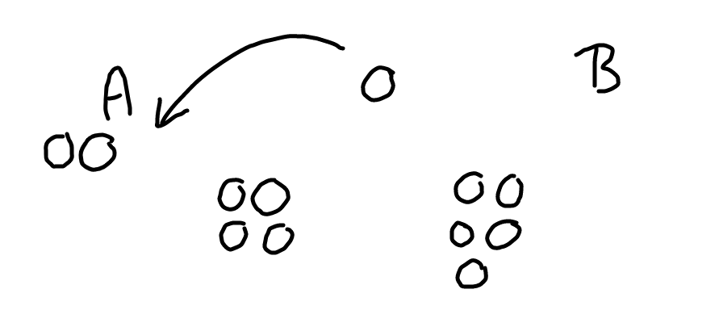

Slide 7
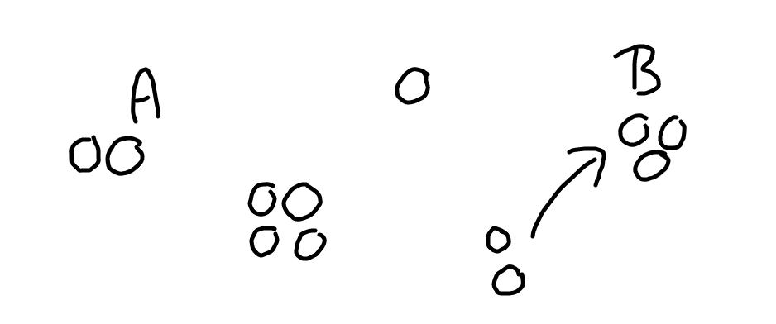

Slide 8
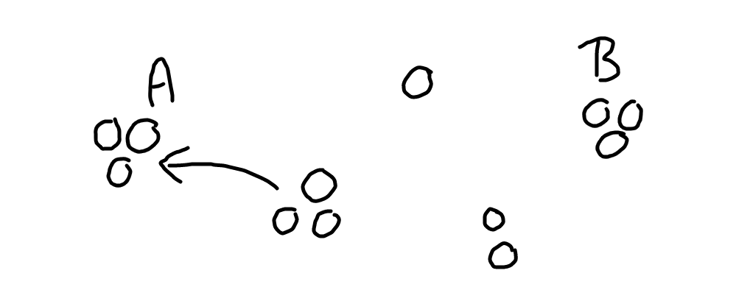

Slide 9
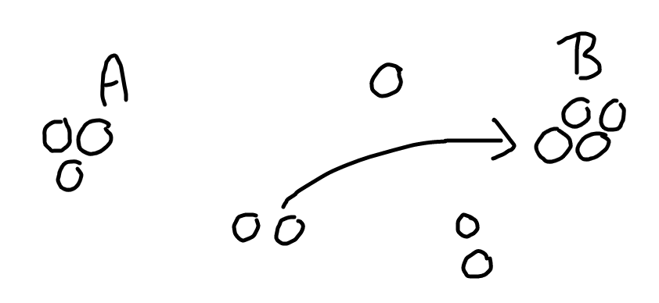

Slide 10
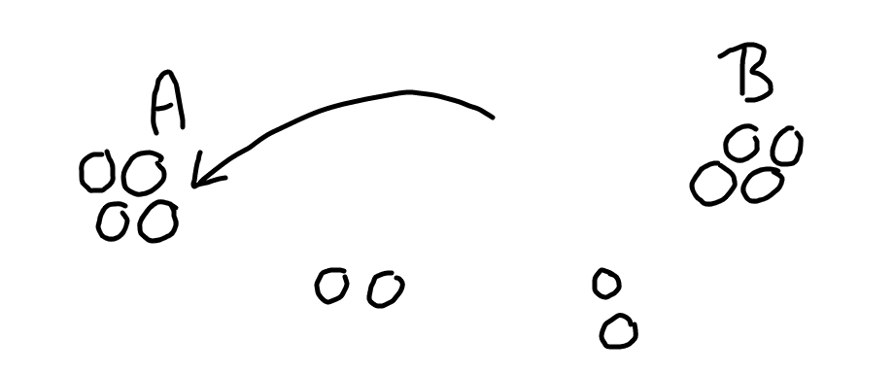

Slide 11
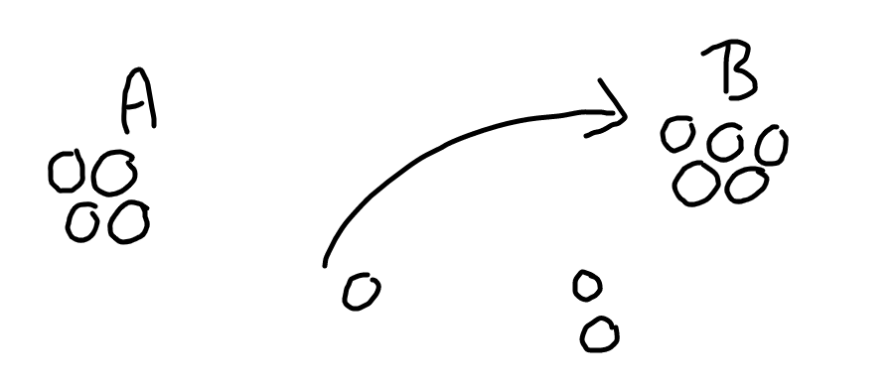

Slide 12
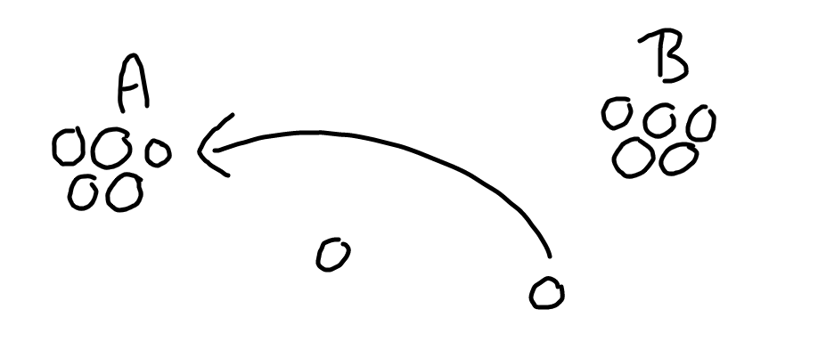

Slide 13
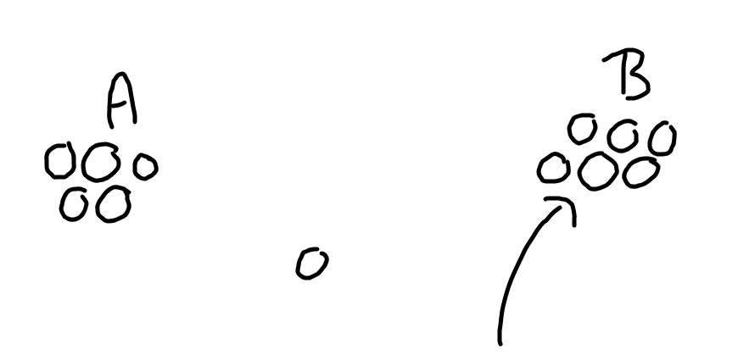

Slide 14
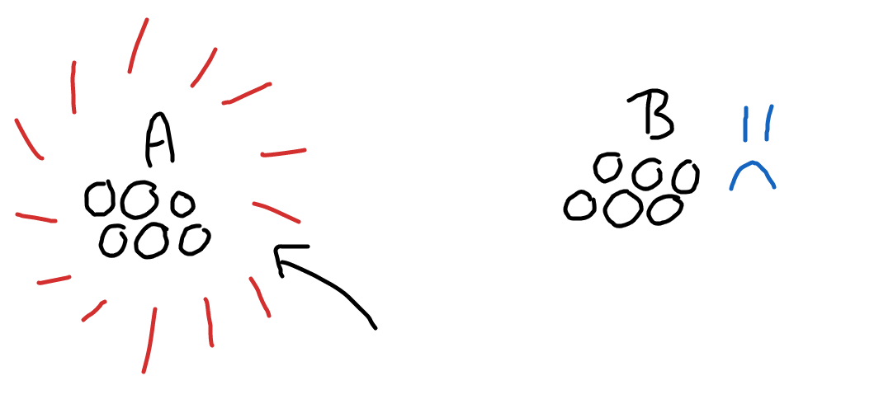

Slide 15
Solving Nim
We saw in the example game that the first player, player A, won the game. The game of Nim has actually been solved, meaning that the outcome of any Nim game can be calculated before the game even begins.
How was Nim Solved?
Firstly, a binary operation called Nim-sum or Xor (exclusive or) is defined and denoted as ⊕
If there are an odd number of 1s being nim-summed, the answer is 1
If there is an even number of 1s being nim-summed, the answer is 0
The heaps are converted into a base-2 binary which follows:
0 0 0 1 numerical value 2⁰
0 0 1 0 numerical value 2¹
0 1 0 0 numerical value 2²
1 0 0 0 numerical value 2³
The binary heaped are nim-summed, if it equates to 0 then the board is in a losing position

Slide 16
Solving Nim
(cont.)
We will look at our example nim game, which had heaps of 3, 4, and 5 objects:
3 = 0011
4 = 0100
5 = 0101
3 ⊕ 4 ⊕ 5 = 0010 = *2 so it is in a winning position to start i.e. player A wins
This resulting value is our Nimber denoted *n, which is used to determine what the player should do to win
The winning player can figure out what move to make next by nim-summing each heap with the nimber:
3 ⊕ 2 = 0011 + 0010 = 0001 = 1
4 ⊕ 2 = 0100 + 0010 = 0110 = 6
5 ⊕ 2 = 0101 + 0010 = 0111 = 7
The only heap that reduces after the nim-sum is 3, so player A should reduce the heap of 3 to the resulting nimber 1 in order to place player B in a losing position

Slide 17
P-positions and N-positions
In the last few slides, we discussed the idea of losing positions and winning positions. This can be more explicitly defined with P-positions and N-positions
P-position: the board is in a state where the previous player to move wins (e.g. a nimber of *0).
N-position: the board is in a state where the next payer to move wins (e.g. a nimber of *1).

Slide 18
Minimum Excluded Value (mex)
The minimum excluded value is the smallest value non-negative integer that is NOT included in a set of non-negative integers.
Examples:
mex{1, 3, 5, 6} = 0
mex{0, 2, 4, 7} = 1

Slide 19
Sprague-Grundy Theorem
Theorem (Sprague 1935, Grundy 1939): Every impartial combinatorial game under the normal play convention is equivalent to a Nimber.
We can use this theorem to create graphs of impartial combinatorial games labeled with P-positions and N-positions, and assign Grundy values using the mex.

Slide 20
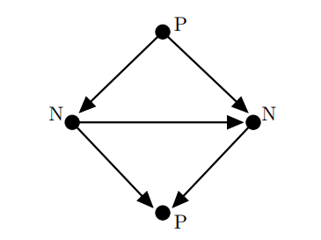
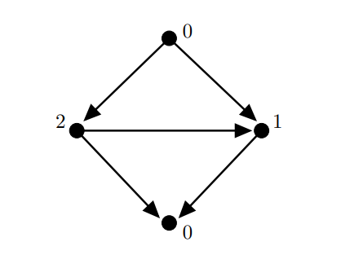
Grundy Graphs and Grundy Numbers
A Grundy graph represents all the possible positions of a game starting with the initial position. To label these with P-positions and N-positions, start by labeling the vertices with no arcs leaving them as “P.” Any vertex that points to a “P” position is an “N.” Any vertex that only points to “N” positions is a “P.”
The Grundy number labeling uses the mex function. We begin by labeling the vertices with no arcs leaving them as 0. Then, the vertices will be labeled based on the mex of the vertices they point to.

Slide 21
Combinatorial Games Played on Graphs
Graph Nim and Game of Thrones

Slide 22
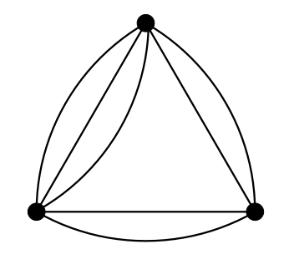
Graph Nim
Graph nim is a representation of nim where you can take objects from two heaps at once, where the objects in adjacent heaps are somehow associated. In the multi-edge graph, the edges represent heaps and each player on their turn can choose a vertex and remove any number of edges that are incident to that vertex.

Slide 23
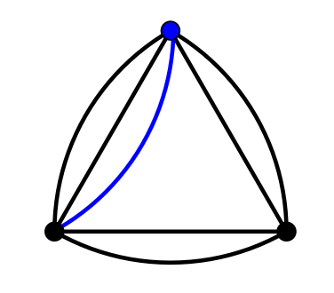

Slide 24
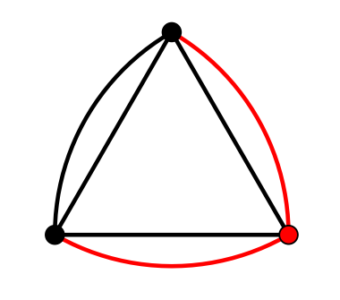

Slide 25
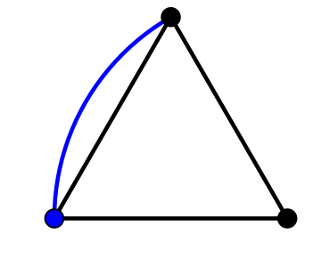

Slide 26
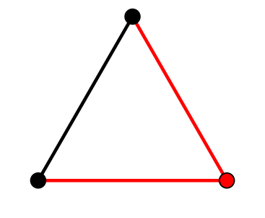

Slide 27
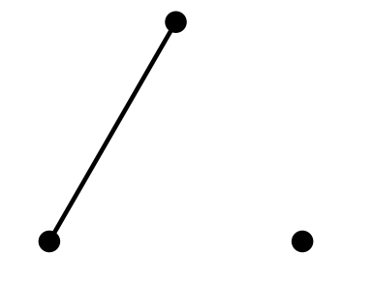

Slide 28
Winning Strategy for 3-vertex Graph Nim
Theorem: The losing position of Graph Nim played on 3-vertex graph is any 3-vertex graph such that there are an equal number of edges incident to every vertex.
Proof: We will be describing the number of edges between two vertices as the weight of an edge. Assume we have the simplest losing position where each edge has weight 1 which we will call G₁, and Player 1 is at this position of the game. Player 1 can pick a vertex and reduce the weight of one edge to zero or two edges to zero. Either way, Player 2 will be able to remove the rest of the edges and win. If we have a position where every edge has weight 2, which we will call G₂, and Player one reduces one or two edges to weight 1, then Player 2 can reduce the graph to the simplest losing position G₁. So for any G_{k} where k is the weight of each edge, no matter what Player 1 does Player 2 can always reduce it to a smaller weight.

Slide 29
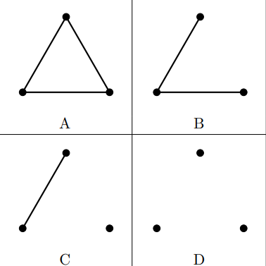
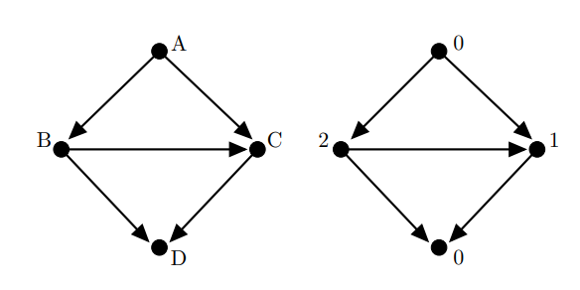
Sprague-Grundy and 3-Vertex Graph Nim
We will be examining Sprague-Grundy of the 3-vertex Graph Nim where there the weight is limited to one or less per edge.
The picture to the left shows every possible position of 3-vertex Graph Nim under this condition.
The picture below shows the Sprague-Grundy graph for a game of 3-vertex Graph Nim with starting position A.
We can see that this game has a nimber of 0*, as shown by the Grundy numbers.

Slide 30
Game of Thrones
Played on a type of graph called tournaments, which are complete directed graphs or digraphs.
If there is an edge from x to y, we say that x beats y. The score of a vertex is how many vertices it beats.
A king in a tournament is a vertex v such that for every other vertex x, there exists either an edge from v to x OR there exists a vertex y such that there is an edge from v to y AND y to x.
Players take turns removing vertices where the next player will play on the induced subgraph of the tournament, and ends when there is exactly one king left in the tournament

Slide 31
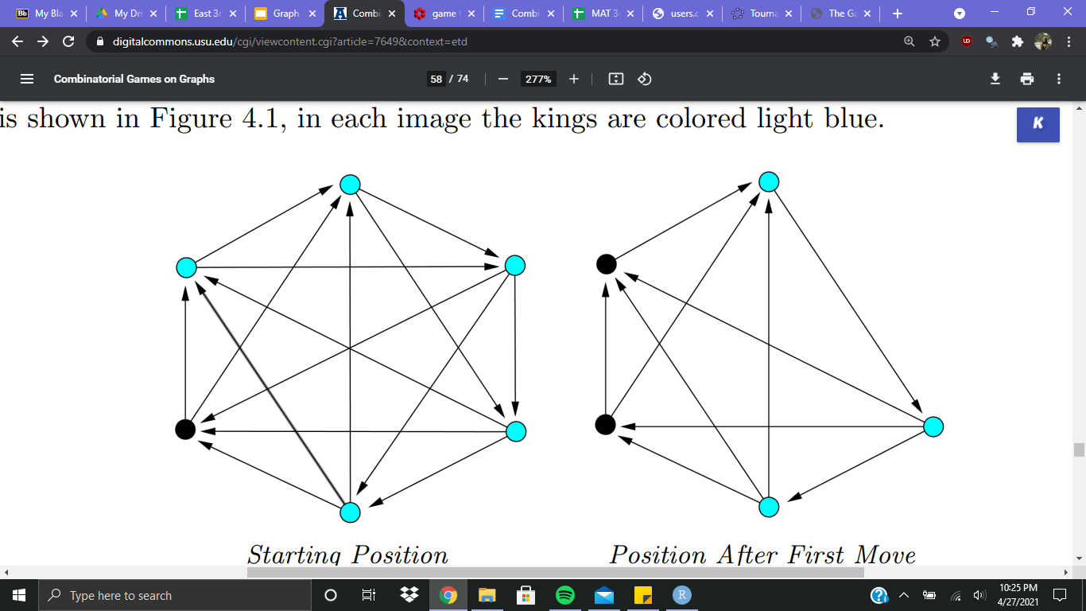

Slide 33
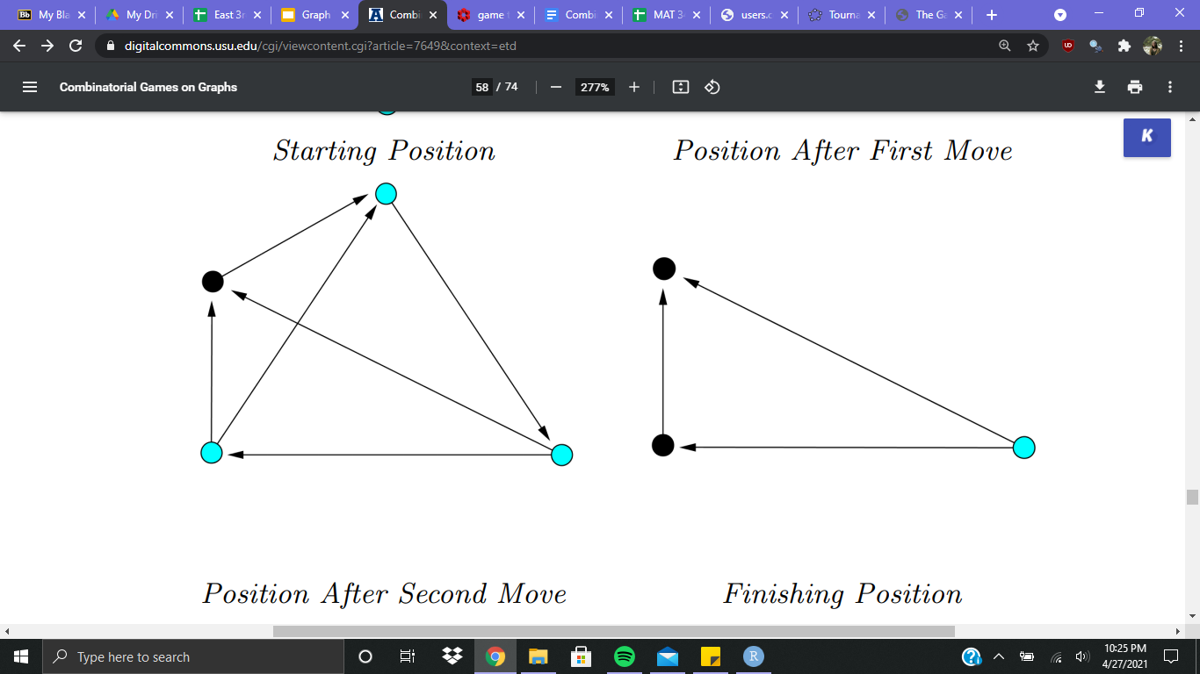

Slide 35
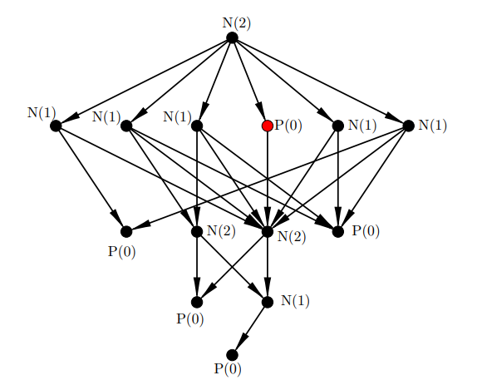
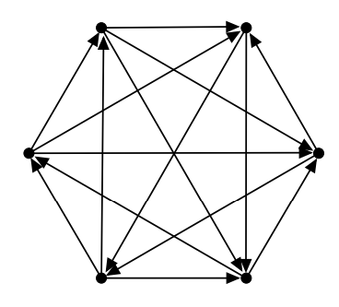
Sprague-Grundy and Game of Thrones
Here is out Sprague-Grundy labeled graph of Game of Thrones on the 6-vertex tournament to the left. We can see that this tournament is in a winning position for the first player if they make a specific move.

Slide 36
Game of Thrones Applet
Following the JavaScript code in Trevor’s William’s 2017 dissertation, I was able to recreate his tournament’s applet in GeoGebra. It takes in a binary string that represents the adjacencies of the upper triangle of a tournament and creates a tournament that can show/hide any kings. When in edit mode, you can manually delete vertices to play the game.
Find applet here: https://www.geogebra.org/m/gfc8v9dz
Find tournaments here: http://users.cecs.anu.edu.au/~bdm/data/digraphs.html
Or you may email me for a downloaded .ggb file for use on desktop GeoGebra scamara1@une.edu.

Slide 37
Sum of Graph Games
What if we played Graph Nim and Game of Thrones at the same time? On a players turn, they select either Graph Nim or Games of Thrones to make a move. A game formed by combining games is called the disjunctive sum of games.
If we have n progressively bounded graphs (limited for the purpose of only finite games), the game played combining all graphs is graph G or the sum of G₁, G₂, …, G_{n}.
G = (X, F), where X is the cartesian product of all sets of vertices {X₁, X₂, …, X₃}

Slide 38
Sprague-Grundy of Sum Graph Games
The Sprague-Grundy function for a sum of graph games is the nim sum of the Sprague-Grundy functions of the individual graph games.
If g_{i} is the Sprague-Grundy function of G_{i}, i = 1, ..., n, then G = G₁ + ··· + G_{n} has Sprague-Grundy function g(x₁, ..., x_{n}) = g₁(x₁) ⊕··· ⊕ g_{n}(x_{n}).
Rather than make a new Sprague-Grundy graph for all possible positions of a sum of graph games, we can take the nim sum of the Grundy values for already known games.

Slide 39
Sum of Graph Nim and Game of Thrones
Here on the left we have our known Game of Thrones position, which we will denote G₁ and we know that g₁ = 2. On the right is our Graph Nim game, which we will denote G₂, where g₂ = 7.
2 = 0010
7 = 0111
2⊕7 = 0101 = *5
Our sum of these two graph games is *5, which means that it is in a winning position if the next player makes the right move.

Slide 40
Sources
https://en.wikipedia.org/wiki/Sprague%E2%80%93Grundy_theorem#Proof
https://digitalcommons.usu.edu/cgi/viewcontent.cgi?article=7649&context=etd
https://www.cs.cmu.edu/afs/cs/academic/class/15859-f01/www/notes/comb.pdf
https://math.rice.edu/~michael/teaching/2012Fall/nim.pdf

