Slide 1

Elm
Functional reactive programming for the browser

Slide 2
Agenda
Elm Architecture by example
Why Elm?
Is it production ready?

Slide 3
An Elm Program

Slide 4
type alias Model = Int
type Msg
= Add
| Sub
init : Model
init = 0
update : Msg -> Model -> Model
update msg model =
case msg of
Add ->
model + 1
Sub ->
model - 1
view : Model -> Html Msg
view model =
div []
[ span [] [text (toString model)]
, button [ onClick Add ] [ text "+" ]
, button [ onClick Sub ] [ text "-" ]
]

Slide 5
type alias Model = Int
init : Model
init = 0

Slide 6
type Msg
= Add
| Sub
update : Msg -> Model -> Model
update msg model =
case msg of
Add ->
model + 1
Sub ->
model - 1

Slide 7
view : Model -> Html Msg
view model =
div []
[ span [] [text (toString model)]
, button [ onClick Add ] [ text "+" ]
, button [ onClick Sub ] [ text "-" ]
]

Slide 8
Model
View
Controller

Slide 9
Elm
DOM
Model
View
Update

Slide 10
Elm
DOM
Model
View
Update
Model

Slide 11
Elm
DOM
Model
View
Update
HTML

Slide 12
Elm
DOM
Model
View
Update
Model
Msg

Slide 13
Elm
DOM
Model
View
Update
Model

Slide 14
Characteristics

Slide 15
An Elm program has / is
only true (pure) functions (no side effects)
immutable data
no state (DOM / Model)

Slide 16
Benefits

Slide 17
testing of stateless / pure functions is easy
testing without global state is easy
better maintainability
no concurrency problems
Time Travel Debugger (build-in)(debug.elm-lang.org)

Slide 18
Performance ?

Slide 19
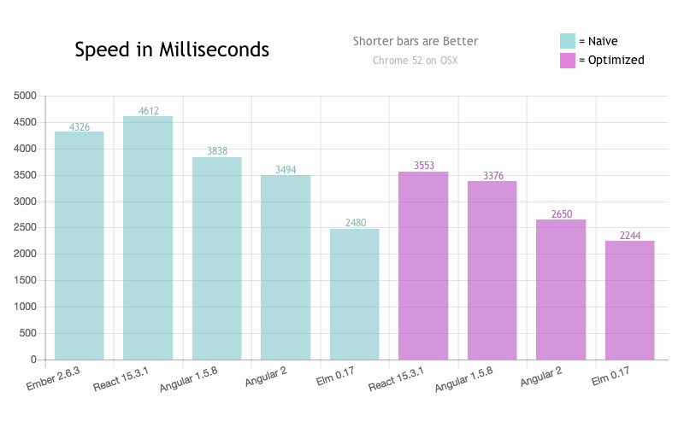
http://elm-lang.org/blog/blazing-fast-html-round-two

Slide 20
Reactive

Slide 21
Elm
DOM
Model
View
Update

Slide 22
Elm
DOM
Model
View
Update
Model

Slide 23
Elm
DOM
Model
View
Update
HTML + Sub

Slide 24
Elm
DOM
Model
View
Update
Model
Msg

Slide 25
Elm
DOM
Model
View
Update
Model

Slide 26
Elm
DOM
Model
View
Update
Model

Slide 27
Elm
DOM
Model
View
Update
HTML + Sub

Slide 28
Elm
DOM
Model
View
Update
Model
Msg

Slide 29
Elm
DOM
Model
View
Update
Model

Slide 30
Elm
DOM
Model
View
Update
Model

Slide 31
Elm
DOM
Model
View
Update
HTML + Sub

Slide 32
driven by events (messages)
view function delivers not only HTML but ‘subscriptions’ to DOM events

Slide 33
view : Model -> Html Msg
view model =
div []
[ span [] [text (toString model)]
, button [ onClick Add ] [ text "+" ]
, button [ onClick Sub ] [ text "-" ]
]

Slide 34
How to subscribe to other events? (WebSockets, URL changes, ...)

Slide 35
type alias Model = Time
type Msg
= Tick Time
init : (Model, Cmd Msg)
init =
(0, Cmd.none)
update : Msg -> Model -> (Model, Cmd Msg)
update msg model =
case msg of
Tick time ->
(time, Cmd.none)
view : Model -> Html Msg
view model =
div []
[ span [] [text (model |> toString)]
]
subscriptions : Model -> Sub Msg
subscriptions model =
Time.every Time.second Tick

Slide 36
subscriptions : Model -> Sub Msg
subscriptions model =
Time.every Time.second Tick
update : Msg -> Model -> (Model, Cmd Msg)
update msg model =
case msg of
Tick time ->
(time, Cmd.none)

Slide 37
Elm
DOM
Model
View
Update
Sub

Slide 38
Elm
DOM
Model
View
Update
Model
Model
Sub

Slide 39
Elm
DOM
Model
View
Update
HTML + Sub
Sub
Sub

Slide 40
Elm
DOM
Model
View
Update
Model
Msg
Sub

Slide 41
Elm
DOM
Model
View
Update
Model
Sub

Slide 42
Elm
DOM
Model
View
Update
Model
Model
Sub

Slide 43
Elm
DOM
Model
View
Update
HTML + Sub
Sub
Sub

Slide 44
Side effects

Slide 45
How to work with side effects? (REST call, Websocket send, ...)

Slide 46
update : Msg -> Model -> ( Model, Cmd Msg )
update msg model =
case msg of
ReqRndVal ->
( model, Random.generate NewRndVal (Random.int 1 100) )
NewRndVal value ->
( value, Cmd.none )
view : Model -> Html Msg
view model =
div []
[ span [] [ text (toString model) ]
, button [ onClick ReqRndVal ]
[ text "New random value" ]
]

Slide 47
Elm
DOM
Model
View
Update
Sub

Slide 48
Elm
DOM
Model
View
Update
Model
Model
Sub

Slide 49
Elm
DOM
Model
View
Update
HTML + Sub
Sub
Sub

Slide 50
Elm
DOM
Model
View
Update
Model
Msg
Sub

Slide 51
Elm
DOM
Model
View
Update
Model + Cmd
Sub

Slide 52
Elm
Execute
DOM
Model
View
Update
Sub

Slide 53
Elm
DOM
Model
Msg
View
Update
Model
Sub

Slide 54
Elm
DOM
Model
View
Update
Model
Sub

Slide 55
Elm
DOM
Model
View
Update
Model
Model
Sub

Slide 56
Elm
DOM
Model
View
Update
HTML + Sub
Sub
Sub

Slide 57
type Msg
= RestPost User
| RestPostResult (Result Http.Error UserId)
update : Msg -> Model -> ( Model, Cmd Msg )
update msg model =
case msg of
RestPost user ->
( model, RestClient.postUser RestPostResult user )
RestPostResult (Ok userId) ->
(model, Cmd.none)
RestPostResult (Err error) ->
(model, Cmd.none)

Slide 58
side effects are delegated to Elm runtime
Elm program is free of side effect → purely functional

Slide 59
Why Elm?

Slide 60
Why Elm ?
Why functional ?

Slide 61
no mutable state
no side effects
⇒ testable
⇒ predictable
⇒ understandable

Slide 62
Why Elm ?
Why not JavaScript ?

Slide 63
ML class language
concise
⇒ easy to understand
strongly typed
static
side effect free
⇒ if it compiles it won’t crash

Slide 64
Why Elm ?
Why not PureScript ?

Slide 65
only basic language features
opinionated framework
made for one purpose
⇒ easy to get into (Elm to PureScript is like C to C++)
⇒ similar architecture and design

Slide 66
Is Elm ready for production?

Slide 67
Pro:
Performance of JavaScript
DOM Performance (Graph)
Stable
Active community

Slide 68
Con:
Language and Libraries not final
very helpful with migrations
Tooling not mature (package management)
Documentation

Slide 69
Give it a try, but be warned: it is addictive
© 2017 Steffen Eichenberg

