Slide 1

Elm
Functional reactive programming for the browser

Slide 2


Slide 3
Agenda
Elm by example
Why Elm?
Is it production ready?

Slide 4
An Elm Program

Slide 5
type alias Model = Int
type Msg
= Add
| Sub
init : Model
init = 0
update : Msg -> Model -> Model
update msg model =
case msg of
Add ->
model + 1
Sub ->
model - 1
view : Model -> Html Msg
view model =
div []
[ span [] [text (toString model)]
, button [ onClick Add ] [ text "+" ]
, button [ onClick Sub ] [ text "-" ]
]

Slide 6
The Model

Slide 7
type alias Model = Int
init : Model
init = 0

Slide 8
The View

Slide 9
view : Model -> Html Msg
view model =
div []
[ span [] [text (toString model)]
, button [ onClick Add ] [ text "+" ]
, button [ onClick Sub ] [ text "-" ]
]

Slide 10
The Controller Update

Slide 11
type Msg
= Add
| Sub
update : Msg -> Model -> Model
update msg model =
case msg of
Add ->
model + 1
Sub ->
model - 1

Slide 12
Model
View
Controller

Slide 13
Elm
DOM
Model
View
Update

Slide 14
Elm
DOM
Model
View
Update
Model

Slide 15
Elm
DOM
Model
View
Update
HTML

Slide 16
Elm
DOM
Model
View
Update
Model
Msg

Slide 17
Elm
DOM
Model
View
Update
Model’

Slide 18
… let’s watch it live ...

Slide 19
Characteristics

Slide 20
An Elm program always consists of
Model
View
Update

Slide 21
An Elm program has / is
static+strongly typed
only true (pure) functions (no side effects)
immutable data

Slide 22
Benefits

Slide 23
Better understandability

Slide 24
Testing of pure functions is easy

Slide 25
No concurrency problems

Slide 26
If it compiles, it will not crash!

Slide 27
Time Travel Debugger (build-in)(debug.elm-lang.org)

Slide 28
Performance ?

Slide 29
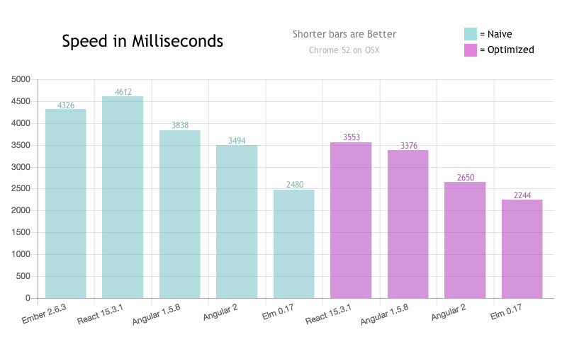
Virtual DOM + functional
http://elm-lang.org/blog/blazing-fast-html-round-two

Slide 30
Reactive

Slide 31
Elm
DOM
Model
View
Update

Slide 32
Elm
DOM
Model
View
Update
Model

Slide 33
Elm
DOM
Model
View
Update
HTML + Sub

Slide 34
Elm
DOM
Model
View
Model
Update
Msg

Slide 35
Elm
DOM
Model
View
Update
Model’

Slide 36
Elm
DOM
Model
View
Update
Model

Slide 37
Elm
DOM
Model
View
Update
HTML + Sub

Slide 38
view : Model -> Html Msg
view model =
div []
[ span [] [text (toString model)]
, button [ onClick Add ] [ text "+" ]
, button [ onClick Sub ] [ text "-" ]
]

Slide 39
driven by DOM events (messages)
view function delivers HTML plus ‘subscriptions’ to DOM events

Slide 40
How to subscribe to other events? (WebSockets, URL changes, ...)

Slide 41
type alias Model = Time
type Msg
= Tick Time
init : (Model, Cmd Msg)
init =
(0, Cmd.none)
update : Msg -> Model -> (Model, Cmd Msg)
update msg model =
case msg of
Tick time ->
(time, Cmd.none)
view : Model -> Html Msg
view model =
div []
[ span [] [text (model |> toString)]
]
subscriptions : Model -> Sub Msg
subscriptions model =
Time.every Time.second Tick

Slide 42
type alias Model = Time
init : (Model, Cmd Msg)
init =
(0, Cmd.none)

Slide 43
type Msg
= Tick Time
subscriptions : Model -> Sub Msg
subscriptions model =
Time.every Time.second Tick
update : Msg -> Model -> (Model, Cmd Msg)
update msg model =
case msg of
Tick time ->
(time, Cmd.none)

Slide 44
Elm
DOM
Model
View
Update
Sub

Slide 45
Elm
DOM
Model
View
Update
Model
Model
Sub

Slide 46
Elm
DOM
Model
View
Update
HTML + Sub
Sub
Sub

Slide 47
Elm
DOM
Model
View
Update
Model
Msg
Sub

Slide 48
Elm
DOM
Model
View
Update
Model’
Sub

Slide 49
Elm
DOM
Model
View
Update
Model
Model
Sub

Slide 50
… let’s watch it live ...

Slide 51
Side effects

Slide 52
How to work with side effects? (REST call, Websocket send, ...)

Slide 53
view : Model -> Html Msg
view model =
div []
[ span [] [ text (toString model) ]
, button [ onClick ReqRndVal ] [ text "New random value" ]
]

Slide 54
type alias Random =
{ rnd : Int
}
type alias Model =
Int
type Msg
= ReqRndVal
| NewRndVal (Result Http.Error Random)

Slide 55
update : Msg -> Model -> ( Model, Cmd Msg )
update msg model =
case msg of
ReqRndVal ->
( model, makeRESTRequestForRnd NewRndVal )
NewRndVal (Err error) ->
( model, Cmd.none )
NewRndVal (Ok result) ->
( result.rnd, Cmd.none )

Slide 56
Elm
DOM
Model
View
Update
Sub

Slide 57
Elm
DOM
Model
View
Update
Model
Model
Sub

Slide 58
Elm
DOM
Model
View
Update
HTML + Sub
Sub
Sub

Slide 59
Elm
DOM
Model
View
Update
Model
Msg
Sub

Slide 60
Elm
DOM
Model
View
Update
Model + Cmd
Sub

Slide 61
Elm
Execute
DOM
Model
View
Update
Sub

Slide 62
Elm
DOM
Model
Msg
View
Update
Model
Sub

Slide 63
Elm
DOM
Model
View
Update
Model’
Sub

Slide 64
Elm
DOM
Model
View
Update
Model’
Model’
Sub

Slide 65
Elm
DOM
Model
View
Update
HTML + Sub
Sub
Sub

Slide 66
… let’s watch it live ...

Slide 67
side effects are delegated to Elm runtime
Elm program is free of side effect → purely functional

Slide 68
Why Elm?

Slide 69
Simple architecture pattern
+
fail-safe language
reactive
functional (pure, immutable, static+strong typed)
managed state
separation of concerns

Slide 70
⇒ robust
⇒ testable
⇒ predictable
⇒ understandable

Slide 71
Is Elm ready for production?

Slide 72
Pro:
Performance of JavaScript
DOM Performance
Stable
Active community

Slide 73
Con:
Language and Libraries not final
very helpful with migrations
Tooling not mature (package management)
Documentation

Slide 74

Give it a try, but be warned: it is addictive
© 2017 Steffen Eichenberg

Slide 75
Why Elm ?
Why not PureScript ?

Slide 76
only basic language features
opinionated framework
made for one purpose
⇒ easy to get into (Elm to PureScript is like C to C++)
⇒ similar architecture and design

