Slide 1
Fetal Health Classification
BBM469 Data Intensive Applications Laboratory
Data Science Capstone Project
Sadık Can Acar - 21626843
Mustafa Kollu - 21627485

Slide 2

Problem
Although the quality of prenatal care is still improving and the fetus mortality rate decreases every year, the death of a fetus in its later stages of development is still a very real possibility. Therefore, fetus observation and actual state evaluation is very important throughout the whole gestation.

Slide 3
The questions that are need to be answer to solve the problem :
1. How accurately can we make a healthy diagnosis for a fetus?
2. Are costly and difficult tests and procedures required to control the health of the fetus? Can we draw conclusions about fetus health from past data using machine learning?

Slide 4
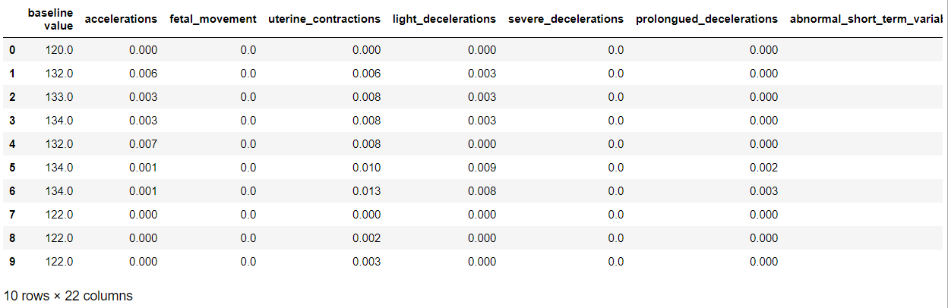
Data Review

Slide 5
Import Library
The project has been implemented using python machine learning libraries:
Linear Algebra - numpy
Data Processing - pandas
Visualization - matplotlib, seaborn
Algorithms - scikit-learn
Input File – CSV [fetal_health.csv]

Slide 6
Data Understanding
The stage of understanding the data, 'Is the collected data sufficient to solve our problem?' answers the question. We examined the rows and columns of our data in the process of understanding the data. We will draw graphs such as histograms and interpret our data set for a better understanding of the data.

Slide 7
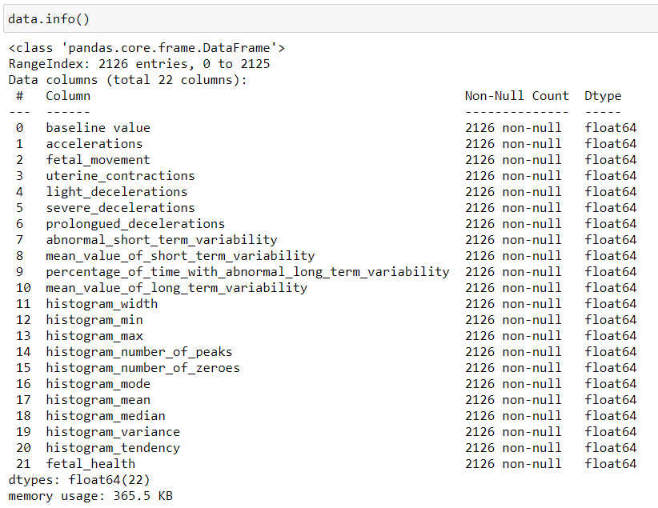
Checking Data Information
Checking column types, missing values, number of columns-rows

Slide 8
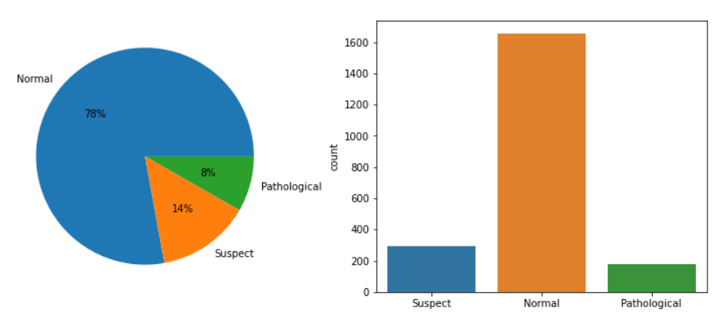
Target Column Review
When we look at the 'fetal_health' column, which is our target label, we see that the majority of fetuses are healthy. Still, we see that the health of fetuses is undeniably suspicious and pathological.

Slide 9
Data Preparation
In the data preparation phase, there are all the activities that create the data to be used for modeling. In the data understanding part of our project, we observed that our data is not very complex. There were problems in some places, such as column capitals. In the data preparation phase, we will clean our data, check the missing and duplicate data, and adapt our data to machine learning approaches.

Slide 10
Data Cleaning
Looking at Data Quality - Checking Missing Values
Removing Duplicate Rows
Renaming Columns
Removing Dirties (Unnecessary columns, ineffective columns, Columns with low correlation etc. )

Slide 11
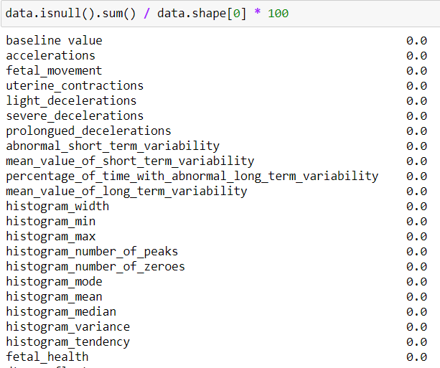
Checking Missing Values

Slide 12
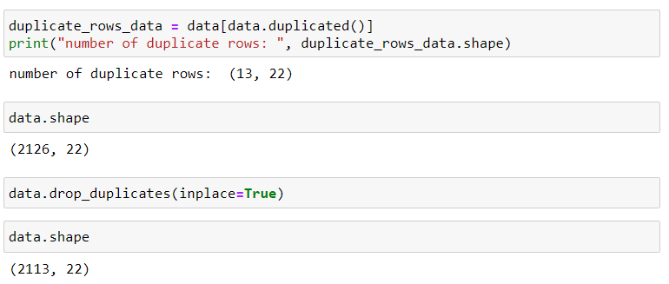
Removing Duplicate Rows

Slide 13
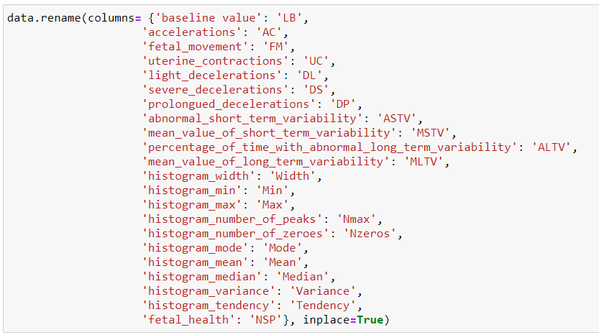
Renaming Columns

Slide 14
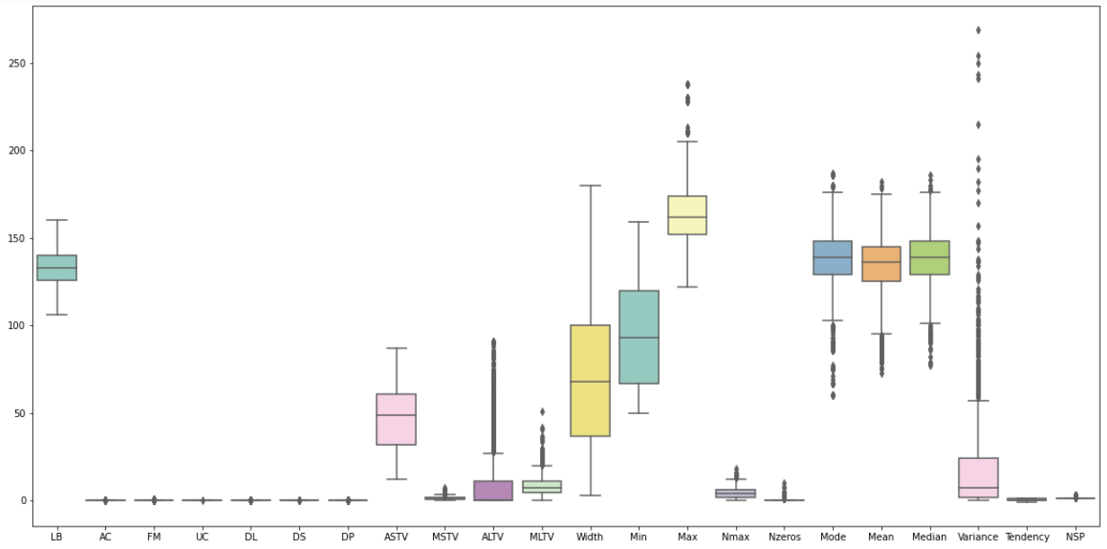
Checking Outliers

Slide 15
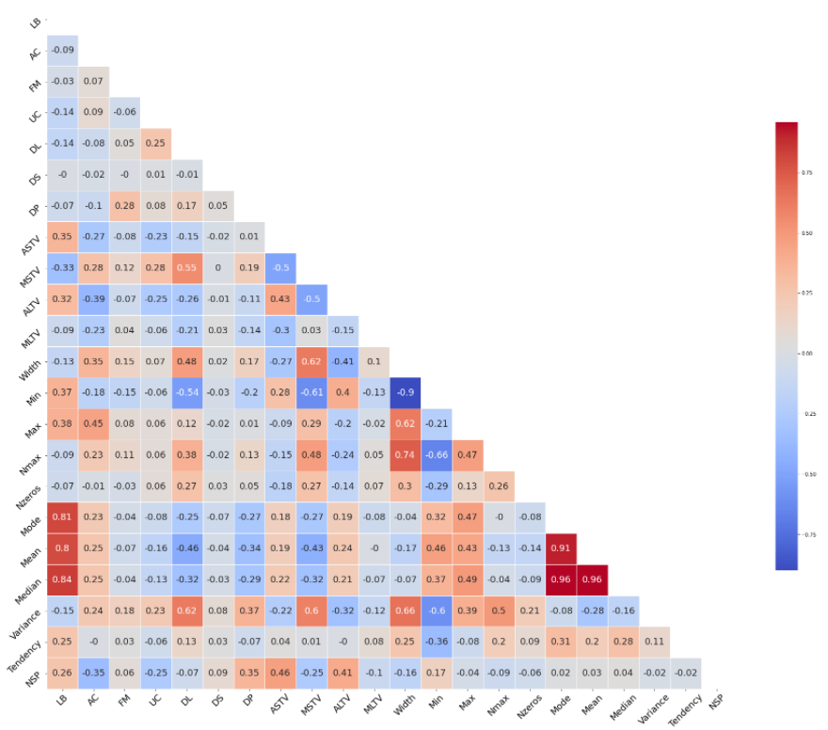
Correlation
Correlation between all features

Slide 16
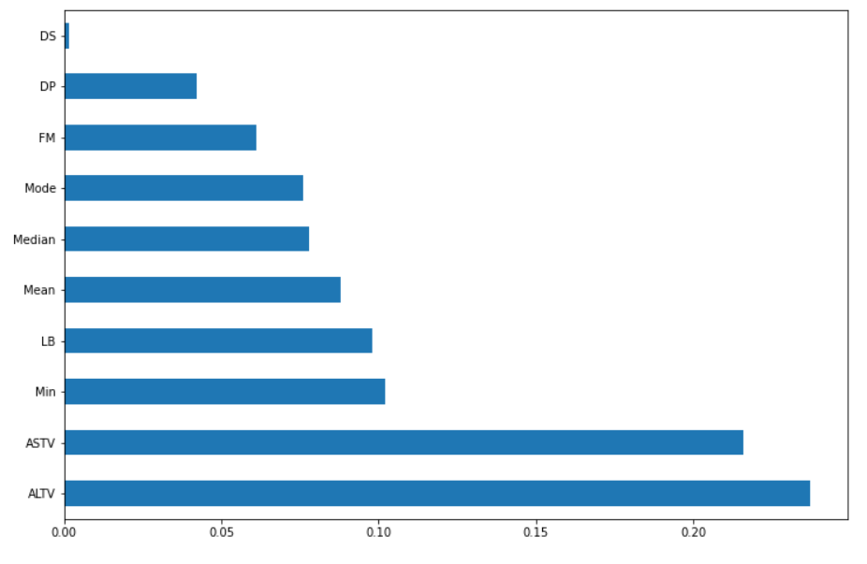
Feature Importance

Slide 17
Train-Test Split
Labeled Data
Train Data
Test Data
%75
%25
MinMaxScaler
Numerical Data
Normalized Data

Slide 18
Modeling
In the modeling phase, we make predictions using machine learning approaches on the data set we have prepared. The data set we use in these approaches is the training set. The modeling process is repeated for 5 approaches.

Slide 19
Supervised Learning
Classification Algorithms
92.2%
90.5%
87.9%
91.5%
81.6%
Random Forest Classifier
K-Nearest Neighbors
Decision Tree Classifier
Support Vector Machines
Gaussian Naive Bayes

Slide 20
Hyperparameters Tuning
Random Forest
We used GridSearchCV to calculate the best parameters in our models. We evaluated our models using the best estimator we got with the GridSearchCV results.
K-NN
DATA
GridSearchCV
Decision Tree
SVM
Gaussian Naive Bayes

Slide 21
Evaluation
The evaluation phase evaluates the quality of the models created and checks whether they respond fully and appropriately to the problem. Doing this requires the calculation of various diagnostic measures - other outputs such as tables and graphs, using a test set for the estimated model.

Slide 22
Evaluating a Classification Model
Train / Test Accuracy : Percentage of correct predictions across the results we have.
Classification Report : To evaluate values such as precision, recall, f1-score
Confusion Matrix : Table that describes the performance of a classification model and how correctly it is classifying result
Roc Curve : It tells how much model is capable of distinguishing between classes.

Slide 23
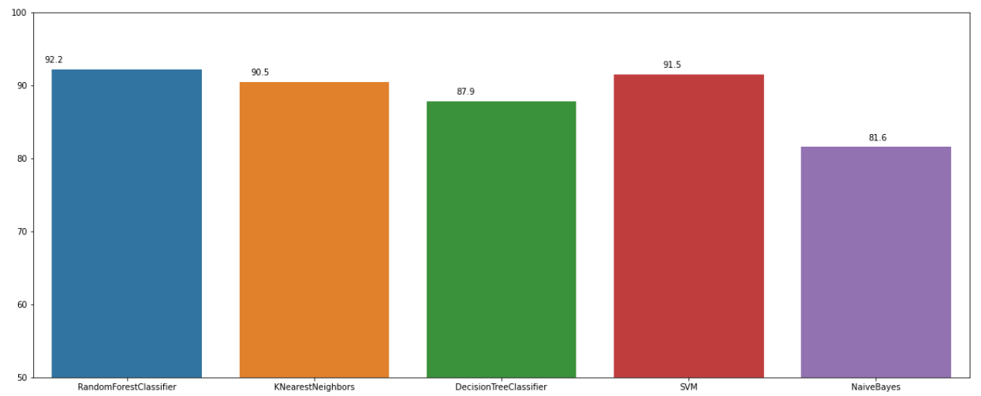
Success of Our Models

Slide 24
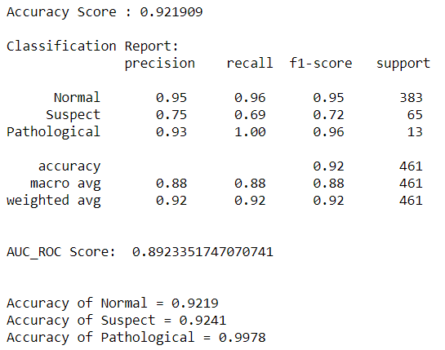
The Most Successful Classifier
Random Forest Classifier

Slide 25
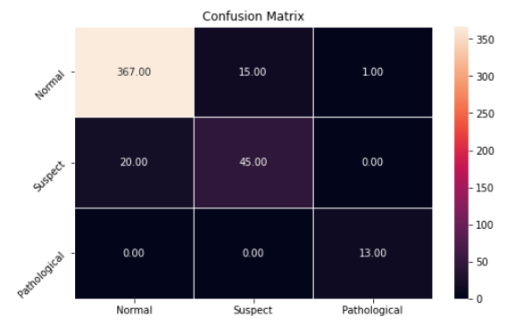
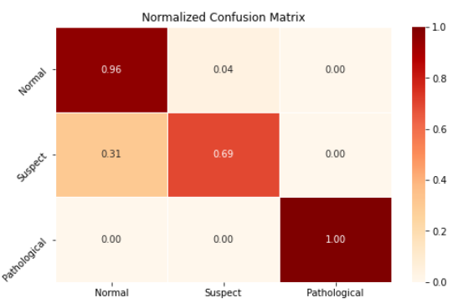
Random Forest Confusion Matrices

Slide 26
References
1. Kaggle Dataset : https://www.kaggle.com/andrewmvd/fetal-health-classification
2. Article : https://www.ncbi.nlm.nih.gov/pmc/articles/PMC6822315/
3. Medium Notebook : https://medium.com/analytics-vidhya/classification-fetal-health-bd578beae25
4. Article : https://www.researchgate.net/publication/258858381_Classification_of_Fetal_State_from_the_Cardiotocogram_Recordings_using_ANN_and_Simple_Logistic
5. Kaggle Notebook : https://www.kaggle.com/sociopath00/random-forest-using-gridsearchcv
6. Lecture Notes : http://yunus.hacettepe.edu.tr/~akal/BBM467/
7. Datacamp : https://learn.datacamp.com/

