Slide 1
Test-Driven Development of a new Critical Decoder
Micah Dowty

Slide 2
The Citizen Explorer's
Critical Decoder
Microcontroller board located in the C&DH box, responsible for:
  Controlling power to the other microcontrollers and the flight computer
  Command routing in “critical mode” when the flight computer is unavailable
  Reading critical analog and digital sensors
  Controlling the radio transmit power
  Watchdog and power-on timers

Slide 3
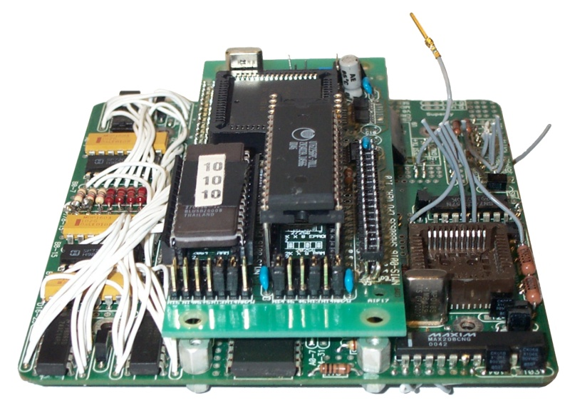
The Old CD
Many problems, hidden until recently
Very little correct documentation
The one working board was physically damaged

Slide 4
Hidden Problems
Relay drivers underspecified
Software locks up under heavy load
  Overuse of buffers
  Not fully async
Data corruption in critical mode
Watchdog used ineffectively, SEUs could still cause unrecoverable failure

Slide 5
The Last Straw
The one working board was damaged:
  Bad IC sockets
  Many IC failures due to power supply overvoltage
  Too many wires, many of which were failing
No documentation on building a replacement

Slide 6
The Biggest Design Flaw...
There was no good way to test the Critical Decoder, so these problems were only discovered long after the design was “done”

Slide 7
Replacing the CD
Several relatively obvious design changes could be made:
  Simplify by removing unused features
  Simplify by rethinking the design
  Robust fully-asynchronous software with real-time constraints
  SEU robustness and extra layers of protection (supervisor chip)
  All on one simple PCB, no wires

Slide 8
Not Quite Enough...
Starting with an improved design doesn't prevent the same problems from occurring again
Other satellite testing will be happening concurrently, so we need a usable prototype as quickly as possible
Comprehensive testing is imperative, to prevent hidden problems

Slide 9
A Different Development Methodology
We adopted Test Driven Development from the software world to work on embedded systems with custom hardware and software
Popularized by Extreme Programming
Write failing test cases for necessary functionality, then make the simplest software that passes 100% of the tests

Slide 10
Advantages of Test Driven Development
The prototype is always fully integrated and working, with a subset of its final functionality
Comprehensive tests protect against regression and provide an easy way to verify completed hardware
Encourages simple designs with refactoring when necessary
Developers don't have to worry about refactoring causing hidden problems
The test harness acts as an executable test procedure, and should always be up to date

Slide 11
Compared to Traditional Testing
It is common to test each component of an embedded system with a specialized tool:
  PCB electrical testing
  Firmware debuggers and simulators
  VHDL/Verilog simulation
These tools are still useful when available, but are often expensive and don't test a fully integrated device

Slide 12
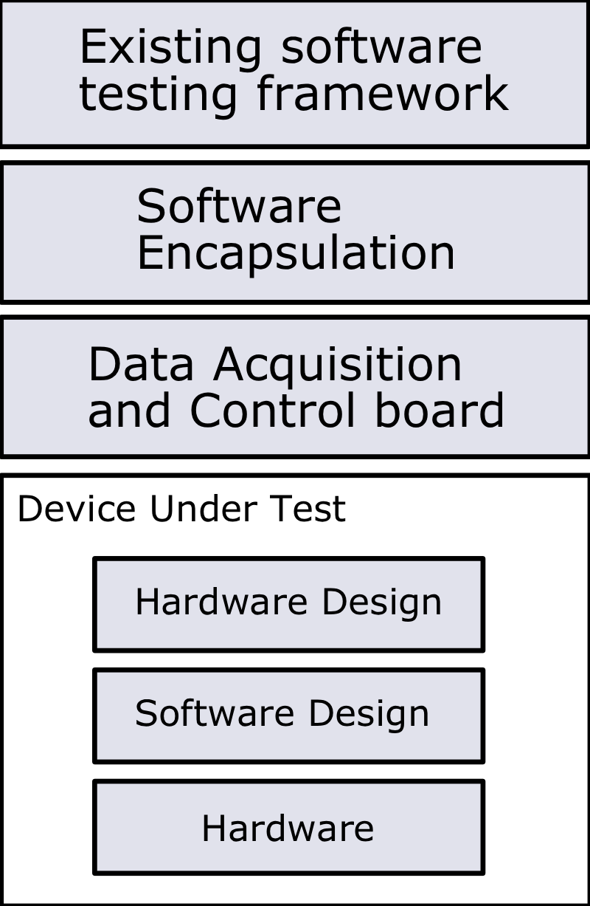
Software Encapsulation Method
The entire embedded system under test is wrapped in a software layer
This software layer is then tested with existing methods

Slide 13
Special Concerns with Software Encapsulation
The software encapsulation must preserve all of the hardware's likely failure modes
Hardware contains similar failure modes to those in software, plus some only seen in hardware: bus timing errors, loose wires, faulty components, etc.

Slide 14
Applying Software Encapsulation to the CD
Requirements for DAQ/control board:
  Speed isn't very important
  Digital I/O, analog I/O, RS-232, RS-485
Rather than an expensive commercial DAQ/control solution, a simple and cheap “RCPOD” board was developed
Encapsulation layer written in Python
PyUnit test framework

Slide 15
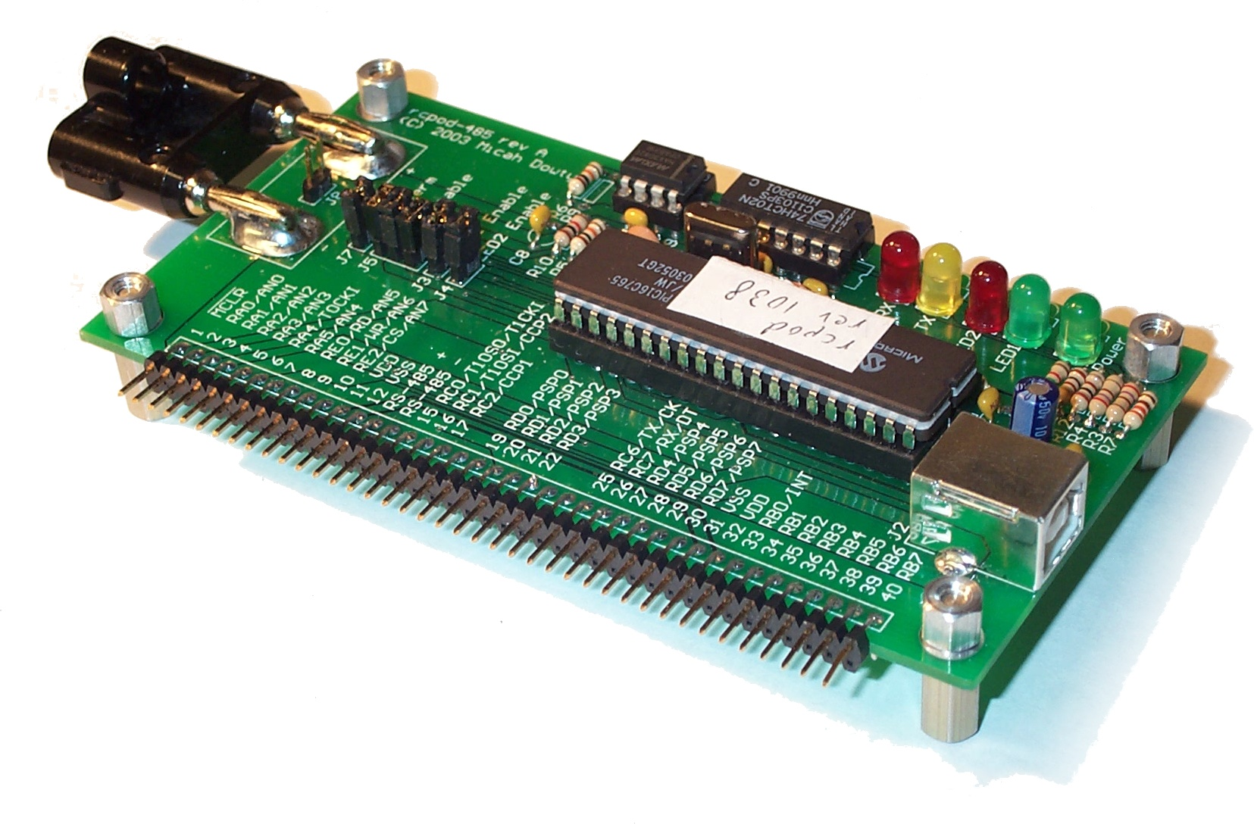
The RCPOD
RS-485
Analog Input
USB
Digital I/O

Slide 16
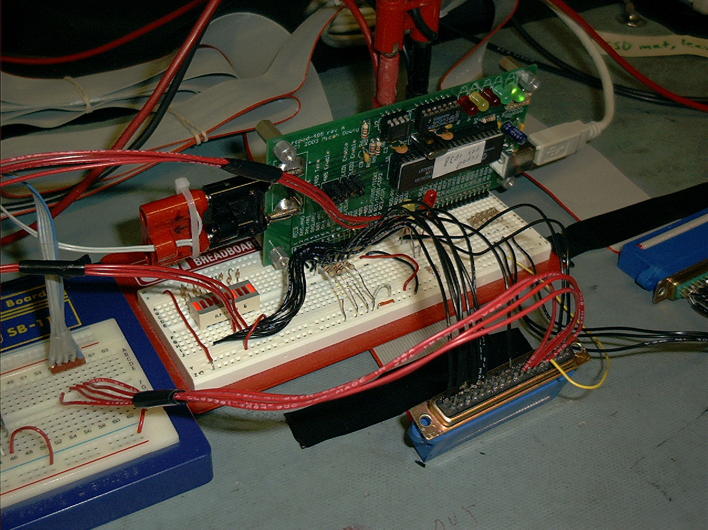

Slide 17
RCPOD Advantages
Cheaper than an equivalent commercial solution
Convenient USB interface
Easy Python and C software interfaces
More reliable RS-485 than the old “blue box” adaptor since timing is controlled by the RCPOD's microcontroller
The RCPOD would also be used to run other Citizen Explorer tests using the same Micronet RS-485 bus used to test the CD

Slide 18
RCPOD Disadvantages
No analog outputs
Only one RS-232/RS-485 serial port
Relatively slow

Slide 19
RCPOD Workarounds
Used USB to Serial adaptors for the two RS-232 ports
In place of analog outputs, six digital outputs and resistors were used to present test patterns to the CD's analog inputs
The RCPOD could not simulate the TX power DAC in software, so a hardware simulation had to be built

Slide 20
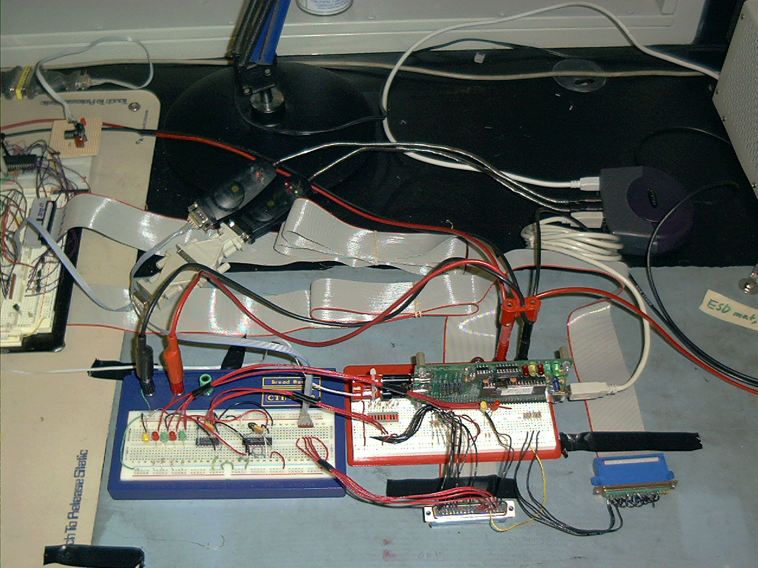

Slide 21
Future Work on the DAQ/Control Layer
The RCPOD worked well for the CD, but an ideal DAQ/Control layer would:
  Eliminate the breadboarded adaptor by including a built-in way to route signals using an FPGA or multiplexers
  Provide a way to compile timing-sensitive test cases into a form that could be executed on the DAQ/Control board
  Include more I/O

Slide 22
CD Software Encapsulation
On top of the Python interface to the RCPOD, a Python interface for manipulating and sending Micronet commands was built
This interface was shared by a PyUnit test suite for the CD, and by other graphical and command line tools for testing Citizen Explorer's microcontrollers

Slide 23
Development Results
Time savings: a fully automated test suite elimiated the tedious manual testing used on most other CX components
The firmware and hardware are routinely tested in corner cases that would never show up in normal integration testing, such as processing packets as fast as they can be received, from all ports.
Test driven development was a natural way to gradually extend the feature set of the CD while remaining a reliable part of other satellite tests

Slide 24
Development Results, cont.
The test suite quickly identified simple problems like broken wires or loose cables that would be tedious to identify by hand
Once the test suite identified a software regression, traditional simulation and debugging tools were still useful to debug the problem further

Slide 25
