Slide 1

Yelp Review Data Prediction Part I
Jiyun Chen Shiwei Cao Jing Guo

Slide 2
Content
Overview
Text
Language
Cleaning Procedure
Length of Characters
Special Punctuation
Categories
Future work plan

Slide 3
Data Overview
Overall: 1546379 obs. of 8 variables
stars; name; text; date; city; longitude; latitude; categories
Names & location & date: not considered
Categories: 606 in train data and 611 in total
Text: 464938 words in total after first step data cleaning
Focus on text and categories

Slide 4
Text - Language
Foreign Language: 32
English: 98.56%
Language | English | German | French | Spanish | Italian | Japanese
Counts | 1524126 | 13547 | 7190 | 553 | 187 | 143

Slide 5
Text - Cleaning Procedure
Text Clean
remove all punctuation, digits, extra space, and foreign language
Raw Text
Final
about 16000 words are remaining
Remove Rare Words
remove rare words from the vocabulary (frequency < 250)

Slide 6
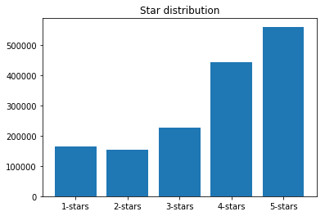
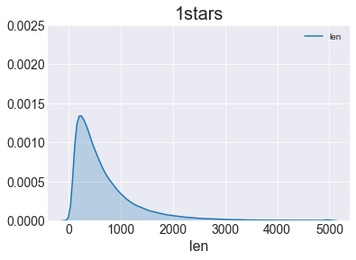
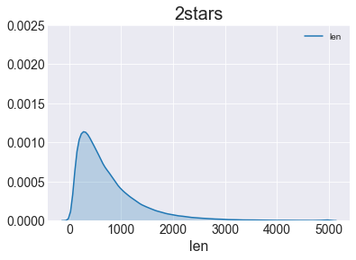
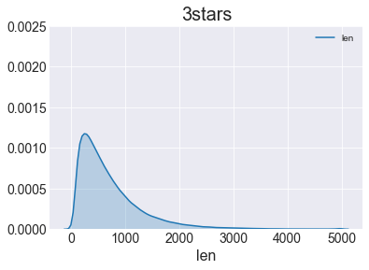
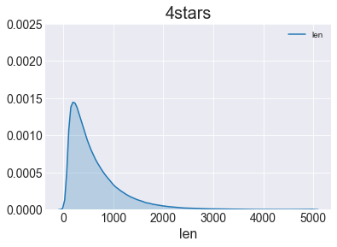
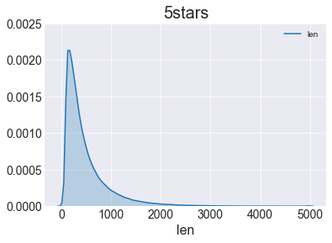
Text – Length of Characters
Star Distribution & Text Length Based on Rating
Star Distribution
1-star
2-star
3-star
4-star
5-star

Slide 7
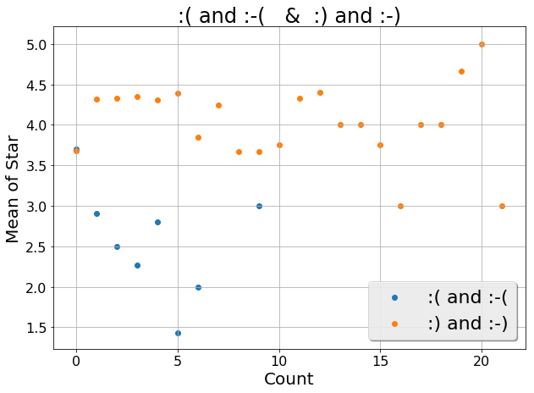
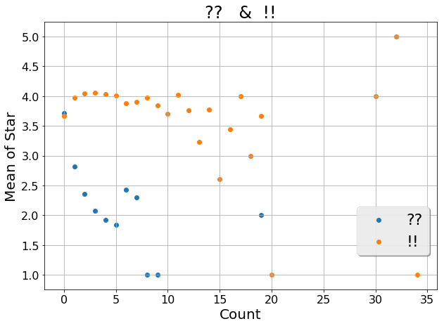
Text – Special Punctuation
Special Punctuation | .. | !! | ?? | :) & :-) | :( & :-(
Counts | 692215 | 253755 | 23956 | 47460 | 9332

Slide 8
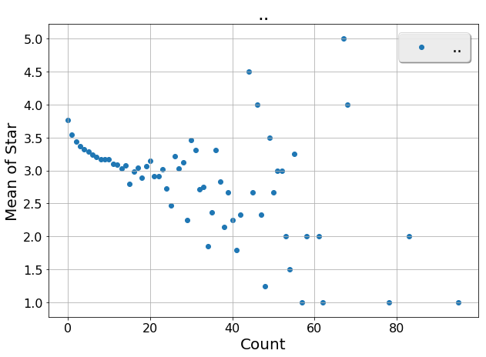
Text – Special Punctuation
Special Punctuation | .. | !! | ?? | :) & :-) | :( & :-(
Counts | 692215 | 253755 | 23956 | 47460 | 9332

Slide 9
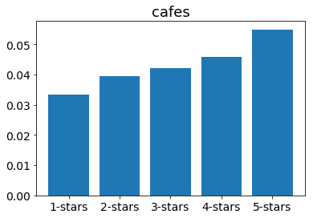
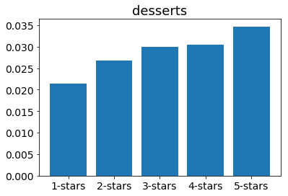
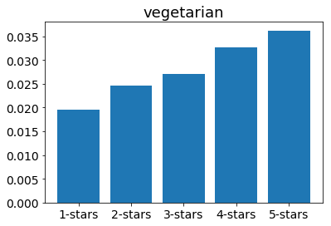
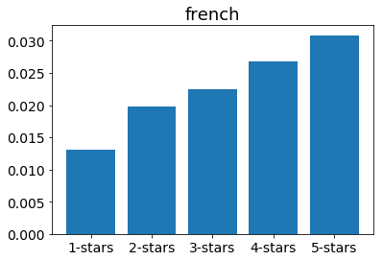
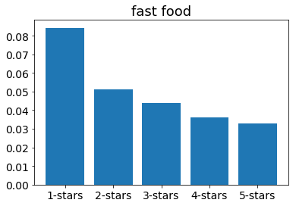
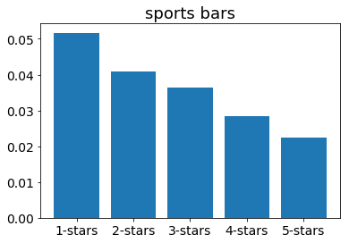
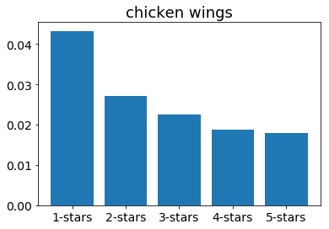
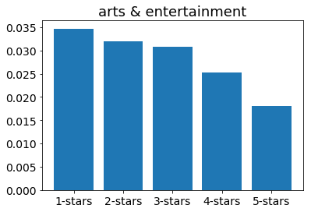
Categories
Positive Categories
Negative Categories

Slide 10
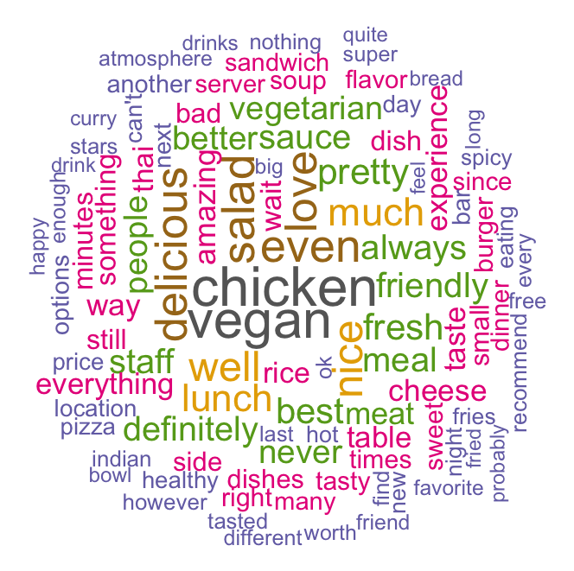
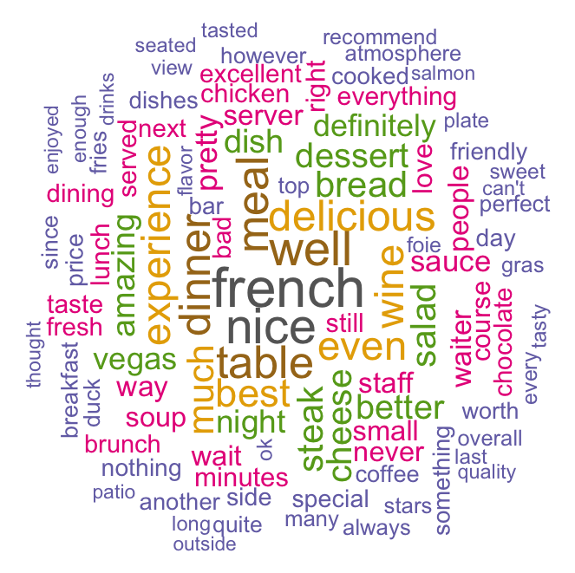
Categories – Word Frequency
Positive Categories Examples
Vegan & Vegetarian
French

Slide 11
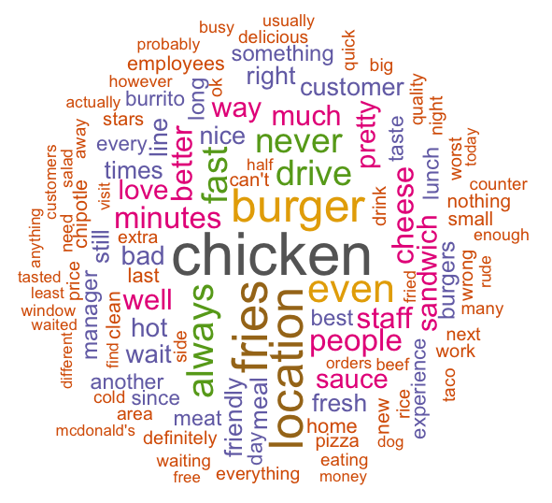
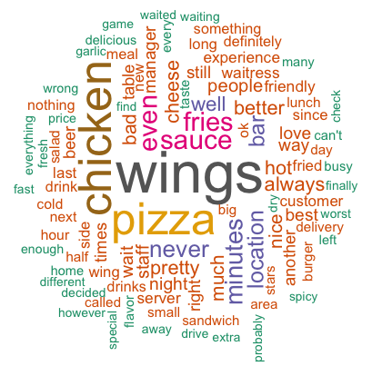
Categories – Word Frequency
Negative Categories Examples
Fast Food
Chicken Wings

Slide 12
Future work
Linear model
LASSO: select important words
Add interaction terms of adverbs(prep) and adjectives:
e.g: not : good
very : good
however : fast
Neural network
A good method to do natural language processing

Slide 13
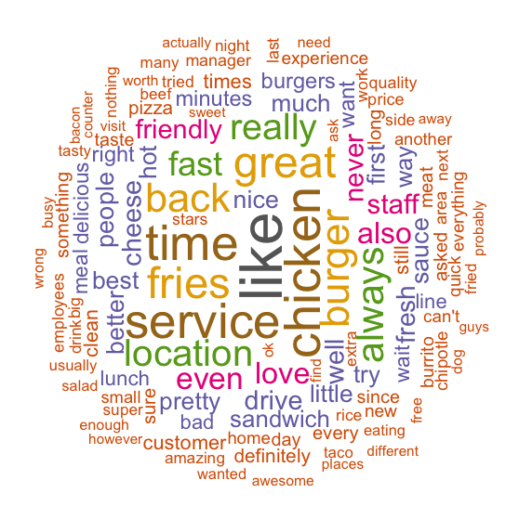
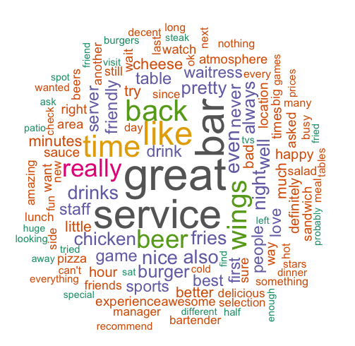
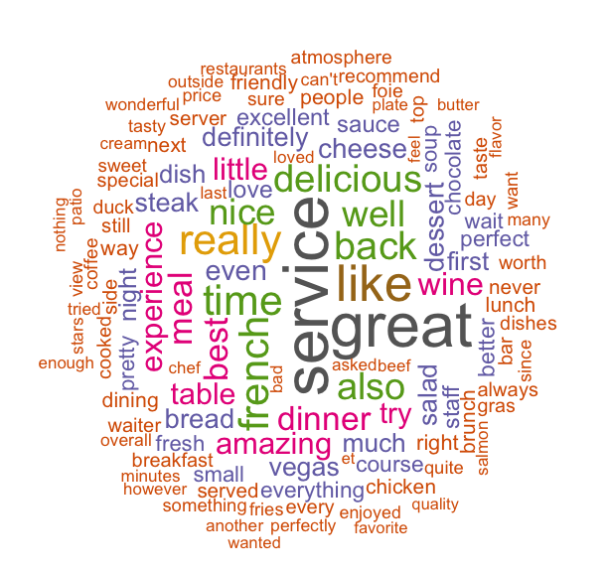
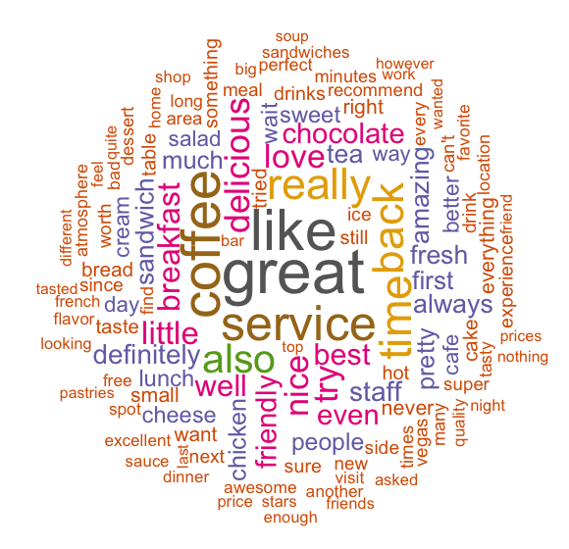
Thank You!

Slide 14
Words Deleted for Word Cloud
"take", "took", "came", "come", "one", "two", "say", "said", "told", "go", "going", "would", "get", "got", "give", "gave", "i'm", "i'll", "i'd", "could", "n", "put", "see", "put", "coming", "thru", "made", "make", "though", "in", "that's", "i've","out", "five", "bit", "eat", "maybe", "inside", "us", "around", "ever", "restaurant", "restaurants", "thing", "things", "think", "went", "know", "und", "ordered", "good", "food", "place", "menu", "order", "lot", "le", "de", "la", "great", "service", "sure", "also", "back", "first", "really", "like", "time", "little", "et", "try", "ask", "asked", "want", "wanted", "tried”

