Slide 1


CHAPTER 2
SET

Slide 2



SET
A set is a well-defined collection of distinct objects of any kind. The word “well defined” means that we can determine whether an object belongs to a set or not and “distinct’ means that we do not replicate the same object in a set. If an object belongs to a set, it is called a member or element of a set which is symbolized by ∈. The number of elements in a given set is called cardinal number and symbolized by n.
Example:
The set of students in a certain class
The set of counting numbers greater than 5
A = {a, e, i, o, u}

Slide 3
SET
Example:
The set of students in a certain class
The set of counting numbers greater than 5
A = {a, e, i, o, u}

Slide 4
How is Set Represented?
Roster or Tabular Method
In this method, elements of the set are written one by one and separated from each other using comma.

Slide 5

How is Set Represented?
Roster or Tabular method

Slide 6
How is Set Represented?
Rule or Defining Property Method
This is also called set-builder form. This method is used if the elements of the set are too many that listing them one by one becomes inconvenient. This is done by using descriptive phrases to list down the elements of the set.

Slide 7
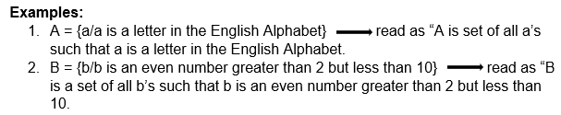
How is Set Represented?
Rule or Defining Property Method

Slide 8
Kinds of Sets
Empty or Null Set
A set that has no element denoted as Ø or { }. Thus, n(Ø) = 0.

Slide 9

Kinds of Sets
Empty or Null Set

Slide 10
Kinds of Sets
Singleton Set
A set that has one and only one element and also called as unit set. It is denoted as
A = {x/x = A} or A = {x: x = A}

Slide 11

Kinds of Sets
Singleton Set

Slide 12
Kinds of Sets
Finite Set
A set that has predetermined number of elements or finite number of elements.

Slide 13

Kinds of Sets
Finite set

Slide 14
Kinds of Sets
Infinite Set
A set that contains unlimited number of elements or a set whose elements cannot be counted.

Slide 15

Kinds of Sets
Infinite set

Slide 16
Relation on Sets
Sometimes sets are compared or one is describe.

Slide 17
Relation on Sets
Equal Sets
Two sets A and B are said to be equal if they contain the same elements and is denoted by an equal sign (=). Every element of A is an element of B and every element of B is an element of A.

Slide 18
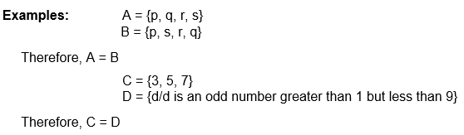
Relation on Sets
Equal Sets

Slide 19
Relation on Sets
Equivalent Sets
Two sets A and B are said to be equivalent if their cardinal number is the same, that is, n(A) = n(B) and is denoted by tilde (~).

Slide 20
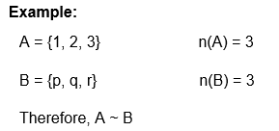
Relation on Sets
Equivalent Sets

Slide 21
Relation on Sets
Subset
If A and B are two sets, and every element of set A is also an element of set B, then A is called a subset of B and denoted as A ⊂ B. The symbol ⊂ stands for ‘is a subset of’ or ‘is contained in’
Note:
Every set is a subset of itself, i.e., A ⊂ A, B ⊂ B.
Empty set is a subset of every set.

Slide 22

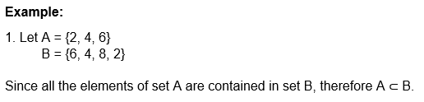
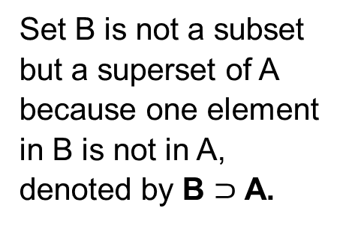
Relation on Sets
Subset
Set B is not a subset but a superset of A because one element in B is not in A, denoted by B $⊃$ A.

Slide 23
Your activity will be posted on tbl- hub.

Slide 24

SET OPERATIONS
Union of Sets (U)
Union of two or more sets is a set of all elements that belong to every given set. In the union of sets, every element is written only once even if they belong to both sets. It is denoted as A U B.

Slide 25


SET OPERATIONS
Union of Sets (U)
The union of two sets is always commutative, that is, A U B = B U A.

Slide 26
SET OPERATIONS
Intersection of Sets (U)
Intersection of two or more sets is a set of elements that are common to all the given sets. It is denoted as A ∩ B.

Slide 27


SET OPERATIONS
Intersection of Sets (U)
Sets A and B are said to be disjoint, if they do not have any element in common.

Slide 28
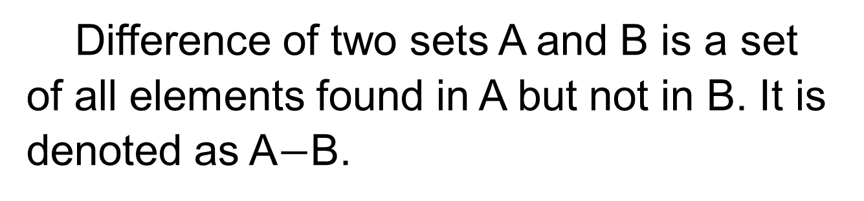

SET OPERATIONS
Difference Between Sets ($−$)
Difference of two sets A and B is a set of all elements found in A but not in B. It is denoted as A$−$B.

Slide 29


SET OPERATIONS
Difference Between Sets ($−$)

Slide 30

SET OPERATIONS
Complement (’) or (^{c})
The complement of a set is a set of all elements found in the Universal set but not in A. It is denoted as A’ or A^{c}.

Slide 31
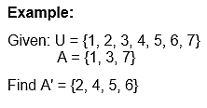

SET OPERATIONS
Complement (’) or (^{c})

Slide 32
Your activity will be posted on tbl-hub.

Slide 33

VENN DIAGRAM
Pictorial representations of sets represented by closed figures are called set diagrams or Venn diagrams.
Venn diagrams are useful in solving simple logical problems. Mathematician John Venn introduced the concept of representing the sets pictorially by means of closed geometrical figures called Venn diagrams.

Slide 34
VENN DIAGRAM
In Venn diagrams, the Universal Set U is represented by a rectangle and all other sets under consideration by circles within the rectangle. Venn diagrams are used to illustrate various operations (union, intersection, difference).
• A rectangle is used to represent a universal set.
• Circles or ovals are used to represent other subsets of the universal set.

Slide 35
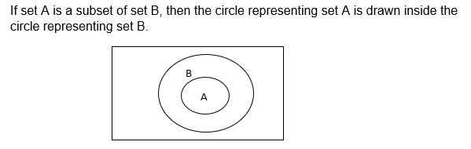
Venn diagrams in different situations

Slide 36
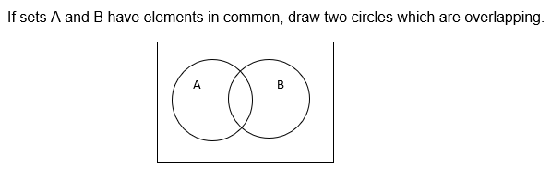
Venn diagrams in different situations

Slide 37
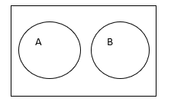
Venn diagrams in different situations

Slide 38

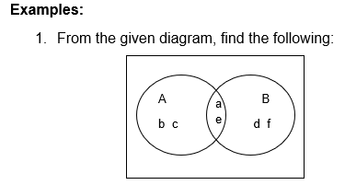
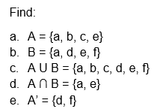
Venn diagrams in different situations

Slide 39
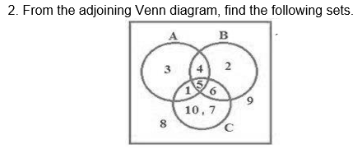
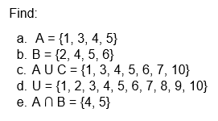
Venn diagrams in different situations

Slide 40
Your activity will be posted on tbl-hub.

Slide 41
APPLICATION OF THE VENN DIAGRAM
1. In a group of 100 customers at Big Red's Pizza Emporium, 80 of them ordered mushrooms on their pizza and 72 of them ordered pepperoni. 60 customers ordered both mushrooms and pepperoni on their pizza.
a. How many customers ordered mushrooms but no pepperoni?
b. How many customers ordered pepperoni but no mushrooms?
c. How many customers ordered neither of these two toppings?

Slide 42
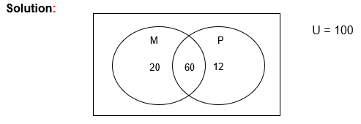
APPLICATION OF THE VENN DIAGRAM
1. In a group of 100 customers at Big Red's Pizza Emporium, 80 of them ordered mushrooms on their pizza and 72 of them ordered pepperoni. 60 customers ordered both mushrooms and pepperoni on their pizza.
a. How many customers ordered mushrooms but no pepperoni?
Twenty (20) customers ordered mushroom pizza only

Slide 43
APPLICATION OF THE VENN DIAGRAM
1. In a group of 100 customers at Big Red's Pizza Emporium, 80 of them ordered mushrooms on their pizza and 72 of them ordered pepperoni. 60 customers ordered both mushrooms and pepperoni on their pizza.
b. How many customers ordered pepperoni but no mushrooms?
Twelve (12) customers ordered pepperoni pizza only

Slide 44
APPLICATION OF THE VENN DIAGRAM
1. In a group of 100 customers at Big Red's Pizza Emporium, 80 of them ordered mushrooms on their pizza and 72 of them ordered pepperoni. 60 customers ordered both mushrooms and pepperoni on their pizza.
c. How many customers ordered neither of these two toppings?
100 – (20+60+12) = 8 customers

Slide 45
APPLICATION OF THE VENN DIAGRAM
2. A survey of 85 students asked them about the subjects they liked to study. Thirty five students liked math, 37 liked history, and 26 liked physics. Twenty liked math and history, 14 liked math and physics, and 3 liked history and physics. Two students liked all three subjects.
a. How many of these students like math or physics?
b. How many of these students didn’t like any of the three subjects?
c. How many of these students liked math and history but not physics?

Slide 46
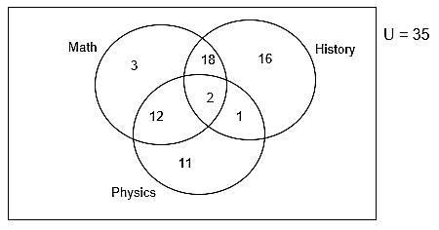
APPLICATION OF THE VENN DIAGRAM
2. A survey of 85 students asked them about the subjects they liked to study. Thirty five students liked math, 37 liked history, and 26 liked physics. Twenty liked math and history, 14 liked math and physics, and 3 liked history and physics. Two students liked all three subjects.
a. How many of these students like math or physics?
47 students like math or physics.

Slide 47
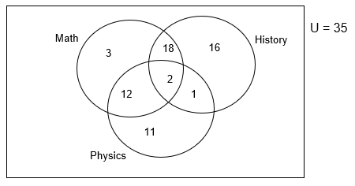
APPLICATION OF THE VENN DIAGRAM
2. A survey of 85 students asked them about the subjects they liked to study. Thirty five students liked math, 37 liked history, and 26 liked physics. Twenty liked math and history, 14 liked math and physics, and 3 liked history and physics. Two students liked all three subjects.
b. How many of these students didn’t like any of the three subjects?
22 students didn’t like any subject.

Slide 48
APPLICATION OF THE VENN DIAGRAM
2. A survey of 85 students asked them about the subjects they liked to study. Thirty five students liked math, 37 liked history, and 26 liked physics. Twenty liked math and history, 14 liked math and physics, and 3 liked history and physics. Two students liked all three subjects.
c. How many of these students liked math and history but not physics?
18 students liked math and history but not physics.

Slide 49
Your activity will be posted on tbl-hub.

