Slide 1
What is SCAP?
17 January 2020

Slide 2
Security Content Automation Protocol (SCAP)
SCAP is a suite of specifications that standardize the assessment of endpoints across several use cases including:
Configuration management
Software asset management
Hardware asset management
Vulnerability management
SCAP is supported by commercial security tools that use SCAP to assess their security posture
It allows interoperability between different security tools from different vendors providing a more consistent view of the security posture
There are two main parts of SCAP:
SCAP Content
SCAP Scanners

Slide 3
SCAP Content
Content provides SCAP scanning tools with instructions that drive the collection and evaluation of endpoint data
A wide range of assessment capabilities are supported
Content can be tailored and filtered based on user’s need
Open format allows content to be modified, combined, and reused
Content can be easily packaged and shared

Slide 4
SCAP Scanners
SCAP Scanner: A tool that collects and/or evaluates endpoint data using SCAP content
Capable of performing compliance verification and vulnerability scanning using SCAP content
Many commercial and open-source SCAP scanners are available, from enterprise-level scanning to personal computer use
SCAP-validated scanners all use common content and store results in a common format

Slide 5
SCAP Version 2 – Major Enhancements
SCAP v2 will standardize protocols and architecture
SCAP v1 had standard languages, but not standard interfaces - tools used the same content, but did not interoperate directly
A common interface will allow security tools to be interoperable
SCAP v2 will facilitate event-driven data collection and security baseline updates as they are published
SCAP v1 supported point-in-time audits
SCAP v2 supports audits, but will add support for real-time compliance checking to create a continuous understanding of enterprise state

Slide 6


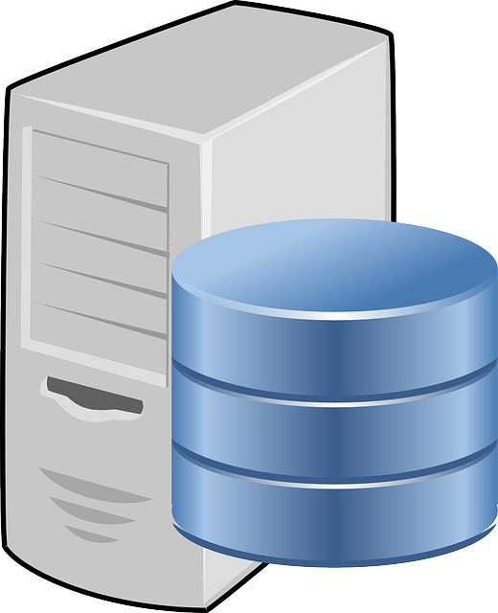
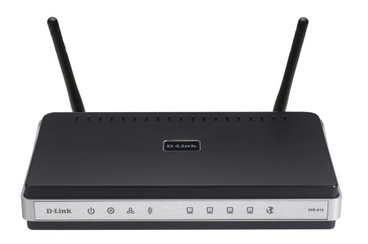

SCAP v2 Architecture
Behind the scenes the SCAP management interface automatically coordinates data-gathering requests to the appropriate/devices and tools to resolve the query.
Enterprise managers invoke a single management interface using standards-based instructions.
Pictures are licensed under CC BY-SA

Slide 7
SCAP v2 Community Engagement
Work is being done within an SCAP-focused community, leveraging international standards
Work in standards bodies will be in addition to (not instead of) dedicated SCAP community discussions
The USG is supporting and participating in the SCAP v2 effort and is looking for broad involvement in SCAP content creation
This ensures that SCAP v2 will meet the needs of other sectors such as healthcare, finance, etc.
Broad sector support will require broad participation
Visit the NIST SCAP 2.0 page for more information or to join the community
https://csrc.nist.gov/projects/security-content-automation-protocol-v2/scapv2-community
Notes:
SCAP v2 is not a USG point solution.
USG wants to be one customer among many, one requirements producer among many.

