Slide 1
Configuration Management Using the Security Content Automation Protocol (SCAP)

Slide 2
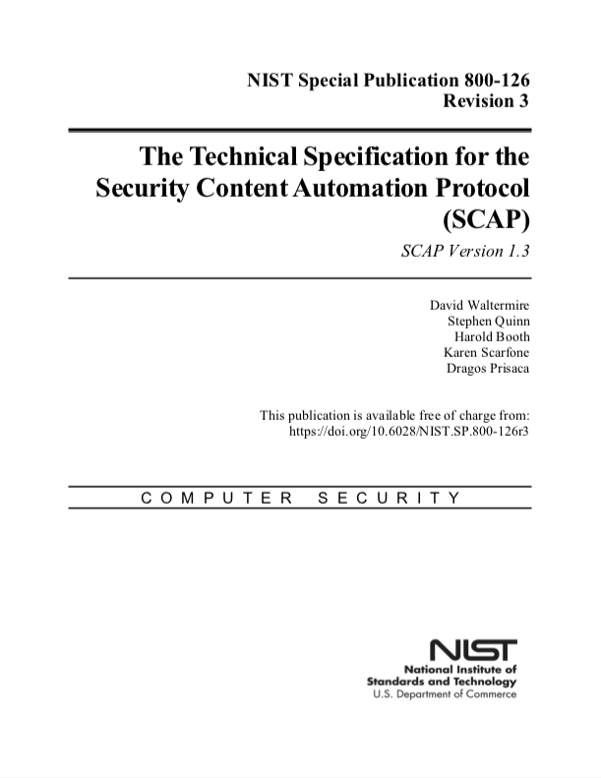
Background
SCAP is a suite of specifications that standardize the assessment of endpoints [1]
First published in 2009
Expressed in the Extensible Markup Language (XML)
SCAP covers several use cases
Configuration Management
Software Asset Management
Hardware Asset Management
Vulnerability Management
Several vendor products support SCAP v1 [2]
The SCAP Community is currently working on SCAP v2 [3][4]

Slide 3
What is Configuration Management?
SCAP defines configuration data as the state of a given configuration control
SCAP defines configuration management as the process of:
Configuring software installed on endpoints
Assessing the configuration data of software over time
Remediating software that is improperly configured
To support this, we need to know the following:
Which endpoints are on the network
The list of software installed on an endpoint
Applicable security configuration guides

Slide 4


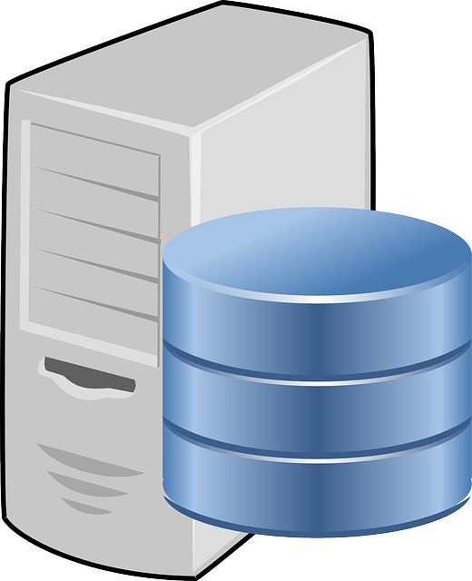


Workflow
Step 2: Collection Manager
orchestrates baseline
collections of endpoints
Step 1: Policy is sent to the
Collection Manager
Policy
Step 3: Audit results are collected, stored in the CMDB, and sent to the Evaluation Manager for evaluation
Policy is reevaluated as audits and changes arrive
Step 4
CMDB
Endpoints are monitored for changes to security controls
Endpoints
Collection Manager
Evaluation Manager
Step 5: Change alerts are sent to Evaluation Manager for evaluation

Slide 5
Benefits
Transparency of Operations: See what information is collected from endpoints and how it is assessed
Standardized Data: Configuration data is represented using standardized formats that can be used in a range of analytic-based activities
Event-Driven Updates: Configuration data is monitored and ongoing policy compliance updates are provided
Interoperability Among Products: Standardized formats, interfaces, and protocols enable interoperability and best-of-breed product selection

Slide 6
Resources
https://csrc.nist.gov/Projects/Security-Content-Automation-Protocol/SCAP-Releases/SCAP-1-3
https://csrc.nist.gov/Projects/scap-validation-program/Validated-Products-and-Modules
https://nvlpubs.nist.gov/nistpubs/CSWP/NIST.CSWP.09102018.pdf
https://csrc.nist.gov/Projects/Security-Content-Automation-Protocol-v2

