Slide 1
Software Asset Management Using the Security Content Automation Protocol (SCAP)

Slide 2
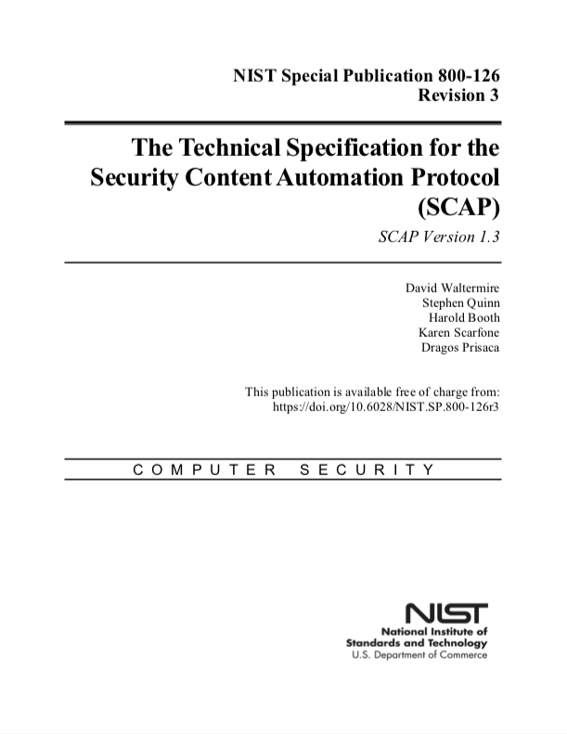
Background
SCAP is a suite of specifications that standardize the assessment of endpoints [1]
First published in 2009
Expressed in the Extensible Markup Language (XML)
SCAP covers several use cases
Configuration Management
Software Asset Management
Hardware Asset Management
Vulnerability Management
Several vendor products support SCAP v1 [2]
The SCAP Community is currently working on SCAP v2 [3][4]

Slide 3
What is Software Asset Management?
SCAP defines software asset management as the process of:
Detecting the software installed on endpoints
Determining if required or prohibited software is present
Determining if present software is up-to-date (patch management)
To support this, we need to know the following:
Which endpoints are on the network
The list of authorized and unauthorized software
Patches with SCAP-compliant identifiers as to the software to which they apply

Slide 4

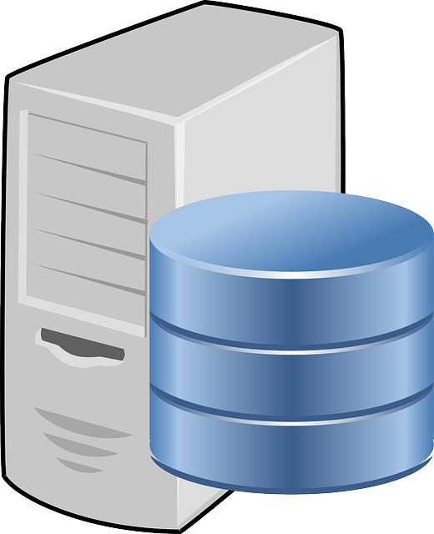


Workflow (Authorized Software)
Step 3
Software
Policy
Step 1
Step 2
Collection Manager sends software data updates to the Evaluation Manager for assessment
Organization defines policy for authorized software
Endpoints collect and publish software data to the CMDB on install, update, and removal
Step 4
Software data is evaluated against policy to determine if it is authorized and up-to-date
CMDB
Endpoints
Collection Manager
Evaluation Manager

Slide 5

Workflow (Patch Checking)
Step 2
The Collection Manager searches the CMDB for impacted software
Step 3
Step 1
Ongoing
Collection Manager sends software and endpoint data to the Evaluation Manager
Vendors
Organization receives patch alerts from vendors
Endpoints collect and publish software data to the CMDB on install, update, and removal
Step 4
Organization now has a list of impacted endpoints that can be leveraged for follow-up actions
CMDB
Endpoints
Collection Manager
Evaluation Manager

Slide 6
Benefits
Transparency of Operations: See what information is collected from endpoints and how it is assessed
Standardized Data: Software inventory data is represented using standardized formats
Event-Driven Updates: Software inventory data is updated whenever software is installed, updated, or removed
Interoperability Among Products: Standardized formats, interfaces, and protocols enable interoperability and best-of-breed product selection
Reusable Data: Real-time software inventory data in the CMDB supports a wide range of use cases beyond software asset management such as configuration and vulnerability management

Slide 7
Resources
https://csrc.nist.gov/Projects/Security-Content-Automation-Protocol/SCAP-Releases/SCAP-1-3
https://csrc.nist.gov/Projects/scap-validation-program/Validated-Products-and-Modules
https://nvlpubs.nist.gov/nistpubs/CSWP/NIST.CSWP.09102018.pdf
https://csrc.nist.gov/Projects/Security-Content-Automation-Protocol-v2

