Slide 1
Vulnerability Management Using the Security Content Automation Protocol (SCAP)

Slide 2
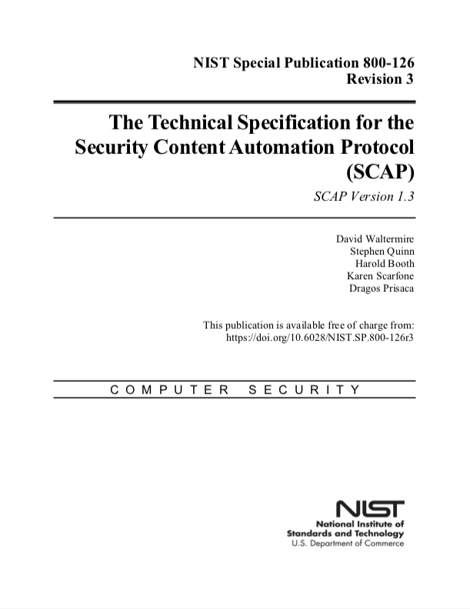
Background
SCAP is a suite of specifications that standardize the assessment of endpoints [1]
First published in 2009
Expressed in the Extensible Markup Language (XML)
SCAP covers several use cases
Configuration Management
Patch Management
Software Inventory Management
Vulnerability Management
Several vendor products support SCAP v1 [2]
The SCAP Community is currently working on SCAP v2 [3][4]

Slide 3
What is Vulnerability Management?
SCAP defines vulnerability management as the process of:
Retrieving vulnerability information applicable to the network
Determining if and where the vulnerability is present on the network
Applying a remedy that eliminates or mitigates the vulnerability
To support this, we need to know the following:
Which endpoints are on the network
The software inventory of the endpoints
When a security advisory for applicable software is published

Slide 4




Workflow (Authorized Software)
Step 3
Software
Policy
Step 1
Step 2
Collection Manager sends software data updates to the Evaluation Manager for assessment
Organization defines policy for authorized software
Endpoints collect and publish software data to the CMDB on install, update, and removal
Step 4
Software data is evaluated against policy to determine if it is authorized and up-to-date
CMDB
Endpoints
Collection Manager
Evaluation Manager

Slide 5

Workflow
Step 3
Step 2
Step 1
Step 4
Collection Manager checks the CMDB for recent data and to determine which endpoints to query
Evaluation Manager dispatches collection request to Collection Manager
Vendors
Organization receives security advisories from vendors
Endpoints collect and publish data to the CMDB and from there to the Evaluation Manager
Step 5
Endpoint data is evaluated to determine if a vulnerability is present
CMDB
Endpoints
Collection Manager
Evaluation Manager

Slide 6
Benefits
Transparency of Operations: See what information is collected from endpoints and how it is assessed
Standardized Data: Collection results and evaluation results are represented using standardized formats
Interoperability Among Products: Standardized formats, interfaces, and protocols enable interoperability and best-of-breed product selection

Slide 7
Resources
https://csrc.nist.gov/Projects/Security-Content-Automation-Protocol/SCAP-Releases/SCAP-1-3
https://csrc.nist.gov/Projects/scap-validation-program/Validated-Products-and-Modules
https://nvlpubs.nist.gov/nistpubs/CSWP/NIST.CSWP.09102018.pdf
https://csrc.nist.gov/Projects/Security-Content-Automation-Protocol-v2

