Slide 1
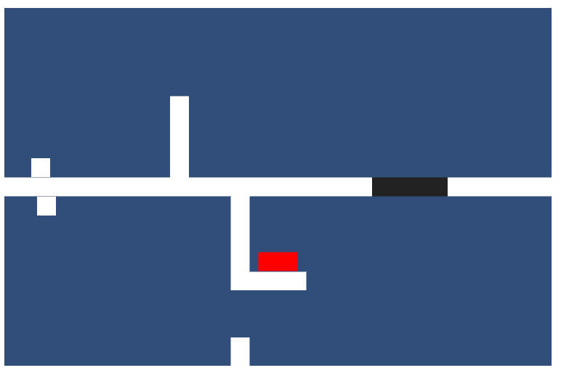
Inversion
Developed by Disfunctional
(Rhys, Odin, Guri and Amber)
Puzzle game about reuniting the player with their reflection while travelling through a maze and solving puzzles.
Today: Movement, Platform objects e.g. Doors, walls, buttons, Gravity, 3 tutorial levels
Tomorrow: Game Art, camera zoom based on level, main levels, fix collision bouncing, background

