Slide 1

H-1B Visa Petitions 2011-2016 TEAM : SHAATAS
ARAVINTH RAJ SC
NITIN SUNDA
NIKHIL KUKREJA

Slide 2
INTRODUCTON
H-1B visas are a category of employment-based, non-immigrant visas for temporary foreign workers in the United States.
Most common visa status applied for and held by international students once they complete college or higher education and begin working in a full-time position.
This project predicts the probability of getting H1B status of such employees and students

Slide 3

DATA
Data consists of 1 lakh rows and 10 columns.
These are the features :
CASE_STATUS | EMPLOYER_NAME
SOC_NAME | JOB_TITLE
PREVAILING_WAGE | FULL_TIME_POSITION
YEAR | WORKSITE
ION | IAT

Slide 4
Choosing the correct model
Since, It’s a classification problem, we chose K-nearest neighbor(kNN) algorithm
Out of 1 lakh data, we are splitting data as follows :
70,000 – Training
15000 – Validation
15000 – Testing

Slide 5
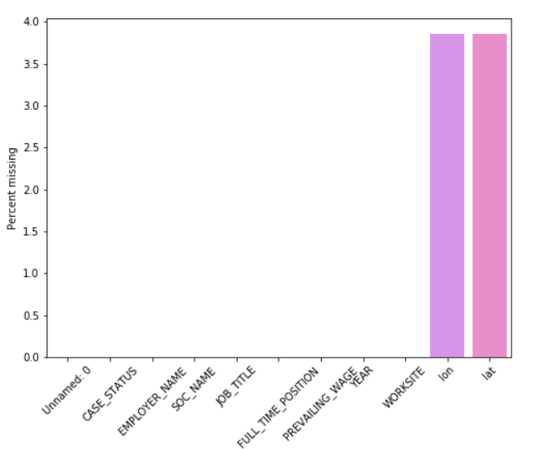
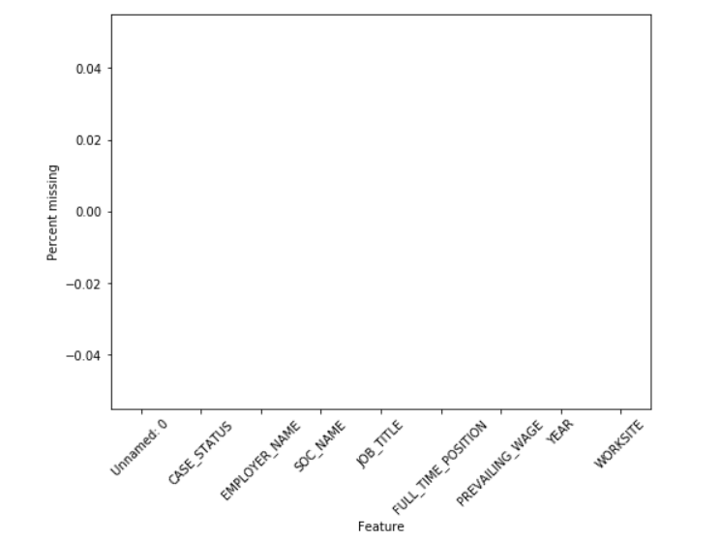
Data pre-processing
Many missing values were found in the column ION and IAT .We decided to drop the columns.

Slide 6
TRAINING OUTCOME
Accuracy Score – 0.885
Matthews Correlation Coefficient – 0.308
F1 Score - 0.885

Slide 7
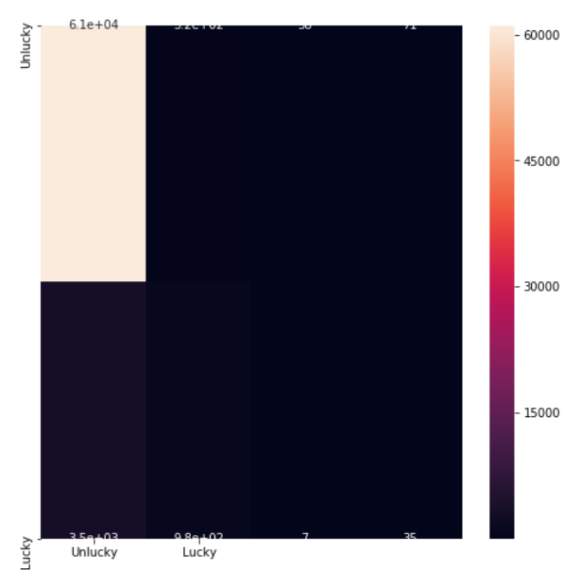
CONFUSION MATRIX

Slide 8
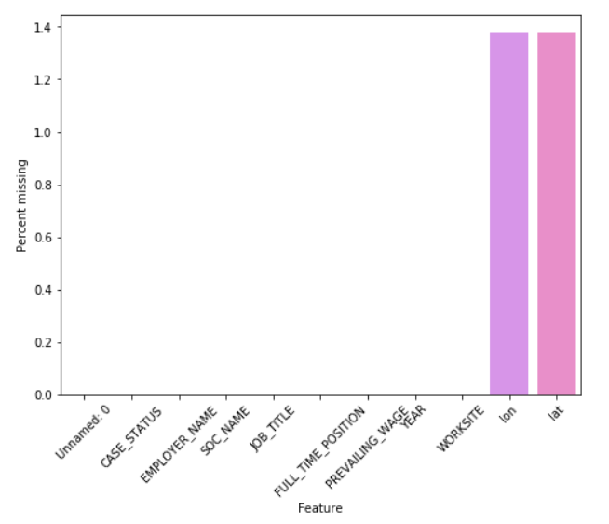
TESTING MODEL
In test data, many rows were missing from columns ION and IAT
We dropped those columns.

Slide 9
RESULT
After pre-processing, these are our prediction scores for the trained model which we saved
ACCURACY SCORE– 0.907
F1 SCORE – 0.907

