Slide 1
How do you find people to workout with or play sports with at a short notice?

Slide 2

Fitso
“Play AND TRAIN TOGETHER”
Meredith, Raj, Rodrigo & Akarsh

Slide 3
OUR MISSION
Incorporate relationships in exercise
Involve every level of athlete
Encourage trying new things
Notes:
1: most important, unique twist on exercise
Can be good for accountability
2: because you are matched with someone of similar age and grouped by gender, you’re guaranteed to find someone close to your level of skill
3: to get people to try new things. By designing an interface to easily find events in any area, we are encouraging people to match through more than their main activity

Slide 4
Features
Multifaceted peer matching through our matching algorithm
In-app messenger
FitScore- Our universal measurement of activity
Support for 4 sports (many more to come)

Slide 5
How it works
Sign up → Choose your activities → Find your match and get going
Notes:
1: design a profile that includes your name and basic information that will be used to match your fitness interests
2: choose what activities you would like to find workout friends for
3: meet your match and discuss plans for meeting and playing

Slide 6
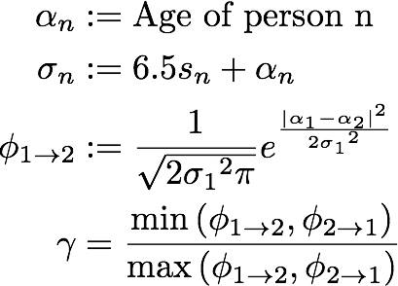
The Matching Algorithm
A few test cases:
Ages 18 and 23, Skill level 3
Match: 90%
2. Ages 18 and 45, Skill level 3 and 4
Match: 43.5%

Slide 7
How to fully utilize fitso
Check for pick up games while home
Try new sports and activities
Challenge yourself with new opponents
Integrate your fitness wearables
Meet friends through a healthy lifestyle
Notes:
1: especially useful for college campuses; ex. Soccer fields at GT and pick up games
2: problem in small cities where not enough friends can get together, now you can meet up with people with the same problem; nice for 1v1 sports like tennis or if you need a gym friend
3: win win scenario- make friends and get a workout in, no matter how intense it is

Slide 8
Future Updates
Support for more sports, and individual cardio and gym activities
Complete social media integration and user rating functionality
Notifications for nearby activities
Fitness wearable and Google Fit integration to track user activity
In-app fitness store
Notes:
1: if we can get a sponsor we can integrate a shop option related to the user’s sports
2: so you don’t have to constantly check your phone, you will be able to receive notifications for your sports events
3: we will include cardio and gym workout pairings for people who want to run, bike, or swim together or need a gym partner of similar abilities

Slide 9
Revenue generation
Sponsored products in the in-app fitness store
Sponsored location suggestions (like gyms & fields)
Big data on fitness trends and preferences

Slide 10
App Screenshots

