Slide 1
PHYS4150 Tutorial
Yu Ziyang
yzy1996@connect.hku.hk
Room 418, CYM Physics Building
20191009

Slide 2
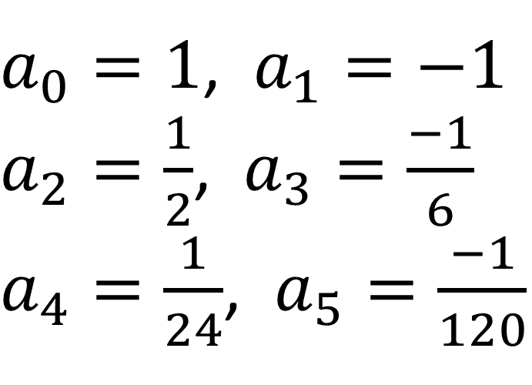
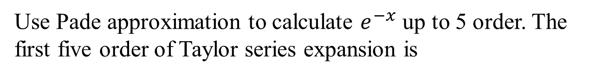
Pade approximation
Use Pade approximation to calculate $e^{−x}$ up to 5 order. The first five order of Taylor series expansion is
$a_{0}=1$, $a_{1}=−1$
$a_{2}=\frac{1}{2}$, $a_{3}=\frac{−1}{6}$
$a_{4}=\frac{1}{24}$, $a_{5}=\frac{−1}{120}$

Slide 3
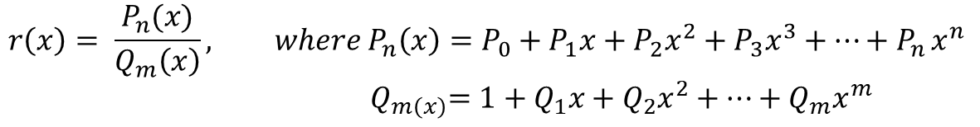
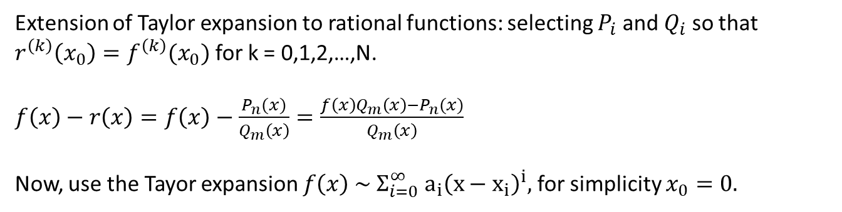
We are going to use rational functions, r(x), of the form
$$r\left(x\right)= \frac{P_{n}(x)}{Q_{m}\left(x\right)}, where P_{n}\left(x\right)=P_{0}+P_{1}x+P_{2}x^{2}+P_{3}x^{3}+…+P_{n }x^{n}$$
$${ Q}_{m\left(x\right)}=1+Q_{1}x+Q_{2}x^{2}+…+Q_{m}x^{m}$$
The degree of such a function is $N=m+n$
Extension of Taylor expansion to rational functions: selecting $P_{i}$ and $Q_{i}$ so that $r^{\left(k\right)}\left(x_{0}\right)=f^{\left(k\right)}(x_{0})$ for k = 0,1,2,…,N.
$f\left(x\right)−r\left(x\right)=f\left(x\right)−$ $\frac{P_{n}(x)}{Q_{m}\left(x\right)}=\frac{{f\left(x\right)Q_{m}\left(x\right)−P}_{n}(x)}{Q_{m}\left(x\right)}$
Now, use the Tayor expansion $f\left(x\right) \sim Σ_{i=0}^{∞} a_{i}{\left(x−x_{i}\right)}^{i},$ for simplicity $x_{0}=0.$

Slide 4
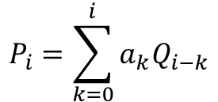
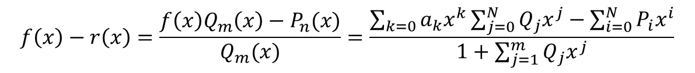
$$f\left(x\right)−r\left(x\right)=\frac{f\left(x\right)Q_{m}\left(x\right)−P_{n}(x)}{Q_{m}(x)}=\frac{\sum_{k=0}{a_{k}x^{k}}\sum_{j=0}^{N}{Q_{j}x^{j}}−\sum_{i=0}^{N}{P_{i}x^{i}}}{1+\sum_{j=1}^{m}{Q_{j}x^{j}}}$$
From this representation, we can obtain
$$P_{i}=\sum_{k=0}^{i}{a_{k}Q_{i−k}}$$

Slide 5
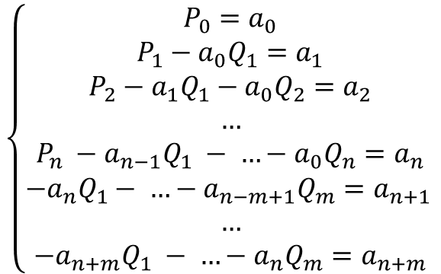
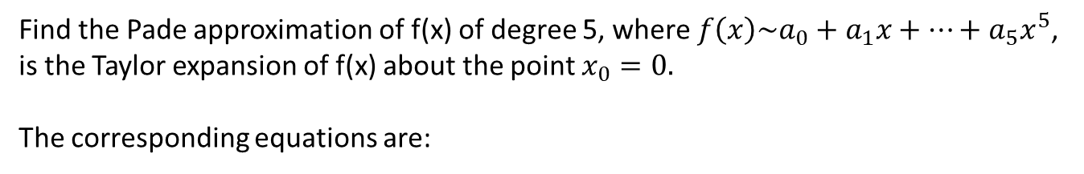
Find the Pade approximation of f(x) of degree 5, where $f\left(x\right)\sim a_{0}+a_{1}x+…+a_{5}x^{5}$, is the Taylor expansion of f(x) about the point $x_{0}=0.$
The corresponding equations are:
$$\left\{\begin{aligned}P_{0}=a_{0} \\ P_{1}−a_{0}Q_{1}=a_{1} \\ P_{2}−a_{1}Q_{1}−a_{0}Q_{2}=a_{2} \\ … \\ P_{n} −a_{n−1}Q_{1} − …−a_{0}Q_{n}=a_{n} \\ −a_{n}Q_{1}− …−a_{n−m+1}Q_{m}=a_{n+1 } \\ … \\ −a_{n+m}Q_{1} − …−a_{n}Q_{m}=a_{n+m}\end{aligned}\right.$$

Slide 6
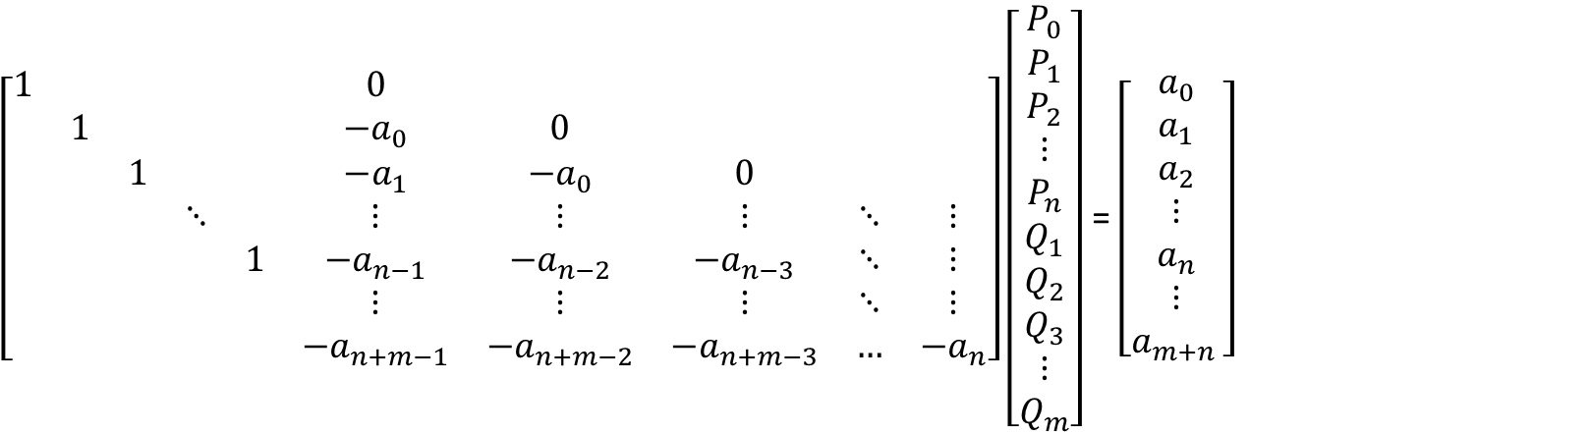
The matrix representation:
$\left[\begin{matrix}1 & & & & & 0 & & & & \\ & 1 & & & & −a_{0} & 0 & & & \\ & & 1 & & & −a_{1} & −a_{0} & 0 & & \\ & & & ⋱ & & ⋮ & ⋮ & ⋮ & ⋱ & ⋮ \\ & & & & 1 & −a_{n−1} & −a_{n−2} & −a_{n−3} & ⋱ & ⋮ \\ & & & & & ⋮ & ⋮ & ⋮ & ⋱ & ⋮ \\ & & & & & −a_{n+m−1} & −a_{n+m−2} & −a_{n+m−3} & … & −a_{n}\end{matrix}\right]\left[\begin{matrix}P_{0} \\ P_{1} \\ P_{2} \\ ⋮ \\ P_{n} \\ Q_{1} \\ Q_{2} \\ Q_{3} \\ ⋮ \\ Q_{m}\end{matrix}\right]$ = $\left[\begin{matrix}a_{0} \\ a_{1} \\ a_{2} \\ ⋮ \\ a_{n} \\ ⋮ \\ a_{m+n }\end{matrix}\right]$

Slide 7
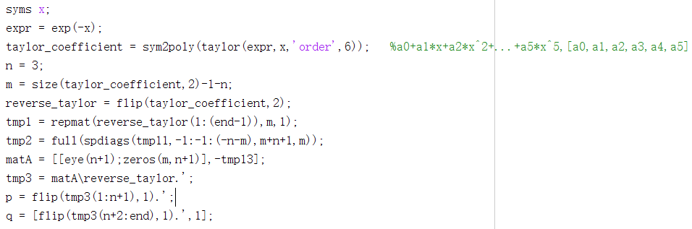
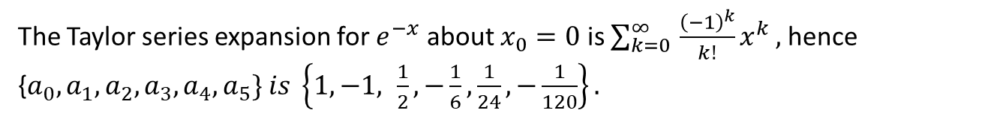
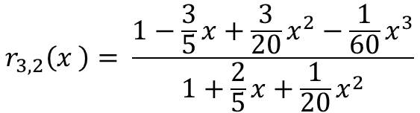
The Taylor series expansion for $e^{−x}$ about $x_{0}=0$ is $\sum_{k=0 }^{∞}{\frac{{\left(−1\right)}^{k}}{k!}x^{k}},$hence {$a_{0}, a_{1}, a_{2}, a_{3}, a_{4}, a_{5}\} is \left\{1, −1, \frac{1}{2}, −\frac{1}{6}, \frac{1}{24},−\frac{1}{120}\right\}.$
The result gives {$Q_{1}, Q_{2}, P_{1}, P_{2}, P_{3}\}=\{\frac{2}{5},\frac{1}{20}$, $−\frac{3}{5}$, $\frac{3}{20,}$, $−\frac{1}{60}$}
$$r_{3,2}\left(x \right)= \frac{1−\frac{3}{5}x+\frac{3}{20}x^{2}−\frac{1}{60}x^{3}}{1+\frac{2}{5}x+\frac{1}{20}x^{2}}$$

