Slide 1
PHYS4150 Tutorial
Yu Ziyang
yzy1996@connect.hku.hk
Room 418, CYM Physics Building
20191030

Slide 2
Matrix methods
Determinant
Gaussian-Jordan elimination method
Gaussian-Jordan with pivot alone column
Linear equation
Matrix inverse
LU decomposition

Slide 3

Determinant
1.The determinant of a square matrix is:
2. Properties:
a. Triangular matrix:
b. Adding a scalar multiple of one column to another column doesn’t change the value of the determinant.
3. Increasing one pair of columns or rows in a matrix cause its determinant change sign once.

Slide 4
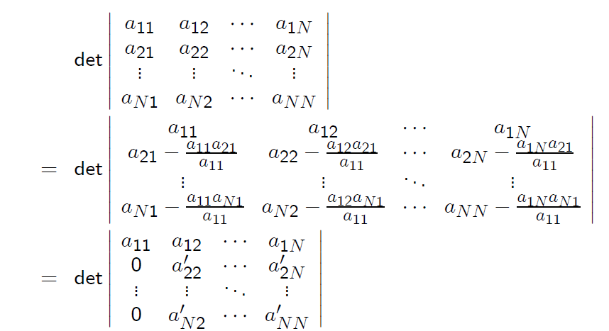
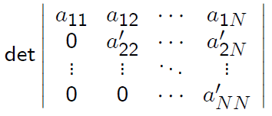


Determinant: Gauss-Jordan Elimination
Assume $a_{11} !=0$
Repeat this procedure N-1 times

Slide 5
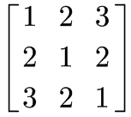
Classwork:
Use Gauss-Jordan elimination method to calculate the determinant of this matrix:

Slide 6
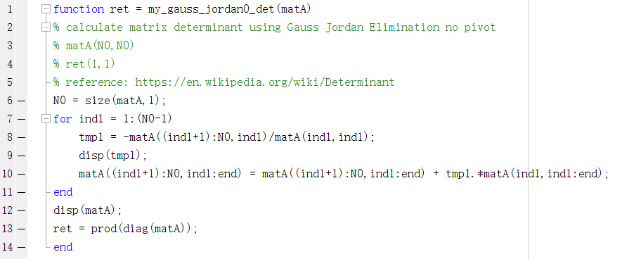

Solution: 20191101/detGJ.m

Slide 7

Refinement: pivot
The above methods will fail to solve the following matrix:
Pivoting alone column: find the absolute maximum value in that column and exchange two rows. ( To make sure the diagonal element absolute value is large enough.
See TS20191101/detGJ_pivot.m

Slide 8
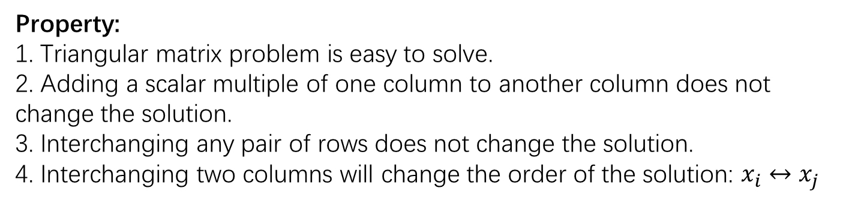
Linear equations (classwork)
Equations:
Transform into matrix form:
Property:
1. Triangular matrix problem is easy to solve.
2. Adding a scalar multiple of one column to another column does not change the solution.
3. Interchanging any pair of rows does not change the solution.
4. Interchanging two columns will change the order of the solution: $x_{i}↔x_{j}$

Slide 9
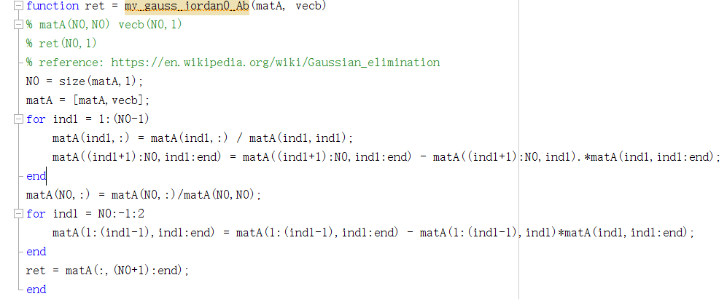
Solution
Perform Gauss-Jordan elimination to the concatenated [m,y]
Perform linear combinations among the rows of the matrix to get the solution.

Slide 10
Matrix inverse
Similar to the linear equation, just replace the right column vector with identity matrix.

Slide 11
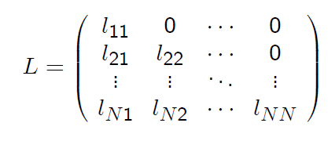
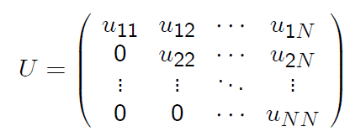

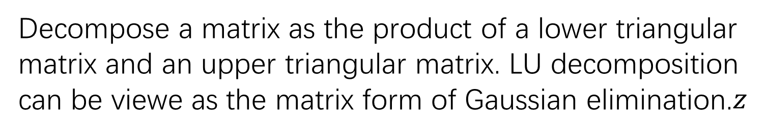
LU decomposition
Decompose a matrix as the product of a lower triangular matrix and an upper triangular matrix. LU decomposition can be viewe as the matrix form of Gaussian elimination.$z$
$$A=LU$$

Slide 12

LU decomposition
First row: $U_{1j}=A_{1j}$
First column: $L_{i1}=A_{i1}/U_{11}$
Second row, second column, …, until last row and last column
$U_{ij}=A_{ij}−\sum_{m=1}^{i−1}{L_{im}U_{mj}}$
$L_{ij}=\frac{1}{U_{jj}}\left(A_{ij}−\sum_{m=1}^{j−1}{L_{im}U_{mj}}\right)$

Slide 13
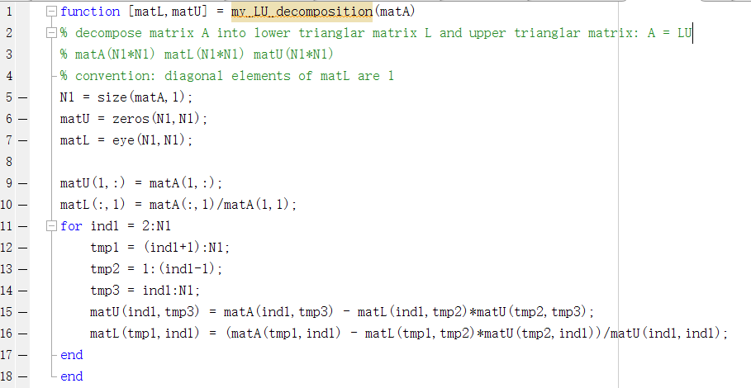
Solution

