Slide 1
PHYS4150 Tutorial
Yu Ziyang
yzy1996@connect.hku.hk
Room 418, CYM Physics Building
20190927

Slide 2
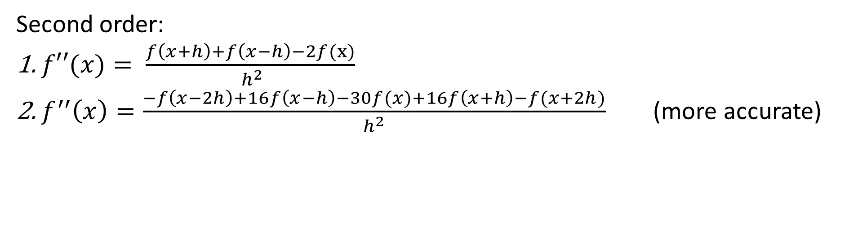
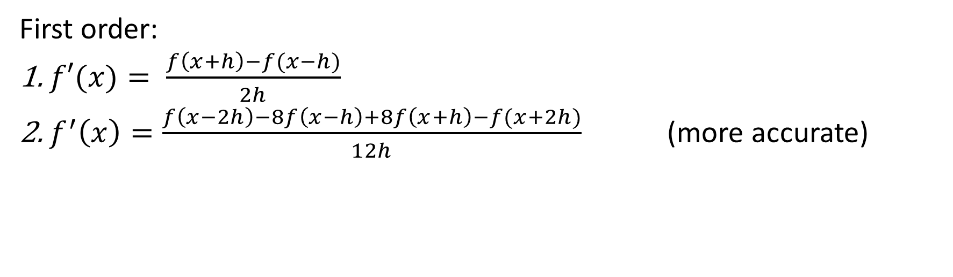
Differentiation
First order:
$f′(x)= \frac{f\left(x+h\right)−f(x−h)}{2h}$
$f^{′}\left(x\right)=\frac{f\left(x−2h\right)−8f\left(x−h\right)+8f\left(x+h\right)−f(x+2h)}{12h}$ (more accurate)
Second order:
$f′′(x)= \frac{f\left(x+h\right)+f\left(x−h\right)−2f(x)}{ h^{2}}$
$f^{′′}\left(x\right)=\frac{−f\left(x−2h\right)+16f\left(x−h\right)−30f(x)+16f\left(x+h\right)−f(x+2h)}{h^{2}}$ (more accurate)

Slide 3

Classwork(1)
Use finite difference method to get the first and second derivative of function y=sin(x) at x=0, and calculate the first and second derivative of function $y=x^{5}$ at x=1

Slide 4
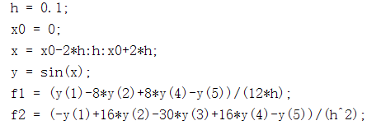
Solution

Slide 5
Interpolation
Use the Lagrangian Polynomial interpolation to find the value of f(x) for x=0.55.

Slide 6
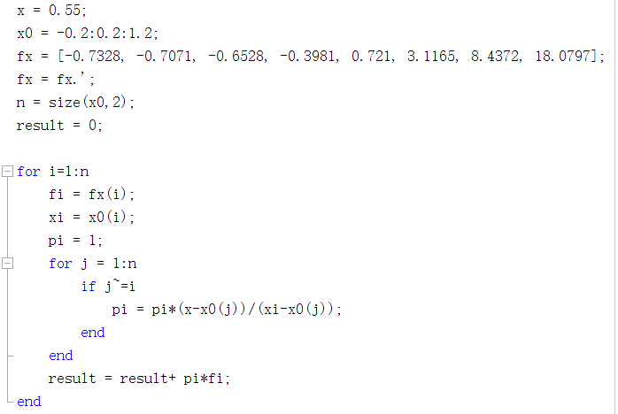
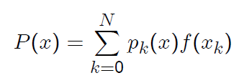
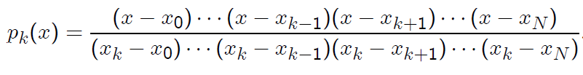

Solution

