Slide 1
PHYS4150 Tutorial
Yu Ziyang
yzy1996@connect.hku.hk
Room 418, CYM Physics Building
20190913

Slide 2
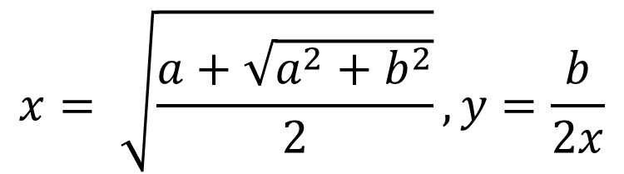

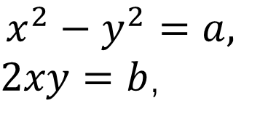
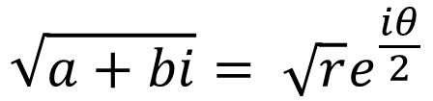
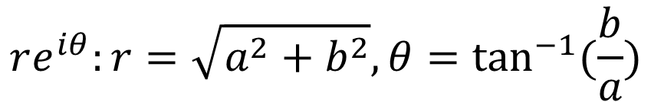
Homework submit sample
Classwork: 1. calculate the square root of a complex number with the function that could only calculate the square root of a real number. (not ‘$sqrt(a+bi)$’).
$$re^{iθ}:r=\sqrt{a^{2}+b^{2}}, θ=\tan^{−1}{(\frac{b}{a})}$$
$$Solution1:(a+bi)$$
$$\sqrt{a+bi}= \sqrt{r}e^{\frac{iθ}{2}}$$
$$x^{2}−y^{2}=a,$$
$2xy=b$,
$$Solution2:{ \left(x+iy\right)}^{2}=(a+bi)$$
$$x= \sqrt{\frac{a+\sqrt{a^{2}+b^{2}}}{2}}, y=\frac{b}{2x}$$

Slide 3
How to finish and submit your homework.
1. Read the requirement on the website.
2. Download the code_template on the GitHub page and complete it.
3. For those homework with unittest, better run it to make sure your code work.
4. Send your .m files via email to me. Remember to fill in the information in code.

Slide 4
Classwork2: generate k prime numbers
Features of prime number: the prime number is defined as an integer that is divisible only by unity and by itself.
The first prime number is 2.
How to get first k prime number and save it into a list?
Hint: use mod function in MATLAB: mod(5,2) = 1, mod(6,2) = 0

Slide 5
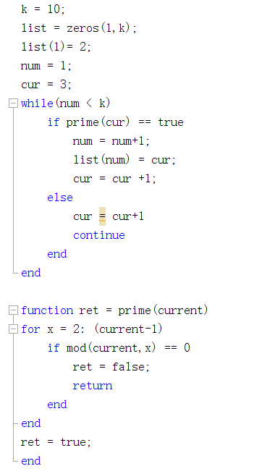
Solution:
Initial value
“num” helps to record how many prime numbers we have already found.
“cur” means the current number we are discussing.
We need a function “prime” to determine whether cur is a prime number.

Slide 6
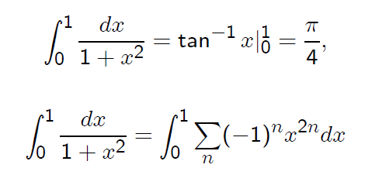
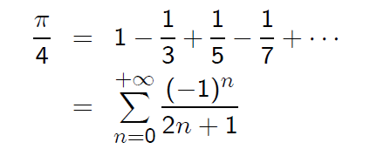

Classwork3: calculate the $π$ with series expansion method

Slide 7
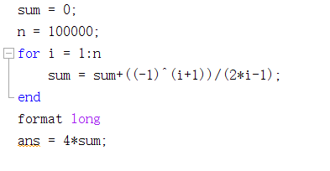
Solution:
Don’t forget to time 4

Slide 8

Homework
1. optimize the k prime number generator.
2.calculate$π$ with Liu Hui’s method.
3. calculate$π$ with Buffon’s method.
4. Radioactive decay

