Slide 1
PHYS4150 Tutorial
Yu Ziyang
yzy1996@connect.hku.hk
Room 418, CYM Physics Building
20190920

Slide 2
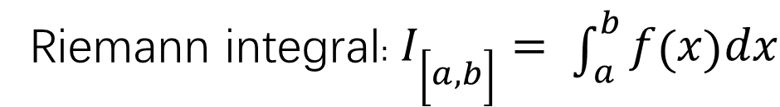
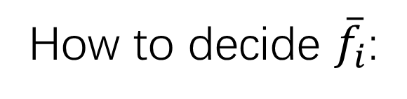
Numerical integration
Riemann integral$: I_{\left[a,b\right]}= \int_{a}^{b}{f\left(x\right)dx}$
Numerical calculation $: I_{\left[a,b\right]}=\lim_{N→∞}{\frac{b−a}{N}{\sum_{i=0}^{N}{\overline{f}}}_{i} }$
How to decide ${\overline{f}}_{i}$:
Rectangular rule, Trapezoidal rule, Simpson’s rule
Monte Carlo integration: random sampling

Slide 3
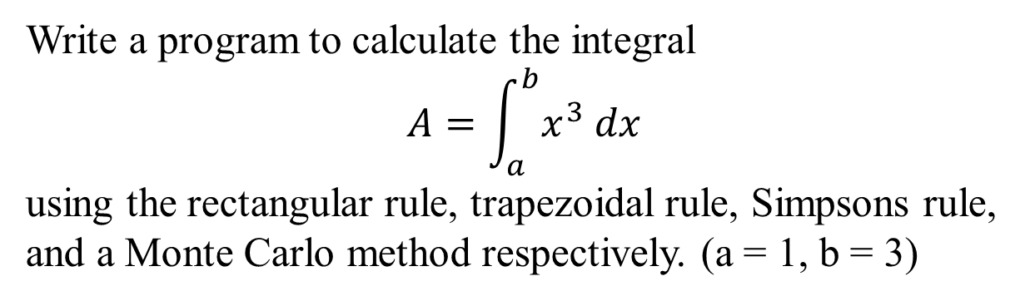
classwork
Write a program to calculate the integral
$$A=\int_{a}^{b}{x^{3} dx}$$
using the rectangular rule, trapezoidal rule, Simpsons rule, and a Monte Carlo method respectively. (a = 1, b = 3)

Slide 4

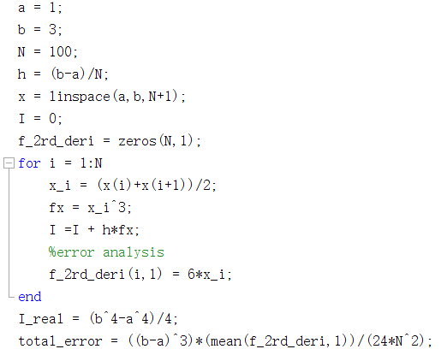


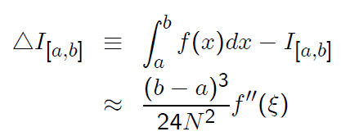
Rectangular rule
The total error is:

Slide 5

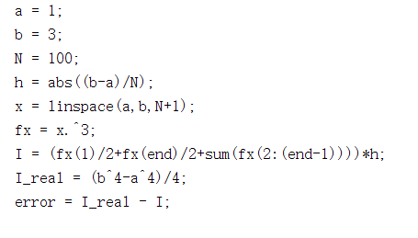
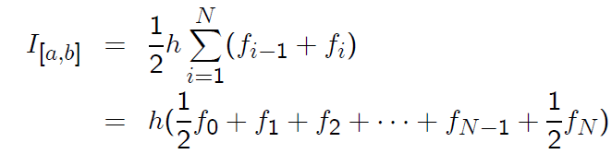
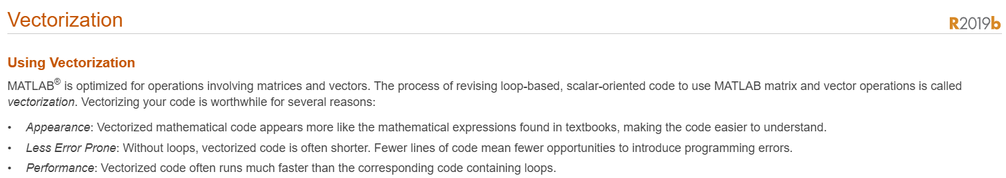
Trapezoidal rule

Slide 6

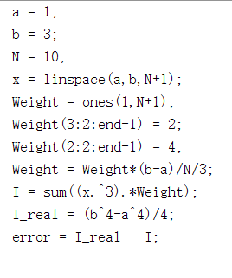
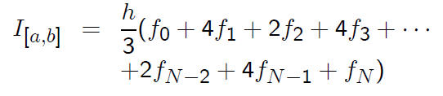
Simpson’s rule

Slide 7

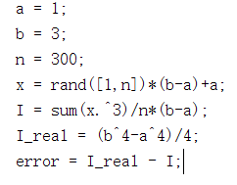
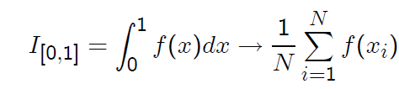
Monte Carlo integration

