Slide 1
PHYS4150 Tutorial
Yu Ziyang
yzy1996@connect.hku.hk
Room 418, CYM Physics Building
20191011

Slide 2
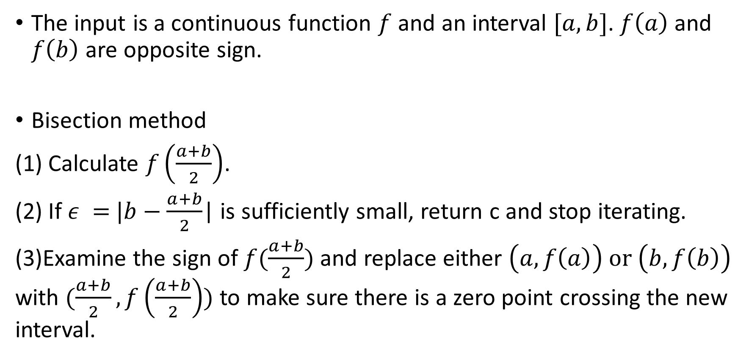
Root finding
The input is a continuous function $f$ and an interval $[a, b]$. $f\left(a\right)$ and $f\left(b\right)$ are opposite sign.
Bisection method
(1) Calculate $f\left(\frac{a+b}{2}\right)$.
(2) If $ε =$ $|b−\frac{a+b}{2}$| is sufficiently small, return c and stop iterating.
(3)Examine the sign of $f(\frac{a+b}{2})$ and replace either $\left(a,f\left(a\right)\right) or$ $\left(b,f\left(b\right)\right)$ with $(\frac{a+b}{2}, f\left(\frac{a+b}{2}\right))$ to make sure there is a zero point crossing the new interval.

Slide 3
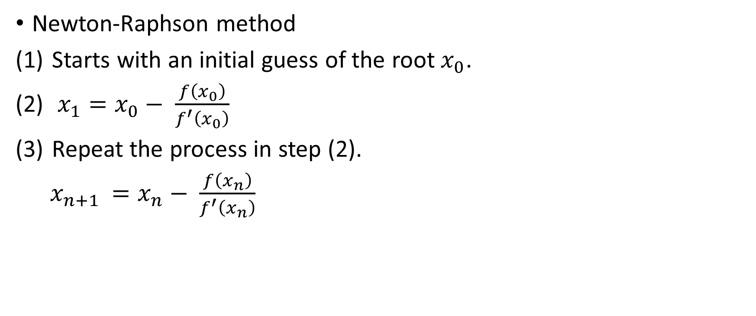
Root finding
Newton-Raphson method
Starts with an initial guess of the root $x_{0}$.
$x_{1}=x_{0}− \frac{f\left(x_{0}\right)}{f^{′}\left(x_{0}\right)}$
Repeat the process in step (2).
$x_{n+1 }=x_{n}− \frac{f\left(x_{n}\right)}{f^{′}\left(x_{n}\right)}$

Slide 4
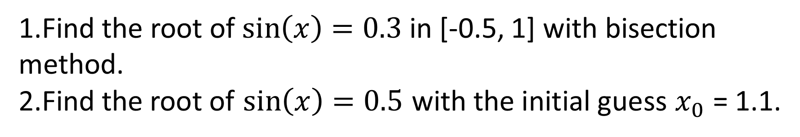
Classwork
1.Find the root of $\sin\left(x\right)=0.3$in [-0.5, 1] with bisection method.
2.Find the root of $\sin\left(x\right)=0.5$ with the initial guess $x_{0}$ = 1.1.

Slide 5
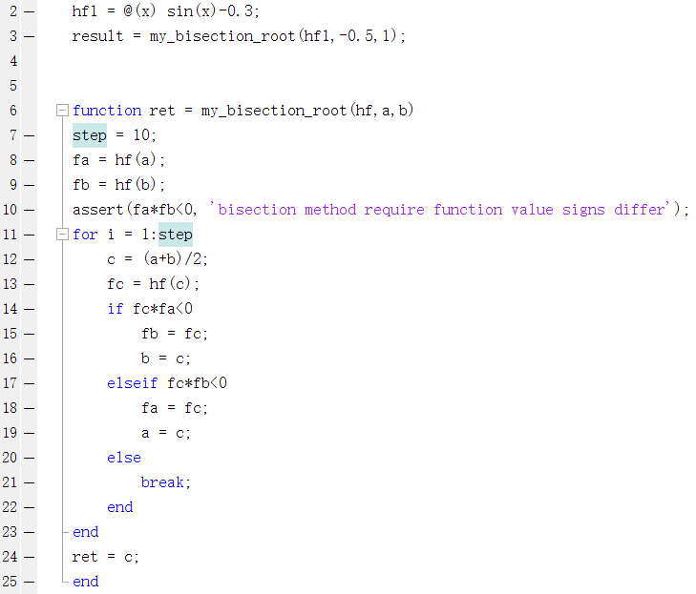
Bisection method solution
Make sure one root exist in the interval.
Judge if the root exsits in [a,c] or [c,b] or the root is c.

Slide 6
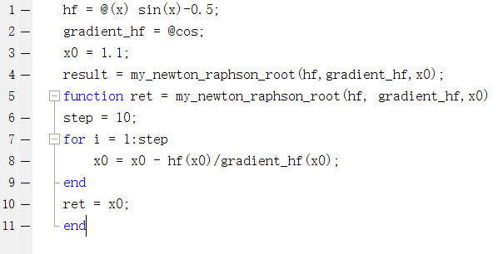
Newton-Raphson method solution

