Slide 1
Walking Motion Control in Partial Immersion

Slide 2
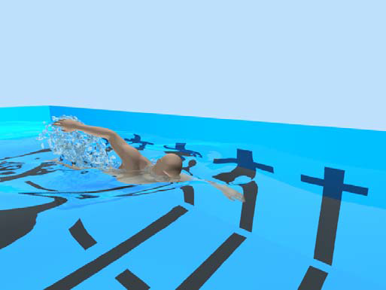
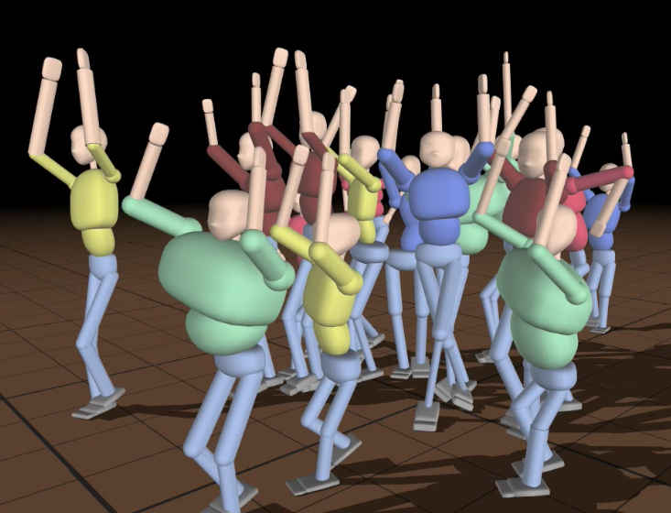
Context
Biomechanical simulation of human swimming [Si2014]
A dancing crowd [coros2010]
Notes:
A dire:
Pb monde complexes ➔ anim physique
Def animation basée physisque.
Dire que chaque controler est très spécifique
Dire que l'on s'intéressera à la marche, immersion partielle, temps réel

Slide 3
Previous works

Slide 4
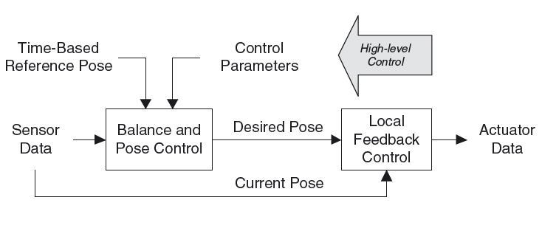
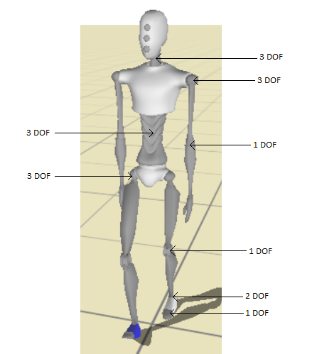
Physic-based controller
Example of physic-based controller [Geijtenbeek2012]
Example of human model

Slide 5
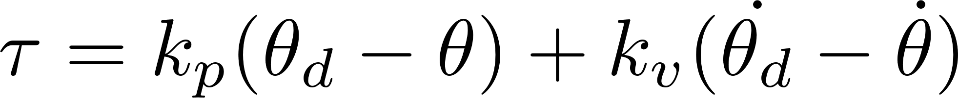
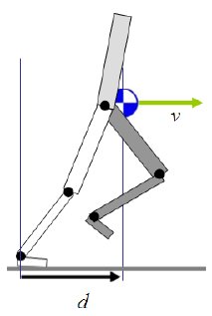
SIMBICON
PD- controller:
PD-controlled Articulations Feedback

Slide 6
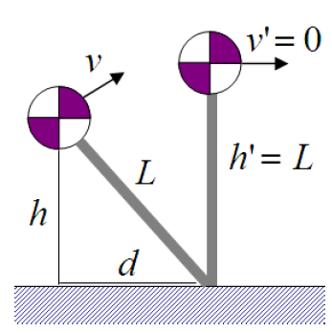
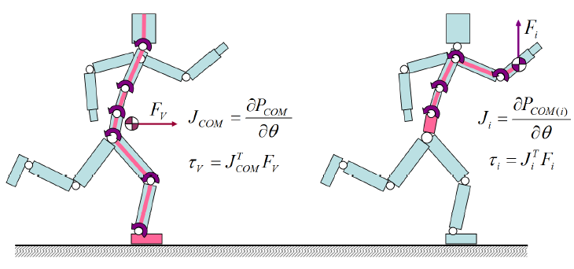
SIMBICON
Stable state combiner [Coros2009]
Gravity compensation [Coros2010]
Inversed pendulum Model (IPM) [Coros2010]
Fine scale velocity and balance control [Coros2010]
Fine scale velocity tuning (left) and gravity compensation (right). [Coros2010]
IPM [Coros2010]

Slide 7
Mettre vidéo du sys de 2010

Slide 8
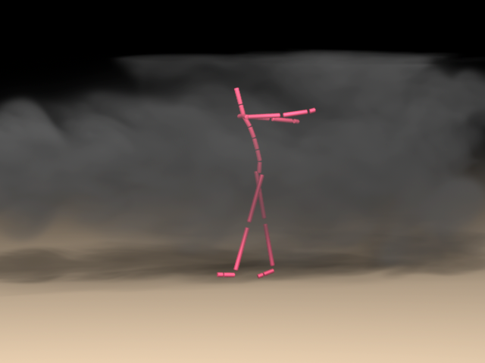
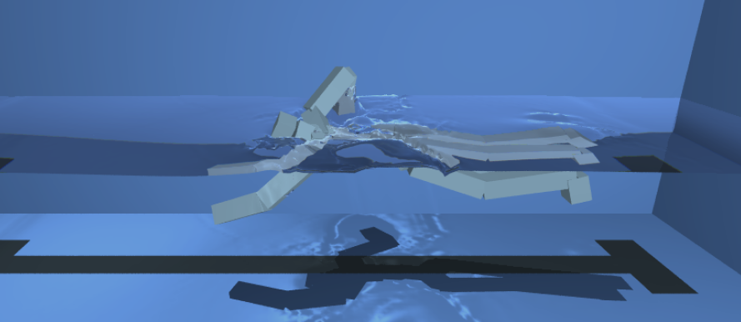
Physic based controllers in fluids
Navier-Stokes equations in Eulerian space
Human swimming driven by motion capture [Kwatra2010]
Human walking under constant wind force [Lentine2011]

Slide 9
Limits and contributions
Limits | Contributions
liquid interactions not in real time | Simplified liquid model
Gait specifications limited | Intelligent IPM usage State combiner
Unable to follow desired speed | IPM alteration Intra-step speed variation consideration
Unable to handle immersion | Immersion aware gravity compensation. Learning based systems.

Slide 10
Contributions

Slide 11
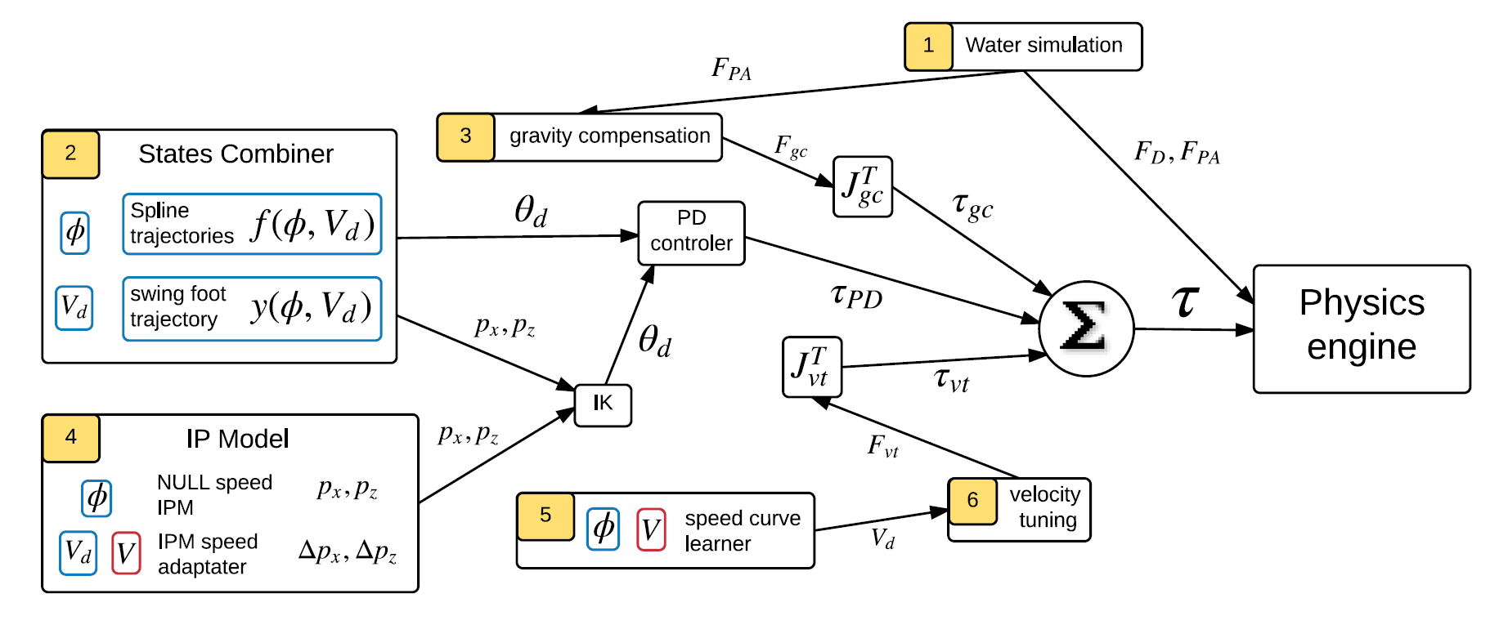
Controller overview

Slide 12
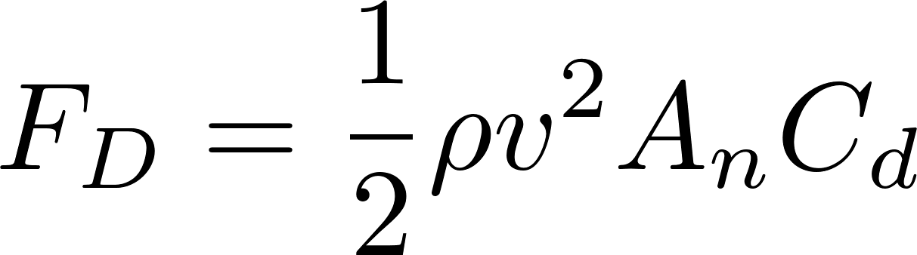
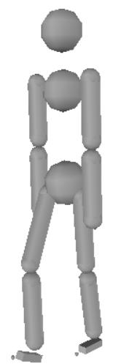
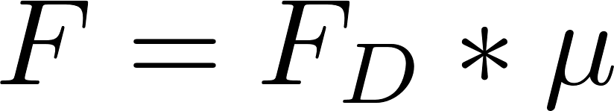
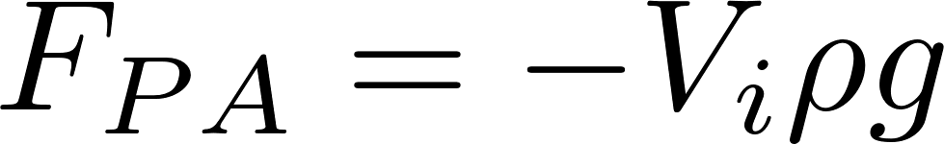
Liquid model
Liquid drag:
Friction:
Buoyancy:

Slide 13
Gait Specification: State combiner
Goals:
Define main characteristic of the gait
Define conditions specific gaits
Can be enable on selected joints
Interpolation following a square law

Slide 14
Gait Specification: IPM
Used in the descending phase of each step
User defined swing foot trajectory for ascending phase
IPM override user defined trajectory if the balance is lost

Slide 15
Speed Control
Learning based systems
IPM result alteration
Next step nearer ➔ accelerate character
Next step further ➔ slow character
Principle:
Add a Δ to the IPM result.
Adapt the Δ depending on speed at the end of each step

Slide 16
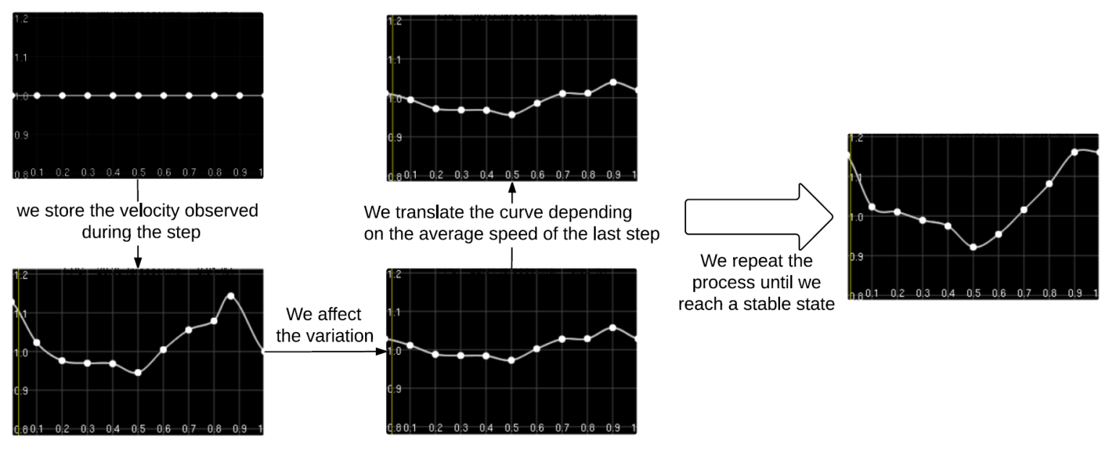
Speed Control
Based on fine scale control from (coros2010)
Goal:
adapt virtual force to intra-step speed variations.
Speed curve learning process

Slide 17
Gravity compensation

Slide 18
Optimization
Evaluation formula:
F_energ: consumed energy
F_drag: opposition of liquid
F_acc: sum of desired and observed acceleration
R_ipm_alt: ipm alteration used/max ipm alteration
F_speed: respect of desired speed
F_balance: maintains stable motion
Covariant Matrix Adaptation (CMA)

Slide 19
Results

Slide 20
Analyze optimization results
VIDEO
10 reference states (5 liquid levels, 2 speed)

Slide 21
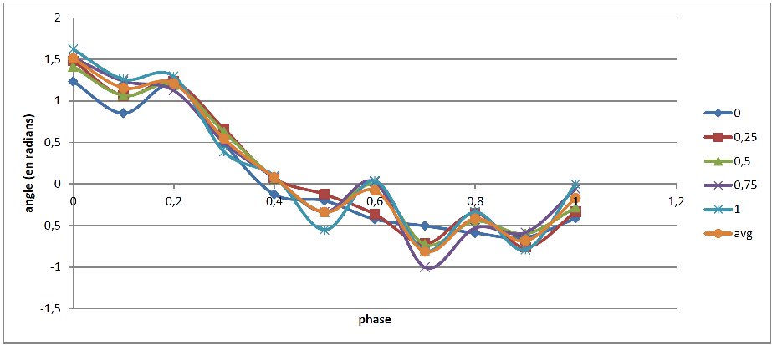
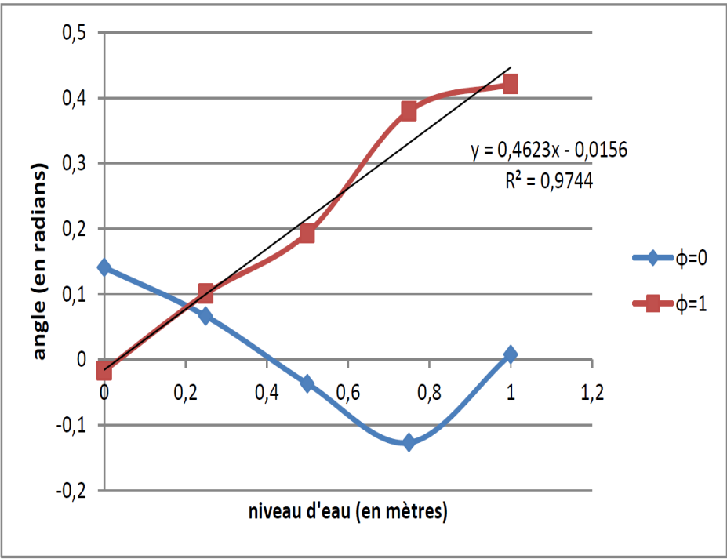
Reference states studies
Significant linear relations between liquid levels

Slide 22
Final controller
VIDEO
Show the part with diff levels
Show the collision with balls and also the fall part

Slide 23
Conclusion
Contributions:
Simple liquid through basic hydrodynamics
Gaits combiner
Balance strategy activated on need only
Learning strategy for easy adaptation to liquid
Limits:
Static Thresholds based systems
Unstable contact between foot and ground.
Simplified liquid model may create unrealistic results
Future works:
More realistic liquid model
Extension to more motions

Slide 24
Questions ?

Slide 25
References

