Slide 1

WebRTC in a
Radio-Controlled Car via 5G
Raul Hidalgo Caballero
Master in Computer Engineering
Director: David Sarrat González
University of Lleida, September 2026
Notes:
Timing: 30 seconds
Introduce the project as a video-path study built around a physical RC-car prototype.
State the central design choice: the application server coordinates peers but does not carry video.
Sources:
- TFM.docx, cover and pp. 7–9.
- UdL brand: https://www.imatge.udl.cat/ca/marca/color-corporatiu/

Slide 2
OPENING
Research Question
Can an RC car deliver live video to a remote browser with less than 400ms glass-to-glass latency?
< 400 ms
5G
4G
Intended deployment context
Prototype validation actually performed
LATENCY TARGET
The presentation keeps the target and the evidence separate.
02
Notes:
Timing: 50 seconds
Read the question once, then separate the intended 5G context from the network used for the prototype measurement.
Do not imply that the thesis validated 5G behavior. The tested mobile link used a Huawei 4G dongle.
Sources:
- TFM.docx, pp. 7–9, 13, 36–37.

Slide 3
OPENING
Project Scope
“
The project scope is to establish a low-latency video connection between an RC car and a remote web browser, targeting a glass-to-glass latency below 400 ms. Data transport and vehicle control are not included.
VIDEO INCLUDED
DATA / CONTROL EXCLUDED
Capture, encode, negotiate, transport, play
No command loop, actuation, or safety controller
03
Notes:
Timing: 55 seconds
Use the exact scope statement because later slides discuss control only as future work.
The repository contains unused DataChannel scaffolding, but it does not implement vehicle control.
Sources:
- PLAN.md, Project Scope.
- TFM.docx, pp. 8–9 and 37.
- Repository: useRtcPeerConnection.tsx and WebRtcSessionManager.cs; DataChannels are created but unused.

Slide 4
OPENING
Presentation Roadmap
01
Theory
9 min
02
Issues and Iterations
10 min
03
Future Work
3 min
04
Potential Applications
2 min
05
Demo / Video
3 min
04
Notes:
Timing: 45 seconds
Preview the five main sections in this exact order.
The timings leave about one minute for transitions inside the thirty-minute defense.
Sources:
- PLAN.md, Slide Structure and Visual and Source Treatment.

Slide 5
Theory
Notes:
Theory

Slide 6
THEORY
WebRTC as a Whole
Real-time media
Browser and native APIs
ICE connectivity
RTCPeerConnection
Application-defined signaling
DTLS-SRTP encryption
Congestion control
WebRTC combines APIs and protocols. It does not prescribe how the application carries signaling messages.
06
Notes:
Timing: 60 seconds
Present WebRTC as a system rather than a single wire protocol.
The browser API manages peer state. The IETF protocols provide connectivity, secure media transport, and feedback.
SignalR is an application choice for signaling because WebRTC deliberately leaves that transport open.
Sources:
- RFC 8825: https://www.rfc-editor.org/rfc/rfc8825.html
- W3C WebRTC: https://www.w3.org/TR/webrtc/
- RFC 9429 JSEP: https://www.rfc-editor.org/rfc/rfc9429.html
- TFM.docx, p. 20.

Slide 7
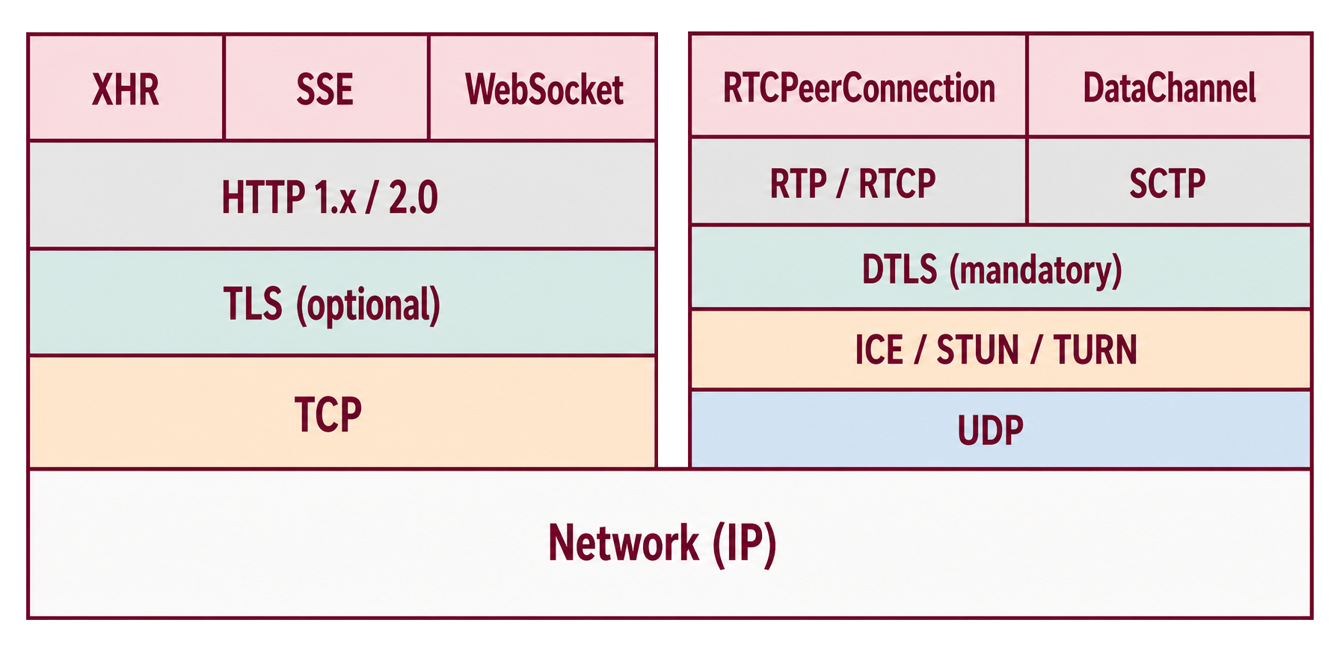
THEORY
The WebRTC Protocol Stack
07
Notes:
Timing: 60 seconds
Walk from capture at the top to UDP and IP at the bottom.
RTP and RTCP carry media and feedback. WebRTC protects them as SRTP and SRTCP.
DTLS-SRTP derives media keys on the selected ICE path. DataChannel is part of the standard but outside this project's implemented scope.
Sources:
- RFC 8835: https://www.rfc-editor.org/rfc/rfc8835.html
- RFC 8834: https://www.rfc-editor.org/rfc/rfc8834.html
- RFC 3711: https://www.rfc-editor.org/rfc/rfc3711.html
- RFC 5764: https://www.rfc-editor.org/rfc/rfc5764.html
- TFM.docx, pp. 22–23.

Slide 8
THEORY
STUN Discovery and TURN Relay
LOOKUP ONLY
Returns the public IP and port
STUN
Media never passes through STUN
Pi
Raspberry Pi
DIRECT MEDIA WHEN REACHABLE
WEB
Remote browser
WebRTC peer
WebRTC peer
FALLBACK MEDIA THROUGH TURN
RELAY
Forwards media when the direct path fails
TURN
Traffic enters and leaves the relay
STUN returns the public IP and port only. TURN relays media when no direct path works.
08
Notes:
STUN lookup: each peer asks a STUN server for its public mapped IP address and port. STUN does not carry the media stream.
Direct path: ICE checks candidate pairs and prefers a working direct connection.
TURN fallback: when no direct candidate pair succeeds, the peers use an authenticated allocation on the Metered TURN service and media crosses the relay.
Project sources: WebRtcHub.cs lines 10–16 and 24–35; WebRtcSessionManager.cs lines 33–69 and 78; Control.tsx around line 128.

Slide 9
THEORY
SDP Offer and Answer
Raspberry Pi
OFFERER
SignalR server
FORWARDS ONLY
Remote browser
ANSWERER
SDP OFFER VIA SIGNALR
SDP ANSWER VIA SIGNALR
THE LINES DESCRIBE
ILLUSTRATIVE SDP OFFER (ABBREVIATED)
01
media + direction
v=0
m=video 9 UDP/TLS/RTP/SAVPF 101
a=sendonly
a=rtpmap:101 H264/90000
a=fmtp:101 packetization-mode=1;profile-level-id=42e01f
a=ice-ufrag:TpaA
a=ice-pwd:t2Ouhc67y8JcCaYZxUUTgKw/
a=fingerprint:sha-256 A2:F3:A5:…:CE:4D
a=setup:actpass
02
codecs + RTP
03
ICE credentials
04
DTLS fingerprint
SignalR forwards this SDP text unchanged. WebRTC peers interpret it.
09
Notes:
Timing: 65 seconds
The Raspberry Pi creates the offer after a browser joins. SignalR forwards that offer to the selected browser.
The browser applies the offer, creates the answer, and returns it through the hub.
SDP carries the parameters needed to agree on media and establish ICE and DTLS. The application server does not become a media endpoint.
The SDP excerpt on the slide uses illustrative values adapted from RFC 9429. The fingerprint is shortened for readability.
Sources:
- RFC 8866 SDP: https://www.rfc-editor.org/rfc/rfc8866.html
- RFC 9429 JSEP: https://www.rfc-editor.org/rfc/rfc9429.html
- TFM.docx, pp. 21, 33–34.
- Repository: WebRtcSessionManager.cs, WebRtcSignalingBackgroundService.cs, Control.tsx.

Slide 10
THEORY
ICE Candidates After SDP
1
2
3
4
5
Initial SDP
offer / answer
Candidates
trickle
Connectivity
checks
Pairs ranked
by priority
Winning pair
nominated
HOST
SRFLX
PRFLX
RELAY
local interface
mapping learned via STUN
mapping learned in checks
TURN allocation
Gathering and SDP creation can overlap at runtime. Trickle ICE sends candidates as soon as they appear.
10
Notes:
Timing: 70 seconds
Present SDP first for explanatory clarity, then note that gathering can already be in progress while the descriptions are created.
Trickle ICE sends candidates incrementally. Each side forms pairs, runs STUN checks, ranks viable paths, and nominates the selected pair.
Peer-reflexive candidates can appear during checks even when they were not gathered beforehand.
Sources:
- RFC 8445: https://www.rfc-editor.org/rfc/rfc8445.html
- RFC 8838: https://www.rfc-editor.org/rfc/rfc8838.html
- W3C ICE events: https://www.w3.org/TR/webrtc/#rtcpeerconnectioniceevent
- TFM.docx, p. 21.

Slide 11
THEORY
WebRTC Video Codec Comparison
CODEC | WEBRTC SUPPORT | RELATIVE DATA USE | ENCODING AND DEPLOYMENT
VP8 | Required baseline | Medium | Mature software support Hardware support varies
H.264 CB | Required baseline | Medium | Broad hardware acceleration Profile and licensing checks
VP9 | Optional Negotiate fallback | Lower | Better compression Hardware support varies
AV1 | Optional Capability check | Lowest | Best efficiency Demanding without hardware acceleration
H.265 | Optional Fragmented | Low | Efficient on supported hardware Browser and licensing risk
720p AT 30 FPS LOW-LATENCY VIDEO
1.5 Mb/s
about 2 Mb/s
video target
sustained uplink with headroom
11
Notes:
Timing: 65 seconds VP8 and H.264 Constrained Baseline are the WebRTC video interoperability baselines. VP9, AV1 and H.265 require capability checks and a negotiated fallback. The network callout uses a 1.5 Mb/s video target for an illustrative 720p30 low-latency stream. About 2 Mb/s sustained uplink adds packet and control overhead plus roughly 25% operating headroom. It is a planning estimate, not a codec minimum. Relative data use is qualitative. Real bitrate depends on content, encoder implementation, resolution, frame rate, quality target and latency settings. Lower bitrate can reduce mobile-data and TURN-relay traffic, while newer codecs can require more compute or dedicated hardware. Sources: - RFC 7742 sections 5–6: https://www.rfc-editor.org/rfc/rfc7742.html#section-5 - Chromium WebRTC 720p singlecast defaults: https://chromium.googlesource.com/external/webrtc/+/refs/heads/master/rtc_base/experiments/encoder_info_settings.cc#47 - Google VP9 live encoding settings: https://developers.google.com/media/vp9/settings - Alliance for Open Media, Meta AV1 case study: https://aomedia.org/av1-adoption-showcase/meta-story/ - ITU-T HEVC overview: https://www.itu.int/en/ITU-T/studygroups/2017-2020/16/Pages/video/jctvc.aspx - TFM.docx, pp. 23–24. - Repository reference: appsettings.json video settings.

Slide 12
THEORY
WHIP and WHEP
WHIP
Central media server
WHEP
Publisher / device
ingest
egress
Viewer / browser
WebRTC session 1
WebRTC session 2
HTTP session lifecycle
POST offer, 201 answer + Location, PATCH ICE updates, DELETE teardown
WHIP is RFC 9725. WHEP remains draft-ietf-wish-whep-04 as of 5 September 2026.
12
Notes:
Timing: 70 seconds
WHIP covers unidirectional ingest from a publisher to a media server. WHEP covers egress from a media server to a viewer.
Combining them normally creates two server-terminated WebRTC sessions, so the media server sits in the video path.
WHIP is a Standards Track RFC. WHEP is still an active Internet-Draft, revision 04, on the date of this defense.
Sources:
- RFC 9725: https://www.rfc-editor.org/rfc/rfc9725.html
- WHEP draft-04: https://www.ietf.org/archive/id/draft-ietf-wish-whep-04.html
- WHEP status: https://datatracker.ietf.org/doc/draft-ietf-wish-whep/
- TFM.docx, pp. 24–25.

Slide 13
Issues and Iterations
Notes:
Issues and Iterations

Slide 14
ISSUES AND ITERATIONS
Initial Prototype Architecture
ASP.NET Core
SignalR coordination
SIGNALING
SIGNALING
RC car / Raspberry Pi
Camera + WebRTC sender
Remote browser
React + WebRTC viewer
EXPECTED DIRECT WEBRTC VIDEO
STUN
Initial assumption: Let WebRTC handle the magic
14
Notes:
Timing: 50 seconds
The first design already separated signaling from media. ASP.NET and SignalR coordinated the two peers, while WebRTC was expected to carry video directly.
The early configuration contained Google STUN only. TURN was explicitly absent.
Sources:
- Repository history: commit 5b2433a, 14 February 2026; commit 6bc9041, 19 February 2026.
- TFM.docx, pp. 16–19.

Slide 15
ISSUES AND ITERATIONS
Problem: NAT
STUN reports one
mapped IP:port
Carrier network
possible CGNAT
Camera peer
private IPv4
Mobile hotspot
first NAT
Browser network
NAT or firewall
Viewer peer
private IPv4
STUN finds a candidate. ICE must prove reachability.
WHY ICE CHECKS CAN FAIL
Private IPs are not publicly routable
NAT may change the mapping by destination
NAT or a firewall may filter peer UDP
15
Notes:
Timing: 60 seconds
SignalR can still connect because both peers open outbound connections to the coordination server. The media path is separate: the camera and browser must establish a usable route between themselves.
Both endpoints may use private IPv4. The mobile side can add hotspot NAT and carrier-grade NAT, while the browser network may add another NAT or firewall. STUN reports the IP address and UDP port observed by the STUN server, but that mapping may change for another destination and filtering may reject the peer's UDP.
ICE therefore tests candidate pairs. If no direct pair succeeds, signaling still works but direct WebRTC media cannot start. This motivates the TURN relay on the next slide.
Sources:
- RFC 8489: https://www.rfc-editor.org/rfc/rfc8489.html
- RFC 8445: https://www.rfc-editor.org/rfc/rfc8445.html
- RFC 4787: https://www.rfc-editor.org/rfc/rfc4787.html
- TFM.docx, pp. 21–22 and 36–38.

Slide 16
ISSUES AND ITERATIONS
Solution: IPv6
PROMISING
ICE can test IPv6 beside IPv4 and TURN.
IPv4 path
IPv4
carrier-grade NAT
IPv4 NAT / firewall
Mobile device
Remote browser
IPv6 Internet
Firewall policy
IPv6 can avoid the IPv4 CGNAT layer, but not firewall policy or latency limits.
16
Notes:
Timing: 50 seconds
IPv6 could remove the mobile carrier-grade IPv4 translation layer, so ICE should test it alongside IPv4 and TURN.
IPv6 does not bypass endpoint firewalls and is not automatically faster.
The current repository uses IPv6 loopback only between FFmpeg and .NET. No end-to-end public IPv6 test has been recorded.
Sources:
- TFM.docx, pp. 36 and 38.
- Repository: CameraVideoSource.cs line 158 uses IPv6Loopback for local RTP only.
- RFC 8445: https://www.rfc-editor.org/rfc/rfc8445.html

Slide 17
ISSUES AND ITERATIONS
Solution: TURN
WHY DIRECT CAN FAIL
WHY TURN WORKS
STUN discovers an address
A public relay bridges NAT
NAT may still block packets from the other peer.
Learning the public IP and port does not
guarantee that a direct path will work.
The client sends outbound traffic to TURN.
NAT allows replies over that mapping. TURN
forwards the peer’s media back along this path.
DIRECT CANDIDATES PREFERRED
Device
Browser
TURN relay
ICE USES THE RELAY WHEN DIRECT CHECKS FAIL
TURN must be reachable. Relaying adds a network hop and server bandwidth cost.
17
Notes:
TURN allocates a public relay IP address and port. The client initiates traffic to the TURN server, creating a NAT mapping and filter state that permit return traffic from that server. After permission setup, TURN forwards media between the peer and the client using this established path. If both peers need a relay, each can use a TURN allocation. ICE checks candidate pairs and selects a working path. STUN address discovery alone cannot guarantee direct reachability with restrictive NAT mappings or filtering. TURN still requires an allowed network path to its server. Source: https://www.rfc-editor.org/rfc/rfc8656.html (Sections 1 and 2).

Slide 18
ISSUES AND ITERATIONS
Problem: “Perfect” Signaling
SignalR carries messages. The application keeps the WebRTC peers in sync.
Protocol and roles
Define who creates offers, where answers go,
and which device or viewer owns each session.
SDP and ICE timing
ICE candidates can arrive before the remote SDP.
Queue them until the peer is ready.
Reconnects and stale state
SignalR and WebRTC have separate connection states.
Rejoin groups and repair the peer connection if needed.
Session lifecycle
Track active peers, handle timeouts and disconnects,
and clean up abandoned sessions.
Clear roles and session lifecycles motivated the WHIP / WHEP investigation.
18
Notes:
These are signaling design responsibilities, not claims of currently broken behavior. “Perfect” here means robust application signaling, rather than only the WebRTC perfect-negotiation pattern.
WebRTC leaves signaling transport to the application. The project uses SignalR to route SDP and ICE between device and browser. Fixed device/viewer roles make offer ownership explicit. Both peers buffer ICE until remote SDP exists. Transport reconnection, WebRTC recovery, and session cleanup require separate handling.
Project evidence: src/ScarletRadioControl.Web/Hubs/WebRtcHub.cs; src/ScarletRadioControl.Device/Services/WebRtcSessionManager.cs; src/ScarletRadioControl.Device/BackgroundServices/WebRtcSignalingBackgroundService.cs; src/ScarletRadioControl.Web.Frontend/src/pages/device/Control.tsx; PLAN.md.
WHIP and WHEP informed the roles and session-lifecycle model. The next slide explains the project’s SignalR concept mapping, which is not full HTTP WHIP/WHEP compliance.
References: https://webrtc.org/getting-started/peer-connections ; https://www.rfc-editor.org/rfc/rfc9725.html ; https://datatracker.ietf.org/doc/draft-ietf-wish-whep/

Slide 19
ISSUES AND ITERATIONS
Solution: WHIP and WHEP
The protocol model behind the full SignalR signaling rework.
WHIP
WHEP
WebRTC-HTTP Ingestion Protocol
Publisher sends media to a server.
WebRTC-HTTP Egress Protocol
Viewer receives media from a server.
Shared HTTP session lifecycle
POST
PATCH
DELETE
Create a session
Exchange SDP and receive
a session URL.
Update ICE
Send candidates or restart ICE,
when supported.
End the session
Release the session
resources.
Full SignalR rework
Strongly inspired by these roles and lifecycle concepts,
applied across the device, hub and browser.
19
Notes:
Timing: 50 seconds
WHIP and WHEP supplied a concrete signaling model for the full rework. WHIP defines ingestion: a publisher sends WebRTC media to a streaming service. WHEP defines egress: a viewer receives WebRTC media from a streaming service. Their role model separates publishing from playback.
The shared HTTP lifecycle makes each media session an explicit resource. In the common setup flow, POST exchanges SDP and returns the session URL in the Location header. PATCH carries trickle ICE candidates or ICE restarts when supported. DELETE terminates the session and releases its resources. Media itself travels over WebRTC.
WHEP draft-04 additionally supports a server counter-offer, with the client sending an SDP answer using PATCH. Therefore POST is the session-creation entry point and PATCH is not exclusively for ICE in every WHEP flow.
These clear roles, ordered negotiation and lifecycle concepts strongly inspired the complete application signaling rework across the device, hub and browser. The project adapts the ideas through SignalR. It does not claim WHIP/WHEP wire-protocol compliance or a completed HTTP endpoint implementation.
WHIP is RFC 9725. WHEP is draft-ietf-wish-whep-04, a work in progress, checked 7 September 2026.
Sources:
WHIP, RFC 9725: https://www.rfc-editor.org/rfc/rfc9725.html
WHEP, draft-ietf-wish-whep-04: https://datatracker.ietf.org/doc/html/draft-ietf-wish-whep-04
Repository history: 248f094 (WHEP reference), 529de9a and 72b7dd1 (endpoint prototypes), 87bc7cc (device routes), 643142b (ICE configuration returned from SignalR join methods).
Implementation: src/ScarletRadioControl.Web/Hubs/WebRtcHub.cs; src/ScarletRadioControl.Device/Services/WebRtcSessionManager.cs; browser WebRTC lifecycle code.

Slide 20
ISSUES AND ITERATIONS
Problem: Libcamera
libcamera is the advertised route.
Advertised route
Raspberry Pi promotes libcamera as the modern
camera stack, especially for its camera modules.
Practical reality
The Logitech C920 is a USB camera.
The working FFmpeg integration uses V4L2 directly.
Working capture path
FFmpeg opens the V4L2 device and captures MJPEG
for H.264 encoding and WebRTC delivery.
20
Notes:
The project experience contrasted the advertised libcamera route with direct V4L2 capture in the working prototype. The final hardware was a Logitech C920 USB webcam. This distinction concerns the project hardware and FFmpeg integration, not a claim that libcamera is universally unsuitable.
Sources: user clarification; Raspberry Pi, Camera software documentation, https://www.raspberrypi.com/documentation/computers/camera_software.html (accessed 7 September 2026); Raspberry Pi, Bullseye camera system, https://www.raspberrypi.com/news/bullseye-camera-system/; project PLAN.md and src/ScarletRadioControl.Device/Options/FfmpegArgumentTemplate.cs; original presentation, Final Media Pipeline.

Slide 21
ISSUES AND ITERATIONS
Problem: Ffmpeg Shared
Direct integration tied the .NET application to compatible native FFmpeg libraries.
First implementation
SIPSorceryMedia.FFmpeg handled camera capture
and encoding inside the .NET process.
Encoded-sample callbacks
The application received encoded video samples directly
through in-process callbacks.
Version compatibility
FFmpeg 8.1 native libraries had to match
the FFmpeg.AutoGen bindings.
Raspberry Pi deployment
Deployment required a compatible shared-library build
beyond the older distribution packages.
Native library versions became a deployment constraint.
21
Notes:
Sources: original PRESENTATION.pptx, slide 18; PLAN.md, Camera integration approaches; repository commit 4b357dd, PLAN.md (FFmpeg 8.1 and FFmpeg.AutoGen 8.1.0 compatibility and Raspberry Pi distribution package constraint); commit 4b357dd, src/ScarletRadioControl.Device/Video/CameraVideoSource.cs (FFmpegInit.Initialise, FFmpegCameraSource and OnVideoSourceEncodedSample).

Slide 22
ISSUES AND ITERATIONS
Solution: Ffmpeg RTP
A supervised FFmpeg executable sends encoded H.264 over local RTP.
Separate process
FFmpeg captures and encodes the camera stream.
.NET starts and supervises the executable.
Local RTP transport
FFmpeg sends RTP over IPv6 loopback.
The .NET receiver rebuilds H.264 access units.
WebRTC delivery
SIPSorcery repacketizes the encoded video
and sends it to the browser through WebRTC / SRTP.
Deployment benefit
The executable replaces shared-library bindings.
FFmpeg can restart while the local receiver stays active.
Software H.264 encoding still consumes CPU on the Raspberry Pi.
22
Notes:
Sources: original PRESENTATION.pptx, slides 18-20; PLAN.md:119-143; current src/ScarletRadioControl.Device/Services/CameraVideoSource.cs (IPv6 loopback RTP receiver, process supervision, restart, RTP parsing and H.264 depacketization); TFM.docx, Camera-to-WebRTC Video Pipeline and Runtime Resilience. External FFmpeg addresses native-library deployment fragility. Software encoding remains on the Raspberry Pi.

Slide 23
ISSUES AND ITERATIONS
Solution: Final Media Pipeline
FFMPEG PROCESS
.NET + SIPSORCERY
Logitech C920
MJPEG
V4L2
capture
MJPEG
decode
RTP parse +
H.264 depacketize
Annex-B +
SPS / PPS
SIPSorcery
WebRTC / SRTP
libx264
H.264 baseline
RTP over
IPv6 loopback
Browser
playback
1280×720 at 30 fps, 1.5 Mb/s, superfast, zerolatency, no B-frames
FFmpeg captures and encodes; SIPSorcery owns the secure WebRTC peer connection.
23
Notes:
Timing: 80 seconds
Follow the pipeline from the C920 to the browser. FFmpeg receives MJPEG through V4L2, decodes it, and software-encodes H.264 Constrained Baseline.
FFmpeg emits RTP on IPv6 loopback. .NET parses RTP, depacketizes H.264, assembles Annex-B access units, and caches SPS and PPS.
SIPSorcery repacketizes the encoded access unit into the negotiated WebRTC stream and owns SRTP and the peer connection.
The .NET layer avoids a second decode and encode, but FFmpeg still performs the MJPEG decode and software H.264 encode.
Sources:
- TFM.docx, pp. 29–30 and 36.
- Repository: appsettings.json; CameraVideoSource.cs lines 152–188, 359–493; WebRtcSessionManager.cs lines 99–101 and 247–264.

Slide 24
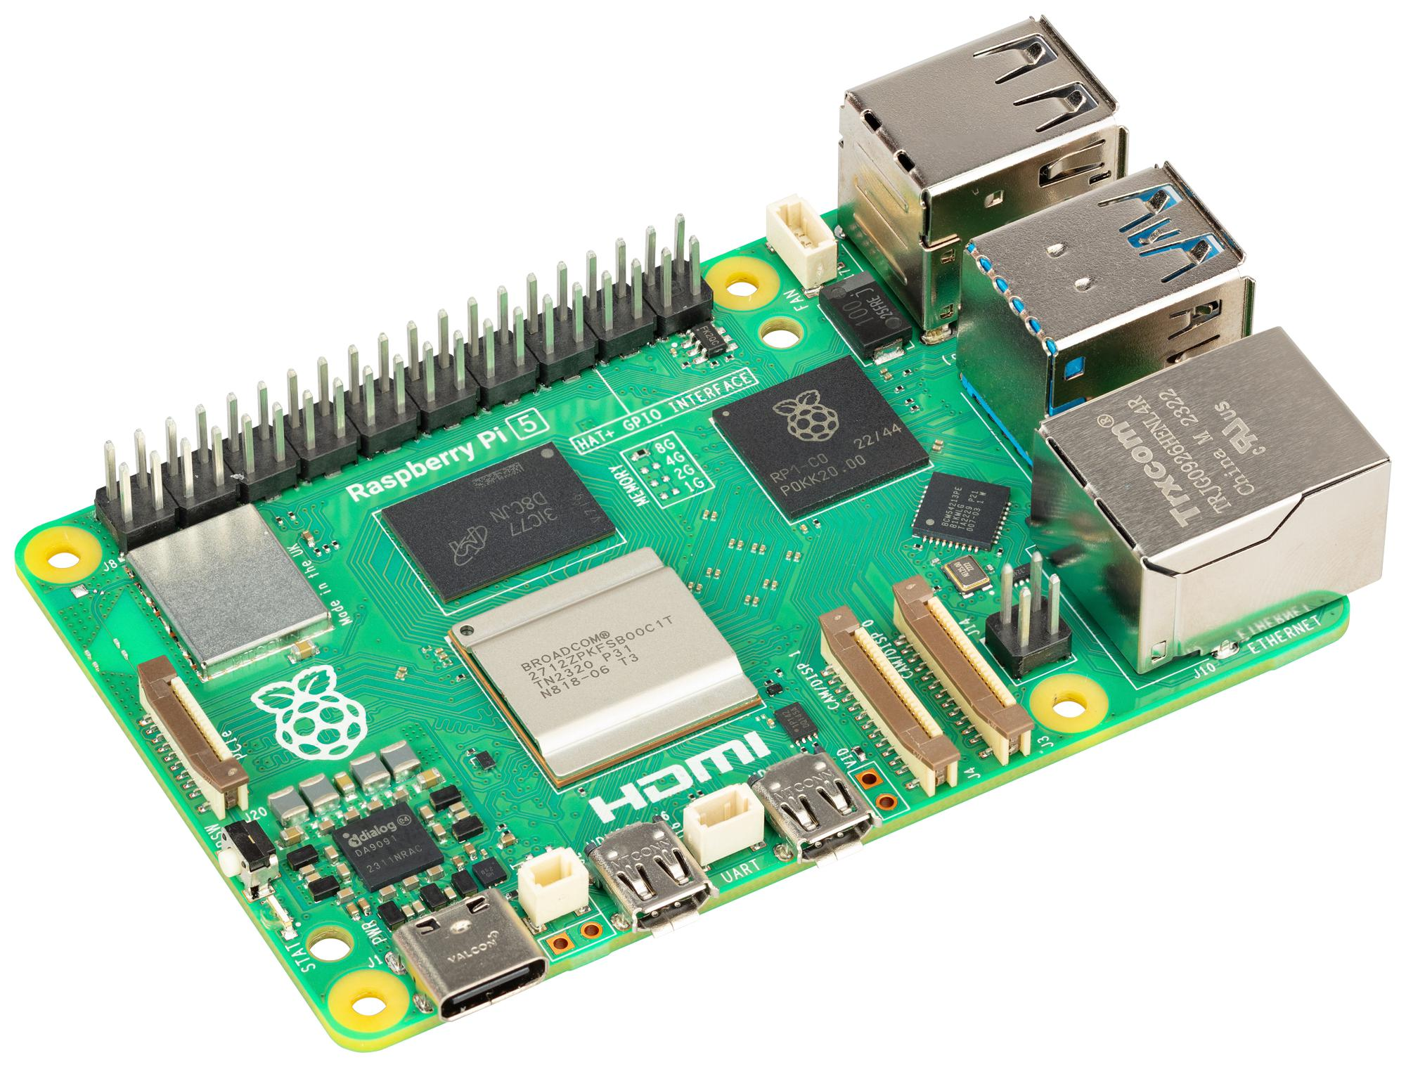
ISSUES AND ITERATIONS
Problem: CPU Encoding
Advertised H.264 support
Logitech advertised the C920 as H.264-ready.
Newer revisions removed the in-camera encoder.
Re-encoding on the Raspberry Pi
Our camera supplies MJPEG. The Raspberry Pi
must decode it and re-encode to H.264 using
FFmpeg/libx264 for our WebRTC stream.
CPU ENCODING COST
More CPU load, heat and encoding latency
Low-latency settings reduce buffering, but encoding still runs on the CPU.
24
Notes:
Timing: 60 seconds
Logitech originally advertised the C920 with H.264 video encoding. Logitech later explained that it removed in-camera encoding resources from C920 and related webcam models.
The advertised capability therefore does not describe newer hardware revisions. The project camera supplies MJPEG, and the repository configures FFmpeg to decode it and encode H.264 with libx264.
Software encoding adds CPU work, heat and encoding latency on the Raspberry Pi. No measured CPU percentage or encoding-only latency is claimed.
The external FFmpeg process improves deployment isolation but leaves software encoding on the Raspberry Pi.
Sources:
Logitech, Logitech Webcams and H.264 Encoding: https://support.logi.com/hc/en-gb/articles/40102104890647-Logitech-Webcams-and-H-264-Encoding
Logitech, 2012 C920 announcement: https://news.logitech.com/press-releases/news-details/2012/Logitech-Unveils-Full-HD-Webcam-for-1080p-Video-Calling/default.aspx
Repository: PLAN.md, appsettings.json and CameraVideoSource.cs.
TFM.docx, pp. 29-30 and 36-39.
Image: TFM.docx Figure 3, Raspberry Pi 5 product image.

Slide 25
ISSUES AND ITERATIONS
Solution: WebCam with H264
PENDING IMPLEMENTATION
Proposed hardware
Use a webcam with a verified onboard H.264 encoder.
Check H.264 output on the exact hardware revision.
Planned media path
Capture browser-compatible H.264 directly and feed it
into the existing RTP and WebRTC pipeline.
Expected benefit
Skip MJPEG decoding and software H.264 encoding.
Measure CPU savings and latency after integration.
25
Notes:
This solution is pending implementation. The current prototype still captures MJPEG and uses libx264 to encode H.264 in software.
Select and verify a webcam whose exact hardware revision exposes an onboard H.264 stream. No replacement camera has been selected or validated for this slide.
Adapt capture to receive browser-compatible H.264 and feed the encoded video into the existing RTP and WebRTC pipeline. Confirm profile, SPS/PPS, packetization, bitrate and keyframe behavior during integration.
The expected benefit is removing MJPEG decoding and software H.264 encoding from the Raspberry Pi. CPU savings and end-to-end latency remain to be measured.
Sources: existing presentation slide Hardware and Direct H.264; repository PLAN.md, appsettings.json and CameraVideoSource.cs; requested implementation status.

Slide 26
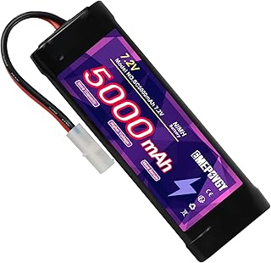
ISSUES AND ITERATIONS
Problem: Electrical Input to the Raspberry Pi
AUTHOR-REPORTED OBSERVATION
Motor demands
high current
Suspected
voltage dip
Raspberry Pi
disconnects briefly
Effect on video
NiMH supply
Brief Raspberry Pi disconnections
interrupt the live stream.
The prototype already has a small DC-DC regulator.
Supply voltage during motor load still needs measurement.
26
Notes:
The author reports brief Raspberry Pi disconnections when the RC car demands high current. A supply-voltage dip is a suspected mechanism, not a measured brownout diagnosis.
The prototype uses a NiMH battery and an existing small DC-DC regulator. Electrical protection and validation are proposed future work on the following slide.
Sources: PLAN.md, author observation on electrical input; TFM.docx, Power Supply System and Protected Electrical Design. No measured voltage waveform or completed protection validation is supplied.

Slide 27

ISSUES AND ITERATIONS
Temporary Solution: Xiaomi 33W Power Bank
Power source
The Raspberry Pi uses a Xiaomi 33W power bank.
Reason for the change
Separate its power supply from the motor’s
high current demand.
Temporary workaround
Use the power bank for the prototype.
A permanent protected supply remains future work.
Xiaomi product image
27
Notes:
The implemented temporary solution uses a Xiaomi 33W power bank to supply the Raspberry Pi. The aim is to separate its power source from the motor current demand described on the preceding problem slide.
The user confirmed the power bank and temporary status on 8 September 2026. No exact model, battery capacity, output profile, operating duration or measured improvement was provided. The 33W label identifies the user-described product; it is not a measurement of Raspberry Pi power consumption.
The permanent protected electrical design remains future work, as described in TFM.docx under Protected Electrical Design and in the corresponding Future Work slide. It is separate from the temporary power bank setup.
Image source: Xiaomi official product page, https://www.mi.com/global/product/xiaomi-33w-power-bank-10000-integrated-cable/
Original image: https://i02.appmifile.com/mi-com-product/fly-birds/xiaomi-33w-power-bank-10000-integrated-cable/pc/e3920e7dc32c0b681d251394550f7f70.jpg
The photograph is a product reference for the Xiaomi 33W Power Bank 10000 (Integrated Cable), not a photograph of the prototype. The user did not specify capacity or colour. No added model specification is a claim about the installed unit.

Slide 28
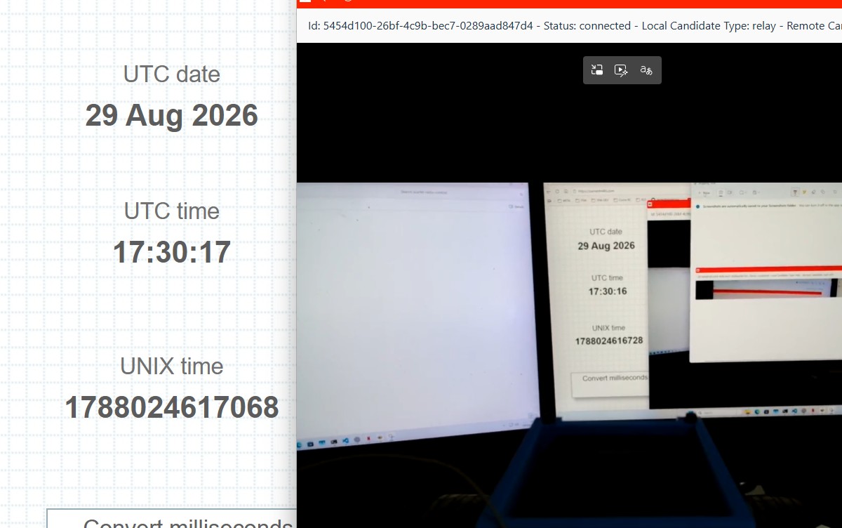
ISSUES AND ITERATIONS
Prototype Result and Limitations
340 ms
ONE OBSERVATION
Glass-to-glass under the tested 4G configuration
TARGET
< 400 ms
1788024617068 − 1788024616728 = 340 ms
28
Notes:
Timing: 75 seconds
The measurement compares the visible time reference with the received browser image. The two Unix timestamps differ by exactly 340 milliseconds.
The browser status line shows a relay local candidate in this captured run, so the observed path appears TURN-relayed.
Treat this as one 4G observation that supports feasibility. It does not establish a latency distribution, a guarantee, or 5G validation.
Sources:
- TFM.docx, pp. 8–9 and 36; Figure 10.
- Resum-TFG-TFM-Raul-Hidalgo-Caballero.docx.pdf, p. 2.

Slide 29
Future Work
Notes:
Future Work

Slide 30
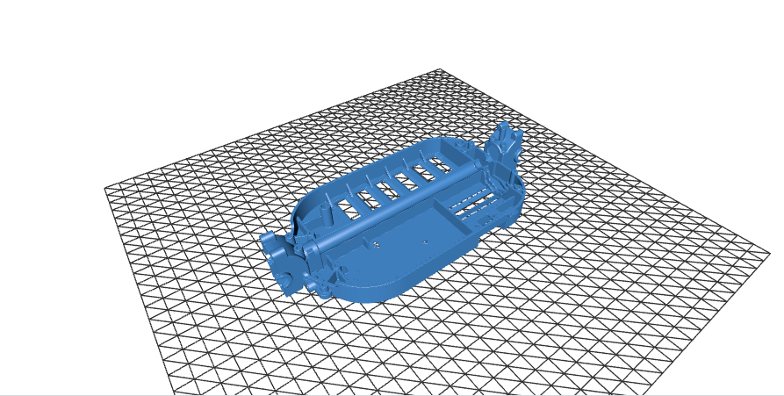
FUTURE WORK
Complete Remote Control
NEXT PHASE
Add a verified command loop without changing the completed video-scope claim.
INPUT
MESSAGE
DEVICE
ACTUATION
periodic gamepad sampling
version + sequence + timestamp
range and staleness checks
steering and throttle PWM
Fail safe to neutral on timeout, invalid data, channel loss, or emergency stop.
30
Notes:
Timing: 45 seconds
Vehicle control belongs to the next phase, not the completed project scope.
A production command loop needs explicit sequencing, timestamps, validation, actuation, and a neutral fail-safe whenever communication or input becomes unsafe.
Sources:
- TFM.docx, pp. 37–38.
- Image: TFM.docx Figure 2, 3D chassis design.

Slide 31
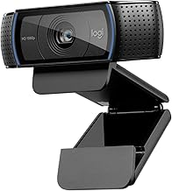
FUTURE WORK
Hardware and Direct H.264
CURRENT
C920
MJPEG
MJPEG
decode
Software
libx264
TARGET
Camera or SoC
H.264 output
Packet adaptation
only
Remove two expensive stages where hardware permits
Validate profile, SPS/PPS, GOP, bitrate, buffering, CPU load, and measured latency.
31
Notes:
Timing: 35 seconds
The best next optimization is direct H.264 from the camera or a hardware encoder, removing MJPEG decode and software libx264 where possible.
Direct output still needs validation. The profile, parameter sets, packetization, GOP, buffering, and measured latency must match the WebRTC path.
Sources:
- TFM.docx, pp. 38–39.
- Image: TFM.docx Figure 4, Logitech HD Pro C920.

Slide 32
FUTURE WORK
IPv6 SIM Card and USB Dongle
SIM AND DONGLE SEARCH CRITERIA
Component | Requirement | Verification | Status
SIM / data plan | IPv6-enabled APN | Confirm with carrier | To source
USB dongle | IPv6 + Linux support | Test on Raspberry Pi | To source
SIM + dongle | Direct IPv6 connection | Test remote access | To validate
VALIDATE BEFORE SELECTION
IPv6 address
APN support
Linux drivers
remote access
stable uplink
32
Notes:
Timing: 35 seconds
Run a controlled matrix rather than another single demonstration. Compare IPv4 direct, IPv6 direct, and TURN relay across realistic mobile network modes.
Record distributions and stability, not only a best-case latency number. Include NAT type, mobility, loss, and uplink consistency.
Sources:
- TFM.docx, pp. 38 and 40.
- RFC 8445: https://www.rfc-editor.org/rfc/rfc8445.html

Slide 33
FUTURE WORK
Electrical Wiring and Voltage Stability
POWER WIRING
Battery
Fuse + transient
protection
Dedicated DC-DC
regulator
Raspberry Pi
Motor branch
Separate motor and compute power branches. Use short, adequately sized wires and secure connectors.
VOLTAGE DROP PREVENTION
Improve cable sizing and connections. Add local decoupling at the Raspberry Pi and check DC-DC capacity during motor startup.
Stable power supply
Measure supply voltage under load and log brownouts to verify the wiring changes.
33
Notes:
Timing: 35 seconds
The hardware priority is a protected and measurable power tree that isolates motor transients from the Raspberry Pi rail.
The plan also calls for complete WHIP and WHEP. That is a separate protocol track because true compliance requires HTTP session resources and a central media server that terminates WebRTC.
Sources:
- TFM.docx, p. 39.
- RFC 9725: https://www.rfc-editor.org/rfc/rfc9725.html
- WHEP draft-04: https://www.ietf.org/archive/id/draft-ietf-wish-whep-04.html

Slide 34

FUTURE WORK
ESP32-P4 Integrated Rust Platform
ESP32-P4
Camera input and H.264 encoding
Rust application and safety logic
Ethernet or an external modem
WHY INVESTIGATE
OPEN QUESTIONS
Dual-core RISC-V
Camera + ISP
Hardware H.264
Ethernet MAC
WebRTC stack and memory budget
Rust driver maturity
Thermal and power envelope
5G modem integration
Espressif documents H.264 encode up to 1080p30. End-to-end feasibility still requires a prototype.
34
Notes:
Timing: 30 seconds
ESP32-P4 is a long-term consolidation candidate because it combines RISC-V cores, camera interfaces, an image pipeline, hardware H.264, and Ethernet.
It has no integrated 5G radio, so a modem or network companion remains necessary. Rust HAL support exists, but peripheral maturity and a practical WebRTC stack still need validation.
Sources:
- TFM.docx, p. 39.
- Espressif ESP32-P4 datasheet: https://documentation.espressif.com/esp32-p4_datasheet_en.html
- Espressif product overview: https://www.espressif.com/en/node/7617
- esp-hal: https://github.com/esp-rs/esp-hal
Image source: Espressif Systems, ESP32-P4 announcement. https://www.espressif.com/en/news/ESP32-P4
Image: https://www.espressif.com/sites/default/files/MicrosoftTeams-image%20%2816%29.png

Slide 35
Potential Aplications
Notes:
Potential Aplications

Slide 36

POTENTIAL APPLICATIONS
Autonomous Motorway Driving with Remote Final Approach
A truck handles the long motorway segment autonomously. A remote driver takes over for depot entry, loading areas, and other complex final manoeuvres.
This project contributes the low-latency video path. Safe teleoperation also requires redundant control, vehicle safety systems, and operational approval.
CONCEPT ILLUSTRATION
Notes:
Timing: 60 seconds
Use this as an application concept, not as a tested system.
The motorway segment can run autonomously, while a remote operator handles the final approach where context and interaction are harder to automate.
Low-latency video is one dependency. Production teleoperation needs redundant control, a safety case, secure operations, and regulatory approval.
Sources:
- Application example specified in PLAN.md.
- Concept illustration generated for this presentation with OpenAI ImageGen; it is not project evidence.

Slide 37
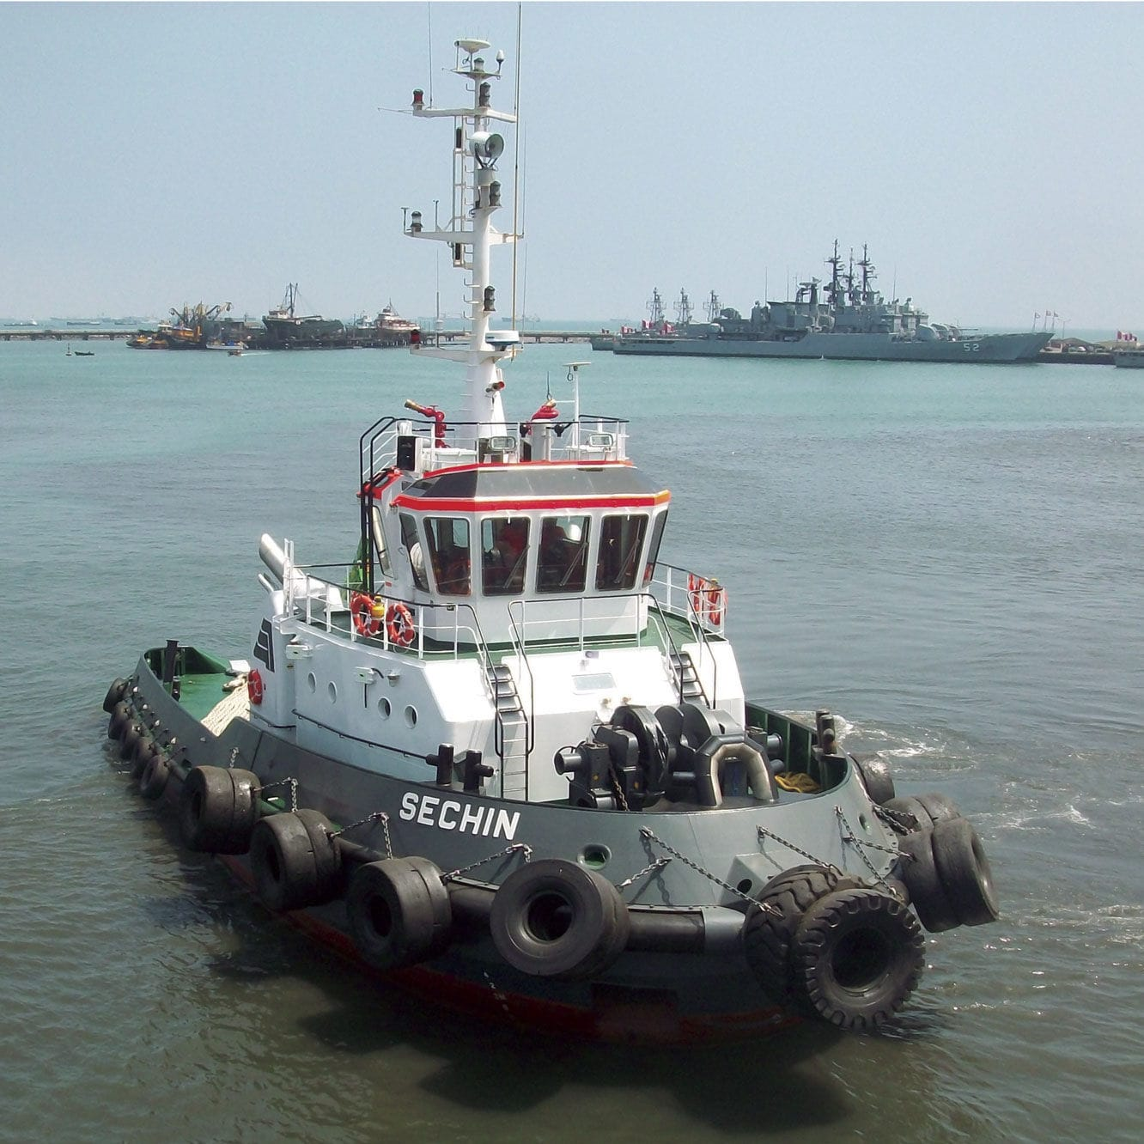


POTENTIAL APPLICATIONS
Teleoperated Heavy Vehicles
CRANES
MINING
WORKBOATS
Move operators away from suspended loads
Operate in dust, heat, and unstable terrain
Support manoeuvres in hazardous port areas
Concept only. Production systems require redundant command paths and task-specific safety engineering.
Notes:
Timing: 60 seconds
Cranes, mining equipment, and workboats share the value proposition of moving people away from hazardous work zones.
The video link must remain usable under motion, vibration, coverage changes, and harsh radio conditions.
The prototype addresses only the video-path question. Each domain needs its own redundant control and safety design.
Sources:
- Application examples specified in PLAN.md.
- Concept illustration generated for this presentation with OpenAI ImageGen; it is not project evidence.

Slide 38
Demo / Video
Notes:
Demo / Video

Slide 39

DEMO / VIDEO
Fallback Video
41
Notes:
Timing: 55 seconds
This slide reserves the required 16:9 media frame for a real RC-car recording.
No physical-car video file exists in the repository. The countdown is a 66.94-second simulator asset and can demonstrate the signaling and media path only.
Keep the placeholder label until real footage is inserted.
Sources:
- Repository: src/ScarletRadioControl.Web.Frontend/src/assets/countdown.mp4 and ControlTest.tsx.
- PLAN.md, Fallback Video.

Slide 40
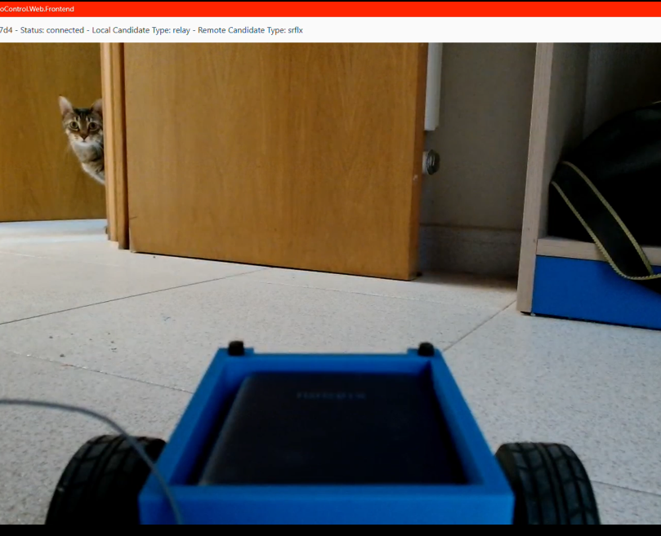
FINAL TAKEAWAYS
WebRTC can meet the prototype latency target
Questions?
Notes:
Timing: 40 seconds plus questions
Close with the evidence: the prototype demonstrates feasibility under one tested 4G configuration.
The most consequential engineering work involved NAT traversal and the software media pipeline.
Name the next priorities, then invite questions.
Sources:
- TFM.docx, pp. 36–40; Figure 11.
- PLAN.md, Final Takeaways and Questions.

