Slide 1
2D FEP frame subtraction
Can we run it inline on the beamline?
I11 PXRD pipeline | engineering handover | October 2026
Notes:
Purpose of the meeting: show the working Python script that removes FEP tube scattering from each raw 2D frame, explain exactly what it does, and decide together whether and how it can be automated at the beamline.

Slide 2
What it does: one frame in, one frame out
In
Process
Out
Raw 2D frame (Pixium, 2881 x 2880)
Merged reference (.npz)
Calibration (.poni) and detector mask (.npy)
Fit one scale s per frame
corrected = frame − s × reference
Mask pixels, keep negatives
Corrected 2D frame, float32
Same file name as the raw frame
Per-frame scale and quality flags
➜
➜
Scope: this stage only produces the clean 2D frame. Hit sorting, integration and baselining happen afterwards in the offline app.
Notes:
The contract is deliberately small. Everything the engineer needs to know about interfaces is on this slide. The reference is built beforehand in the offline app from tube-only frames; during the experiment only the subtraction runs.

Slide 3
What you need to run it
fep2d_inline.py
InlineSubtractor class, folder watcher, command line
fep2d_pipeline.py
Shared settings, mask building, reference checks
fep2d_v3.py
Core maths and HDF5 file reading and writing (tested, unchanged)
Packages
Inputs prepared beforehand
numpy, scipy, h5py, pyFAI. No GPU. pybaselines is only needed for the offline baselining step, not for this stage.
Merged reference from about 46 or more tube-only frames. Calibration (.poni) and detector mask from the beamtime calibration.
Notes:
Three Python files and the usual scientific stack. The calibration is needed only to build the 2theta mask that hides the strong FEP line.

Slide 4
The algorithm
1
Robust scale fit
s = Σ(frame × ref) / Σ(ref²), over all unmasked pixels. Six passes. Each pass keeps pixels whose residual is below +3σ and above −6σ (σ = 1.4826 × MAD), so Bragg spots do not inflate s.
2
Subtract
corrected = frame − s × reference. No offset term. Negative values are kept (40 to 50% negative is normal).
3
Mask
Detector-bad pixels plus a 2θ ring 5.30 to 6.10° (from the .poni) are set to 0. Output is float32.
Reference: plain mean of screened frames (Welford streaming, float64). Frames with total under 30% of the median, 5-sigma outliers or poor thumbnail correlation are dropped.
Notes:
Everything is a few lines of numpy. The only non-trivial part is the iterative clipping in the scale fit, which is what keeps crystal peaks from biasing the fitted scale. The whole detector is used for the fit.

Slide 5
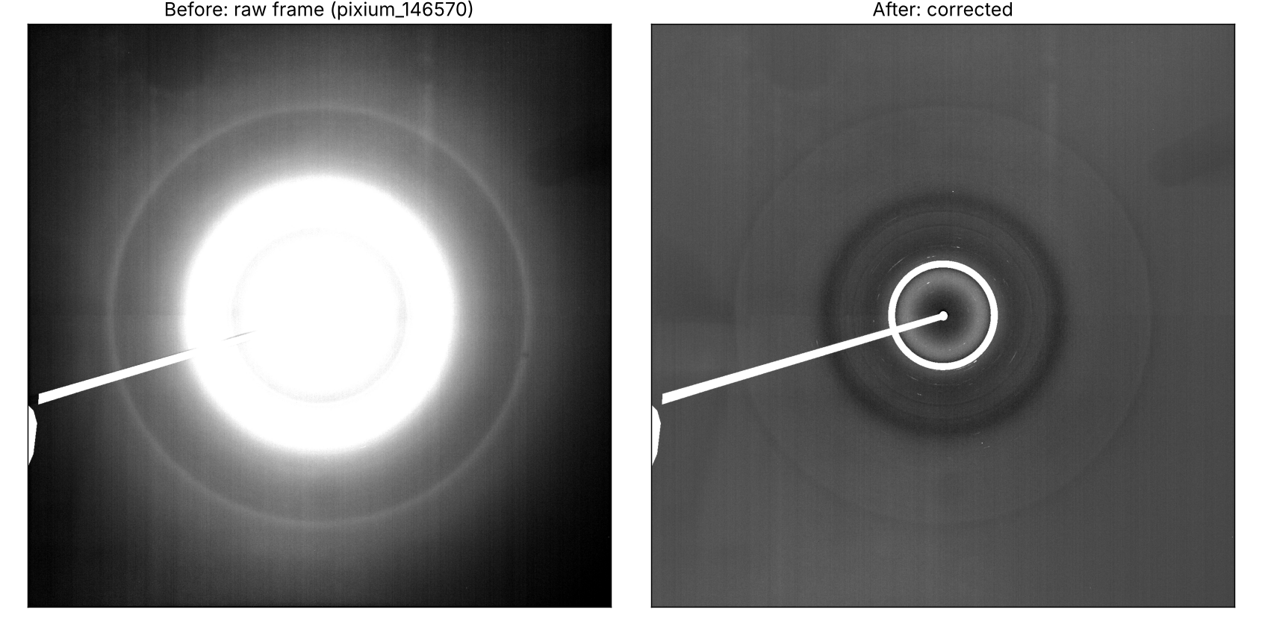
Real data: one frame, before and after
Frame 146570, run 007 (seeded carbamazepine, sorted as a hit). White = masked: the 2θ ring 5.30° to 6.10° and the beam stop. The tube rings and solvent background drop out and crystal spots show as small bright marks inside the ring.
Notes:
Real frame from the AP39 trial, run 007, frame 146570. Left: raw, display saturated so the weak outer rings are visible. Right: after subtraction with the merged 70:30 reference. White is masked: the 5.30 to 6.10 degree ring and the beam-stop shadow. Small bright marks near the ring are crystal spots. A smooth halo remains and is removed by baselining later in the offline app.

Slide 6
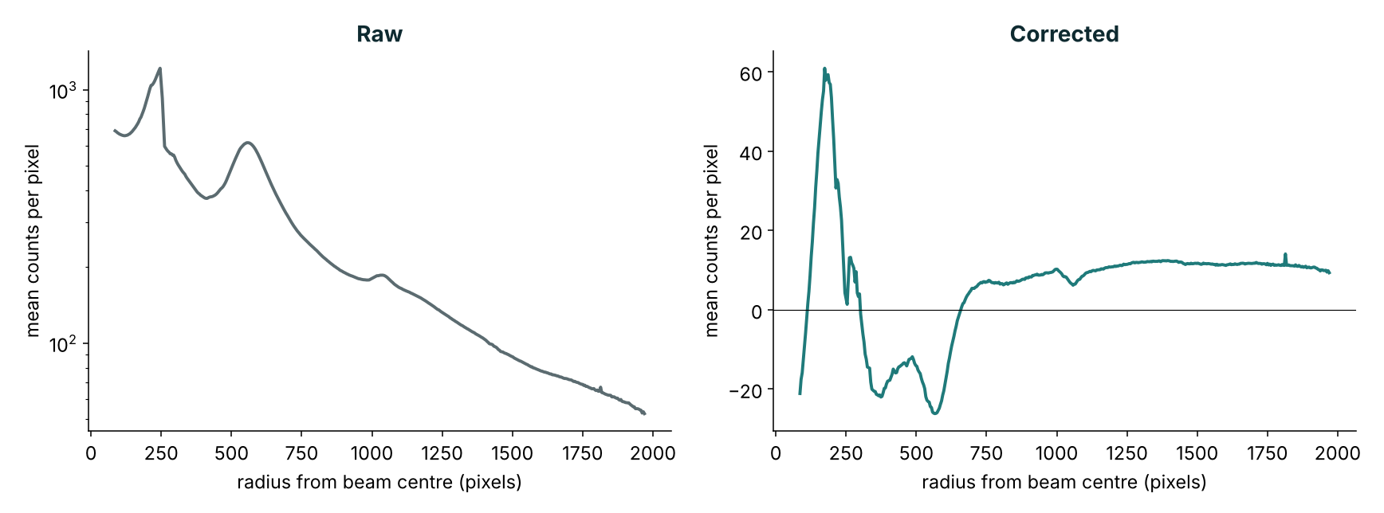
What the subtraction removes
Frame 146570 averaged around rings (masked pixels excluded). The sharp tube peaks are gone. A smooth residual remains: about −26 to +12 counts per pixel away from the centre, plus a hump near the beam centre (up to about +60). Baselining follows in the offline app.
Notes:
This is frame 146570 averaged in rings around the beam centre, with the centre found from the masked annulus. Left is log scale. The raw profile has the tube peak near 250 pixels and the solvent halo. After subtraction the sharp features are gone but a smooth residual stays, because one global scale cannot match the solvent halo exactly. It is smooth, so baselining removes it.

Slide 7
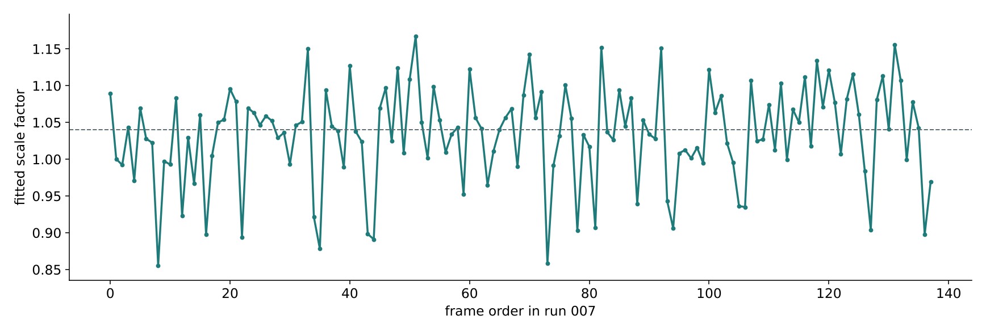
The fitted scale across a real run
Run 007, 138 frames, one reference for all. Median 1.04, range 0.86 to 1.17. The robust fit kept at least 96% of pixels in every frame. All 138 frames were written with no errors.
Notes:
Why the scale is fitted per frame: it moves from frame to frame by several per cent. This is the diagnostic the inline version would log and monitor. Source: subtraction_diagnostics.csv from the offline app run on 19 October.

Slide 8
Using it from your own code
sub = InlineSubtractor(
fm.load_reference("merged_reference.npz"),
pyFAI.load("calib.poni"), np.load("mask.npy")) # once, <1 s
res = sub.process(frame_2d, name="pixium_146588") # never raises
res.ok, res.flags # False or any flag: look at this frame
res.corrected # float32 2D array, same shape
res.scale # fitted scale factor
sub.process_file("pixium_146588.hdf", out_dir) # read, subtract, write
Array mode
File mode
Watcher
pass numpy frames, get arrays back
reads .hdf or .nxs, writes the corrected file
python fep2d_inline.py --watch <folder> …
Notes:
Two ways in. Either hand it numpy arrays from your own acquisition code, or point it at files or a folder. process() catches all exceptions and reports them in the result, so it cannot take down a calling loop. State such as the scale history is held in the object; it has not been tested for concurrent use.

Slide 9
Checks on every frame
Rejected, not written
Written, but flagged
Wrong shape
NaN or infinite pixels
Total under 30% of the reference (dark or shutter closed)
File will not open
Scale outside 0.3 to 3.0
Under half the pixels kept by the fit
Scale over 5 robust sigma from the running median (last 200, after 10 frames)
Start-up also checks the reference (finite, positive, frame count) and that at least 1000 usable pixels remain. A failed frame is skipped and logged, never replaced by the previous one.
Notes:
Hard failures never reach the output folder. Soft flags are in inline_log.csv, so a monitoring layer can alert on them. A drifting scale is the main sign that the reference no longer matches the setup.

Slide 10
What it writes, and how safely
01_corrected_2D/<raw name>
Corrected frame, self-contained HDF5 (about 59 MB)
subtraction_diagnostics.csv
Scale, fit fraction, negative fraction, sum per frame
inline_log.csv
One line per frame: ok, flags, timing, output path
inline_manifest.json
Settings, reference and calibration used
Written under a hidden temporary name, then renamed, so a downstream reader never sees a half-written file. The watcher takes .hdf only, waits for the size to settle and for the file to open, and gives up on a bad file after 60 s.
Notes:
Output format and names match the offline app's subtract tab, so existing downstream tools read it unchanged.

Slide 11
Performance and validation
~4.2 s
~27 s
0.0
0.88–1.17
per frame incl. writing, 2 CPU cores
between frames arriving
pixel difference vs the offline app, 4 real frames
scale range over 96 frames (1 drift flag)
Not yet measured
Peak memory (a float64 detector array is about 66 MB, so a few of those); behaviour on a live feed; concurrent use.
Timings are from the tested set-up (AP39 carbamazepine frames), not from beamline hardware.
Notes:
Be upfront about what has and has not been measured. Timing and the identical-output check are real measurements on recorded frames. Memory and live-feed behaviour are open items.

Slide 12
Limits to know about
Reference must match
Same tube, solvent and geometry. Rebuild after any change. Drifting scale is the warning.
Blind window
5.30 to 6.10° is set to 0. A crystal peak there is invisible, so treat it as missing, not as no signal.
Frame-to-frame order
Scale history is per object and ordered; it is not shared across processes.
Scope
No hit sorting, no integration, no baselining at this stage.
Notes:
These are the things that would surprise an engineer. The blind window is the scientific trade-off for hiding the strong FEP line.

Slide 13
Questions for you
1
Frames: watch a folder of files, or pass arrays from your acquisition code?
2
Where would this run, and how many cores and how much disk are available?
3
Where do flags and failures go: log file only, or an alert to the beamline team?
4
Reference handling: who builds it, and how is a mismatch detected and refreshed mid-run?
Notes:
These are the decisions we need from the engineer. The code supports both file and array input, so the first question is about the surrounding system, not the script.

