Slide 1
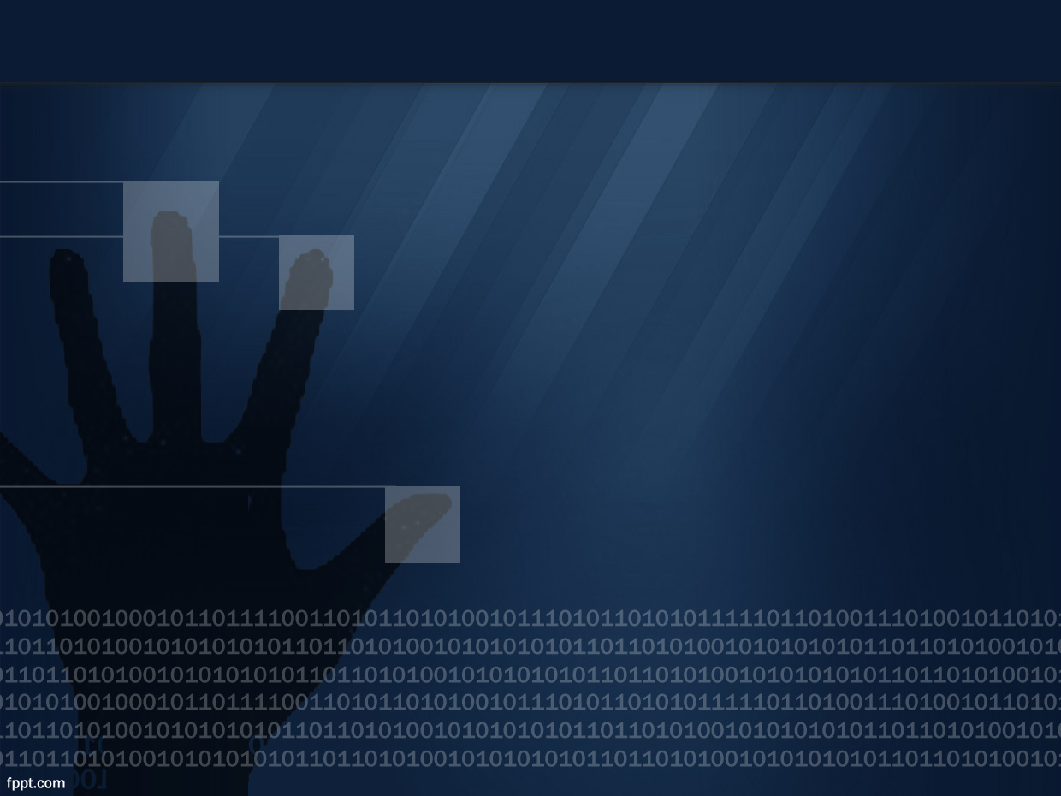
Website Fingerprinting
S. Carroll, M. Diloreto, R. Youn

Slide 2
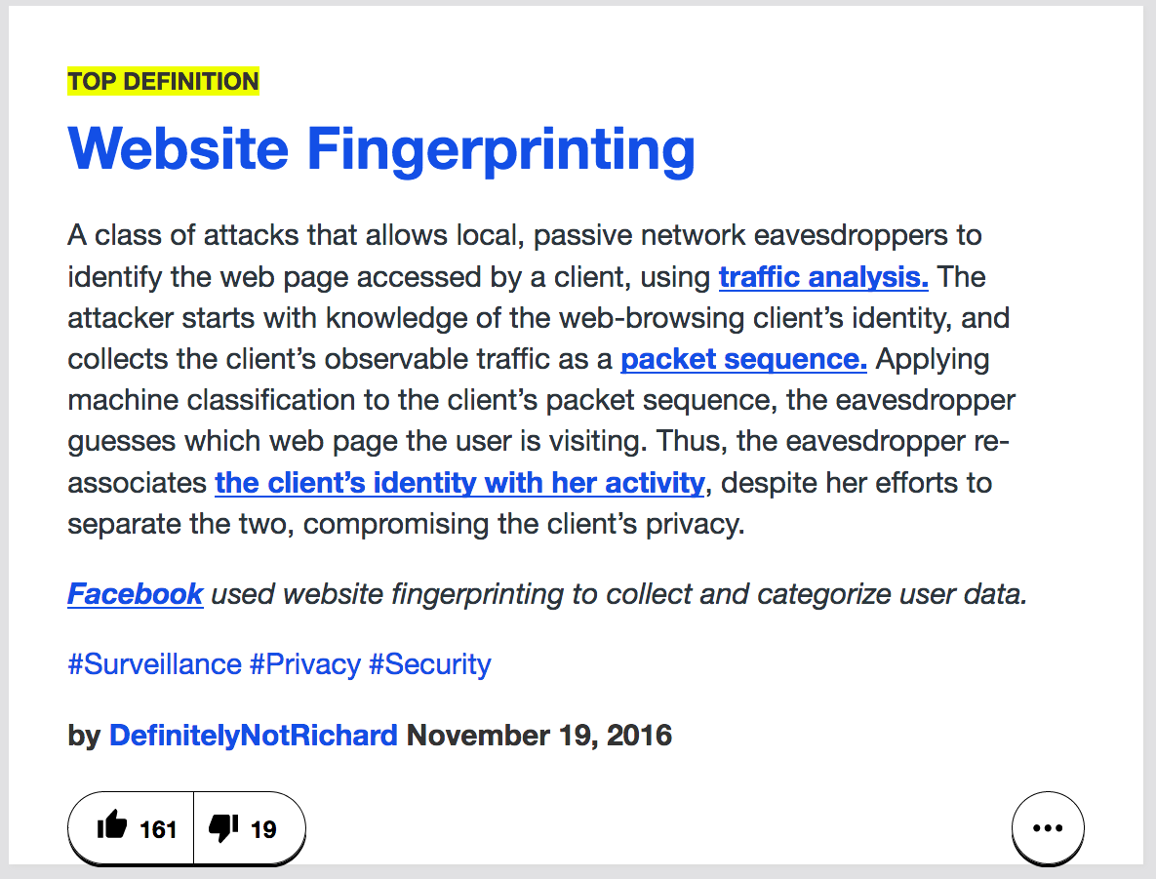
Security
Privacy
Notes:
Richard

Slide 3
Uniqueness
We can precisely identify a device thanks to its unique combination of identifiers
Stability
A fingerprint does not drastically change over time
Properties of a Fingerprint
Notes:
Richard

Slide 4
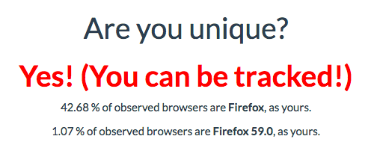
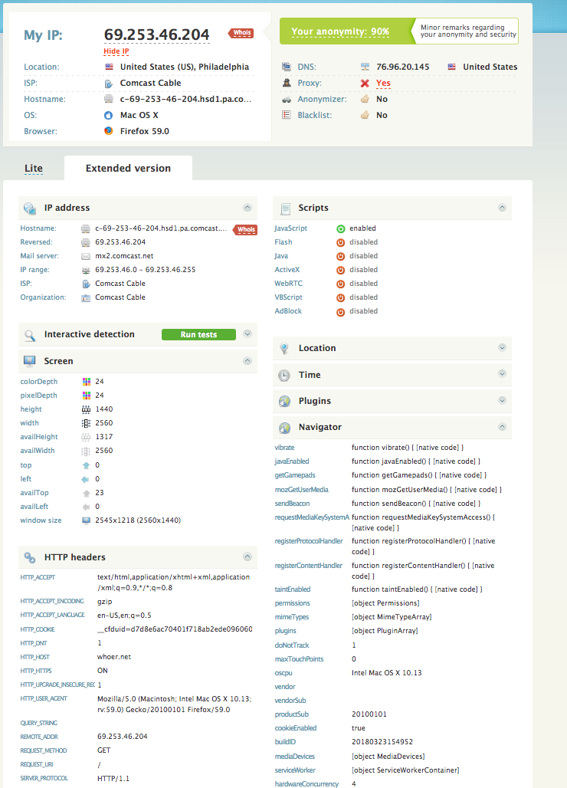
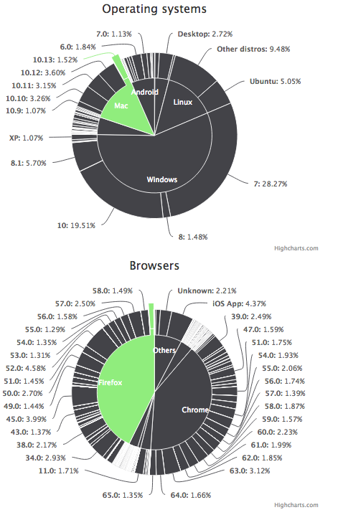
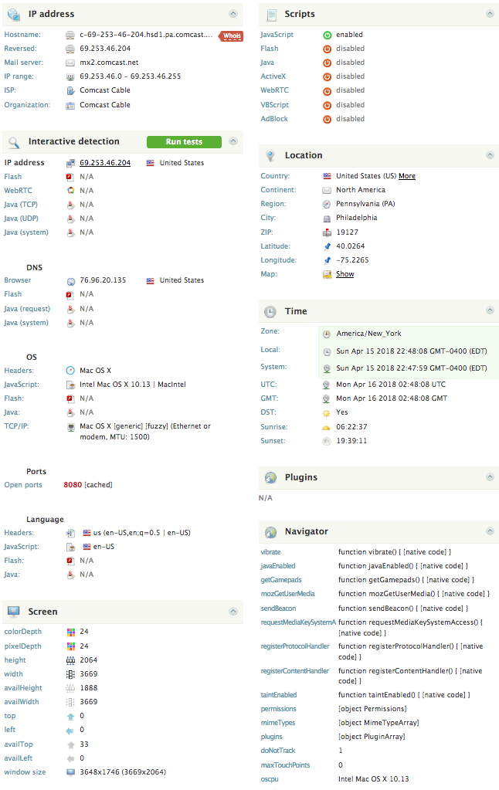
Notes:
Seam

Slide 5
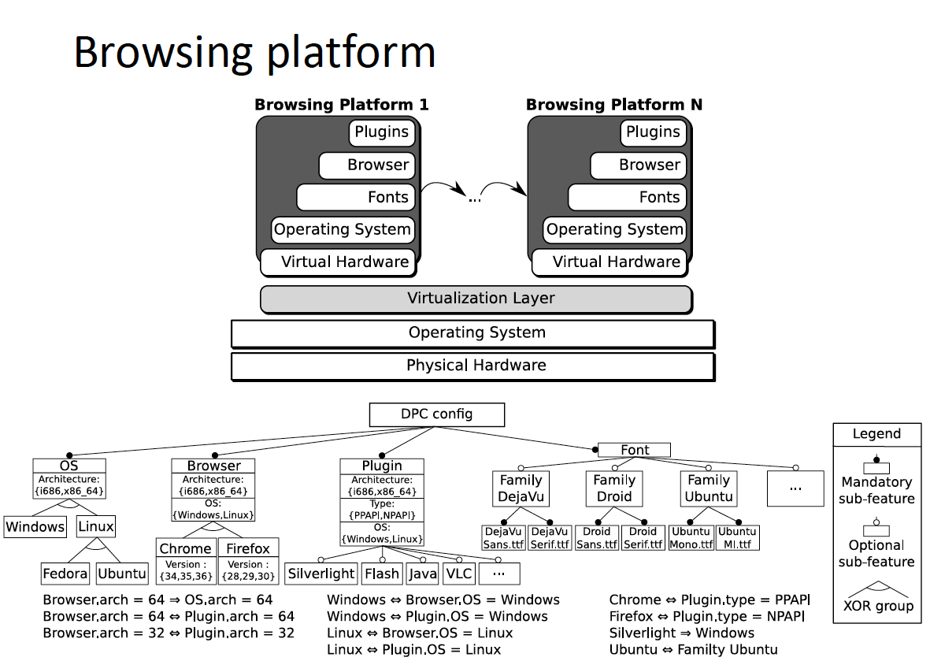
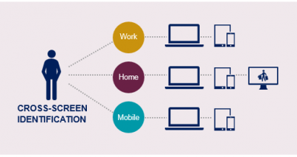
Notes:
Sean

Slide 6
Notes:
Mike

Slide 7
Positives and Negatives of Website Fingerprinting
Positives
Negatives
Used in fraud detection systems
Third-party tracking using cookies without optional opt-out
Intrusion detection, anomaly detection, and user-auth
Delivers tailored malware, targeted content
Desired FFP rates can be achieved with learning algorithms with small samples.
Anti-detect, RDPs, SOCKS5, and other fingerprinting obfuscation tools
Notes:
Mike

Slide 8
Trends in Fraud & Anomaly Detection
VPN + RDP
Antidetect or Fraudfox VM + Socks5
Mobile Phones
Tor +/- Tails
Notes:
Sean

Slide 9
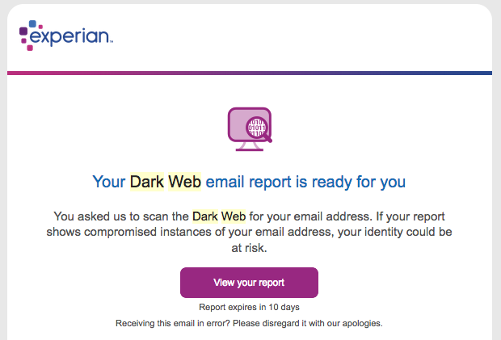
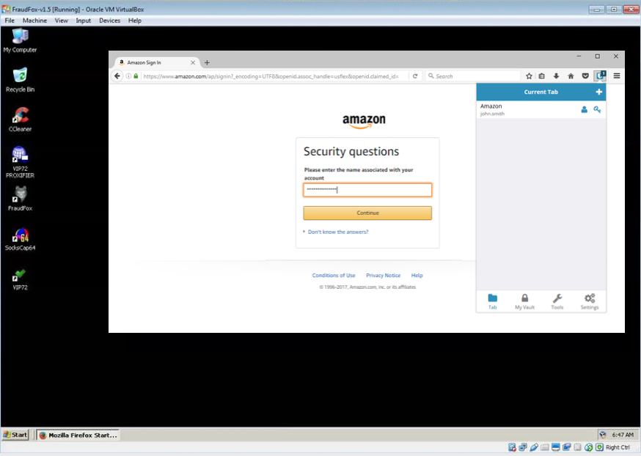
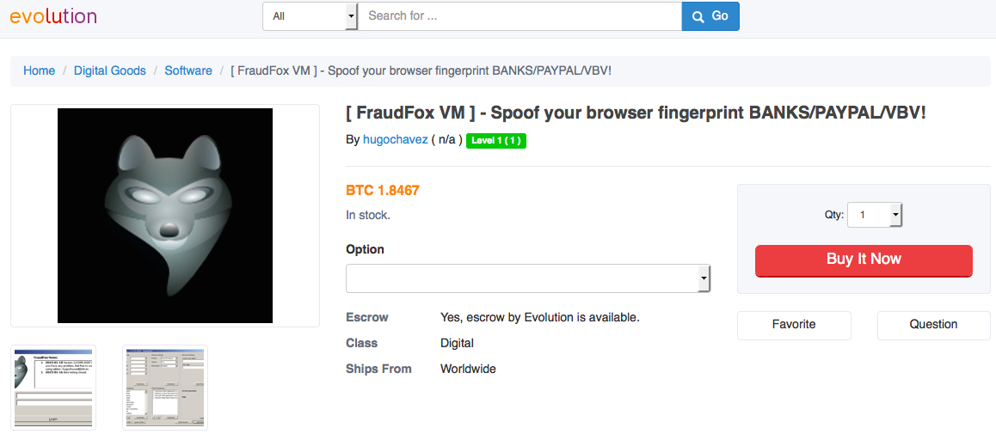
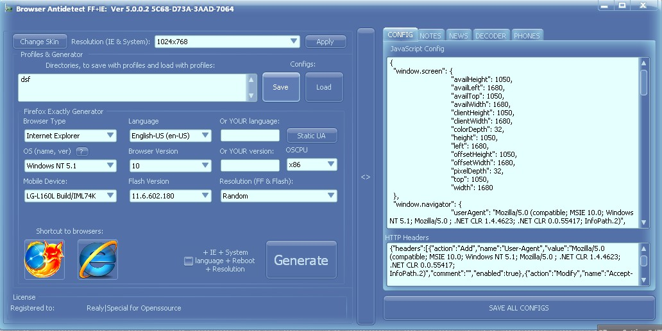
Case Study: User-agent Spoofing
Notes:
Sean

Slide 10
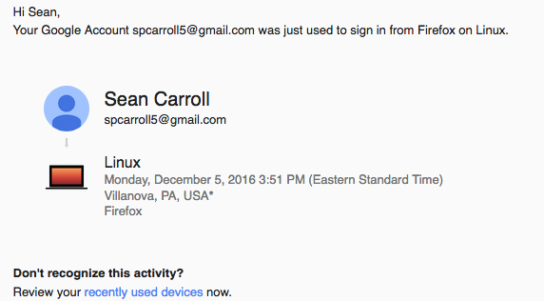
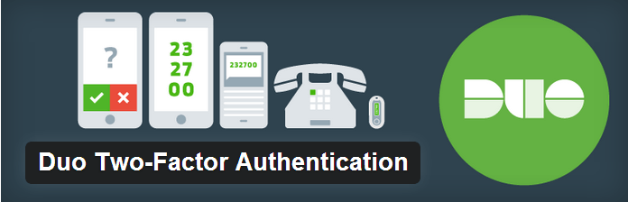
Conclusions & Suggestions
Security-Oriented Tools
VPN and/or tunneled SSH
SOCKS5
TOR | I2P
Chromium + Security Add-ons
Opt-out
Duo Mobile (2-FA)
Optout.aboutads.info
Browser Testing
Whoer.com
Browseraudit.com
Amiunique.com
Do Not Track (DNT)
Security Awareness
Update software
Web-browser add-ons
NoScript
Google, Facebook, Data Privacy Options
Notes:
MIke

Slide 11

Questions?
Notes:
Mike

