Slide 1



CUSTOMER XP

Slide 2

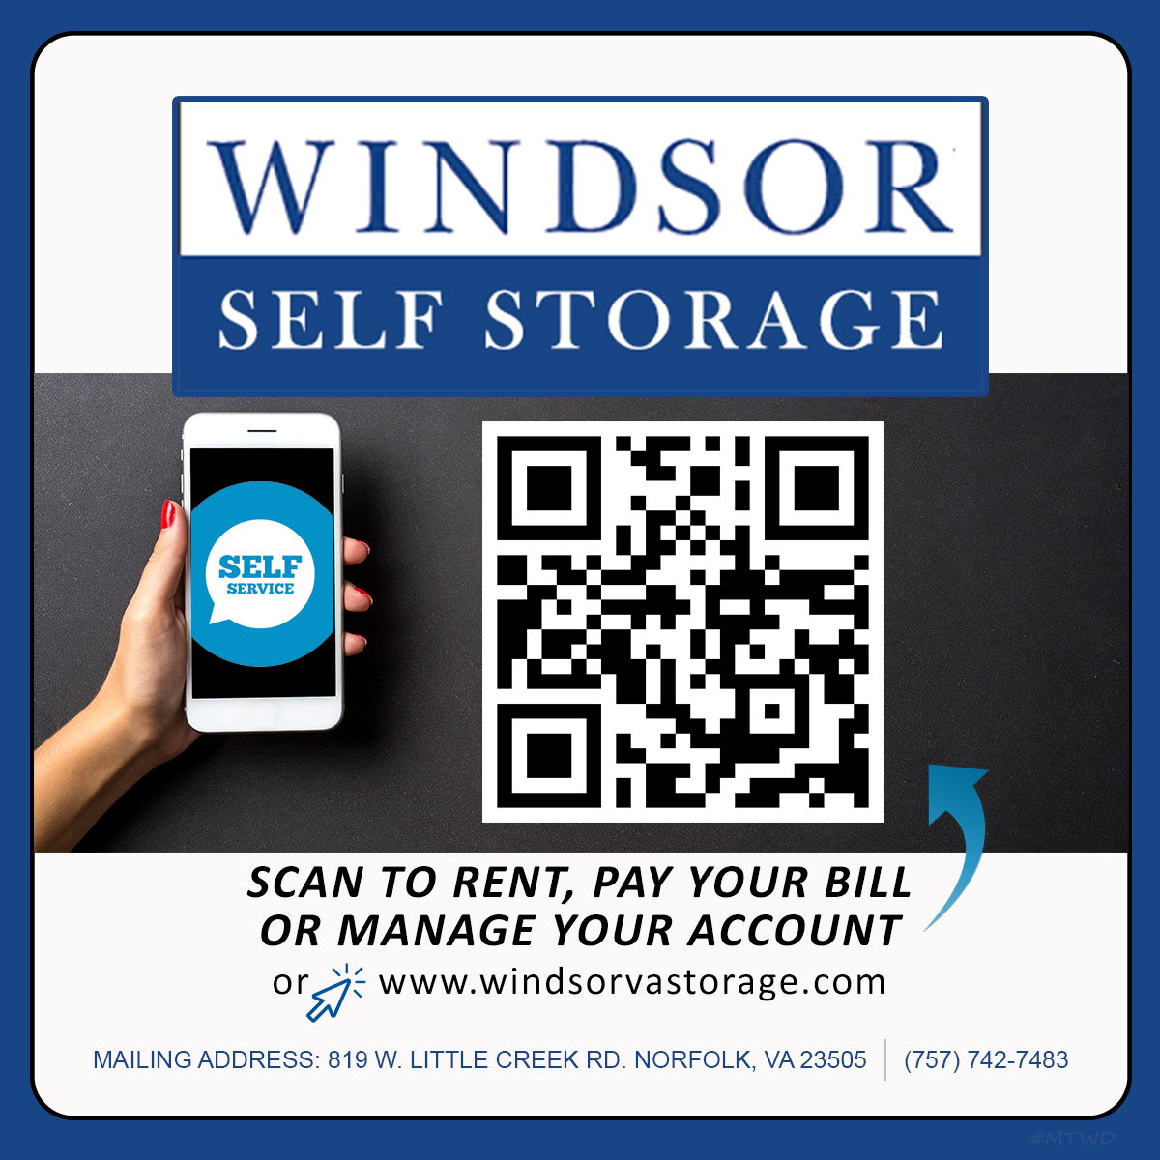
HUB Management Technologies
A simple QR CODE
is like a Kiosk in your hand:
Rent from your phone
Pay from your phone
Manage your account
Leave Reviews or send messages

Slide 3
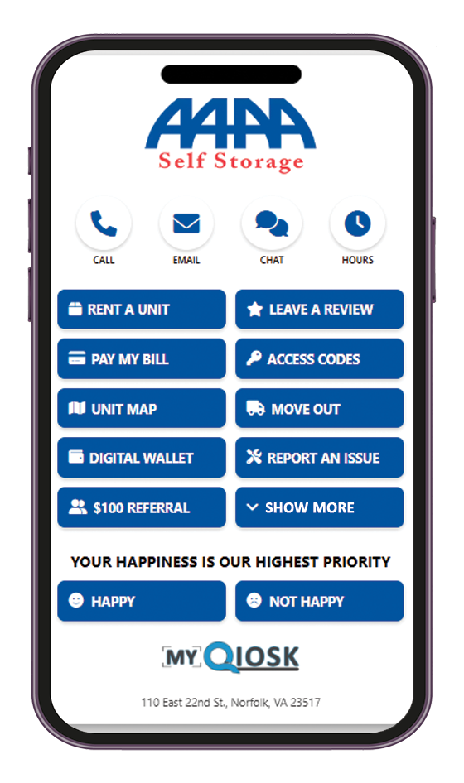
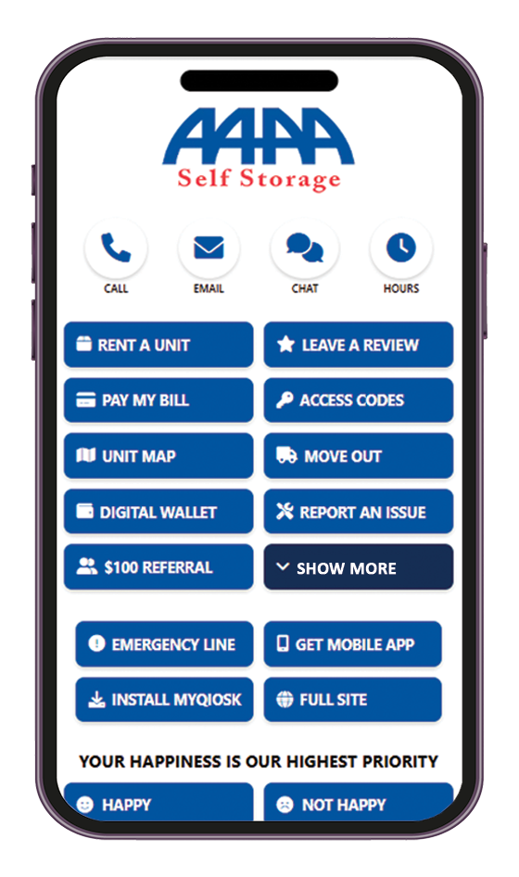
Quick Access Buttons: Call, Chat/Video & more across the top
Most common features: Rent a Unit, Leave a review, Pay My Bill & More
Emergency Line: Contact the on-call support for urgent assistance
Full Site: Access the full desktop or mobile version of the website
Your Happiness is Our Highest Priority
Happy starts a new Google Review
Not Happy starts a new QA case for trackable resolutions

Slide 4
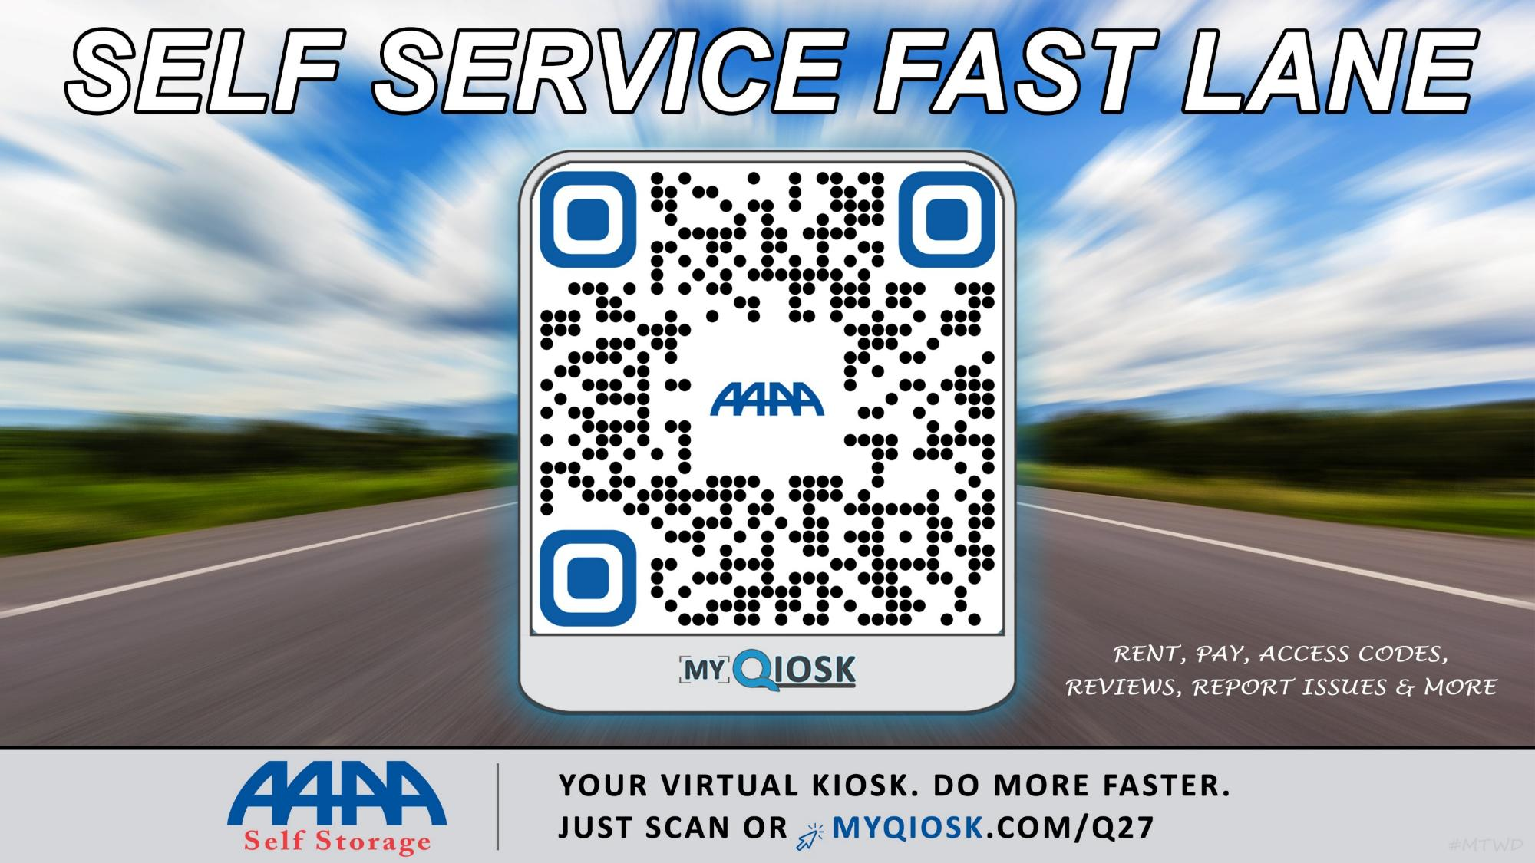


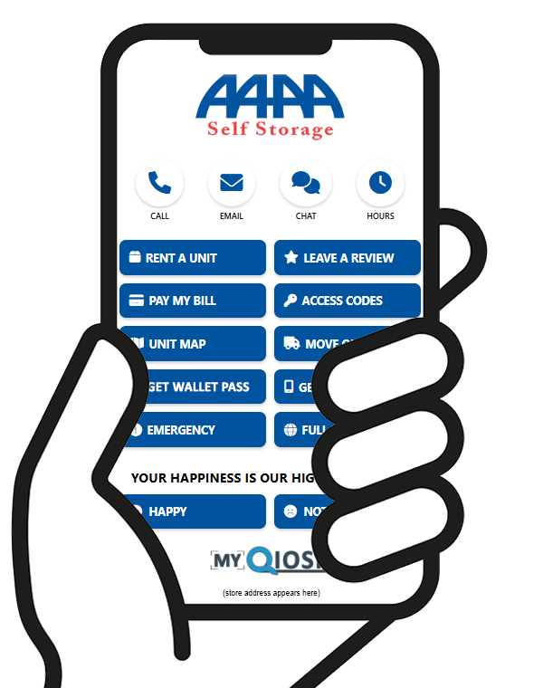
YOUR
SELF STORAGE
YOUR
DO STORAGE FASTER WITH THE VIRTUAL KIOSK
SELF STORAGE
001

Slide 5


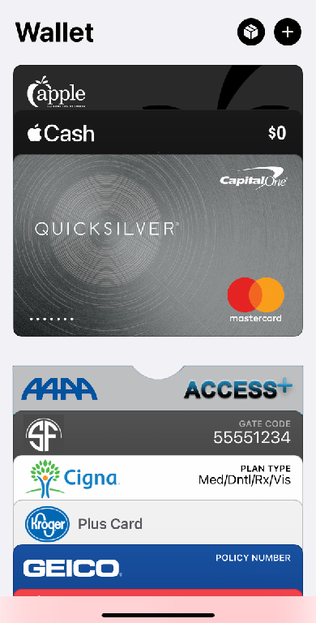
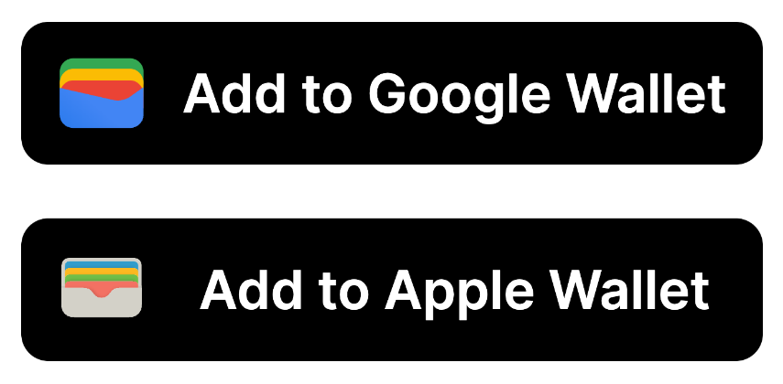
Notes:
Complete courses in College format
All courses are self-paced but some require instructor interaction or approvals
Pass, Fail, Retake and Scores on all Courses

Slide 6
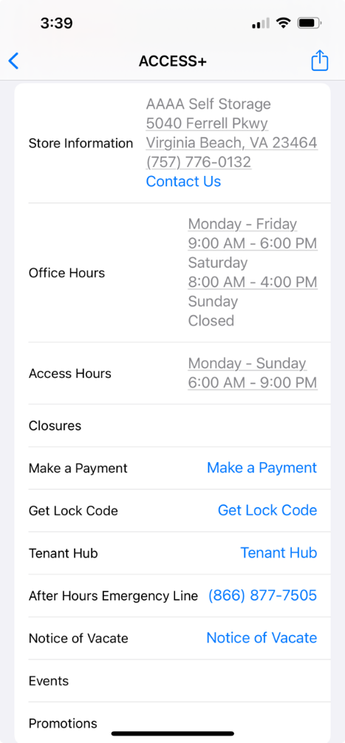
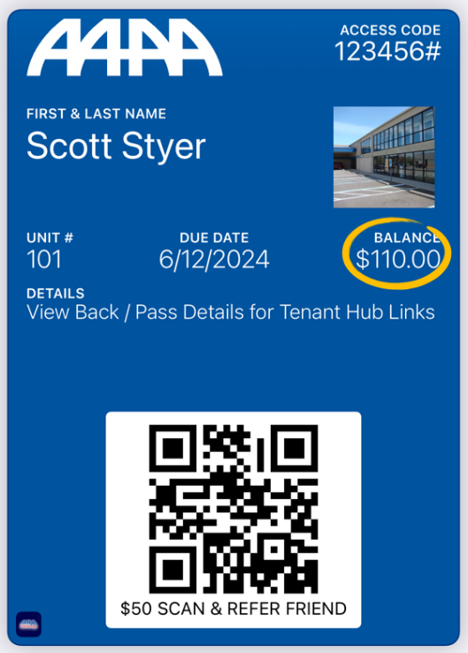
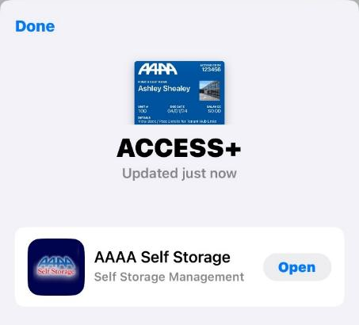
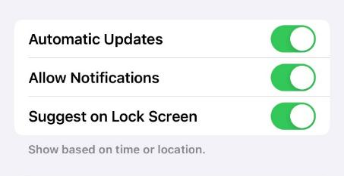
Backside (pass details)
$100
Notes:
Complete courses in College format
All courses are self-paced but some require instructor interaction or approvals
Pass, Fail, Retake and Scores on all Courses

Slide 7
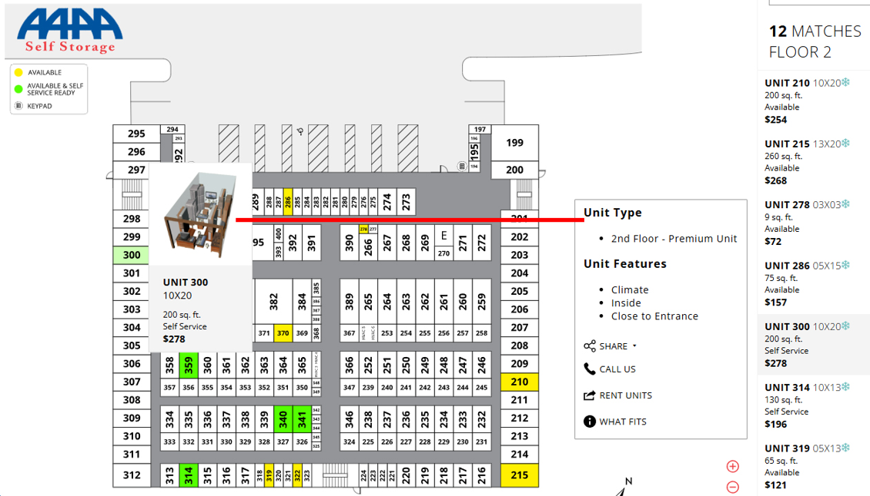
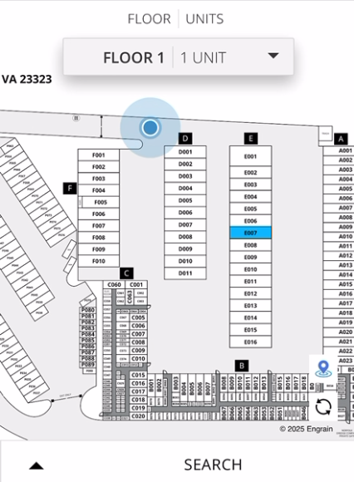
Notes:
Engrain Sitemap
Interactive Sitemaps for your customers delivered by Text, Email or Online.
Setup Fees and Monthly Fees apply.

