Slide 1


Slide 2
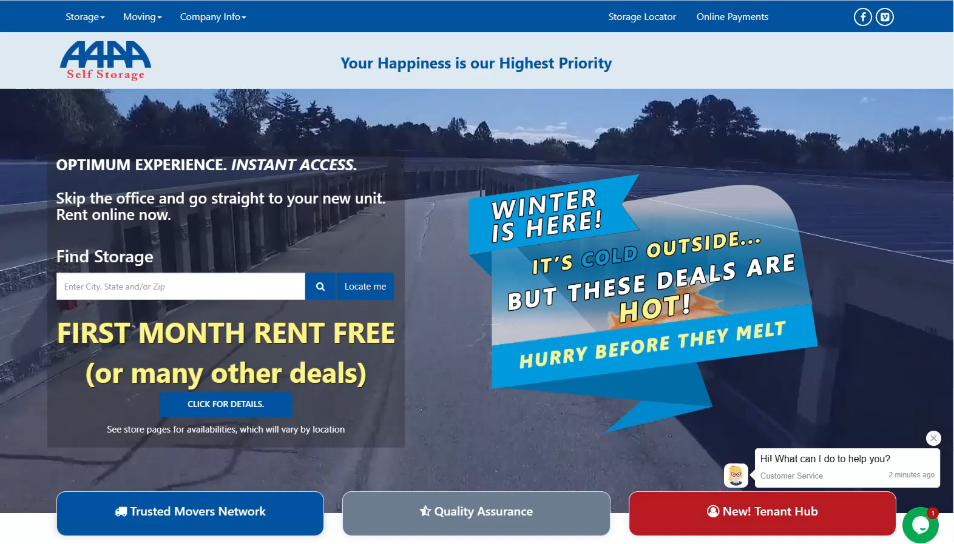
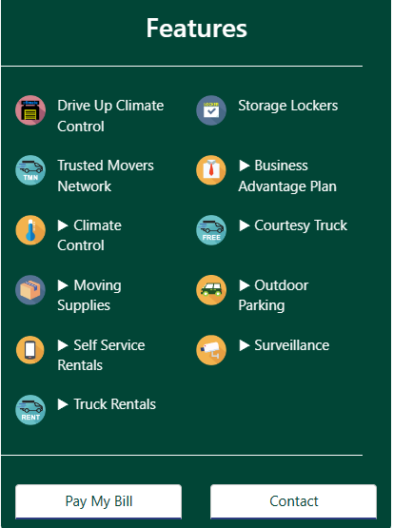
Part of a Large Nationally Recognized Website, but with Custom Branding
Your
Self Storage
Dynamic, Responsive Website with Call To Action, Search and Fast Load Times

Slide 3
PRIMARY FEATURES AND BENEFITS:
Responsive Desktop & Mobile Designs
Self Service Online Rentals, Reservations & Waiting Lists
Automatic Texting of Access Codes for unattended online rentals
Dynamic Pricing & Promotions beyond that of Sitelink’s capabilities
Ongoing In-house SEO / Ongoing In-house Support / Ongoing Development

Slide 4
OPTIMUM EXPERIENCE. INSTANT ACCESS.
Skip the office and go straight to your new unit. Rent online now.
Customer selects unit from website inventory list or map view (map view varies by location)
Customer completes rental online (or over the phone with our Sales Center) in
under 2 Minutes in most situations
Customer signs lease, submits ID and payment digitally
Customer receives access code and Self Service lock code via text or email

Slide 5
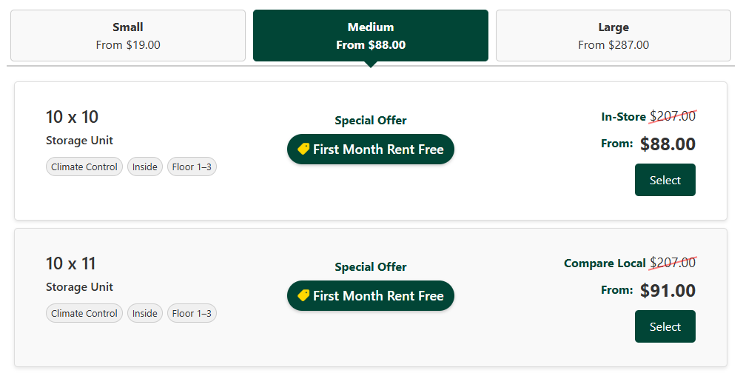
RO is Rentable Occupancy. Same as typical Occupancy, except removes unrentable, reserved or pre-rented units from the equation. Rentable Occupancy focuses on what is available now.
Pricing will change instantly based on RO
Specials will change instantly based on RO
The ability to Rent, Reserve and/or Hold
will change based on RO
Alternatively, “Compare Locally” can be selected to show in place of in-store rates. This will instead display the highest comparable rate of a similar size/type within the local market radius.
Notes:
Our website uses dynamic pricing and specials based on Rentable Occupancy. If the occupancy decreases, it will slash the standard rate and offer a lower rate and better special to entice rental of that size. On the flip side, if the occupancy increases and you starting to sell out of a particular unit size, it will increase the rate and decrease the special offer. In this scenario, the website will use "Compare Local" instead of an in-store rate so it does not show a slashed standard rate that is lower than the new advertised rate.
This is all based on Rentable Occupancy, which differs from your physical occupancy in that it takes unrentable, reserved and pre-rented units from the occupancy equation. This is important because those units are not truly available and can skew your occupancy numbers. For example – if you have multiple 10x10 units down for maintenance for a while, you don't want the 1 10x10 unit you do have to have the best special and lowest price because your FMS thinks you have 20 vacant and is pushing the rate down.

Slide 6
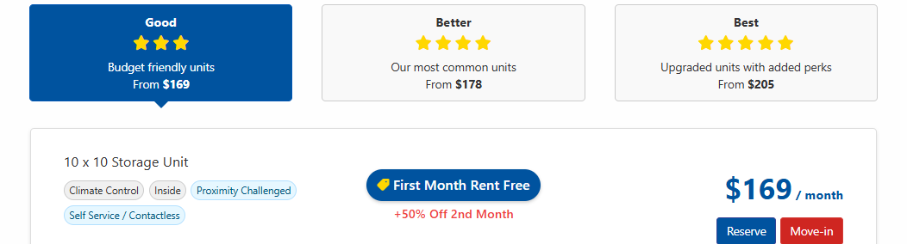
Notes:
Our website features good better and best options to give tenants more choice on what's most important to them whether they want the cheapest or the best unit. This is done using value pricing, where units that are less desirable like being farther from a entrance door are priced slightly lower than those that are considered premium by being closest to the entrance.

Slide 7
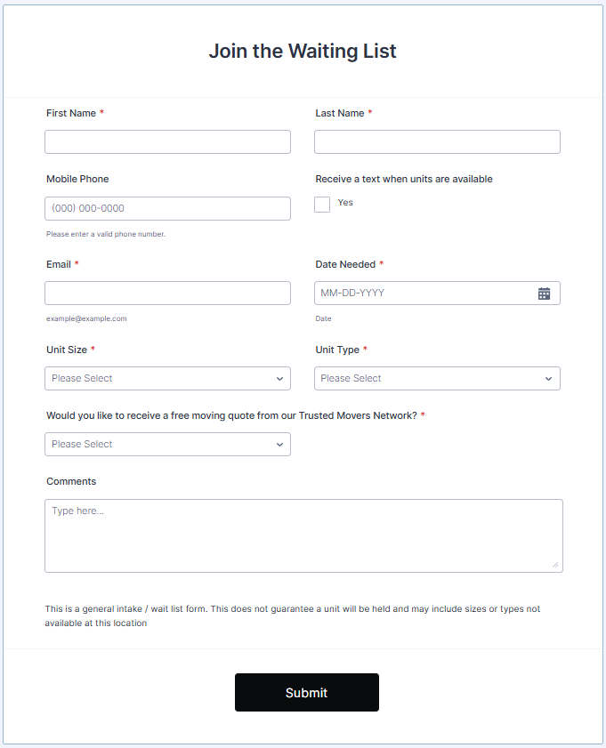
Notes:
NOA’s Dynamic Waiting List: If your store is opening soon (not ready to rent yet) or if you’ve reached 100% Rentable Occupancy on any unit class, NOA will display the Waiting List. Customers on the waiting list will be automatically notified when units become available to rent or reserve, and Managers are alerted to new signups on the waiting list.

Slide 8
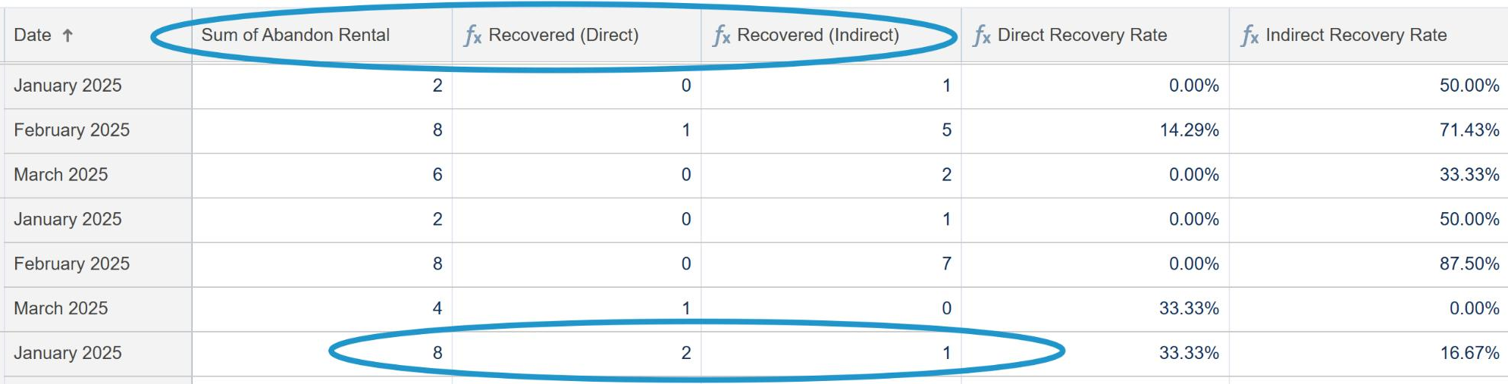
Notes:
When a customer begins a rental (or reservation) but does not complete the payment, that is referred to as an Abandoned Cart.
When this occurs, NOA sends messages to the customer (text and/or email) attempting to complete the transaction. This occurs without any additional cost or man power.
Direct Recovery = Customer followed the links and completed the rental.
Indirect Recovery = Customer ultimately rented, but not via following the links.

Slide 9
