Slide 1


Slide 2

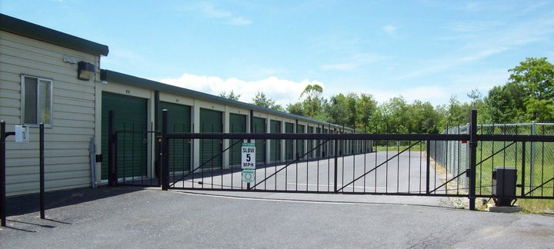
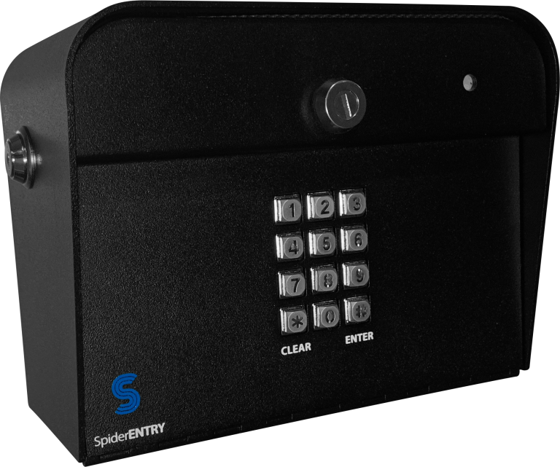
HUB Management Technologies
Automated Gate Access with Spiderdoor Access.
Access codes sent thru text.
No onsite computer or staff needed.

Slide 3


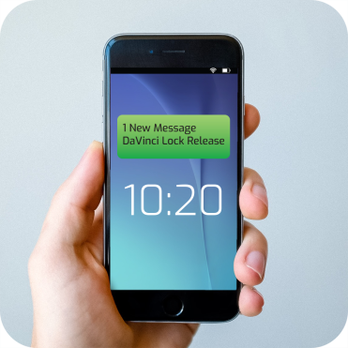
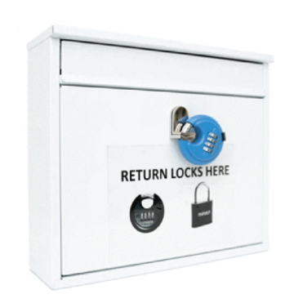
HUB Management Technologies
Place DaVinci locks on vacant units
or overdue/delinquent units
When a customer rents a new unit or pays their overdue account, they get a code to open the DaVinci lock
Customers return the DaVinci locks to the designated area (or pay a fee if not done, as agreed to in the lease)

Slide 4
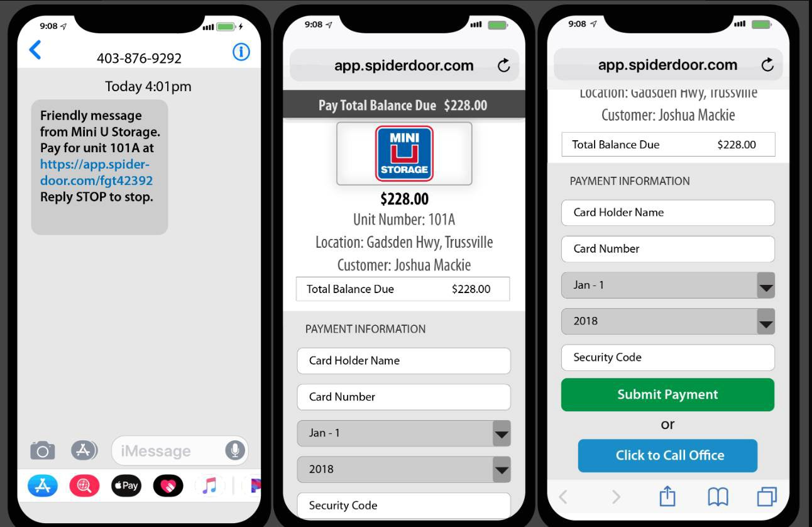
MOBILE APP

Slide 5

HUB--Staffed by Highly Trained Store Managers
Notes:
Cut Your Payroll Costs Significantly – Without Cutting Your Customer Experience – so we only put the best of the best of our field managers as remote HUB managers. These are managers that have demonstrated exceptional performance in customer service, sales, and efficient day-to-day operations management, while having the hands-on experience gained from their time in the field. You will have 1 assigned HUB manager responsible for your site.

Slide 6

HUB Manager Features & Benefits:
Normal Business Hours Coverage 9am to 5pm Monday to Saturday
Self Storage Industry Trained Professionals
Outbound Follow-up Calls & Email Correspondence
Detailed & Effective Collection Call Schedule
Full Coverage & Tasks for a Fraction of the Cost
Coordination and Assistance with Davinci Lock program
You or Your FSA Provide:
Property Maintenance
Overlocks / Unlocks (onsite)
Unit Prep (sweep / ready for self service)
Onsite Auction Tasks
Notes:
HUB managers work Mon-Sat 9am-5pm handling the day-to-day operations, but you don't pay them hourly or salary. Instead we have a flat fee for the service.
What you do need to pay hourly is the part-time FSA or MN that will do on-site tasks, but therir hours will be minimal. I would estimate ___ hours per week.
Explain Davinci locks and spiderdoor keypads

Slide 7
HUB MANAGER DUTIES:
Sales/ Rentals/ Reservations
Process Reservations & Rentals
Manage Move-ins / outs *
Outbound Lead Follow-up
Reconcile Rentals & Prospects
Assistance with Self-Service Rental Issues
Payments & Collections
Collection Calls
Negotiate Tenant Settlements
Waive Fees & Process Refunds
Manage Lien Sales *
Manage IVR Payments Received; email Receipts
Account Billing & Support
Update Tenant Info
Manage Tenants in Autopay
Address Tenant Account Issues
Email Tenant Documents
General Tenant Correspondence
Site Maintenance & Management
Schedule Unit Overlocks / Unlocks / Self Service Locks *
Coordinate Site Repairs *
Manage Vendor Appointments *
Assist Tenants Navigating Your Property
Coordinate Property Maintenance & Upkeep *
CGPP Claims management *
* Does not include any tasks physically onsite such as cleaning units or picking up the property
Notes:
Why leave poor performing managers in place when so much can be done remotely?
Day-to-day operations – assisting with rental completion, following up with prospective renters and closing sales, managing customer information, addressing account issues and complaints, encouraging autopay enrollment, communicating with tenants, handling past due accounts, and coordinating with the boots-on-ground personnel (FSA+MN) for overlocking past due units, making vacated units ready to rent, scheduling vendor appointments or repairs, and cutting locks for auction to name a few.

Slide 8
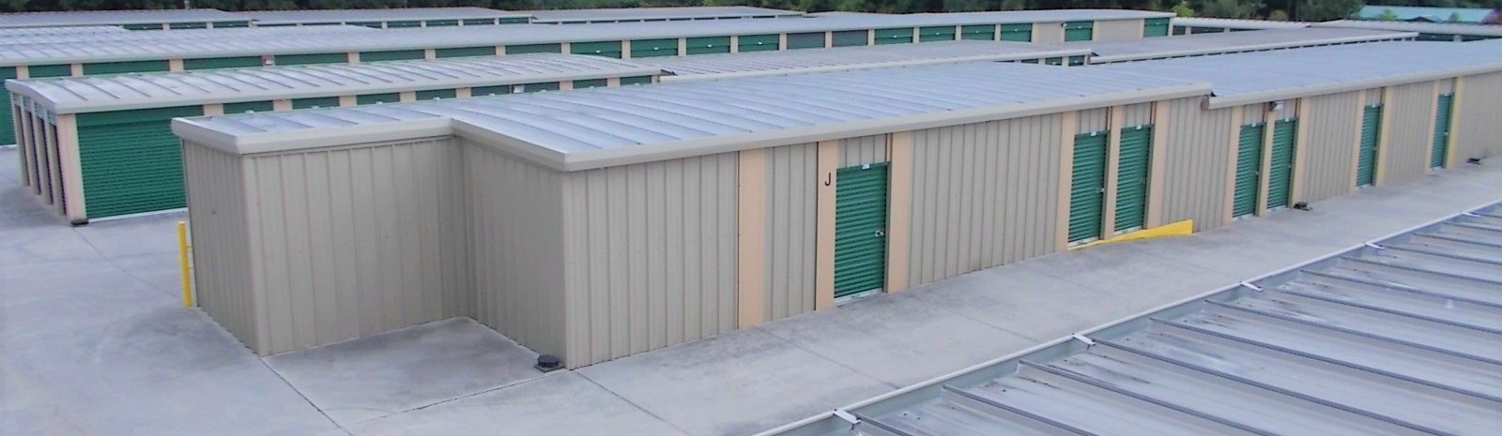
Roles of the FSA Comments
Overlocks and Unlocks
Managing DaVinci lock returns and inventory
Cleaning Property & Light Maintenance
Auction Unit Photos & Inventory
Cleaning Vacant Units & Prepping for Self Service rentals |  | Placing lock, welcome cards inside unit + adding DaVinci locks on hasp
Vendor Meetups |  | Example: Assisting with a Door Contractor or Gate Vendor
Space Audits and Security Patrols

Slide 9
Physical kiosk setup video

Slide 10
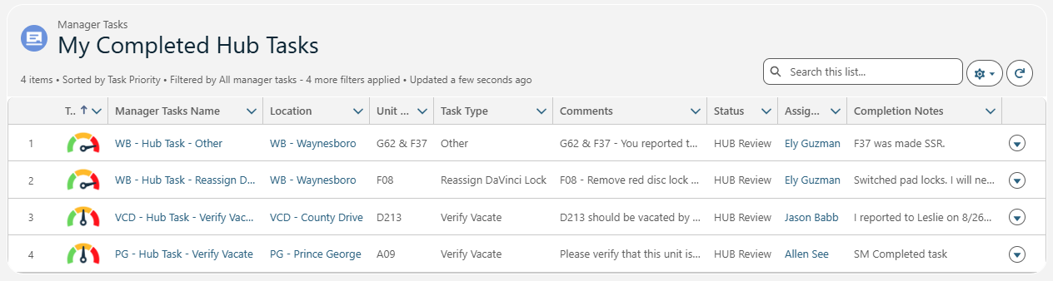
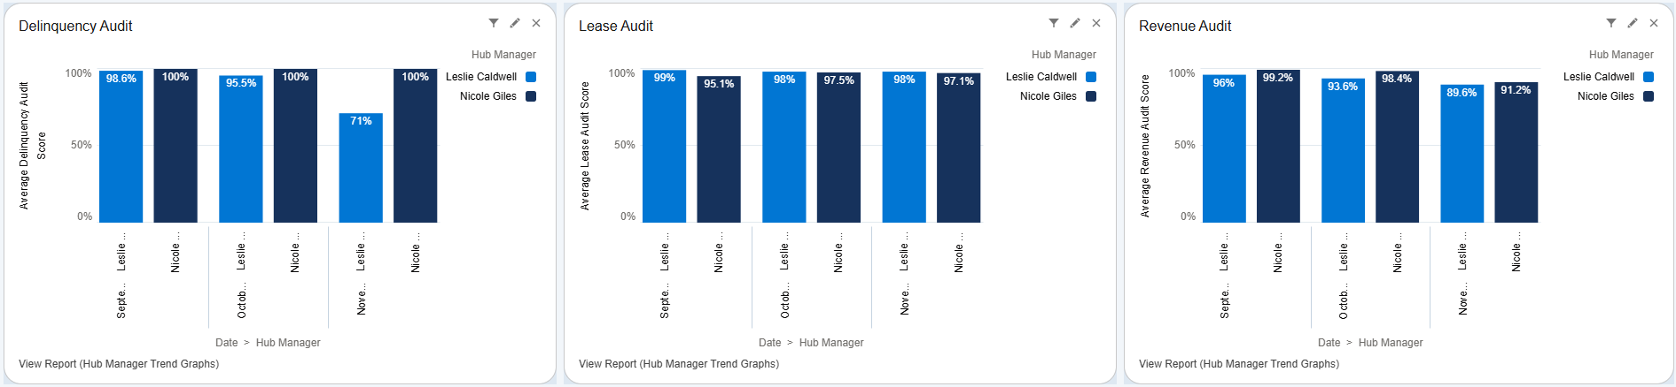
Notes:
Hub managers, FSAs and MN use NOA heavily for streamlined task management so nothing is missed.
Hub managers and site performance are evaluated monthly on various criteria such as delinquency percentage, proper lease execution, and sales performance scoring. We have a bonus program that rewards our managers when goals are met or exceeded.

Slide 11
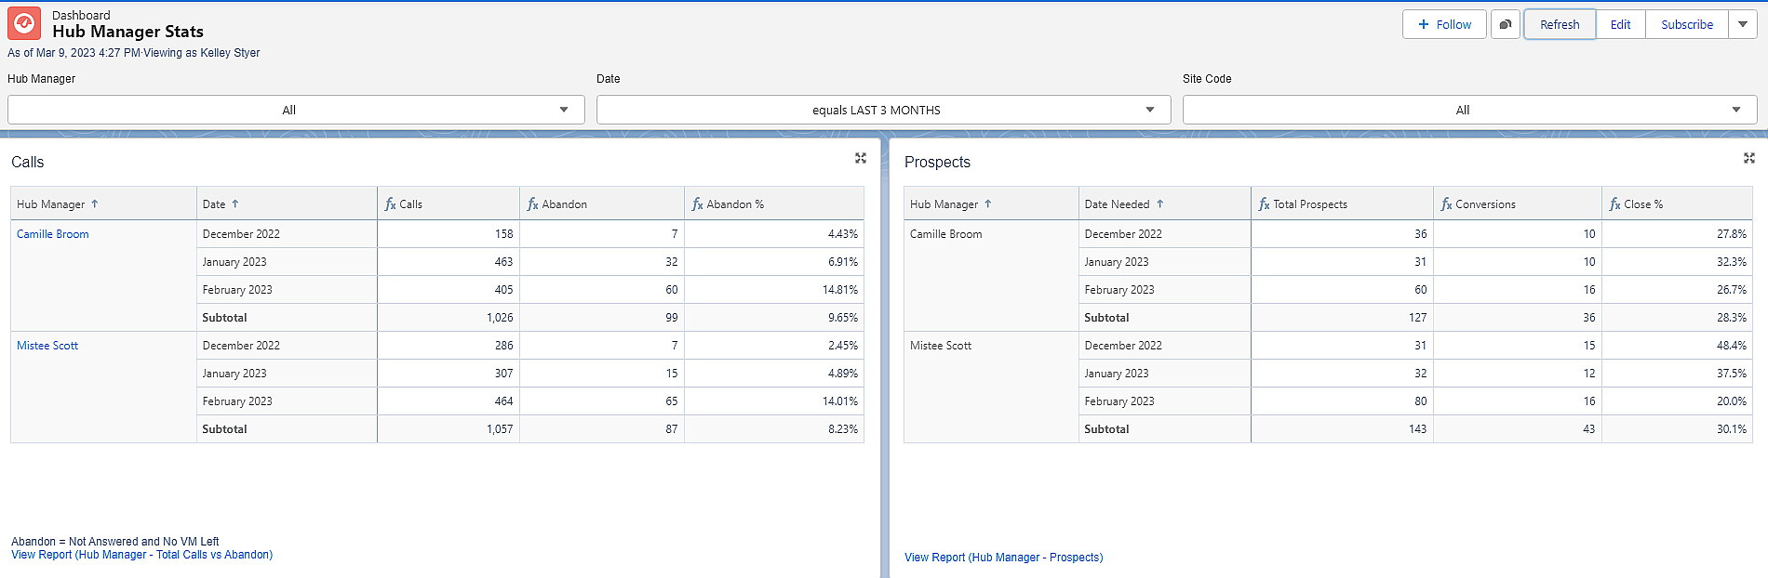
HUB Management Audits

Slide 12
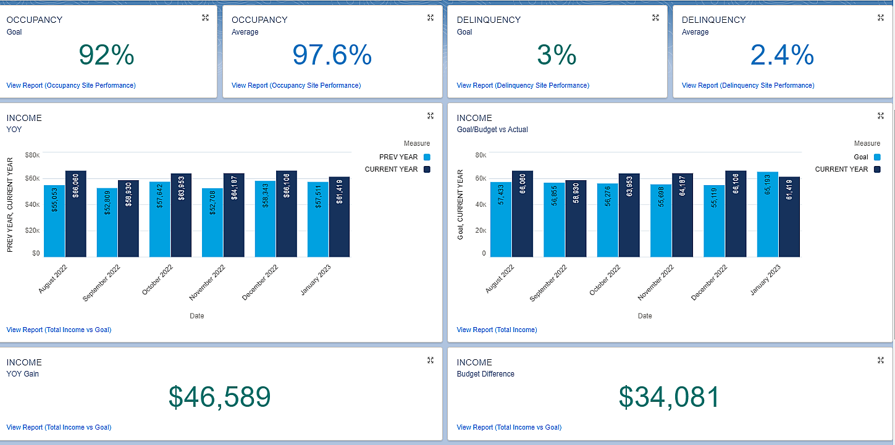
HUB Management Audits

Slide 13
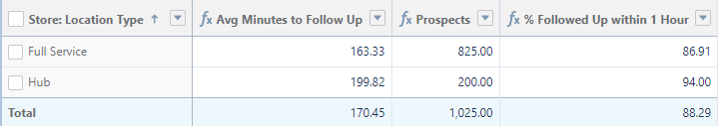
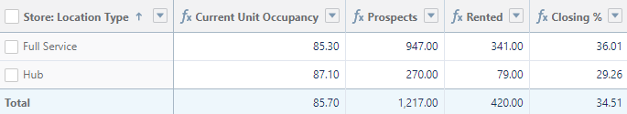
Comparing HUB Management to Full Service
Follow-up Scores – Last 3 Months
Closing Scores – Last 3 Months

Slide 14
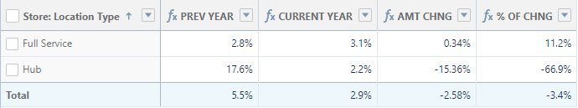
Comparing HUB Management to Full Service
Delinquency

Slide 15
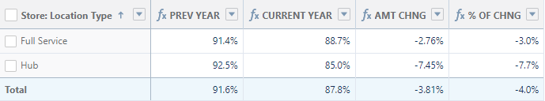
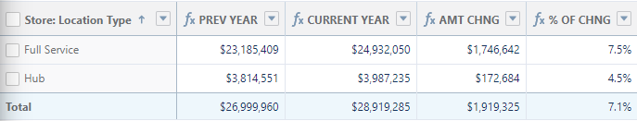
Comparing HUB Management to Full Service
Occupancy
Income (% of Change YOY - Trailing 12 months)

Slide 16
Comparing HUB Management to Full Service
January 2023
 | Calls | Talk Time | Avg Time | Calls | Talk Time | Avg Time | Calls | Talk Time | Avg Time
 | Inbound |  |  | outbound |  |  | total
HUB (10 / 3,251) | 968 (97/.30) | 48:54 hrs (4.9/.02) | 3:01 min | 1,734 (173/.53) | 41:03 hrs (4.1/.01) | 1:33 min | 2,702 (270/.83) | 89:55 hrs (8.9/.03) | 2:07 min
FULL (35 / 17,720) | 9,868 (282/.56) | 376:20 hrs (10.74/.02) | 2:17 min | 19,083 (545/1.07) | 548:47 hrs (15.66/.03) | 1:01 min | 28,951 (827/1.63) | 925:07 hrs (26.43/.05) | 1:29 min
SUBSET ROW:
HUB = 10 stores, with rented unit count of 3,251 units.
FULL Service = 35 stores, with rented unit count of 17,720 units.
(blue) = avg per store; (red) = avg per rented unit

Slide 17
SAMPLE STORE / FRANKLIN VA (VAD)
(converted to HUB Management in the middle of 2022)
 | Revenue | Expenses * | Payroll Expenses
Q4 2021 (ACTUALS) | $148,202 | $62,595 | $21,654
Q4 2022 (ACTUALS) | $159,895 | $46,492 | $11,031
HUB effect | + 11,693 | - $16,103 | - $10,623
AVG per month | + $3,898 | - $5,367 | - $3,541
 | Unit Occupancy | Area Occupancy | Economic Occupancy
End Q4 2021 (ACTUALS) | 99.5% | 99.6% | 98.3%
End Q4 2022 (ACTUALS) | 93.8% | 93.0% | 102.7%
HUB effect | - 5.7 | - 6.6 | + 4.4
Result: A healthier (albeit decreased) occupancy while greatly improving revenue
* includes all expenses except real estate taxes

Slide 18
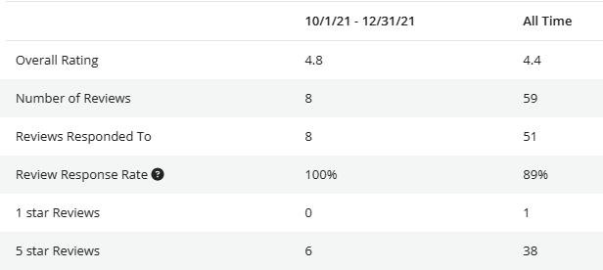
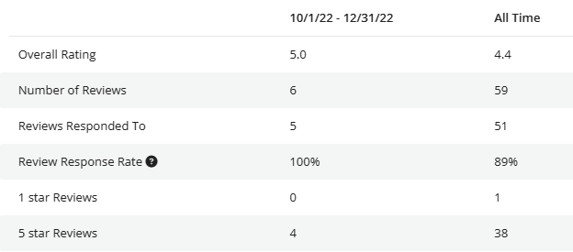










SAMPLE STORE / FRANKLIN VA (VAD) - REPUTATION
(converted to HUB Management in the middle of 2022)
BEFORE HUB
AFTER HUB

