Slide 1


Taking the Guesswork out of Revenue Management
Your Virtual REVENUE GENIUS

Slide 2
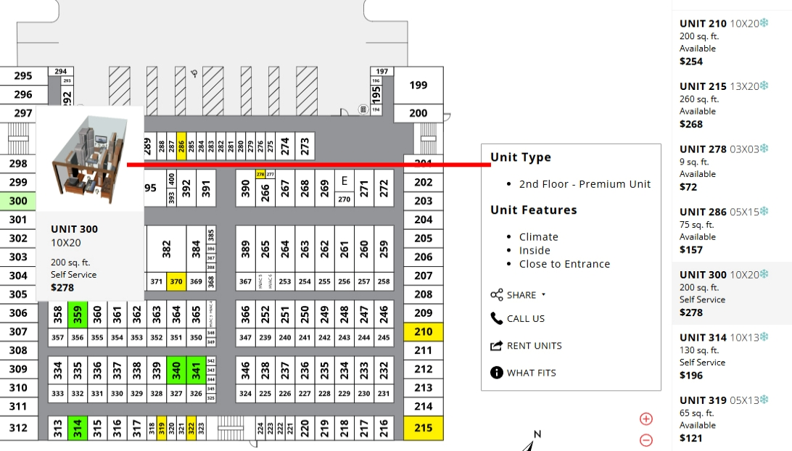

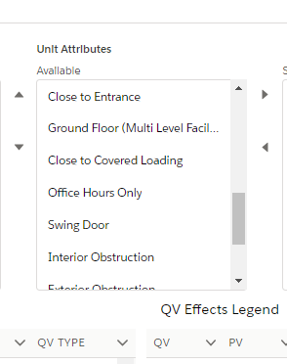

Receive increased revenue on popular units such as those based on proximity
and/or receive increased occupancy on units that are typically more difficult to rent
Notes:
Value pricing units based on criteria that makes a unit either more or less desirable to give tenants more choice in what unit suits their needs.
By doing so, we increase revenue on popular units by increasing their rates, and increase occupancy on units that are more difficult to rent by offering them for a lower rate.

Slide 3
QV Attributes (sample list; incomplete) | Value
Door Alarm | +3
Humidity Controlled | +3
Extra High Ceilings | +3
Electronically Controlled Doors | +3
24 Hour Access | +3
Immediate Access | +3
Shelving | +1
Front & Back Doors | +1
Extra Tall Door | +1
Multiple Doors | +1
Extra Wide Door | +1
Interior Obstruction | -1
Exterior Obstruction | -1
Irregular Shape | -1
Proximity Challenged | -1
Point Value Score | Rate Change
-3 | -10%
-2 | -8%
-1 | -5%
0 | 0%
1 | 5%
2 | 8%
3 | 10%
4 | 12%
5 | 15%
6 | 20%

Slide 4
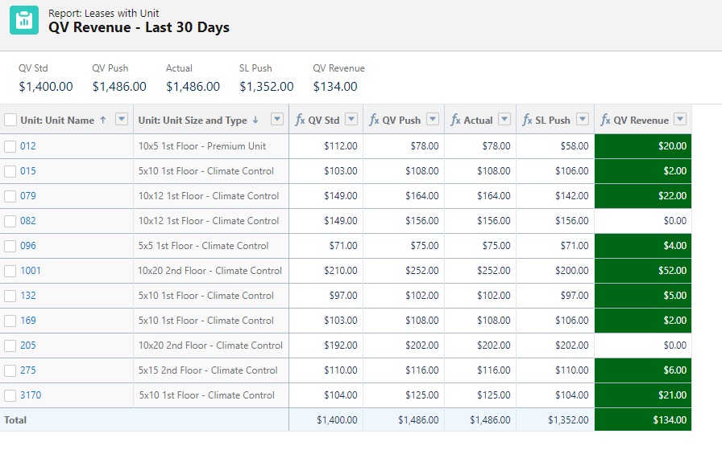

Slide 5
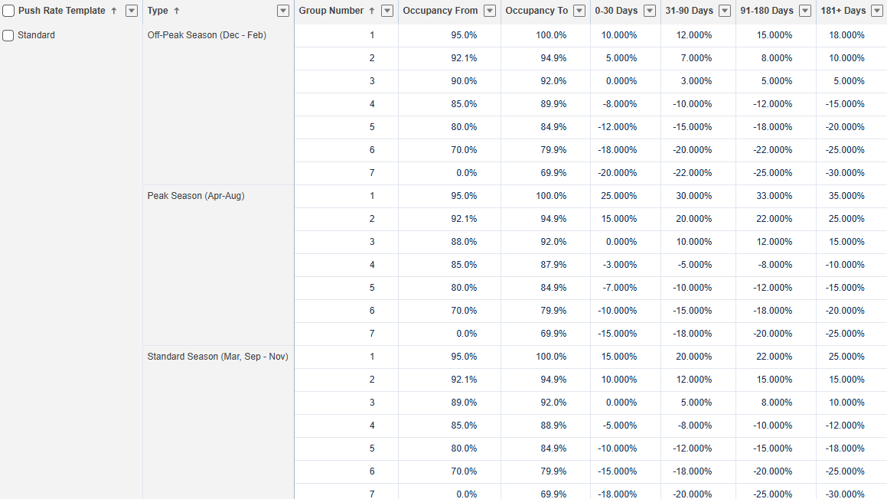
PUSH RATE TEMPLATES
Template Name: |  | All Down | All Down | Competitive | Competitive | Standard | Controlled | Controlled | All Up | All Up
 |  | Extreme |  | Extreme |  |  |  | Extreme |  | Extreme
Push Effect: |  | All Negative | All Negative | Mostly Negative | Mixed | Mixed | Mixed | Mostly Positive | All Positive | All Positive
Revenue Effect: |  | - | + | + + | + + | + + | + + + | + + + + | + + + + | + + + + +
Occupancy Effect: |  | + + + + + | + + + + | + + + + | + + + | + + | + + | + + | + | -

Slide 6
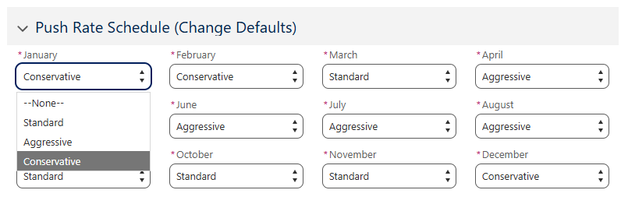
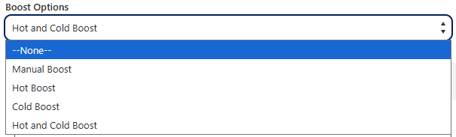
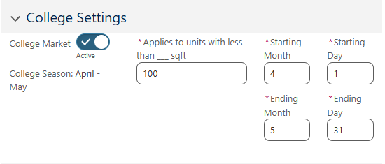
Revenue Pro Templates can adjust dynamically by Time of Year and even Time of Day
Notes:
NOA’s advanced methods to Push Rate management include several revenue template options for scheduling changes based on market conditions and time of year. Additional options include Hot and Cold boosts based on time of day and day of week.

Slide 7
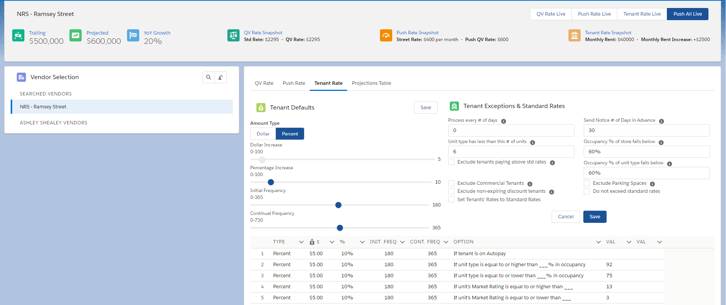
Notes:
Expanding on typical Tenant Rate settings, NOA offers advanced options for when, how much and why to increase specific tenants based on various criteria

Slide 8
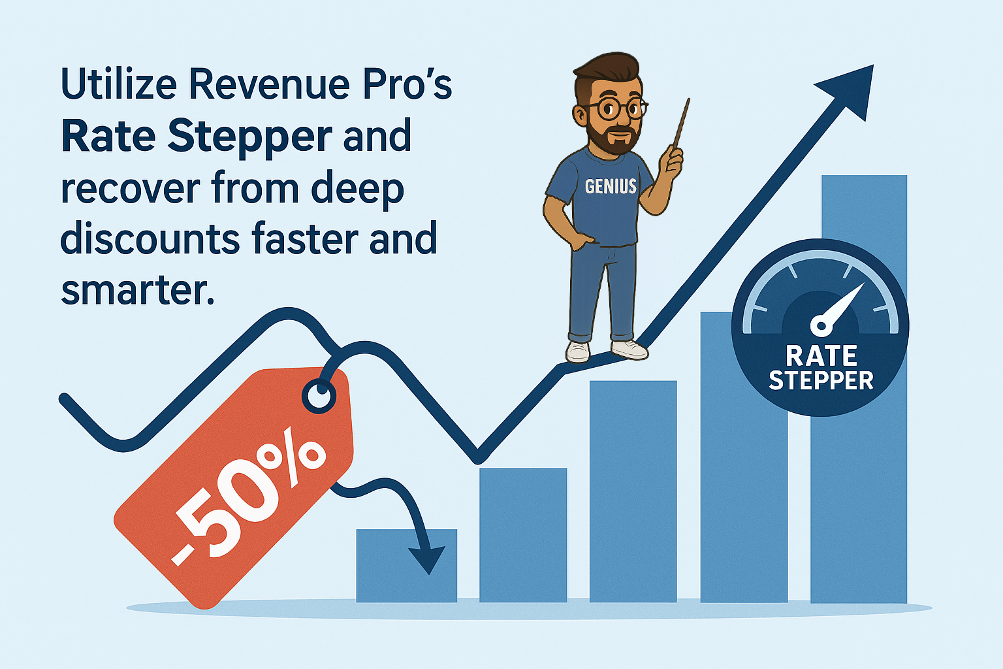

DYNAMIC SPECIALS

Slide 9
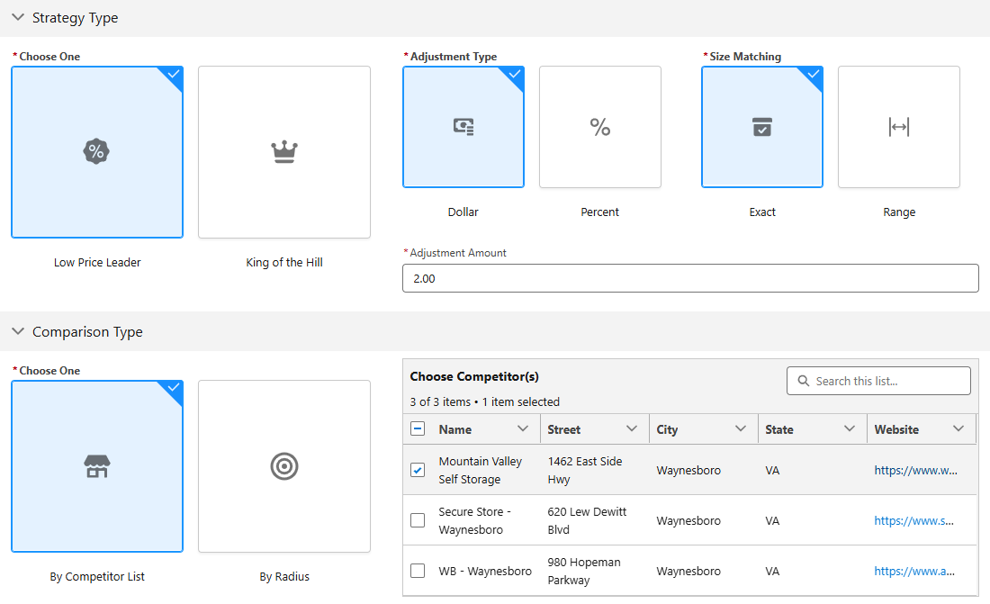
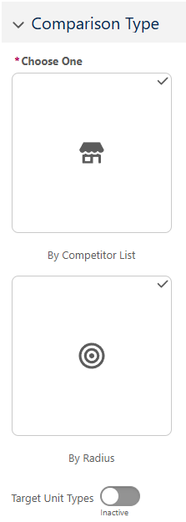
Notes:
Low price leader and king of the hill

Slide 10


Notes:
As unit size and type occupancy increases or decreases, specials and rate are automatically adjusted. No need to delay the change by waiting for your approval. You have already set the thresholds

Slide 11
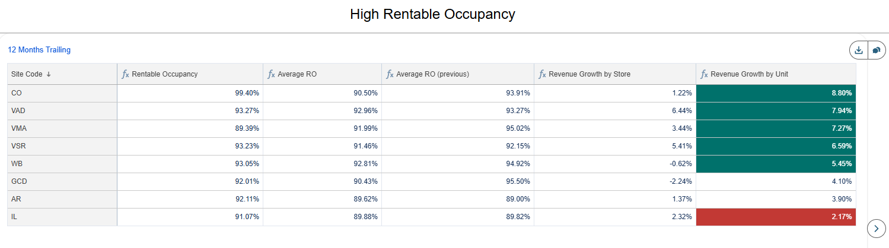
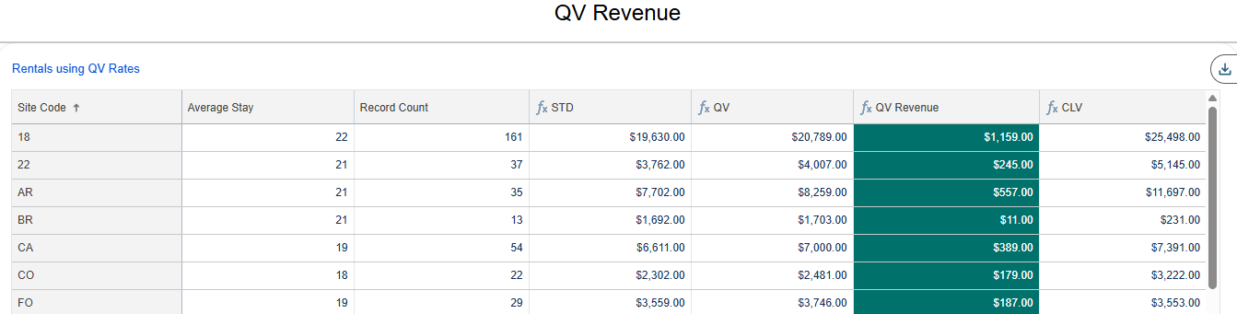

Slide 12
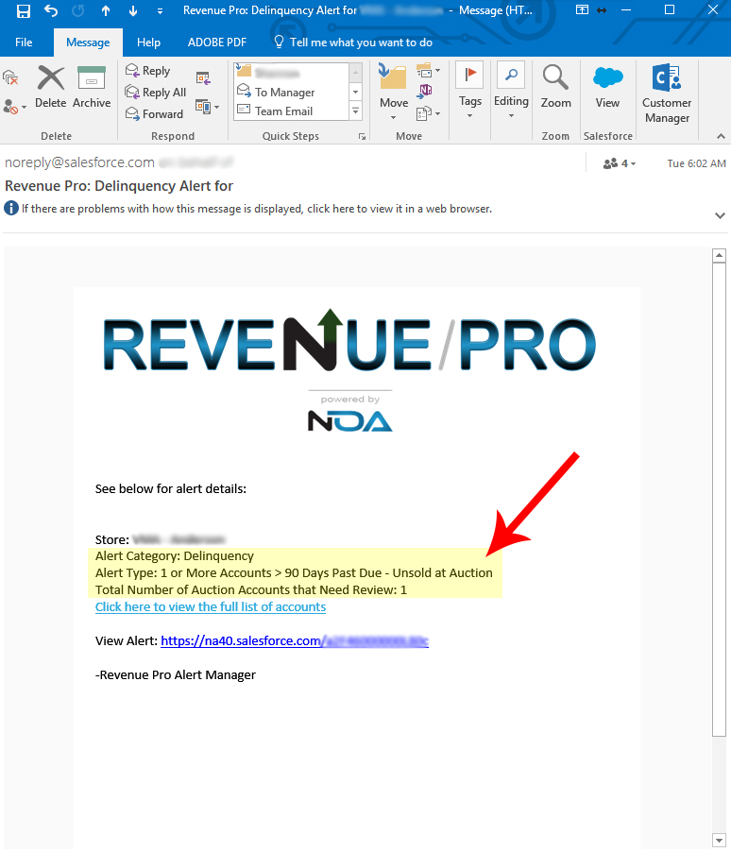

Alerts for Key Thresholds and Measurables
  Occupancy Trends
  Revenue Thresholds
  Delinquency Thresholds
  Auction Alert – Tenant Accounts > 90 Days Past Due
  Rate Increase Alert – No Increase > 1 Year
  Variance Alert – Variance > 20% Below Standard Rate
  Unit Type Occupancy less than 80% with No Push Rate Down
  Unit Type Occupancy greater than 92% with No Push Rate Up
  Customizable by Location,
  Frequency, Recipients, Trends and Metrics

