Slide 1


A suite of essential applications for running your self storage stores.
BETA · Included in all management plans
Next ›
Packed Planet Self Storage Solutions

Slide 2





Five essential apps in one suite
Store Audit
Work Orders
Budgets
Contracts
Claims
Digital walkthru, property checks and space audits.
Created right from your Field Tools walkthrough.
Budgets alongside your daily store operations.
Vendor contracts managed in NOA.
Protection claims tracked in NOA.
‹ Back
Next ›
Packed Planet Self Storage Solutions

Slide 3
Each app works alone. Together, they connect.
Every application functions on its own
They connect to one another to make your work easier
Example: work orders can be created during a Store Audit walkthru
Store Audit
Claims
Office Pro
Work Orders
Contracts
Budgets
‹ Back
Next ›
Packed Planet Self Storage Solutions

Slide 4
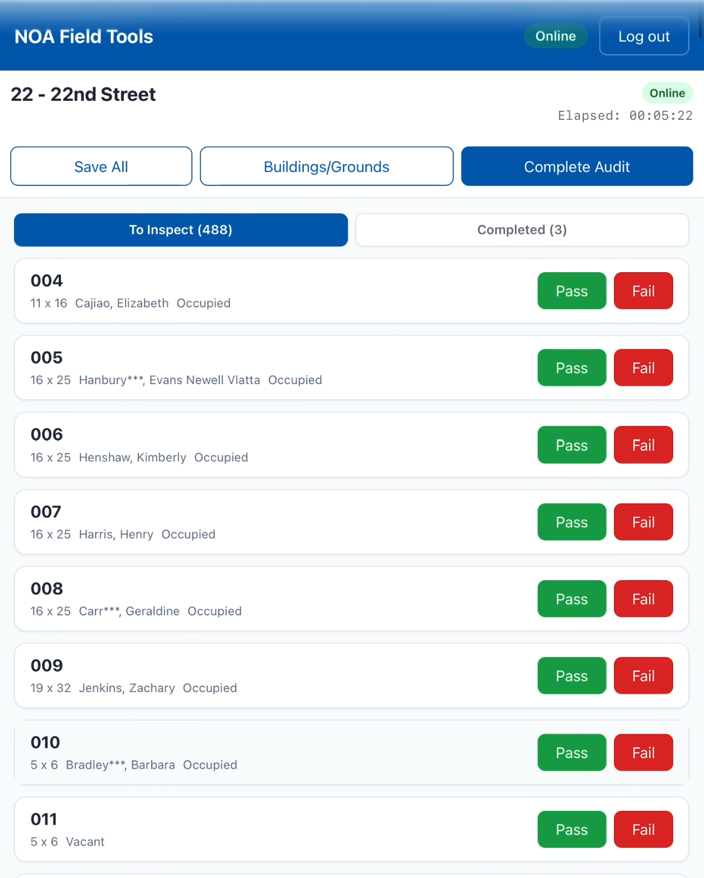
Store Audit with Field Tools:
Using the Field Tools app, complete your walkthru digitally and sync it back up to the Store Audit in NOA when you return to the office.
<insert screenshot of Work Order dashboard
and description of what is being shown>
‹ Back
Next ›
Packed Planet Self Storage Solutions

Slide 5

<insert screenshot of Budgets and include description of what is being shown>
<insert screenshot of Contracts and include description of what is being shown>
<insert screenshot of Claims
and include description of what is being shown>
Reach out today to discuss Office Pro
(757) 998-8481
‹ Back
Packed Planet Self Storage Solutions

