Slide 1

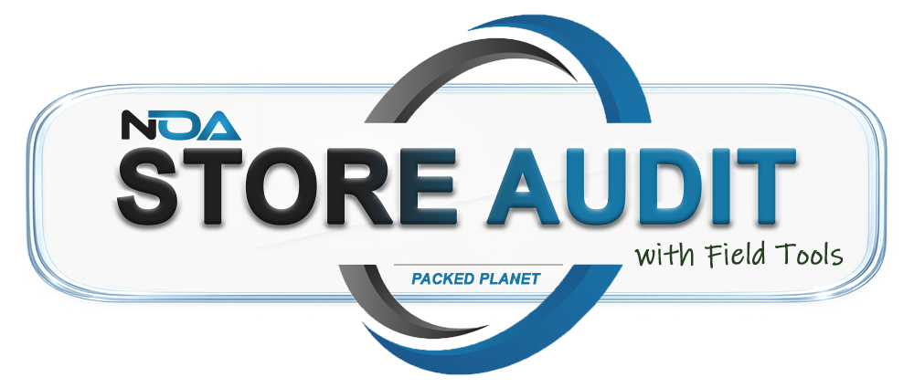
Ditch the clipboard and let NOA take it from there.
Currently in BETA
Next ›
Packed Planet Self Storage Solutions

Slide 2
Ditch the clipboard
THE OLD WAY
WITH STORE AUDIT
Writing notes by hand
Remembering what you saw
Duplicating your entries
Scores compiled on Spreadsheets
Complete your walkthru, property checks and work orders in the Field Tools app
Open the Store Audit in NOA and everything syncs from the app
No more duplicate entries
Property / Security checks, Space Audits and FSA walkthrus are included in Field Tools
‹ Back
Next ›
Packed Planet Self Storage Solutions

Slide 3



How it works: walk, sync, score
STEP 1
STEP 2
STEP 3
Walk the property
Return to the office
Score and complete
Install Field Tools on your phone or tablet, or launch it with a QR code scan or NFC tap. Complete your full walkthrough on the device.
Launch the Store Audit in NOA. Everything from the Field Tools app syncs into it.
Your data is synced and scored in the audit form, where you complete the full store audit.
‹ Back
Next ›
Packed Planet Self Storage Solutions

Slide 4






Everything you check, in one walkthru
Walkthru
Property checks
Work orders
Maintenance tasks
Lock checks
Vacant unit inspections
‹ Back
Next ›
Packed Planet Self Storage Solutions

Slide 5
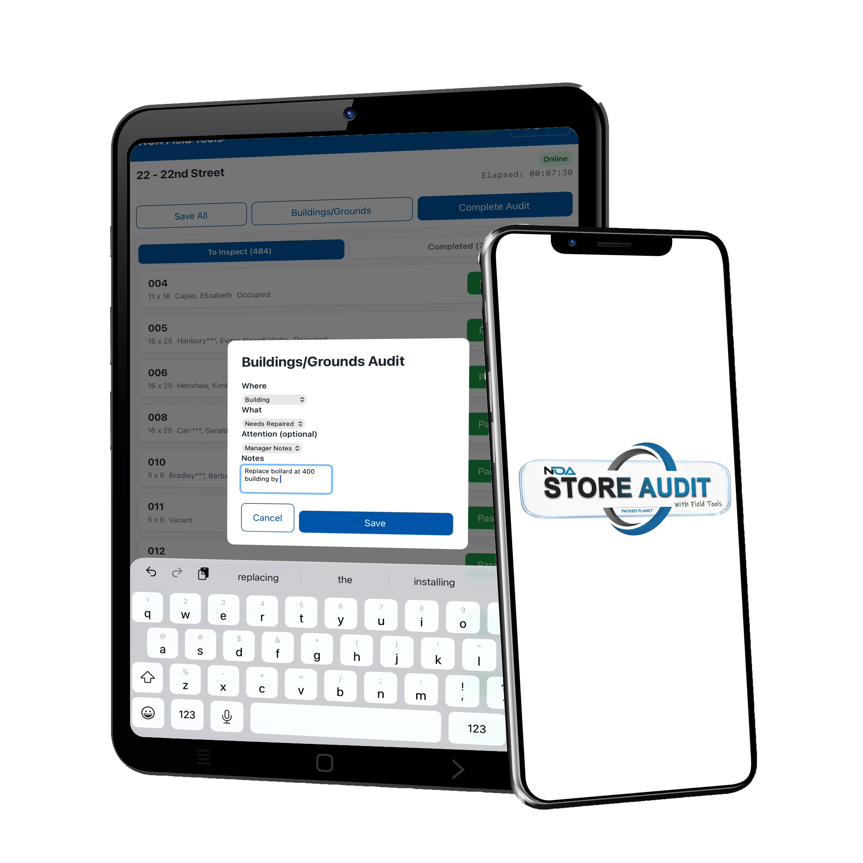

Built for the field,
online and off
Out of range? No problem.
Field Tools works online and off. If you wander out of range during your walkthru, it caches everything until you return and syncs up.
‹ Back
Next ›
Packed Planet Self Storage Solutions

Slide 6
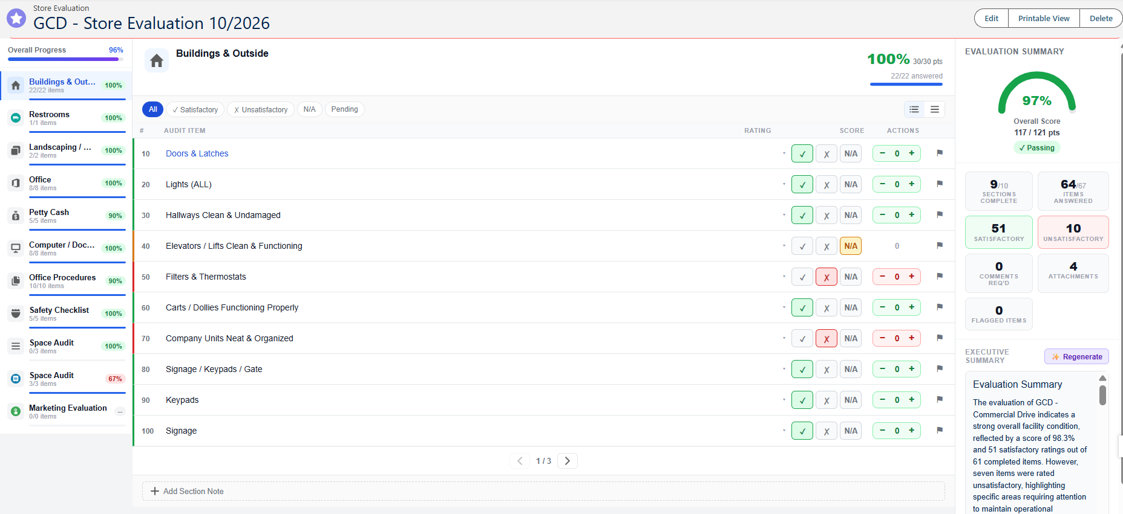
Request a demo: (757) 998-8481
See it at MSM The Show, November 4-6
‹ Back
Packed Planet Self Storage Solutions

