Slide 1

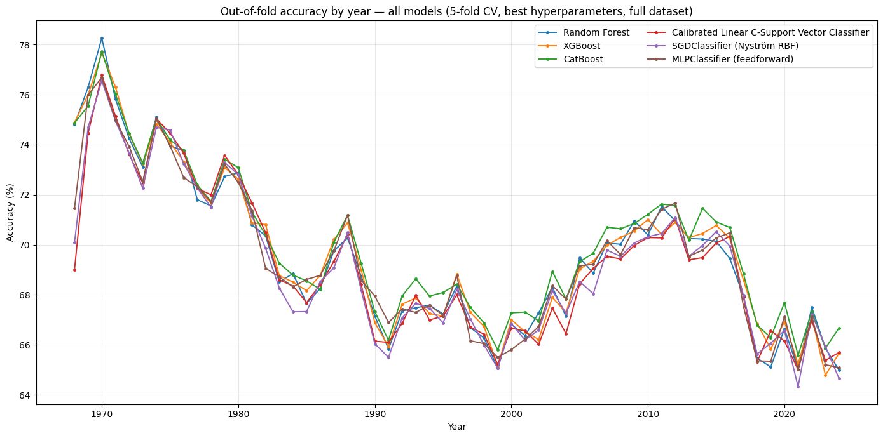
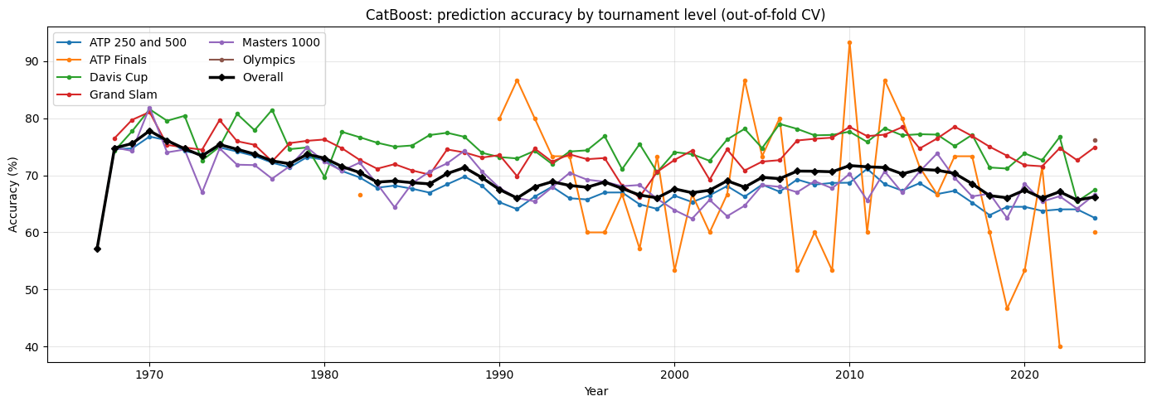
Predicting the Results of Professional Tennis Matches with Machine Learning
Sergio de Carvalho
Introduction
Predicting the outcome of professional sporting events is a long-standing challenge with broad applications from athletic training to broadcast media engagement. Tennis offers a unique setting for machine learning because results are determined from one-to-one matches, with fewer confounding variables than team sports. Traditional match prediction relies heavily on official rankings that prioritize cumulative participation and tournament prestige over absolute strength of opposition and recent form.
This project establishes a machine learning framework to predict professional tennis match outcomes strictly using pre-match data. Using an extensive tabular dataset spanning over five decades of matches from the Association of Tennis Professionals (ATP), the project focuses on domain-driven feature engineering. Central to the methodology is the integration of dynamic “enhanced covariates”—such as Elo and Glicko [1] rating systems—computed strictly in chronological order to eliminate data leakage.
Methodology
Aggregated historical records from 189,373 matches across tournaments from 1967 to 2024, covering 7,477 players
Enriched match records with player information: age, height, dominant playing hand, current ATP rank and ranking points
Calculated historical metrics for each player in strict chronological order: highest rank, total matches played and win rates (career and last 12 months), head-to-head wins
Maintained alternative rankings based on dynamic paired comparison models (Elo and Glicko) that estimate the abilities of players considering the strength of opponents, including weighted Elo and Glicko variants that account for the margin of victory (number of games won in a match) [2]
Considered results on specific court surfaces separately (grass, clay, hard courts) to compute additional per-surface metrics such as win rates, head-to-head counts, Elo and Glicko rankings [3]
Trained and tuned six supervised classifiers: Random Forest, XGBoost, CatBoost, Calibrated Linear C-Support Vector Classifier (C-SVC), Nyström kernel approximation with SGD (RBF mapping), and a Multi-Layer Perceptron
Analysis
Figure 1: Overall accuracy of predictions from all models, by year.
Evaluation and Results
Prediction accuracy fluctuates noticeably by era (Figure 1), tournament level (Figure 2), and match format (matches in best-of-five sets format are easier to predict than best-of-three)
All models converge near a 70% accuracy ceiling in line with results in the literature [4], outperforming the standalone ATP ranking baseline (66.24%) and overall Elo (68.31%)
Figure 2: Accuracy of CatBoost model by year and tournament level.
Model | Accuracy | Precision | Recall
CatBoost | 69.97 % | 69.98 % | 69.97 %
XGBoost | 69.85 % | 69.85 % | 69.85 %
Multi-Layer Perceptron | 69.53 % | 69.54 % | 69.53 %
Random Forest | 69.51 % | 69.51 % | 69.51 %
Nyström + SGD | 69.23 % | 69.27 % | 69.23 %
Linear C-SVC | 68.98 % | 68.98 % | 68.98 %
References
[1] Glickman, M.E. (1999). “Parameter estimation in large dynamic paired comparison experiments”. In: Applied Statistics 48.3, pp. 377-394.
[2] Angelini, G., V. Candila, and L. De Angelis (2022). “Weighted Elo rating for tennis match predictions”. In: European Journal of Operational Research 297.1, pp. 120-132.
[3] Williams, L.V. et al. (2021). “How well do Elo-based ratings predict professional tennis matches?” In: Journal of Quantitative Analysis in Sports 17.2, pp. 91-105.
[4] Wilkens, S. (2021). “Sports prediction and betting models in the machine learning age: The case of tennis”. In: Journal of Sports Analytics 7.2, pp. 99-117.
Table 1: Overall accuracy, precision and recall of all models.
Discussion and Future Work
Predicting professional tennis matches remains challenging, in part due to factors that are not fully captured in historical records: weather conditions, variations in court pace, the mental and physical state of players, tournament schedules, and situational pressure
Minimal performance differences among algorithms confirm that feature engineering quality—rather than model architectural choice—drives predictive power
Future work should expand the scope to include the Women’s Tennis Association (WTA) circuits as well as lower-tier events (Challengers, Futures, and qualifying rounds)
Further gains can be pursued by incorporating court speed indexes, indoor/outdoor court status, weather conditions, home advantage, fatigue factors (e.g. total time on court, rest days), as well as match-level metrics (first-serve percentages, aces, double faults, break points saved/won)

