Slide 1
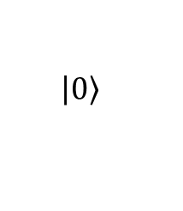
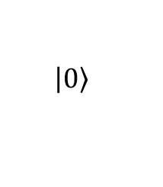
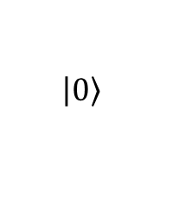

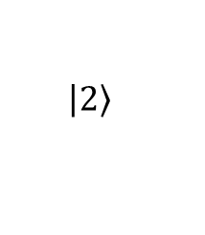






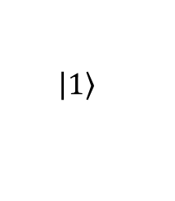
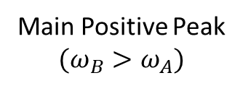
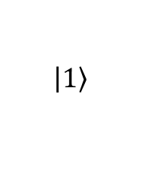

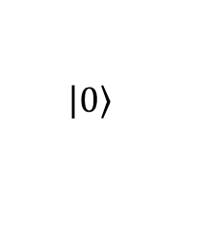


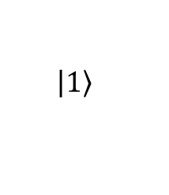
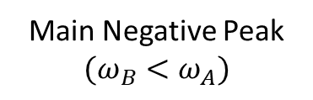
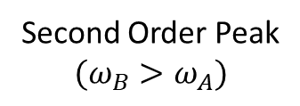
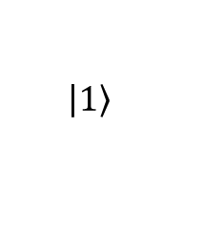


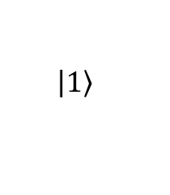







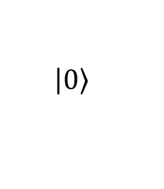



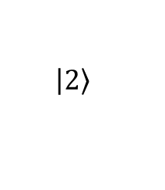
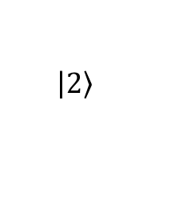
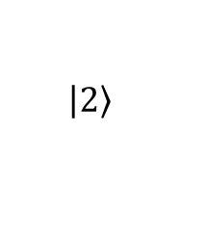
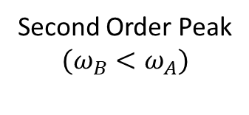
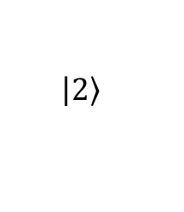



(a)
Energy
(b)
(p1)
(p2)
$$\left.\left|1\right.\right\rangle$$
$$\left.\left|1\right.\right\rangle$$
$$∆_{1}<0$$
$${{}_{ }^{1}S}_{0}+{{}_{ }^{3}P}_{1}$$
$$ω_{A}$$
$$ω_{B}$$
$$ω_{B}$$
$$ω_{A}$$
$$∆_{1}$$
$$ω_{B}$$
$$ω_{A}$$
$$E_{1}$$
$$\left|\left.1\right\rangle \right.$$
$$\left.\left|0\right.\right\rangle$$
$$\left.\left|0\right.\right\rangle$$
$$Γ_{1}$$
$$\left.\left|2\right.\right\rangle$$
$$\left.\left|2\right.\right\rangle$$
$$689nm$$
Main Positive Peak
$$(ω_{B}>ω_{A})$$
Second Order Peak
$$(ω_{B}>ω_{A})$$
$$ω_{B}$$
$$ω_{A}$$
(n1)
$$\left.\left|1\right.\right\rangle$$
(n2)
$$\left.\left|1\right.\right\rangle$$
$$\left|\left.0\right\rangle \right.$$
$$0$$
$${{}_{ }^{1}S}_{0}+{{}_{ }^{1}S}_{0}$$
$$ω_{A}$$
$$ω_{B}$$
$$ω_{A}$$
$$ω_{B}$$
$$∆_{2}$$
$$ω_{A}$$
$$ω_{B}$$
$$E_{b}^{0}$$
$$\left|\left.2\right\rangle \right.$$
$$\left.\left|0\right.\right\rangle$$
$$\left.\left|0\right.\right\rangle$$
$$\left.\left|2\right.\right\rangle$$
$$\left.\left|2\right.\right\rangle$$
$$Γ_{2}$$
Main Negative Peak
$$(ω_{B}<ω_{A})$$
Second Order Peak
$$(ω_{B}<ω_{A})$$
Internuclear Separation
(c)
Δ₁/2π = -1.5 MHz, Intensity = 0.66 W/cm²
(e)
Δ₁/2π = -3 MHz, Intensity = 0.66 W/cm²
Second Order Peak (p2)
Main Negative Peak (n1)
Main Positive Peak (p1)
Second Order Peak (n2)
Δ₁/2π = -1.5 MHz, Intensity = 0.17 W/cm²
(f)
Δ₁/2π= -3 MHz, Intensity = 0.18 W/cm²
(d)

Slide 2
Figure 2: Experiment (Axis Adjusted)
(a)
(b)
Model
Experiment
Linear Fit

Slide 3
Figure 3: Floquet Prediction (Axis Adjusted)
Model
Floquet Theory

Slide 4
Figure 3: Floquet (2 Pole – 44MHz extra level, best fit)

Slide 5
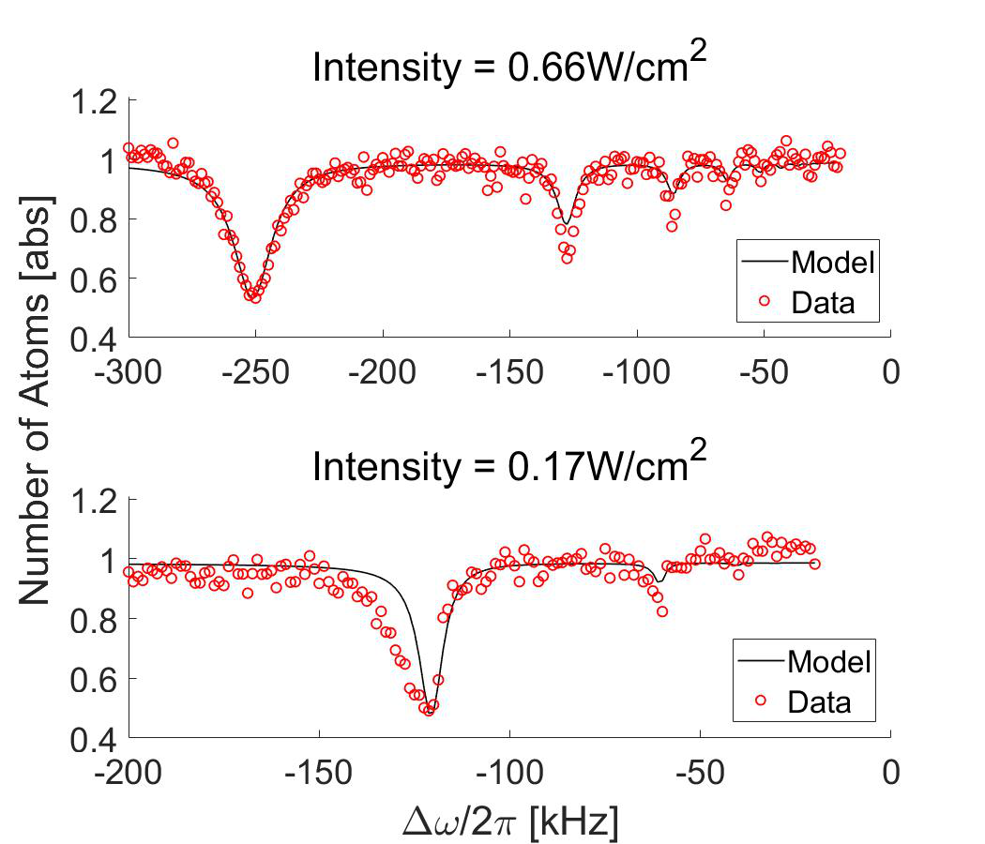
Figure 4: Linewidth (High/Low Int – Shape Fit)

Slide 6





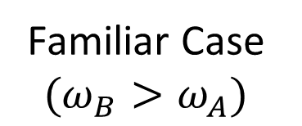
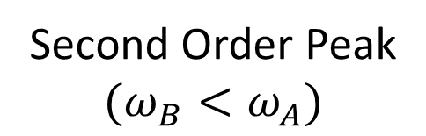


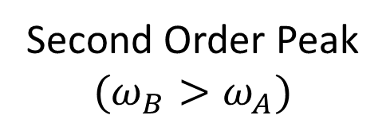







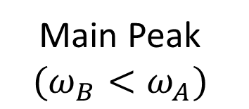








Figure 5: Multiphoton Understanding?
(a1)
$$\left.\left|1\right.\right\rangle$$
(a2)
$$\left.\left|1\right.\right\rangle$$
$$∆_{1}$$
$$ω_{A}$$
$$ω_{B}$$
$$ω_{B}$$
$$ω_{A}$$
$$ω_{B}$$
$$ω_{A}$$
$$\left.\left|0\right.\right\rangle$$
$$\left.\left|0\right.\right\rangle$$
$$\left.\left|2\right.\right\rangle$$
$$\left.\left|2\right.\right\rangle$$
Familiar Case $(ω_{B}>ω_{A})$
Second Order Peak
$$(ω_{B}>ω_{A})$$
(b1)
$$\left.\left|1\right.\right\rangle$$
(b2)
$$\left.\left|1\right.\right\rangle$$
$$ω_{A}$$
$$ω_{B}$$
$$ω_{A}$$
$$ω_{B}$$
$$ω_{A}$$
$$ω_{B}$$
$$\left.\left|0\right.\right\rangle$$
$$\left.\left|0\right.\right\rangle$$
$$\left.\left|2\right.\right\rangle$$
$$\left.\left|2\right.\right\rangle$$
Second Order Peak
$$(ω_{B}<ω_{A})$$
Main Peak
$$(ω_{B}<ω_{A})$$

Slide 7








Figure 5: 4-level
$$\left.\left|X\right.\right\rangle$$
$$∆_{X}$$
$$\left.\left|1\right.\right\rangle$$
$$∆_{1}$$
$$ω_{A}$$
$$ω_{B}$$
$$\left.\left|0\right.\right\rangle$$
$$\left.\left|2\right.\right\rangle$$

Slide 8
Figure ?: Newest FWHM – x=37.5
(a)
(b)

