Slide 1
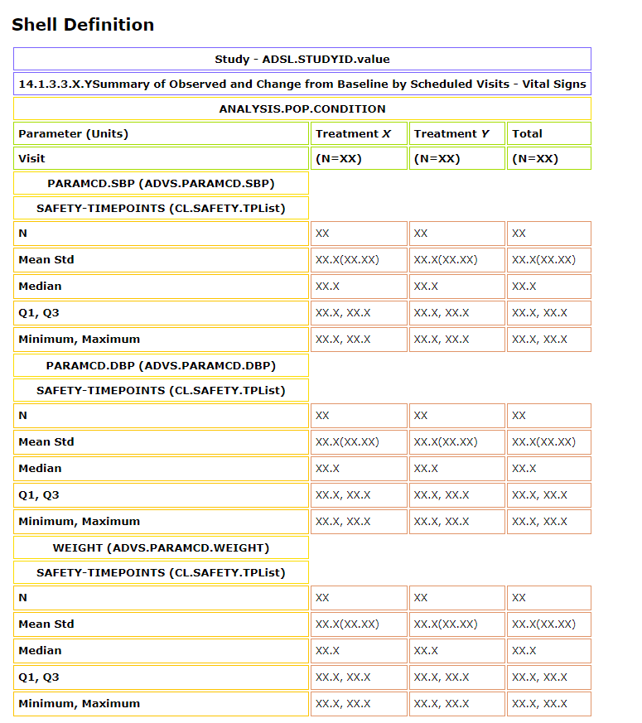

Slide 2
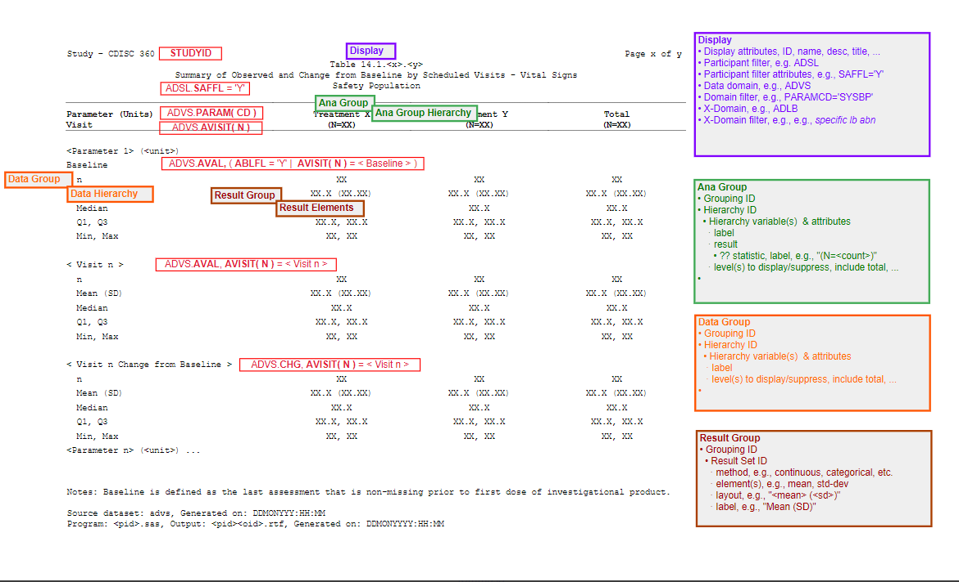

Slide 3
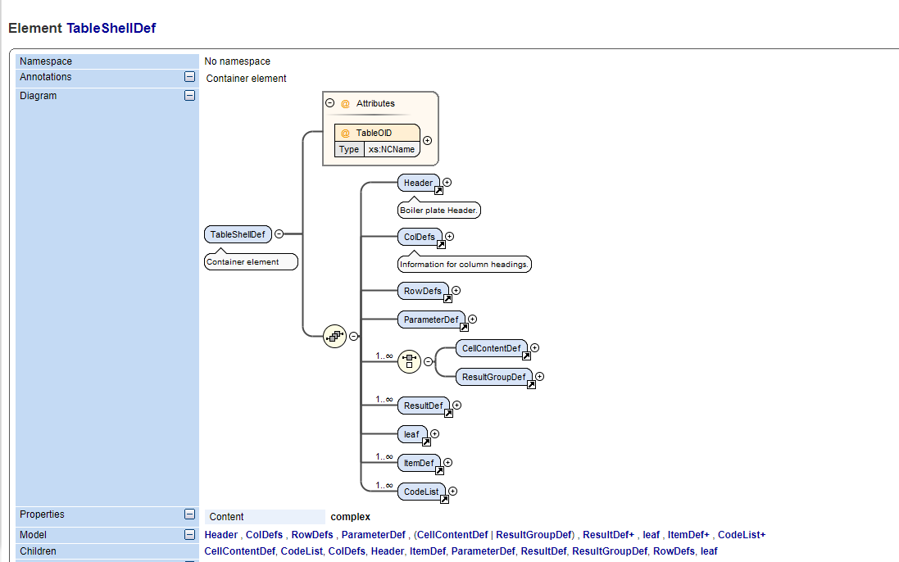
Draft-Shell-Schema

Slide 4
Show annotations using mouseover/Javascript?
Make instance for multiple results per column layout
Continue working on ARM++/Display/Results model details

Slide 5
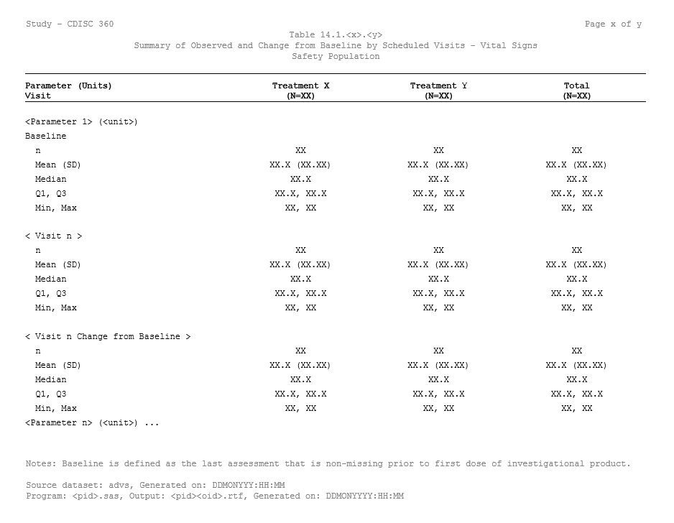
Shell-XML Annotations
Header/Title
Study@ItemOID
AnalysisPopulationRef@AnalysisPopultaionOID
ResultRef/@ResultOID
TreatmentVarRef[/@ItemOID
ColDefs
ParameterRef/@ParamOID
RowDefs
AnalysisTimepoint/@ItemOID
CellContentDef/@ResultGroupOID
ResultGroupRef/ResultGroupOID
ResultDef/@StatResultOID
StatResultDef/Format

Slide 6
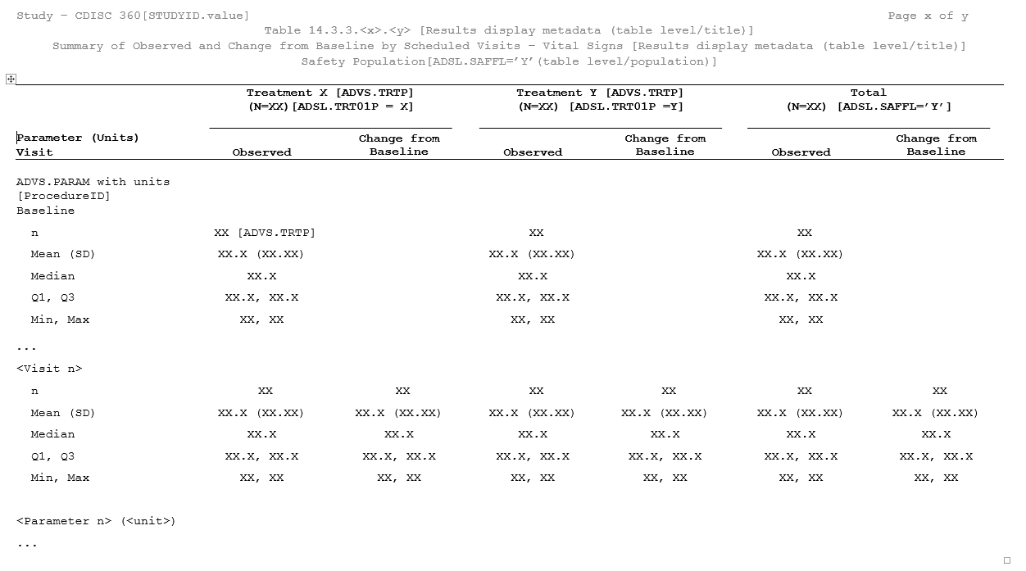
Shell-XML Annotations
Study@ItemOID
Header/Title
AnalysisPopulationRef@AnalysisPopultaionOID
TreatmentVarRef[/@ItemOID
ColDefs
ResultRef/@ResultOID
RowDefs
ParameterRef/@ParamOID
AnalysisTimepoint/@ItemOID
CellContentDef/@ResultGroupOID
ResultGroupRef/ResultGroupOID = ADVS.PARAM.AVAL.BASE
ResultDef/@StatResultOID
StatResultDef/Format
ResultGroupRef/ResultGroupOID = ADVS.PARAM.AVAL.POSTBASELINE
ResultGroupRef/ResultGroupOID = ADVS.PARAM.CHG.POSTBASELINE
Notes:
Note that ResultGroups may contain ResultGroups. If more than one result is needed per column, the first row has a blank header and the first ResultRef. The second ‘result row’ has the headers and the Result labels.
If there is only one Result be column, the first column header row has Parameter as the header, the second has the result info and the visit.
NOTE – use the Nested ResultDef rather than a Result Group for the header.

Slide 7
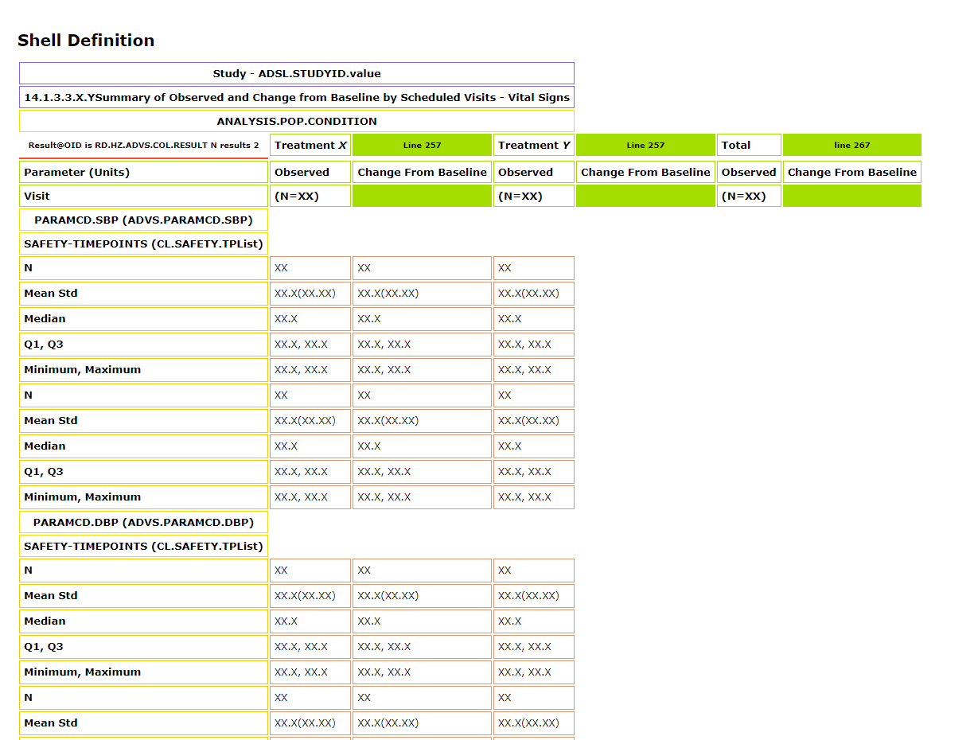
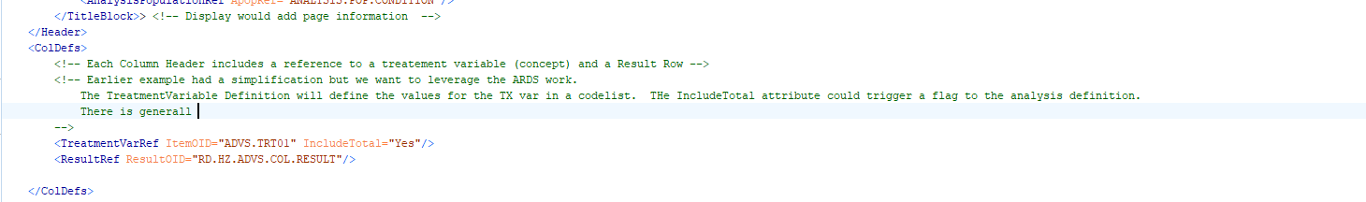
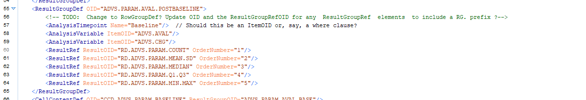
Notes:
The ResultRef in the ColDefs element may be nested. It is NOT a ResultGroup sisnce there is usually only 1 result in the hdr
If the ResultRef is nested, some or all of rht ResultGroupDefs in the RowDefs will have extra Analyiis Variables. I am assuming a parallel structure, I

Slide 8
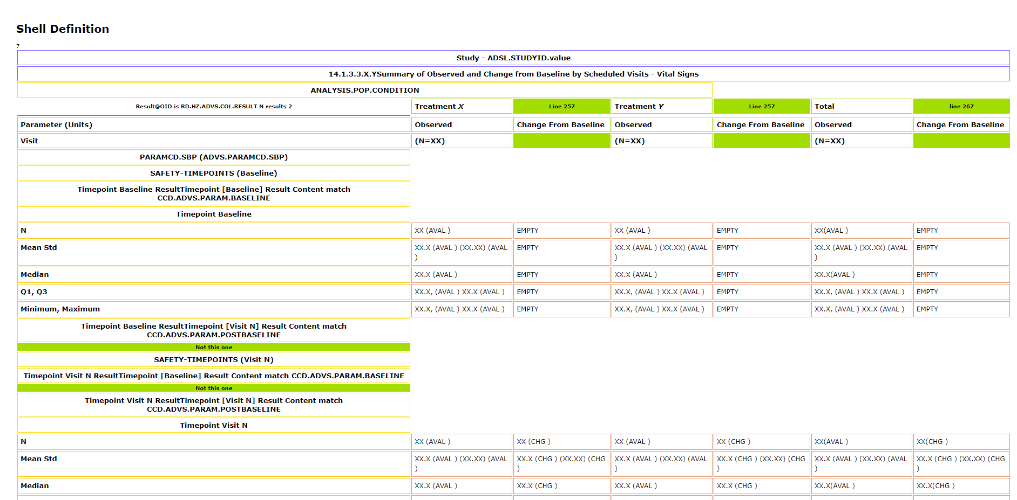
Notes:
Rowdefs
ResultGroupDef Where AnalysisTimePointName = RowDef/ timepointVariable Codelist Value.
The model for the Result group is the set of results that should be displayed for a single timepoint for one or more analysis variables. In the vertical layout, each result group has one timepoint and one analysis variable. In the horizontal display model there are two analysis variables per timepoint (per variable).

Slide 10
XML Shell to ARD
Header/Study/ItemOID
AnalysisID will need to specify the Analysis Dataset (via ItemGroupOID)
SafetyPop (NIY)
ColumnDefs/TreatmentVar/@ItemOID, Result(s)
Parameter, Visits (CL), AVAL. CHG. (expect AVAL and CHG metadata )
For each result group # (computed), resultOIDs with grouping

Slide 11
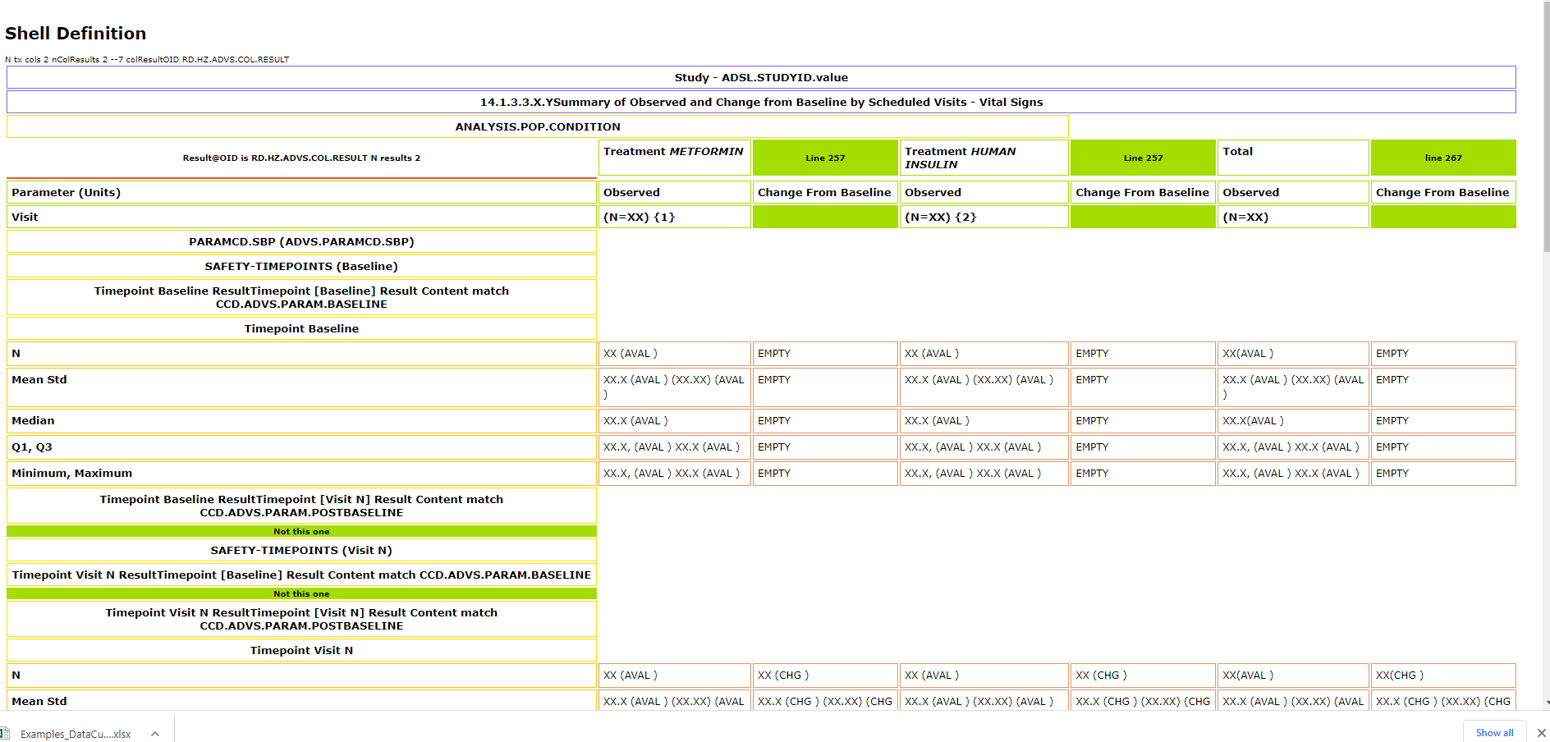
Data Source Layer
Display
Analysis
Analysis Results
Analysis Results

Slide 12
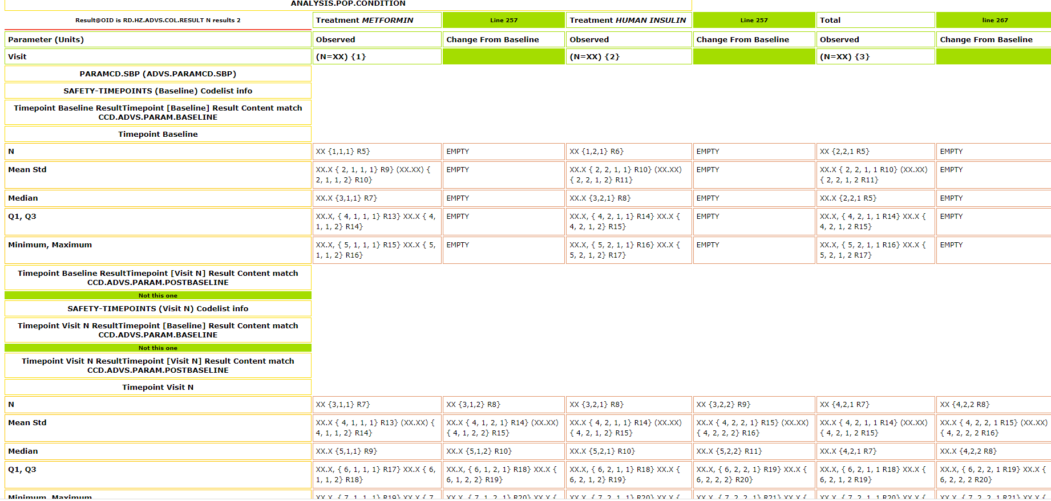
Notes:
Result numbering still FooBarred

