Slide 1
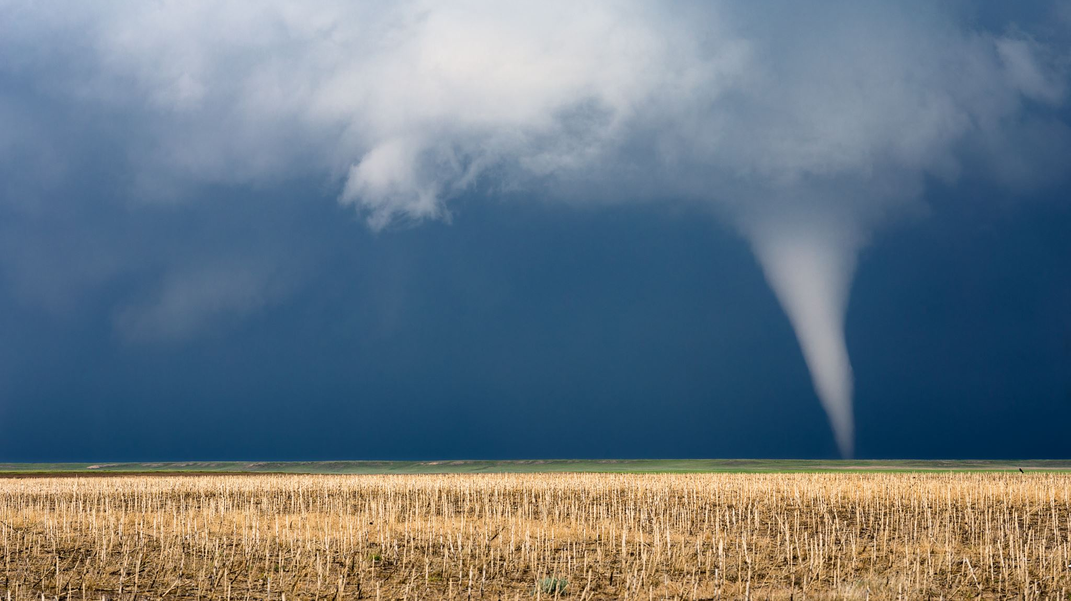
Hurricane Formation Prediction Using Supervised Machine Learning
Santiago Castillo

Slide 2
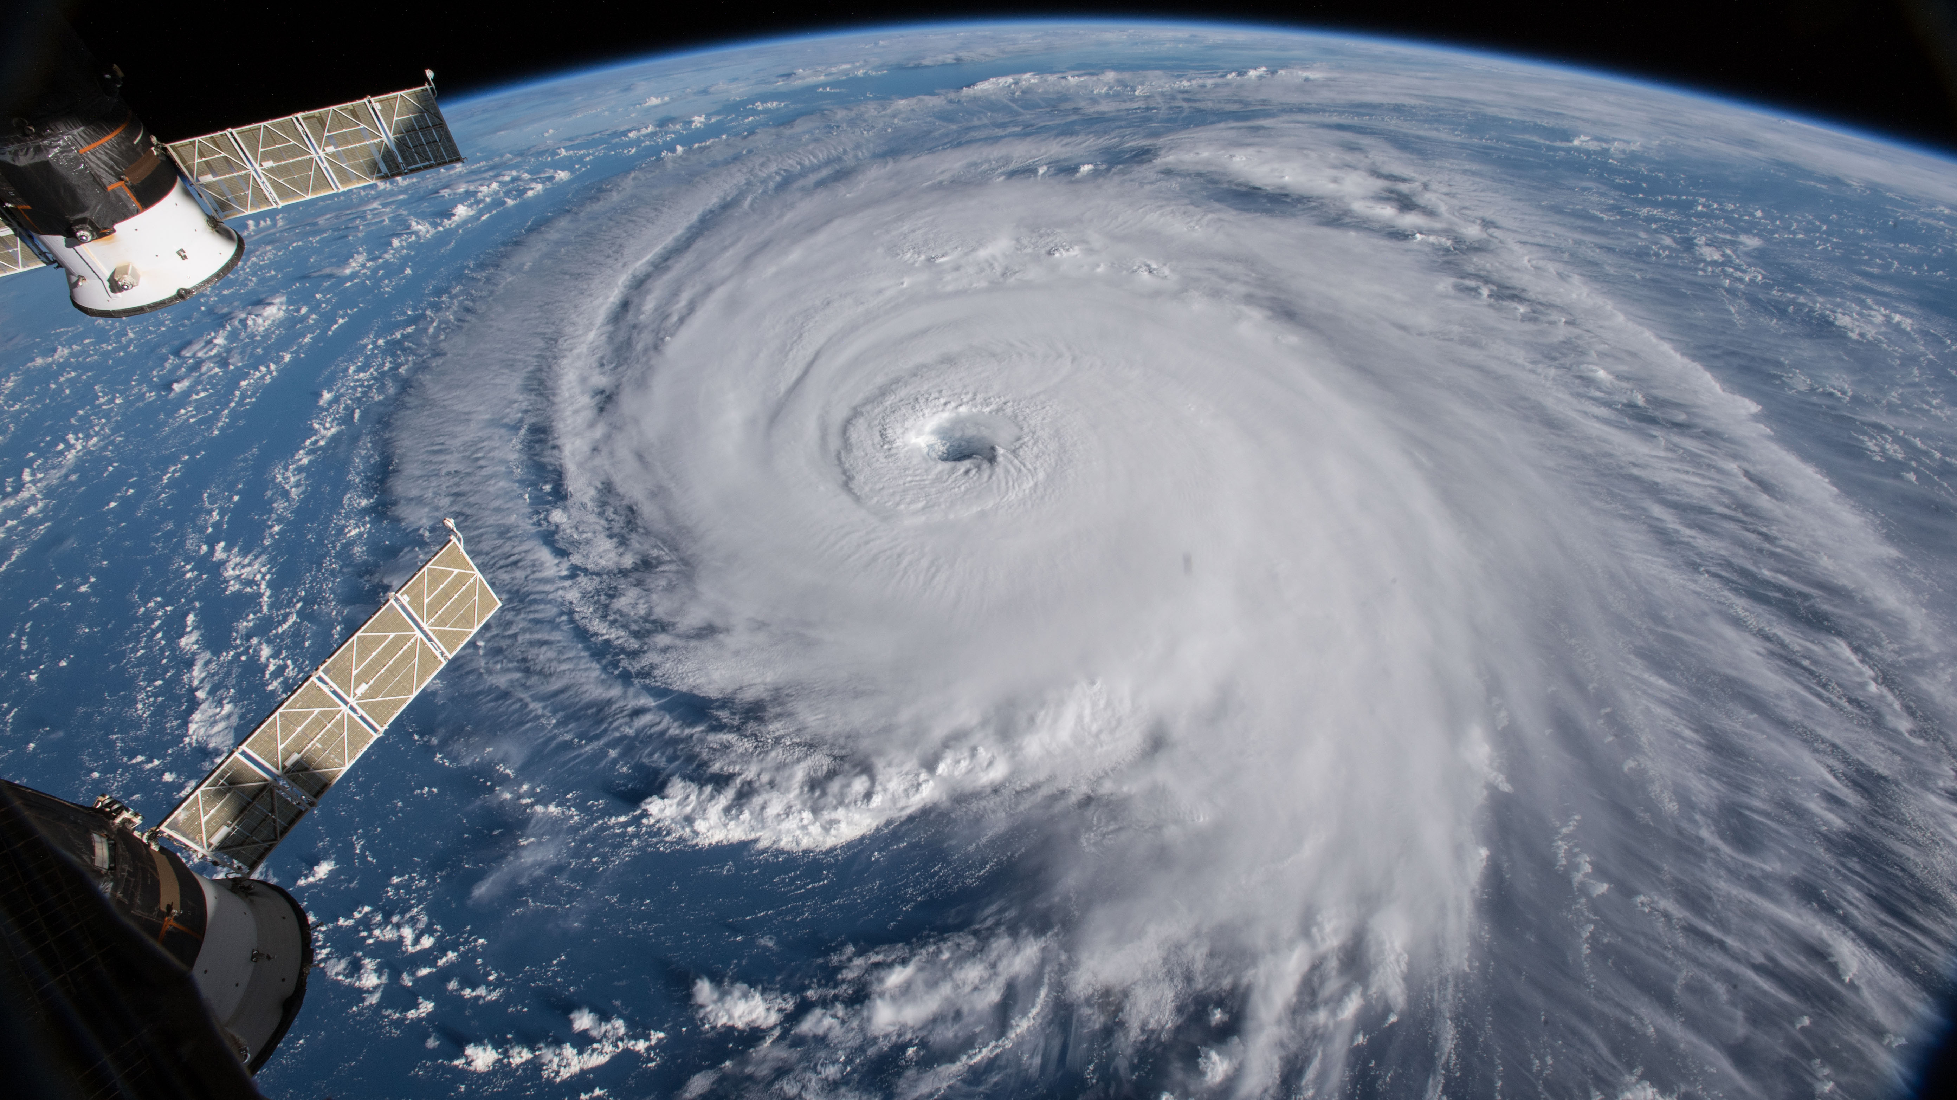
Background

Slide 3

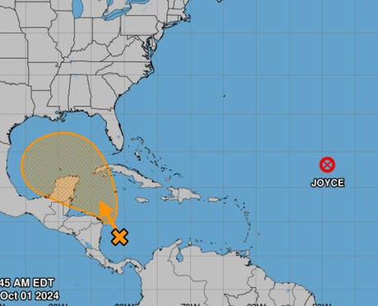
Dataset
Atlantic and Pacific
23 features
Date: The date of the hurricane event.
Time: The time in UTC.
Status: The status of the hurricane (e.g., Tropical Depression, Tropical Storm, Hurricane).
Latitude & Longitude: Geographical coordinates of the hurricane.
Maximum Wind: Maximum sustained wind speed (knots).
Minimum Pressure: Minimum central pressure (mb).
Event: Describes specific events such as landfall or intensity peaks.

Slide 4
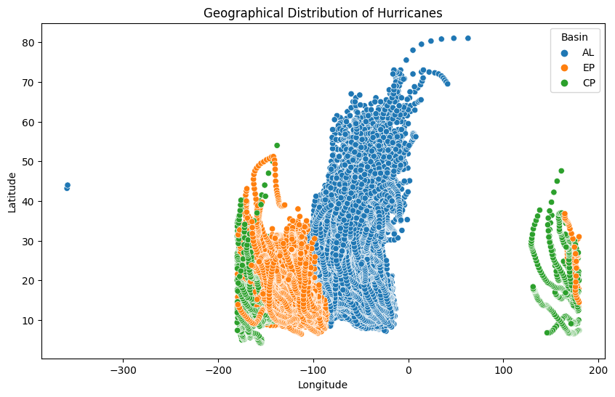
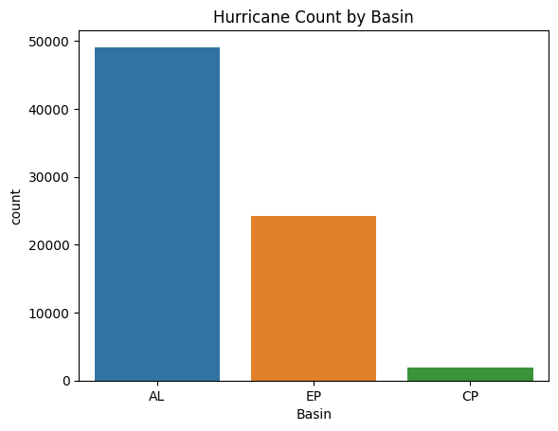
Data Preprocessing
Visualizations
Modifying longitude and latitude datasets
Combining datetime features
Combining datasets
Creation of target feature
Train/Test Split (80-20)

Slide 5

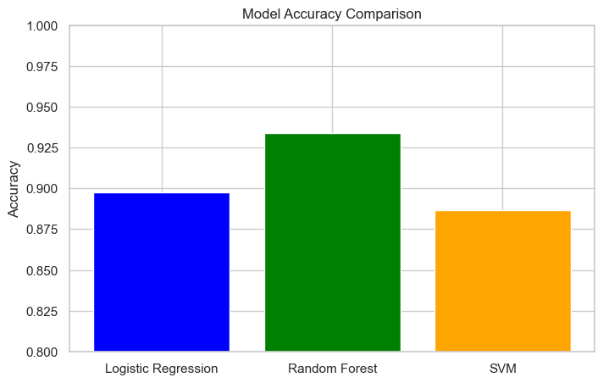
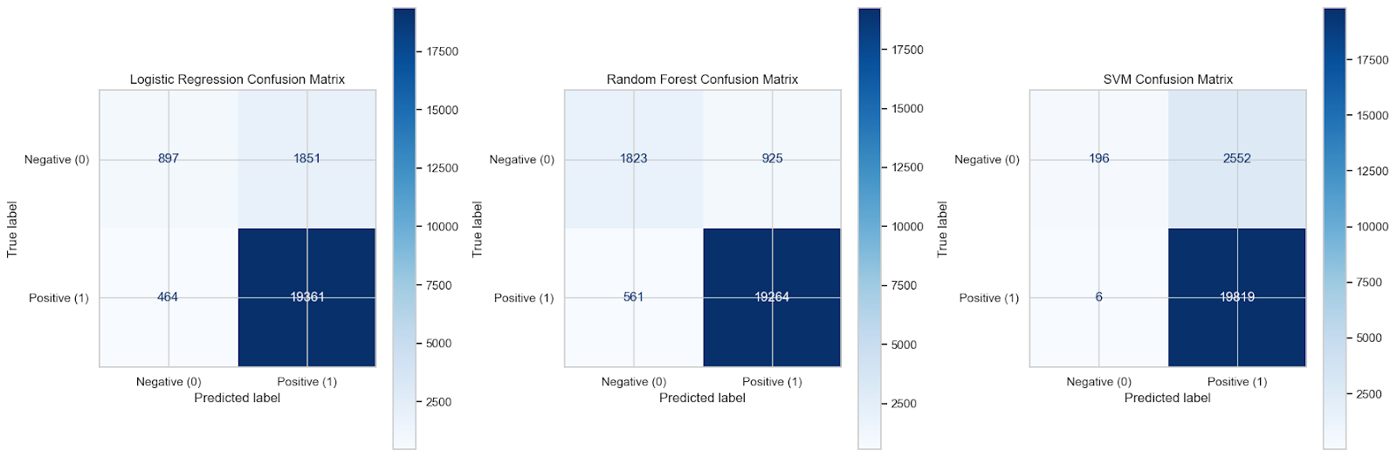
Model Selection

Slide 6
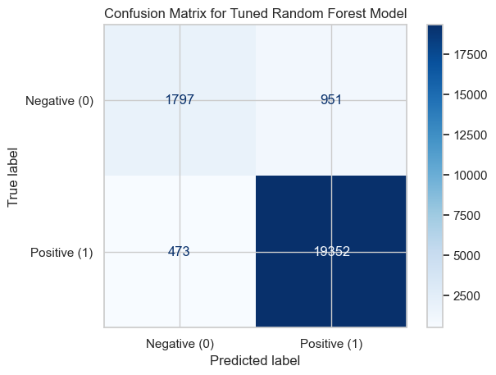
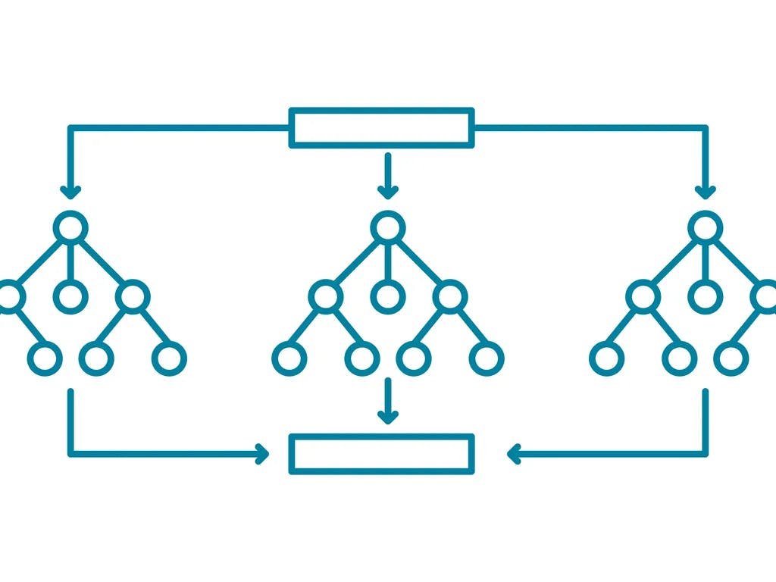
Hyperparameter tuning
n_estimators: 200
max_depth: 20
min_samples_split: 5
min_samples_leaf: 1
max_features: 'log2’
93.6% Accuracy

Slide 7

Ethical Considerations
Geographical Bias
Accuracy affecting lives
Real time climate factors
Account for changing climate

Slide 8

Conclusion

