Slide 1
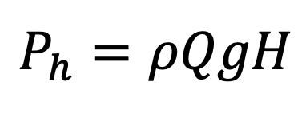
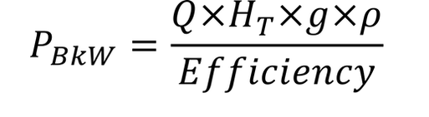
Old Pump
Total Power
EAM Data
Flow
Total Head
Speed
Efficiency
Motor hp
Energy Cost ($)
Motor and transmission efficiency
Energy Data
WHP
Current Operating Point
Pump Efficiency
Pump Curves
Changes in
Energy Cost
Efficiency
Efficiencies shouldn’t change
New Pump
Manufacturer Information
Flow
Total Head
Speed
Efficiency
Horsepower
Pump Curves
Pump Efficiency
BHP
Total Power
Information Needed:
Pump runtimes
Peak Hours
Energy Bill Rates
Some Pump Curves
Properties of fluid going through pump
Notes:
Field Measurements: Q, h, power
HMI: speed, Q, h
Calculated Inputs:
Power
Specific Gravity, water should be 1
New Pump BEP points:
Q, h, speed, efficiency, Power, assume same runtime

Slide 2
Old Pump
EAM Data
Flow
Total Head
Speed
Efficiency
New Pump
Manufacturer Information
Flow
Total Head
Speed
Efficiency
Power

