Slide 1

angular 2
introduction to

Slide 2
about me
My name is Sebastian Castaldi
Professional life:
  Software Engineer with a Masters Degree from USF
  20+ years of experience in Oil Industry, Health Care, Government, Banks, etc
  Working experience is mostly with Microsoft stack: WPF, WCF, WebApi, ASP.Net, MicrosoftCRM, SQL/Server.
  The last few of years I moved my focus into the open source
  Currently working at DATIS, a cloud provider for HR and Payroll
  On my spare time I do consulting and custom development at Tampa Software LLC
Recreational:
  I pretty much live at the YMCA, you can find me swimming, biking at flat woods, and running (don’t really like running, but is part of the Triathlons which I do sporadically).
  I’m also into martial arts (all my life), right now focusing in Judo
You can contact me at:
  https://twitter.com/wwwsebas
  https://tampasoftware.com/
  scastaldi@tampasoftware.com

Slide 3
ui frameworks
Notes:
it seems like every year a new framework pops out people floods to the new framework, and next year we start all over again, it may be good or bad depending on how you see it, in my case it keeps me on my toes always learning new things

Slide 4
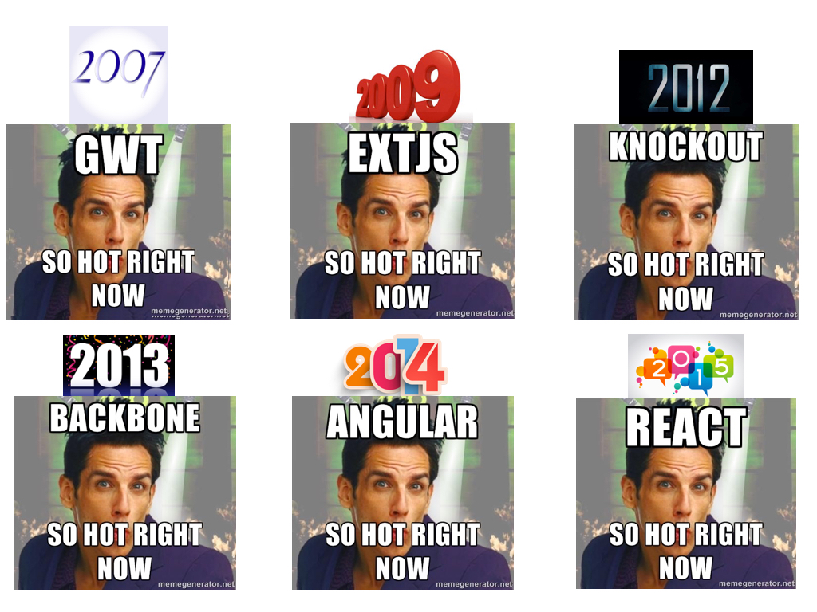

Slide 5
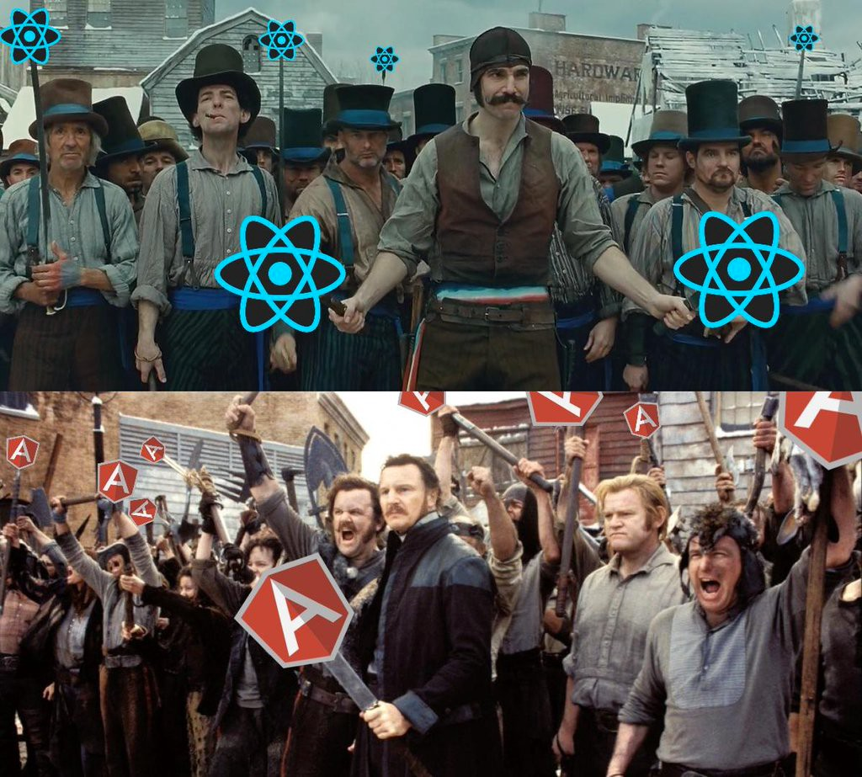

Slide 6
what is angular2
Angular 2 is a framework to help us build client applications in HTML and either JavaScript or a language (like Dart or TypeScript) that compiles to JavaScript.
Total rewrite of AngularJS
Angular 2 is currently in Release Candidate, the final release should be ready anytime now
Notes:
Brad Green called Angular2 a Platform

Slide 7
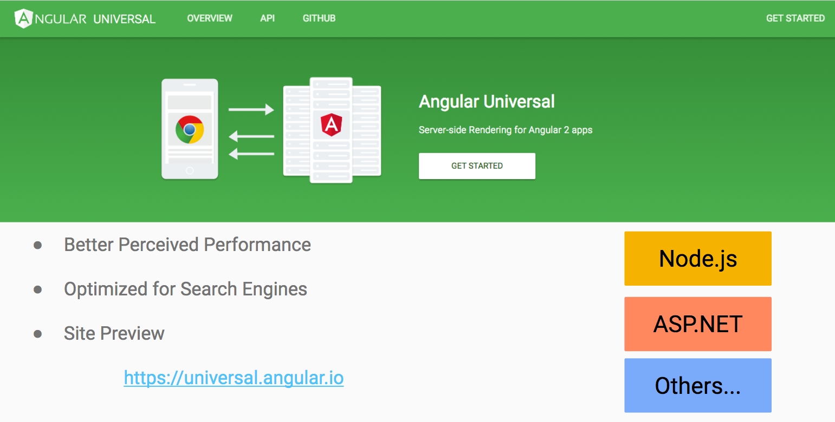
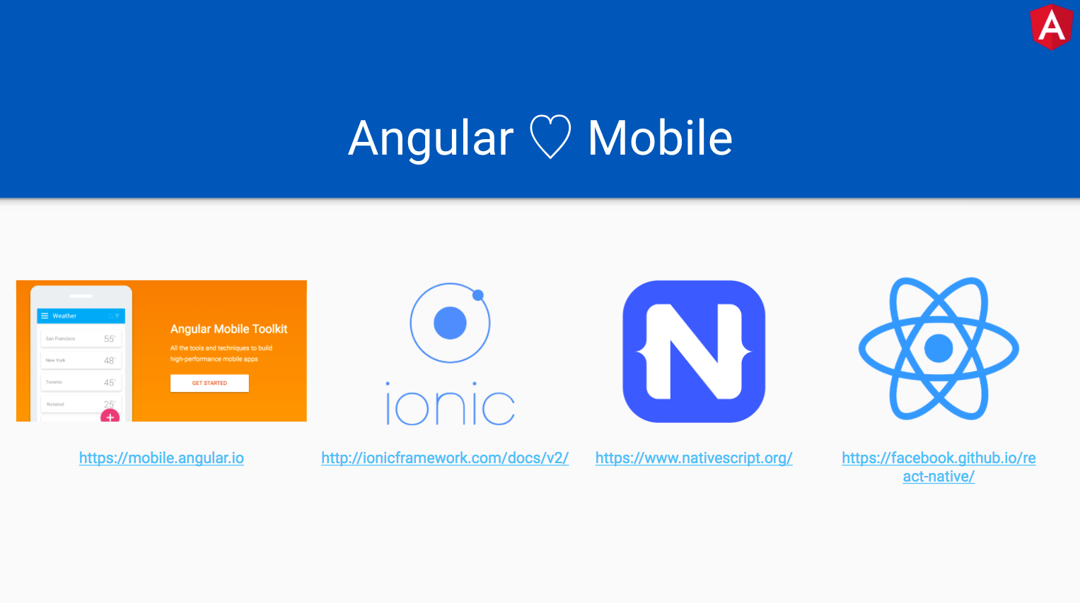
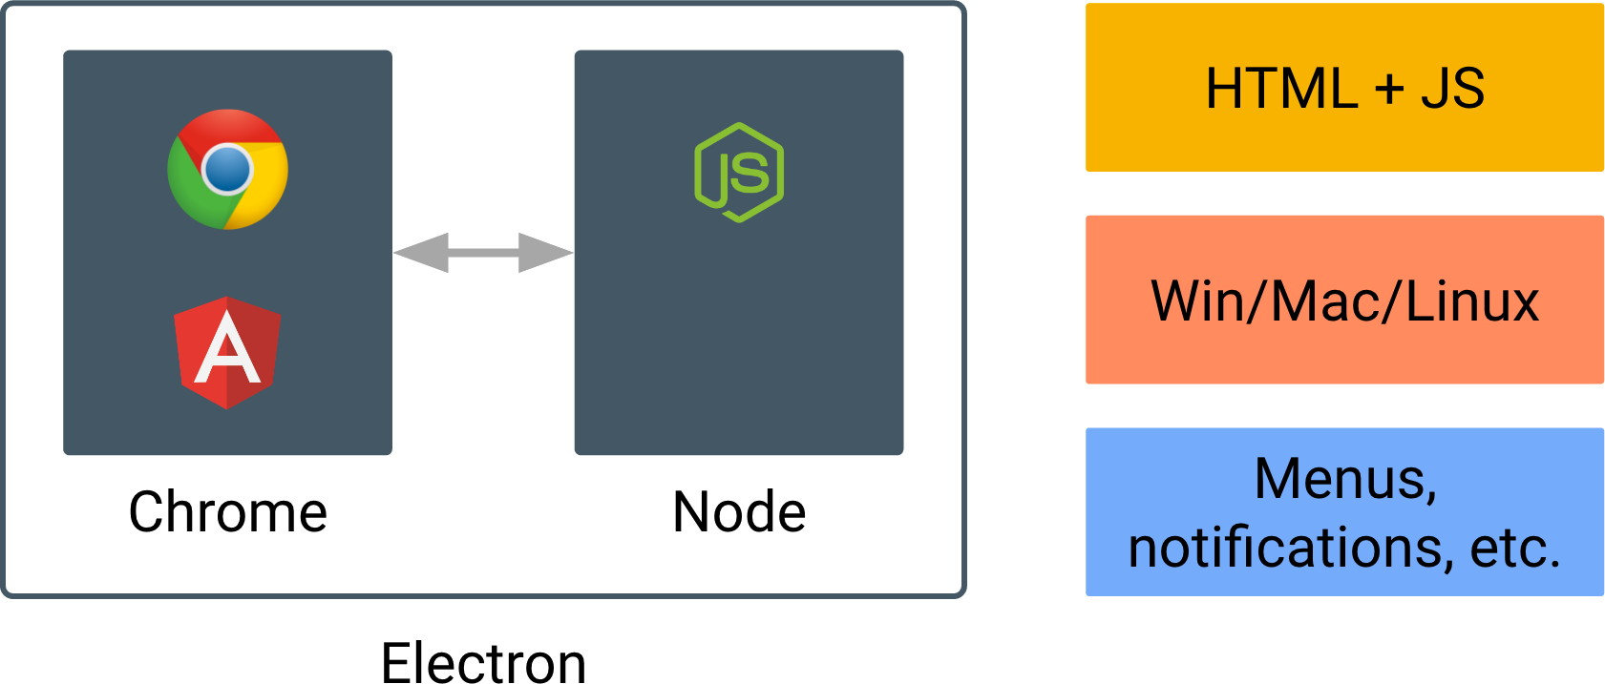
Notes:
it does not matter what framework you are working right now, if you are starting a new project, make sure is mobile first, whether is a progressive, hybrid or just responsive design
progressive design is a step ahead of responsive design, it feels like a native app but it runs on the browser
with Electron you can build hybrid apps that run on the desktop, think of cordoba for the desktop

Slide 8
what is typescript and why should I care anyways?
ES7-ES2016
Array.prototype.includes
> ['a', 'b', 'c'].includes('a')
true
> ['a', 'b', 'c'].includes('d')
false
Exponentiation operator
x ** y
ES5
Very flexible (maybe too flexible), need good practices or the code will quickly be unmaintainable:
- ‘option strict’
- IIFEs
- Closures
- Unit Testing
TypeScript
ES6-ES2015
Arrow Functions
Promises
Classes
Modules
Default Parameters
Template Literals
Multi-line Strings
ES2016
ES2015
ES5
Notes:
We cannot talk about angular without talking about TypeScript, what is this anyways?
First we start with ES5, the framework we all know and love
Staring last year ECMAScript started releasing every year, so we can expect smaller updates, but that leaves the browsers always trying to catchup, and the rest of us that work for a living we have to support older browsers, in my case is always a battle to convince management to drop support for older browsers
ECMAScript is going to start releasing every year, while we have to support older browsers that will never support the new code
TypeScript compiles down to ES5, which means, you can write the latest code and don’t worry about browser compatibility

Slide 9
what is typescript and why should I care anyways?
Invented by Anders Hejlsberg (Turbo Pascal, Delphi, and C#)
Is superset of Javascript, compiles to clean, simple JavaScript code which runs on any browser, in Node.js, or in any JavaScript engine
Static checking and code refactoring
Support the latest and evolving JavaScript features
TypeScript is developed and supported by Microsoft
Angular2 is written entirely in TypeScript
Notes:
if the guy invented these languages I can at least give him the benefit of the doubt that I’ll be fine with TypeScript
in 2012 I was in Orlando at TechEd the first time I heard of TypeScript

Slide 10
build for speed
Angular 1x
Angular 2
43 Directives
[ ] ( )
Controllers $scope
components
two way data binding
unidirectional data flow
Comparing Performance of Blaze, React, Angular and Angular 2 with Meteor
Notes:
I’m not going to spend too much time comparing 1x with 2x is just to draw a contrast of how different the two frameworks are
when people heard about no more controllers, $scope, two way data binding… they fled to reacts

Slide 11
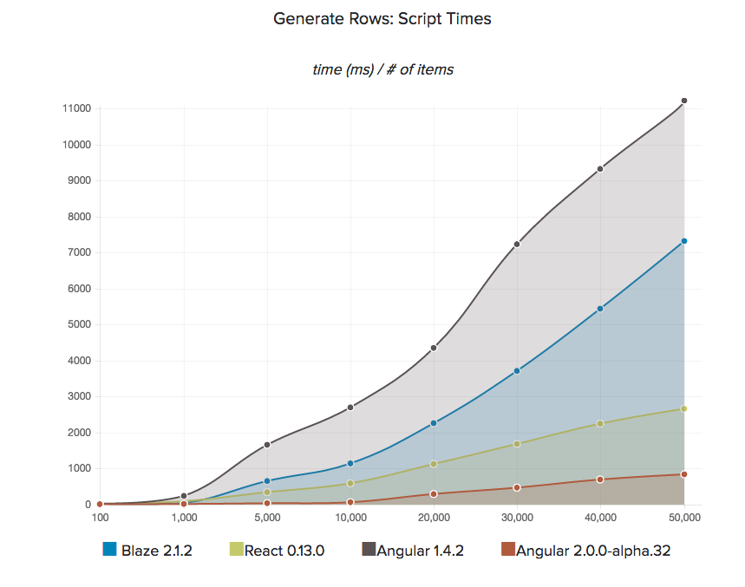
Rendering Script Times
http://info.meteor.com/blog/comparing-performance-of-blaze-react-angular-meteor-and-angular-2-with-meteor

Slide 12
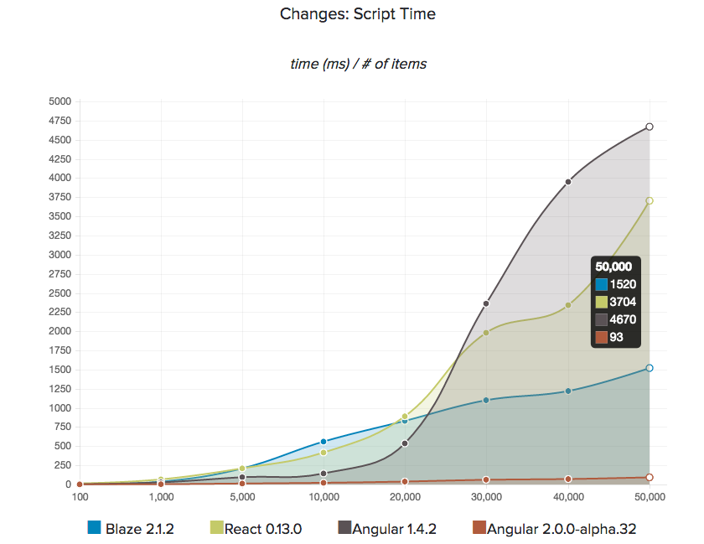
Re-rendering Script Times on Changes
http://info.meteor.com/blog/comparing-performance-of-blaze-react-angular-meteor-and-angular-2-with-meteor

Slide 13
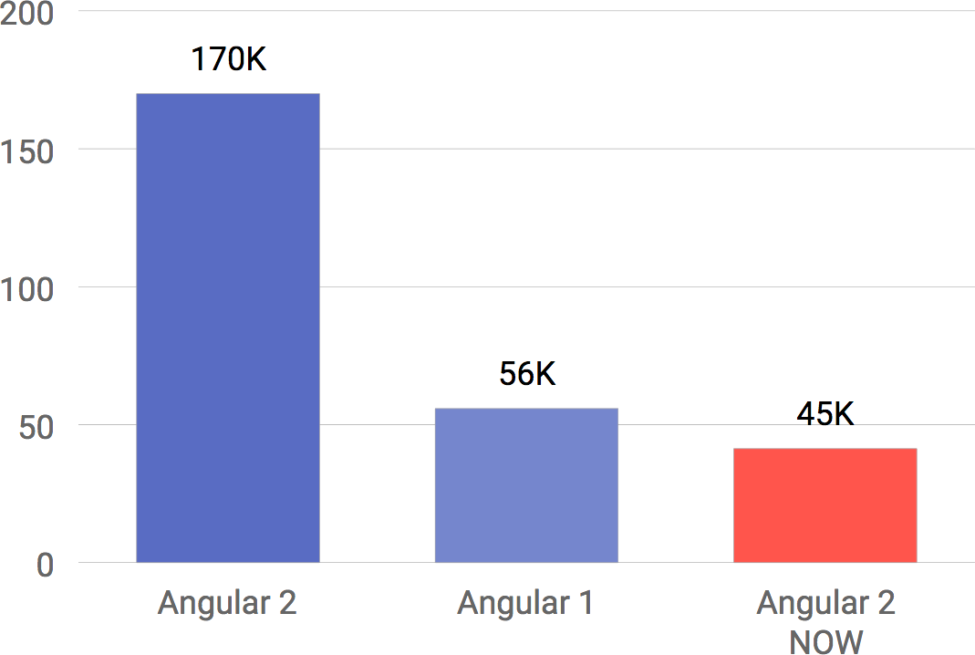

Slide 14
do not take my word for it
Meteor Website:
https://www.meteor.com/
Download the code and try it yourself:
https://github.com/ShMcK/Framework-Performance-Tests-with-Meteor

Slide 15
demo

Slide 16
learning resources
Websites
  https://angular.io/docs/ts/latest/quickstart.html
  https://angular.io/docs/ts/latest/tutorial/
  https://angular.io/styleguide
  https://angular-university.io/
Online classes
  https://www.pluralsight.com/
  https://egghead.io/
  https://www.udemy.com/

Slide 17
you can access the presentation and code in github
https://github.com/scastaldi/tampacc-intro-angular2

Slide 18
questions?

Slide 19
thank you!

