Slide 1
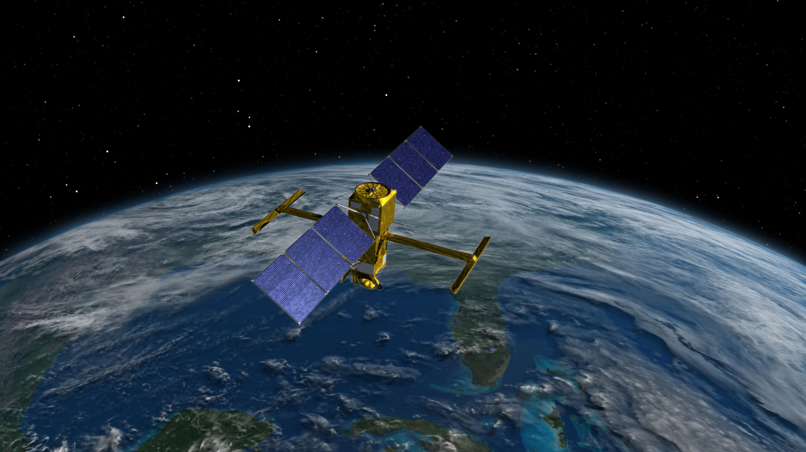
Estimating river discharge by learning processes in spatial hydrology
Sébastien Castets
Quentin Douzery
Elisa Escanez
Institut National des Sciences Appliquées de Toulouse
Applied Mathematics Department
Tutored project
May 26th, 2021
Tutors:
Kévin Larnier
Jérome Monnier
Notes:
Zazoui
BC: 4AM…not all the audience is going to know what department this is. Write it out in full, aswell as INSA. Add the name of your scientific tutot

Slide 2
1. Introduction
2. Datasets
3. Descriptive analysis
b. River classification
4. Neural networks
b. LSTM
5. Conclusion
a. ANN
a. Variable selection
Outline
Notes:
Zoui
BC:
This is an outline, not a table of contents.
Be concise (Database, NOT Database presentation – you can talk about it being a presentation of the database – also change this on the actual slide).

Slide 3
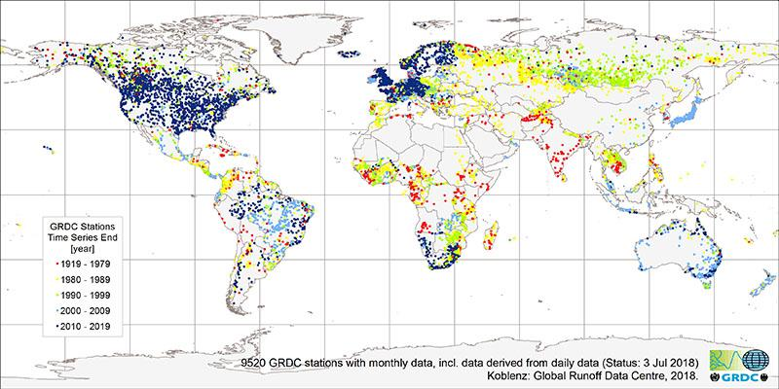

1. Introduction
Context
Scientific approach
Inverse problem
Bias
Ill-posed problem
Introduction
Solutions discussed
Figure 1: GRDC Stations Time Series end [1]
Artificial Neural networks
Long-Short Term Memory networks
Low-Froude Model
Hydric stress
Flooding
Lack of water
Lack of data
SWOT Mission
1
Notes:
Importance of knowing precisely river flows:
Hydric stress
Flooding
Lack of water
Lack of data + ill-posed problem
SWOT Mission
River flows variation ok but there is a bias
Aim: Reducing the bias/predicting river flows using neural networks
Mettre des goutes d'eau à la place de bulle
Seb le bg
BC:
Make sure the citation for the figure is clearly visible
Do you need Introduction twice on the slide? At the top and on the side?
I love the water drop bullet points – your expression teacher would be proud ☺

Slide 4

2. Datasets
PEPSI and Hydroswot variables:
HydroSwot
16638 In-situ observations
river: river name
Q: river flow (m3/s)
dH: water depth above unobserved flow
W: free surface top width
flowacc: flow accumulation
S: free surface slope
dA: cross-sectional flow area above A0
Floor composition
Annual temperature and pluviometry
PEPSI
55525 Synthetic observations
Delete observations with:
NaN values
Width < 80m
River Discharge < 100m3/s
Remove variables
Remove sites with 1 observation (HydroSwot)
Update river names (HydroSwot)
Datasets
Other PEPSI variables:
day: simulation day
reach: reach index
A0: unobserved cross-sectional flow area
U: flow velocity
Manning Strickler variables
29% less
8% less
HydroSwot
PEPSI
2
Notes:
Zaza
Mettre logo des databases pour loss
Enlever 3 petits points de delete observations ( oral suffit)
BC:
Do you need ‘Database’ twice on the slide? At the top and on the side?
I would highlight all the variables in a different colour for consistency
29% less NOT 29% loss (ie the final database has 29% less observations?)

Slide 5
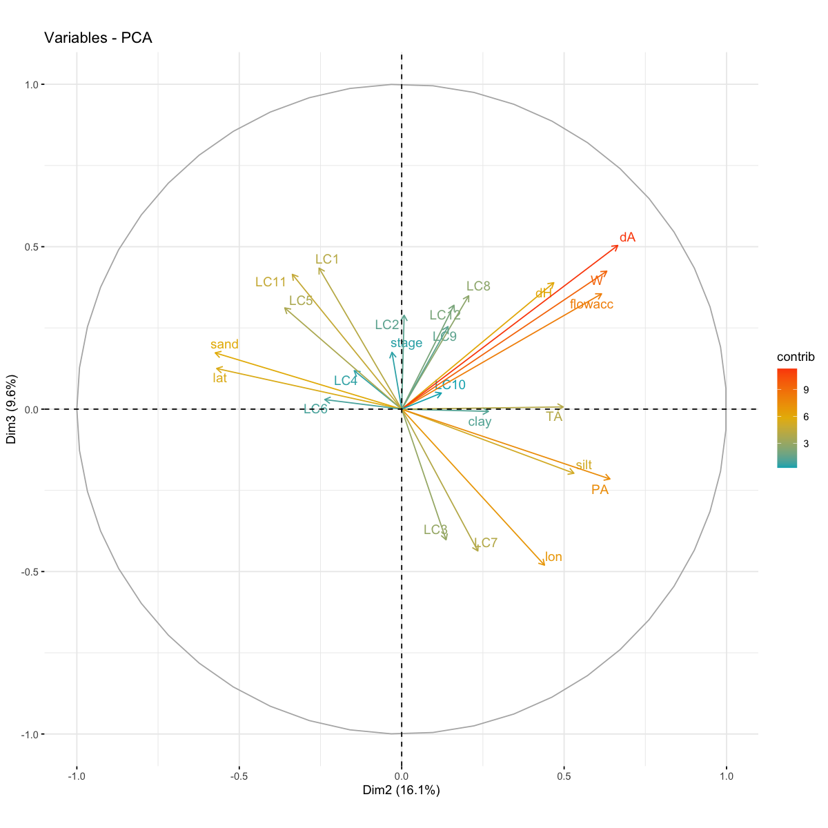
3.a. Variable selection
Correlations with Q
PCA
Consistent with the correlations
dA = 0.86
W = 0.65
flowacc = 0.62
dH = 0.32
Descriptive analysis
Note
dA | cross-sectional flow area above A0
W | free surface top width
flowacc | flow accumulation
Figure 2: Loading plot in the span formed by components 2 and 3, HydroSwot
+ S, the free surface slope
3
Notes:
Quentin
Écrire concrètement quelles variables on va utilizer pour ANN et LSTM
BC:
Make sure the Figure title can be read by the audience – check ALL slides. Is the font the same?

Slide 6
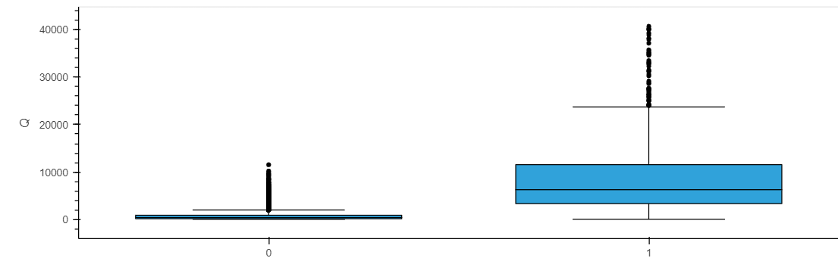
3.b. River classification
K-means classification
Low Q
High Q
Handmade classification
HydroS
10 490
PEPSI
47536
HydroS
1 140
PEPSI
2 674
Low Q
High Q
HydroS
6 714
<1000 m3/s
PEPSI
47 548
<3000 m3/s
HydroS
5 129
>1000 m3/s
PEPSI
3 721
>3000 m3/s
Descriptive analysis
Figure 3: Boxplot Q according to the k-means class
4
Notes:
zazai

Slide 7
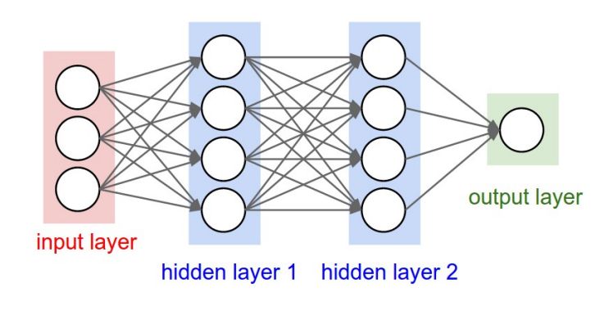

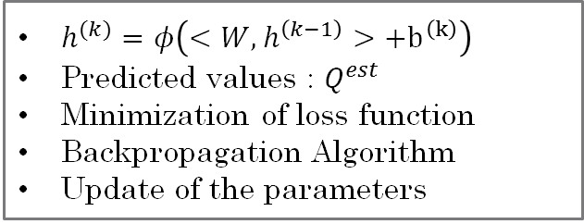
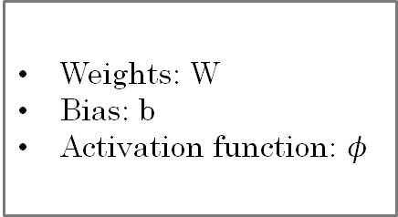
4.a. ANN
Theory
Setup
Hidden layers
Neurons
Loss function: MSE
Metrics: MAE – MSE - nRMSE
Optimizer: Adam
Batch size: 25
Epochs: 100
Neural networks
Figure 4: Architecture of a neural network [2]
Parameters
Computation
Weights: W
Bias: b
Activation function: $φ$
$h^{(k)}=φ\left(<W,h^{\left(k−1\right)}>+b^{\left(k\right)}\right)$
Predicted values : $Q^{est}$
Minimization of loss function
Backpropagation Algorithm
Update of the parameters
5
Notes:
Seb
Changer tirets
Faire graphe intéractifs si possible
Encadrement Théorie / Setup
Flèche pour montrer epoch
BC:
No space before : in English. Check all slides (For example: database…)

Slide 8
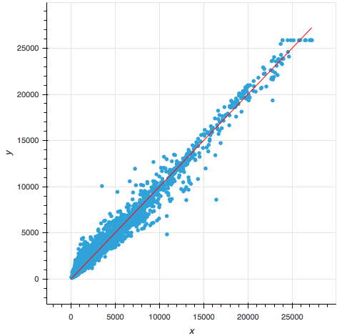
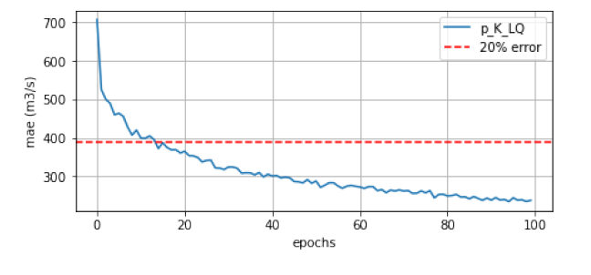
4.a. ANN results
Training
Testing
Neural networks
nRMSE = 0.25
Figure 5: Goodness of fit of the ANN
PEPSI, K-means Low Q class
Figure 6: Predictions against real values of the ANN
PEPSI, K-means Low Q class
6
Notes:
Quentin
BC
Check size of figure titles

Slide 9
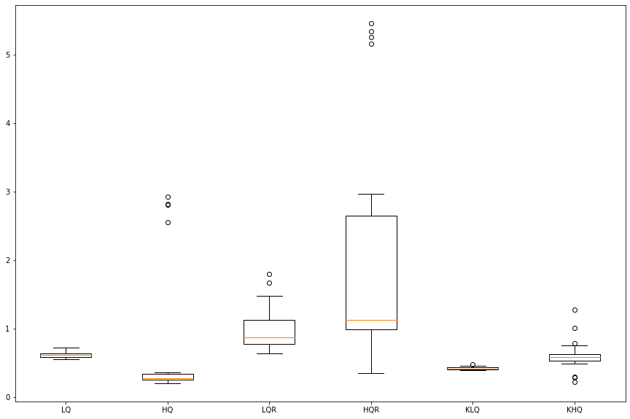
4.a. ANN results
nRMSE
20 iterations
Quality of class predictions
Good for classes done on observations
Unsatisfactory for full rivers classes
Neural networks
Low Q classes give much more robust results
Figure 7: Boxplots of the nRMSE for all HydroSwot classes
7
Notes:
Quentin
Dire combine d’iterations de Monte-Carlo
BC:
Check figure titles
BE concise and clear (Quality of class predictions:……Good for observations…Unsatisfactory for full rivers…..(avoid ‘bad’)
Robust NOT robust

Slide 10
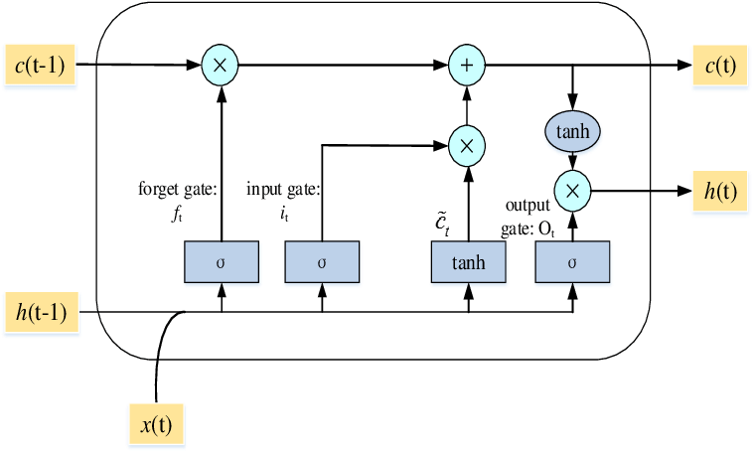





4.b. LSTM
c(t): Cell memory
h(t): hidden state vector (output vector of the LSTM unit)
Theory
t–1
t
t+1
LSTM cell
LSTM cell
Neural networks
Figure 8: LSTM cell schema [3]
Setup
10 LSTM cells
20 epochs
Loss function : MSE
Metrics: MAE, MSE, nRMSE
Batch size: 16
Sequence length: 16
Features: W, S, dA
River periodisation
Forget gate :
Input gate :
Ouput gate :
8
Notes:
Elisa
Be concise: hidden state vector (output vector of the LSTM unit)
Quite a busy slide. Make sure you talk about everything!
Utile de mettre toutes les fonctions à gauche ? Surtout si on en parle pas à l'oral : elles font parties des équations décrites à l’oral (derrière LSTM cell)
Pas certain que mettre le nom ET la définition mathématique soit utile en fait, j'aurais plus vu que le nom des portes. Pas que ce soit inutile, juste que ça rend la slide très chargée. -> Peut-être séparer en 2 slides différentes pour alléger un peu sinon (sans rien retirer pour autant) ?

Slide 11
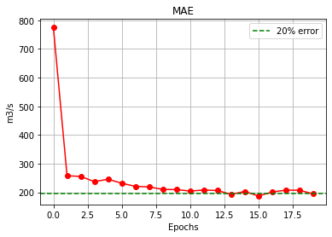
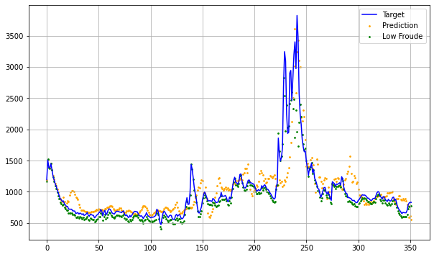
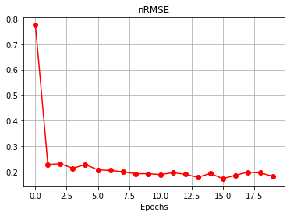
4.b. LSTM results
Training
Testing
Q (m3/s)
Neural networks
days
Figure 10: Prediction of MissouriDownStream by LSTM and Low-Froude Model
 | nRMSE
Q predict | 0.28626674
Low-Froude on Q predict | 0.31700262
Figure 9: MAE and nRMSE metrics
9
Notes:
Seb

Slide 12




5. Conclusion
2 different neural networks, 2 different aims
ANN
LSTM
Can make predictions for any river
Quality of the prediction depends on the dataset size
Efficient even with a small dataset
Can predict the river discharge of one particular river
Conclusion
10
Notes:
Quentin
Check prepositions; Can make predictions for any river
Prefer: Can predict the river flow of one particular river
Prefer to be concise: Efficient even with a small dataset t

Slide 13
Bibliography
[1] https://swot.jpl.nasa.gov/
[2] wikistat.fr
[3] https://doi.org/10.7717/peerj-cs.476/fig-4
11

Slide 14
Contact details
Sébastien Castets, INSA Toulouse, Applied Mathematics Department, sbcastets@gmail.com
Quentin Douzery, INSA Toulouse, Applied Mathematics Department, qdouzery@free.fr
Elisa Escanez, INSA Toulouse, Applied Mathematics Department, elisa.escanez@g-mail.fr
12

